Slide 1


Mastering Web Development: A Journey into the Digital World
Welcome to the world of web development, a dynamic and ever-evolving field that shapes the digital landscape. This presentation will explore the fundamentals of web development, introducing key technologies and showcasing their transformative power.
by Wajih Krimi

Slide 2
Web Development: The Foundation of the Internet
Web development is the process of creating and maintaining websites. It involves various technologies and skills to design, build, and deploy functional and engaging web experiences. It's the backbone of the internet, enabling communication, information sharing, and commerce across the globe.
Without web development, the internet wouldn't exist in its current form. We wouldn't have the websites we use to access information, shop online, connect with friends and family, or share our thoughts and ideas. It's an essential field that powers countless aspects of our digital lives.

Slide 3

HTML: The Building Blocks of Web Pages
HyperText Markup Language
The Blueprint
User Experience
HTML (HyperText Markup Language) is the foundation of every website. It provides the structure and content of a web page. It's a markup language that uses tags to define elements like headings, paragraphs, images, and links.
Think of HTML as the blueprint of a website. It outlines the essential elements, organizes the content, and establishes the basic layout of the page. Web browsers interpret this code and display the page to users.
HTML's ability to structure content and organize elements influences the user experience significantly. It determines how users interact with the information presented on a page, enhancing readability and navigation.

Slide 4
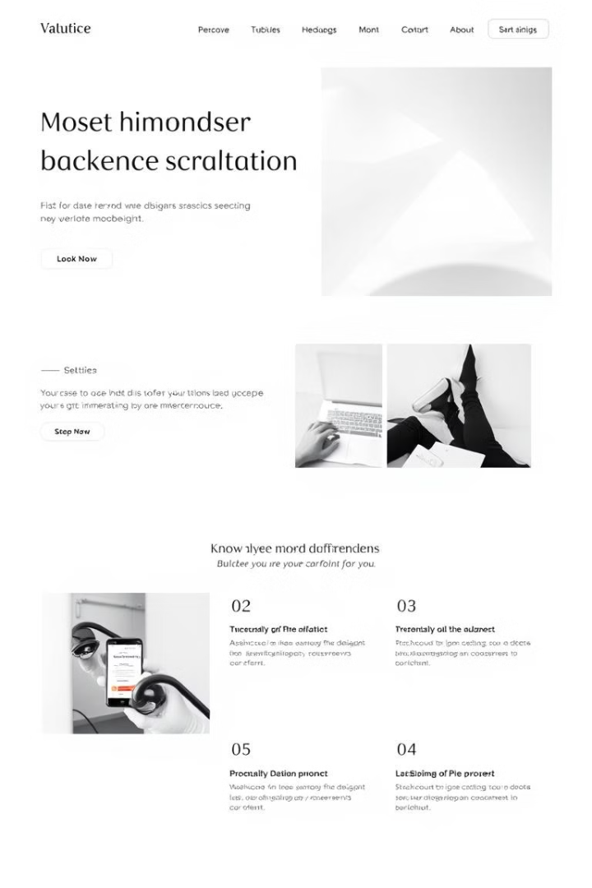



CSS: Styling the Web
Cascading Style Sheets
CSS (Cascading Style Sheets) controls the visual presentation of web pages. It adds the style and aesthetics to the HTML structure, defining aspects like colors, fonts, sizes, and layout. It's like the decorator of the web.
Separation of Concerns
CSS separates style from content, allowing for easier maintenance and flexibility. It allows designers and developers to modify the look and feel of a website without altering the underlying HTML code, enhancing efficiency and maintainability.
Responsive Design
With CSS, you can create responsive websites that adapt to different screen sizes and devices. This ensures a smooth user experience regardless of whether someone is browsing on a desktop computer, a tablet, or a smartphone.

Slide 5
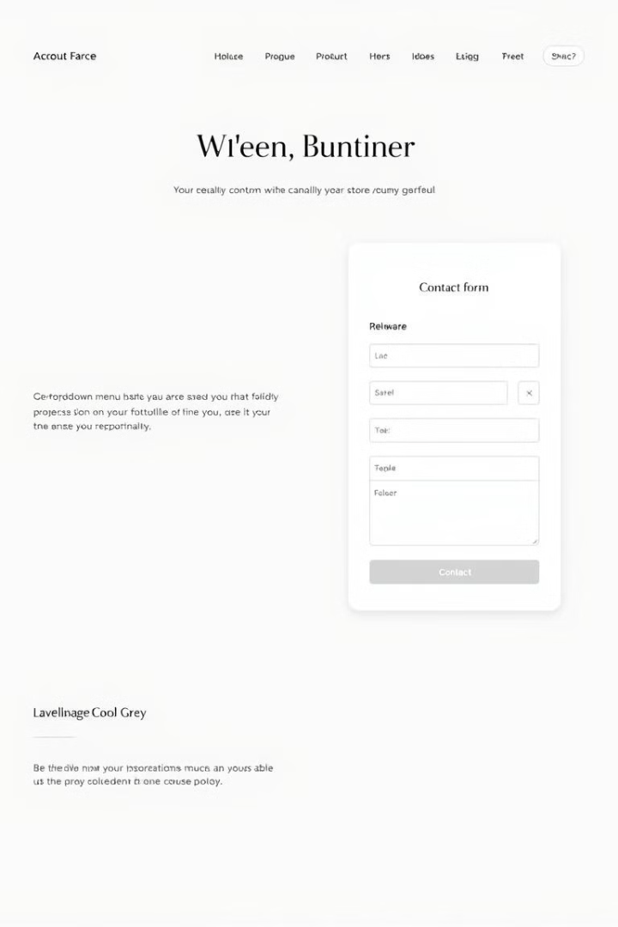



JavaScript: Bringing Web Pages to Life
JavaScript is a scripting language that adds interactivity and dynamic behavior to web pages. It allows for things like interactive maps, animated graphics, and dynamic updates without requiring a page reload.
Think of JavaScript as the animator of the web. It brings elements to life, adds functionality, and enhances user engagement by creating interactive and dynamic experiences that make websites more engaging.
JavaScript enables real-time communication between the user and the server, making websites feel more responsive. It can handle tasks like validating form inputs, updating content without page refreshes, and creating complex user interactions.

Slide 6



React: Building User Interfaces with JavaScript
Declarative
React uses a declarative approach to build user interfaces. It's a JavaScript library that simplifies the process of building dynamic, interactive web applications by breaking them into reusable components.
1
Component-Based
2
React encourages developers to break down user interfaces into smaller, independent components. This modular approach makes development faster, easier, and more maintainable. Each component can be reused across the application.
Virtual DOM
3
React uses a virtual DOM (Document Object Model) to efficiently update the real DOM. This optimization improves performance and makes changes to the user interface feel smoother and more responsive.

Slide 7
Node.js: Server-Side JavaScript
1
2
3
JavaScript Everywhere
Performance
Scalability
Node.js is a runtime environment that enables JavaScript to be used on the server-side. This means you can use JavaScript not only for front-end development but also for back-end tasks like database interactions, API handling, and server logic.
Node.js is known for its speed and efficiency, making it ideal for building high-performance web applications. It's used by companies like Netflix, LinkedIn, and PayPal for its ability to handle large volumes of traffic and requests.
Node.js is a scalable technology, allowing applications to grow and handle more traffic without significant performance degradation. It's well-suited for building applications that need to be able to scale quickly as user bases grow.

Slide 8

Web Development: Your Path to the Future
Learning web development opens doors to exciting opportunities in the tech industry. It allows you to create dynamic and responsive websites, develop engaging user interfaces, and build robust and scalable web applications. By mastering HTML, CSS, JavaScript, React, and Node.js, you'll gain the skills to thrive in the ever-evolving world of web development.

