Slide 1

Food Donation & Waste Reduction Platform
Team Name: Victory bytes
Team Leader Name: Gohil Surbhi Vinaybhai
Institute Name: Parul Institute of Engineering and Technology
Track Name: Web 2.0

Slide 2
Introduction
Food wastage is a major problem worldwide while many people suffer from hunger.
This project provides a digital platform to connect food donors, NGOs, and delivery partners.

Slide 3
Problem Statement
Lack of real-time coordination
Edible food wasted daily
Manual donation processes
No centralized food donation system

Slide 4
Project Objectives
Reduce food wastage
Enable quick food distribution
Connect donors and NGOs
Build a sustainable solution

Slide 5
Purpose of the Project
To minimize food waste and ensure surplus food reaches needy people efficiently while promoting social responsibility.

Slide 6
Unique Features
Real-time food availability
Smart NGO matching
Time-based food safety
Pickup tracking system
Role-based dashboards

Slide 7
System Users
Restaurants / Donors
NGOs
Delivery Partners
Admin

Slide 8
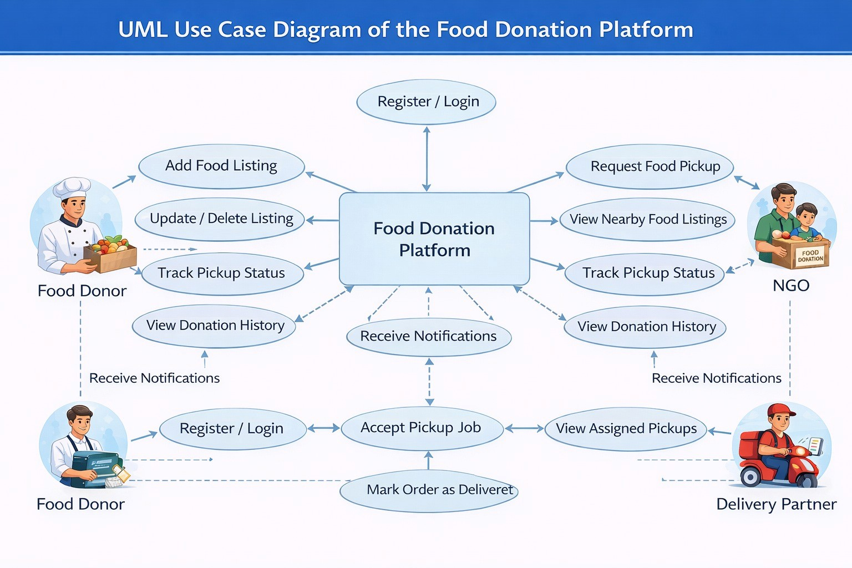

Slide 9
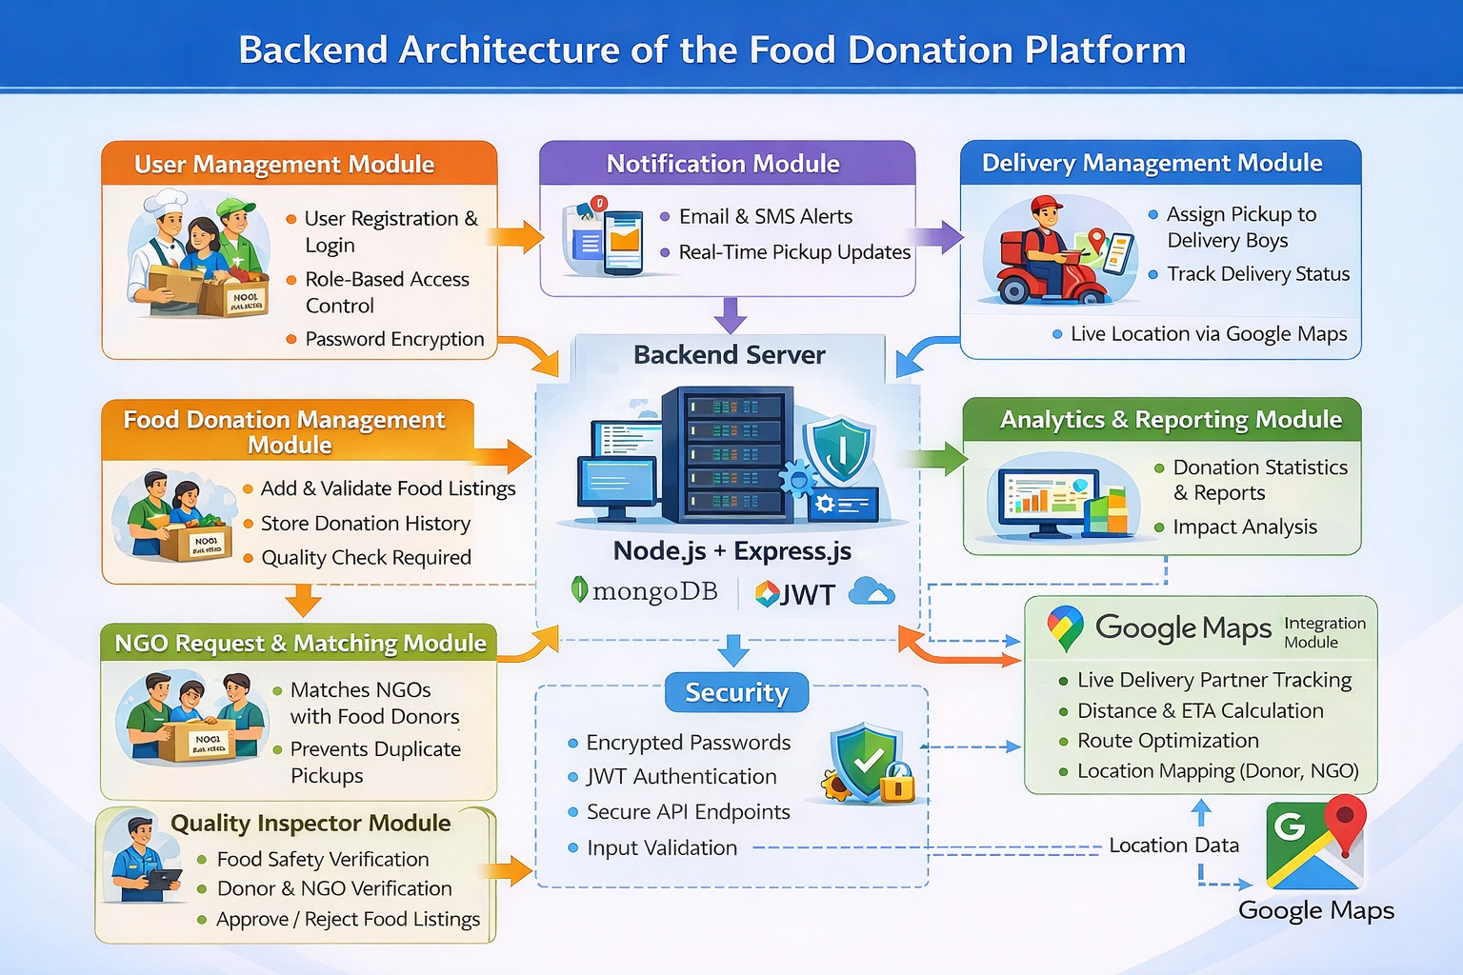
System Architecture

Slide 10
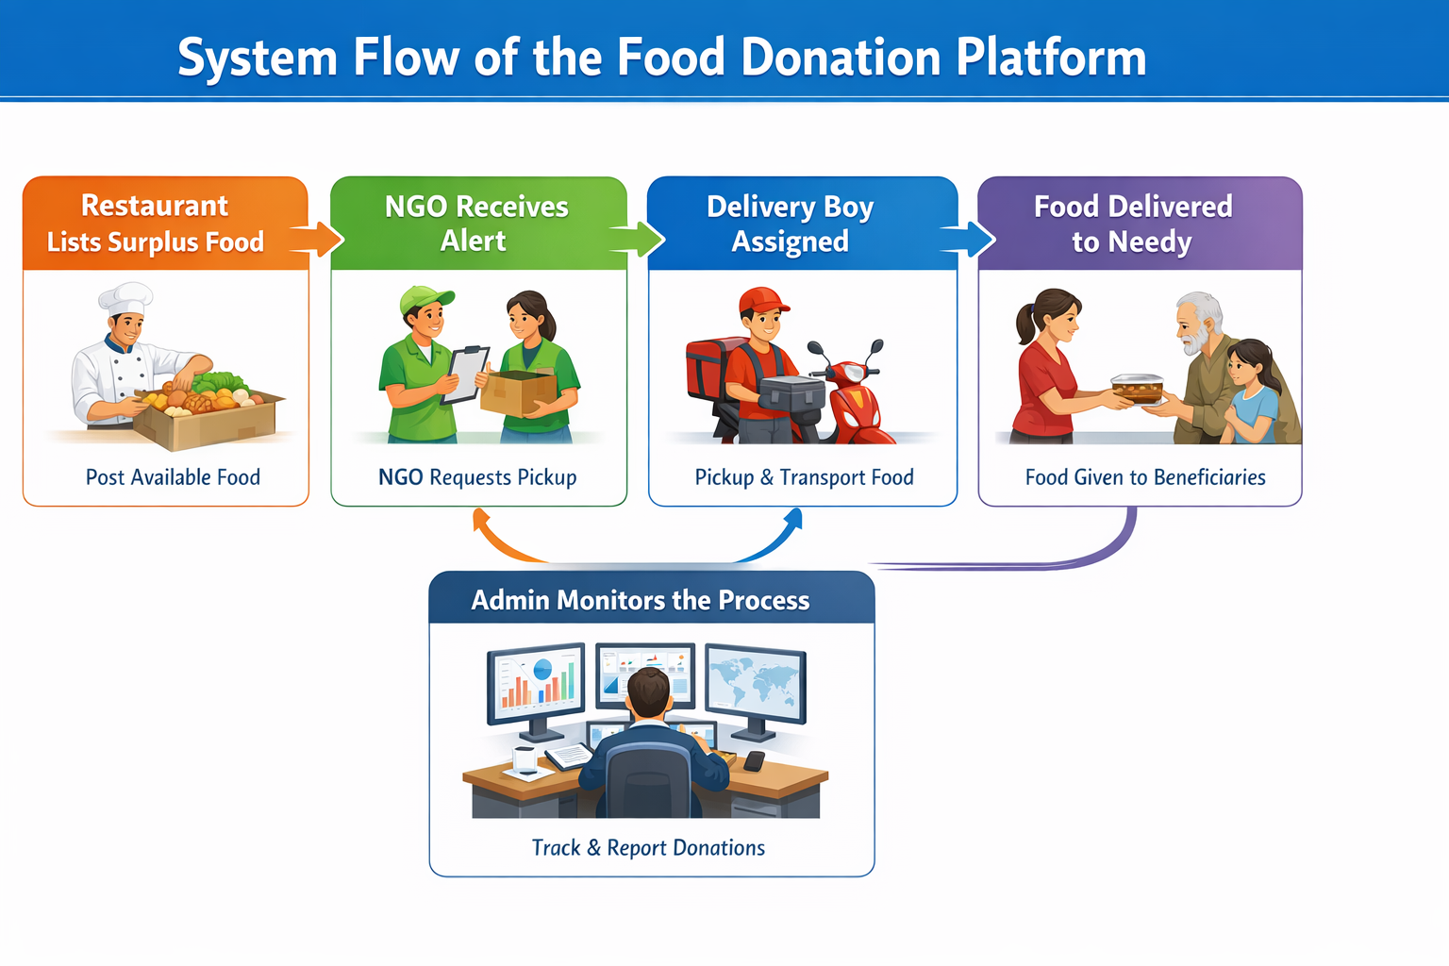
System Flow Diagram

Slide 11
Restaurant Pricing Model
Pay-per-kg: ₹20
Monthly Plan: ₹999
Premium Plan: ₹1499
Enterprise: Custom pricing

Slide 12
Delivery Boy Earnings
₹20 – ₹50 per delivery depending on distance
₹5 – ₹10 per km additional payout
Bonus ₹200 – ₹500 for completing 10+ deliveries/day
Extra incentives during festivals and peak hours

Slide 13
Profit Model
Restaurant commissions
Subscription plans
CSR sponsorship
Analytics services

Slide 14
Benefits to Society
Reduced food waste
Hunger relief
Support to NGOs
Environmental sustainability

Slide 15
Benefits to Us
Real-world development experience
Improved technical skills
Team collaboration
Career readiness

Slide 16
Future Scope
Mobile application
GPS-based tracking
AI food demand prediction
Multi-city expansion

Slide 17
Conclusion
The project effectively combines technology and social service to reduce food waste and fight hunger.

Slide 18
Thank You
Thank You!
Any Questions?

