Slide 1



Smilecure dental care
Prepared By:
Name:Krinal Beladiya
Roll No: 26
Enrollment No: 23002170220001
Batch: D1 Branch: IT

Slide 2
Project Outline
Idea: The idea behind creating our dental hospital website stems from a vision of transforming the delivery of dental healthcare through digital innovation. In today's fast-paced world, we recognize the importance of leveraging technology to enhance patient experience, accessibility, and quality of care.
Functionality: 1) Provide detailed information about dental services, treatments, and procedures offered at the hospital.
2) Patients can easily schedule appointments online, choosing their preferred date, time.
3) provide contact details to provide ease of connect with hospital.
Components: Front End: HTML, CSS, Bootstrap, Javascript

Slide 3
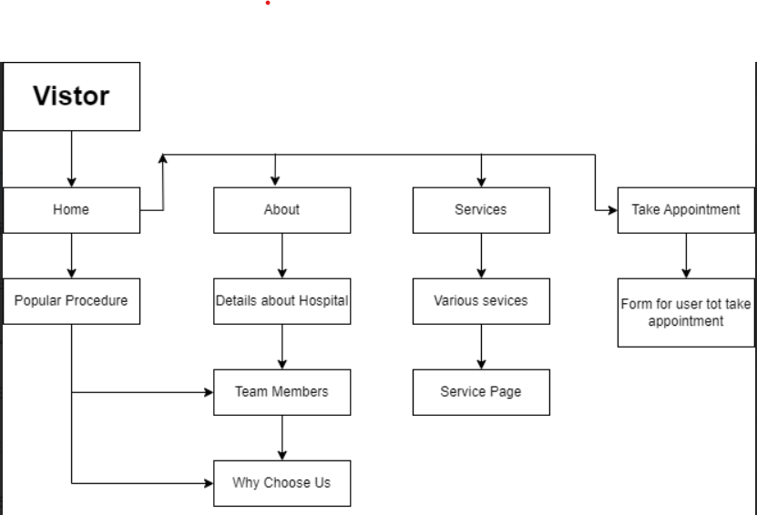
Block Diagram

Slide 4
Merits
DEMerits
Provides convenient access to information about services, treatments, and dental professionals.
The site is not dynamic, so patient can not take appointment.
Future scope
Smilecure Dental Care will be dynamic in future,so that patient can take appointment and will provide daily blog on website.it will be responsive as everyone can use it through mobile.
References
1) https://getbootstrap.com/
2) https://www.w3schools.com/
3) https://apollodental.in/

Slide 5

Thank you

