Slide 1
Project «Immaterium»

Slide 2
Table of contents
Problem
Our ideas
Decision
Advantages
Usage examples
Conclusion

Slide 3
Ideas
A virtual obstacle course with a gradual increase in difficulty.
A statistical system showing the dynamics of results
Creating conditions for real piloting
An obstacle course. A chain of checkpoints with a constant change in their position in space.
The statistics system. It will allow the student to see the progress and their mistakes.
Full immersion in conditions that fully reflect the real.

Slide 4
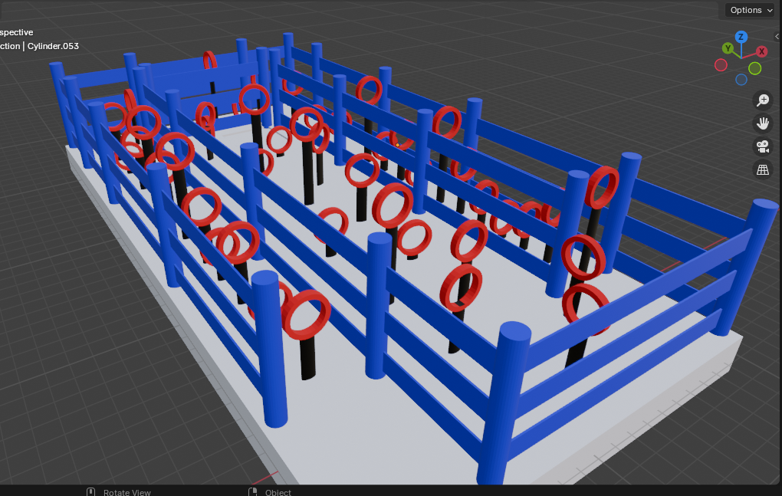
Obstacle course

Slide 5
Problem
Complexity and danger

Slide 6
Decision
Safety for the student
There is no need for the drone itself.
The ability to simulate any flight conditions
There is no need for the drone flight platform itself.

Slide 7

Unlimited possibilities for expanding learning
Opening new horizons

Slide 8
Advantages
Временная шкала запуска продукта
Safety
Cost-effectiveness
Flexibility
Effectiveness
Learning in a virtual environment eliminates the risk of equipment damage and injury.
Reduce fuel costs, repair and maintenance of drones.
The opportunity to train at any time and in any conditions.
Improving the quality of training by repeatedly repeating complex maneuvers.

Slide 9

Usage examples

Slide 10

Usage examples
Military affairs
Rescue operations
Commercial delivery.

Slide 11
Thanks for your attention!
from «Bad Boys Team»

