Slide 1


FIXora-Sorting, not ignoring Solutions to your all the problems ,at a single platform The all-in-one platform desig
Proposed by : TEAM CODE QUEST

Slide 2
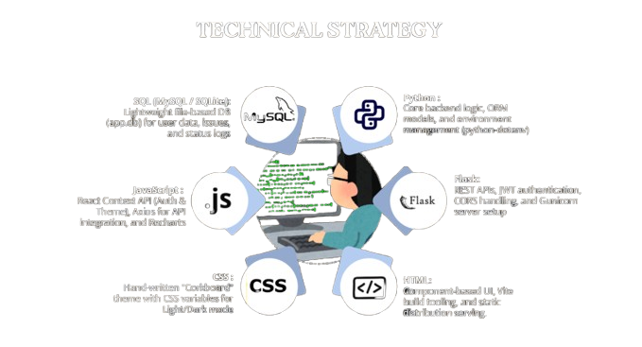

Slide 3
UNDERSTANDING THE PROBLEM
.Traditional campus complaint mechanisms fail students, wardens, and management daily through manual friction and complete lack of tracking.
.The Situation: Campus issues (broken fans, leaking taps, Wi-Fi failures) are reported via scattered, unmonitored channels like WhatsApp or verbal complaints.
.The Gap: No single record, zero accountability, and no timeline for resolution.
The Consequence: Complaints get lost in a "black hole," trust erodes, and minor issues escalate into costly or dangerous hazards.

Slide 4
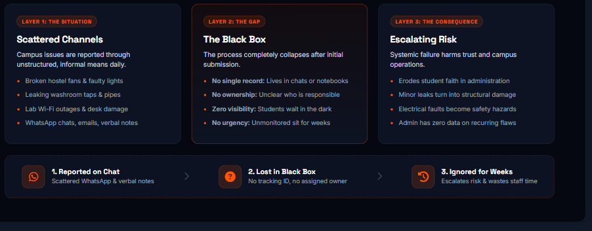
THE PROBLEM:- 3 LAYER FRICTION

Slide 5
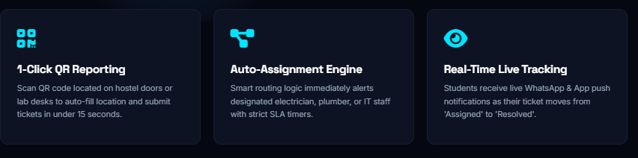

THE SOLUTION:-
A Centralized, Closed-Loop Campus Maintenance Engine
Snap & Report: Log any campus issue in under 15 seconds with photo & location.
Smart Routing: Tickets are automatically assigned to the responsible department/warden.
Total Transparency: Real-time status updates (Reported $→$In Progress $→$Resolved) with photo proof upon completion.

Slide 6
THE WORKING
Student Logs Issue:- Selects category, adds photo + room/lab number.
Auto-Assignment:- System notifies the technician/warden with a resolution timer.
Verification & Feedback:- Staff uploads photo of fixed issue; student confirms closure.

Slide 7
TARGET AUDIENCE AND IMPACT
Students: 100% visibility, faster resolution, and improved living conditions.
Maintenance Staff: Organized job queues, clear priority levels, and reduced repeated calls.
Campus Admin: Data-driven maintenance budgeting and complete operational control.
Visual Tip: Simple 3-column table ya 3 cards (Students | Staff | Admin).

Slide 8
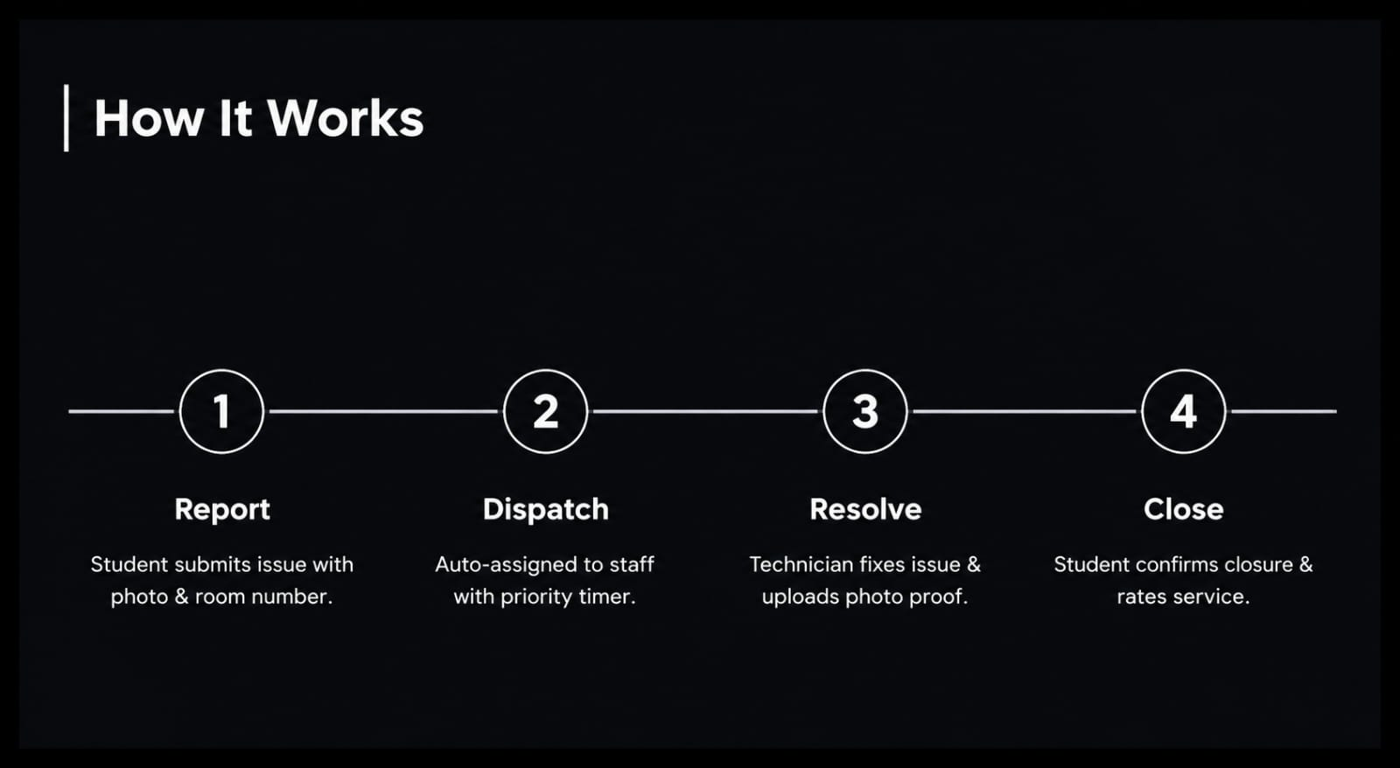
TECHNICAL STRATEGY
The all-in-one platform designed to turn your ideas into reality.

Slide 9
IMPACT AND BENEFITS ENVISAGED
. Key benefits for users, stakeholders, or society.
. Potential improvements in efficiency, accessibility, sustainability, or cost-
effectiveness.
. Long-term value and scalability of the solution.

Slide 10
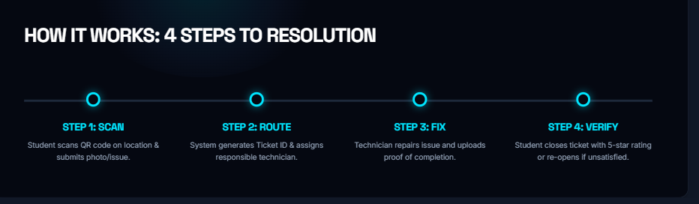
HOW THIS SOLVES THE PROBLEM?

Slide 11
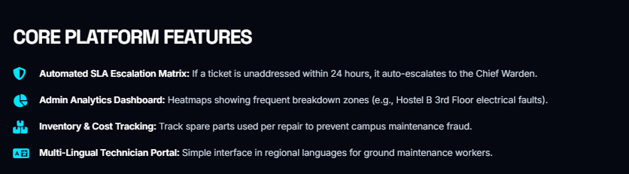
WHY CHOOSE US?
80% Reduces repair resolutioFa80% Faster Response Time: Reduces repair resolution turnarounds from weeks to Time: n turnarounds from weeks to

Slide 12
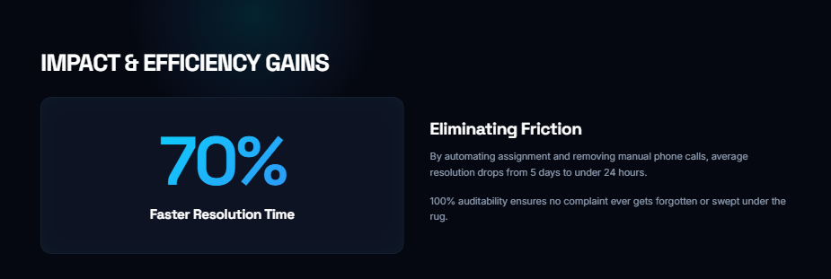

Slide 13

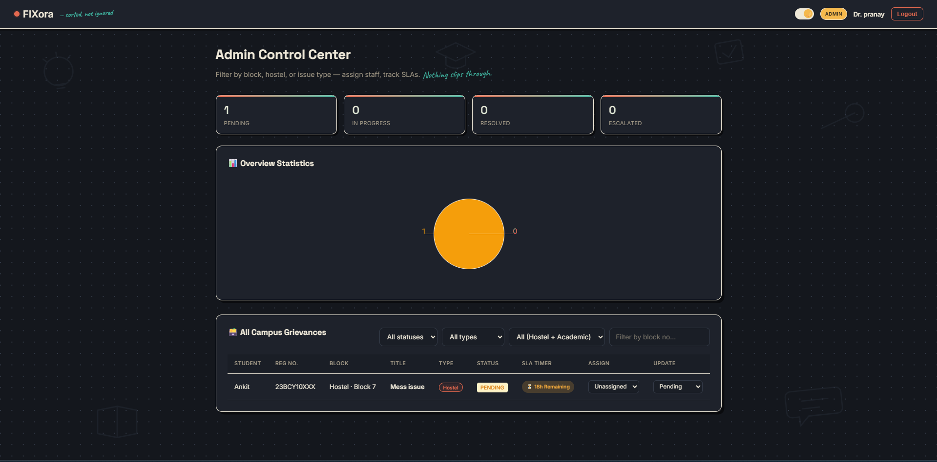
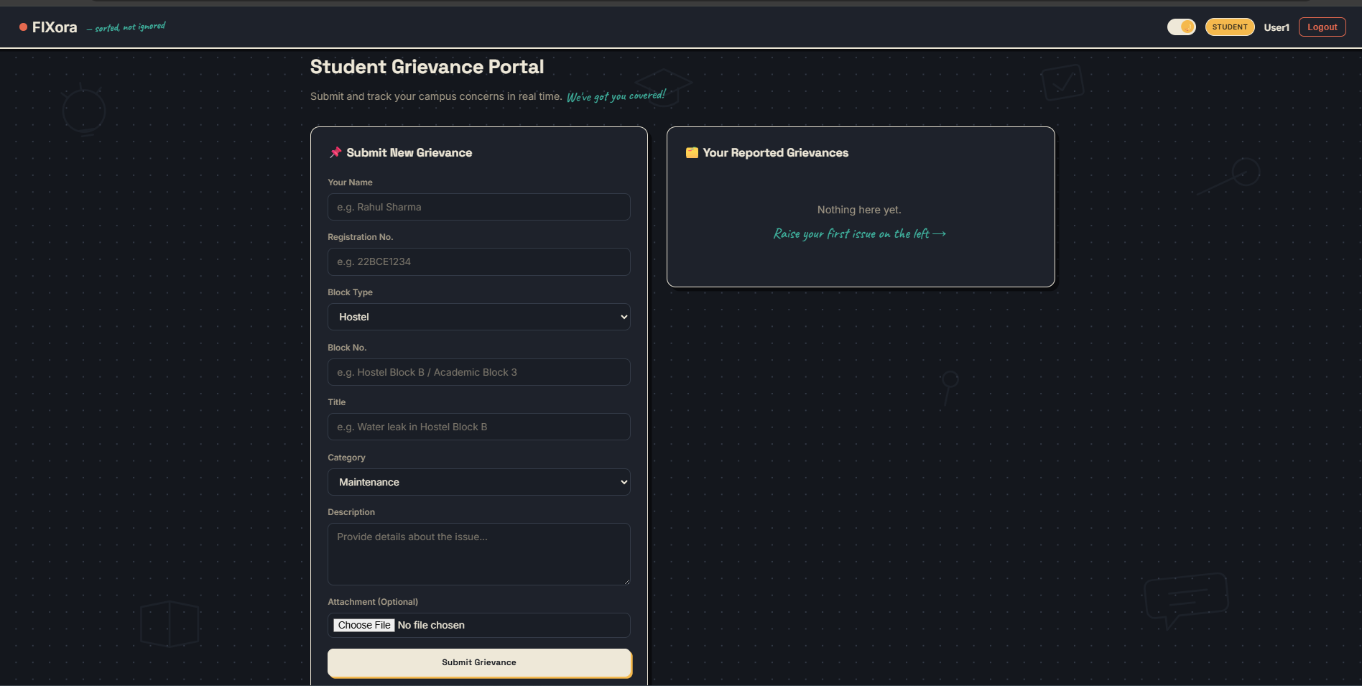
LOGIN PAGE
ADMIN DASHBOARD
STUDENT DASHBOARD

Slide 14
T H A N K YO U
Sponsored by
BY - TEAM CODE QUEST
Kripa Mehndiratta, Avinash Dubey, Sristi Kumari,
Akash Kumar Gautam, Saumya Kumari

