Slide 1
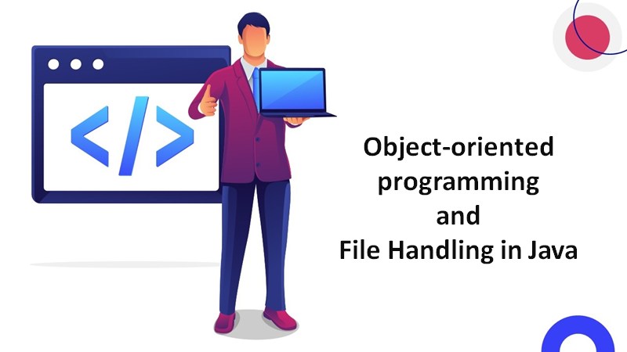
By: Kripank Kumbhare

Slide 2

Agenda
Introduction
OOP Concepts in Java
Advanced concepts of OOP
File Handling in Java
methods for file handling

Slide 3

Introduction
Object-oriented programming (OOP) is a paradigm that uses objects to model real-world entities and behaviors.
Objects have attributes (data) and methods (functions) that operate on the data.
OOP provides several benefits, such as code reusability, modularity, encapsulation, abstraction, inheritance, and polymorphism.

Slide 4
Java is a popular object-oriented programming language that supports OOP concepts and features.
File handling in Java refers to reading from and writing data to a file using the classes and methods of the java.io package.
Files are abstract data types that represent a named location in the file system.
File handling in Java allows us to work with different formats of files, such as text, binary, image, etc.

Slide 5

OOP Concepts in Java
Class: A blueprint or template that defines the attributes and methods of a type of object.
Object: An instance or example of a class that has a specific state and behavior.
Method: A block of code that performs a specific task or operation on the data of an object.

Slide 6

Constructor: A special method that is used to initialize an object when it is created.
Access modifier: A keyword that specifies the visibility or accessibility of a class, object, attribute, or method.
this keyword: A reference variable that refers to the current object within its own class or method.

Slide 7

The advanced concepts of OOP in Java
Inheritance
A mechanism that allows a class to acquire the attributes and methods of another class. The class that inherits is called the subclass or child class. The class that is inherited is called the superclass or parent class.

Slide 8

Polymorphism
A feature that allows an object to behave differently depending on the context or situation.
There are two types of polymorphism in Java: compile-time polymorphism and run-time polymorphism.
Compile-time polymorphism is achieved by method overloading, which means defining multiple methods with the same name but different parameters.
Run-time polymorphism is achieved by method overriding, which means redefining a method of the superclass in the subclass with the same name and parameters.

Slide 9
Abstraction
A process of hiding the implementation details and showing only the essential features or functionality. Abstraction can be achieved by using abstract classes and interfaces. An abstract class is a class that cannot be instantiated but can have abstract and concrete methods. An abstract method is a method that has no body and must be overridden by the subclasses. An interface is a collection of abstract methods and constants that can be implemented by multiple classes.

Slide 10
Encapsulation
A technique of wrapping or binding the data and methods of an object together into a single unit. Encapsulation ensures data security and integrity by preventing unauthorized access or modification. Encapsulation can be implemented by using private access modifiers and getter and setter methods.

Slide 11
File Handling in Java
File handling in Java involves creating, opening, closing, reading, writing, deleting, and manipulating files using the classes and methods of the java.io package.

Slide 12
Classes for file handling in Java
File: A class that represents a file or directory in the file system. It provides methods for creating, deleting, renaming, checking, and getting information about files and directories.
FileInputStream: A class that reads bytes from a file. It is used for reading binary data, such as images, audio, video, etc.
FileOutputStream: A class that writes bytes to a file. It is used for writing binary data, such as images, audio, video, etc.
FileReader: A class that reads characters from a file. It is used for reading text data, such as plain text, XML, JSON, etc.

Slide 13

FileWriter: A class that writes characters to a file. It is used for writing text data, such as plain text, XML, JSON, etc.
BufferedReader: A class that reads text from a character-input stream. It buffers the input for efficient reading.
BufferedWriter: A class that writes text to a character-output stream. It buffers the output for efficient writing.

Slide 14
Methods for file handling
createNewFile(): A method of the File class that creates a new empty file if it does not exist already.
delete(): A method of the File class that deletes a file or directory if it exists.
exists(): A method of the File class that checks whether a file or directory exists or not.
getName(): A method of the File class that returns the name of the file or directory.
getAbsolutePath(): A method of the File class that returns the absolute path of the file or directory.

Slide 15
Conclusion
OOP in Java and file handling in Java are important topics for any Java programmer to learn and master.
OOP in Java helps us to design and develop software applications that are modular, reusable, maintainable, and extensible.
File handling in Java enables us to store, retrieve, manipulate, and process data in various formats of files.

Slide 16
Thank You

