Slide 1
One-stop or two-stop — the decision this tool supports
WHO USES IT
INPUTS
OUTPUTS
Race strategy engineer Pre-race meeting 60–90 min before lights out
Grid position · constructor tier Circuit type · historical rate Strategy scenario (1-stop / 2-stop)
P(top10) — points finish P(top5) — strong result One pair per scenario
"The decision this tool supports is: which strategy protects which objective — and which one destroys it."
Morales · Orellana · IIT414W 2026
1 / 5

Slide 2
Approach
DATA
TEMPORAL SPLIT
MODEL
2,447 driver-race observations 2019 – 2024 · 6 seasons Pre-race features: grid position · constructor circuit type · historical rate Strategy fields → what-if controls (not observed predictions)
Train → 2019 – 2021 Calibrate → 2022 (held out from training; isotonic regression only) Test → 2023 – 2024 (untouched until evaluation)
Gradient boosting + isotonic calibration Two targets: ● is_top10 — points finish ● is_top5 — strong result Benchmarks: ● Logistic scenario model ● Grid-rule heuristic
Morales · Orellana · IIT414W 2026
2 / 5

Slide 3
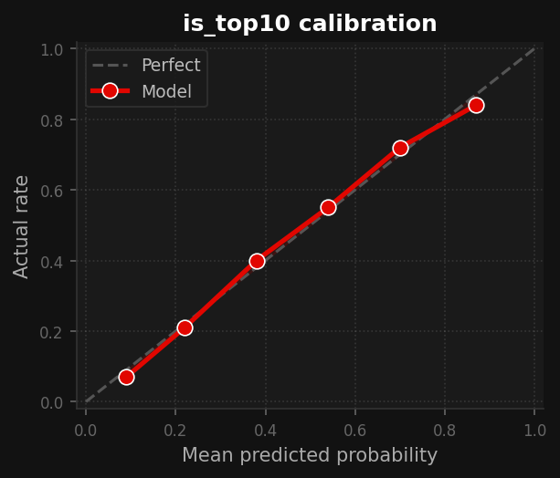
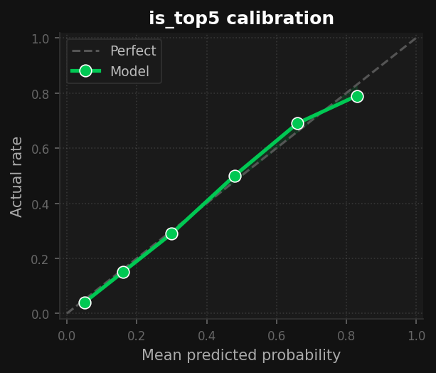
Results — held-out 2023–2024 test block
Target | Model | Brier↓ | AUC↑ | vs Reference
is_top10 | Gradient boosting | 0.125 | 0.902 | Docent 0.132 ✓
 | Logistic | 0.139 | 0.883 | —
 | Grid-rule | 0.160 | 0.839 | —
is_top5 | Gradient boosting | 0.090 | 0.934 | Grid-rule 0.113 ✓
 | Logistic | 0.096 | 0.929 | —
 | Grid-rule | 0.113 | 0.881 | —
Calibration curves: predicted probability vs actual outcome rate. Estimates in the 0.2–0.8 range are well-behaved for both targets.
Probabilities are reliable enough to support a paired scenario comparison. Compare two plans — read the delta.
Morales · Orellana · IIT414W 2026
3 / 5

Slide 4
Austrian GP 2023 — Ocon, P12 Same driver · same race · different strategy
Context held fixed: driver · constructor · circuit · grid position | Only strategy changes.
Target | One-stop (M-H, lap 32) | Two-stop (S-M-H, laps 18+42) | Δ Two minus One
P(top10) | 0.134 | 0.154 | +0.020 → indifferent
P(top5) | 0.087 | 0.436 | +0.349 → quadrupled ▲
Choose the target before choosing the strategy. One-stop protects the points objective. Two-stop is only justified when chasing top-5 upside.
Observational — not causal. Faster cars select into different strategies historically.
Morales · Orellana · IIT414W 2026
4 / 5

Slide 5
Verdict
Use this tool to surface strategy scenarios where P(top10) and P(top5) diverge — before lights out.
We do not recommend deploying this tool for live pit-wall decisions unless:
1
The model is recalibrated on the current season before each race weekend.
2
The confounding between strategy choice and car pace has been explicitly controlled through matched-constructor comparisons.
3
The tool has been validated on wet-race and safety-car scenarios, where current error rates are 15–20% higher than dry conditions.
Morales · Orellana · IIT414W 2026
5 / 5

