Slide 1
Final-Work Presentation
Presenter: Haotian Wei
Lingzheng Dong
Zoneze Li

Slide 2
Outline
1. Data Analysis
2. Overview and System Present
3. Reflection

Slide 3
Data Analysis
1. Pre-processing
2. Textdata-processing
3. Trajectory-processing

Slide 4
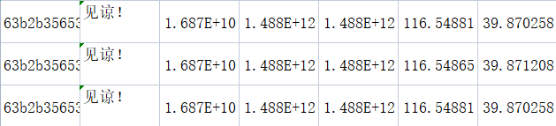
Pre-processing
1. Data missing
Solution: Judge the length of the content and reject those with missingness

Slide 5
Textdata-processing
1. Words extraction
- Given a sentence, we eliminate the stop words including numbers,
modal particles and punctuation
- Use jieba.cut() to cut the sentence into words
2. Word2Vec
- A neural network model for mapping a word to a vector, representing
the relationship between words

Slide 6
Textdata-processing
3. Kmeans clusters for words semantics
- Clustering the words into several groups by word vectors
- In our data processing, we classify all the words into 8 groups
4. Kmeans clusters for sentence semantics
- Clustering the sentence into several groups by words clusters
- In our data processing, we classify all the sentence into 4 groups

Slide 7
Textdata-processing
5. Recogize the kinds of junk messages artificially
- 4 kinds: Commercial Advertisement, Bills Promotion,
Pornography Fraud, Card Scam
- Perniciousness: Increases from first to last

Slide 8
Trajectory-processing
1. Pseudo base-station finding
- Form circles with real base-station as centers and 1500m as radius
- Extract positions with higher density than surroundings
2. Daily trajectory finding
- Taking position, time, content and phone number into considerations.

Slide 9
Overview and System Present

Slide 10
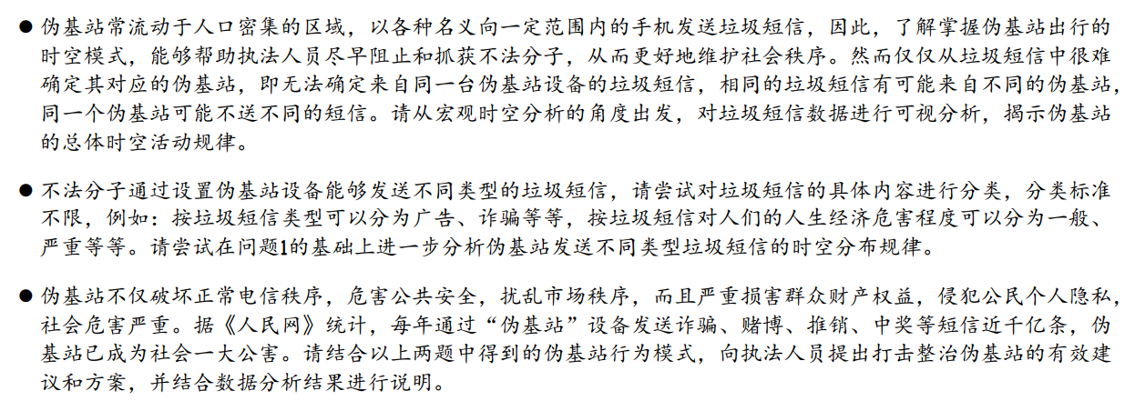
Solving problem
Notes:
商务广告，卡贷诱骗，票据推销分布较广，遍布市中心还有外扩； 时间基本遍布在全天，细分还可分为早晨7-12点一段和17-21点一段；
商务广告数量上较少，基本以聚类分布(集中于具体镇，村，乡，街道）。因为诈骗相对目标对象更广，人都有贪利的思想，反之，1.商务广告目标人群有局限性，比如推销购买手机，有手机的就不想买。2. 信息爆炸，人人每天都被各式各样的广告充斥：大街、网络上；不像以前主要广告途径只有电视，报纸，短信等等。所以相对短信发商务广告的收益率不高，也会少。
色情诈骗，空间更小局限于CBD，时间上晚上19：00-02：00.推出CBD受众更多（更有钱，好宰），且符合晚上多发裸聊、卖淫等违法活动的规律。
物理巡视，技术拦截（根据空间分布，以及对应时间）；对应时段发送一些反诈短信（对应类别）

Slide 11
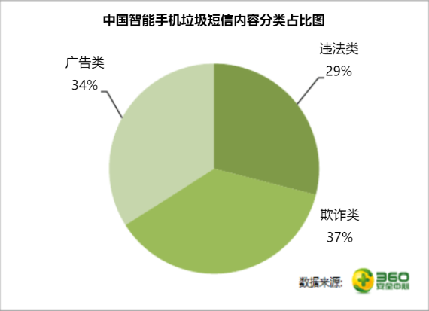
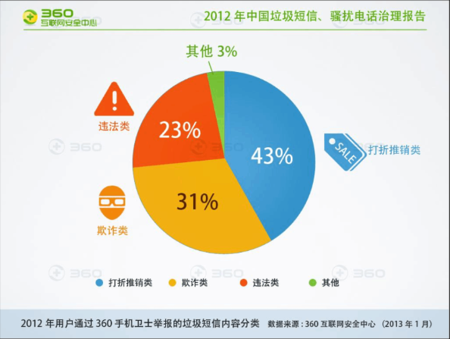
2012上下半年垃圾短信类型统计

Slide 12
Reflection
1. Labor Division
2. Critical Thinking

Slide 13
Labor Division
Lingzheng Dong : Text data processing, word cloud format processing and drawing,
PPT making
Zoneze Li : Radial time format processing and drawing, Themeriver format processing and drawing ,PPT making
Haotian Wei : Trajectory format processing and drawing, video record, poster making

Slide 14
Critical Thinking
Advantage:
- Show the spatial and temporal distribution of pseudo base-station
and junk messages clearly.
Disadvantage:
- Algorithm needed to be improved.(As to Trajectory chart, Heat map)
- Format needed to be improved.(A little rough module integration)
Future plans:
- If needed, rearrange the format with coherent coding style.
- Add more novel elements in the system.

Slide 15
Thanks

