Slide 1
Machine Learning Approaches for Credit Default Prediction QM640 V1: Data Analytics Capstone
Final Presentation
Mothy Krishna Nanduri
Sudha B G (Mentor)
Notes:
Student name - 2 marks
Mentor’s name - 2 marks
Topic name - 2 marks
-> automated grading

Slide 2
Executive Summary
Developed ML models to predict borrower credit‑default using the UCI German Credit Dataset (1,000 records).
Built an end‑to‑end pipeline: EDA → preprocessing → modelling → interpretability → fairness analysis.
Evaluated Logistic Regression, Random Forest, SVM (RBF), and Gradient Boosting.
Logistic Regression delivered the most balanced performance (Accuracy ≈ 0.78, ROC‑AUC ≈ 0.80).
SHAP and fairness metrics confirmed transparency, key drivers, and no major demographic bias.
GitHub: https://github.com/KrisAimlGitHub/credit-risk-capstone

Slide 3
Gap Analysis
Traditional credit‑scoring models emphasize accuracy but often lack interpretability and fairness evaluation.
Regulatory bodies increasingly require explainable and non-discriminatory AI in lending decisions.
Many studies use modern ML models but do not integrate SHAP‑based interpretability and fairness metrics.
This project fills the gap by combining performance, transparency, and fairness in a unified framework.

Slide 4
Research Questions
Research Questions
• RQ1: Which borrower attributes most strongly predict credit default?
• RQ2: Which ML model provides the highest predictive accuracy?
• RQ3: How do SHAP values explain model predictions?
• RQ4: Do models show fairness concerns across age and gender?
Hypotheses
• H0: No significant performance difference exists between models.
• H1: At least one model significantly outperforms the others.
Methods Used
• EDA, Logistic Regression, Random Forest, SVM, Gradient Boosting
• SHAP interpretability
• Fairness metrics (DI, EOD, FPR Diff, Accuracy Diff)

Slide 5
Data Description and EDA
Dataset Overview
• Source: UCI Statlog German Credit Dataset
• Size: 1,000 borrowers, 20 predictors, 1 target
• Types: 13 categorical, 7 numerical
• Target distribution: 70% good credit, 30% bad credit
Key EDA Insights
• Credit amount varies widely (250–18,424) → scaling required.
• Dominant categories in checking_status, credit_history, purpose.
• No missing values; moderate class imbalance.
• Mixed data types → hybrid preprocessing pipeline.

Slide 6
Architecture diagram/Workflow
End‑to‑End Workflow
• Data ingestion & cleaning
• Exploratory Data Analysis
• Preprocessing (one‑hot encoding + scaling)
• Train/test split (70/30 stratified)
• Model training (LR, RF, SVM, GB)
• Performance evaluation
• SHAP interpretability
• Fairness analysis (age, gender)
Tools
Python, scikit‑learn, SHAP, fairness metrics

Slide 7
Model building
Model Choices & Rationale
• Logistic Regression: Interpretable, regulatory friendly baseline.
• Random Forest: Captures nonlinear patterns and interactions.
• SVM (RBF): Strong discriminative power in high dimensional space.
• Gradient Boosting: Effective for structured tabular data.
Preprocessing
• One hot encoding for categorical variables
• StandardScaler for numerical variables
• ColumnTransformer for unified pipeline

Slide 8
Results
Model Performance (Test Set)
• Logistic Regression: Accuracy 0.78, ROC AUC 0.80
• SVM (RBF): Highest precision (0.73) & ROC AUC (0.80+)
• Random Forest: Lower recall (more false negatives)
• Gradient Boosting: Moderate performance overall
Key Insights
• Logistic Regression = most balanced model
• SVM = strongest discriminator but lower recall
• Ensemble models did not outperform LR/SVM
Model | Accuracy | Precision | Recall | F1 Score | ROC‑AUC
Logistic Regression | 0.7833 | 0.6761 | 0.5333 | 0.5963 | 0.8011
Random Forest | 0.7600 | 0.6731 | 0.3889 | 0.4930 | 0.7955
SVM (RBF) | 0.7767 | 0.7255 | 0.4111 | 0.5248 | 0.8022
Gradient Boosting | 0.7533 | 0.6250 | 0.4444 | 0.5195 | 0.7708

Slide 9
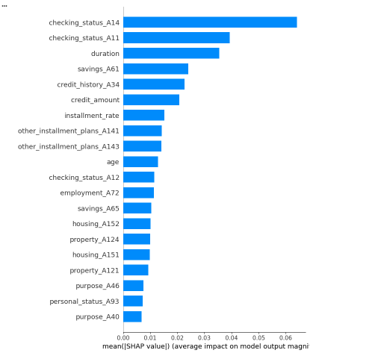
Interpretability (SHAP)
Global Feature Importance
• Checking account status
• Credit history
• Installment obligations
• Credit amount
• Duration
Local Explanations
• High risk borrowers: low account balance, poor credit history, multiple obligations
• Low risk borrowers: stable employment, good credit history, moderate loan amounts
Impact
• SHAP provides transparent, regulator friendly explanations.

Slide 10
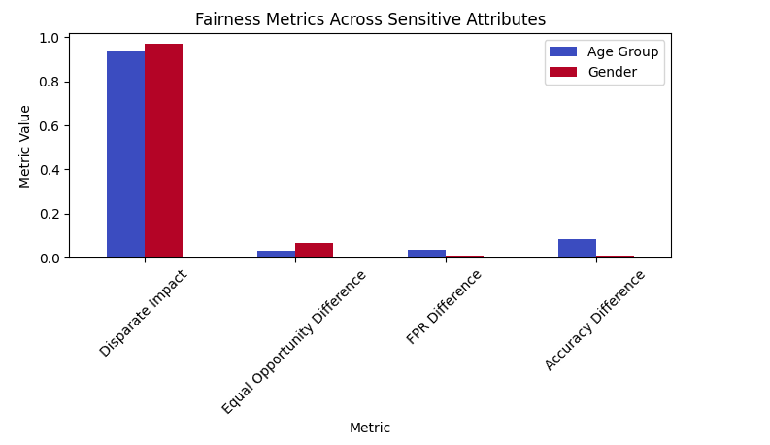
Fairness Analysis
Metrics Across Age & Gender
• Disparate Impact: Age 0.94, Gender 0.97 (above 0.80 threshold)
• Equal Opportunity Difference: Near zero
• FPR Difference: Minimal
• Accuracy Difference: Small and acceptable
Conclusion
• No major fairness concerns detected.
• Model treats demographic groups consistently.
• Supports responsible AI deployment.

Slide 11
Implementation and User Benefit
Key Benefits
• Can be integrated into existing credit scoring workflows.
• SHAP explanations support auditability and regulatory compliance.
• Fairness metrics enable ongoing bias monitoring.
• Reduces financial risk by improving identification of high-risk borrowers.
• Scalable pipeline adaptable to modern datasets and production systems.

Slide 12
Conclusion
Conclusion
• Logistic Regression is the best overall model for balanced, interpretable credit default prediction.
• SHAP reveals intuitive, domain consistent key drivers.
• Fairness analysis confirms no major demographic bias.
Limitations
• Dataset is older and limited in sensitive attributes.
• No temporal or stress testing capability.
• Single dataset limits generalizability.
Future Work
• Use modern datasets with richer attributes.
• Explore XGBoost/LightGBM and calibrated models.
• Implement fairness mitigation techniques.
• Build dashboards for real time monitoring.

Slide 13
Bibliography
Brown, I., & Mues, C. (2012). An experimental comparison of classification algorithms for imbalanced credit scoring data. Expert Systems with Applications, 39(3), 3446–3453.
Hand, D. J., & Henley, W. E. (1997). Statistical classification methods in consumer credit scoring: A review. Journal of the Royal Statistical Society: Series A, 160(3), 523–541.
Lundberg, S. M., & Lee, S.-I. (2017). A unified approach to interpreting model predictions. Advances in Neural Information Processing Systems.
Hardt, M., Price, E., & Srebro, N. (2016). Equality of opportunity in supervised learning. Advances in Neural Information Processing Systems.
UCI Machine Learning Repository. (2024). German Credit Data Set. University of California, Irvine.

