Slide 1
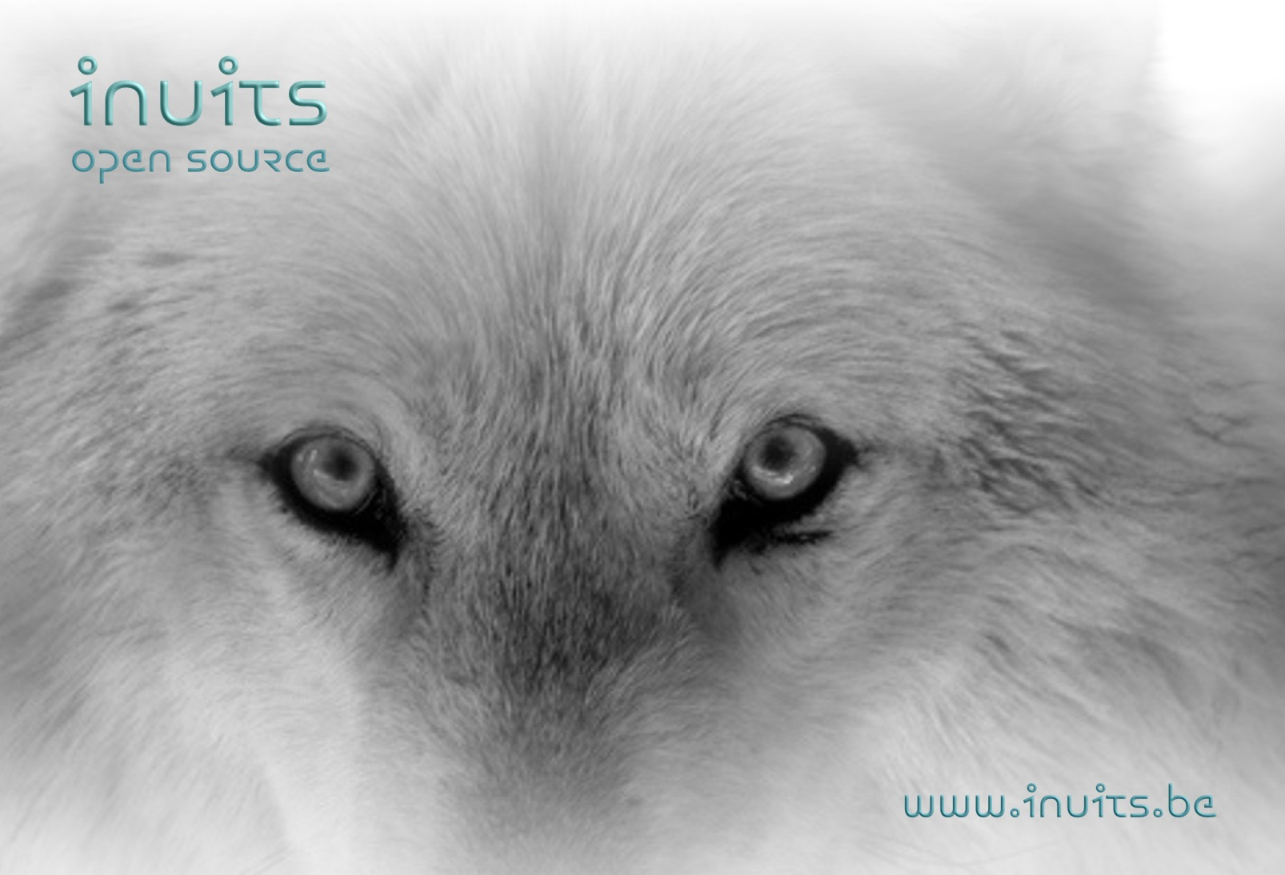
Using Virtualization in the
Real world

Slide 2
Whoami ?
Kris Buytaert@inuits.be
Senior Linux and Open Source Consultant
„Infrastructure Architect“
Linux since 0.98
Linux Expert @ Newtec.eu
Large Scale Deployment , High Availability
Surviving the 10th floor test
CoAuthor @
  Virtualization with Xen(tm): Including Xenenterprise, Xenserver, and XenExpress by David E. Williams

Slide 3
Agenda
Why use Virtualization
Do you know Xen ?
A Too Early Adopter
An uninformed Customer
A telco environment
  Why Xen @ Newtec
  Automated Xen Installations
  Complex Xen Networking
  Problem Situation
  Virtual Build Instances with Xen
Lessons Learned

Slide 4
Why Virtualisation Matters ?
Consolidation
Saving Idle Cycles
Security
Separating Development/Staging/Production platforms
A Greener Environment
Following The Hype
Having a budget that needs to be emptied.

Slide 5
Virtualisation vs Virtualisation
Single OS image: Ensim, Vservers, Solaris Zones
  Group user processes into resource containers
  Hard to get strong isolation
  Typically used for Hosting/Virtual Hosting/ISP
Chroot’s on steroids

Slide 6
Virtualisation vs Virtualisation
Full virtualization: VMware, VirtualPC, Qemu
  Run multiple unmodified guest OSes
  Hard to efficiently virtualize x86
  No Access to the hardware
  No Realtime guarantees
  Problematic for certain privileged instructions

Slide 7
Virtualisation vs Virtualisation
Para-virtualization: UML, Xen,
  Run multiple guest OSes ported to special arch
  Arch Xen/x86 is very close to normal x86
  Some Access to underlying hardware
  Better Performance
  Needs modification to the OS

Slide 8
Virtualisation vs Virtualisation
Hardware Supported Virtualisation
  Xen
  KVM
  Others adopted slowly
No more changes to the software ,
Hardware solves the problem

Slide 9
Let‘s talk about Xen
Pioneered ParaVirtualisation
Pioneered VT support
Went Mainstream real fast !
Stable and performant platform
Scriptable
Open Source
Scriptable
Targeted at Server Platforms
98% CPU Speed
Open Source
Known Developers
Let's not talk about KVM (yet)

Slide 10
DomU vs Dom0
Xen boots
Bye bye “x86”
HOSTA:/etc/xen/scripts # xm list
  Name Id Mem(MB) CPU State Time(s) Console
  Domain-0 0 123 0 r---- 41.2
Domain0 = management
DomainU = virtual machines

Slide 11
Xen 3.0 Arch
Device
Manager &
Control s/w
Unmodified
User
Software
Unmodified
User
Software
Unmodified
User
Software
GuestOS
(XenLinux)
GuestOS
(XenLinux)
GuestOS
(XenLinux)
Unmodified
GuestOS
(WinXP))
AGP
ACPI
PCI
Back-End
Back-End
SMP
Native
Device
Driver
Native
Device
Driver
Front-End
Device Drivers
Front-End
Device Drivers
VT-x
Control IF
Safe HW IF
Event Channel
Virtual CPU
Virtual MMU
Xen Virtual Machine Monitor
Hardware (SMP, MMU, physical memory, Ethernet, SCSI/IDE)

Slide 12
A too early adopter
Chose a core service first !
Add more complexity than needed
  Complexity is the enemy of High Availability
Mix beta Software with more beta software
Do not test
Act first, then plan
Go directly to production
Downtime guaranteed

Slide 13
An uninformed Customer
Major Hardware Vendor
  Orders 2 weeks Consultancy
  Orders software licenses
  Does not allow direct contact with customer
First Contact with customer
  Just install the boxes please
  How do you want them ?
The Magical Migration
  Of an uninventarized services
Oh and they ordered licenses for the wrong architecture :)

Slide 14
Newtec
Newtec is world renowned as a market leader in Satellite Communications, delivering an extensive range of highly innovative products and solutions. Since being founded in 1985, TV broadcasters, Telecom Service Providers, Integrators and Satellite Operators from all over the world have been relying on the exceptional performance and reliability of our unrivaled products.
They build devices such as Modulators / Demodulators
Platforms around these devices
  DVB-RCS
  SatMode
  Sat3Play
  Menos
  ...

Slide 15
Why Open Source @ Newtec ?
Because We Love It
T.i.n.a
We are part of the community
We contribute back
  Patches
  Documentation
  Xen in 2004
  Production with Xen2
  MySQL Cluster in 2005
  ...

Slide 16
Linux in a DVB-RCS/S3P Platform
Hub : Original Environment :
+/-198 machines (maximum)
  1 x Common = 2 x 4 Applications HA
  16 x Blade
    6 x Cache
    2 x shaping
    2 x measurement
    2 x pop management
    2 x device management
Terminals:

Slide 17
Our specific reasons for Virtualisation
Testing Large Scale System Deployment
  How to you test bootstrapping a large environment ?
      Buy machines for your test platform ?
      Interrupt regular services
      Take down a chain ?
  How do you test upgrade and rollback procedures ?
No Budget for full test platforms :)

Slide 18
Virtual Platforms
Full Hub in 1 machine
Testing network paths
Testing Failover
Prototyping
Testing Configuration Management

Slide 19
Consolidation in the 2Way Sat Hub
Each application had it's own machine
Highly Available
Over Powered
Small identical web applications
Each on their own identical network
In a different VLAN
Perfect match for Virtualisation

Slide 20
Deploying Virtual Machines in a Large Environment
  Consolidation of previously deployed machines
  Repeated work is boring and error prone
  We automated the physical machine deployment already so ...
==> Automating Xen Virtual Machine Deployment

Slide 21
Xen in Action
6+16x(2x3+6))=198 machines
  Consolidated already 1 application
  now 6 + 16x(2x2+6) = 166 machines (6+2x(2x2+6) = 24)
  we moved already 2 redundant applications to 1 of the 6 shared machines
Less Cabling
Less Switches
Less Power

Slide 22
Virtual Gateway Cluster
Different test and validation platforms
All with identical network topologies
Gateways (SSH) to each virtual platform
GW-1, GW-2, GW-3 , GW-8
==> vGW1- vGW8
Became highly critical
GW-X & GW-Y both containg vGW-1 - vGW-14

Slide 23
Solving Netfilter Problems
Building a truly transparant proxy
  Integration of LVS and Tproxy fails
  Required multiple machines to work
  CONNTRACK module conflicts
Used Xen to build this on 1 machine

Slide 24
Solution: Dynamic Build Environments
Use a virtual environment with linux instances:
  that are set up every time specific software needs to be build
  for every type of software
These Linux instances have their own filesystem image:
  With specific build software installed
  Can only be used to build one type of software
  As small as possible
Information about the type of software
  Is stored in release notes (versioning systems)‏
  Will be used to determine the linux image to use
  Can be stored together with the software
.. On one physical machine
Notes:
Not all virtual instances are needed at the same time; they can be deployed when they are needed.
This will make sure we can manage enough different types of linux images on just one physical machine.
Storing information in these releasenotes will make sure
The know-how per software type is stored with the software
Reduces the tasks of the buildmaster
Makes automation of the build process easier
Using Linux images makes it possible to easy clone virtual instances, in case multiple physical servers will act as a build server.
Advantages of small Linux images:
Reduce storage issues
Easier to maintain
Faster to setup
Scalability

Slide 25
Lessons Learned:
Only virtualise when needed
Test , test , test
Put delays between machine booting
Xen highlighted some issues with typical linux setups (bridging code) and improved it there
Customers need to be stopped in time
Complexity is the enemy of availability

Slide 26

Contact:
```
Kris Buytaert <Kris.Buytaert@inuits.be>
Further Reading
http://www.krisbuytaert.be/blog/
http://wiki.xensource.com/

Slide 27
Hybrid Deployment Goals
Hands off (Virtual) Machine Deployment
Minimal impact on the current infrastructure
Fast deployments
Easy to redeploy / reproduce
No vendor lock in‘s
We don't like doing the same stuff for different distributions

Slide 28
The 10th Floor Test
Grab a random machine
(don’t take a backup before)
Throw it out a 10th floor window
Can you recover it in <10 minutes ?
Even for Virtual Machines ?
(Steve Traugot)

