Slide 1
Beyond Configuration Management a rant by
Kris Buytaert

Slide 2
Kris Buytaert
I used to be a Dev, Then Became an Op,
Today I feel like a dev again
Senior Linux and Open Source Consultant @inuits.be
„Infrastructure Architect“
Building Clouds since before the Cloud
Surviving the 10th floor test
Co-Author of some books
Guest Editor at some sites

Slide 3
Today
About Puppet
About SIPX
Deploying SipX
...
Running into troubles

Slide 4
Introduction 2 Puppet

Slide 5

Not quite a Muppet...
Did you really expect ? A tutorial ?
This is PuppetCamp !

Slide 6
SipXecs
As an example, but you'll come up with a zillion more cases

Slide 7
What is sipXecs ?
sipX ECS (Enterprise Communications Server)
Open Source voice over IP telephony server
Implementation of the Session Initiation Protocol (SIP)
IP based communications system (IP PBX)
Not unlike Asterisk
Development started in 1999
GNU Lesser General Public License (LGPL)
Commercial offering from eZuce Inc.
Designed around FreeSWITCH
Modular and highly scalable system

Slide 8
We don't know VOIP
External VOIP consultancy
  Hardware selection
  Codecs etc
  Scale out
Irc.freenode.org #sipx
s/don/didn/t
Don't buy the book

Slide 9
Installing sipxecs
Prebuilt ISO
Kickstart
Install scripts placed in .bashrc
Ncurses based
Lots of python scripts
Heavy GUI usage

Slide 10
Why not Just ?
Backup and Restore ?
  CDR Integration etc
Image ?
Productization
  Think 20-100 setups
  For different customers
  Different networks, different domains

Slide 11
So, that Python Script ?
Configures your network
Configures your dhcpd
Configures your dns
Configures your ntpd
Configures your tftp
Generates SSL stuff for you
There's puppet modules for that !

Slide 12
SipXconfig
Is enabled by writing
“enabled” to /var/sipxdata/process-state/ConfigServer
The configuration and management server (sipXconfig) provides Web administration and user portals, Web services APIs, as well as all the abstraction logic to make using sipXecs as simple as it is. It provides centralized management of all the aspects of sipXecs, including installation, configuration, backup & restore, upgrade, troubleshooting and cluster management.
“Pushes” configs to other nodes
Should be rewritten in Puppet !

Slide 13
Configuring sipXecs
A couple of files
Some of them even obsoleted
Putting the SSL stuff in the right location

Slide 14
Everything is a funky SSL problem
Sipx generates keys at install time
  Ca + keypairs per node
2nd node needs those keys
Copy to puppetmaster and transfer back to other nodes ?
Or generate on puppetmaster and redistribute ?
  => Generated on Puppetmaster

Slide 15
Adding a second node
<> clustering
<> high availability ( please don't start crying)
Create an entry in the management interface
Then repeat manual installation using ncurses
Or just do a wget to register it with the primary

Slide 16
class voip::sipx {
sipx::netconfig {
"sipx":
ipaddress => $ip_address,
netmask => $netmask;
}
if $nodename == 'sipx-a' {
sipx::configserver{ "sipx": }
sipx::staticcertdbca{ "$hostname": }
sipx::staticcertdbnodes{ "SIPX-A.${platformdomainextension}":
clientname => "SIPX-A"; }
sipx::staticcertdbnodes{ "SIPX-B.${platformdomainextension}":
clientname => "SIPX-B"; }
include sipx::runmaster
}
else {
include sipx::runslave
sipx::register{ "$nodename":
clientname =>"${nodename}.${platformdomainextension}",
password =>"yourpw",}
}
sipx::supervisor { "$hostname":
sipx_supervisor => "sipx-a.$platformdomainextension";
}
sipx::staticssl{ "$hostname": }
}

Slide 17
More complexity
Or regular puppet ordering
Sipx requires PgSQL
You want PgSQL on an isolated LV
PgSQL configuration has to be done after it initialized a DB
SipX insist on starting PgSQL for you

Slide 18
class voip::storage {
file {
"/var/lib/pgsql":
ensure => directory;
lvm::volume { "pgsql":
vg => "systemvg",
pv => "/dev/cciss/c0d0p2",
fstype => "ext3",
size => "20G",
ensure => present,
}
mount { "/var/lib/pgsql":
atboot => true,
device => "/dev/systemvg/pgsql",
ensure => mounted,
fstype => "ext3",
options => "defaults",
require => [Logical_volume['pgsql'],File['/var/lib/pgsql']],
}
}
class voip::pgsql {
include postgres
postgres::initdb { "sipx": }
postgres::config{ "sipx":
listen => "*",
postgres::hba { "sipx":
allowedrules => [
"host SIPXCDR all ${clientip}/32 trust",
],
}
}

Slide 19
include voip::storage
include voip::pgsql
include voip::sipx
Class["voip::storage"] -> Class["voip::pgsql"] -> Class["voip::sipx"]

Slide 20
Manual config of the services via the gui is still required :(

Slide 21
I want to
Automatically create my admin pw
Automatically add that second node
Automatically disable/ enable functions in the sipX server
  e.g conferencing, openfire
Add users/phones
There's an API !
Which only implements limited functionality , and no configuration

Slide 22
The Problem in General
3rd Party software
Network Devices (thnx Brice)
Appliances
Application Configuration Mgmt

Slide 23
Abusing Test Frameworks to configure services on a webgui

Slide 24
Screen scraping ?
(03:28:30 PM) lazyboy: y, you just need a form processing library, one that can read a form values and allow you to post back your changes
(03:30:04 PM) lazyboy: the problem w/this method as you know is that it is constantly breaking
(03:30:41 PM) sdog: yep .. whan you change the gui .. it will break ....
(03:30:45 PM) lazyboy: maybe we need a serverside abstraction layer, that does the screenscraping and exports out a clean REST API
(03:31:13 PM) lazyboy: overtime, APIs go straight thru
(03:36:18 PM) lazyboy: so it's possible some of what you want to do is available w/not a lot of screen scraping.

Slide 25
Cucumber
Looks extremely easy
  “Hey our manager could write these test”
Isn't
  Heavily under documented
  Best docs are in the RSpec book
  Online examples are mostly broken
Requires to write a lot of code

Slide 26
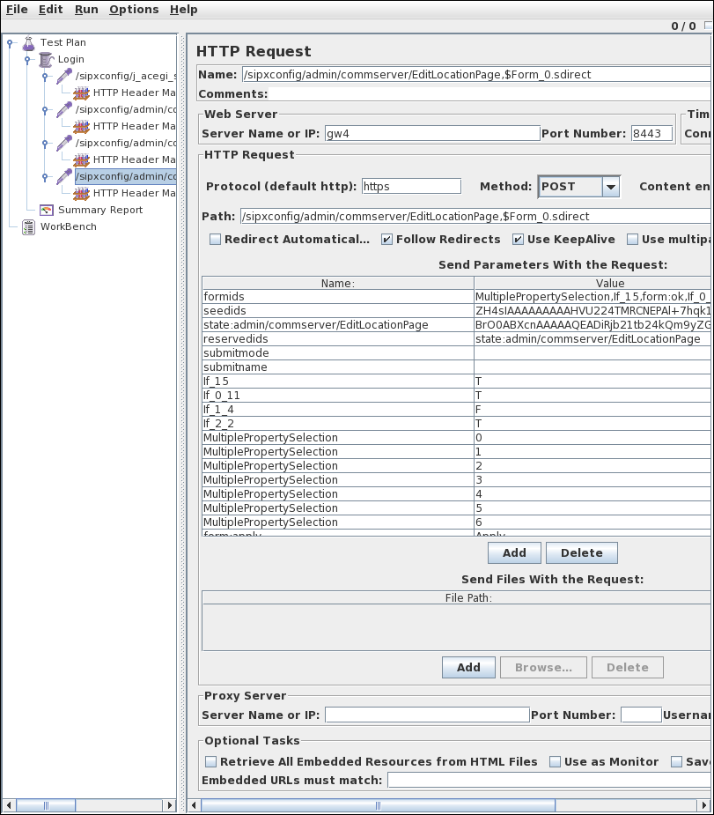
Apache Jmeter
Test tool
Load generation tool
Lets you record session by using a proxy
Only recent versions support SSL

Slide 27
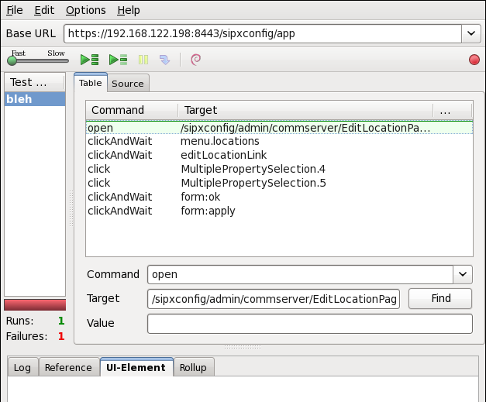
Selenium
Firefox plugin
Replays your actions
  No need to write code
Can export to perl, php, ruby ..
  Which requires the a Selenium Remote Control Server
  Which launches Firefox
SSL Fun ahead

Slide 28
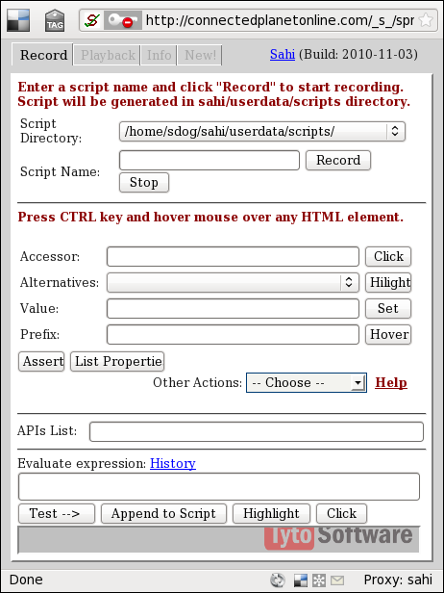
Alternatives
Sahi
  Similar to selenium
  Requires proxy
www::mechanize
Mechanize rubygem
Webtest
Your idea ?

Slide 29
Other Solutions
Use the java bindings
  Undocumented
  Will change
Sniff and Replay Traffic ?
Yours ?

Slide 30
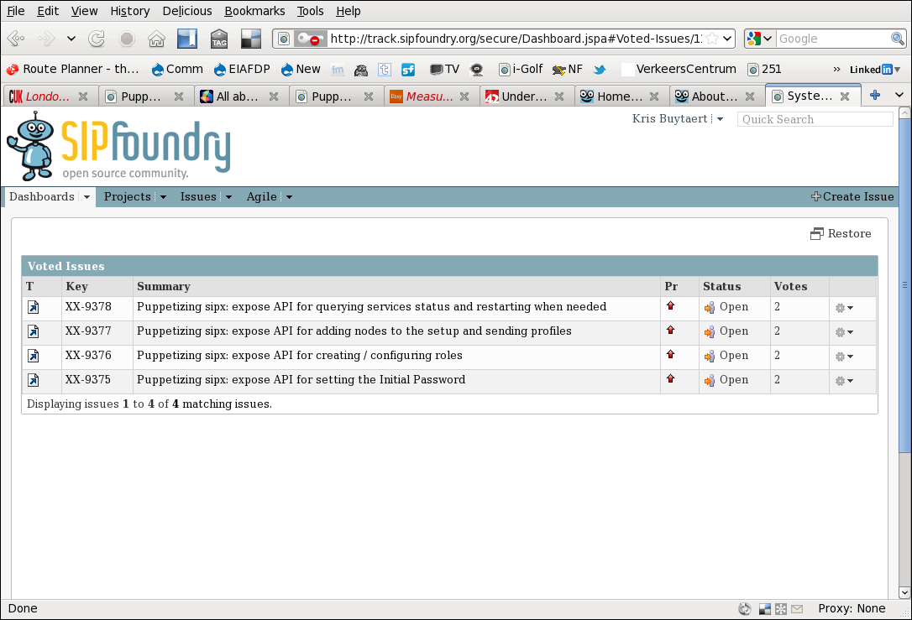
I want an API

Slide 31
But
GUI's will change
  “Test will have to be rewriten”
SSL Keymanagement stays hell
This still is a one off approach

Slide 32
Conclusions
No good solution yet :(
Talk to your upstream supplier
  Vendor / project
Be patient
Show the good example
All bugs produced during this experience are on
  https://github.com/KrisBuytaert

Slide 33
So how would YOU solve this ?

Slide 34

Contact
Kris Buytaert Kris.Buytaert@inuits.be
Further Reading
@KrisBuytaert
http://www.krisbuytaert.be/blog/
http://www.inuits.be/
http://www.virtualization.com/
http://www.oreillygmt.com/
Inuits
't Hemeltje
Gemeentepark 2
2930 Brasschaat
891.514.231
+32 473 441 636
Esquimaux
Kheops Business Center
Avenque Georges Lemaître 54
6041 Gosselies
889.780.406
+32 495 698 668

