Slide 1
Building (Virtual) Appliances
Kris Buytaert

Slide 2
Kris Buytaert
I used to be a Dev,
Then Became an Op
Senior Linux and Open Source Consultant @inuits.be
„Infrastructure Architect“
Building Virtual Appliances/Clouds since 2004
Surviving the 10th floor test
Co-Author Virtualization with Xen
Guest Editor at Virtualization.com
But mostly, a DevOp

Slide 3
Agenda
What Is A Virtual Appliance ?
Build once, Run Everywhere
Why people don't like Virtual Appliances
Why Build Virtual Appliances
So you are building a Virtual Appliance ?

Slide 4
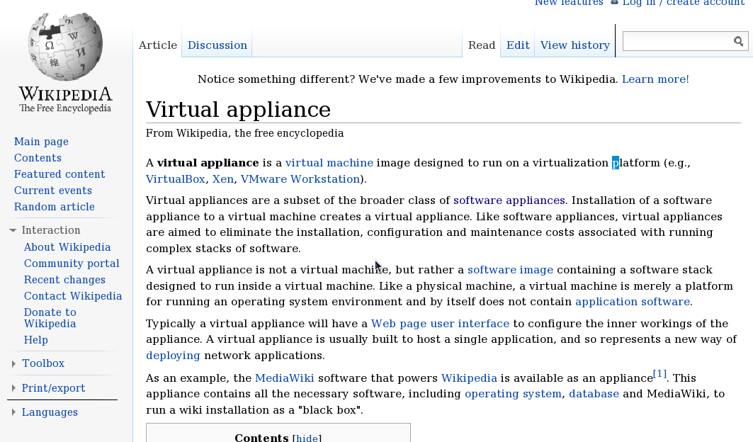
What Is A Virtual Appliance ?

Slide 5
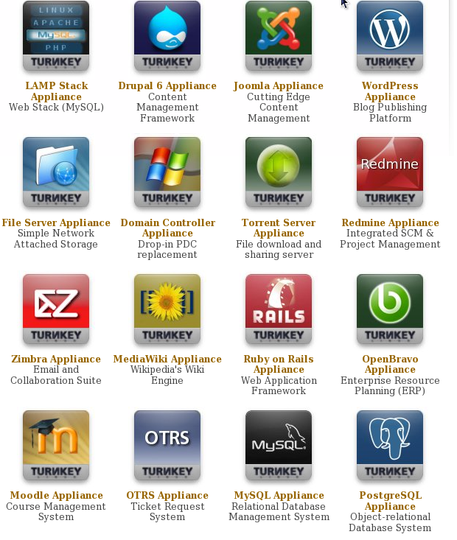
Examples:

Slide 6
Where to get them ?
TurnKey Linux: http://www.turnkeylinux.org/
VirtualBox : http://virtualboximages.com/
Rpath :
LMGTFY
the software vendor himselve
VMWare : http://www.vmware.com/appliances/
Citrix : Announced

Slide 7
Build once, Run Everywhere
Remember a fellow called Duke in 1996 ?
His “VM” just got bigger

Slide 8
OVF
Open Standard
Packaging & Distributing
Hypervisor independant
Support Multiple VM's in 1 package
Defines : CPU, Memory, Network, Storage

Slide 9
NOT OVF
File Format
Conversion between fileformats still needed
  e.g VMDK to VHD (Xen)
  But there are some availble

Slide 10
OVF in products
VirtualBox
RHEV as of v2.2 import and export available
Citrix Labs : Project Kensho
VMWare export tool

Slide 11
Why people don't like Virtual Appliances
Doesn't fit with their deployment tools
Doesn't fit with their authentication infrastructure
Doesn't fit with their standard database
Doesn't fit with their backup infrastructure
Doesn't fit with their operating system of choice

Slide 12
Why people don't like Virtual Appliances
Security
  Who did build this device ?
What about updates ?
Did we mention authentication ?
How secure is the application
The application servers ?
The Firewall ?

Slide 13
Image Sprawl, your update nightmare
Image sprawl
  Copy VM, Deploy VM, Modify VM, Copy VM
How do you patch 1 VM ?
Did you patch before or after that one was copied ?
How do you patch 100 VM's ?
What about machines that are offline ?

Slide 14
Image Sprawl, your update nightmare
The biggest challenges we have in virtualization cloud are operational and organizational rather than technical.
Christofer Hoff

Slide 15
Why Build Virtual Appliances
Give customers a no fuzz working platform
Save potential customers time by giving them a working demo
  No wasted time trying to satisfy dependencies
Technology Previews
Deploy your application on a virtual platform
A tool dedicated for virtual platforms (virtual networking, virtual security)

Slide 16
So you are building a Virtual Appliance ?
What to firewall ?
    Subnet ?
    Localhost ?
Are you going to build LDAP/??? libraries in ?
How secure is the The Firewall ?
What about updates ?

Slide 17
How to build virtual appliances
Rpath (Conary)
Suse Studio (Suse)
UshareSoft (distro indep)
Bitnami (distro indep)
But , how do you build your own software / infrastructure ?

Slide 18
Your Software
should be managed using version control
should build using a CI setup
should be tested in a test environment

Slide 19
Your Build environment
should be managed using version control
should be automated
should be disposable
Think deploy a VM , build software, transfer build results, destroy VM

Slide 20
Your Test Environment
should reproducible
should disposable
should automated
Think deploy a VM , test software, destroy VM

Slide 21
Deploying
Automated Deployments
If my computer can't install it , the installer is borken
Reproducable
Think:
  Kickstart, FAI, Preseeding, SystemImager Suite
Also in a VM

Slide 22
How to Upgrade ?
Provide Public Repository
  Feature upgrades
  Security upgrades
Provide Fresh Images

Slide 23
Config Propagation
Is this your config or Customer config ?
Overwrite customer preferences ?
Hosted Cfg Mgmt tools

Slide 24
Config Propagation
Is this your config or Customer config ?
Overwrite customer preferences ?
Hosted Cfg Mgmt tools

Slide 25
Package & Ship
Clocks HW vs Internal
Filesystems
Firewalls
Webmin
Vlan support

Slide 26
Conclusion
Standardize
Automate
Situation normal, nothing must change
Devops

Slide 27



`
Kris Buytaert <Kris.Buytaert@inuits.be>
Further Reading
http://www.krisbuytaert.be/blog/
http://www.inuits.be/
http://www.virtualization.com/
http://www.oreillygmt.com/
?
!

