Slide 1
Why your cloud needs a new team
Kris Buytaert

Slide 2
Kris Buytaert

Slide 3
A typical Cloud Deployment
As seen by the marketing departement
  Because Internal IT is to expensive
  Because IT takes 6 months for a machine to be delivered and our campaign goes live next week
  Because our CMS isn't an approved platform
  Because there are no “stupid” policies to follow

Slide 4
A typical Cloud Deployment
As seen by the developers
  Because Internal IT doesn't provide Ubuntu
  Because Internal IT doesn't provide the latest and brightest PHP version
  Because Internal IT doesn't support Drupal
  Because Internal IT only provides Postgress
  Because Internal IT doesn't put our changes in production fast enough

Slide 5
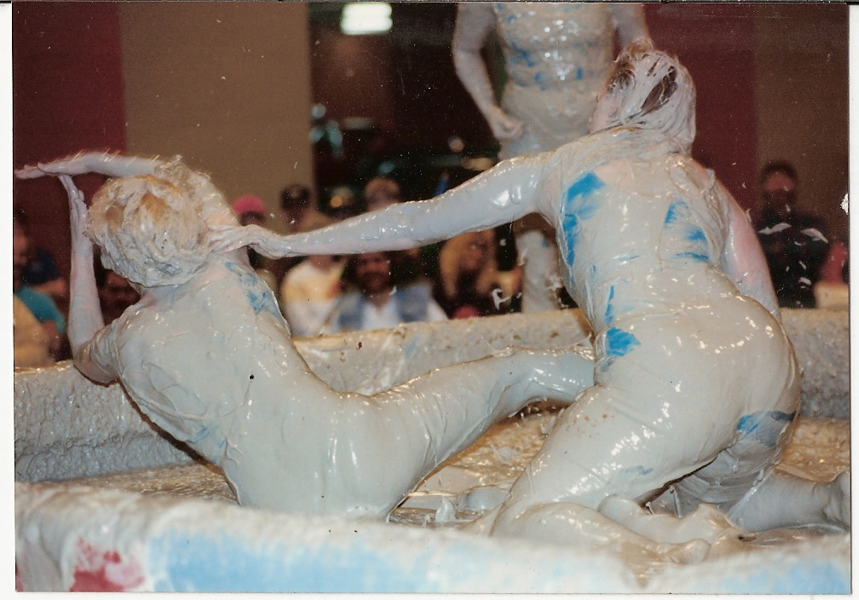
Devs vs Ops

Slide 6
Disaster Strikes
Platform team wasn't involved
  There are No Backups
  Site crashes frequently and there is no HA
  It is dead slow
Security wasn't involved
  Users are being added manually
  Spammers have fun
  And the site is being hijacked ..

Slide 7
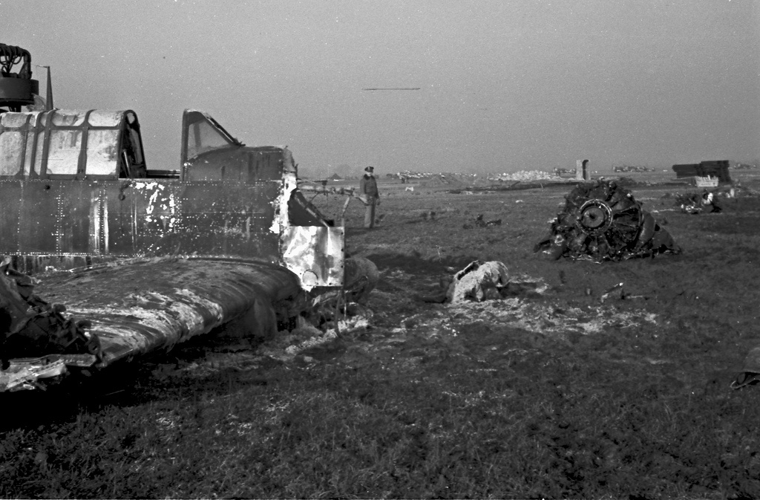
11 days into operations

Slide 8
So you've installed your box
Can you do it again ?
Do you know when you have to add another one ?
How do you plan on upgrading your application
    Bring it down for 4 hours a week ?
Do you know if it is up ?

Slide 9
So how much do you know about
Backups
IO Performance
Cron Jobs
LVM
Query Optimalization
Memory Mgmt
NTP
Replication
GlusterFS
Icinga
Varnish
Iptables
Selinux
Dns

Slide 10
So how much do you know about
Chef
Zookeeper
Cassandra
Puppet
Mcollective
BGP
LDAP
...

Slide 11

We can solve this !
Some people think the Ops work starts on deployment
It starts much earlier
Get Devs and Ops to talk asap

Slide 12
A typical Cloud Deployment
As seen by a Platform person
  Scalable
  Automated
  Reproducible
  Flexible
  Fast
  Agile

Slide 13
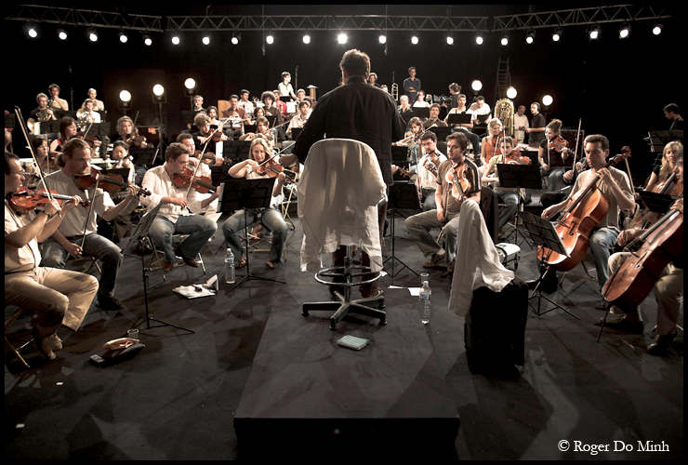
Configuration Mgmt

Slide 14

High Availabilty

Slide 15
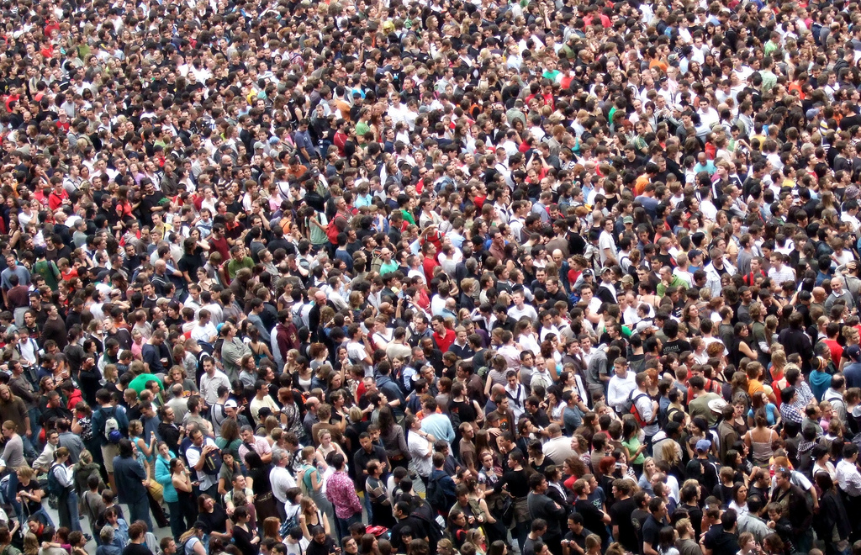
Scalability

Slide 16

Monitor

Slide 17

Surviving the test !
After 5+ years of preaching I`m not alone anymore
Devops, a new Movement !
Join the movement !
  Devopsdays.org
  Agile System Adminstration GoogleGroups

Slide 18



`
Kris Buytaert <Kris.Buytaert@inuits.be>
Further Reading
http://www.krisbuytaert.be/blog/
http://www.inuits.be/
http://www.virtualization.com/
http://www.oreillygmt.com/
?
!

Slide 19
Images:
http://www.flickr.com/photos/huffstutterrobertl/4135257384/
http://www.flickr.com/photos/gchorus/2074271352/
http://www.flickr.com/photos/30302096@N06/2953698548/
http://www.flickr.com/photos/jamescridland/613445810/
http://www.flickr.com/photos/johnmcga/4468003947/
http://www.flickr.com/photos/hitchica/719072170/

