Slide 1
Devops
Kris Buytaert

Slide 2
Kris Buytaert
I used to be a Dev,
Then Became an Op
Senior Linux and Open Source Consultant @inuits.be
„Infrastructure Architect“
Building Clouds since 2004
Surviving the 10th floor test
Co-Author Virtualization with Xen
Guest Editor at Virtualization.com
But mostly, a DevOp

Slide 3
Alternative Titles
Grumpy old Sysadmin
Devministration, a new Jobtitle
Surviving the 10th floor test
Agile Administration

Slide 4
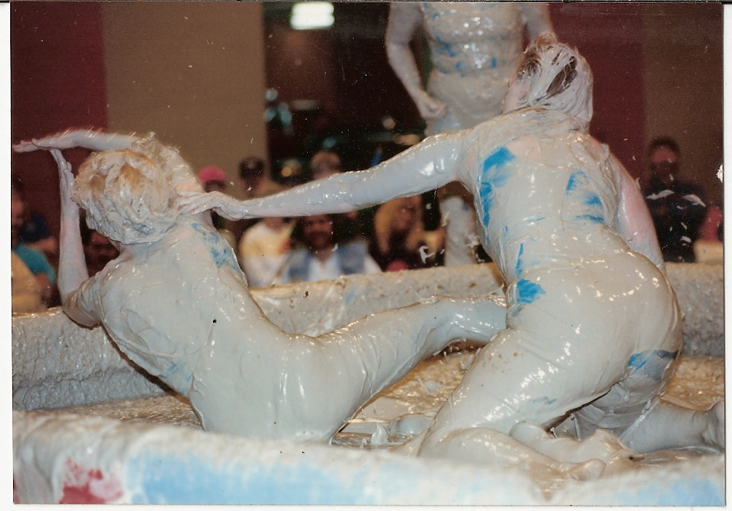
Devs vs Ops

Slide 5
The Old Days
“Put this Code Live, here's a tarball” NOW!
What dependencies ?
No machines available ?
What database ?
Security ?
High Availability ?
Scalability ?
My computer can't install this ?

Slide 6
10 days into operation
What High Load ? What Memory usage ?
Are these Logs ? Or this is actualy customer data ?
How many users are there , should they launch 100 queries each ?? Oh we're having 10K users
Why is debugging enabled ?
Who wrote this ?

Slide 7
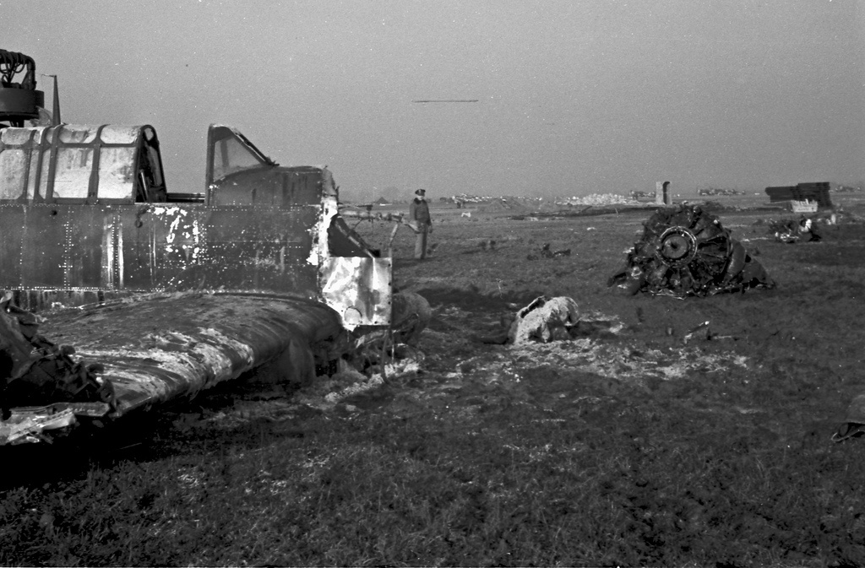
11 days into operations

Slide 8

We can solve this !
Some people think the Ops work starts on deployment
  Ops = both system, app as platform !
It starts much earlier
Get Devs and Ops to talk asap

Slide 9
Talk about Non functional Reqs
Security
Backups
High Availability
Upgradability
Configuration Mgmt
Monitoring

Slide 10
During Development
Version Control
Automate Builds
Integrated Bugtracking
Continous Integration
Integrated Testing
Automated deployment on test platforms

Slide 11
Devministration ?
For Both Devs and Ops
Yes we write code also
  Shell, perl, ruby, python, puppet
Everyone is a developer these days
  Automate your infrastructure !
So those rules apply for Ops Too !

Slide 12
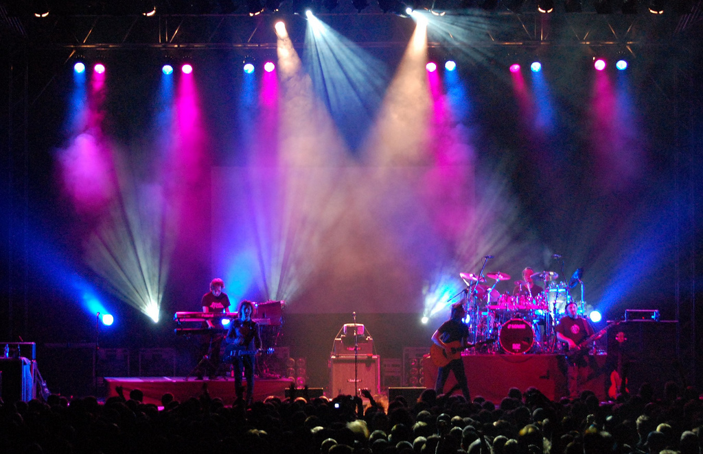
Going Live

Slide 13
Deploying
Automated Deployments
If my computer can't install it , the installer is borken
Reproducable
Think:
  Kickstart, FAI, Preseeding, SystemImager Suite

Slide 14
What to install ?
Thin Foil
JeOS
On Virtual / Cloudalike setups

Slide 15
Configuration Mgmt
Configure 1000 nodes,
Modify 2000 files,
Together
Think :
  Cfengine, bgcfg2, isconf
  Puppet, Chef
Put configs under version control

Slide 16
Deploy Apps
Code vs Config
Think:
  Capistrano, Controltier, ..
Test your deployment !

Slide 17
Deployment isn't the End
The job isn't done yet
Monitoring
Upgrading

Slide 18

High Availabilty

Slide 19
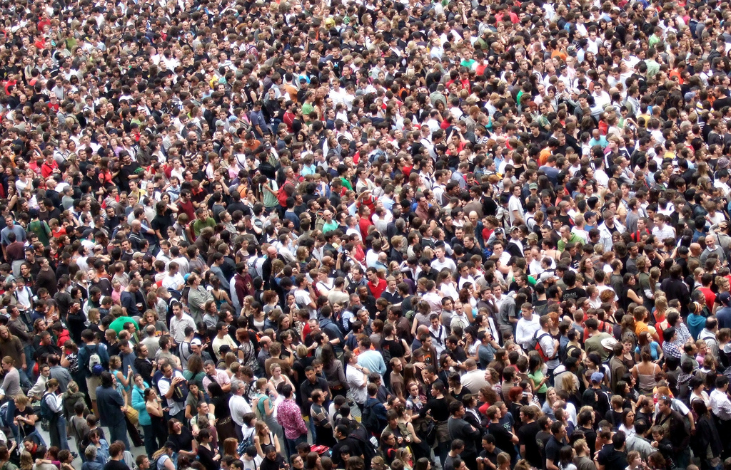
Scalability

Slide 20
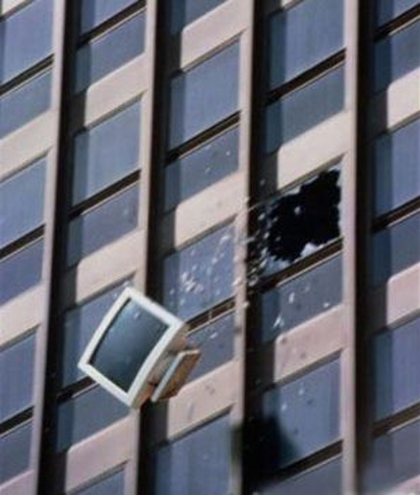
Surviving the test !
After 5+ years of preaching I`m not alone anymore
Devops, a new Movement !
Join the movement !
  Devopsdays.org
  Agile System Adminstration GoogleGroups

Slide 21



`
Kris Buytaert <Kris.Buytaert@inuits.be>
Further Reading
http://www.krisbuytaert.be/blog/
http://www.inuits.be/
http://www.virtualization.com/
http://www.oreillygmt.com/
?
!

Slide 22
Images:
http://www.flickr.com/photos/huffstutterrobertl/4135257384/
http://www.flickr.com/photos/brighton/2153602543/
http://www.flickr.com/photos/gchorus/2074271352/
http://www.flickr.com/photos/49024304@N00/2951673691/sizes/l/
http://www.flickr.com/photos/30302096@N06/2953698548/
http://www.flickr.com/photos/jamescridland/613445810/

