Slide 1

`
Deploying Xen in a Large Infrastructure

Slide 2

Who Am I
  Linux and Open Source Consultant
  „Infrastructure Architect“
  Linux since 0.98
  IANAKH
  Senior Consultant/CTO @ x-tend.be

Slide 3
Agenda
Reasons for Virtualisation
Installing Xen
Managing Xen today
Automated Xen Installations, a Case

Slide 4
Why Virtualisation Matters ?
Consolidation
Security
Separating Development/Staging/Production platforms
...

Slide 5
Lowering # machines
Telco Environment with maximum 6+16x(2x3+6))=198 machines (actually 6+2x(2x3+6)= 30)
  Consolidated already 1 application
    now 6 + 16x(2x2+6) = 166 machines (6+2x(2x2+6) = 24)
    we moved already 2 redundant applications to 1 of the 6 shared machines
    more are following

Slide 6
High Availability
High Availablilty
Failover many to 1 ?
Failover all physical machines to multiple virtual machines on 1 physical machine.
Novell HA Storage Foundation. (“reboot” virtual machines on other physical machine)
Multiple Virtual to multiple virtual

Slide 7
Virtualisation in HPC
Minimal performance penalty
Hot deployment of different distro's
Isolate the Hardware from the Cluster platform

Slide 8
Solving Netfilter Conflicts
Building a truly transparant proxy
  Integration of LVS and Tproxy fails
  Required multiple machines to work
  CONNTRACK module conflicts
Used Xen to build this on 1 machine

Slide 9
Our specific reasons for this work
Testing Large Scale System Deployment
  How to you test bootstrapping a large environment ?
      Buy machines for your test platform ?
      Interrupt regular services
      Take down a chain ?
  How do you test upgrade and rollback procedures ?

Slide 10
Our specific reasons for this work(2)
Actually deploying Virtual machines in a large environment
  Consolidation of previously deployed machines
  Repeated work is boring and error prone
  We automated the physical machine deployment already so ...

Slide 11
Getting Started with Xen

Slide 12
DomU vs Dom0
Xen hypervisor boots
Bye bye “x86”
HOSTA:/etc/xen/scripts # xm list
  Name Id Mem(MB) CPU State Time(s) Console
  Domain-0 0 123 0 r---- 41.2
Domain0 = management
DomainU = virtual machines

Slide 13
Todays Xen Installs
Out of the box on
  Sles
  FC 6
  Other distros.
Multiple Live CD's
Or download binaries from http://getxen.org

Slide 14
From the Tarball
Download binary install tarball
Check prerequisites
Python twisted
Bridging utils
./install
modify grub.conf
Reboot

Slide 15
Getting Started Fedora Core
Yum install xen kernel-xen0 kernel-xenU
http://people.redhat.com/riel/xen_for_fc4/
modify grub.conf
Reboot

Slide 16
Xen „Disks“
LVM
LVM
Actual /dev/hdxy
(g)NBD
Loopback files
\(NFS)

Slide 17
Xen Vhost Configuration
/etc/xen/hostname :
kernel = "/boot/vmlinuz-2.6.11-1.1366_FC4xenU"
memory = 128
name = "dokeos.x-tend.be"
nics = 1
extra ="selinux=0 3"
vif = ['ip = "10.0.11.13", bridge=xen-br0']
disk = ['phy:vm_volumes/root.dokeos,sda1,w'
,'phy:vm_volumes/var.dokeos,sda3,w'
,'phy:vm_volumes/www.dokeos,sda4,w'
,'phy:vm_volumes/swap.dokeos,sda2,w'
]
root = "/dev/sda1 ro"

Slide 18
Xen Networking
Bridging our Routing
Man brctl
/etc/xen/scripts/
Brctl show
Echo “1” > /proc/sys/net/ipv4/ip_forward

Slide 19
Managing Xen Instances
Xm create -c domainname
Xm list
Name Id Mem(MB) CPU State Time(s) Console
Domain-0 0 891 0 r---- 62.3
dokeos.x-tend.be 1 127 1 -b--- 24.6 9601
newhope.x-tend.be 2 127 1 -b--- 177.2 9602
Xm console $id
Xm shutdown $id
Xm destroy $id

Slide 20
Why Typical Linux Installs din‘t work for dom U
No Xen enabled Distribution CD‘s (yet)
No „install“ tool (anaconda etc)
No booting from device X and copying data
  Network
  Cd
  Disk

Slide 21
Typical Early Xen DomU installations
„Copy“ an existing image
Yum –installroot=/path/ -y groupinstall Base
Debootstrap
Urpmi –root=/path basesystem urpmi ssh-server
Yast
Rpmstrap
jailtime.org

Slide 22
  Managing Xen Virtual Machines

Slide 23
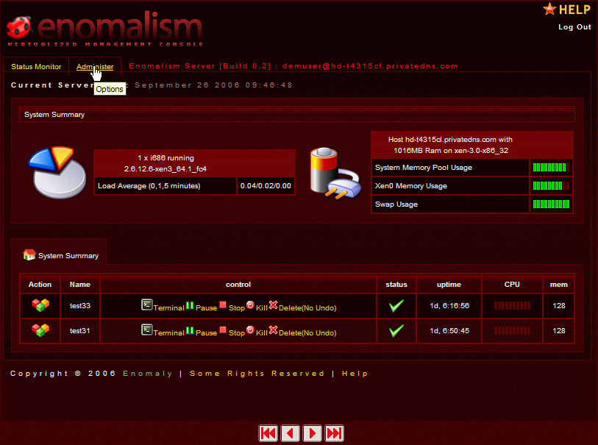
Enomalism
Long time Vapour
Difficult to Install
Lots of dependencies

Slide 24
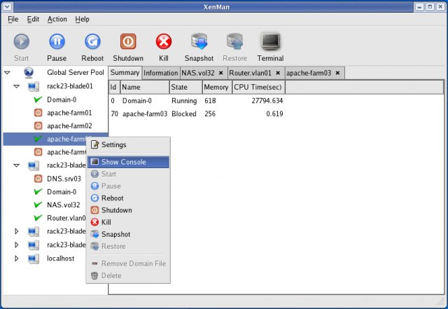
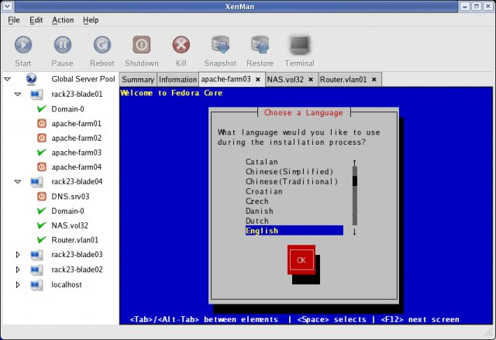
XenMan
FC Centric
Install tool
Management tool
Active development!
Remote Management

Slide 25
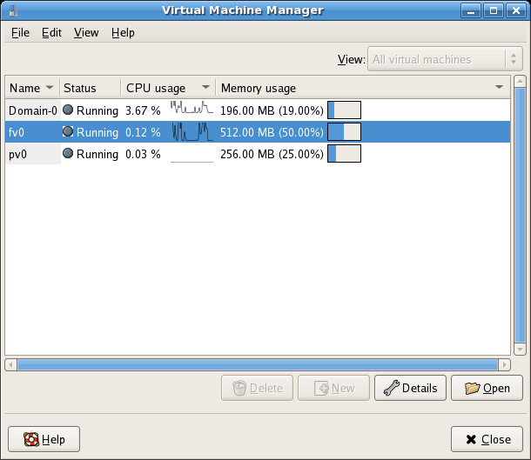
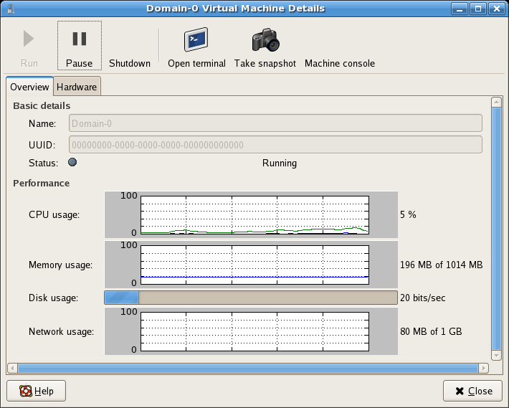
Virtual Machine Manager
RedHat development

Slide 26
OpenQRM
Data Center Management Framework
Automatic, Policy based Provisioning
Supports booting servers from local disk, NAS or iSCSI
Multiple Interfaces: CLI/ Web / etc
Plugin Modules

Slide 27
OpenQRM
Partitioning
  Deploy an image either physically or
  Virtually
Supports Multiple Virtualisation Engines
Still boots over newtork, disk provisioning planned for next versions
Commercial Version by Qlusters

Slide 28
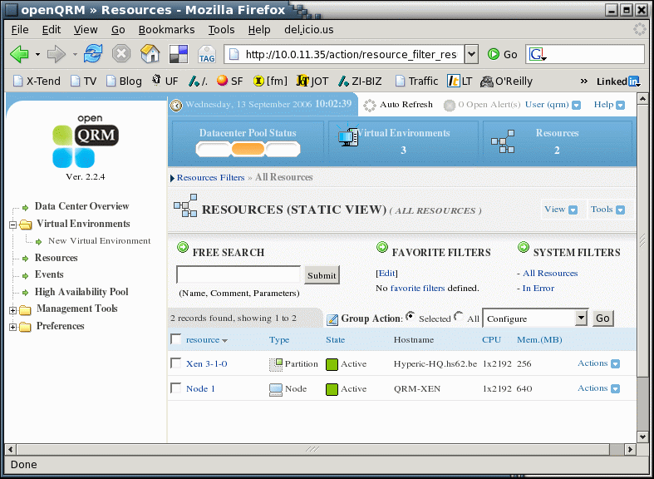
OpenQRM

Slide 29
Xen Enterprise
Commercial Supported by Xensource
Dedicated distribution + Management Console (Java Based)
Easy To Install
Templates to install Debian and RHEL 4.X
P2V Migration for above and SLES

Slide 30
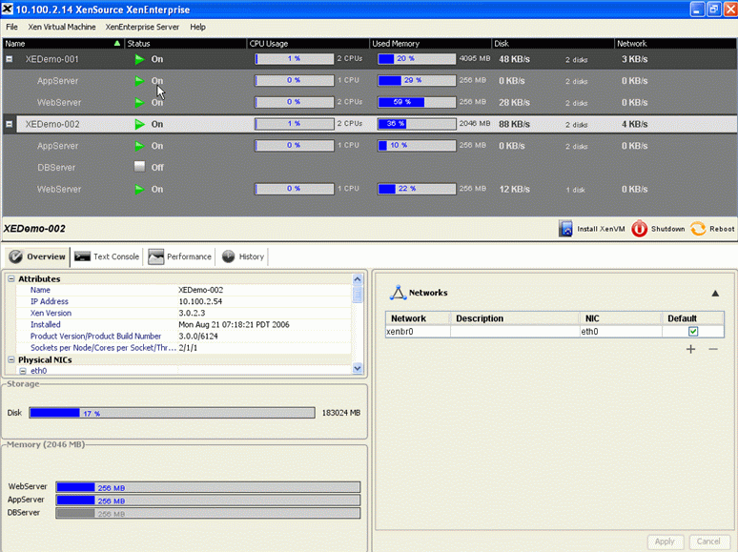
Xen Enterprise

Slide 31
Xen Enterprise
Not all the Xen functionality from the gui
Perfect for Virtual Hosting Management
Product is available NOW!

Slide 32
Xen in a Large Infra
No All in one
Mostly extremely Distro specific
No way automate deployment
  Except for Kickstarting Xen-E
No tools to integrate with existing package management
No tools to measure
  Ganglia

Slide 33
Xen in a Large Infra
Tools exist in the HPC world
Tools exist OpenSource
Nagios
OpenQRM comes close
Xen-E works for specific environments
Best of Breed: Hybrid Deployment

Slide 34
Large Scale Infrastructure Theory

Slide 35
Goals
Hands off Virtual Machine Deployment
Minimal impact on the current infrastructure
Fast deployments
Easy to redeploy / reproducable
I hate vendor Lock In‘s
I hate doing the same stuff for different distros

Slide 36
The 10th Floor Test
Grab a random machine (don’t take a backup before)
Throw it out a 10th floor window
Can you recover it in <10 minutes ?
Even for Virtual Machines ?
(Steve Traugot)

Slide 37
Imaging vs Installing
Imaging
  Speed
  Identical machines
  Multicasting
Installing
  “slower”
  Finegrained

Slide 38
Tools vs Tools
Disclaimer :
  Tools are examples,
  alternatives exist
Automated
  Fai
  Autoyast
  Kickstart
  System Imager

Slide 39
Systemimager Suite
SystemImager
    Fast deployment
    Golden client based
    Multicast features
    Centrally Stored Images
    Boel framework

Slide 40
SystemImager Suite (2)
SystemInstaller
    Evolved from LUI
    Generates Images based on
            Packagelist
            Distro type
            Partition Definition

Slide 41
SystemImager Suite (3)
SystemConfigurator
    Post install configuration
    Hardware detection / bootloader config
    Distro integration

Slide 42
Overriding „standard“ configs
SystemImager Concept
Over-rides an image per host
Used for „non packagable“ files
Contains machine specific information
  e.g. Package lists

Slide 43
Autoinstall , the script / the cd
Create a dhcp config file
PXE Boot and downloads the initial kernel and initrd
Creates an initial ramdisk and asks ip addres, hostinfo, and installserver information.
download boel image and setup a minimal environment (rsync)
Based on the hostinfo downloads the host specific script (autoinstallscript)

Slide 44
Beyond Installing
Package management
Central Repository
  Updates of relevant packages
    Yum
    Apt
    Juliux

Slide 45
Beyond Installing(2)
Configuration Management
  Isconf
  Cfengine
  Puppet

Slide 46
Hybrid Deployment
Keep everything in CVS
Image a basic image
Generate that image
Then install the delta's on a per host basis via packages
Use a repository to update systems
Keep everything in CVS
Use a configuration management tool.

Slide 47
Existing Alternatives
The alternatives
  Preseeding d-i
  OLS Paper (snapshotting + containers)
Issues with them :
  Distro Specific
  Valid in Isolated environments

Slide 48
Building your own ? What do we need ?
Installing a basic image in a chroot
Creating „partitions“
Creating/Updating configurations
Booting

Slide 49
„Modifying“ an Autoinstall Script
create_vhost : {
Create LVM partitions
Chroot
Rsync
Configure
}

Slide 50
Generation of scripts
mksiimage based template
Creates
  lvm create script
  xen config
  fstab

Slide 51
The full monty
Install hostX
if (xen=enabled) then
  add xen packages from repository
  overrides include /etc/xen/auto files
  for $vhost in /etc/xen/auto/* ;
    create_vhost
    done
reboot into xen enabled

Slide 52
From here to ..
Management of virtual machine is identical to physical machine
Deploy new virtual machine is as easy as running create_vhost $hostname
Cfengine and repositories are being used as within physical machines

Slide 53
Further Reading
Automating Xen Virtual Machine Deployment, LinuxKongress 2005
O'ReillyNet , Getting Started with Xen
http://www.x-tend.be/~buytaert/blog/
http://xen.sf.net

Slide 54
Contact
Kris.Buytaert@x-tend.be
http://www.x-tend.be/~buytaert/blog/
X-Tend
Veldkant 35d
B-2550 Kontich
Belgium

Slide 55


Questions ?
?
!

Slide 56
Xen Summary

Slide 57
Let‘s talk about Xen
ParaVirtualisation
Going Mainstream real fast !
Stable and performant platform
Scriptable

Slide 58
Xen
“ParaVirtualization”
Provides some exposure to the actual hardware
  Performance increase
  OS Needs to be modified
  Multiplexes resources at OS granularity (vs Process level granularity)
100 virtual OS's per machine

Slide 59
Xen
X86 supports 4 levels of privileges
  0 for OS, and 3 for applications
  Xen downgrades the privilege of Oses
Xen exposes a set of simple device abstractions

Slide 60
Porting an OS to Xen
X86 Like
Priviledged instructions
  are replaced with Xen hypercalls
  for Linux 2.6 only arch-dep files were modified
Network Device Driver
Block Device Driver
Source code availaiblity !
<2% of code-base

Slide 61
Xen & Disk Access
Only Domain0 has direct access to disks
Other domains need to use virtual block devices
  Use the I/O ring
  Reorder requests prior to enqueuing them on the ring
  If permitted, Xen will also reorder requests to improve performance

Slide 62
Xen 3.0 Arch
Device
Manager &
Control s/w
Unmodified
User
Software
Unmodified
User
Software
Unmodified
User
Software
GuestOS
(XenLinux)
GuestOS
(XenLinux)
GuestOS
(XenLinux)
Unmodified
GuestOS
(WinXP))
AGP
ACPI
PCI
Back-End
Back-End
SMP
Native
Device
Driver
Native
Device
Driver
Front-End
Device Drivers
Front-End
Device Drivers
VT-x
Control IF
Safe HW IF
Event Channel
Virtual CPU
Virtual MMU
Xen Virtual Machine Monitor
Hardware (SMP, MMU, physical memory, Ethernet, SCSI/IDE)

