Slide 1

MySQL High Availability
& Drupal

Slide 2
Who is Kris Buytaert
  Not related to Dries (afaik)
  Linux and Open Source Consultant
  Infrastructure Architect
  Linux since 0.98
  Senior Consultant @ inuits.be
  Drupal Newbie
  Surviving the 10th floor test

Slide 3
Why High Availability Matters
  Downtime is expensive
  You miss $$$
  Your boss complains
  New Users don't return

Slide 4
Lies, Damn Lies, and Statistics
Counting nines
(slide by Alan R)

Slide 5
The rules of High Availability
  Prepare for failure
  Keep It Simple
  Complexity is the enemy of reliability
            (Alan R)

Slide 6
Historical MySQL “Clustering”
  Replication
  LVS
  1 read write node
  Multiple read only nodes
  Application needed to be modified

Slide 7
More Recent Alternatvies
  DRBD
  Cluster (ndbd)
  Multimaster Replication (autoidx)
  MySQL Proxy

Slide 8
Data HA vs Connectivy Ha
  MySQL = DATA
  Connection
        Linux Heartbeat
          Client (multi DS)

Slide 9
Shared Nothing
No SPOF
      Any single server can fail
      often multiple failures also survive
No extra hardware (expensive) required
No dependency on other nodes

Slide 10
Data Partitioning
  Data is horizontally partitioned over the nodes
- Each node is in charge of only a piece of
the data
- Data can be read in parallel
- E.g 4 data nodes could have 4 data
fragments with each ¼ of the data.
4Gb database requires 1Gb on 4 nodes
each.

Slide 11
Replication
  Data is replicated to NrOfReplicas Nodes
  Typically 2 or more
  Highly Available
  Guaranteed at Commit time to be present
  in multiple nodes
  - Automatic node takeover.
  If you only have 2 nodes and you need to
  store 2 Gb of data you need 2Gb of memory
  per node!

Slide 12
Main Memory System
  Everything (data + indexes) are in Memory !
  High Perfomance
  Asynchronous disk writes
  Available memory restricts database size

Slide 13
Cluster Components
  ndb_mgmd the management nodes
  ndbd the cluster storage nodes
  mysqld , the traditional MySqld talking to
  the cluster engine
  Can run on the same or different servers
  For true HA ndb_mgmd can’t be on one of
  the ndbd nodes.

Slide 14
Management Node
  In charge of cluster config
  Only Needs to be running when nodes
  start
  Further Management roles
    Start Backups
    Monitor node status
    Logging
    Master / slave Arbitration

Slide 15
MySQL Node
  Standard MySQL node compiled with ndbd
  Can use other storage engines
  One creates tables with
    ENGINE=NDBCluster
  Can be enabled by default

Slide 16
NDB Data Nodes
  The actual Data Stores
  Handle
    Replication
    Partitioning
    Failover
  Has to be a multiple of NrOfReplicas

Slide 17
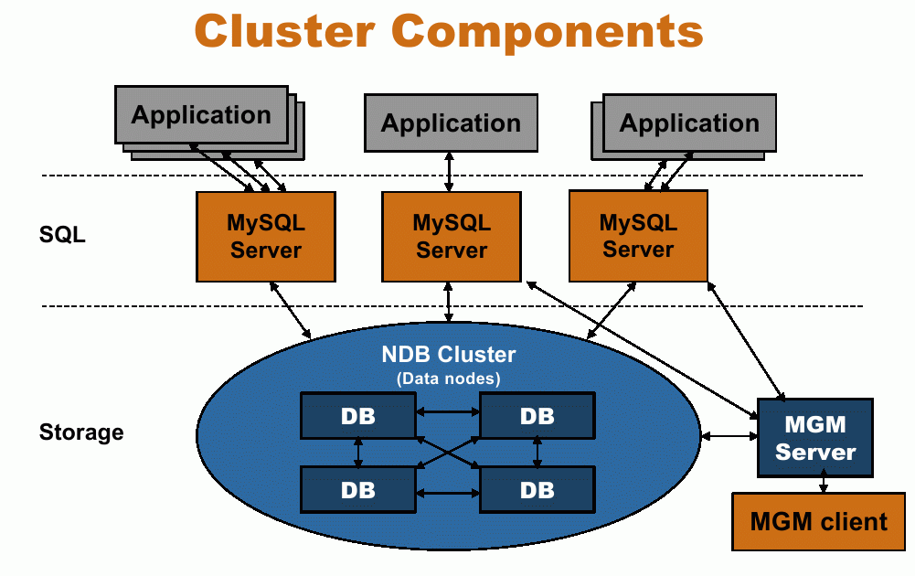
Title
  Data

Slide 18
Limitations
Database Size = Required Memory
Network troughput
      ==> Dolphin HSI

Slide 19
Adding Disk Based Storage
Certain tables do not Fit In Memory
Feature as of 5.1.6
Uses Tablespaces and Logfiles groups in files
Only non indexed fields are on disk !

Slide 20
Creating A Table to using Disk based Storage
CREATE TABLE t1 (a int, b int, c int, d int, e int,
  primary key(a), index(a,b))
  TABLESPACE ts1 STORAGE DISK
  engine=ndb;

Slide 21
Limitations (2)
slow complex JOINs or full table scans
Not supported :
    Foreign keys
    Full-text search

Slide 22
Pulling Traffic to the Cluster
DNS Loadbalancing
Advertise routing (ripd/vrrpd/bgpd)
LVS
Linux HA

Slide 23
My Test Cluster
2 management
2 data
DataMemory = 1650M
IndexMemory = 500M

Slide 24
Drupal on MySQL Cluster
Mysql dump or running drupal
s/engine innodb/ndb/g;
Restore dump
Success!

Slide 25
Devel module
Accelerate development of your site or module by quickly generating nodes, comments, terms, users, and more.
Create 1000 users
Create 1000 nodes
Create 1000000 users
Create 1000000 nodes

Slide 26
Devel module(2)
Timeouts before the actual amount reached
Perceived as “extremely slow”

Slide 27
Drupal.org Database
Gerhard Killesreiter
600Mb zipped
I now 0wn your passwords :)
2.6 Gb

Slide 28
Drupal.org Database

Slide 29
Drupal.org Node_revisions
0.45G of data 0.01G of indexes.
mysql> alter table dnbd.node_revisions engine ndb;
First need to make changes to the config file
  TimeBetweenLocalCheckpoints=5
  NoOfFragmentLogFiles=128
Can't get the original 480Mb Data + 126Mb IDX in memory (1650Mb+500Mb)

Slide 30
Drupal.org Node_revisions(2)
CREATE TABLE `node_revisions` ()
TABLESPACE ts1 STORAGE DISK
ENGINE=ndb DEFAULT CHARSET=utf8;
Memory:
2008-02-17 12:26:44 [MgmSrvr] INFO -- Node 3: Data usage is 14%(7713 32K pages of total 52800)
2008-02-17 12:26:44 [MgmSrvr] INFO -- Node 3: Index usage is 1%(1017 8K pages of total 64032)
Disk:
| file_id | file_name | tablespace_name | engine | free_extents | total_extents | data_free | status
| 0 | datafile.dat | ts1 | ndbcluster | 1019 | 16000 | NULL | NORMAL |

Slide 31
Drupal.org Node_revisions(3)
  ndb_desc -d dnbd node_revisions
  -- node_revisions --
  Version: 1
  Fragment type: 5
  K Value: 6
  Min load factor: 78
  Max load factor: 80
  Temporary table: no
  Number of attributes: 9
  Number of primary keys: 1
  Length of frm data: 406
  Row Checksum: 1
  Row GCI: 1
  SingleUserMode: 0
  ForceVarPart: 1
  TableStatus: Retrieved
  -- Attributes --
  nid Unsigned NOT NULL AT=FIXED ST=MEMORY
  vid Unsigned PRIMARY KEY DISTRIBUTION KEY AT=FIXED ST=MEMORY
  uid Int NOT NULL AT=FIXED ST=MEMORY
  title Longvarchar(384;utf8_general_ci) NOT NULL AT=FIXED ST=DISK
  body Text(256,8000;4;utf8_general_ci) NULL AT=FIXED ST=MEMORY
  teaser Text(256,8000;4;utf8_general_ci) NULL AT=FIXED ST=MEMORY
  timestamp Int NOT NULL AT=FIXED ST=DISK
  format Int NOT NULL AT=FIXED ST=DISK
  log Text(256,8000;4;utf8_general_ci) NULL AT=FIXED ST=MEMORY
  -- Indexes --
  PRIMARY KEY(vid) - UniqueHashIndex
  PRIMARY(vid) - OrderedIndex
  uid(uid) - OrderedIndex
  nid(nid) - OrderedIndex

Slide 32
Drupal.org search_index
The biggest index
0.43G of data 0.25G of indexes.
mysql> alter table dnbd.search_idx TABLESPACE ts1 STORAGE DISK
ENGINE=ndb
Does not fit in memory :(

Slide 33
Drupal.org search_index(2)
ndb_desc -d ddisk search_index
-- search_index --
Version: 16777218
Fragment type: 5
K Value: 6
Min load factor: 78
Max load factor: 80
Temporary table: no
Number of attributes: 7
Number of primary keys: 1
Length of frm data: 371
Row Checksum: 1
Row GCI: 1
SingleUserMode: 0
ForceVarPart: 1
TableStatus: Retrieved
-- Attributes --
word Varchar(150;utf8_bin) NOT NULL AT=SHORT_VAR ST=MEMORY
sid Unsigned NOT NULL AT=FIXED ST=MEMORY
type Varchar(48;utf8_bin) NULL AT=SHORT_VAR ST=MEMORY
fromsid Unsigned NOT NULL AT=FIXED ST=MEMORY
fromtype Varchar(48;utf8_bin) NULL AT=SHORT_VAR ST=MEMORY
score Float NULL AT=FIXED ST=DISK
$PK Bigunsigned PRIMARY KEY DISTRIBUTION KEY AT=FIXED ST=MEMORY
-- Indexes --
PRIMARY KEY($PK) - UniqueHashIndex
from_sid_type(fromsid, fromtype) - OrderedIndex
word(word) - OrderedIndex
sid_type(sid, type) - OrderedIndex
NDBT_ProgramExit: 0 - OK

Slide 34
Drupal.org comments
-- comments --
Version: 1
Fragment type: 5
K Value: 6
Min load factor: 78
Max load factor: 80
Temporary table: no
Number of attributes: 16
Number of primary keys: 1
Length of frm data: 590
Row Checksum: 1
Row GCI: 1
SingleUserMode: 0
ForceVarPart: 1
TableStatus: Retrieved
-- Attributes --
cid Int PRIMARY KEY DISTRIBUTION KEY AT=FIXED ST=MEMORY
pid Int NOT NULL AT=FIXED ST=DISK
nid Int NOT NULL AT=FIXED ST=MEMORY
uid Int NOT NULL AT=FIXED ST=MEMORY
subject Varchar(192;utf8_general_ci) NOT NULL AT=FIXED ST=DISK
comment Text(256,8000;4;utf8_general_ci) NULL AT=FIXED ST=MEMORY
hostname Longvarchar(384;utf8_general_ci) NOT NULL AT=FIXED ST=DISK
timestamp Int NOT NULL AT=FIXED ST=MEMORY
score Mediumint NOT NULL AT=FIXED ST=DISK
status Tinyunsigned NOT NULL AT=FIXED ST=MEMORY
users Text(256,8000;4;utf8_general_ci) NULL AT=FIXED ST=MEMORY
thread Longvarchar(765;utf8_general_ci) NOT NULL AT=FIXED ST=DISK
name Varchar(180;utf8_general_ci) NULL AT=FIXED ST=DISK
mail Varchar(192;utf8_general_ci) NULL AT=FIXED ST=DISK
homepage Longvarchar(765;utf8_general_ci) NULL AT=FIXED ST=DISK
format Int NOT NULL AT=FIXED ST=DISK
-- Indexes --
PRIMARY KEY(cid) - UniqueHashIndex
tracker_global(status, timestamp) - OrderedIndex
tracker_user(uid, status, timestamp) - OrderedIndex
lid(nid) - OrderedIndex
PRIMARY(cid) - OrderedIndex
timestamp(timestamp) - OrderedIndex
NDBT_ProgramExit: 0 - OK

Slide 35
Drupal.org cache_filter
-- cache_filter --
Version: 1
Fragment type: 5
K Value: 6
Min load factor: 78
Max load factor: 80
Temporary table: no
Number of attributes: 6
Number of primary keys: 1
Length of frm data: 355
Row Checksum: 1
Row GCI: 1
SingleUserMode: 0
ForceVarPart: 1
TableStatus: Retrieved
-- Attributes --
cid Longvarchar(765;utf8_general_ci) PRIMARY KEY DISTRIBUTION KEY AT=MEDIUM_VAR ST=MEMORY
data Blob(256,7256;4) NULL AT=FIXED ST=MEMORY
expire Int NOT NULL AT=FIXED ST=MEMORY
created Int NOT NULL AT=FIXED ST=DISK
headers Text(256,2000;16;utf8_general_ci) NULL AT=FIXED ST=MEMORY
serialized Int NOT NULL AT=FIXED ST=DISK
-- Indexes --
PRIMARY KEY(cid) - UniqueHashIndex
PRIMARY(cid) - OrderedIndex
expire(expire) - OrderedIndex
NDBT_ProgramExit: 0 - OK

Slide 36
Drupal.org project_usage_day
-- project_usage_day --
Version: 1
Fragment type: 5
K Value: 6
Min load factor: 78
Max load factor: 80
Temporary table: no
Number of attributes: 5
Number of primary keys: 3
Length of frm data: 313
Row Checksum: 1
Row GCI: 1
SingleUserMode: 0
ForceVarPart: 1
TableStatus: Retrieved
-- Attributes --
timestamp Unsigned PRIMARY KEY DISTRIBUTION KEY AT=FIXED ST=MEMORY
site_key Varchar(96;utf8_general_ci) PRIMARY KEY DISTRIBUTION KEY AT=SHORT_VAR ST=MEMORY
pid Unsigned PRIMARY KEY DISTRIBUTION KEY AT=FIXED ST=MEMORY
nid Unsigned NOT NULL AT=FIXED ST=DISK
tid Unsigned NOT NULL AT=FIXED ST=DISK
-- Indexes --
PRIMARY KEY(timestamp, site_key, pid) - UniqueHashIndex
PRIMARY(timestamp, site_key, pid) - OrderedIndex
NDBT_ProgramExit: 0 - OK

Slide 37
Drupal.org search_dataset
-- search_dataset --
Version: 16777217
Fragment type: 5
K Value: 6
Min load factor: 78
Max load factor: 80
Temporary table: no
Number of attributes: 4
Number of primary keys: 1
Length of frm data: 285
Row Checksum: 1
Row GCI: 1
SingleUserMode: 0
ForceVarPart: 1
TableStatus: Retrieved
-- Attributes --
sid Unsigned NOT NULL AT=FIXED ST=MEMORY
type Varchar(48;utf8_general_ci) NULL AT=SHORT_VAR ST=MEMORY
data Text(256,8000;4;utf8_general_ci) NOT NULL AT=FIXED ST=MEMORY
$PK Bigunsigned PRIMARY KEY DISTRIBUTION KEY AT=FIXED ST=MEMORY
-- Indexes --
PRIMARY KEY($PK) - UniqueHashIndex
sid_type(sid, type) - OrderedIndex
NDBT_ProgramExit: 0 - OK

Slide 38
Drupal.org project_subscription
-- project_subscriptions --
Version: 1
Fragment type: 5
K Value: 6
Min load factor: 78
Max load factor: 80
Temporary table: no
Number of attributes: 4
Number of primary keys: 1
Length of frm data: 298
Row Checksum: 1
Row GCI: 1
SingleUserMode: 0
ForceVarPart: 1
TableStatus: Retrieved
-- Attributes --
nid Unsigned NOT NULL AT=FIXED ST=MEMORY
uid Unsigned NOT NULL AT=FIXED ST=MEMORY
level Tinyunsigned NOT NULL AT=FIXED ST=MEMORY
$PK Bigunsigned PRIMARY KEY DISTRIBUTION KEY AT=FIXED ST=MEMORY
-- Indexes --
PRIMARY KEY($PK) - UniqueHashIndex
project_subscriptions_nid_uid_level(nid, uid, level) - OrderedIndex
NDBT_ProgramExit: 0 - OK

Slide 39
Drupal.org accesslog
-- accesslog --
Version: 2
Fragment type: 5
K Value: 6
Min load factor: 78
Max load factor: 80
Temporary table: no
Number of attributes: 9
Number of primary keys: 1
Length of frm data: 413
Row Checksum: 1
Row GCI: 1
SingleUserMode: 0
ForceVarPart: 1
TableStatus: Retrieved
-- Attributes --
aid Int PRIMARY KEY DISTRIBUTION KEY AT=FIXED ST=MEMORY
title Longvarchar(765;utf8_general_ci) NULL AT=FIXED ST=DISK
path Longvarchar(765;utf8_general_ci) NULL AT=FIXED ST=DISK
url Longvarchar(765;utf8_general_ci) NULL AT=FIXED ST=DISK
hostname Longvarchar(384;utf8_general_ci) NULL AT=FIXED ST=DISK
uid Unsigned NULL AT=FIXED ST=DISK
timestamp Unsigned NOT NULL AT=FIXED ST=MEMORY
timer Unsigned NOT NULL AT=FIXED ST=DISK
sid Varchar(192;utf8_general_ci) NOT NULL AT=FIXED ST=DISK
-- Indexes --
PRIMARY KEY(aid) - UniqueHashIndex
PRIMARY(aid) - OrderedIndex
accesslog_timestamp(timestamp) - OrderedIndex
NDBT_ProgramExit: 0 - OK

Slide 40
Drupal.org node
-- node --
Version: 1
Fragment type: 5
K Value: 6
Min load factor: 78
Max load factor: 80
Temporary table: no
Number of attributes: 12
Number of primary keys: 2
Length of frm data: 625
Row Checksum: 1
Row GCI: 1
SingleUserMode: 0
ForceVarPart: 1
TableStatus: Retrieved
-- Attributes --
nid Unsigned PRIMARY KEY DISTRIBUTION KEY AT=FIXED ST=MEMORY
type Varchar(96;utf8_general_ci) NOT NULL AT=SHORT_VAR ST=MEMORY
title Longvarchar(384;utf8_general_ci) NOT NULL AT=MEDIUM_VAR ST=MEMORY
uid Int NOT NULL AT=FIXED ST=MEMORY
status Int NOT NULL AT=FIXED ST=MEMORY
created Int NOT NULL AT=FIXED ST=MEMORY
comment Int NOT NULL AT=FIXED ST=DISK
promote Int NOT NULL AT=FIXED ST=MEMORY
moderate Int NOT NULL AT=FIXED ST=MEMORY
changed Int NOT NULL AT=FIXED ST=MEMORY
sticky Int NOT NULL AT=FIXED ST=DISK
vid Unsigned PRIMARY KEY DISTRIBUTION KEY AT=FIXED ST=MEMORY
-- Indexes --
PRIMARY KEY(nid, vid) - UniqueHashIndex
vid(vid) - OrderedIndex
vid$unique(vid) - UniqueHashIndex
node_created(created) - OrderedIndex
node_changed(changed) - OrderedIndex
node_promote_status(promote, status) - OrderedIndex
node_moderate(moderate) - OrderedIndex
uid(uid) - OrderedIndex
PRIMARY(nid, vid) - OrderedIndex
tracker_user(uid, status, changed) - OrderedIndex
tracker_global(status, changed) - OrderedIndex
node_status_type_uid(status, type, nid, uid) - OrderedIndex
node_type(type) - OrderedIndex
node_status_type(status, type, nid) - OrderedIndex
nid(nid) - OrderedIndex
node_title_type(title, type) - OrderedIndex

Slide 41
Drupal.org cache_menu
-- cache_menu --
Version: 1
Fragment type: 5
K Value: 6
Min load factor: 78
Max load factor: 80
Temporary table: no
Number of attributes: 6
Number of primary keys: 1
Length of frm data: 355
Row Checksum: 1
Row GCI: 1
SingleUserMode: 0
ForceVarPart: 1
TableStatus: Retrieved
-- Attributes --
cid Longvarchar(765;utf8_general_ci) PRIMARY KEY DISTRIBUTION KEY AT=MEDIUM_VAR ST=MEMORY
data Blob(256,7256;4) NULL AT=FIXED ST=MEMORY
expire Int NOT NULL AT=FIXED ST=MEMORY
created Int NOT NULL AT=FIXED ST=DISK
headers Text(256,2000;16;utf8_general_ci) NULL AT=FIXED ST=MEMORY
serialized Int NOT NULL AT=FIXED ST=DISK
-- Indexes --
PRIMARY KEY(cid) - UniqueHashIndex
PRIMARY(cid) - OrderedIndex
expire(expire) - OrderedIndex
NDBT_ProgramExit: 0 - OK

Slide 42
Drupal.org history
Version: 1
Fragment type: 5
K Value: 6
Min load factor: 78
Max load factor: 80
Temporary table: no
Number of attributes: 3
Number of primary keys: 2
Length of frm data: 283
Row Checksum: 1
Row GCI: 1
SingleUserMode: 0
ForceVarPart: 1
TableStatus: Retrieved
-- Attributes --
uid Int PRIMARY KEY DISTRIBUTION KEY AT=FIXED ST=MEMORY
nid Int PRIMARY KEY DISTRIBUTION KEY AT=FIXED ST=MEMORY
timestamp Int NOT NULL AT=FIXED ST=MEMORY
-- Indexes --
PRIMARY KEY(uid, nid) - UniqueHashIndex
timestamp(timestamp) - OrderedIndex
PRIMARY(uid, nid) - OrderedIndex
NDBT_ProgramExit: 0 - OK

Slide 43
Drupal.org search_index(2)
ndb_desc -d ddisk search_index
-- search_index --
Version: 16777218
Fragment type: 5
K Value: 6
Min load factor: 78
Max load factor: 80
Temporary table: no
Number of attributes: 7
Number of primary keys: 1
Length of frm data: 371
Row Checksum: 1
Row GCI: 1
SingleUserMode: 0
ForceVarPart: 1
TableStatus: Retrieved
-- Attributes --
word Varchar(150;utf8_bin) NOT NULL AT=SHORT_VAR ST=MEMORY
sid Unsigned NOT NULL AT=FIXED ST=MEMORY
type Varchar(48;utf8_bin) NULL AT=SHORT_VAR ST=MEMORY
fromsid Unsigned NOT NULL AT=FIXED ST=MEMORY
fromtype Varchar(48;utf8_bin) NULL AT=SHORT_VAR ST=MEMORY
score Float NULL AT=FIXED ST=DISK
$PK Bigunsigned PRIMARY KEY DISTRIBUTION KEY AT=FIXED ST=MEMORY
-- Indexes --
PRIMARY KEY($PK) - UniqueHashIndex
from_sid_type(fromsid, fromtype) - OrderedIndex
word(word) - OrderedIndex
sid_type(sid, type) - OrderedIndex
NDBT_ProgramExit: 0 - OK

Slide 44
Drupal.org Conclusions
Little benefit from diskbased storage
Usage on disk x4 =~ Usage in memory
We would need a LOT of memory
Not really a fit :(

Slide 45
When to use MySQL Cluster ?
Small Datasets
No large datasets
e.g Session Handling
HA
Speed

Slide 46
What with Large data ?
Typically “logs”
Use MySQL Cluster as frontend
Select from into
    archived
Delete from

Slide 47
What else with Large data ?
Partition your data manually
Use MySQL partitioning
Use MultiMaster Replication
Use proxy to partition

Slide 48
MySQL Proxy
Man in the middle
Decides where to connect to
LuA

Slide 49
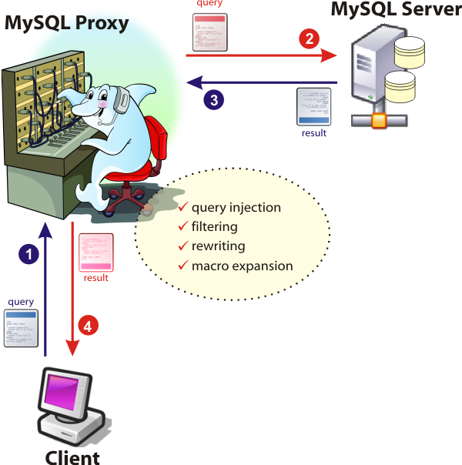

Slide 50
MySQL Proxy
Split Read and Write actions
Send specific queries to a specific node
    per customer
    per user
    per table
Loadbalance

Slide 51
Conclusions :
MySQL only cares about your data
You need to look after connections
With ndbd: limit = your memory budget
Cluster and Big Drupal setups are
    Not Friends :(
Multimaster is back
Proxy deserves your attention

Slide 52

Contact:
```
Kris Buytaert <Kris.Buytaert@inuits.be>
Further Reading
http://www.krisbuytaert.be/blog/

