Slide 1
Monitoring Your Infrastructure the open source way

Slide 2
Kris Buytaert
Senior Linux and Open Source Consultant @inuits.be
„Infrastructure Architect“
Linux since 0.98
OpenMosix, openQRM, ...
Early Adopter (Xen, MySQL Cluster)
Automating Large Scale Deployment , High Availability
Surviving the 10th floor test
http://www.krisbuytaert.be/blog/
http://www.virtualization.com/

Slide 3
Tom De Cooman
Linux and Open Source Consultant @inuits.be
Tom De Cooman has been a Linux user for over 8 years, and active in system's administration for about 4 years.
He is a general Unix system administrator with focus/strong interest in monitoring, mail and virtualisation.
Previously he has been working mostly for System Integrators
He also has a lot of experience with SUN hardware and software.

Slide 4
Do you know what your children do at 5 am in the morning ?
Are they asleep
Or Crashing at a party ?
Why are there cops at your front door ?
Did something happen to them ?
How long have they been gone already ?

Slide 5
Do you know what your servers are doing at 5 am in the morning ?
You can't afford to be down
You can't afford to be slow
Systems grow and scale beyond manual/human capacity
Plan for growth
Good admins know how their systems behave
And what's abnormal systems behaviour

Slide 6
Monitoring
Check status
  Define Limits
  Running ?
How to check ?
  Script
  Status File
  Agent
  SNMP

Slide 7
Active vs Passive Checks
Active : checks performed by the monitoring tool itself
  Http , ping , ...
Passive : checks performed and submitted by an external application
  snmptrap , syslog ,

Slide 8
Agent(less)
Agent Based
  Impact on Measurement
  More detailed information
  Often Big performance penalty
Agent Less
  Non intrusive
  Less detail
SNMP

Slide 9
Alerts / Notifications
Send a Warning Signal
  Email, SMS , xmpp , other
Choose based on situation
  Based on time
  Based on service
  Based on state of system
Escalation
SLA

Slide 10
Reporting
Up / down
Since
Graphical Overview
Summary
Lies, damn lies and statistics

Slide 11
Trending
Chart the data
A Visionary approach
Find Anomalies
Plan for Growth

Slide 12
What do you want from a tool ?
Easy to configure
Autodetection
Supporting Gui
Automatable
Consistent
SNMP Integration
Trending Included ?
Agentless
Templates
Non Intrusive
Plenty of notification
Active community
Hackable

Slide 13
The Contenders
Hyperic HQ
Zabbix
Zenoss
OpenNMS
Nagios
GroundWorks
Hobbit
...

Slide 14
Initial Experience
First Phase
Setup Different Tools/Platforms
Initial Feeling
Installation Experience

Slide 15
Nagios
The Standard
A zillion tools based on it
Awkward config for the newbie
Very configurable
Very Pluggable
Great ecosystem
Often integrated with Cacti

Slide 16
GroundWorks
Claims to be Nagios ++
Be prepared to be spammed
Integrates 70+ tools
Worst Installation experience ever (twice)
  Installation failed multiple times
  Broke existing setups
  Required env variables to install RPM

Slide 17
GroundWorks
Documentation is inside the tool , no basic instructions on how to log on to it.
Errorhandling during installation is weak
  Java-1.5.06 vs Java 1.5.06 ?
Locked on port 80 (tunnels anyone ?)
Fails exactly where it claims to be strong :-(

Slide 18
Zenoss
Integrated package featuring
  Availability
  Performance
  Events handling
  Reporting
Zope Based
SNMP for Autodetection
Based on standard protocols

Slide 19
Zenoss
Almost perfect installation
Python = Lightweight
Gui is often confusing
Nice graphics (network map)
Good Community
Experienced Crowd

Slide 20
OpenNMS
Used to be Nagios only contender
SNMP Based
Focus on Network
J2EE Framework
Smooth installation

Slide 21
Zabbix
“LightWeight”
Multi Tier
  Agents
  Database + Daemon
  Web Interface
Template based

Slide 22
Zabbix
Find the right package for your distro = smooth installation
“Auto detects” agents
Create your own screens

Slide 23
HypericHQ
Heavy Weight
Agent Based (Heavy)
Java
Autodiscovery (of services)
SIGAR (System Information Gatherer and Reporter)

Slide 24
HypericHQ
Quick setup
Inside the applications
    Real focus towards application monitoring
    Focus on State
    Focus on functionality
Great to do debugging

Slide 25
HypericHQ & OpenNMS
Announced Integration
Similar Frameworks
Complementary

Slide 26
Hobbit
Big Brother ++
We dropped Big Brother a decade ago
Same annoyancies still exist today

Slide 27
Who made the Cut ?
Hyperic HQ 3.2.4
Nagios
Zabbix 1.4.5
Zenoss 2.2

Slide 28
Nagios Overview
Monitoring of network services
Monitoring of host resources
Simple plugin design
Different methods of notifications

Slide 29
Nagios Supported Platforms
Designed originally to run under GNU/Linux but runs well also on other *nix
Can monitor M$ window machine eg via the nrpe_nt plugin

Slide 30
Nagios : Configuration
The first configuration is often chaotic for beginners
Use flat text files (easy for massive deployment)
define service{
use generic-service
host_name localhost
service_description HTTP
check_command check_http
notifications_enabled 0
}

Slide 31
Nagios : Monitoring methods
Nagios plugins
NRPE : Nagios remote Plugin Execution
Custom Scripts (SNMP, ...)

Slide 32
Nagios , Features
Alerting
  Default alerting are supported like e-mail, pager, sms
  But user-defined methods can be easily implemented
Reporting
  Availability
  Alert Histogram
  Alert History
  Alert Summary
  Notifications
  Event Log
Trending
  Use plugins (NagiosGraph, ...) , or use Cacti

Slide 33
Nagios : Conclusion
Con:
  “steep” learning curve
  No trending/graphs by default
Pro:
  The Standard
  Flexible
  Giant Community (nagiosexchange, ...)

Slide 34
Zabbix Overview
3 Tier Architecture
  Server
  PHP based webfrontend
  Agent
keywords
  Item
  Trigger
  Action
Notes:
An item has all the data to define how a check is to be performed on the host. ( important ones: a name for the item, a check type: info about what data we want and how to get it, a check interval). The result is that a 'key' is stored for a certain host. (eg FTP-key being 0 or 1, off or on)
In Zabbix, we speak of several 'Check types' the most important ones being 'simple checks' and 'external checks'.

Slide 35
Zabbix Supported Platforms
In Ubuntu/Debian/Fedora by default
EPEL in CentOS
Windows supported as well (agent)
Source => Solaris/ BSD/*NIX

Slide 36
Zabbix Monitoring methods/tools
Simple checks
Agent (availability of params depending OS)
SNMP
Other
  External checks
  Internal checks
  Aggregated checks
Notes:
Zabbix sender: command line util used to send perfdata to zabbix
item: ftp on
trigger: ftp down
action: if ftpdown then mail
system.cpu.load
system.proc.mun
Simple checks
Agent
SNMP
Other
Scripts
Internal checks : used to monitor the inernals of zabbix
Aggregated checks : direct datbase queries (calculate avg cpuload of a group)

Slide 37
Zabbix Configuration
Auto discovery (agent based)
Screens: Customization of page layout
Parts can be loadbalanced among multiple servers
Templates: Items, Triggers, Graphs
Notes:
Applications: group that can contain all items related to smth mysql

Slide 38
Zabbix Features
Alerting
  Harder to configure notifications
  No sign of escalation (planned)
Reporting
  Customizable layouts
Trending
  Slideshow mode
  Correlation of different graphs

Slide 39
Zabbix Conclusion
Con:
  Pretty cumbersome to configure
  Important features missing ( but planned in next version ): escalation, better reporting ,....
Pro:
  Lightweight both server and agents
  Fully Integrated
  Screens : Correlation of graphs

Slide 40
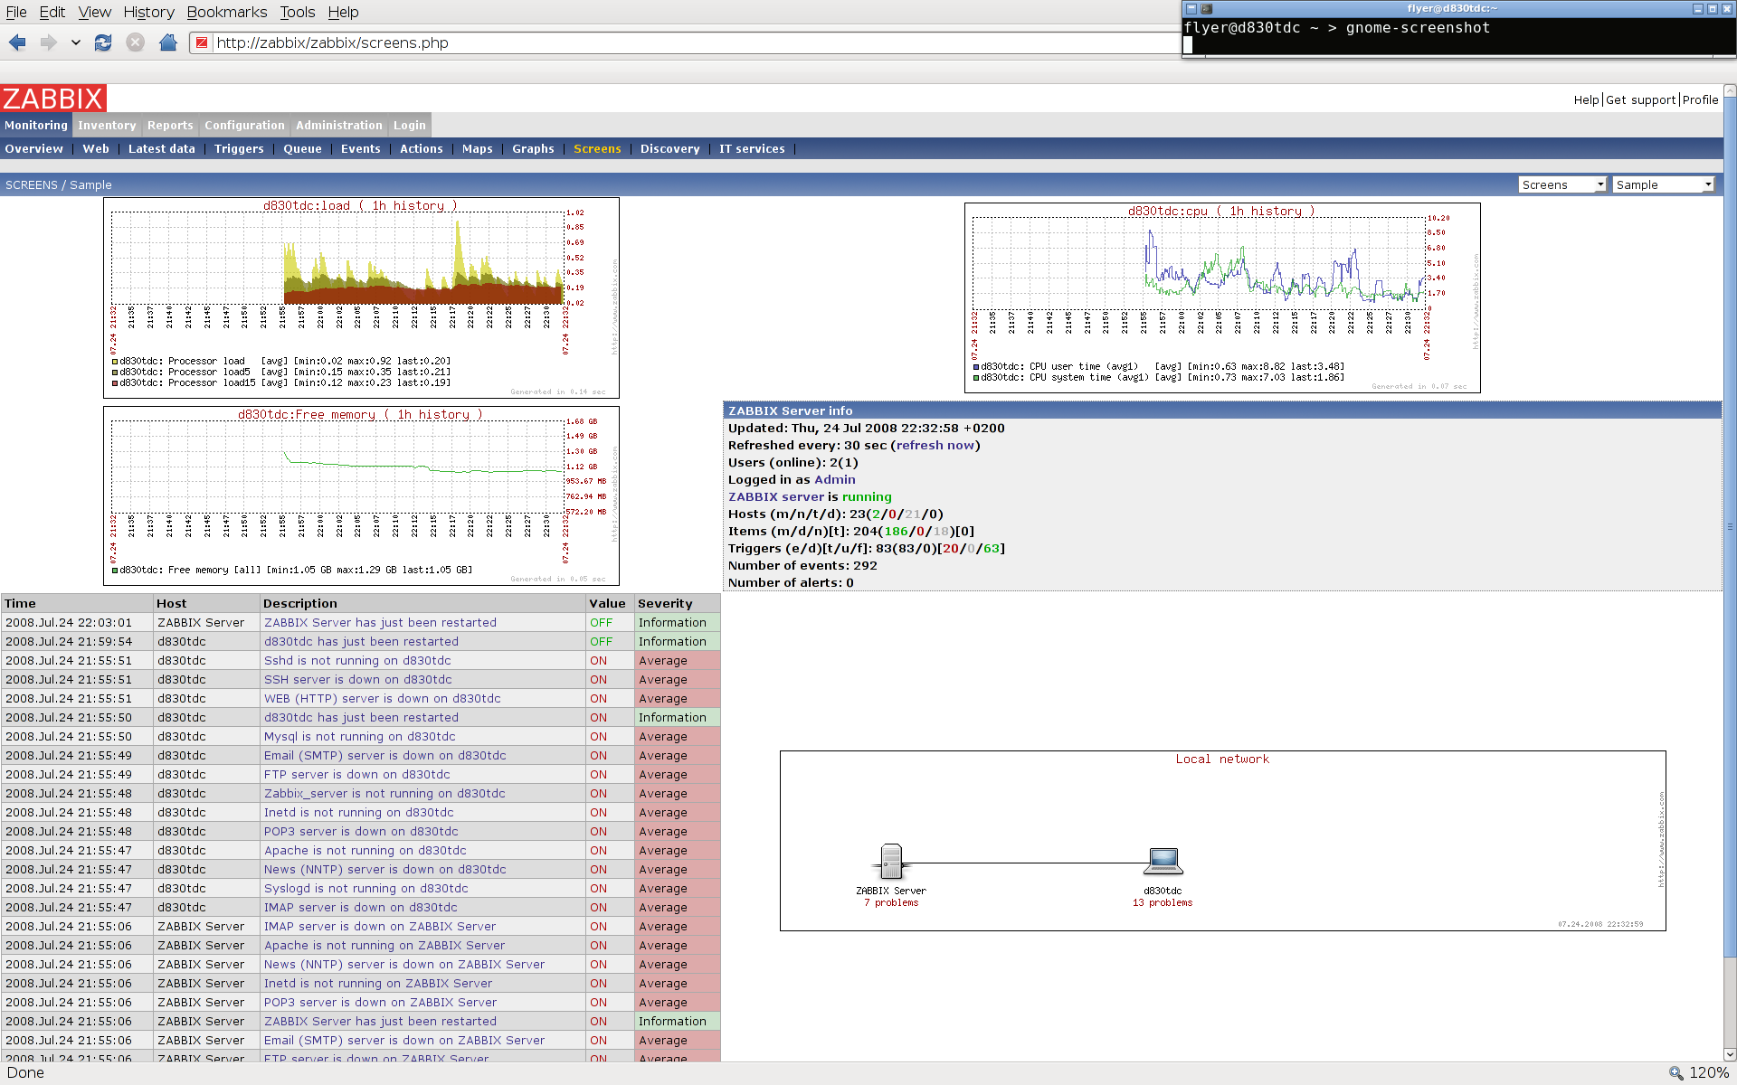

Slide 41
Zenoss Overview
an open source core infrastructure (Zenoss Core)
extra layer of (payable) services available (Zenoss Enterprise)
Easy to install, configure and affordable. ( according to them :)

Slide 42
Zenoss
3 part Architecture
  Web Console / Portal : visualizes data
  Process Layer : daemons collect data
      ZenPing, ZenProcess, ZenSyslog, ZenEventlog ...
  Data Layer : stores data
Data is stored in 3 places
  CMDB (Configuration Management DB) : Zope
  Historical data : RRD
  Events : MySQL

Slide 43
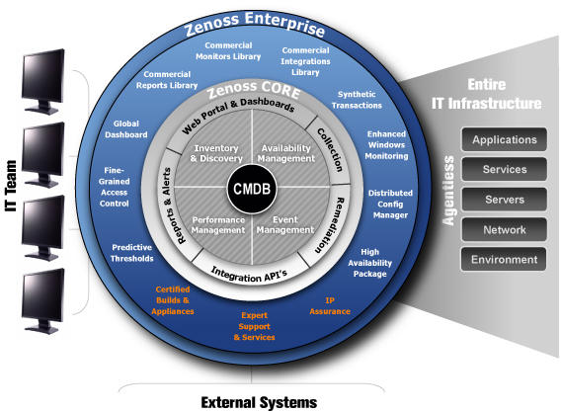

Slide 44
Zenoss Supported OS/Arch,
Packages for
* RHEL/Centos 4
* RHEL/Centos 5
* SLES 10
* Ubuntu Server 6.06
* Ubuntu Server 8.04
* openSUSE 10.2
* openSUSE 10.3
* Fedora 6
* Fedora 7
* Fedora 8
* Debian 4.0
Source for a lot of others: FreeBSD, OSX, Gentoo, Solaris)

Slide 45
Zenoss Presentation
Ajax based web interface
Customisable Dashboard
Browse by: Systems, Groups, Locations, Networks
Filesystem-alike tree-view

Slide 46
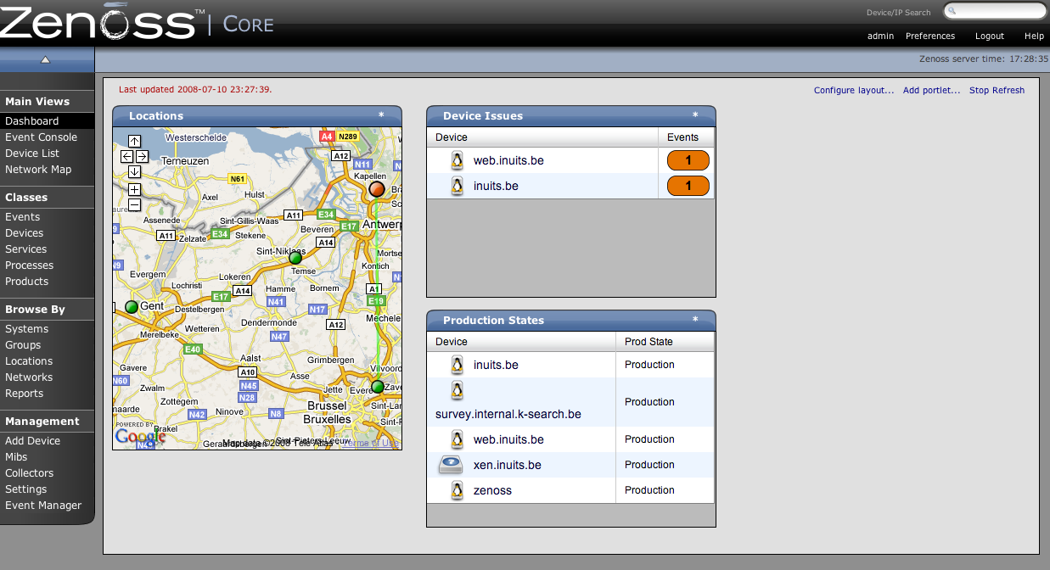

Slide 47
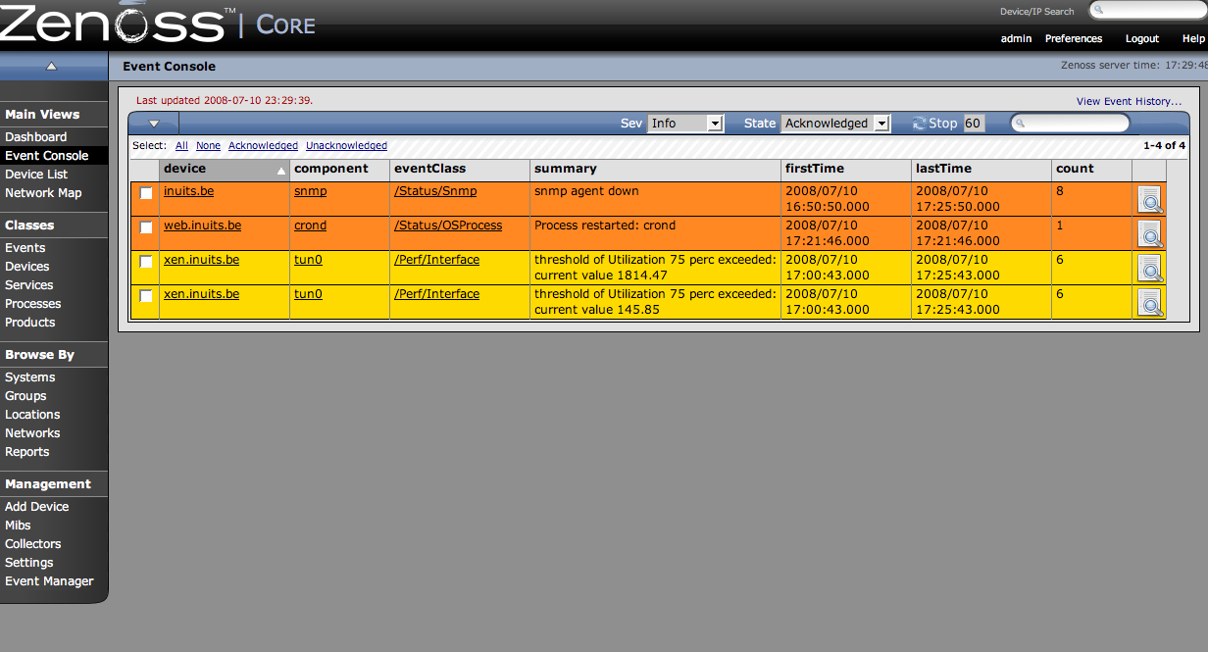

Slide 48
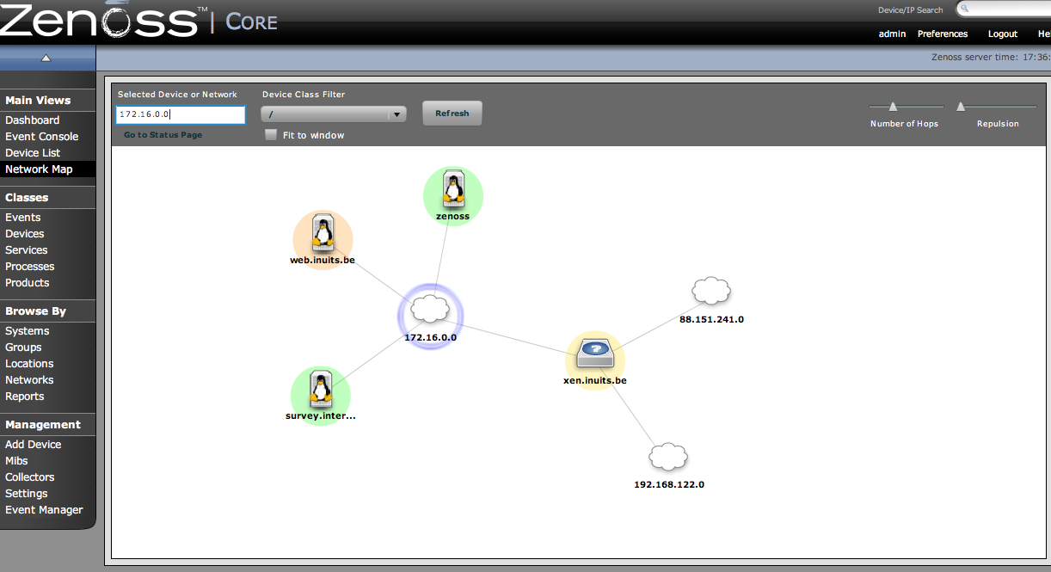

Slide 49
Zenoss Monitoring methods/tools
SNMP
Nagios plugins
Custom commands
ZenPacks: User commands, Perf templates, Graphs ...

Slide 50
Zenoss Configuration
No config files, web interface only
API
Templates
Production states for servers
Severity setting for alerts
Locations

Slide 51
Zenoss Features
Alerting
  Done on a per user basis (on/off)
  Alerting rules: quite configurable with action type, production-state, severity ...
Reporting
  Applied on almost all available trees: devices, events, graphs, ...
  Custom Device reports
Trending
  RRDTool based
  Standard SNMP Perf stats: CPU, Mem, Swap
  Possibility to add custom Perf-templates

Slide 52
Zenoss Conclusion
Con:
  Resource overhead (server)
  Snmp required
  Help I`m lost
  Commercial features missing
Pro:
  Scalabilty: multiple collectors
  Nice interface

Slide 53
Hyperic Overview
Server/Agent method
Focusses strongly on application/db/ performance
Intuitive
Easy
Grouping of servers/services
Very nice Dashboard!

Slide 54
Hyperic Supported platforms
not included in any distro
must be downloaded from the webpage
not available in .deb
rpm available
size is 160MB ... (incl JVM)
Lot's of plugins available on Hyperforge

Slide 55
Hyperic Ease of installation
rpm is unpacking stuff, running setup.sh
setup.sh unpacks .tgzs and initializes the database
rpm is almost identical to tgz
really easy to install , very limited user interaction needed.
Agent has property file you can prepopulate

Slide 56
Hyperic Features
direct links to help and screencasts from top-right
dashboard, drag-n-drop, add remove elements
no user roles in opensource edition
good auto-detection
  Detecting hosts via agent
  Detecting Services
Graphing is Top!

Slide 57
Hyperic Configuration
Very straight forward
Everything happens in webgui, config is stored in DB ( postgresql )
Servers/Services are added in no time.
Adding 'servers' ( like postfix ) ==> adding 'services' ( like postqueue )
Grouping of OperatingSystems, services, clusters, ... _really_ easy

Slide 58
Hyperic Configuration (agent)
Agent has a property file
Can be used to hint to a service
  Eg different /usr/local/jboss or tomcat path

Slide 59
Hyperic Monitoring methods/tools
Agent based
Snmp possible
Lot's of plugins ( on Hyperforge )
  Major frameworks are supported
    Apache/ tomcat / jboss / mysql / postgresql
  SIGAR

Slide 60
Hyperic Inside the Apps
MySQL
  Table level
    Row count, qps, table size
PostgresQL
  same
Jboss
  Inside the JMX
  Deployed WARS

Slide 61
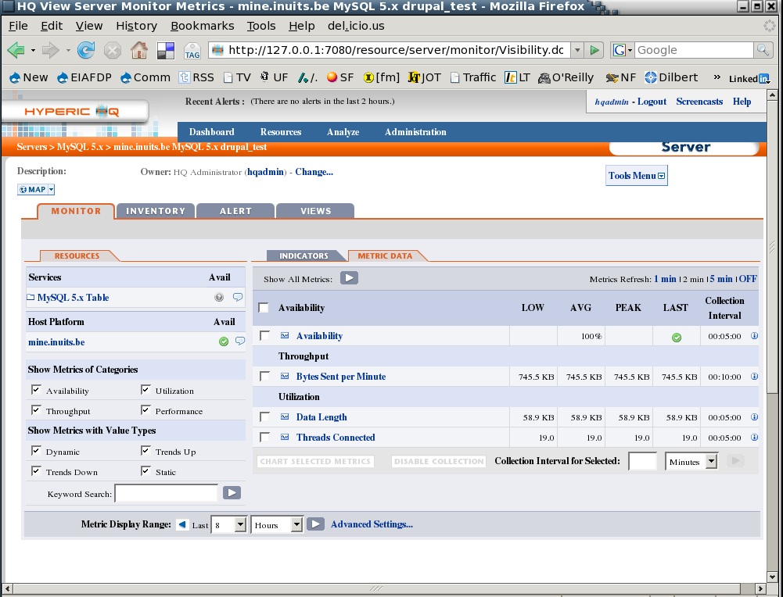
Hyperic Inside the Apps

Slide 62
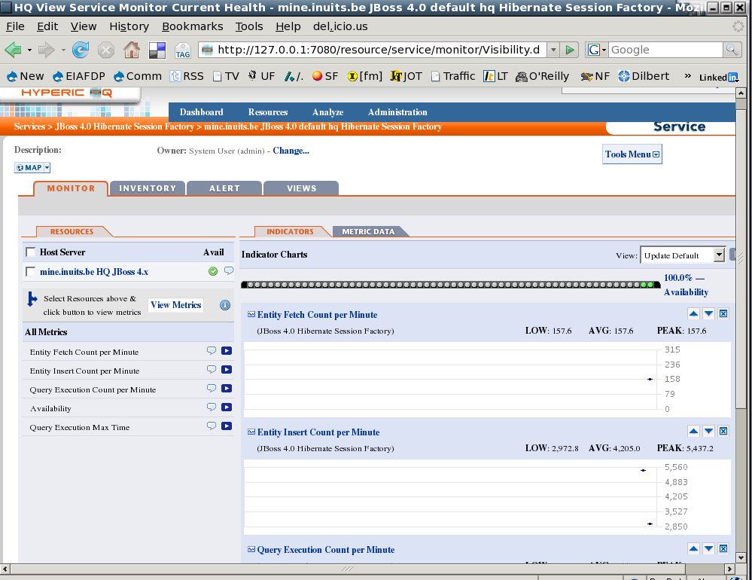
Hyperic Inside the Apps

Slide 63
Hyperic Other
Alerting
  Using an Alert Center you get an immediate overview of all errors/alerts
Trending
  through the Hyperic HQ Enterprise Subscription

Slide 64
Hyperic Conclusion
Con:
  Help , I'm lost !
  Agent integration on the nodes could have been better
  Lots of NTH features in Commercial Version
  Not for your typical LAMP shop
Pro:
  Very nice/simple/straight forward
  “Low” on java-memory, very responsive webfrontend, not 'sluggish' at all
  Goes DEEP Inside the Application

Slide 65
The Feature Matrix

Slide 66
Conclusion
DIY
  Nagios
    Nagios
    Cacti
    Puppet

Slide 67
Conclusion
Java Shops
  Hyperic HQ
    Great Detail
    Inside the VM
    Inside the DB
    Application monitoring vs Newtork monitoring

Slide 68
Conclusion
One Package :
  Zabbix
    3 votes
  Zenoss
    3 votes

Slide 69
Conclusion
We still don't know yet ..
It depends
We voted ...
  It was a tie
The blogcrowd voted

Slide 70
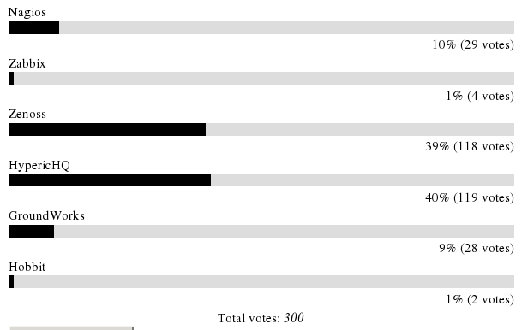
Conclusion

Slide 71



`
Kris Buytaert <Kris.Buytaert@inuits.be>
Tom De Cooman <Tom.DeCooman@inuits.be>
Further Reading
http://www.krisbuytaert.be/blog/
http://www.inuits.be/
http://www.virtualization.com/
http://www.oreillygmt.com/
?
!

