Slide 1
MySQL HA
An overview
Kris Buytaert

Slide 2
Kris Buytaert
Senior Linux and Open Source Consultant @inuits.be
„Infrastructure Architect“
I don't remember when I started using MySQL :)
Specializing in Automated , Large Scale Deployments , Highly Available infrastructures, since 2008 also known as “the Cloud”
Surviving the 10th floor test
DevOp

Slide 3
What is HA Clustering ?
One service goes down
  => others take over its work
IP address takeover, service takeover,
Not designed for high-performance
Not designed for high troughput (load balancing)

Slide 4
Does it Matter ?
Downtime is expensive
You mis out on $$$
Your boss complains
New users don't return

Slide 5
Lies, Damn Lies, and Statistics
Counting nines
(slide by Alan R)

Slide 6
The Rules of HA
Keep it Simple
Keep it Simple
Prepare for Failure
Complexity is the enemy of reliability

Slide 7
You care about ?
Your data ?
  Consistent
  Realitime
  Eventual Consistent
Your Connection
  Always
  Most of the time

Slide 8
Eliminating the SPOF
Find out what Will Fail
  Disks
  Fans
  Power (Supplies)
Find out what Can Fail
  Network
  Going Out Of Memory

Slide 9
Split Brain
Communications failures can lead to separated partitions of the cluster
If those partitions each try and take control of the cluster, then it's called a split-brain condition
If this happens, then bad things will happen
  http://linux-ha.org/BadThingsWillHappen

Slide 10
Historical MySQL HA
Replication
  1 read write node
  Multiple read only nodes
  Application needed to be modified

Slide 11
Solutions
BYO
DRBD
MySQL Cluster NDBD
Multi Master Replication
MySQL Proxy
MMM
Flipper

Slide 12
Data vs Connection
DATA :
  Replication
  DRBD
Connection
  LVS
  Proxy
  Heartbeat / Pacemaker

Slide 13
Shared Storage
1 MySQL instance
Monitor MySQL node
Stonith
$$$ 1+1 <> 2
Storage = SPOF
Split Brain :(

Slide 14
DRBD
Distributed Replicated Block Device
In the Linux Kernel (as of very recent)
Usually only 1 mount
  Multi mount as of 8.X
    Requires GFS / OCFS2
Regular FS ext3 ...
Only 1 MySQL instance Active accessing data
Upon Failover MySQL needs to be started on other node

Slide 15
DRBD(2)
What happens when you pull the plug of a Physical machine ?
  Minimal Timeout
  Why did the crash happen ?
  Is my data still correct ?
  Innodb Consistency Checks ?
    Lengthy ?
    Check your BinLog size

Slide 16
MySQL Cluster NDBD
Shared-nothing architecture
Automatic partitioning
Synchronous replication
Fast automatic fail-over of data nodes
In-memory indexes
Not suitable for all query patterns (multi-table JOINs, range scans)

Slide 17
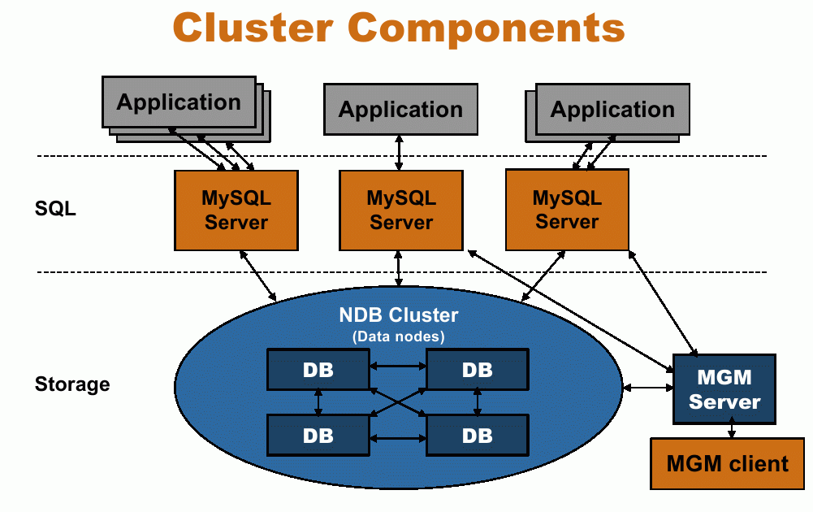
Title
  Data

Slide 18
MySQL Cluster NDBD
All indexed data needs to be in memory
Good and bad experiences
  Better experiences when using the API
  Bad when using the MySQL Server
Test before you deploy
Does not fit for all apps

Slide 19
Multi Master Replication
Replicating the same table data both ways can lead to race conditions
  Auto_increment, unique keys, etc.. could cause problems If you write them 2x
Both nodes are master
Both nodes are slave
Write in 1 get updates on the other
M|S
M|S

Slide 20
MySQL Proxy
Man in the middle
Decides where to connect to
  LUA
Write rules to
  Redirect traffic

Slide 21
Master Slave & Proxy
Split Read and Write Actions
No Application change required
Sends specific queries to a specific node
Based on
  Customer
  User
  Table
  Availability

Slide 22
MySQL Proxy
Your new SPOF
Make your Proxy HA too !
  Heartbeat OCF Resource

Slide 23
Breaking Replication
If the master and slave gets out of sync
Updates on slave with identical index id
  Check error log for disconnections and issues with replication

Slide 24
Monitor your Setup
Not just connectivity
Also functional
  Query data
  Check resultset is correct
Check replication
  MaatKit
  OpenARK

Slide 25
Pulling Traffic
Eg. for Cluster, MultiMaster setups
  DNS
  Advanced Routing
  LVS
  Or the upcoming slides

Slide 26
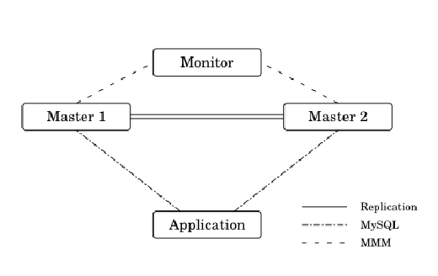
MMM
Multi-Master Replication Manager for MySQL
  Perl scripts to perform monitoring/failover and management of MySQL master-master replication configurations
Balance master / slave configs based on replication state
  Map Virtual IP to the Best Node
http://mysql-mmm.org/

Slide 27
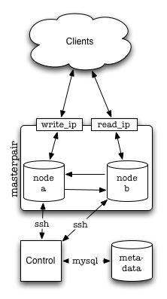
Flipper
Flipper is a Perl tool for managing read and write access pairs of MySQL servers
master-master MySQL Servers
Clients machines do not connect "directly" to either node instead,
One IP for read,
One IP for write.
Flipper allows you to move these IP addresses between the nodes in a safe and controlled manner.
http://provenscaling.com/software/flipper/

Slide 28
Linux-HA PaceMaker
Plays well with others
Manages more than MySQL
...v3 .. don't even think about the rest anymore
http://clusterlabs.org/

Slide 29
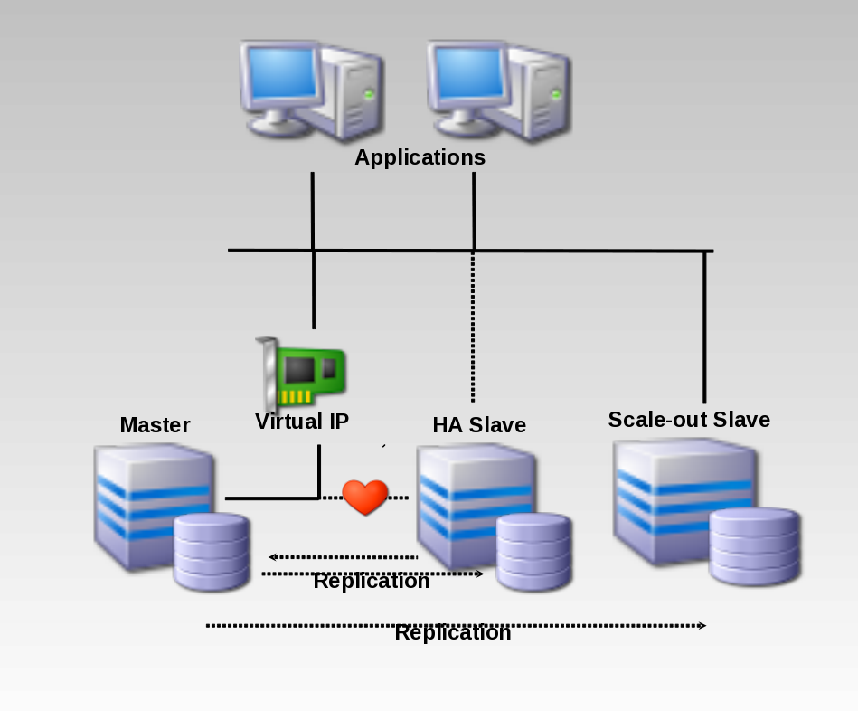

Slide 30
Conclusion
Plenty of Alternatives
Think about your Data
Think about getting Queries to that Data
Complexity is the enemy of reliability
Keep it Simple
Monitor inside the DB

Slide 31



`
Kris Buytaert <Kris.Buytaert@inuits.be>
Further Reading
http://www.krisbuytaert.be/blog/
http://www.inuits.be/
http://www.virtualization.com/
http://www.oreillygmt.com/
?
!

