Slide 1

MySQL High Availability

Slide 2
Why High Availability Matters
  Downtime is expensive
  You miss $$$
  Your boss complains
  New Users don't return

Slide 3
What Is HA Clustering?
One service goes down => others take over its work
IP address takeover, service takeover,
Not designed for high-performance
Not designed for high troughput (load balancing)

Slide 4
Split-Brain
Communications failures can lead to separated partitions of the cluster
If those partitions each try and take control of the cluster, then it's called a split-brain condition
If this happens, then bad things will happen
  http://linux-ha.org/BadThingsWillHappen

Slide 5
Eliminating the SPOF
  Find out what will fail
      Disks
  Find out what can fail
      Network Cables
      Going out of Memory

Slide 6
The rules of High Availability
  Prepare for failure
  Keep It Simple
  Complexity is the enemy of reliability
            (Alan R)

Slide 7
Data HA vs Connectivy Ha
  MySQL = DATA
  Connection
        Linux Heartbeat
          Client (multi DS)

Slide 8
Historical MySQL “Clustering”
  Replication
  LVS
  1 read write node
  Multiple read only nodes
  Application needed to be modified

Slide 9
More Recent Alternatvies
  Cluster
  Multimaster Replication (autoidx)
  MySQL Proxy
  DRBD

Slide 10
Other Alternatives
  MySQL HA Scripting stuff
      How to Fail back ?
      Are we sure about the replicated data ?
        Mysql-ha.sf.net
  PeerFS
      Proprietary
      Support for myisam cluster
      No support for innodb
  Emic (now Continuent)
      HA , Scalablilty, Manageability

Slide 11
MySqL Cluster
  Original Ericsson Code
  Bought by MySQL
- Is an Engine such as MyISAM, InnoDB

Slide 12
MySQL Cluster
  Shared Nothing Clustering
  Automatic Partitioning
  Synchronous Replication
  Main Memory Engine only !
    All data lives in memory !
    Disk Based is in progress
  As of MySQL 4.1

Slide 13
Shared Nothing
No SPOF
      Any single server can fail
      often multiple failures also survive
No extra hardware (expensive) required
No dependency on other nodes

Slide 14
Data Partitioning
  Data is horizontally partitioned over the nodes
- Each node is in charge of only a piece of
the data
- Data can be read in parallel
- E.g 4 data nodes could have 4 data
fragments with each ¼ of the data.
4Gb database requires 1Gb on 4 nodes
each.

Slide 15
Replication
  Data is replicated to NrOfReplicas Nodes
  Typically 2 or more
  Highly Available
  Guaranteed at Commit time to be present
  in multiple nodes
  - Automatic node takeover.
  If you only have 2 nodes and you need to
  store 2 Gb of data you need 2Gb of memory
  per node!

Slide 16
Main Memory System
  Everything (data + indexes) are in Memory !
  High Perfomance
  Asynchronous disk writes
  Available memory restricts database size

Slide 17
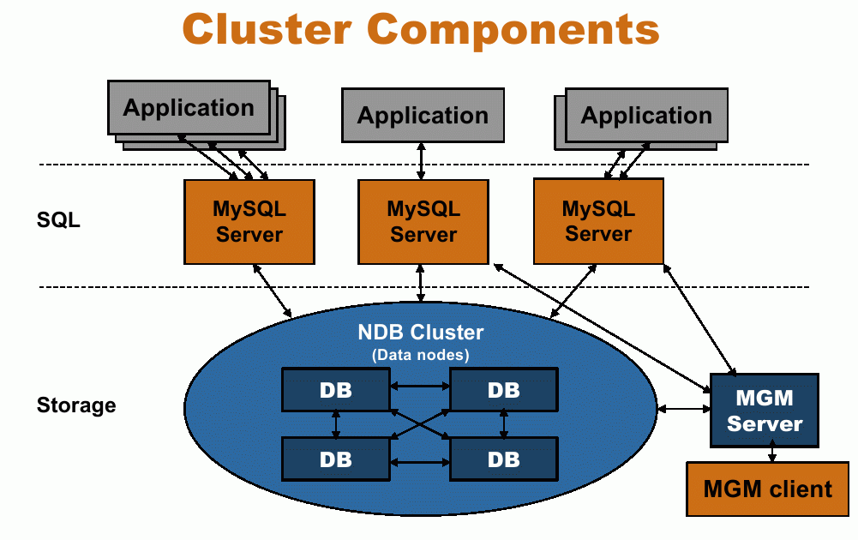
Title
  Data

Slide 18
Cluster Components
  ndb_mgmd the management nodes
  ndbd the cluster storage nodes
  mysqld , the traditional MySqld talking to
  the cluster engine
  Can run on the same or different servers
  For true HA ndb_mgmd can’t be on one of
  the ndbd nodes.

Slide 19
Management Node
  In charge of cluster config
  Only Needs to be running when nodes
  start
  Further Management roles
    Start Backups
    Monitor node status
    Logging
    Master / slave Arbitration

Slide 20
MySQL Node
  Standard MySQL node compiled with ndbd
  Can use other storage engines
  One creates tables with
    ENGINE=NDBCluster
  Can be enabled by default

Slide 21
NDB Data Nodes
  The actual Data Stores
  Handle
    Replication
    Partitioning
    Failover
  Has to be a multiple of NrOfReplicas

Slide 22
Title
  Data

Slide 23
Limitations
Database Size = Required Memory
Network troughput
      ==> Dolphin HSI

Slide 24
Pulling Traffic to the Cluster
DNS Loadbalancing
Advertise routing (ripd/vrrpd/bgpd)
LVS
Linux HA

Slide 25
Mon + HeartBeat
To which mysqld does your application talk ?
Create 1 Virtual MySQL IP
  Have mon connect to the MySQL DB
  Test content select from cluster node.
  Really test content select !
  If mysqld fails (according to mon)
  Failover using heartbeat.
Only IP is taken over + routing

Slide 26
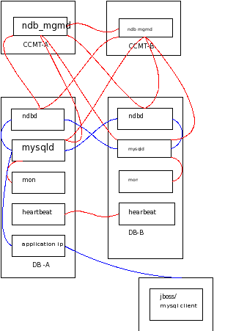
/

Slide 27
Mon
http://www.kernel.org/software/mon/
General purpose scheduler and alert management tool
  Monitors service availability
  Triggers alerts upon failure detection
/etc/mon/
/usr/lib/mon/mon.d/
/usr/lib/mon/alert.d/

Slide 28
2 Clusters
MySQL Cluster
Linux HA Cluster
  Both can have different master nodes
  MySQL Query traffic can be on DB-B
  Where as the NDB Master node is on DB-A

Slide 29
Adding Disk Based Storage
Certain tables do not Fit In Memory
Feature as of 5.1.6
Uses Tablespaces and Logfiles groups in files
Only non indexed fields are on disk !

Slide 30
Configuring Table Spaces
Create a LOGFILE GROUP and a TABLESPACE.
  CREATE LOGFILE GROUP lg1
  ADD UNDOFILE 'undofile.dat'
  INITIAL_SIZE 16M
  UNDO_BUFFER_SIZE = 1M
  ENGINE = NDB;
  CREATE TABLESPACE ts1
  ADD DATAFILE 'datafile.dat'
  USE LOGFILE GROUP lg1
  INITIAL_SIZE 12M
  ENGINE NDB;

Slide 31
Creating A Table to using Disk based Storage
CREATE TABLE t1 (a int, b int, c int, d int, e int,
  primary key(a), index(a,b))
  TABLESPACE ts1 STORAGE DISK
  engine=ndb;

Slide 32
Verifying NDB tables(diskbased)
[validation-newtec@CCMT-A ~]$ ndb_desc -d pmt terminalderivedmetric
-- terminalderivedmetric --
Version: 33554433
Fragment type: 5
K Value: 6
Min load factor: 78
Max load factor: 80
Temporary table: no
Number of attributes: 5
Number of primary keys: 4
Length of frm data: 369
Row Checksum: 1
Row GCI: 1
TableStatus: Retrieved
-- Attributes --
isp_id Int PRIMARY KEY DISTRIBUTION KEY AT=FIXED ST=MEMORY
sit_id Int PRIMARY KEY DISTRIBUTION KEY AT=FIXED ST=MEMORY
derivedmetricclass_id Varchar(50;latin1_swedish_ci) PRIMARY KEY DISTRIBUTION KEY AT=SHORT_VAR ST=MEMORY
timestamp Timestamp PRIMARY KEY DISTRIBUTION KEY AT=FIXED ST=MEMORY
value Double NOT NULL AT=FIXED ST=DISK
-- Indexes --
PRIMARY KEY(isp_id, sit_id, derivedmetricclass_id, timestamp) - UniqueHashIndex
PRIMARY(isp_id, sit_id, derivedmetricclass_id, timestamp) - OrderedIndex
DMID(derivedmetricclass_id, timestamp) - OrderedIndex
IDS(isp_id, sit_id) - OrderedIndex
NDBT_ProgramExit: 0 - OK

Slide 33
When to use MySQL Cluster ?
Small Datasets
No large datasets
e.g Session Handling
HA
Speed

Slide 34
What with Large data ?
Typically “logs”
Use MySQL Cluster as frontend
Select from into
    archived
Delete from

Slide 35
What else with Large data ?
Partition your data manually
Use MySQL partitioning
Use MultiMaster Replication
Use proxy to partition

Slide 36
DRBD
Replicates your data
Recovery is still needed

Slide 37
MySQL Proxy
Man in the middle
Decides where to connect to
LuA

Slide 38
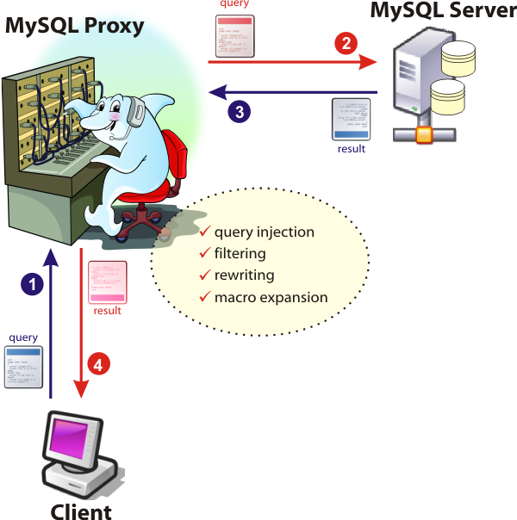

Slide 39
MySQL Proxy
Split Read and Write actions
Send specific queries to a specific node
    per customer
    per user
    per table
Loadbalance

Slide 40
Conclusions :
MySQL only cares about your data
You need to look after connections
With ndbd: limit = your memory budget
Multimaster is back
Proxy deserves your attention

Slide 41

Contact:
```
Kris Buytaert <Kris.Buytaert@inuits.be>
Further Reading
http://www.krisbuytaert.be/blog/

