Slide 1
MySQL HA with PaceMaker
Kris Buytaert

Slide 2
Kris Buytaert
Senior Linux and Open Source Consultant @inuits.be
„Infrastructure Architect“
I don't remember when I started using MySQL :)
Specializing in Automated , Large Scale Deployments , Highly Available infrastructures, since 2008 also known as “the Cloud”
Surviving the 10th floor test
DevOp

Slide 3
In this presentation
High Availability ?
MySQL HA Solutions
MySQL Replication
Linux HA / Pacemaker

Slide 4
What is HA Clustering ?
One service goes down
  => others take over its work
IP address takeover, service takeover,
Not designed for high-performance
Not designed for high troughput (load balancing)

Slide 5
Does it Matter ?
Downtime is expensive
You mis out on $$$
Your boss complains
New users don't return

Slide 6
Lies, Damn Lies, and Statistics
Counting nines
(slide by Alan R)

Slide 7
The Rules of HA
Keep it Simple
Keep it Simple
Prepare for Failure
Complexity is the enemy of reliability
Test your HA setup

Slide 8
You care about ?
Your data ?
  Consistent
  Realitime
  Eventual Consistent
Your Connection
  Always
  Most of the time

Slide 9
Eliminating the SPOF
Find out what Will Fail
  Disks
  Fans
  Power (Supplies)
Find out what Can Fail
  Network
  Going Out Of Memory

Slide 10
Split Brain
Communications failures can lead to separated partitions of the cluster
If those partitions each try and take control of the cluster, then it's called a split-brain condition
If this happens, then bad things will happen
  http://linux-ha.org/BadThingsWillHappen

Slide 11
Historical MySQL HA
Replication
  1 read write node
  Multiple read only nodes
  Application needed to be modified

Slide 12
Solutions Today
BYO
DRBD
MySQL Cluster NDBD
Multi Master Replication
MySQL Proxy
MMM
Flipper

Slide 13
Data vs Connection
DATA :
  Replication
  DRBD
Connection
  LVS
  Proxy
  Heartbeat / Pacemaker

Slide 14
Shared Storage
1 MySQL instance
Monitor MySQL node
Stonith
$$$ 1+1 <> 2
Storage = SPOF
Split Brain :(

Slide 15
DRBD
Distributed Replicated Block Device
In the Linux Kernel (as of very recent)
Usually only 1 mount
  Multi mount as of 8.X
    Requires GFS / OCFS2
Regular FS ext3 ...
Only 1 MySQL instance Active accessing data
Upon Failover MySQL needs to be started on other node

Slide 16
DRBD(2)
What happens when you pull the plug of a Physical machine ?
  Minimal Timeout
  Why did the crash happen ?
  Is my data still correct ?
  Innodb Consistency Checks ?
    Lengthy ?
    Check your BinLog size

Slide 17
MySQL Cluster NDBD
Shared-nothing architecture
Automatic partitioning
Synchronous replication
Fast automatic fail-over of data nodes
In-memory indexes
Not suitable for all query patterns (multi-table JOINs, range scans)

Slide 18
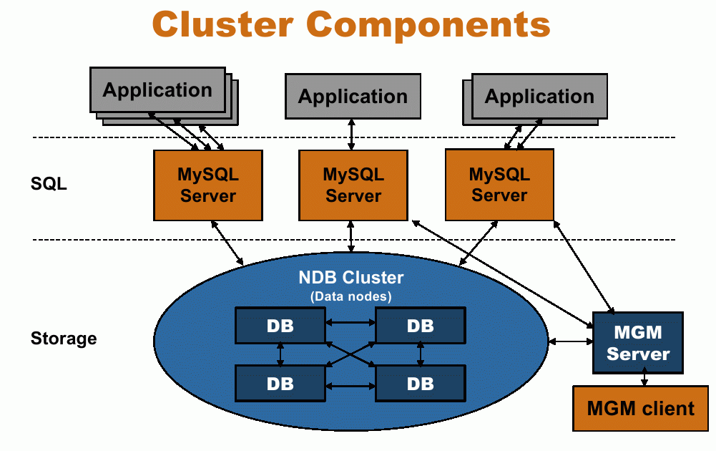
Title
  Data

Slide 19
MySQL Cluster NDBD
All indexed data needs to be in memory
Good and bad experiences
  Better experiences when using the API
  Bad when using the MySQL Server
Test before you deploy
Does not fit for all apps

Slide 20
How replication works
Master server keeps track of all updates in the Binary Log
  Slave requests to read the binary update log
  Master acts in a passive role, not keeping track of what slave has read what data
Upon connecting the slaves do the following:
  The slave informs the master of where it left off
  It catches up on the updates
  It waits for the master to notify it of new updates

Slide 21
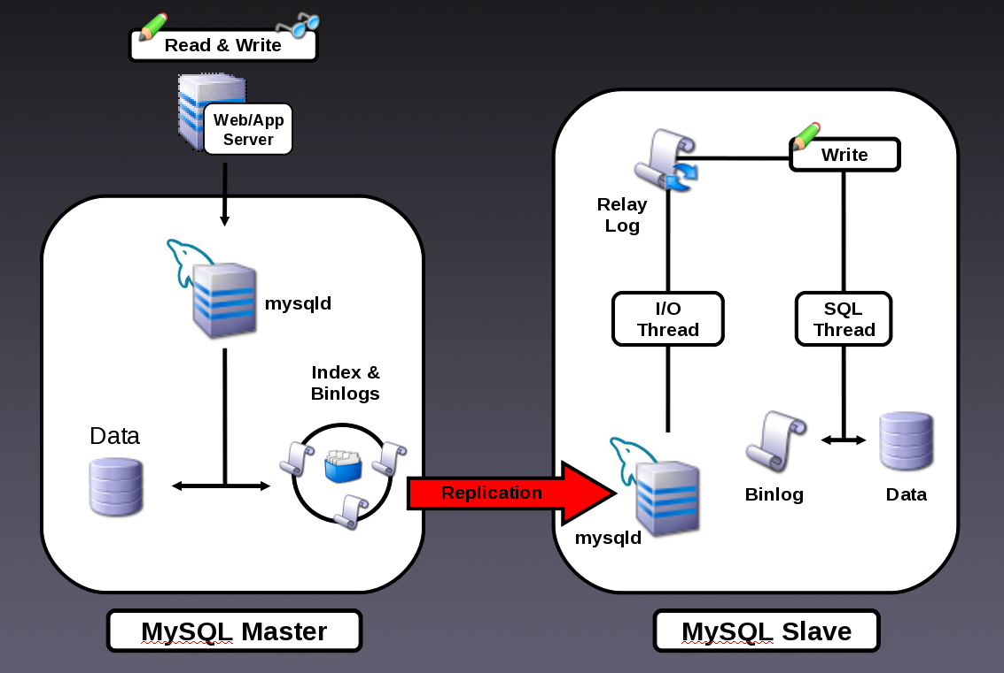

Slide 22
Two Slave Threads
How does it work?
  The I/O thread connects to the master and asks for the updates in the master’s binary log
  The I/O thread copies the statements to the relay log
  The SQL thread implements the statements in the relay log
Advantages
  Long running SQL statements don’t block log downloading
  Allows the slave to keep up with the master better
  In case of master crash the slave is more likely to have all statements

Slide 23
Replication commands
Slave commands
START|STOP SLAVE
RESET SLAVE
SHOW SLAVE STATUS
CHANGE MASTER TO…
LOAD DATA FROM MASTER
LOAD TABLE tblname FROM MASTER
Master commands
SHOW MASTER STATUS
PURGE MASTER LOGS…

Slide 24
Show slave status\G
Slave_IO_State: Waiting for master to send event
Master_Host: 172.16.0.1
Master_User: repli
Master_Port: 3306
Connect_Retry: 60
Master_Log_File: XMS-1-bin.000014
Read_Master_Log_Pos: 106
Relay_Log_File: XMS-2-relay.000033
Relay_Log_Pos: 251
Relay_Master_Log_File: XMS-1-bin.000014
Slave_IO_Running: Yes
Slave_SQL_Running: Yes
Replicate_Do_DB: xpol
Replicate_Ignore_DB:
Replicate_Do_Table:
Replicate_Ignore_Table:
Replicate_Wild_Do_Table:
Replicate_Wild_Ignore_Table:
Last_Errno: 0
Last_Error:
Skip_Counter: 0
Exec_Master_Log_Pos: 106
Relay_Log_Space: 547
Until_Condition: None
Until_Log_File:
Until_Log_Pos: 0
Master_SSL_Allowed: No
Master_SSL_CA_File:
Master_SSL_CA_Path:
Master_SSL_Cert:
Master_SSL_Cipher:
Master_SSL_Key:
Seconds_Behind_Master: 0
Master_SSL_Verify_Server_Cert: No
Last_IO_Errno: 0
Last_IO_Error:
Last_SQL_Errno: 0
Last_SQL_Error:
1 row in set (0.00 sec)

Slide 25
Row vs Statement
Pro
  Proven (around since MySQL 3.23)
  Smaller log files
  Auditing of actual SQL statements
  No primary key requirement for replicated tables
Con
  Non-deterministic functions and UDFs
Pro
  All changes can be replicated
  Similar technology used by other RDBMSes
  Fewer locks required for some INSERT, UPDATE or DELETE statements
Con
  More data to be logged
  Log file size increases (backup/restore implications)
  Replicated tables require explicit primary keys
  Possible different result sets on bulk INSERTs

Slide 26
Multi Master Replication
Replicating the same table data both ways can lead to race conditions
  Auto_increment, unique keys, etc.. could cause problems If you write them 2x
Both nodes are master
Both nodes are slave
Write in 1 get updates on the other
M|S
M|S

Slide 27
MySQL Proxy
Man in the middle
Decides where to connect to
  LUA
Write rules to
  Redirect traffic

Slide 28
Master Slave & Proxy
Split Read and Write Actions
No Application change required
Sends specific queries to a specific node
Based on
  Customer
  User
  Table
  Availability

Slide 29
MySQL Proxy
Your new SPOF
Make your Proxy HA too !
  Heartbeat OCF Resource

Slide 30
Breaking Replication
If the master and slave gets out of sync
Updates on slave with identical index id
  Check error log for disconnections and issues with replication

Slide 31
Monitor your Setup
Not just connectivity
Also functional
  Query data
  Check resultset is correct
Check replication
  MaatKit
  OpenARK

Slide 32
Pulling Traffic
Eg. for Cluster, MultiMaster setups
  DNS
  Advanced Routing
  LVS
  Or the upcoming slides

Slide 33
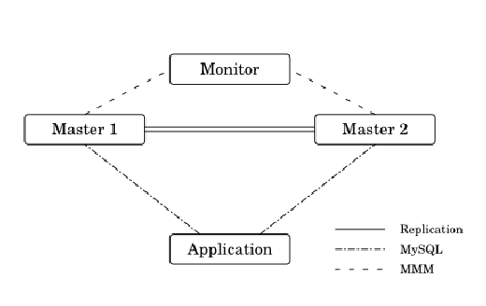
MMM
Multi-Master Replication Manager for MySQL
  Perl scripts to perform monitoring/failover and management of MySQL master-master replication configurations
Balance master / slave configs based on replication state
  Map Virtual IP to the Best Node
http://mysql-mmm.org/

Slide 34
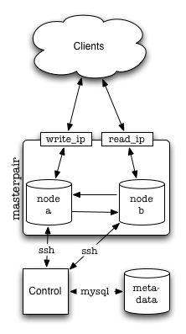
Flipper
Flipper is a Perl tool for managing read and write access pairs of MySQL servers
master-master MySQL Servers
Clients machines do not connect "directly" to either node instead,
One IP for read,
One IP for write.
Flipper allows you to move these IP addresses between the nodes in a safe and controlled manner.
http://provenscaling.com/software/flipper/

Slide 35
Linux-HA PaceMaker
Plays well with others
Manages more than MySQL
...v3 .. don't even think about the rest anymore
http://clusterlabs.org/

Slide 36
Heartbeat
Heartbeat v1
  Max 2 nodes
  No finegrained resources
  Monitoring using “mon”
Heartbeat v2
  XML usage was a consulting opportunity
  Stability issues
  Forking ?

Slide 37
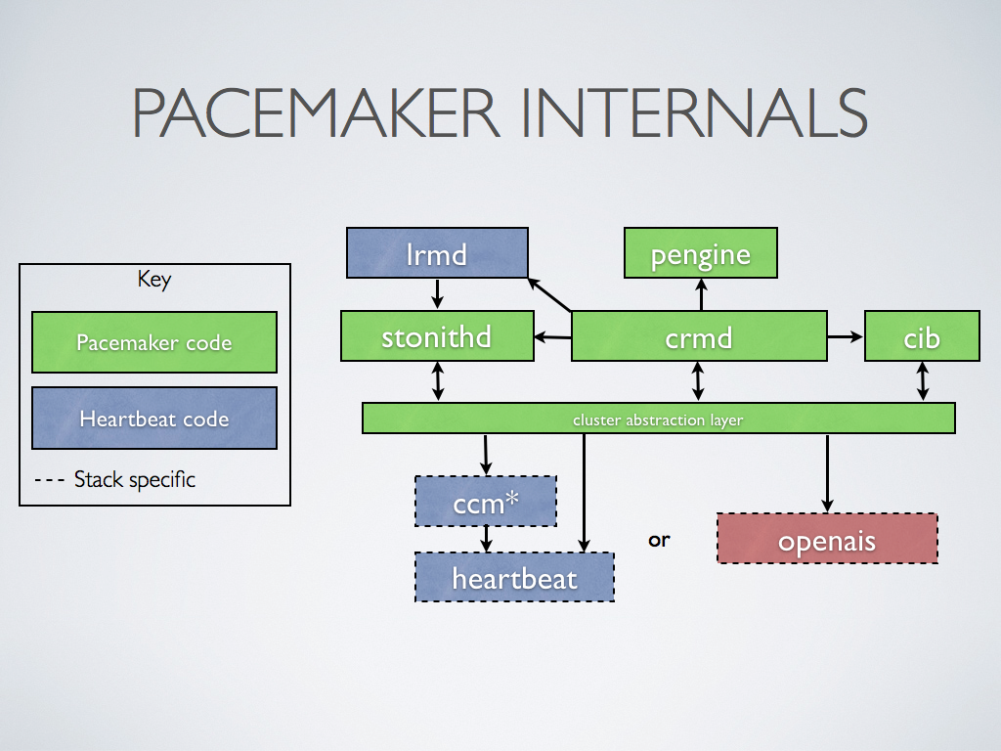
Pacemaker Architecture
Stonithd : The Heartbeat fencing subsystem.
Lrmd : Local Resource Management Daemon. Interacts directly with resource agents (scripts).
pengine Policy Engine. Computes the next state of the cluster based on the current state and the configuration.
cib Cluster Information Base. Contains definitions of all cluster options, nodes, resources, their relationships to one another and current status. Synchronizes updates to all cluster nodes.
crmd Cluster Resource Management Daemon. Largely a message broker for the PEngine and LRM, it also elects a leader to co-ordinate the activities of the cluster.
openais messaging and membership layer.
heartbeat messaging layer, an alternative to OpenAIS.
ccm Short for Consensus Cluster Membership. The Heartbeat membership layer.

Slide 38
Pacemaker ?
Not a fork
Only CRM Code taken out of Heartbeat
As of Heartbeat 2.1.3
  Support for both OpenAIS / HeartBeat
  Different Release Cycles as Heartbeat

Slide 39
Heartbeat, OpenAis ?
Both Messaging Layers
Initially only Heartbeat
OpenAIS
Heartbeat got unmaintained
OpenAIS has heisenbugs :(
Heartbeat maintenance taken over by LinBit
CRM Detects which layer

Slide 40
Pacemaker
Heartbeat
OpenAIS
or
Cluster Glue

Slide 41
Configuring Heartbeat
/etc/ha.d/ha.cf
  Use crm = yes
/etc/ha.d/authkeys

Slide 42
Configuring Heartbeat
heartbeat::hacf {"clustername":
hosts => ["host-a","host-b"],
hb_nic => ["bond0"],
hostip1 => ["10.0.128.11"],
hostip2 => ["10.0.128.12"],
ping => ["10.0.128.4"],
}
heartbeat::authkeys {"ClusterName":
password => “ClusterName ",
}
http://github.com/jtimberman/puppet/tree/master/heartbeat/

Slide 43
Heartbeat Resources
LSB
Heartbeat resource (+status)
OCF (Open Cluster FrameWork) (+monitor)
Clones (don't use in HAv2)
Multi State Resources

Slide 44
The MySQL Resource
OCF
  Clone
    Where do you hook up the IP ?
  Multi State
    But we have Master Master replication
  Meta Resource
    Dummy resource that can monitor
      Connection
      Replication state
      ....

Slide 45
CRM
configure
property $id="cib-bootstrap-options" \
stonith-enabled="FALSE" \
no-quorum-policy=ignore \
start-failure-is-fatal="FALSE" \
rsc_defaults $id="rsc_defaults-options" \
migration-threshold="1" \
failure-timeout="1"
primitive d_mysql ocf:local:mysql \
op monitor interval="30s" \
params test_user="sure" test_passwd="illtell" test_table="test.table"
primitive ip_db ocf:heartbeat:IPaddr2 \
params ip="172.17.4.202" nic="bond0" \
op monitor interval="10s"
group svc_db d_mysql ip_db
commit
Cluster Resource Manager
Keeps Nodes in Sync
XML Based
cibadm
Cli manageable
Crm

Slide 46
Adding MySQL to the stack
Replication
Service IP MySQL
“MySQLd”
“MySQLd”
Resource MySQL
Pacemaker
Cluster Stack
HeartBeat
Node A
Node B
Hardware

Slide 47
Pitfalls & Solutions
Monitor,
  Replication state
  Replication Lag
MaatKit
OpenARK

Slide 48
Conclusion
Plenty of Alternatives
Think about your Data
Think about getting Queries to that Data
Complexity is the enemy of reliability
Keep it Simple
Monitor inside the DB

Slide 49



`
Kris Buytaert <Kris.Buytaert@inuits.be>
Further Reading
http://www.krisbuytaert.be/blog/
http://www.inuits.be/
http://www.virtualization.com/
http://www.oreillygmt.com/
?
!

