Slide 1

Monitoring MySQL the open source way

Slide 2
Kris Buytaert
Senior Linux and Open Source Consultant @inuits.be
(sorry no P)
„Infrastructure Architect“
Linux since 0.98
OpenMosix, openQRM, ...
Early Adopter (Xen, MySQL Cluster)
Automating Large Scale Deployment , High Availability
Surviving the 10th floor test
http://www.krisbuytaert.be/blog/
http://www.virtualization.com/

Slide 3
Why this talk
Monitoring ++
2008 OLS Talk/Study about Monitoring in General
Beyond Geert's Nagiostalk :)
2009 Refocus Study on MySQL
DBA vs Devministrator

Slide 4
In This Talk
In This Talk
Not in This Talk
Monitoring ?
Monitoring MySQL
  as a part of your Infrastructure
  with Open Source tools
In depth Monitoring MySQL Cluster
Monitoring MySQL With commercial tools
A zillion standalone MySQL tools compared
The solution to all your problems

Slide 5
Do you know what your children do at 5 am in the morning ?
Are they asleep
Or Crashing at a party ?
Did something happen to them ?
How long have they been gone already ?
Why are there cops at your front door ?

Slide 6
Do you know what your servers are doing at 5 am in the morning ?
You can't afford to be down
You can't afford to be slow
Systems grow and scale beyond manual/human capacity
Plan for growth
Good admins know how their systems behave
And what's abnormal systems behaviour

Slide 7
Monitoring
Check status
  Define Limits
  Running ?
How to check ?
  Script
  Status File
  Agent
  SNMP

Slide 8
Alerts / Notifications
Send a Warning Signal
  Email, SMS , xmpp , other
Choose based on situation
  Based on time
  Based on service
  Based on state of system
Escalation
SLA

Slide 9
Reporting
Up / down
Since
Graphical Overview
Summary
Lies, damn lies and statistics

Slide 10
Trending
Chart the data
A Visionary approach
Find Anomalies
Plan for Growth

Slide 11
Agent(less)
Agent Based
  Impact on Measurement
  More detailed information
  Often Big performance penalty
Agent Less
  Non intrusive
  Less detail
SNMP

Slide 12
Agent(less) In MySQL
Trough Proxy
By Sniffing Queries
On the Host
On a “modified” mysqld

Slide 13
What do you want from a tool ?
Easy to configure
Autodetection
Supporting Gui
Automatable
Consistent
SNMP Integration
Trending Included ?
Agentless
Templates
Non Intrusive
Plenty of notification
Active community
Hackable

Slide 14
What do you want from a tool ?
Regarding MySQL
QPM/QPS
  Insert
  Select
  Update
  Delete
Replication State
Replication Lag
Queries not using IDX
Slow Queries
Cache hit Ratio
Data Length
Idx Length
Nr Rows
Nr Threads

Slide 15
Isolated vs Integrated tool
Isolated :
  Quick Debugging
  Development platforms
Integrated :
  The Bigger Picture
  Trends
  Find the Real Cause

Slide 16
A Zillion MySQL Focussed Tools
MySQL Activity Report
MyTop
Innotop
Monolith
MonYOG
mtop
mysqlreport
Mysqlsla

Slide 17
One tool to Monitor Cluster
All dump 1000 ?
Ugly Line wraps ?
CMON
Afaik none of the current general tools has native support for Monitoring Cluster

Slide 18
Integrated Monitoring :
The Initial Contenders
Hyperic HQ
Zabbix
Zenoss
OpenNMS
Nagios
GroundWorks
Hobbit
...

Slide 19
Initial Experience
First Phase
Setup Different Tools/Platforms
Initial Feeling
Installation Experience

Slide 20
Who made the Cut ?
Nagios
Hyperic HQ Open Source
Zabbix
Zenoss Core

Slide 21
Nagios
The “Standard”
A zillion tools based on it
Awkward config for the newbie
Very configurable
Very Pluggable
Great ecosystem
Often integrated with Cacti

Slide 22
Nagios : MySQL
Nothing by default
NagiosExchange lists 69 plugins
  Replication checks
  Nagios Stats
  MySQL Perf (http://www.consol.com/opensource/nagios/check-mysql-perf/)
Ask Geert for more :)

Slide 23
Cacti : MySQL
Baron Schwartz: http://code.google.com/p/mysql-cacti-templates/

Slide 24
Nagios : Conclusion
Con:
  “steep” learning curve
  No Default mysql support
  Different unmaintained contributions to choose from
Pro:
  The Standard
  Giant Community (nagiosexchange, ...) to choose from :)

Slide 25
Zenoss
Integrated package featuring
  Availability
  Performance
  Events handling
  Reporting
Zope Based
SNMP for Autodetection
Based on standard protocols
Open Core

Slide 26
Zenoss
3 part Architecture
  Web Console / Portal : visualizes data
  Process Layer : daemons collect data
      ZenPing, ZenProcess, ZenSyslog, ZenEventlog ...
  Data Layer : stores data
Data is stored in 3 places
  CMDB (Configuration Management DB) : Zope
  Historical data : RRD
  Events : MySQL

Slide 27
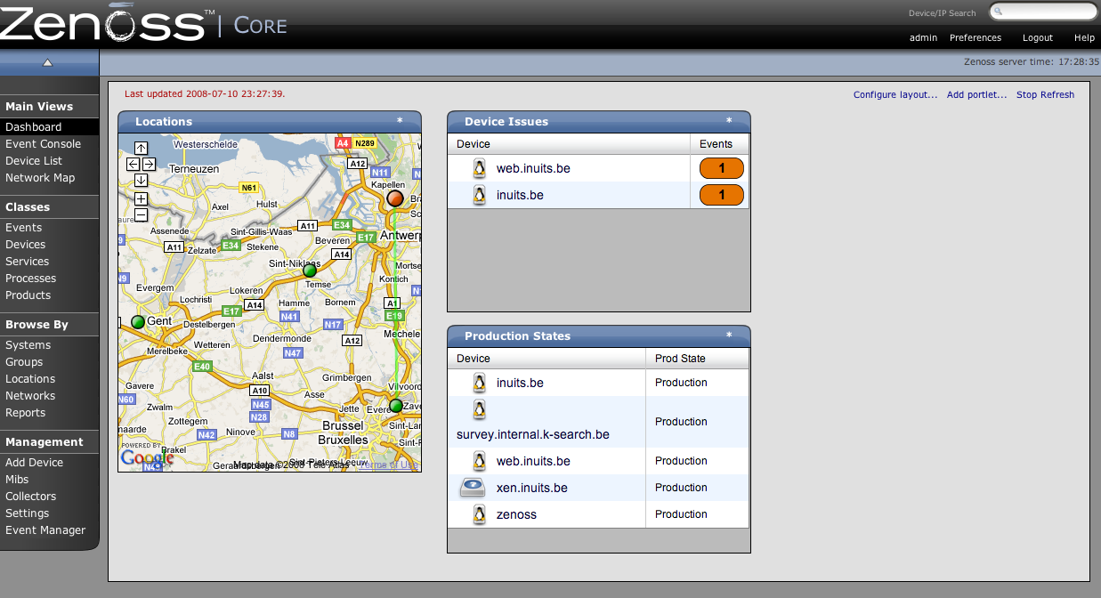

Slide 28
Zenoss Monitoring methods/tools
SNMP
Nagios plugins
Custom commands
ZenPacks: User commands, Perf templates, Graphs ...

Slide 29
Zenoss : MySQL
“Nothing” by default
Nagios Plugins can be used

Slide 30
Zenoss MySQLMonitor ZenPack
Command Statistics (SELECT, INSERT, UPDATE, DELETE)
Select Statistics (Scan, Range Check, Range Join, Full Join)
Handler Statistics (Keyed & Unkeyed Reads, Writes, Updates, Deletes)
Network Traffic (Received & Sent)

Slide 31
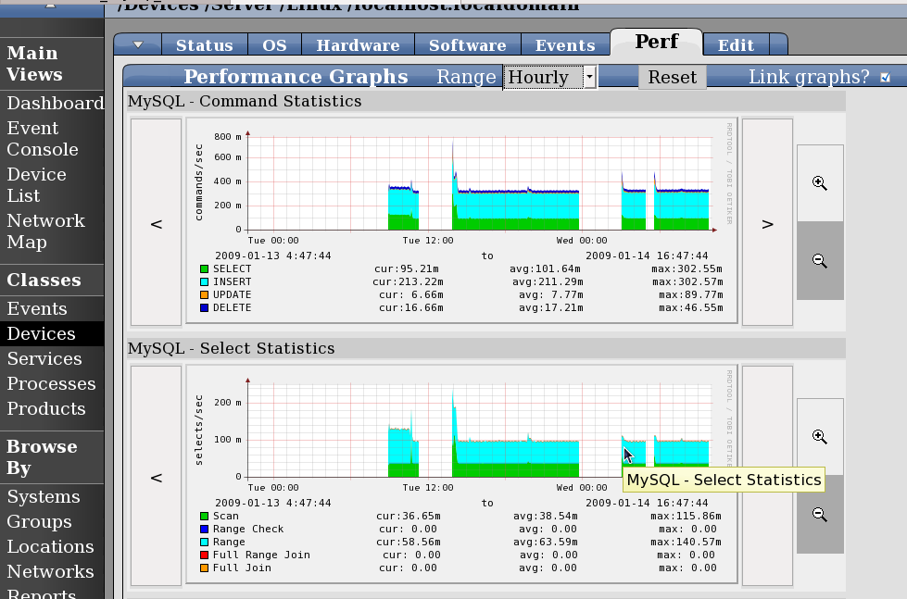
Zenoss MySQLMonitor ZenPack

Slide 32
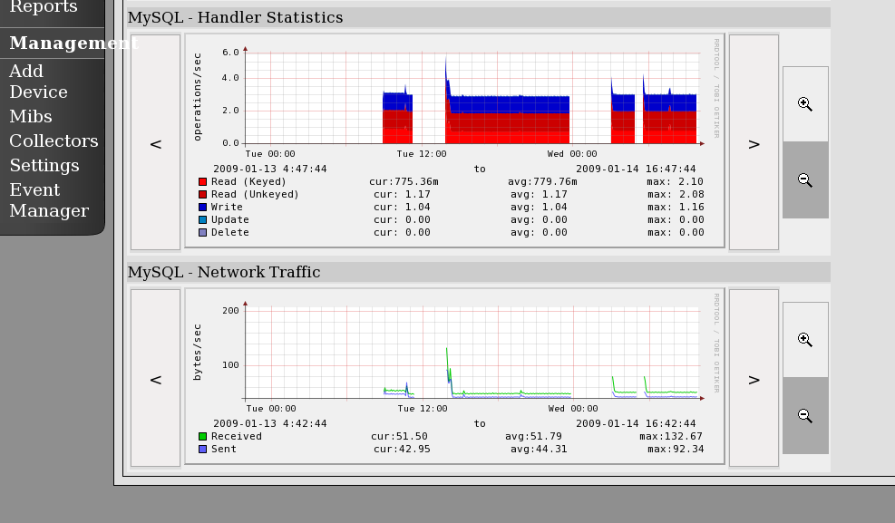
Zenoss MySQLMonitor ZenPack

Slide 33
Zenoss Conclusion
Con:
  Help I`m lost
  Commercial features missing
Pro:
  Scalabilty: multiple collectors
  MySQL Zenpack

Slide 34
HypericHQ
Heavy Weight
Agent Based (Heavy)
Java
Autodiscovery (of services)
SIGAR (System Information Gatherer and Reporter)

Slide 35
HypericHQ
Quick setup
Inside the applications
    Real focus towards application monitoring
    Focus on State
    Focus on functionality
Great to do debugging

Slide 36
Hyperic Overview
Server/Agent method
Focusses strongly on application/db/ performance
Grouping of servers/services
Very nice Dashboard!

Slide 37
Hyperic Inside the Apps
Default installed plugins :
  MySQL
    Table level
    Row count, qps, table size
  PostgresQL
    same
  Jboss
    Inside the JMX
    Deployed WARS

Slide 38
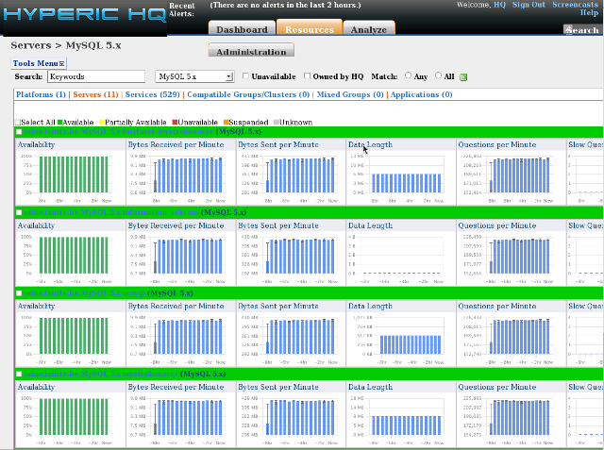
Hyperic Inside the Apps

Slide 39
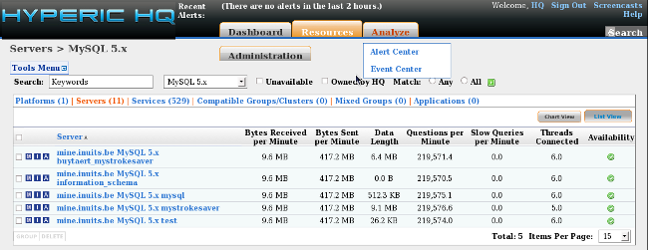
Hyperic Inside the Apps

Slide 40
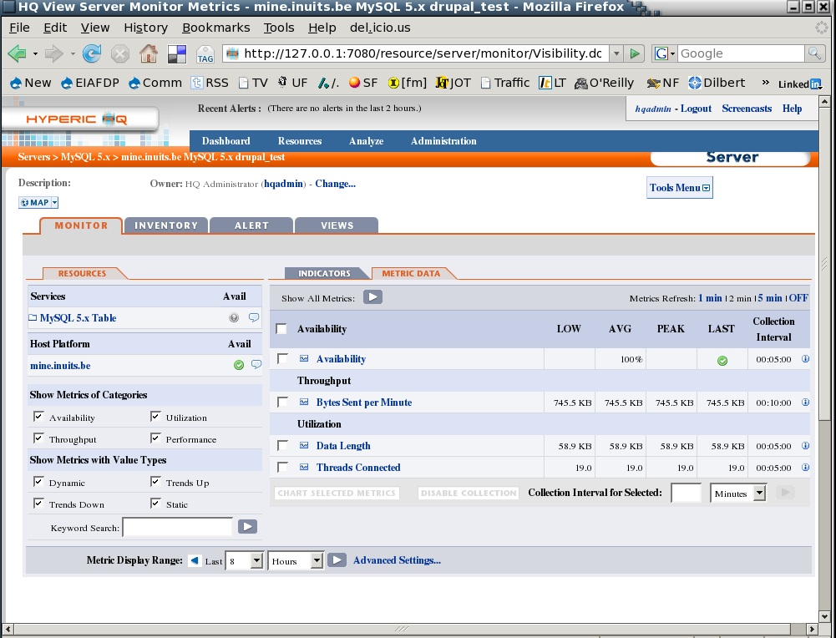
Hyperic Inside the Apps

Slide 41
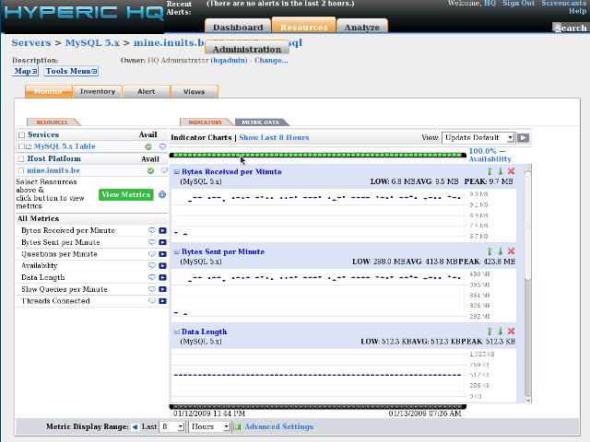
Hyperic Inside the Apps

Slide 42
Hyperic Conclusion
Con:
  Help , I'm lost !
  Lots of NTH features in Commercial Version
  Not for your typical LAMP shop
Pro:
  Very nice/simple/straight forward
  “Low” on java-memory, very responsive webfrontend, not 'sluggish' at all
  Goes DEEP Inside the Application
  MySQL / PgSQL out of the Box

Slide 43
Zabbix
“LightWeight”
Multi Tier
  Agents
  Database + Daemon
  Web Interface
Template based

Slide 44
Zabbix
Find the right package for your distro = smooth installation
“Auto detects” agents
Create your own screens

Slide 45
Zabbix Monitoring methods/tools
Simple checks
Agent (availability of params depending OS)
SNMP
Other
  External checks
  Internal checks
  Aggregated checks
Notes:
Zabbix sender: command line util used to send perfdata to zabbix
item: ftp on
trigger: ftp down
action: if ftpdown then mail
system.cpu.load
system.proc.mun
Simple checks
Agent
SNMP
Other
Scripts
Internal checks : used to monitor the inernals of zabbix
Aggregated checks : direct datbase queries (calculate avg cpuload of a group)

Slide 46
Zabbix Features
Alerting
  Harder to configure notifications
  No sign of escalation (planned)
Reporting
  Customizable layouts
Trending
  Slideshow mode
  Correlation of different graphs

Slide 47
Zabbix MySQL
Agent has checks disabled
Needs uncommenting
### Set of parameter for monitoring MySQL server (v3.23.42 and later)
### Change -u<username> and add -p<password> if required
UserParameter=mysql.ping,mysqladmin -uroot ping|grep alive|wc -l
UserParameter=mysql.uptime,mysqladmin -uroot status|cut -f2 -d":"|cut -f1 -d"T"
UserParameter=mysql.threads,mysqladmin -uroot status|cut -f3 -d":"|cut -f1 -d"Q"
UserParameter=mysql.questions,mysqladmin -uroot status|cut -f4 -d":"|cut -f1 -d" S"
UserParameter=mysql.slowqueries,mysqladmin -uroot status|cut -f5 -d":"|cut -f1 -d"O"
UserParameter=mysql.qps,mysqladmin -uroot status|cut -f9 -d":"
UserParameter=mysql.version,mysql -V

Slide 48
Beyond the Default Zabbix
Zabbix Wiki : Heavy /Extensive MySQL Monitoring
  Consolidates zillion tools in 1
  Sends those checks to Zabbix
  mysql.php script
    Any value
    Replication Slave/Master
Others exist, but aren't published

Slide 49
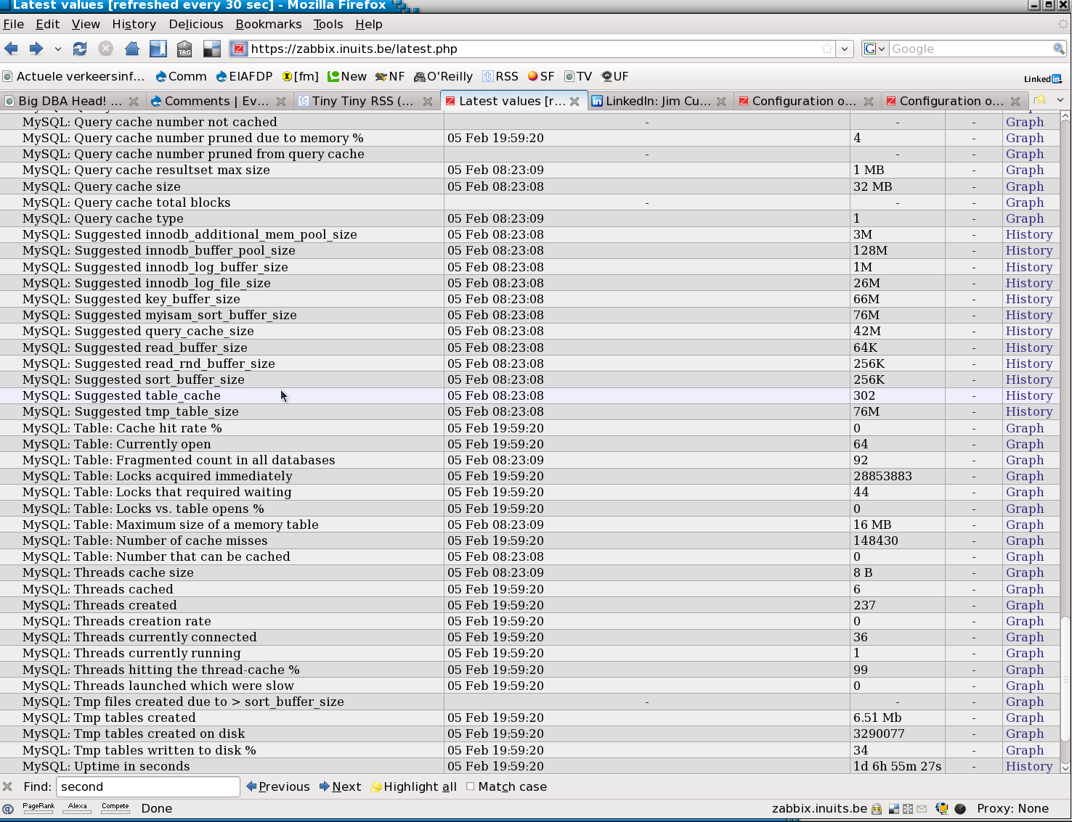
Zabbix MySQL

Slide 50
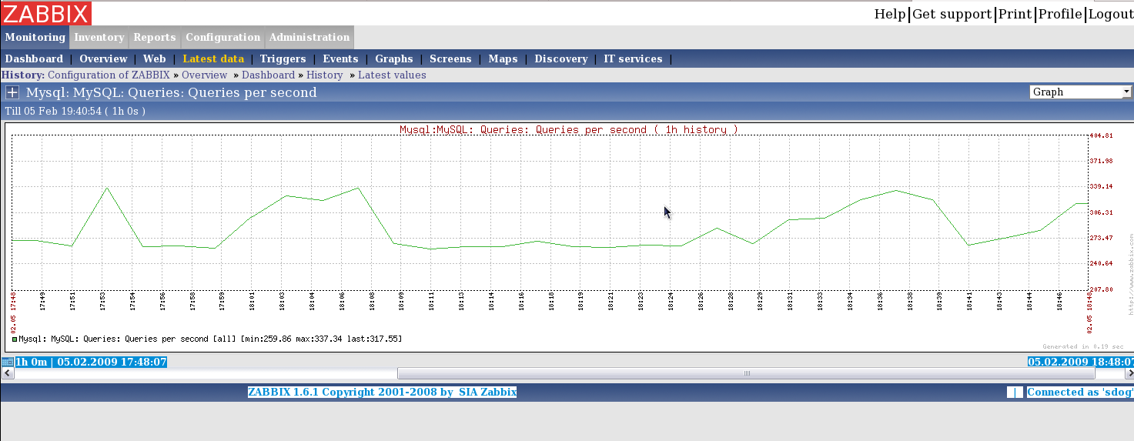
Zabbix MySQL

Slide 51
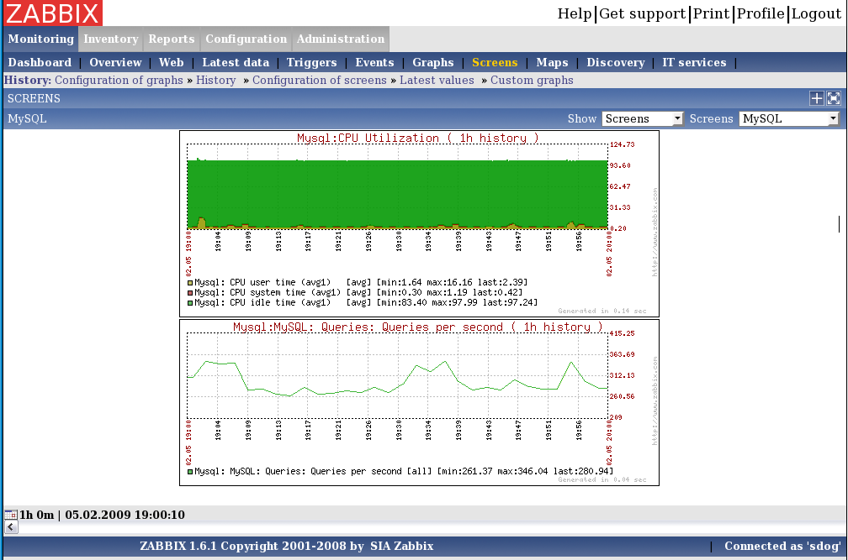
Zabbix MySQL

Slide 52
Zabbix Conclusion
Con:
  Pretty cumbersome to configure
  Important features missing ( but planned in next version ): escalation, better reporting ,....
Pro:
  Lightweight both server and agents
  Fully Integrated
  Screens : Correlation of graphs

Slide 53
Conclusion
Choose yourselve
  Java Shop ?
  LAMP Shop ?
We are using mostly
  Zabbix
  Hyperic

Slide 54



`
Kris Buytaert <Kris.Buytaert@inuits.be>
Further Reading
http://www.krisbuytaert.be/blog/
http://www.inuits.be/
http://www.virtualization.com/
http://www.oreillygmt.com/
?
!

