Slide 1
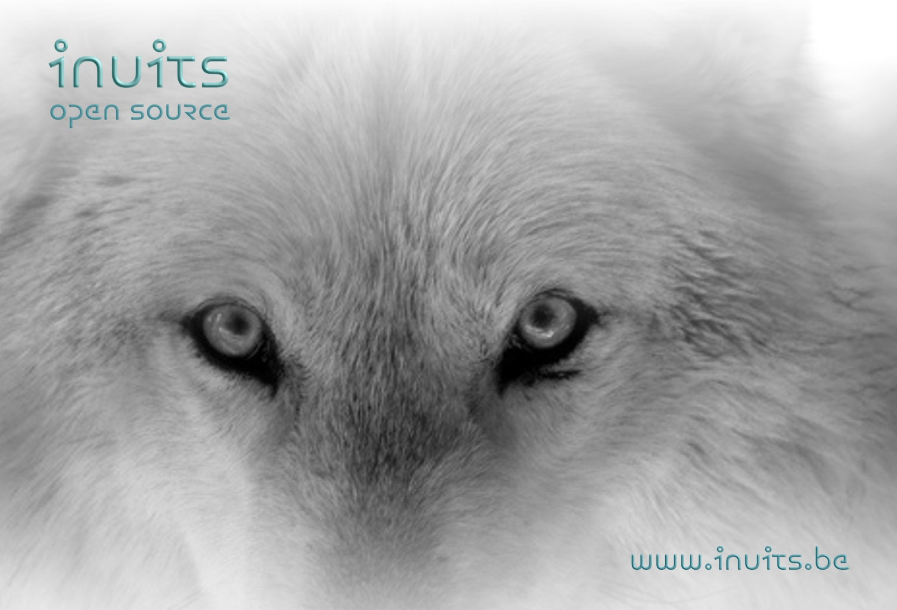
Open Source Virtualization
An overview
Kris Buytaert kris.buytaert@inuits.be

Slide 2
Kris Buytaert
Senior Linux and Open Source Consultant @inuits.be
„Infrastructure Architect“
Linux since 0.98
OpenMosix, openQRM, ...
Early Adopter (Xen, MySQL Cluster)
Automating Large Scale Deployment , High Availability
Surviving the 10th floor test
Virtualization with Xen
http://www.krisbuytaert.be/blog/
http://www.virtualization.com/

Slide 3
Agenda
Why Virtualization Matters
Virtualization vs Virtualization
Where we come from
Now and Xen
Managing Virtual Machines
Where are we heading ?

Slide 4
What is Virtualization ?
Running different operating systems together on 1 machine
separate an operating system from the underlying platform resources

Slide 5
Why Virtualization Matters
Consolidation
Saving Idle Cycles
Security
Separating Development/Staging/Production platforms
Hardware Independence
A Greener Environment
Having a budget that needs to be emptied.
All the cool kids are doing it

Slide 6
Why Virtualization is Dangerous
High Availability
  Live Migration is not a HA solution !
Vendor Lock In
Heavy IO
  Don't virtualize your Databases
  Don't virtualize your heavy loaded mailservers
Hardware Dependencies
  Live Migration ?

Slide 7
Virtualization vs Virtualization
Single OS image: Ensim, Vserver, Solaris Zones, openVZ
  Group user processes into resource containers
  Hard to get strong isolation
  Typically used for Hosting/Virtual Hosting/ISP
  Run a lot of almost identical Virtual Machines
  1 single kernel
Chroot’s on steroids

Slide 8
Virtualization vs Virtualization
Full virtualization: VMware, VirtualPC, Qemu, VirtualBox
  Run multiple unmodified guest OSes
  Hard to efficiently virtualize x86
  No Access to the hardware
  No Realtime guarantees
  Problematic for certain privileged instructions

Slide 9
Virtualization vs Virtualization
Para-virtualization: UML, Xen,
  Run multiple guest OSes ported to special arch
  Arch Xen/x86 is very close to normal x86
  Some Access to underlying hardware
  Better Performance
  Needs modification to the OS

Slide 10
Virtualization vs Virtualization
Hardware Supported Virtualisation
  Xen
  KVM
  Others adopted slowly
No more changes to the software ,
Hardware solves the problem

Slide 11
Looking back at a decade of Virtualization
IBM Mainfraimes
First Virtualization Aquisition Ever ?

Slide 12
Looking back at a decade of Virtualization
IBM Mainframes
First Virtualization Aquisition Ever ?
  1994 Kevin Lawton starts Bochs development
    Full x86 emulator
  1999 Work on Plex86 starts (aka FreeMWare)
    Lightweight Linux Virtualization
  1999 Mandrake Software buys Bochs

Slide 13
Oldskool Emulation
DOSEmu
Win4Lin
Wine

Slide 14
Is this Virtualization ?
VNC
FreeNX
  NoMachines, lightweigth, proxies
But X11 !!!

Slide 15
The land of Confusion:
UML vs UMLinux
Jeff Dike : User Mode Linux
  Run Linux on Linux
    As a “process”
UMLinux
  Run Linux on Linux :)
  Mainly to run test scenarios
  Rebranded later to Faumachine

Slide 16
More Land of Confusion
LVS vs Linux Vserver
Linux Virtual Server
  Act as 1 virtual server
  Pass TCP/IP Connections to others
Linux Vserver
  Kernel Isolation
  Chroot on steroids

Slide 17
OpenVZ , LinuxVServer
Chroots on Steroids
  Based on BSD Jails
Look really really similar
According to the developers no shared codebase

Slide 18
OpenVZ , Virtuozzo
OpenVZ =~ opensource Virtuozzo
  Swsoft 1997
  Virtuozzo 2001
  2003 Swsoft buys Plesk
  SWSoft buys Parallels but “forgets” to tell
  Eventually rebrands to Parallels late 2007
  Kernel Inclusion ?

Slide 19
Looking back at a decade of Virtualization
CoLinux
Running Linux on Windows

Slide 20
Lguest,Lhype, RustyVisor
Paul “Rusty” Russell
Lhype
WonkyVisor
RustyVisor
Lhype
  Linux on Linux, but fast, no vt req , same kernel

Slide 21
Do I really need VMWare ?
Qemu
Fabrice Bellard.
Not just x86
    qemu-arm qemu-mips qemu-i386 qemu-ppc qemu-sparc qemu-m68k
“Slow”
  Patch , first non free, later free
Components Used in A LOT of projects !

Slide 22
Virtualbox
Innotek (Stuttgart)
Open Source
VMWare alternative
Great Desktop Support
Bought by Sun (just before Fosdem)
Now part of the xVM suite

Slide 23
Let‘s talk about Xen
Pioneered ParaVirtualisation
Pioneered VT support
Went Mainstream real fast !
Stable and performant platform
Scriptable
Targeted at Server Platforms
98% CPU Speed
Open Source
Known Developers

Slide 24
Device
Manager &
Control s/w
Unmodified
User
Software
Unmodified
User
Software
Unmodified
User
Software
GuestOS
(XenLinux)
GuestOS
(XenLinux)
GuestOS
(XenLinux)
Unmodified
GuestOS
(WinXP))
AGP
ACPI
PCI
Back-End
Back-End
SMP
Native
Device
Driver
Native
Device
Driver
Front-End
Device Drivers
Front-End
Device Drivers
VT-x
Control IF
Safe HW IF
Event Channel
Virtual CPU
Virtual MMU
Xen Virtual Machine Monitor
Hardware (SMP, MMU, physical memory, Ethernet, SCSI/IDE)

Slide 25
Xen adoption
Major Distro's
  RedHat
  Suse
Who was first ?
Fighting over “stability”
Hardware Vendors
  IBM, Intel, ....

Slide 26
Xen adoption cont.d
Amazon EC2
Oracle VM
  Own Code ?
  Hosting next Xen summit
Sun xVM
  Part of the suite
Virtual Iron

Slide 27
KVM
Kernel Based Virtual Machine
VT Required
“just a module”
/usr/local/kvm/bin/qemu-*
Came out of nowhere
+/- 6 weeks before kernel inclusion
Since 2.6.20
Lean and Mean
Desktop Oriented

Slide 28
Qumranet & KVM
Main Funding of KVM development
A Remote Virtual Desktop Solution
Proprietary Own protocol
Commercial Solid ICE
Now @ RedHat

Slide 29
Managing Your Virtualization Platform
Enomaly
Libvirt
Ovirt
OpenQRM

Slide 30
Building your own cloud
Enomaly
OpenNebula
OpenQRM
Nimbus
...

Slide 31
What is openQRM ?
open-source project at sourceforge.net (GPL)
data-center management platform
Not just your virtual platforms
provides generic virtualization layer
Deploy on demand
Support for physical , Xen, VMWare, Vserver, KVM
OpenQRM 4 is a full rewrite
Notes:
OpenQRM is a data-center management platform. It is an open-source project is hosted on soureforge.net.
OpenQRM consist of a main server based on a tomcat/mysqld combo.This main server implements all core functionalities like imaging your servers, automatic provisioning, high-availability and more. Other features and mechanisms are added by openQRM-plugins which are interacting with the server. Plugins can change the base-functionality and/or add new functionality without any changes in the base-server.
A generic virtualization layer is provided in the core-server. It allows to conform all kinds of different virtualization plugins.
Another key-feature of openQRM is that it is not limited to linux-operation systems. Support for different other operation systems like windows, freebsd, solaris for Intel- and Sparc based systems are available by plugins.
Last but not least i would like to mention the developer-friendly build-architecture. It is designed to allow developers to separately work e.g. On different plugins without the need to change anything in the base-system. Also it provides a build-cache so that developers can re-build + deploy the whole server or only parts from it within minutes.
Sure, this is a lot So let's start with how common data-centers look like.

Slide 32
OpenQRM : build your
Virtual data-center
logical layer for servers/services called virtual environments (VE)
virtual environments consist of :
    a boot-image (e.g. a linux kernel)
    a root-file system (local, NFS, ISCSI)
    provisioning meta-data
deployed according provisioning meta-data on idle resources
Notes:
OpenQRM implements a logical layer for servers and services called virtual environments.
In short named VE.
Those VE's are a combinations of a boot-image, a filesystem-image and provisioning meta-data. The provisioning data consist of the user-configuration for a server/service e.g. When do i need the resource ? How many nodes it needs ? Which type and speed of CPU*s and how many RAM it wants ? Should it be HA ? According to those informations a VE can be started/stopped with a sinlge mouse-click. The openQRM-servers then selects an idle resource (an available, free system) to deploy the server and its services on.
The virtual environment layer allows the sysadmin e.g. To rapidly deploy servers within minutes, to test a kernel upgrade on a cloned VE before going into production, to reduce the resources for under-utilized systems and much more.
So let's have a look. How does our environment looks now by using openQRM ?

Slide 33
Which Virtual Platform to choose
Choice is personal
  Xen for Servers
  VirtualBox for Desktops
    Keeping an eye on KVM
  LinuxVServer for chroot on steriods

Slide 34
The Future
Xen @ Citrix
  Oracle to host next Xen Summit
VMWAre going real open ?
KVM @ RedHat
OpenVZ in the Kernel ?

Slide 35



`
Kris Buytaert <Kris.Buytaert@inuits.be>
Further Reading
http://www.krisbuytaert.be/blog/
http://www.inuits.be/
http://www.virtualization.com/
http://www.oreillygmt.com/
?
!

