Slide 1
Out with the new,
In with the new
Kris Buytaert
@krisbuytaert

Slide 2
Kris Buytaert
I used to be a Dev,
Then Became an Op
Chief Trolling Officer and Open Source Consultant @inuits.eu
Everything is an effing DNS Problem
Building Clouds since before the bookstore
Some books, some papers, some blogs
Evangelizing devops

Slide 3
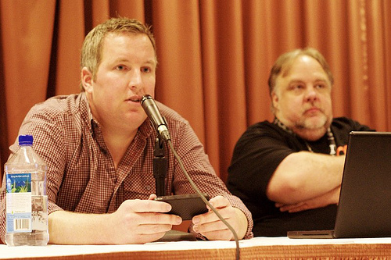
C(L)AMS
Culture
(Lean)
Automation
Measurement
Sharing
Damon Edwards and John Willis
Gene Kim

Slide 4
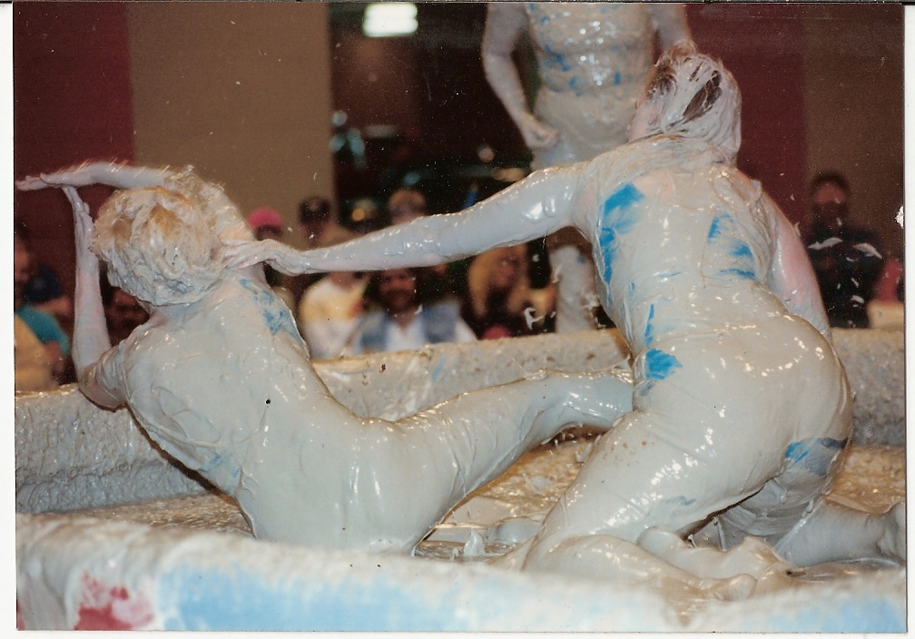
Devs vs Ops

Slide 5
HistoricallyDifferent Goals
Development
New releases
New Features
New platforms
New architectures
Functional Req
Operations
Stable Platform
No Downtime
Scalable Platform
Non Functional Req

Slide 6


Slide 7
Step 1
Don't call it a devops team

Slide 8
Step 2
Be Patient
Devops is hard
Rome/Etsy was not build in 1 week

Slide 9
Analyze This
What are devs nagging about
  Slow builds ?
  No enviroments ?
What are ops nagging about
  Bad artefacts ?
  No logs ?
What is mgmt nagging about
  Quality / Feedback ?

Slide 10
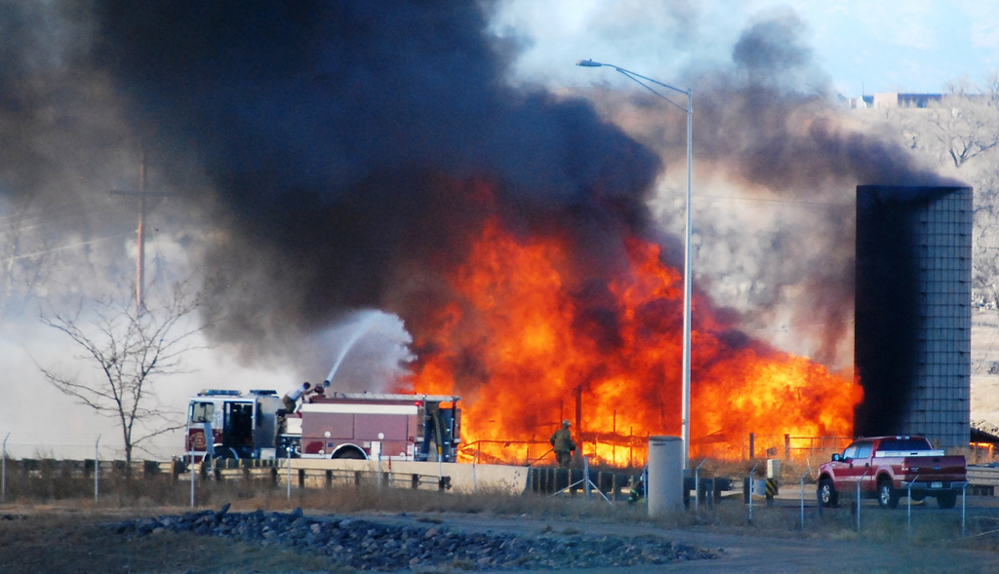
Burn the Silos

Slide 11
Crossfunctional Team
Build a project team with skills from all over
  Development
  Continuous Integration
  Testing
  Infrastructure (HA/ Scale/ Performance)
    Deployment
    Measurement
Seat them together !
Goal = Help the business

Slide 12

Enable Communication

Slide 13
Improve Communication
Chatrooms <- force people to be online
  Topic
  Virtual Watercooler
  ChatOps
Virtual and Physical Standups
Hangout / Jabber

Slide 14
Improve Communication
Not only inside the team
Build visible dashboards with business metrics
Transfer knowledge

Slide 15
Start “Hiring”
Internally / Externally
Get experience on board
Get BuyIn inside the team

Slide 16
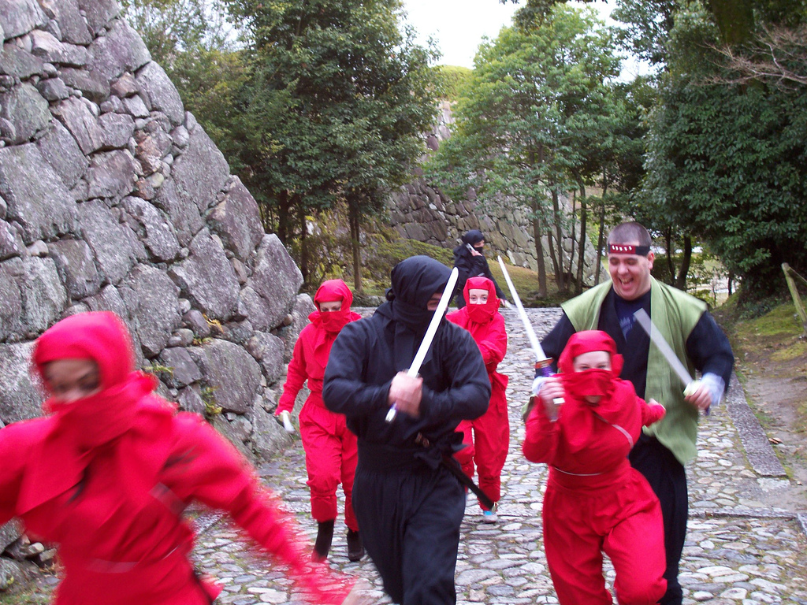
No Code Ninjas

Slide 17
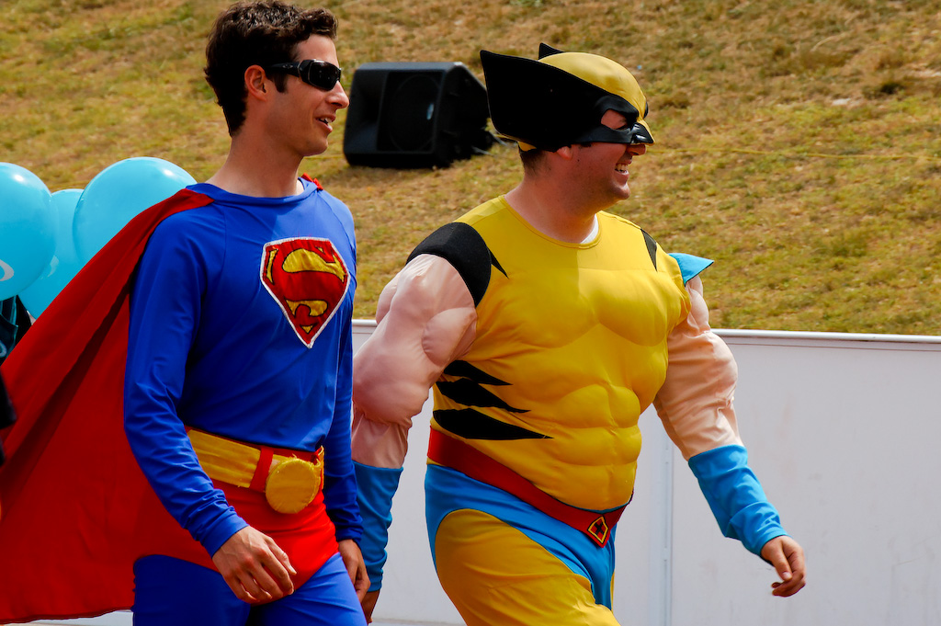
No superhero admins

Slide 18
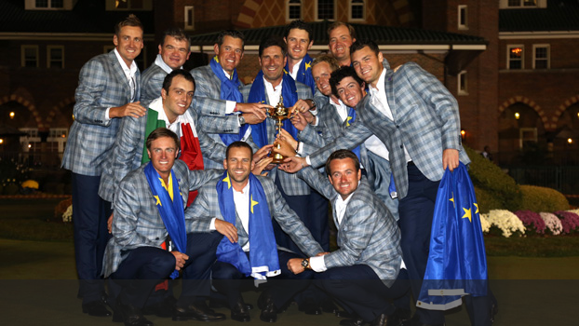
One Team = One Goal !

Slide 19
Set The Rules
Measure all the things
No manual changes
No more technical dept
No Quick Wins
Version all the things
Automate all the things
Have fun

Slide 20

Build Trust
Experiment
  Dev
  Test
Prod
Automate all the things
Measure success
Measure Failure

Slide 21
Give Access
Shared goal -> Shared Problem -> Shared responsibilities
Everyone is on call
Full platform access
  Logs
  Metrics
  Tools
Do you let a blind buy paint your house ?

Slide 22
Grow
Take 1 small step
Prepare
Do not spread the word to soon....
  You won't be ready anyhow
Celebrate Success
Showcase successes
Create Jealousy

Slide 23
Understand Failure
MTTR , Mine is shorter than Yours

Slide 24
Culture,
Automation,
Measurement,
Sharing

Slide 25
Automate all the things
Build
  reproducable builds are undiscussable
Test
  testing reduces risk
  automate deployments of your test infra
Deploy
  Infrastructure as Code
  100% automation
  Can you rebuild your infrastructure ?

Slide 26
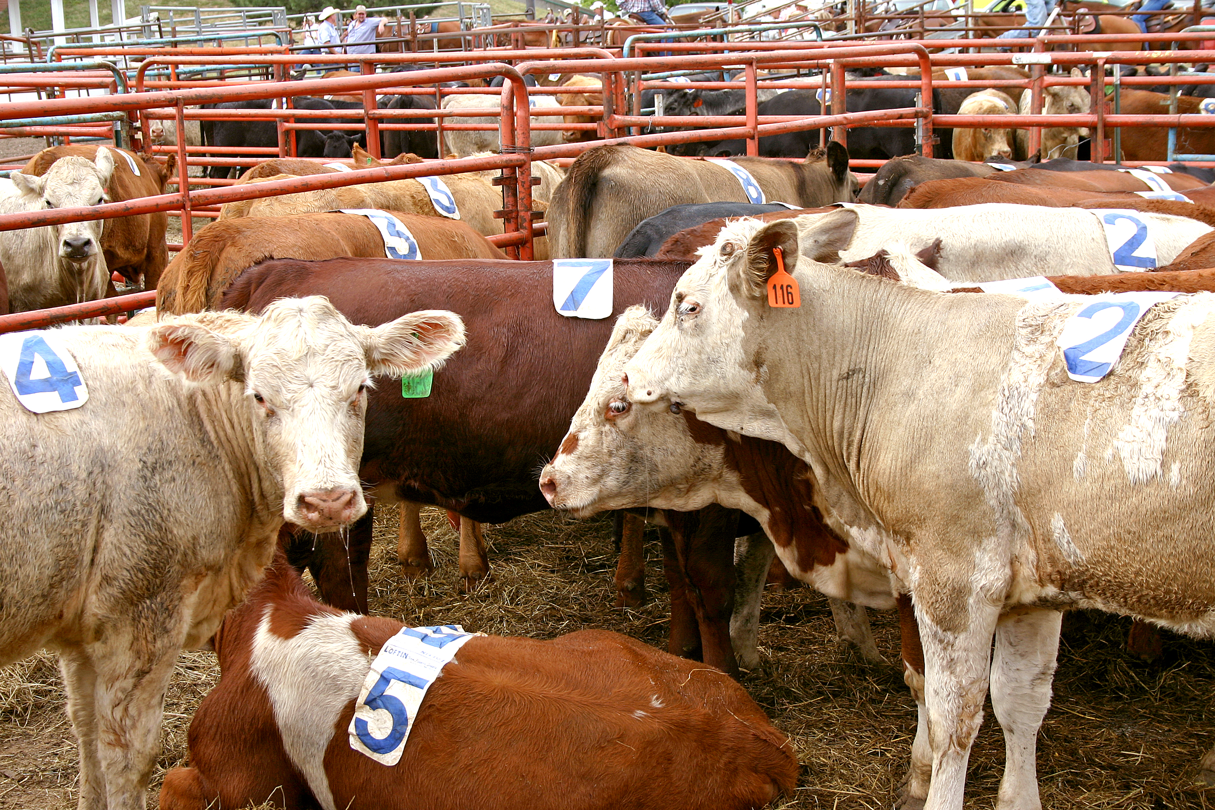
Your machines as Cattle

Slide 27
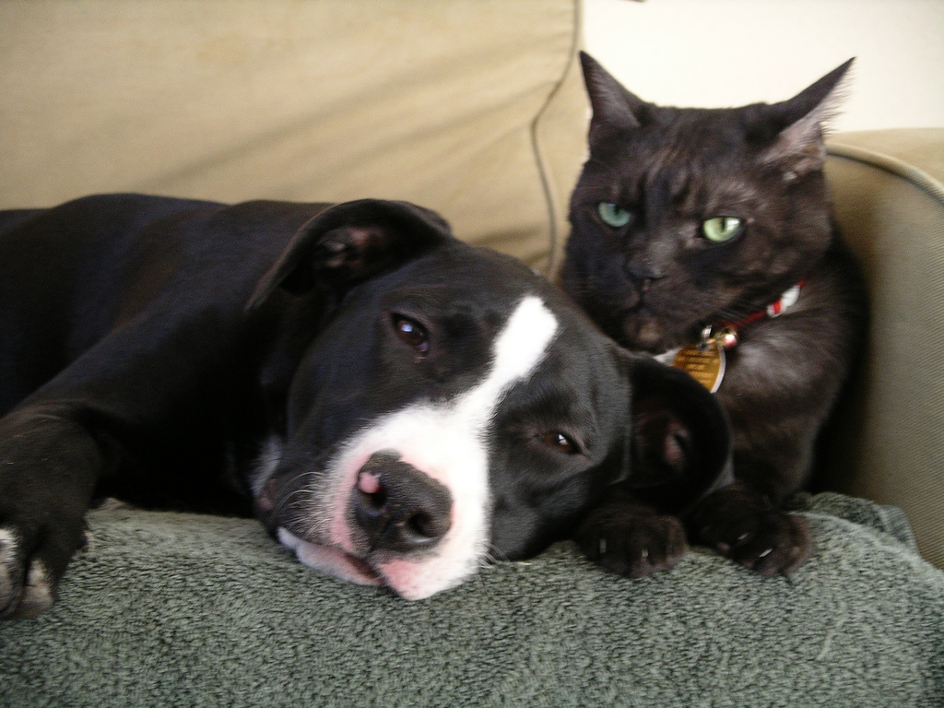
Treat your people as pets

Slide 28
Culture,
Automation,
Measurement :
measure all the things
Sharing

Slide 29


Slide 30
Self Service Metrics
Being able to add new metrics
Build your own dashboards
Look at metrics / logs on all platforms
Learn from the Logfiles
Learn from the platform

Slide 31
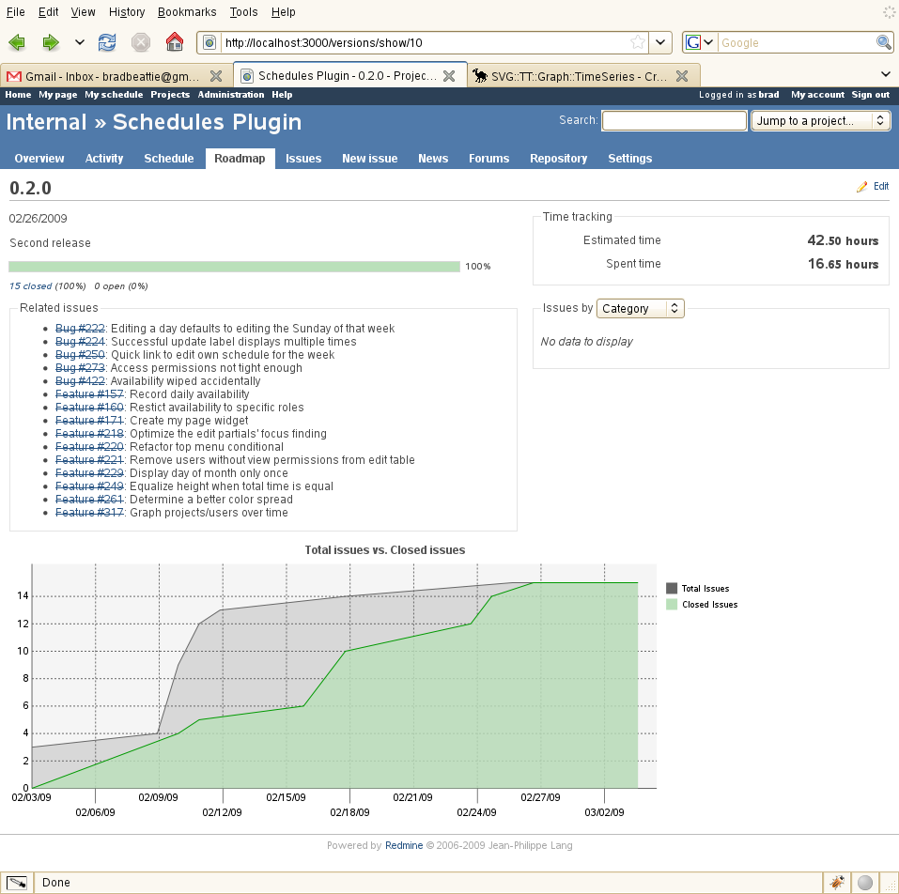
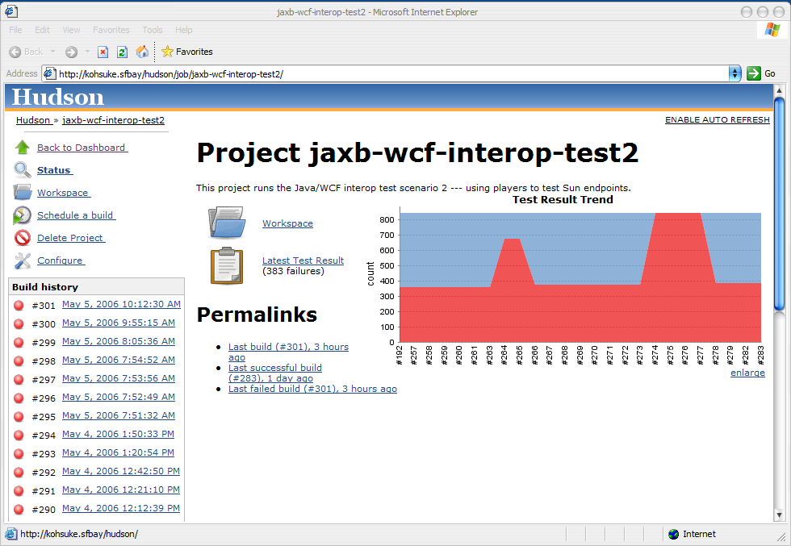
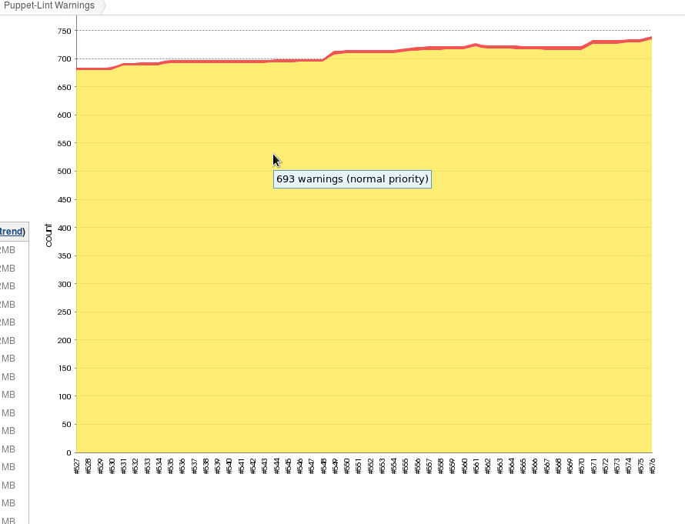
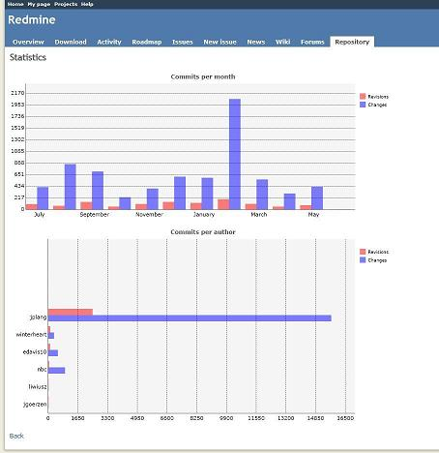
During development

Slide 32
Math 101
f(x)
f'(x)
f''(x)
... statistics 101

Slide 33
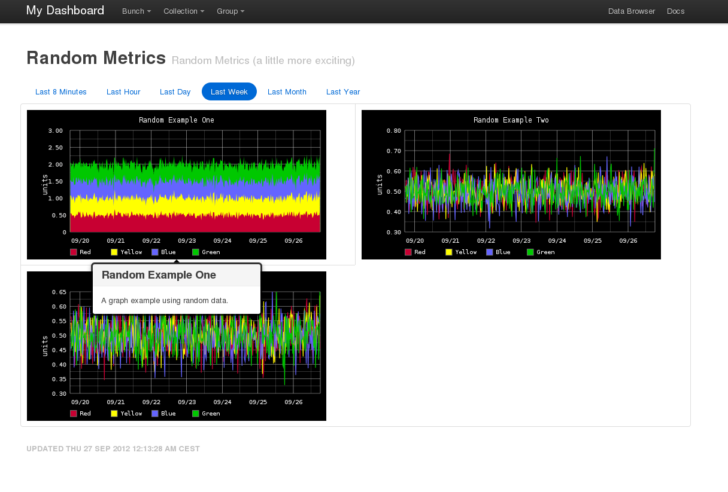
Dashboards

Slide 34
Culture,
Automation,
Measurement,
Sharing

Slide 35
Visualize Business Metrics
$revenue
#sales
signups
conversions
Api calls
Application use

Slide 36
Bond
Hack Days
Teach a collegue days
Ramdon Lunch meetups
Eat Cake
Both inside and outside the office

Slide 37
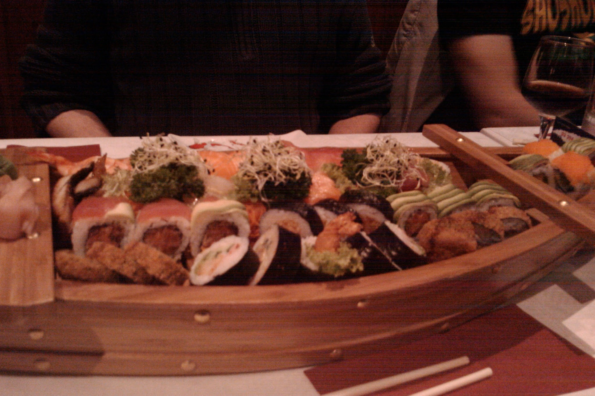
Food

Slide 38
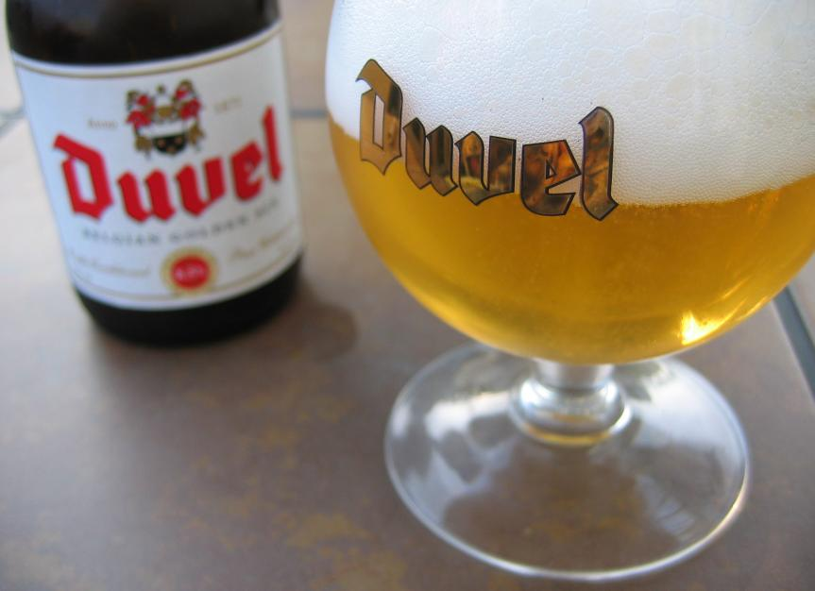
Beer

Slide 39
Done ?
A Software project is not done until your last enduser is in his grave !

Slide 40

It's not about the tools

Slide 41
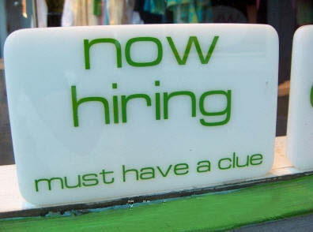
Contact
Kris Buytaert Kris.Buytaert@inuits.be
Further Reading
@krisbuytaert
http://www.krisbuytaert.be/blog/
http://www.inuits.be/
Inuits
Duboistraat 50
2060 Antwerpen
Belgium
891.514.231
+32 475 961221

