Slide 1
INUITS
The real voyage of discovery consists in
having new eyes.
Marcel Proust

Slide 2
Kris Buytaert
Senior Linux and Open Source Consultant @inuits.be
„Infrastructure Architect“
Surviving the 10th floor test
OSSTMM
Co-Author Virtualization with Xen
Guest Editor at Virtualization.com

Slide 3
Today
What is Virtualization
What is VirtSec
Fud and Reality
VirtSec and Open Source
CloudSec

Slide 4
What is Virtualization ?
Running different operating systems together on one machine
Isolate Operating system from the underlying hardware resources
Running multiple identical operating systems together on one machine

Slide 5
Why Virtualization Matters
Consolidation
Saving Idle CPU Cycles
Separating Development/Staging/Production
Hardware independency
Security
Greener Environment
All the cool kids are doing it

Slide 6
Why Virtualization is dangerous
A vendor view of High availability
Live Migration is not a HA Solution
Vendor Lock In
Heavy IO
Hardware dependencies & Live Migration
Security ?

Slide 7
Virtualization and Open Source
Leading the Pack
Paravirtualization
VT Support
The core Virtual Infrastructure is open
Proprietary vendors try to catch up
And Build the Management FrameWorks

Slide 8
Virtualization to Me
Xen
KVM
VirtualBox
Linux Vserver
OpenVZ
Linux Containers
LibVirt
Convirt
Qemu
OpenQRM
Enomaly
UML

Slide 9
What is VirtSec ?
Securing Virtual Platforms , Hypervisors, Host OS
Securing the Guest OS in a Virtual Environment
Running Security tools in a Virtual Environment

Slide 10
Isn't VirtSec just a way for the security people to jump on the Virtualization Hype ?

Slide 11
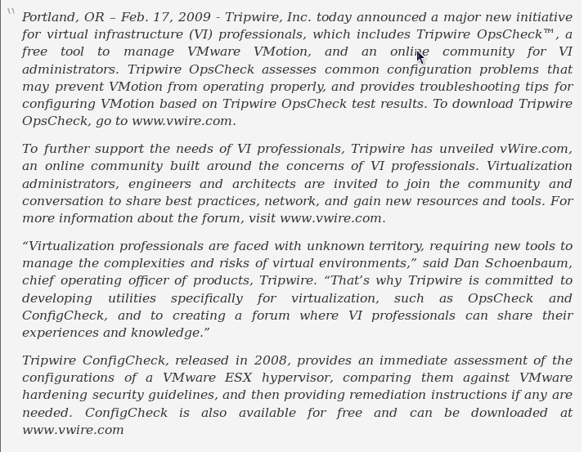

Slide 12
What changes with Virtualization ?
The Network stack
  System vs Network vs Virtualization
  The network goes inside the machine
Live Migration
  Across different VLAN's
  Vlan Spaghetti
Scale
  1 physical machine = MANY VM's

Slide 13
Legacy Apps
Claim: Legacy Apps can't be secured properly
  That old badge logging app running on Win95
  That old batch job running on SCO
Doesn't matter if they are virtual or not

Slide 14
The Virtual Network
Claim: NIDS can't see Inter VM traffic
What about Inter App traffic on the same host , only now we've isolated app from eachother
Bridging / Routing InterVM traffic rather than using proprietary sockets

Slide 15
Flux and Scale
Claim: Traditional HIDS can't follow the quick changing state of Hosts
My HA Clusters, are Active Passive, Active Active, or N+M too. Their state is in constant flux too
The role Config Management and Platform Automation grows every second.

Slide 16
Static Security was DEAD before Virtualization
High Availability Clusters
But the problem is still growing
VM Relocation
Live VM Migration
Rapid ReDeployment
Multiple Instances of a service

Slide 17
Thank you App Developer
Virtual Apliances are Awesome
A flying start
They save you time
They give you a nice preview of technology

Slide 18
Virtual Appliance & Security
Who build it ?
Is the app secured
What about authentication integration ?
How to update it ?
They KILL your time

Slide 19
Image Sprawl, your update nightmare
Image sprawl
  Copy VM, Deploy VM, Modify VM, Copy VM
How do you patch 1 VM ?
Did you patch before or after that one was copied ?
How do you patch 100 VM's ?
What about machines that are offline ?

Slide 20
Image Sprawl, your update nightmare
The biggest challenges we have in virtualization are operational and organizational rather than technical.
Christofer Hoff

Slide 21
Image Sprawl, your update nightmare
Automate Deployment
Implement Configuration Management
Map Security management to Config Mgmt
Prepare to Survive the 10th floor test !

Slide 22
Hypervisor Security

Slide 23
Deus Ex Machina
Remember the E10K fiasco ?
  No you won't be able to get from one VM to another VM ?
  You bet they will !
Buffer overflow in Management soft ?

Slide 24
Ballooning
Critical feature from a proprietary vendor
Not available in off the shelf Xen/OracleVM
Go away or I will replace you with a small shellscript

Slide 25
Blue Pill vs Red Pill
Blue Pill by Invisible Labs
Placing a Hypervisor under an OS
Hoping no one realizes it
Existing Source for POC
Ignorance vs Truth

Slide 26
Blue Pill, a real threat ?
POC vs Real Life
    Become root first
    Then exploit the VM vulnerability ?

Slide 27
Managing Virtual Machines
Early Management Frameworks
Any client can connect ...
An example ..

Slide 28
What is openQRM
open-source project at sourceforge.net (GPL)
data-center management platform
Not just your virtual platforms
provides generic virtualization layer
Deploy on demand
Support for physical , Xen, VMWare, Vserver, KVM
OpenQRM 4 is a full rewrite
Cloud Deployment

Slide 29
OpenQRM & Security
Authentication based on IP
No Encryption
No handshake
Anyone who can spoof the openQRM server IP can reboot / redeploy your infrastructure
Being fixed

Slide 30
Open Source
Not Marketing Driven
Written because there is a need
To scratch an itch
Peer review
Typically more secure than Proprietary
Leading Innovation in Virtualization

Slide 31
Open Source & VirtSec
No known projects
No Need for specialized projects / tools
The VirtSec Vendors claim
  First proprietary -> Then Open Source
  Open Source doesn't innovate
The Open Source Experts claim
  Better Architectures
  No need for bloated hyped tools

Slide 32
Is VirtSec a market? It's an instantiation of technology, practice and operational adjustment brought forth as a derivative of a disruptive technology and prevailing market conditions.
Does that mean it's a feature as opposed to a market? No. In my opinion, it's an evolution of an existing market, rife with existing solutions and punctuated by emerging ones.
The next stop is how "security" will evolve from VirtSec to CloudSec...
Christofer Hoff

Slide 33
Isn't CloudSec just a way for the security people to jump on the Cloud Hype ?

Slide 34
The Cloud ?
Cloud computing refers to the use of Internet ("cloud") based computer technology for a variety of services. It is a style of computing in which dynamically scalable and often virtualised resources are provided as a service over the Internet.
The concept incorporates software as a service (SaaS), Web 2.0 and other recent, well-known technology trends, in which the common theme is reliance on the Internet for satisfying the computing needs of the users.

Slide 35
SAAS <(>) Cloud

Slide 36
SaaSSec
One Vendor
Full control over
  His application
  His application stack
Supposed to manage his platform in Secure Fashion
But do you TRUST him ?

Slide 37
CloudSec
Deploying in an untrusted domain
  This is not your average DMZ
  You don't even own the Vhost
Cloud Datacenters Attrackt Attackers
  Identical Hypervisors => Only 1 exploit needed
  Cloud Hijacking
Pre and Post Deployment
  What was there and what stays behind ?

Slide 38
CloudSec
Increase security as never before
Encrypt all inter Vhost traffic
FireWall as Never before
Don't store critical data in the cloud
  Use it for analytics
  Workload offload
  Volatile data
Build your own Private Cloud

Slide 39
Conclusion
Risks Change
Scale Changes
Automation matters
Complexity is the Enemy of Reliability
Watch out for FUD
  Specially in the closed world

Slide 40
Security still isn't a product you can buy
It's not even a process
It's a lifestyle

Slide 41



`
Kris Buytaert <Kris.Buytaert@inuits.be>
Further Reading
http://www.krisbuytaert.be/blog/
http://www.inuits.be/
http://www.virtualization.com/
http://www.oreillygmt.com/
?
!

