Slide 1

Open Source Virtualisation
and Consolidation

Slide 2
Whoami
Linux and Open Source Consultant
„Infrastructure Architect“
Linux since 0.98
IANAKH
Senior Consultant/CTO @ x-tend.be

Slide 3
Credits !
Lots of stuf in this presentation is taken from Ian’s presentation from OLS 2005

Slide 4
Why Virtualisation Matters ?
Consolidation
Security
Testing Large Scale Rollouts
Separating Development/Staging/Production platforms
...

Slide 5
What is Xen ?
Xen is a virtual machine monitor
  for x86
  execution of multiple guest operating systems
  unprecedented levels of performance and resource isolation.
Xen is Open Source software
Fully functional ports of Linux 2.4 and 2.6 running over Xen

Slide 6
Xen
“ParaVirtualization”
Provides some exposure to the actual hardware
  Performance increase
  OS Needs to be modified
  Multiplexes resources at OS granularity (vs Process level granularity)
100 virtual OS's per machine

Slide 7
Xen
Secure isolation between Vms
Resource controle and QOS
Only guest kernel needs to be ported
Execution performance is close to real speed
Hardware support = Linux Hardware Support
Live Relocation of VM's between nodes

Slide 8
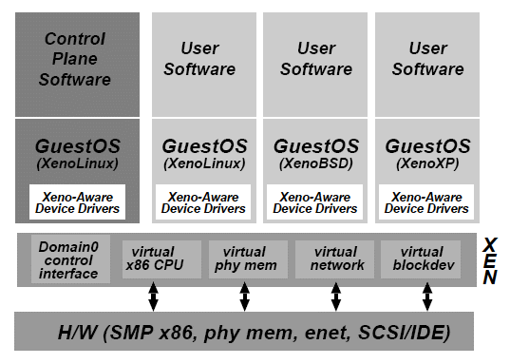
Xen
Domain0 hosts the application-level management software
  Creation and deletion
  of virtual network
  interfaces and block
  devices

Slide 9
Xen & Networking
Virtual firewall-router attached to all domains
Round-robin packet scheduler
To send a packet, enqueue a buffer descriptor into the transmit ring
Bridging

Slide 10
Xen & Disk Access
Only Domain0 has direct access to disks
Other domains need to use virtual block devices
  Use the I/O ring
  Reorder requests prior to enqueueing them on the ring
  If permitted, Xen will also reorder requests to improve performance

Slide 11
Xen and Memory
Reserved at domain creation
Statically Partitioned among domains
Balloon driver enables memory reallocation

Slide 12
Xen 3.0 Arch
Device
Manager &
Control s/w
Unmodified
User
Software
Unmodified
User
Software
Unmodified
User
Software
GuestOS
(XenLinux)
GuestOS
(XenLinux)
GuestOS
(XenLinux)
Unmodified
GuestOS
(WinXP))
AGP
ACPI
PCI
Back-End
Back-End
SMP
Native
Device
Driver
Native
Device
Driver
Front-End
Device Drivers
Front-End
Device Drivers
VT-x
Control IF
Safe HW IF
Event Channel
Virtual CPU
Virtual MMU
Xen Virtual Machine Monitor
Hardware (SMP, MMU, physical memory, Ethernet, SCSI/IDE)

Slide 13
Xen, Live VM Migration
Why ?
  Manage a pool of VM's on a Cluster
  Hardware upgrades
  Loadbalancing VM's in a cluster
Why Difficult ?
  Migrate State of VM's
  Sessions/Response time for databases & webservers
Requires Shared Storage

Slide 14
Early Adopters
From: Wim Coekaerts <wim.coekaerts@oracle.com>
Cc: xen-devel@lists.sourceforge.net
Subject: Re: [Xen-devel] databases and xen?
testing it has already been fine. I ran 4 databases each in one domain
(oracle10g) and it's been amazingly stable. I have not however done
performance testing. soon...
Xen-devel@lists.sourceforge.net
https://lists.sourceforge.net/lists/listinfo/xen-devel

Slide 15
Early Adopters
From: Moshe Bar
Subject: Re: [Xen-devel] databases and xen?
Date: Tue, 18 Jan 2005 04:02:01 +0200
I have run Mysql and Oracle 9i without any problems on 2.0.0 and 2.0.1
, but I didn't have LVM (don't think that would create problems)
Moshe

Slide 16
Solving Netfilter Conflicts
Building a truly transparant proxy
  Integration of LVS and Tproxy fails
  Required multiple machines to work
  CONNTRACK module conflicts
Used Xen to build this on 1 machine

Slide 17
Lowering the # of machines
Telco Environment with maximum 6+16x(2x3+6))=198 machines
(actually 6+2x(2x3+6)= 30)
  Consolidated already 1 application
    now 6 + 16x(2x2+6) = 166 machines
    (6+2x(2x2+6) = 24)
    we moved already 2 redundant applications to 1 of the 6 shared machines
    more are following

Slide 18
Cluster Consolidation
High Availablilty
Failover many to 1 ?
  Failover all physical machines to multiple virtual machines on 1 physical machine.

Slide 19
Xen Future
3.0.2 :)
VT Vanderpool Technology ==> No more ports required
  Also non free OS’s
Embrace and enhance management tools
Infiniband support etc
GUI stuff going beta , Q1.

Slide 20
Conclusions
Xen is a complete and robust GPL VMM
Outstanding performance and scalability
Excellent resource control and protection
Vibrant development community
Strong vendor support
http://xen.sf.net

Slide 21
Further Reading
Automating Xen Virtual Machine Deployment, LinuxKongress 2005
O'ReillyNet , Getting Started with Xen
http://www.x-tend.be/~buytaert/blog/
http://xen.sf.net

Slide 22

Kris Buytaert
buytaert@x-tend.be
Senior Linux Consultant &
CTO @ X-Tend

