Slide 1


Managing your datacenter and Xen Virtual Machines with openQRM by Kris Buytaert
Notes:
Hello Ladies and Gentlemen, nice to have your here at linuxkongress in Nürnberg and welcome to the talk about
Managing enterprise data-centers with openQRM
Some short informations about me :
My name is Matt Rechenburg and i am project manager of different open-source projects like openMosixview or kiscsiadmin. I am living in Bonn/Germany and working as a freelancer for all different kinds of open-source and also commercial projects.
Currently i am heavily involved in the openQRM project working on enhancing the main engine and developing different plugins. You will find me in the openQRM forums and mailling list.

Slide 2
Whoami ?
Senior Linux and Open Source Consultant
„Infrastructure Architect“
Linux since 0.98
CTO @ X-Tend.be
Automating Deployment , High Availability
Surviving the 10th floor test
CoAuthor @
  Virtualization with Xen(tm): Including Xenenterprise, Xenserver, and Xenexpress by David E. Williams

Slide 3
Warning
I have no current experience whatsoever with proprietary or commercial management platforms , operating systems or virtualization platforms.
Every comparison to a proprietary product I happen to make is purely heresay from collegues I trust , stuff I have read in research papers, or is over 7 years old.

Slide 4
Agenda
Managing Physical and Virtual Machines
Why openQRM
Architecture
Plug-ins
Virtual Environments
Virtualization
Notes:
Now we skip the un-interesting part and step directly into the todays agenda.
First we will in generally find out what openQRM is and how it works in detail.
Its architecture and how plugins can enhance the functionality of the main server will be described in the first part of the presentation. We will go on with how servers and services are organized in a virtual environments layer and which benefits we get from this. A bigger part in this talk will be about Virtualization and High-Availability since nowadays those topics are most serious in modern data-centers.
Another key-feature will be explained next, the support for non-linux operation systems. Also a crucial point since most data-centers are heterogeneous meaning they consist of all kinds of different hardware architecture and software platforms. Of course there will be time for questions and answers after this presentation.
So now let's start with and overview of the openQRM-server.

Slide 5
What is openQRM ?
open-source project at sourceforge.net (MPL)
data-center management platform
Not just your virtual platforms
provides generic virtualization layer
supports different operation systems
supports complex network topologies
developer-friendly build system
Notes:
OpenQRM is a data-center management platform. It is an open-source project is hosted on soureforge.net.
OpenQRM consist of a main server based on a tomcat/mysqld combo.This main server implements all core functionalities like imaging your servers, automatic provisioning, high-availability and more. Other features and mechanisms are added by openQRM-plugins which are interacting with the server. Plugins can change the base-functionality and/or add new functionality without any changes in the base-server.
A generic virtualization layer is provided in the core-server. It allows to conform all kinds of different virtualization plugins.
Another key-feature of openQRM is that it is not limited to linux-operation systems. Support for different other operation systems like windows, freebsd, solaris for Intel- and Sparc based systems are available by plugins.
Last but not least i would like to mention the developer-friendly build-architecture. It is designed to allow developers to separately work e.g. On different plugins without the need to change anything in the base-system. Also it provides a build-cache so that developers can re-build + deploy the whole server or only parts from it within minutes.
Sure, this is a lot So let's start with how common data-centers look like.

Slide 6
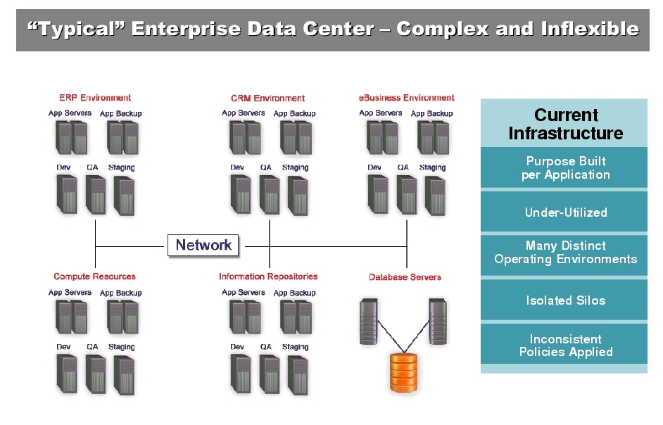
Source: Qlusters
Notes:
Here we have an overview of how a more or less typical data-center is organized today.
We see different islands of server environments for productions, testing, developing or other purposes.
Each server is built for the application it is serving. In most cases those servers are under-utilized which means they are just consuming power and producing heat.
Anyway we have in each separated, or better isolated environment very special needs and complex configurations.
This common scenario of course makes scalability a serious problem. To even increase the complexity there are different SLA's and policies across all the data-centers environments.
At all not a really satisfying situation.
More about data-center requirements now on the next slide...

Slide 7
Data-center Requirements
Rapid multi-environment provisioning
Dynamic load handling
Monitoring and management of commodity servers
Improve servers utilization to cut costs
Patching + configuration management
Notes:
We now have an overview about the typical problematics in common data-center structures. But what are the real requirements for modern, flexible and scalable data-centers ?
A fast, or better rapid provisioning system which supports deployment of different srever-types, system-architectures and operation-systems according to the user-needs is one of the most serious feature-requirements.
Just look into your own data-center !
How long does it normally take from the time a user orders some servers for a specific project and time-frame to the final deployment ? As we heard from our users and partners it is not uncommon that this procedure can take from 2 weeks up to 6 months.
Next point is load-handling. Underutilized servers can and should be consolidated to save power and decrease heating in the server-rooms. Also the “free” CPU-cycles of this systems could be re-used for other purposes.
Of course we need to monitor all the servers and services and take care to detect and handle system-failures in real-time.
We also need to care about security so it is urgent to stay up2date with the latest security patches + fixes. A patch- and configuration management system should do this task.
.... lots of different tools and software packages ....

Slide 8
Managing your Infrastructure
Infrastructures.org
    Kickstart/Fai/SystemImager
    Cfengine / Puppet
Proprietary tools
Platform specific tools
Notes:
How can openQRM help us to archive the requirements ?
A key-feature of openQRM is its plug-able architecture which is designed and implemented to allow users/developers to add (enhance/change) features and components to openQRM without changing code in the main engine. Each plug-in is self contained and can add/modify the functionality of the openQRM engine or of the connected nodes.
The openQRM engine uses an plugin architecture based on "extension points" - the engine publishes different types of extension points. Each plugin can implement "extensions" which connect to those extension points. E.g. a plug-in that wants to add a capability to the openQRM server might have an extension connecting to the Server-Service extension point to initialize the service, and an extension connecting to the MenuItem extension point to add its configuration page to the main menu.
The main extension points are e.g. Server- and nodes-services, menu-items, tabs, page-integration, event-listener and execution-points.
Each plug-in defines in a simple xml.file which extension-points it implements. A sample plug-in is available showing in detail how “things are working”

Slide 9
OpenQRM History
OpenMosix
Qlusters
Managing Clusters
Managing Infrastructures
Open Source early 2006
Notes:
How can openQRM help us to archive the requirements ?
A key-feature of openQRM is its plug-able architecture which is designed and implemented to allow users/developers to add (enhance/change) features and components to openQRM without changing code in the main engine. Each plug-in is self contained and can add/modify the functionality of the openQRM engine or of the connected nodes.
The openQRM engine uses an plugin architecture based on "extension points" - the engine publishes different types of extension points. Each plugin can implement "extensions" which connect to those extension points. E.g. a plug-in that wants to add a capability to the openQRM server might have an extension connecting to the Server-Service extension point to initialize the service, and an extension connecting to the MenuItem extension point to add its configuration page to the main menu.
The main extension points are e.g. Server- and nodes-services, menu-items, tabs, page-integration, event-listener and execution-points.
Each plug-in defines in a simple xml.file which extension-points it implements. A sample plug-in is available showing in detail how “things are working”

Slide 10
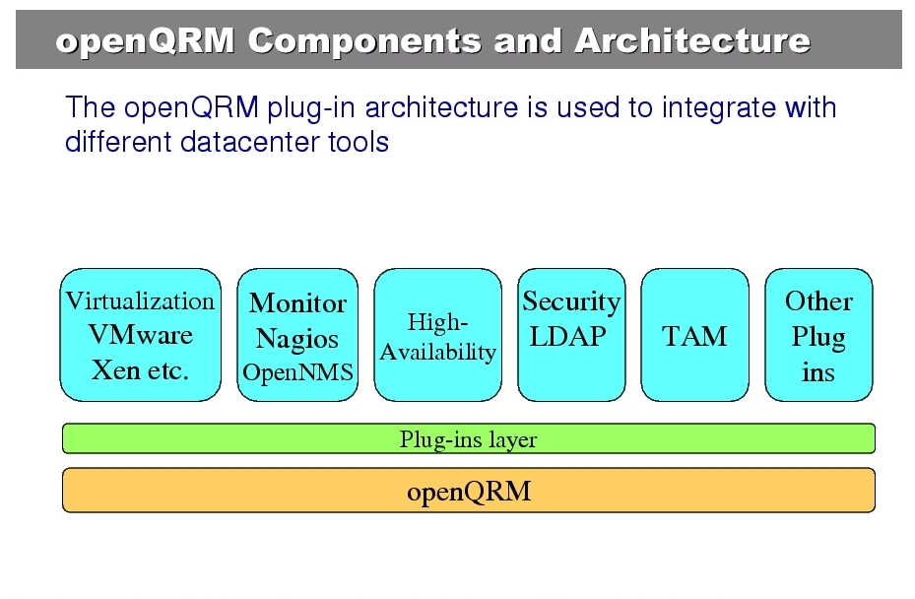
Source: Qlusters
Notes:
We remember the many separated islands with different utilities for each environment?
With its plug-able architecture openQRM integrates with lots of common components which are already used in the today's data-centers. Those components are e.g. Virtualiztation technologies like Vmware, Xen, Qemu and Linux-VServer, System-management- and monitoring tools like Nagios and openNMs, high-availability and security services and others like e.g. The TAM plug-in which supports transparent-application-migration during run-time.
All those components are already implemented as plug-ins and they are connected to the openQRM-server through the Plug-in layer. There will be one slide later in this talk dealing with the plug-in capabilities and API.
Ok, we have a generic server and lots of those common data-center utilities implemented by plugins in one unified management user-interface.
What's next ? How will openQRM solve the trouble with the separated server-islands ?
The coming slide will introduce another logical layer to conform servers and services. We are talking about virtual-environments ....

Slide 11
Plug-able Architecture
base functionality provided by the core tomcat server
plug-ins adding additional features
plug-ins can change and enhance base functionality via extensions
plug-ins can be implemented in: java, binary, shell-scripts, php, etc.
Notes:
How can openQRM help us to archive the requirements ?
A key-feature of openQRM is its plug-able architecture which is designed and implemented to allow users/developers to add (enhance/change) features and components to openQRM without changing code in the main engine. Each plug-in is self contained and can add/modify the functionality of the openQRM engine or of the connected nodes.
The openQRM engine uses an plugin architecture based on "extension points" - the engine publishes different types of extension points. Each plugin can implement "extensions" which connect to those extension points. E.g. a plug-in that wants to add a capability to the openQRM server might have an extension connecting to the Server-Service extension point to initialize the service, and an extension connecting to the MenuItem extension point to add its configuration page to the main menu.
The main extension points are e.g. Server- and nodes-services, menu-items, tabs, page-integration, event-listener and execution-points.
Each plug-in defines in a simple xml.file which extension-points it implements. A sample plug-in is available showing in detail how “things are working”

Slide 12
Virtual data-center
logical layer for servers/services called virtual environments (VE)
virtual environments consist of :
    a boot-image (e.g. a linux kernel)
    a root-file system (local, NFS, ISCSI)
    provisioning meta-data
deployed according provisioning meta-data on idle resources
Notes:
OpenQRM implements a logical layer for servers and services called virtual environments.
In short named VE.
Those VE's are a combinations of a boot-image, a filesystem-image and provisioning meta-data. The provisioning data consist of the user-configuration for a server/service e.g. When do i need the resource ? How many nodes it needs ? Which type and speed of CPU*s and how many RAM it wants ? Should it be HA ? According to those informations a VE can be started/stopped with a sinlge mouse-click. The openQRM-servers then selects an idle resource (an available, free system) to deploy the server and its services on.
The virtual environment layer allows the sysadmin e.g. To rapidly deploy servers within minutes, to test a kernel upgrade on a cloned VE before going into production, to reduce the resources for under-utilized systems and much more.
So let's have a look. How does our environment looks now by using openQRM ?

Slide 13
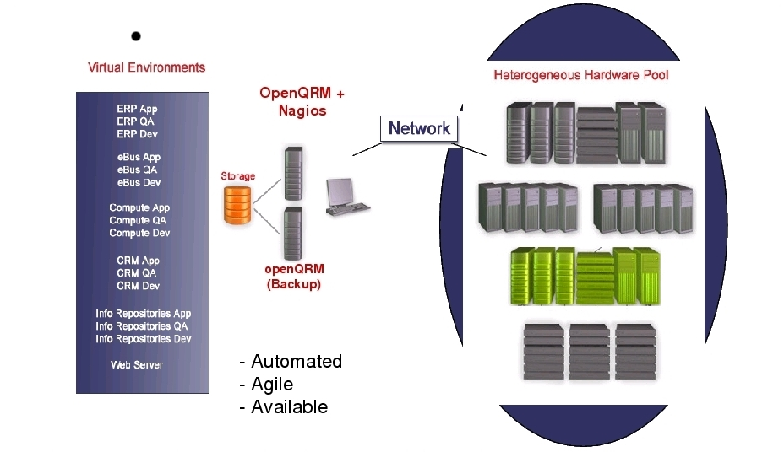
Source: Qlusters
Notes:
We basically have 3 different layers here.
On the right side we see our server hardware. These are our computing-power resources. On this systems we can deploy our VE's according to the users-needs.
The VE's consisting of the boot- and fs-image of our servers are located on the left side, on one or more storage-servers.
In the center we have the openQRM-server, possible in a HA-setup with one or more host-stand-by's, to manage the provisioning, monitoring and management.
Now system-management starts to get a lot more straight-forward and flexible. The monitoring sub-system gives a direct overview about the available resources, the storage-environment holds all the server-images, we have a central point of backup, crashed hardware can be detected immediately and replaced without service interruption by using several layers of high-availability.
Since the data-center now is scalable and manage-able the overall situation seems a lot more satisfying to me :)
Let's speak about the storage environment first ....

Slide 14
Support for non-Linux Operation Systems
heterogeneous data-centers
not limited to Linux-only
supports Linux, Windows, FreeBSD and Solaris (X86 and Sparc)
OS-support via additional plug-ins
generic management system and GUI
Notes:
The openQRM community has created plug-ins to support different, non-Linux Operation Systems like FreeBSD, Solaris (X86) and Solaris (SPARC). These plug-ins providing tools for image creation and net-booting root-file system images created from those non-Linux server Operation Systems. Installing one of those plug-ins allows the system-administrator to manage and monitor Virtual Environments from the specific Operation Systems in the same way than the Linux-Boxes. Since most of the modern data-centers are heterogeneous (different system architectures, different Operation Systems, etc.) being “open” and not limited to only one Operation System is another key-feature of openQRM.

Slide 15
Getting openQRM
openqrm.sf.net
RHEL 3 , RHEL 4 , Fedora, Suse 10 , Debian packages are available
MySQL Database
DHCPd & tftpboot included
Also install the appropriate plugins
  Qemu/Vserver/Xen/VmWare
Notes:
OpenQRM implements a logical layer for servers and services called virtual environments.
In short named VE.
Those VE's are a combinations of a boot-image, a filesystem-image and provisioning meta-data. The provisioning data consist of the user-configuration for a server/service e.g. When do i need the resource ? How many nodes it needs ? Which type and speed of CPU*s and how many RAM it wants ? Should it be HA ? According to those informations a VE can be started/stopped with a sinlge mouse-click. The openQRM-servers then selects an idle resource (an available, free system) to deploy the server and its services on.
The virtual environment layer allows the sysadmin e.g. To rapidly deploy servers within minutes, to test a kernel upgrade on a cloned VE before going into production, to reduce the resources for under-utilized systems and much more.
So let's have a look. How does our environment looks now by using openQRM ?

Slide 16
Installing openQRM
Install the packages
Make sure mysql runs
Qrm-installer
Connect to http://localhost:8080/
Notes:
OpenQRM implements a logical layer for servers and services called virtual environments.
In short named VE.
Those VE's are a combinations of a boot-image, a filesystem-image and provisioning meta-data. The provisioning data consist of the user-configuration for a server/service e.g. When do i need the resource ? How many nodes it needs ? Which type and speed of CPU*s and how many RAM it wants ? Should it be HA ? According to those informations a VE can be started/stopped with a sinlge mouse-click. The openQRM-servers then selects an idle resource (an available, free system) to deploy the server and its services on.
The virtual environment layer allows the sysadmin e.g. To rapidly deploy servers within minutes, to test a kernel upgrade on a cloned VE before going into production, to reduce the resources for under-utilized systems and much more.
So let's have a look. How does our environment looks now by using openQRM ?

Slide 17
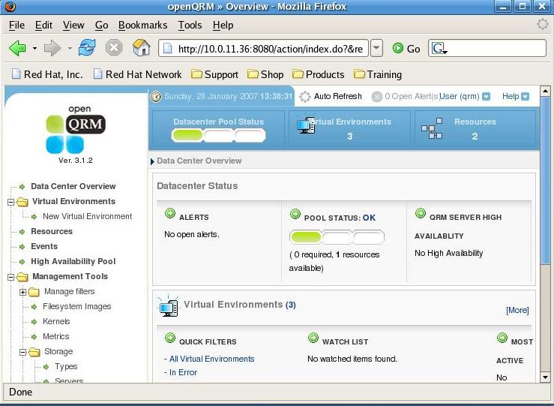
Using openQRM
Notes:
OpenQRM implements a logical layer for servers and services called virtual environments.
In short named VE.
Those VE's are a combinations of a boot-image, a filesystem-image and provisioning meta-data. The provisioning data consist of the user-configuration for a server/service e.g. When do i need the resource ? How many nodes it needs ? Which type and speed of CPU*s and how many RAM it wants ? Should it be HA ? According to those informations a VE can be started/stopped with a sinlge mouse-click. The openQRM-servers then selects an idle resource (an available, free system) to deploy the server and its services on.
The virtual environment layer allows the sysadmin e.g. To rapidly deploy servers within minutes, to test a kernel upgrade on a cloned VE before going into production, to reduce the resources for under-utilized systems and much more.
So let's have a look. How does our environment looks now by using openQRM ?

Slide 18
OpenQRM Concepts
Storage Server
Filesystem Image
Boot Image
Virtual Environment
Notes:
OpenQRM implements a logical layer for servers and services called virtual environments.
In short named VE.
Those VE's are a combinations of a boot-image, a filesystem-image and provisioning meta-data. The provisioning data consist of the user-configuration for a server/service e.g. When do i need the resource ? How many nodes it needs ? Which type and speed of CPU*s and how many RAM it wants ? Should it be HA ? According to those informations a VE can be started/stopped with a sinlge mouse-click. The openQRM-servers then selects an idle resource (an available, free system) to deploy the server and its services on.
The virtual environment layer allows the sysadmin e.g. To rapidly deploy servers within minutes, to test a kernel upgrade on a cloned VE before going into production, to reduce the resources for under-utilized systems and much more.
So let's have a look. How does our environment looks now by using openQRM ?

Slide 19
1 : Storage Server
Centralized storage for fs-images on either NFS or ISCSI , AOE , ...
automatic fs-image creation
fs-image management tools e.g. create, remove, clone
support for local root-file-systems through local-deployment plug-in
Notes:
The normal way to provisioning a VE is through netbooting the servers root-filesystem. OpenQRM provides tow different kinds of netboot-deployment: One is via NFSROOT, the other is via ISCSI-boot. While NFSROOT booting is common in linux- and unix environments booting from an ISCSI-server, or better an ISCSI-target, is a quite unique feature.
A special initrd, created during boot-image creation, handles the net-booting in openQRM. It takes care to detect the nodes hardware, to load all required kernel-modules and to mount the filesystem either via NFS or ISCSI.
The filesystems in openQRM can be created in 2 different ways. One, is by running a fs-image management tool, the other is by automatic-image-creation-on-the-fly. Think of it like cloning an existing server or fs-image during booting it. Before mounting the root-filesystem in the initrd the automatic-image-creation mechanism will create a clone of a given golden-image or a running server. After this cloning procedure it will immediately start the system using the new root-fs.
For all who more relay on local-installed systems openQRM also provides a local-deployment plugin which allows to install systems automatically from a given golden-image.

Slide 20
Creating Storage Server
From the gui
From the cli
  ./qrm-cli -u qrm -p qrm storage add -n NFS -t NFS -i 10.0.11.35 -c "QRMSRC"
Notes:
The normal way to provisioning a VE is through netbooting the servers root-filesystem. OpenQRM provides tow different kinds of netboot-deployment: One is via NFSROOT, the other is via ISCSI-boot. While NFSROOT booting is common in linux- and unix environments booting from an ISCSI-server, or better an ISCSI-target, is a quite unique feature.
A special initrd, created during boot-image creation, handles the net-booting in openQRM. It takes care to detect the nodes hardware, to load all required kernel-modules and to mount the filesystem either via NFS or ISCSI.
The filesystems in openQRM can be created in 2 different ways. One, is by running a fs-image management tool, the other is by automatic-image-creation-on-the-fly. Think of it like cloning an existing server or fs-image during booting it. Before mounting the root-filesystem in the initrd the automatic-image-creation mechanism will create a clone of a given golden-image or a running server. After this cloning procedure it will immediately start the system using the new root-fs.
For all who more relay on local-installed systems openQRM also provides a local-deployment plugin which allows to install systems automatically from a given golden-image.

Slide 21
2: Filesystem Image
From an existing machine (golden image)
Generated Template
Chroot Install
Automagic install
Notes:
The advanced image management allows sharing the servers root-filesystem between resources.That means, a VE can be assigned to more than just one node by provisioning it as a multi-server which uses a single root-file system (shared-image/SSI). This dramatically reduces administration effort because configuration-changes, security updates and patches just need to be applied to a single server and immediately happen on the complete Cluster.This feature is also very useful for clustering-on-demand. Clusters can be formed by using a single root-filesystem and setting the minimum and maximum numbers of nodes. According user-defined metrics e.g. memory-usage, cpu-utilization, or others, openQRM will then load-balance the cluster automatically e.g. By adding and removing nodes. Of course this can be also manually managed by the system-administrator.
Ok, we heard a lot now about openQRM.
Of course introducing a new technology in a production data-center always needs a good plan.
What we do not want is to discover after some integration time that actually the new tool does not fit our needs.
That is a good point. In openQRM migration is smooth and without any risk because of a feature called the easy-migration explained in the next slide.

Slide 22
Creating a Filesystem Image
From the qrm-cli
./qrm-filesystem-image create -u qrm -p qrm -s FC6INSTAL -l 10.0.11.172:/ -t /vhosts/FC6INSTALL
Notes:
The advanced image management allows sharing the servers root-filesystem between resources.That means, a VE can be assigned to more than just one node by provisioning it as a multi-server which uses a single root-file system (shared-image/SSI). This dramatically reduces administration effort because configuration-changes, security updates and patches just need to be applied to a single server and immediately happen on the complete Cluster.This feature is also very useful for clustering-on-demand. Clusters can be formed by using a single root-filesystem and setting the minimum and maximum numbers of nodes. According user-defined metrics e.g. memory-usage, cpu-utilization, or others, openQRM will then load-balance the cluster automatically e.g. By adding and removing nodes. Of course this can be also manually managed by the system-administrator.
Ok, we heard a lot now about openQRM.
Of course introducing a new technology in a production data-center always needs a good plan.
What we do not want is to discover after some integration time that actually the new tool does not fit our needs.
That is a good point. In openQRM migration is smooth and without any risk because of a feature called the easy-migration explained in the next slide.

Slide 23
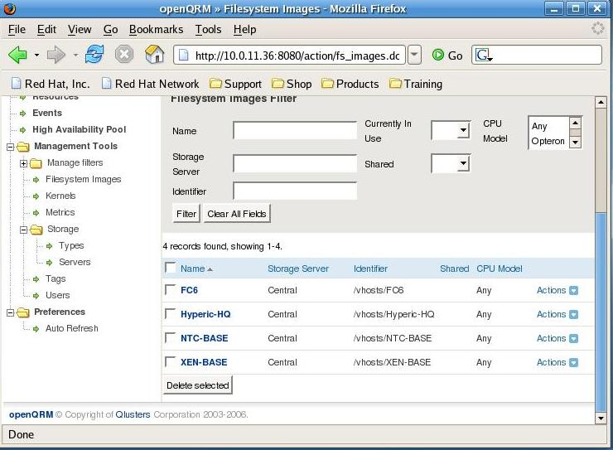
Creating a Filesystem Image
Notes:
The advanced image management allows sharing the servers root-filesystem between resources.That means, a VE can be assigned to more than just one node by provisioning it as a multi-server which uses a single root-file system (shared-image/SSI). This dramatically reduces administration effort because configuration-changes, security updates and patches just need to be applied to a single server and immediately happen on the complete Cluster.This feature is also very useful for clustering-on-demand. Clusters can be formed by using a single root-filesystem and setting the minimum and maximum numbers of nodes. According user-defined metrics e.g. memory-usage, cpu-utilization, or others, openQRM will then load-balance the cluster automatically e.g. By adding and removing nodes. Of course this can be also manually managed by the system-administrator.
Ok, we heard a lot now about openQRM.
Of course introducing a new technology in a production data-center always needs a good plan.
What we do not want is to discover after some integration time that actually the new tool does not fit our needs.
That is a good point. In openQRM migration is smooth and without any risk because of a feature called the easy-migration explained in the next slide.

Slide 24
Shared filesystem-images
shared fs-images provide SSI
(single system image)
all resources within a VE are using the same root-file-system
single point for updates and patches
provides easy-clustering on demand
useful for Web-Farms
useful for HPC-computing
Notes:
The advanced image management allows sharing the servers root-filesystem between resources.That means, a VE can be assigned to more than just one node by provisioning it as a multi-server which uses a single root-file system (shared-image/SSI). This dramatically reduces administration effort because configuration-changes, security updates and patches just need to be applied to a single server and immediately happen on the complete Cluster.This feature is also very useful for clustering-on-demand. Clusters can be formed by using a single root-filesystem and setting the minimum and maximum numbers of nodes. According user-defined metrics e.g. memory-usage, cpu-utilization, or others, openQRM will then load-balance the cluster automatically e.g. By adding and removing nodes. Of course this can be also manually managed by the system-administrator.
Ok, we heard a lot now about openQRM.
Of course introducing a new technology in a production data-center always needs a good plan.
What we do not want is to discover after some integration time that actually the new tool does not fit our needs.
That is a good point. In openQRM migration is smooth and without any risk because of a feature called the easy-migration explained in the next slide.

Slide 25
3: Boot Image
Kernel to boot the different platforms with.
Tied to the hardware => Not to the Service
./qrm-boot-image create -u qrm -p qrm -o -k 2.6.9-22.EL -b qrm -y qrm
Creating boot-image qrm from kernel version 2.6.9-22.EL
Copying the kernel files
Creating the initrd file
Successfully created boot-image qrm
Notes:
The advanced image management allows sharing the servers root-filesystem between resources.That means, a VE can be assigned to more than just one node by provisioning it as a multi-server which uses a single root-file system (shared-image/SSI). This dramatically reduces administration effort because configuration-changes, security updates and patches just need to be applied to a single server and immediately happen on the complete Cluster.This feature is also very useful for clustering-on-demand. Clusters can be formed by using a single root-filesystem and setting the minimum and maximum numbers of nodes. According user-defined metrics e.g. memory-usage, cpu-utilization, or others, openQRM will then load-balance the cluster automatically e.g. By adding and removing nodes. Of course this can be also manually managed by the system-administrator.
Ok, we heard a lot now about openQRM.
Of course introducing a new technology in a production data-center always needs a good plan.
What we do not want is to discover after some integration time that actually the new tool does not fit our needs.
That is a good point. In openQRM migration is smooth and without any risk because of a feature called the easy-migration explained in the next slide.

Slide 26
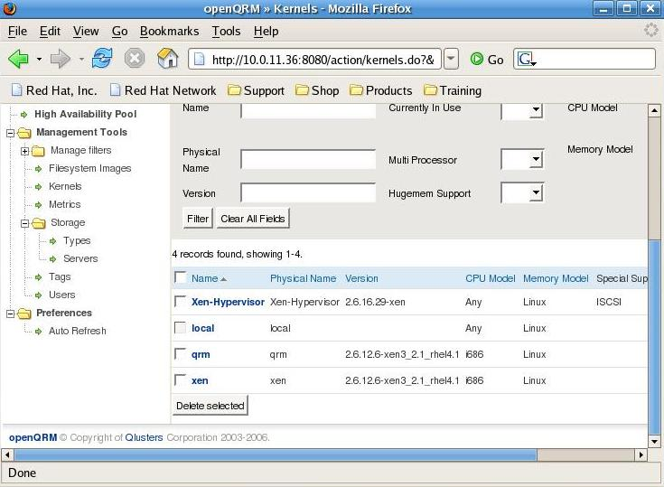
Boot Images
Notes:
The advanced image management allows sharing the servers root-filesystem between resources.That means, a VE can be assigned to more than just one node by provisioning it as a multi-server which uses a single root-file system (shared-image/SSI). This dramatically reduces administration effort because configuration-changes, security updates and patches just need to be applied to a single server and immediately happen on the complete Cluster.This feature is also very useful for clustering-on-demand. Clusters can be formed by using a single root-filesystem and setting the minimum and maximum numbers of nodes. According user-defined metrics e.g. memory-usage, cpu-utilization, or others, openQRM will then load-balance the cluster automatically e.g. By adding and removing nodes. Of course this can be also manually managed by the system-administrator.
Ok, we heard a lot now about openQRM.
Of course introducing a new technology in a production data-center always needs a good plan.
What we do not want is to discover after some integration time that actually the new tool does not fit our needs.
That is a good point. In openQRM migration is smooth and without any risk because of a feature called the easy-migration explained in the next slide.

Slide 27
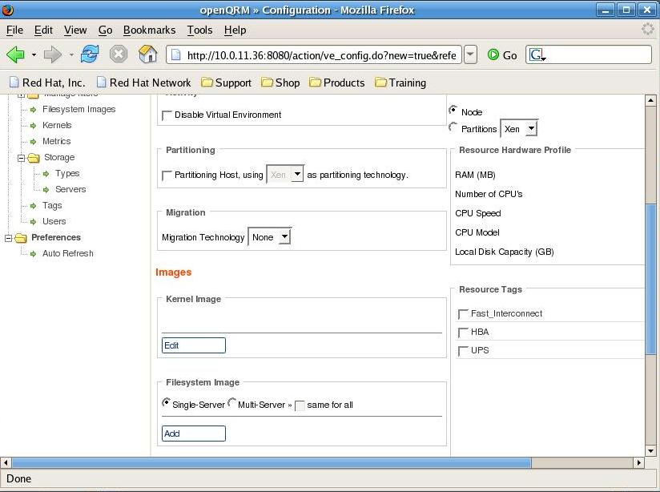
Defining A Virtual Environment
Notes:
The advanced image management allows sharing the servers root-filesystem between resources.That means, a VE can be assigned to more than just one node by provisioning it as a multi-server which uses a single root-file system (shared-image/SSI). This dramatically reduces administration effort because configuration-changes, security updates and patches just need to be applied to a single server and immediately happen on the complete Cluster.This feature is also very useful for clustering-on-demand. Clusters can be formed by using a single root-filesystem and setting the minimum and maximum numbers of nodes. According user-defined metrics e.g. memory-usage, cpu-utilization, or others, openQRM will then load-balance the cluster automatically e.g. By adding and removing nodes. Of course this can be also manually managed by the system-administrator.
Ok, we heard a lot now about openQRM.
Of course introducing a new technology in a production data-center always needs a good plan.
What we do not want is to discover after some integration time that actually the new tool does not fit our needs.
That is a good point. In openQRM migration is smooth and without any risk because of a feature called the easy-migration explained in the next slide.

Slide 28
Initial boot of a datacenter node
Node is empty
Boots from network (dhcp / tftp)
Idle Resource
Notes:
The advanced image management allows sharing the servers root-filesystem between resources.That means, a VE can be assigned to more than just one node by provisioning it as a multi-server which uses a single root-file system (shared-image/SSI). This dramatically reduces administration effort because configuration-changes, security updates and patches just need to be applied to a single server and immediately happen on the complete Cluster.This feature is also very useful for clustering-on-demand. Clusters can be formed by using a single root-filesystem and setting the minimum and maximum numbers of nodes. According user-defined metrics e.g. memory-usage, cpu-utilization, or others, openQRM will then load-balance the cluster automatically e.g. By adding and removing nodes. Of course this can be also manually managed by the system-administrator.
Ok, we heard a lot now about openQRM.
Of course introducing a new technology in a production data-center always needs a good plan.
What we do not want is to discover after some integration time that actually the new tool does not fit our needs.
That is a good point. In openQRM migration is smooth and without any risk because of a feature called the easy-migration explained in the next slide.

Slide 29
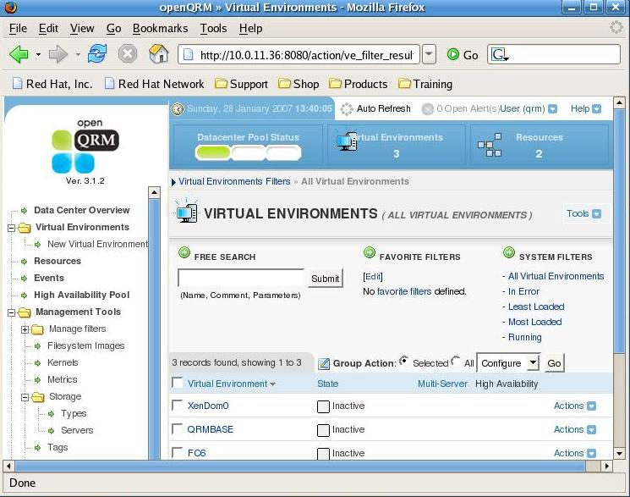
Deployment of a service
Notes:
The advanced image management allows sharing the servers root-filesystem between resources.That means, a VE can be assigned to more than just one node by provisioning it as a multi-server which uses a single root-file system (shared-image/SSI). This dramatically reduces administration effort because configuration-changes, security updates and patches just need to be applied to a single server and immediately happen on the complete Cluster.This feature is also very useful for clustering-on-demand. Clusters can be formed by using a single root-filesystem and setting the minimum and maximum numbers of nodes. According user-defined metrics e.g. memory-usage, cpu-utilization, or others, openQRM will then load-balance the cluster automatically e.g. By adding and removing nodes. Of course this can be also manually managed by the system-administrator.
Ok, we heard a lot now about openQRM.
Of course introducing a new technology in a production data-center always needs a good plan.
What we do not want is to discover after some integration time that actually the new tool does not fit our needs.
That is a good point. In openQRM migration is smooth and without any risk because of a feature called the easy-migration explained in the next slide.

Slide 30
Deployment of a service
Idle node reboots
Chosen kernel boots
Minimal initrd mounts filesystem
Chroots
Starts Virtual Environment
Notes:
The advanced image management allows sharing the servers root-filesystem between resources.That means, a VE can be assigned to more than just one node by provisioning it as a multi-server which uses a single root-file system (shared-image/SSI). This dramatically reduces administration effort because configuration-changes, security updates and patches just need to be applied to a single server and immediately happen on the complete Cluster.This feature is also very useful for clustering-on-demand. Clusters can be formed by using a single root-filesystem and setting the minimum and maximum numbers of nodes. According user-defined metrics e.g. memory-usage, cpu-utilization, or others, openQRM will then load-balance the cluster automatically e.g. By adding and removing nodes. Of course this can be also manually managed by the system-administrator.
Ok, we heard a lot now about openQRM.
Of course introducing a new technology in a production data-center always needs a good plan.
What we do not want is to discover after some integration time that actually the new tool does not fit our needs.
That is a good point. In openQRM migration is smooth and without any risk because of a feature called the easy-migration explained in the next slide.

Slide 31
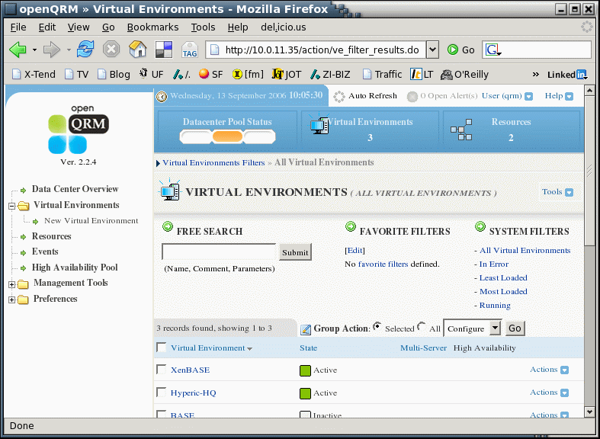
Deployment of a service
Notes:
The advanced image management allows sharing the servers root-filesystem between resources.That means, a VE can be assigned to more than just one node by provisioning it as a multi-server which uses a single root-file system (shared-image/SSI). This dramatically reduces administration effort because configuration-changes, security updates and patches just need to be applied to a single server and immediately happen on the complete Cluster.This feature is also very useful for clustering-on-demand. Clusters can be formed by using a single root-filesystem and setting the minimum and maximum numbers of nodes. According user-defined metrics e.g. memory-usage, cpu-utilization, or others, openQRM will then load-balance the cluster automatically e.g. By adding and removing nodes. Of course this can be also manually managed by the system-administrator.
Ok, we heard a lot now about openQRM.
Of course introducing a new technology in a production data-center always needs a good plan.
What we do not want is to discover after some integration time that actually the new tool does not fit our needs.
That is a good point. In openQRM migration is smooth and without any risk because of a feature called the easy-migration explained in the next slide.

Slide 32
Managing A Node
Start
Stop
Put in Maintenance
Notes:
The advanced image management allows sharing the servers root-filesystem between resources.That means, a VE can be assigned to more than just one node by provisioning it as a multi-server which uses a single root-file system (shared-image/SSI). This dramatically reduces administration effort because configuration-changes, security updates and patches just need to be applied to a single server and immediately happen on the complete Cluster.This feature is also very useful for clustering-on-demand. Clusters can be formed by using a single root-filesystem and setting the minimum and maximum numbers of nodes. According user-defined metrics e.g. memory-usage, cpu-utilization, or others, openQRM will then load-balance the cluster automatically e.g. By adding and removing nodes. Of course this can be also manually managed by the system-administrator.
Ok, we heard a lot now about openQRM.
Of course introducing a new technology in a production data-center always needs a good plan.
What we do not want is to discover after some integration time that actually the new tool does not fit our needs.
That is a good point. In openQRM migration is smooth and without any risk because of a feature called the easy-migration explained in the next slide.

Slide 33
Easy-migration
openQRM adapts to the existing data-center environment
(not the other way around)
step-by-step migration to openQRM environment
Install openqrmplugin on existing system
moving on from easy-migration to full virtualized data-center
Notes:
openQRM supports a “smooth” migration capability by a core feature called the “easy-migration”. Easy-migration allows the system-administrator to integrate local-installed systems into the openQRM-management server. The first integration step is to just install the openQRM-daemons to existing, local installed servers. This will result in a monitoring-only environment without actually automatic provisioning. Next step is to enable network-boot in the servers BIOS but still remaining with booting from the local-harddisk. This means the resource can be net-booted to be available for other VE's but when the “local” VE is provisioned it will still boot from the local disk.
The third step is imaging the local server and switch to fully net-booting and automatic provisioning.
At any time it is possible to switch-back to previous migration steps by re-assigning those systems to “origin” local-boot again.
Now let's talk about high-availability ....

Slide 34
High-Availability
(for the managed nodes)
High-Availability in 2(3) layers
Hardware fail-over
VE restarts on available resource from the high- availability pool . (This is a restart, not a fail-over)
Application fail-over
Application fails over to hot-standby system
(No Magic Cauldron)
(Proprietary Application live-migration (TAM)
Application can move to another system during run-time)
Notes:
We will now talk a bit about the high-availability features for the managed nodes by openQRM.
Here we have HA in 3 different layers.
1) hardware fail-over.
Hardware fail-over can be activated for a VE by a single mouse-click. In case of an error the openQRM server then will select a free resource from the HA-pool to restart the VE on.
2) application fail-over.
In case even a short fail-over time is not acceptable an application running on a VE can be setup to fail-over to another hot-standby VE. This feature is implemented as a plugin called app-ha. Another option for instant fail-over of an application service is xha provided as an additional add-on by Qlusters. It support zero-downtime and failing-over including the memory content of the application.
3) application live-migration.
A plugin called TAM additionally supports to move any application to another system during run-time (p2p, p2v).
All three HA mechanisms are providing a well scalable functionality for the sysadmin to configure and manage the servers and services according to given SLA's.
Now Virtualization ! A big thing in the today's data-center world .....

Slide 35
Partitioning
seamlessly manages physical servers and virtual machines (Partitions)
supports all mainstream virtualization technologies as VMware, Xen, Qemu and Linux-VServer
Partition-engine conforms all different kinds of virtualization
Partition plug-ins provide generic resource from type “partition”
Notes:
openQRM manages physical servers and virtual machines, seamlessly and automatically. In the openQRM-server a generic, logical layer, called “partition engine”, conforms all different kinds of virtualization technologies. This partition-engine provides a virtualized server-resource from the type “partition” which is then used in the same way as a physical system. Plug-ins for all mainstream virtualization technologies like VMWare, Xen, Linux-VServer and Qemu are available for openQRM. Those plug-ins take care to unify the partition capabilities to provide a generic resource from the type of the used partition-component, e.g. the Xen plug-in provides resources type “Xen-partition”. Which type of resource a Virtual Environment should use is configured in the Virtual Environments configuration page. This generic partition layer enables the system-administrator to decide at any time if a VE should be running on “real/physical” systems, on VMWare partitions, Xen-partitions, Linux-VServer partitions or on Qemu partitions without the need to apply any configuration changes to the file system-images used by the VE.
You think we are talking about Linux “only” the whole time ?
No, no. openQRM also supports other, non-Linux OS's.

Slide 36
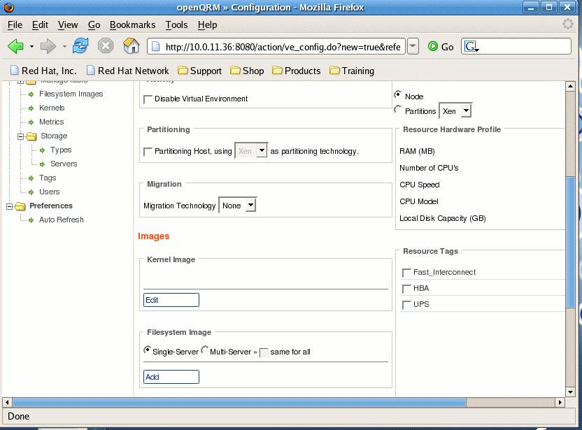
Configuring A Partitionned Host
Notes:
openQRM manages physical servers and virtual machines, seamlessly and automatically. In the openQRM-server a generic, logical layer, called “partition engine”, conforms all different kinds of virtualization technologies. This partition-engine provides a virtualized server-resource from the type “partition” which is then used in the same way as a physical system. Plug-ins for all mainstream virtualization technologies like VMWare, Xen, Linux-VServer and Qemu are available for openQRM. Those plug-ins take care to unify the partition capabilities to provide a generic resource from the type of the used partition-component, e.g. the Xen plug-in provides resources type “Xen-partition”. Which type of resource a Virtual Environment should use is configured in the Virtual Environments configuration page. This generic partition layer enables the system-administrator to decide at any time if a VE should be running on “real/physical” systems, on VMWare partitions, Xen-partitions, Linux-VServer partitions or on Qemu partitions without the need to apply any configuration changes to the file system-images used by the VE.
You think we are talking about Linux “only” the whole time ?
No, no. openQRM also supports other, non-Linux OS's.

Slide 37
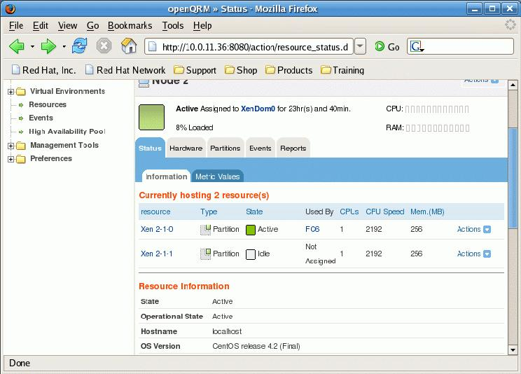
Managing Partitions
Notes:
openQRM manages physical servers and virtual machines, seamlessly and automatically. In the openQRM-server a generic, logical layer, called “partition engine”, conforms all different kinds of virtualization technologies. This partition-engine provides a virtualized server-resource from the type “partition” which is then used in the same way as a physical system. Plug-ins for all mainstream virtualization technologies like VMWare, Xen, Linux-VServer and Qemu are available for openQRM. Those plug-ins take care to unify the partition capabilities to provide a generic resource from the type of the used partition-component, e.g. the Xen plug-in provides resources type “Xen-partition”. Which type of resource a Virtual Environment should use is configured in the Virtual Environments configuration page. This generic partition layer enables the system-administrator to decide at any time if a VE should be running on “real/physical” systems, on VMWare partitions, Xen-partitions, Linux-VServer partitions or on Qemu partitions without the need to apply any configuration changes to the file system-images used by the VE.
You think we are talking about Linux “only” the whole time ?
No, no. openQRM also supports other, non-Linux OS's.

Slide 38
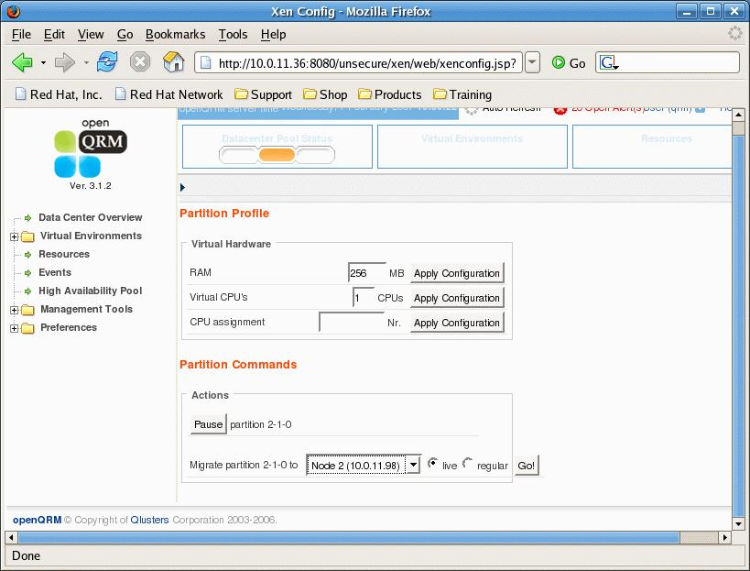
Managing Partitions
Notes:
openQRM manages physical servers and virtual machines, seamlessly and automatically. In the openQRM-server a generic, logical layer, called “partition engine”, conforms all different kinds of virtualization technologies. This partition-engine provides a virtualized server-resource from the type “partition” which is then used in the same way as a physical system. Plug-ins for all mainstream virtualization technologies like VMWare, Xen, Linux-VServer and Qemu are available for openQRM. Those plug-ins take care to unify the partition capabilities to provide a generic resource from the type of the used partition-component, e.g. the Xen plug-in provides resources type “Xen-partition”. Which type of resource a Virtual Environment should use is configured in the Virtual Environments configuration page. This generic partition layer enables the system-administrator to decide at any time if a VE should be running on “real/physical” systems, on VMWare partitions, Xen-partitions, Linux-VServer partitions or on Qemu partitions without the need to apply any configuration changes to the file system-images used by the VE.
You think we are talking about Linux “only” the whole time ?
No, no. openQRM also supports other, non-Linux OS's.

Slide 39
Managing Partitions
Xen plugin is based on the VMWare one
Stop / start
Pause
Change memory config
Live Migrate
Notes:
openQRM manages physical servers and virtual machines, seamlessly and automatically. In the openQRM-server a generic, logical layer, called “partition engine”, conforms all different kinds of virtualization technologies. This partition-engine provides a virtualized server-resource from the type “partition” which is then used in the same way as a physical system. Plug-ins for all mainstream virtualization technologies like VMWare, Xen, Linux-VServer and Qemu are available for openQRM. Those plug-ins take care to unify the partition capabilities to provide a generic resource from the type of the used partition-component, e.g. the Xen plug-in provides resources type “Xen-partition”. Which type of resource a Virtual Environment should use is configured in the Virtual Environments configuration page. This generic partition layer enables the system-administrator to decide at any time if a VE should be running on “real/physical” systems, on VMWare partitions, Xen-partitions, Linux-VServer partitions or on Qemu partitions without the need to apply any configuration changes to the file system-images used by the VE.
You think we are talking about Linux “only” the whole time ?
No, no. openQRM also supports other, non-Linux OS's.

Slide 40
Road-map
Support for KVM
automatic provisioning and deployment by user-request
support for VMware ESX
enhanced windows support through ISCSI-boot
further integration with other useful data-center management components
Second Life Integration
Notes:
Since managing complete data-centers is a complex task which involves all kind of different scenarios, components and mechanisms there are lots of topics for the future road map of openQRM. While the openQRM-project just released the distributed Nagios-plug-in which not only supports to monitor your openQRM managed nodes via Nagios but also manage other, existing Nagios-server, the next releases will include support for VMware ESX, an enhanced support for Windows operation systems via Iscsi-boot, an additional scheduler to deploy VE's at a specific date and time and a local-deploy plug-in to install local systems from golden-images. The next phase of openQRM will be a fully-integrated, new provisioning system plug-in which enables automatic deployment by end-user-requests. In this scenario the user requests a resource through a separated web-portal. Then the system-administrator just has to approve the request and openQRM will automatically deploy and start a system based on the users-configuration. Through an integrated mailing-notifier the end-user then will be informed how to access the requested resources.

Slide 41
Summary and conclusion
Extensible open-architecture
Unique features and lots of automatism
Better data-center performance through better scalability, more flexibility and dynamic management
Supports all mainstream virtualization technologies
Supports non-Linux OS'es
Smooth integration phase
Notes:
The open-architecture of openQRM, its unique features combined with lots of automatism, and flexibility in data-center management results in better scalability, better performance, faster deployment and it decreases services down-times and maintainance of the infrastructure. openQRM is a quite new project which already raised a lot of attention. The generic approach to integrate and implement existing system-management components into a unified server and GUI drives IT-management away from dependencies by e.g. vendors, specialists (who may leave the company at some time) or special “in-house” created tools and scripts through a certified, standardized and open data-center management platform.
Speaking about Virtualization again. OpenQRM supports all mainstream virtualization technologies. Even more, it conforms all those different technologies and unifies them into a generic partition-layer.
We will never find a linux-only data-center !
So, support for non-linux operations systems is a must for a data-center management system. OpenQRM manages Linux, Windows, Freebsd and Solaris operation systems in a transparent way within a single user-interface.
And last but not least openQRM provides a smooth integration phase without any risks.

Slide 42
Further Reading:
Kris Buytaert <Kris.Buytaert@inuits.be>
http://www.krisbuytaert.be/blog/
http://mattinaction.blogspot.com/
openQRM Home page:
http://www.openqrm.org
openQRM Project page:
http://sourceforge.net/projects/openqrm

Slide 43

Contact:
```
Kris Buytaert <Kris.Buytaert@inuits.be>
Further Reading
http://www.krisbuytaert.be/blog/
http://wiki.xensource.com/

Slide 44


Time for questions
?
!
Notes:
There is now the time for questions.
If there is any more informations you need or if still something is unclear about openQRM feel free to ask your question now and i will try my best to answer it.

Slide 45
Live Migration with openQRM
“Live Demo”
Notes:
openQRM manages physical servers and virtual machines, seamlessly and automatically. In the openQRM-server a generic, logical layer, called “partition engine”, conforms all different kinds of virtualization technologies. This partition-engine provides a virtualized server-resource from the type “partition” which is then used in the same way as a physical system. Plug-ins for all mainstream virtualization technologies like VMWare, Xen, Linux-VServer and Qemu are available for openQRM. Those plug-ins take care to unify the partition capabilities to provide a generic resource from the type of the used partition-component, e.g. the Xen plug-in provides resources type “Xen-partition”. Which type of resource a Virtual Environment should use is configured in the Virtual Environments configuration page. This generic partition layer enables the system-administrator to decide at any time if a VE should be running on “real/physical” systems, on VMWare partitions, Xen-partitions, Linux-VServer partitions or on Qemu partitions without the need to apply any configuration changes to the file system-images used by the VE.
You think we are talking about Linux “only” the whole time ?
No, no. openQRM also supports other, non-Linux OS's.

Slide 46
High-Availability
(for the openQRM-server)
designed to provide high-availability
distributed architecture
using a high-available database
openQRM high-availability setup
using one or more host-standbys
avoids single-point-of-failures (SPOF)
Notes:
High-availability in the openQRM environment needs to be separated into 2 areas, one is high-availability for the openQRM-server itself since it manages the complete data-center. The other is high-availability for the managed servers and services.
Let's start with the HA for the server.
The openQRM server is designed for high-availabilioy and to avoid SPOS's. Its distributed architecture allows the sysadmin to spread the openQRM-services across multiple nodes e.g. It makes sense in an high-available setup to use a external, which means remote, high-available myslqd database. Also other services like the tftp-server can be running on different servers as the openQRM-server itself. A distributed setup also serves better performance and scalability. The main services of openQRM can be installed in a high-available manner by using a passive, hot-standby which takes over the processes of the active server in case of errors.
So, our openQRM-server seems to be save. What is about the managed nodes running the VE's ?

