Slide 1
The barriers for predictive control in practice:
1. Complexity and uncertain disturbances;
More accurate prediction, adaptive control.
2. Computational speed of real time optimization;
Longer control horizon.
3. Sensor placement and data availability;
More efficient communication system (not our business), use the least amount of data.
4. (Human interaction and integration with existing systems).

Slide 2
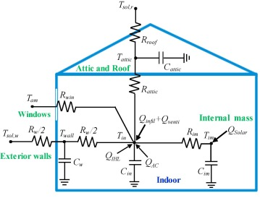
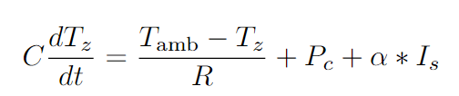

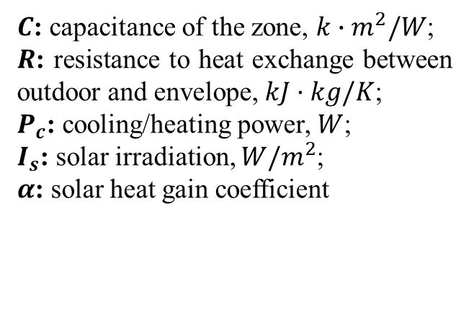
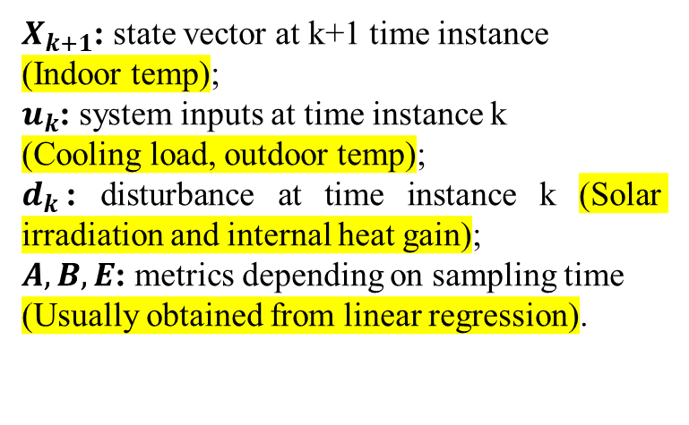
$C$: capacitance of the zone, $k{∙m}^{2}/W$;
$R$: resistance to heat exchange between outdoor and envelope, $kJ·kg/K$;
$P_{c}$: cooling/heating power, $W$;
$I_{s}$: solar irradiation, $W/m^{2}$;
$α$: solar heat gain coefficient
Convert into discrete state-space form
$X_{k+1}$: state vector at k+1 time instance
(Indoor temp);
$u_{k}$: system inputs at time instance k
(Cooling load, outdoor temp);
$d_{k}$: disturbance at time instance k (Solar irradiation and internal heat gain);
$A,B,E$: metrics depending on sampling time (Usually obtained from linear regression).
Relatively low accuracy due to linearity;
Hard to establish RC equation if more zones;
Disturbance is hard to measure.

Slide 3

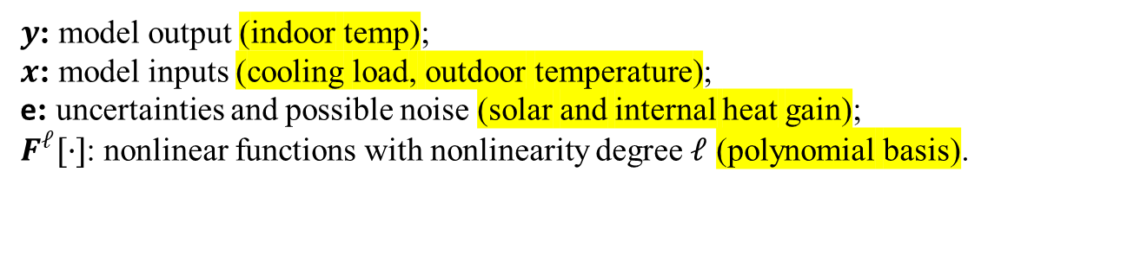
System Identification
Nonlinear Autoregressive models with Moving Average and Exogenous Input (NARMAX):
$y$: model output (indoor temp);
$x$: model inputs (cooling load, outdoor temperature);
e: uncertainties and possible noise (solar and internal heat gain);
$F^{ℓ}[·]$: nonlinear functions with nonlinearity degree $ℓ$ (polynomial basis).
Polynomial basis:

Slide 4
Governing Equation Inferring
Parameter estimation
Measurement Inputs
Nonlinear basis
FROLS
HP cooling load (kWh)
Outdoor T (°C)
Indoor T (°C)
Prediction Output
Polynomial basis
Indoor T (°C)
CatBoostRegressor
Feedback as inputs and residual estimation

Slide 5




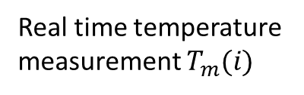

Predictive planning controller
(6 hours scheduling horizon)
Formulate and solve optimization problem
High level optimal planning solver
Control signal $u(j)$
for $j$ in [0, 360, 15]
Follow the planning control signal
HP + PCM storage
New control signal $u′(i)$
No
Is the thermal comfort violated?
Cooling energy $Q_{c}$
PID controller
Yes
Building
Real time temperature measurement $T_{m}(i)$
for $i$ in [0, 360, 5]
Indoor temperature sensor
Local regulator

Slide 6

Polynomial basis:
A good explanation of CatBoostRegressor:
https://towardsdatascience.com/catboost-regression-in-6-minutes-3487f3e5b329
Time series data in
$y=aX_{1}+\text{b}X_{2}\text{+}\text{c}X_{1}^{2}+dX_{2}^{2}+fX_{1}X_{2}+E$
Estimate parameters, ‘E’ iteratively
y, X1, X2
Forward Regression Orthogonal Least Squares (FROLS):
Start with a set of candidate basis functions (or features) that can be used to model the system.
Iteratively select the terms that, when added to the model, provides the greatest reduction in the residual sum of squares (RSS).
At each step, use orthogonalization methods to orthogonalize the new terms with respect to the already selected terms, and evaluate the contribution of the new term.
Continue the process until a stopping criterion is met.
The final model is a linear combination of the selected nonlinear terms.

Slide 7
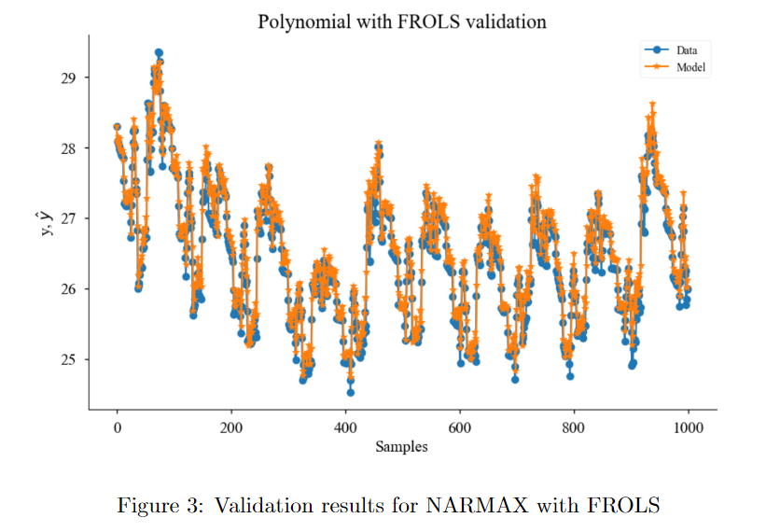
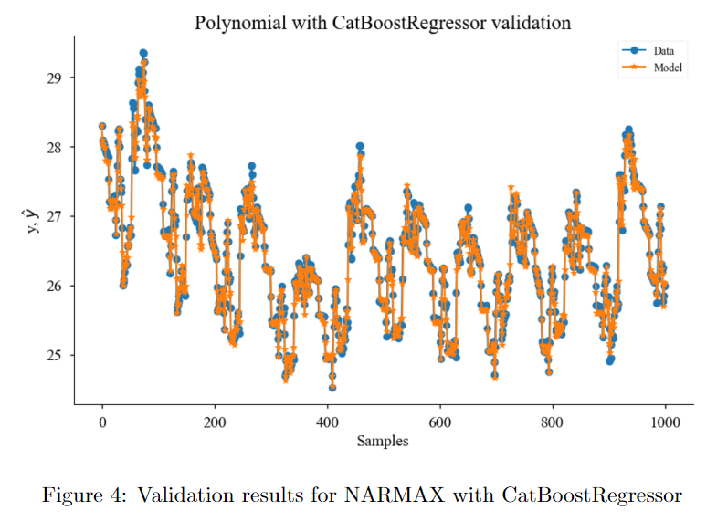
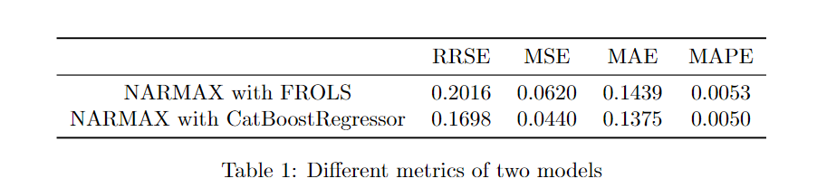

Slide 8
