Slide 1
CSC3050 – Computer Architecture
Prof. Wei Chung Hsu
School of Data Science
Chinese University of Hong Kong, Shenzhen
Notes:
I would like to welcome everyone for the new semester here. This semester I will be the instructor of CSC3050.

Slide 2
Class Information
Instructor
Wei Chung HSU (徐慰中) (hsuweichung@cuhk.edu.cn)
  Office: Dao Yuan Building 道远楼 509a
  Office Hours: Tuesday and Thursday, 2:00 to 3:00
Course TA & USTF
  Lead TA: LAI, Wenhai(赖文海) (221019040@link.cuhk.edu.cn)
  TA: YANG, Linxin(杨林鑫) (222042017@link.cuhk.edu.cn)
  TA: LIU, Yuhao (刘毓昊)(yuhaoliu2@link.cuhk.edu.cn)
  USTF: FENG, Wenjie(冯文杰), HOU, Tianci(侯天赐), CHEN, Danyang(陈丹阳)
Lectures
  Monday 3:30 – 4:50 AB E205
  Wednesday 3:30 – 4:50 AB E205 (1/15 TB 202)
Tutorials and TA office hours
  Tutorials are scheduled on Tuesday and Wednesday evenings. TAs will announce Office hours.
Homepage
  bb.cuhk.edu.cn
  Note that the lecture slides posted on BB may be updated frequently

Slide 3
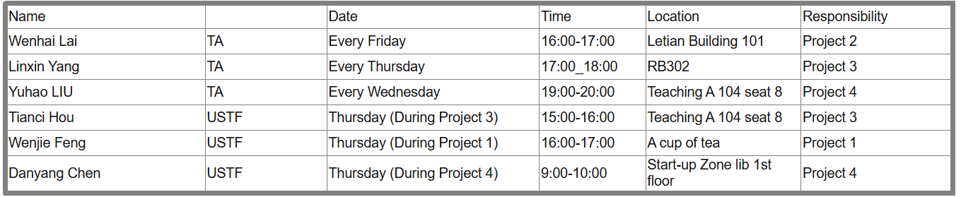
TA Office Hours

Slide 4







Instructor Background
  Computer architect for Cray Supercomputers
  Compiler engineer for Cray-XMP/YMP, Cray-C90, Cray-2, Cray-3
  Tech lead of Hewlett Packard (HP) optimizing compiler group
  Compiler architect for Intel/HP Itanium (IA-64) Processors
  Professor at U. of Minnesota. Research on Binary Translation (BT) for Itanium, Sun SPARC, x86, MIPS, and ARM processors
  Professor at NTU, Research on BT, Virtual Machines, and Finalizer for HSAIL (Heterogenous System Architecture Intermediate Language)
  Intel GPU Compiler
Notes:
Computer architecture : Interface
Cray was called the father of supercomputers
Mascot of UofM
Combine SW and HW
Bring Academia to Industry

Slide 5
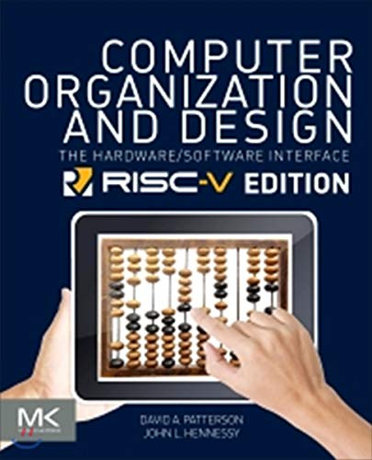
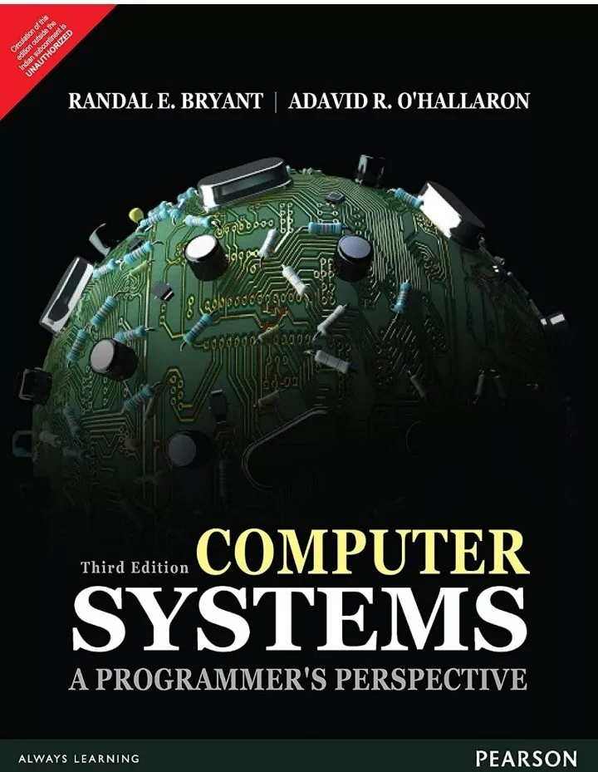
Textbook & Reference
(Textbook)
Computer Organization and Design: The Hardware/Software Interface (RISC-V Edition)
David A. Patterson and John L. Hennessy
(Reference)
Computer Systems : A Programmer's Perspective 3e by Randal INTERNATIONAL EDITION
Bryant, Randal E.; O'Hallaron, David R.
Notes:
This is an excellent textbook for computer organization, the most widely used. Clear explanation and comprehensive coverage of fundamentals.
However, the ISA used there was a little too old. So we adopt the latest ISA on the market, the RISC-V edition.
P&H: Stanford/UCB
B&O: CMU, UofWashington, Harvard, UCSD.

Slide 6
What is RISC-V
RISC
  A broad term for “Reduced Instruction Set Computer”, as opposed to CISC (Complex Instruction Set Computers).
  Many commercial processors like HP PA, SUN SPARC, ARM, IBM Power and PowerPC, DEC Alpha, MIPS, Intel i860/i960 are RISC processors.
RISC-I, RISC-II, RISC-III, RISC-IV, RISC-V
  These are ISA (Instruction Set Architecture) developed at UC Berkeley.
  RISC-V is the fifth generation.
Notes:
Sounds a little risky
RISC-V V also means “Vector”

Slide 7
Why adopt RISC-V?
It is an Open architecture.
  Its standard is open for collaboration, and is maintained by the non-profit RISC-V foundation.
  Unlike Intel x86, and ARM, RISC-V cannot be claimed as USA owned technology
  It is license free, royalty free.
It is an advanced RISC ISA.
It is simple, flexible, extensible and scalable. is suitable for all type of computing, from micro-controllers to supercomputers
Notes:
Three popular CPU architectures on the market: x86, ARM, RISC-V

Slide 8
Misconceptions about RISC-V
RISC-V is often connected with two key words
  Open
  Free
  That caused misconceptions.
Open: RISC-V offers an open standard, but not open source code. Designs in RTL or HDL (e.g. Verilog and VHDL) are proprietary. However, some designs are open source, such as Rocket (in-order), BOOM (out-of-order) and PicoRV32.
Free: There are NO free processor chips. Free means the use of the ISA is royalty-free, and free of license fee.
Notes:
ARM charges royalty and license fee. Each micro-controller may cost you 1-2% of , APPLE pays license fee, MTK pays royalty

Slide 9
License Free, Royalty Free
Two dominant CPU ISAs are both proprietary:
X86
  AMD used to pay Intel license fees, but since AMD came up with x64 ISA, both sides are license-free.
ARM
  Upfront license $1M-$10M, varied by designs
  Royalty 1-2% of the cost of each shipped product.
  Architecture license (Apple, Qualcomm,…)
Notes:
Only a few companies have x86 license: AMD, Via, others expired

Slide 10
A Strong Software Ecosystem
Royalty-free could be a significant incentive to initially attract embedded system developers.
Once a critical mass has formed, open-source system software has the potential to become a robust software ecosystem driving the RISC-V market's growth, creating a positive feedback loop (virtuous circle).
For example, ARM started with embedded systems and gradually expanded into mobile computing, desktops, and servers. RISC-V seems to be following a similar path of advancement and expansion.

Slide 11
Trend of Software First
In the '60s and '70s, hardware designers were the leading architects and decision-makers.
Software, including system software and application software, is becoming more and more influential in computer architectures.
Now, the driver behind computer architecture is software. The API, the OS, and killer applications (such as DNN, ML, LLM) drive the development directions.
  Software-defined radio, software-defined network, …, software-defined everything
The ISA/platform that attracts more developers will eventually win.
Notes:
OpenCL, OpenGL, OpenMP, JavaAPI,DirectX, SAPI, SDL
For example, since virtual machines have become popular in cloud computing, architectures must support VMs.

Slide 12
Simple yet Versatile: Extensibility
ISA | 32b | 64b
x86 | 1300 | 1500
ARM | 500 | 1000
RISC-V | 47 | 61 (47+14)
Extension | Added instructions | Extension | Added instructions
M | 8 | G | MAFD
A | 11 | C | 36
F | 25 | B | 42
D | 25 | V | 186
Q | 27 | H | 2
Notes:
Three dominating ISAs

Slide 13
Course Syllabus
  Computer Abstraction and Technology
  Instructions: Language of the Computer
    Traditional ISA Instruction Set Architecture (ISA)
  Arithmetic for Computers
    Integer and Floating point Addition/Subtraction/Multiplication/Division
    Subword parallelism
  The Processor
    Datapath and Control
    Pipelining
  Large and Fast: Memory Hierarchy
  Parallel Processors from Clients to Cloud

Slide 14
Course Assessment
Class attendance and participation (5%)
In Class Quizzes (25%)
  Pop quiz
  A few written quizzes are scheduled and will be announced two weeks in advance.
Homework: Programming Projects (45%)
  Project#1: Assembly programming (10%)
  Project#2: Assembly debugging (10%) – the bomb lab
  Project#3: A pipelined RISC-V processor simulator (12.5%)
  Project#4: A Data Cache simulator (12.5%)
Final Exam (25%)
  Open book, Open notes

Slide 15

Class Attendance
When you arrive in the classroom,
please use the QR code on the right to
check in for attendance.
Check in between 15:20 pm and 15:50 pm.
Enter your ID and Name.
The QR code is also accessible on BB.
Please keep in mind that the QR code will
only work when you are in close proximity
to the classroom.

Slide 16
Academic Honesty
Zero Tolerance
  Plagiarism, cheating, misconduct in test/exam will be reported to the School for handing.
Consequences
  Zero marks for the concerned assignments/test/exam/whole course, demerits, suspension of study, dismissal from University.
University Policy for Academic Honesty
  http://www.cuhk.edu.cn/departsite/ar/en/Academic.html

Slide 17
MISC. (1)
Open book exams
  Exams are open books and notes but no longer open laptops, tablets, or cell phones.
Makeup exam policy
  If a makeup exam is requested and approved for acceptable reasons, it will be conducted orally in my office. Makeup exams will receive a 10% discount.
Reference letter
  If you require my reference letter, please make a good impression so I can recall our interactions.

Slide 18
MISC. (2)
Reading Assignments
  Reading the textbook is a student’s obligation. There will be reading assignments on book chapters. If you follow the assignments, you will comprehend more from the lectures.
Using AI tools (e.g. ChatGPT, GitHub Co-Pilot, Gemini, … )
  Allowed in your homework (to increase your productivity)
  Be aware that such tools are not allowed in exams and job interviews
Simulator Assignments
  Project#3 and project#4 are writing simulators. The tasks are more challenging. We allow each team to have two students. We do not use Verilog; the simulators are written in C/C++.
Application for Incomplete:
  Health and Mental Conditions: Please inform me immediately if you have any health or mental conditions. Applications submitted just before the final exam will not be accepted.
  Extenuating Circumstances: These are case-by-case and may require supporting documentation.
  If you have never submitted any homework, applications for Incomplete will not be granted.

