Slide 1
CSC3050 – Computer Architecture
Review
Prof. Wei Chung Hsu
School of Data Science
Chinese University of Hong Kong, Shenzhen

Slide 2
Computers – Information Revolution
Moore’s Law
  Original: The number of transistors on a microchip would double every year while the costs would be halved (1965)
  Revised: The number of transistors on a microchip would double approximately every two years. (1975)
Wide spread of computers
  Covering a range of technologies from embedded systems, mobile devices, and personal computers to desktops, servers, cloud computing, and supercomputers.
  Computer performance has improved over 50000 times in the past 50 years. Computer architecture and organization have been in the central place.
Notes:
The major driving force

Slide 3
Computer Architecture
Architecture
  Interface between SW and HW
  ISA: Instruction Set Architecture
Micro-architecture
  Computer organization
  Data path and control implementation
  Different techniques to improve performance, cost, energy, and reliability for different segments.
Notes:
ISA: language for machines
IBM, Intel x86 i3/i5/i7/i9
Pipelined implementation yields higher throughput, but need to deal with hazards

Slide 4
Instruction Set Architecture (ISA)
ISA, or simply architecture – the abstract interface between the hardware and the lowest level software that includes all the information necessary to write a machine language program, including instructions, registers, memory access, I/O, etc.
Enables implementations (Micro-architectures) of varying cost and performance to run identical software. (i.e. a processor family, such as IBM 360, Intel x86, ARM, RISC-V)
The combination of the basic instruction set (the ISA) and the operating system interface is called the Application Binary Interface (ABI).
  The user portion of the instruction set plus the operating system interfaces used by application programmers.
  Define a standard for binary portability across computers.
Notes:
For a family of processors. ISA is important – it is a standard interface. Once you have a standard, then compatibility becomes an issue.

Slide 5
Application Binary Interface (ABI)
ABI is a comprehensive specification defining how different parts of a software system interact at the binary level. It includes many aspects, including
  Data type sizes and alignment
  Memory layout of data structures
  System call numbers and mechanisms
  Calling conventions
Calling convention is part of the ABI specification
It defines specifies rules for register usage in passing arguments
and results for function calls
Including Callee-saved registers vs Caller-saved registers
Leaf routines call no others, so using caller save registers are free
Notes:
Why do we need calling convention? For interoperability cross different compilers, different software, different library.
If not well defined, arguments may not be passed by registers!!!

Slide 6
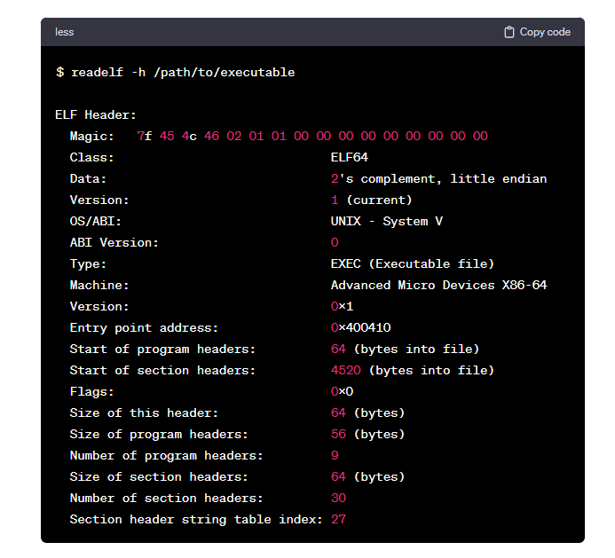
Application Binary Interface (ABI)
readelf
Notes:
Why do we need calling convention? For interoperability cross different compilers, different software, different library.
If not well defined, arguments may not be passed by registers!!!

Slide 7
Why RISC-V?
It is an Open Architecture.
  Its standard is open for collaboration, and is maintained by the non-profit RISC-V foundation.
  Unlike Intel x86, and ARM, RISC-V ISA is not proprietary
  It is license-free and royalty-free.
It is an advanced RISC ISA (e.g., virtualizable, VLA, ..).
It is simple, flexible, extensible (modular), and scalable.

Slide 8
RV64I Instructions
Add/Sub | ADD | SUB | ADDI
Data Transfer | LD/SD | LW/SW | LWU | LH/SH | LHU | LB/SB | LBU | LR/SC | LUI
Logic | AND | OR | XOR | ANDI | ORI | XORI
Shift | SLL | SRL | SRA | SLLI | SRLI | SRAI
Branch Jump | BEQ | BNE | BLT | BGE | BLTU | BGEU | JAL | JALR
Notes:
Some instruction require sign extension, some of them don’t

Slide 9
Instruction Set Design Issues
  Should we have 1024 general-purpose registers in the ISA?
  Should we use Compare and Branch or Condition-Code-based branches?
  Should we support fast procedure calls with a single instruction?
  Should we support 3-operand or 4-operand instruction formats?
  Should we adopt register pairs to handle wider data requirements?
  Should we support post-increment memory loads?
  Should we support a dedicated bit for static branch prediction?
  Should we support a cache prefetch instruction?
  Should we support SIMD/Vector instructions?
Notes:
Strong correlation with the micro-architecture. Please check with DeepSeek/ChatGpt/Gemini to validate your understanding

Slide 10
Major Components of a Computer
Control
Input
Output
Data
Path
Memory

Slide 11
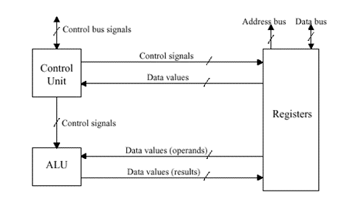
Data Path and Control
Control responsible for
  Instruction fetch and decode
  Issue signals that control the way information flows between datapath components
  Control what operations the datapath’s functional units perform
Datapath responsible for
  Execute instructions – functional units (e.g., adder) and storage locations (e.g., register)
  Interconnect the functional units so that the instructions can be executed as required
  Load data from and store data to memory
Notes:
Data Path: ALU, Registers, memory, bus

Slide 12

Great Ideas in Computer Architecture
Design for Moore’s Law
Use Abstraction to Simplify Design
Make Common Case Fast
Performance via Parallelism
Performance via Pipelining
Performance via Prediction
Hierarchy of Memories
Dependability via Redundancy
ILP
TLP
DLP
MLP
Notes:
Branch prediction, prefetch prediction, value prediction, way prediction, latency prediction (whether a thread should wait for a miss or to switch)

Slide 13
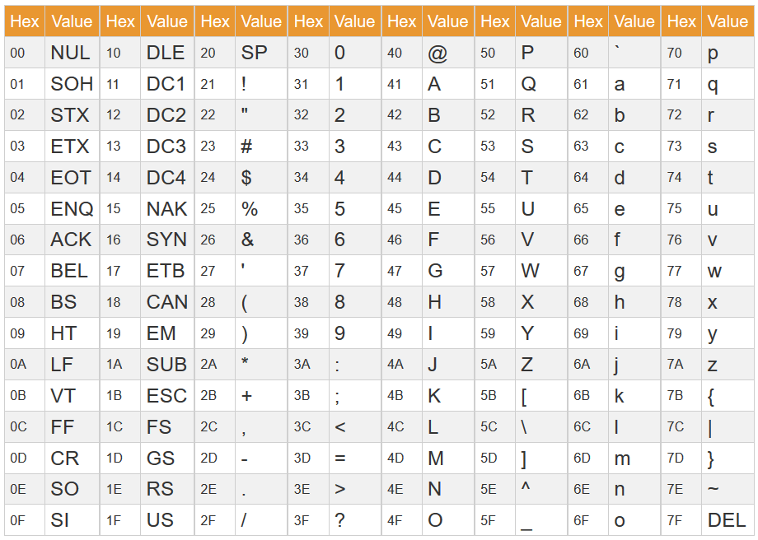
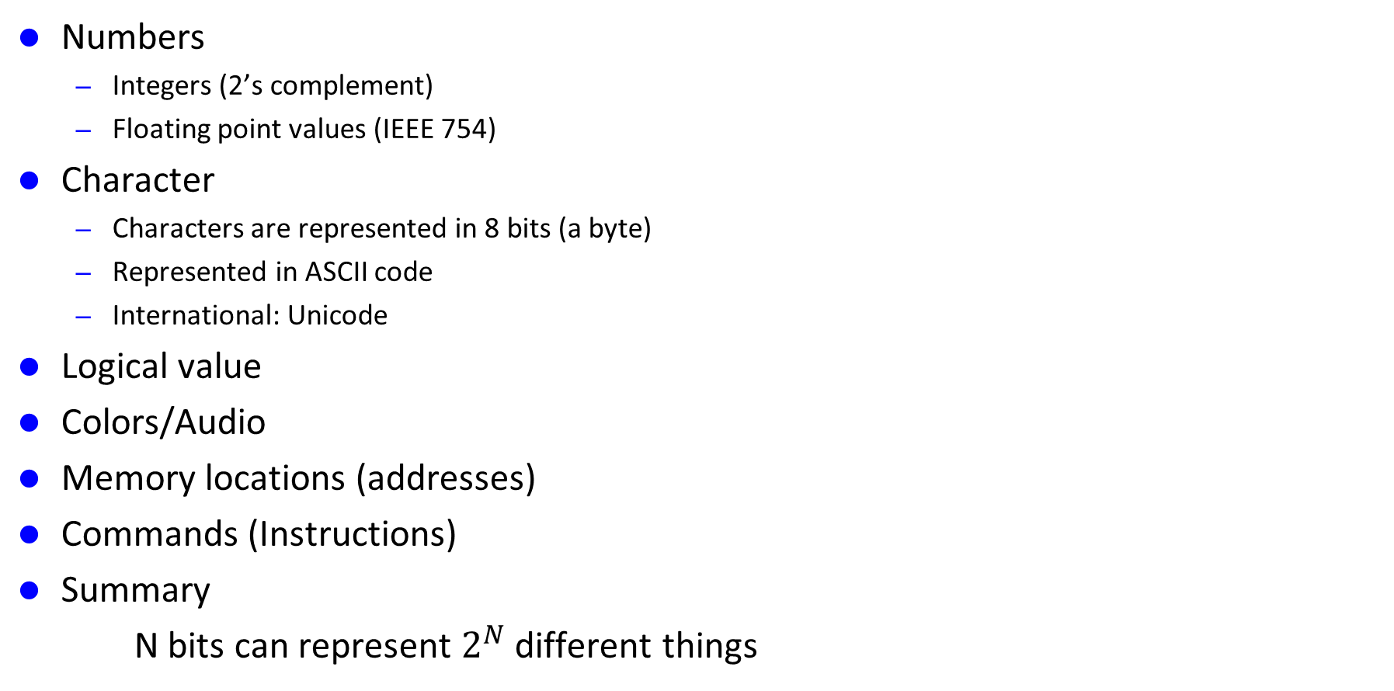
Information Stored in Memory
Numbers
  Integers (2’s complement)
  Floating point values (IEEE 754)
Character
  Characters are represented in 8 bits (a byte)
  Represented in ASCII code
  International: Unicode
Logical value
Colors/Audio
Memory locations (addresses)
Commands (Instructions)
Summary
N bits can represent $2^{N}$ different things

Slide 14

RISC-V ISA
Several variants of RV
  RV32, RV64, RV128 – Different data widths (addressing capability)
  ‘I’ – Base Integer instructions
  ‘M’ – Multiply and Divide
  ‘F’ and ‘D’ – Single and Double precision floating point
  ‘V’ – Vector extension
  ‘C’ – Compressed extension
  ‘A’ – Atomic operation extension
  And many other modular extensions
32 GPR, X0 wired to 0
Six instruction types: R, I, S, B, U, J
Pseudo instructions: e.g. Li ➔ LUi + Addi
Reach of different branch/jump instructions: BR: ± $2^{12} B,$JUMP: ${\text{±}2}^{20 }$B, JALR, $2^{31 }$-1 B
Notes:
S and B similar, but the immediate is treated differently! S is in bytes, B in two bytes

Slide 15
Sign Extension
Sign extension is a method to increase the number of bits of a binary number while preserving its sign (positive or negative) and value. When extending the number to a larger bit width, the sign bit is replicated in all the new higher-order bits.
Example:
  C allows 8b, 16b, 32b, 64b singed integers stored in memory.
  The registers are 32b/64b wide, in RV32/RV64, respectively.
  So when moving a 8b number to a register, sign extension must be applied.
  Assuming the number is +4 : 00000100
  When moving to a 32b register, the sign bit, 0, is replicated 24 times 000000…… 00000100
  2) Assuming the number is -4 : 11111100
  When moving to a 32b register, the sign bit, 1, is replicated 24 times 111111…… 11111100
  without sign extension, the value moved to the register would be incorrect
  It might be either 0000000……11111100 or 10000000 …. 1111110
Load instructions in RV have signed/unsigned versions. Signed loads require sign extensions.

Slide 16
Arithmetic for Computers
Operations on integers
  Addition and subtraction
  Multiplication and division
  Dealing with overflow
Floating-point real numbers
  Representation and operations
Subword Parallelism
SIMD and Vector Architecture
Notes:
Subword parallelism means a single word or double word can store 4 or 8 data items, they can compute 4/8 operations with one instruction.
SIMD is futher push to 128 bit or 512 bits wide SIMD registers. 16 SP numbers may be loaded into a SIMD register, and one instruction can do 16
computation at the same time.

Slide 17
Overflow Handling in RISC-V
RISC-V shifts the burden of arithmetic exception handling to software. It does not require the hardware to generate traps.
For signed/unsigned integer operations, the responsibility is sifted to software. If the program needs to check for overflows, the compiler should generate instructions to check for overflows explicitly.
For floating point operations, the hardware sets a flag to inform that the overflow/underflow had occurred. The software must explicitly check the flags if they care about such exceptions.
Shifting overflow/underflow detection responsibility to software is not new for RISC machines. However, MIPS/ARM/Power ISA still provide a set of instructions to demand the hardware to trap. RISC-V simply do not support such instructions in the core set. (if you really want that, add them to some extensions)

Slide 18
Multiplication Hardware
Start
0010 x 0011
Multiplicand Product
0010 0000 0011
0010 0011
0010 0001 0001
0011 0001
0010 0001 1000
0010 0000 1100
0010 0000 0110
Product0 = 1
1. Test
Product0
Product0 = 0
1a. Add multiplicand to left half of product and
place the result in left half of Product register
2. Shift Product register right 1 bit
32nd
repetition?
No: < 32 repetitions
Yes: 32 repetitions
Done

Slide 19
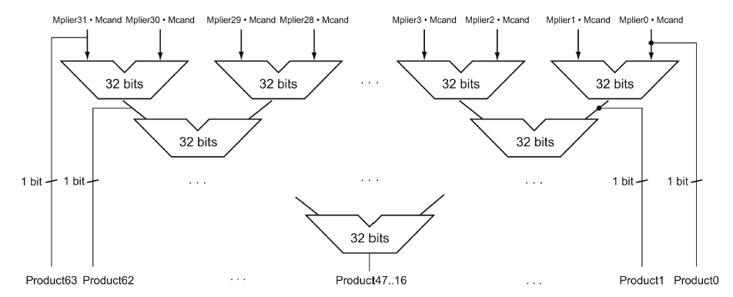
Faster Multiplication
With Moore’s law, we could use more transistors to make the multiplication go faster. Whether the multiplicand should be added at each step can be predetermined by looking at the respective bit in the multiplier. So 31 adders could be used in a pyramid. The delay could be reduced from 31 to 6.
Notes:
In computer industry, this is often called the pyramid in a multiplier.

Slide 20
Signed Division
Dividend = Quotient X Divisor + Remainder
+7 div +2 = +3 , remainder +1
-7 div +2 = -3, remainder -1 ➔ why not quotient -4, remainder +1
Rule: the dividend and the remainder must have the same sign
Division steps:
  Remember signs, make positive, complement quotient and remainder if necessary
  Let Dividend and Remainder have same sign and negate Quotient if Divisor sign & Dividend sign disagree.

Slide 21
Multiply/Divide by Power of 2
Multiply by power of 2 can use shift left
X * 2 = X << 1, X * 4 = X << 2, …
-X *2 = (-X) << 1, -X *4 = (-X) << 2
How about division?
X div 2 = X >> 1. This works for positive numbers
How about negative number such as -7/2?
Assume 8bit integer, 7 is 00000111 and -7 is 11111001
11111001 >> (SRA) 1 = 1111100 -4, this quotient is wrong, it should be -3
The correct way to use >> for X div N, where X is a negative number, and N is a power of 2, is as follows:
(X+(N−1)) ≫ log2​(N)
For example, -7/2, should use (-7+1) >> 1

Slide 22
Floating-Point Standard
Defined by IEEE 754-1985 standard
Developed in response to divergence of representations
  Portability issues for scientific code
Now almost universally adopted
Two representations
  Single precision (32-bit)
  Double precision (64-bit)

Slide 23
IEEE Floating-Point Format
Hidden 1
1 bit
8 bits
23 bits
s
exponent
fraction/mantissa
Single-Precision
x = (−1)^{s} × (1+fraction) × 2^{(exponent−127)}
exponent | fraction | Value represented
00000000 | 0 | 0
00000000 | nonzero | denormalized
1111 1111 | 0 | ±∞
1111 1111 | non-zero | NaN
For denormalized numbers,
there is no hidden 1.
Special values
1 bit
11 bits
52 bits
s
exponent
fraction/mantissa
Double-Precision
x = (−1)^{s} × (1+fraction) × 2^{(exponent−1023)}
Notes:
IEEE 754 uses a bias of 127 for single precision, double precision的bias是1023

Slide 24
Floating-Point Addition
Now consider a 4-digit binary example
  1.000₂ × 2^{–1} + –1.110₂ × 2^{–2} (0.5 + –0.4375)
1. Align binary points
  Shift number with smaller exponent
  1.000₂ × 2^{–1} + –0.111₂ × 2^{–1}
2. Add significands
  1.000₂ × 2^{–1} + –0.111₂ × 2^{–1} = 0.001₂ × 2^{–1}
3. Normalize result & check for over/underflow
  1.000₂ × 2^{–4}, with no over/underflow
4. Round and renormalize if necessary
  1.000₂ × 2^{–4} (no change) = 0.0625

Slide 25
Quadruple Precision, Half-float and minifloat
Quad-precision float and half float format were defined in IEEE 754-2008.
  Quad precision: 1, 15, 112
  Double precision: 1, 11, 52
  Single precision: 1, 8, 23
  Half precision: 1, 5, 10 (fp16), bfloat16 (1,8,7) has the same range as fp32
  Mini-float: 1, 4, 3 (fp8)
  Nibble-float 1,2,1 (fp4)
  Half-float and mini-float are defined (but not IEEE standards) to support AI applications.
Defined by IEEE 754 standard
Notes:
reciprocal

Slide 26
Sub-word Parallelism
Media data are usually 8 or 16 bits. This means one word can store multiple such data. It is not hard to partition the carry chain to allow integer ALU to carry out multiple sub-word computation in parallel. So MMX (Multi-media) extensions in Intel x86 started. Many companies are doing this support at the same time; for example, SUN’s VIS ISA, HP’s MAX-2, and IBM’s AltiVec are doing the same.
Hardware accelerators such as sound cards, graphics cards, and MPEG-2 decoders took over the market initially. After the software developers started catching up with MMX, such media acceleration using sub-word parallelism eventually became more cost-effective.
Intel starts to extend such parallel processing to floating point computation, called SSE (Streaming SIMD Extension), and introduced the 128bit SIMD registers (XMM). SIMD registers have kept expanding; now, the ZMM registers are 512 bits wide. In 2020, Intel introduced AMX instructions, which also support fp16 and bf16.

Slide 27
Example: PADDB
PADDB
PADDW: parallel add 4 16bit words.
Byte 7
Byte 6
Byte 5
Byte 4
Byte 3
Byte 2
Byte 1
Byte 0
Byte 7
Byte 6
Byte 5
Byte 4
Byte 3
Byte 2
Byte 1
Byte 0
+
+
+
+
+
+
+
+
Byte 7
Byte 6
Byte 5
Byte 4
Byte 3
Byte 2
Byte 1
Byte 0
Carry chain needs to be partitioned so that the result of one byte add will not be propagated
to the next. This implements so called saturation math (overflows chopped at the bounds).
Notes:
reciprocal

Slide 28
Extension to SSE/AVX (128/256 bit) SIMD
255
0
ADDPS
SP 7
SP 6
SP 5
SP 4
SP 3
SP 2
SP 1
SP 0
SP 7
SP 6
SP 5
SP 4
SP 3
SP 2
SP 1
SP 0
+
+
+
+
+
+
+
+
SP 7
SP 6
SP 5
SP 4
SP 3
SP 2
SP 1
SP 0
ADDPS means parallel add packed (P) single precision floating point (S) data. With 256bit wide
SIMD registers, one instruction can compute 8 single precision floating point data.
With the newly introduced FP8 format, one instruction can compute 32 minifloat results.
Notes:
reciprocal

Slide 29
Vector Architectures
Basic idea:
  Read sets of data elements into “vector registers”
  Operate on those vector registers
  Write the results back into memory
Vector registers are controlled/allocated by the compiler
  Used to hide memory latency
  Leverage memory bandwidth
  Vector loads/stores are excellent architecture features (they communicate memory reference patterns to the memory system)
RISC-V has the Vector Extension – RVV
RVV is Vector Length Agnostic (VLA). It is more portable than SIMD

Slide 30
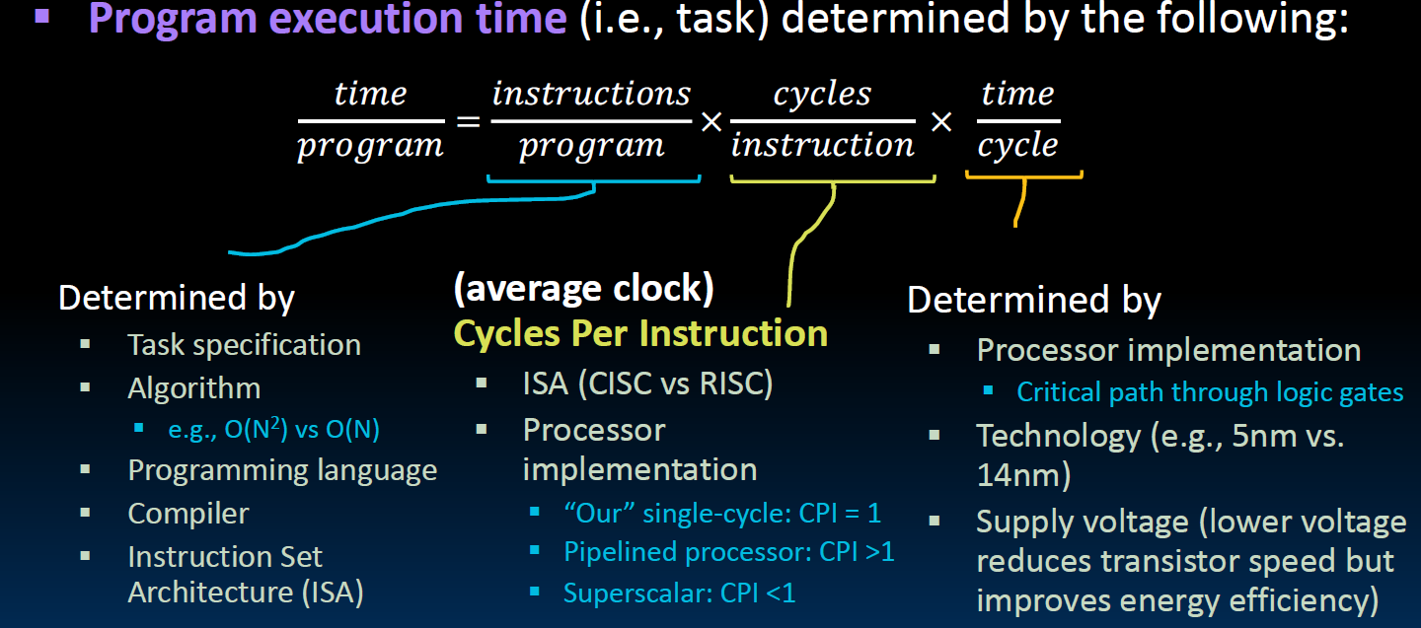
Iron Law: CPU Time = Inst count X CPI X Clock cycle time
Notes:
clock time： the time to complete a task
CPI smaller the better, IPC, the higher the better

Slide 31
Iron Law: CPU Time = Inst count X CPI X Clock cycle time
CPI: the smaller the better
IPC: the larger the better
VE: reduce instruction count
Pipeline: reduce cycle time
Superscalar: reduce CPI
Cache: reduce CPI
Branch Prediction: reduce CPI
Code Scheduling: reduce CPI
CISC: reduce instruction count, but increase cycle time
Calling Convention: reduce instruction count
Notes:
clock time： the time to complete a task
CPI smaller the better, IPC, the higher the better

Slide 32
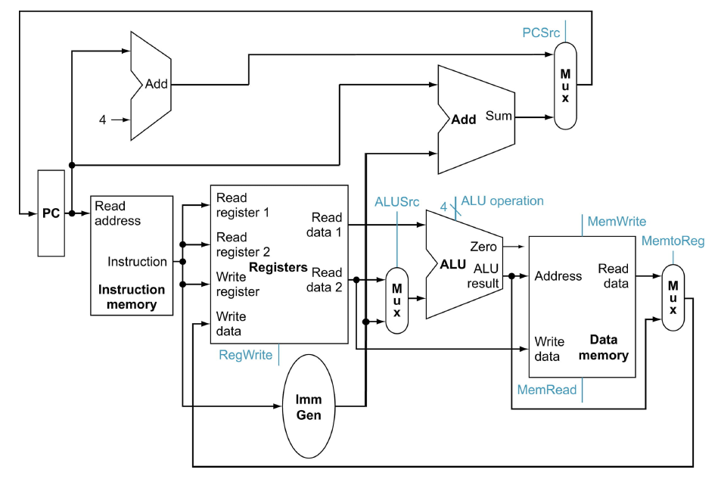
A Single Cycle Data Path

Slide 33
Single Cycle, Multi-Cycle, and Pipelined
Single cycle inefficiency:
  The clock cycle must be timed to accommodate the slowest instruction path.
  Resource inefficiency: some functional units (e.g., adders) must be duplicated because they can not be reused during a clock cycle
Multi-cycle
  Allow a faster clock
  Avoid resource duplication as in the single cycle data path
Pipelining
  Allows for a faster clock as in the multi-cycle implementation
  Allows instructions to overlap – instructions at different stages can execute concurrently

Slide 34
Divide the Single Cycle Data Path into 5 Stages

Slide 35
Pipeline Lessons
Does not help the latency of a single instruction, but overall throughput
The slowest stage limits pipeline rate. Unbalanced stage length limits the perfect speedup.
Multiple tasks are working at the same time using different resources.
Potential speedup = Number of pipeline stages
Time to “fill” & “drain” the pipeline reduces speedup
  This happens at program start-up, branch mispredictions, context switches, exceptions, and interrupts.
Pipeline bubbles from data and control dependencies

Slide 36
Hazards: Pipeline Challenges
Three challenges:
  Structure Hazards
    A conflict that arises due to hardware resource limitations
  Control Hazards
    The pipeline does not know for sure which instruction will be executed next until the branch condition is evaluated
  Data Hazards
    When the pipeline must be stalled because the data needed for the current instruction is not yet generated by previous instructions
Solutions to reduce penalty
  HW and SW (reference to the lecture notes)

Slide 37
Branch Prediction
Whether
  Branch prediction table
  Usually tracks the last two outcomes of a branch instruction: 00, 01, 10, 11
  A finite state machine to predict the next branch direction.
  Tagged branch predictor may not be cost-effectively, the address tag may cost many times of the branch history bits. So the practical branch predictors are not tagged.
Where
  A branch target buffer if often used to predict the branch target
  Branch targets are usually runtime constants: it is PC + immediate, once calculated, unlikely to change
  Indirect branches (including function returns) have changing targets, BTB may not work well.

Slide 38
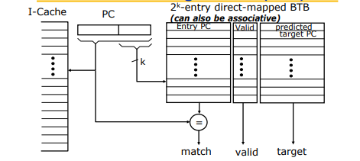
BTB

Slide 39
Memory Wall
In computer architecture, the "memory wall" refers to the growing gap between the speed of processors and the speed of main memory (DRAM).
  Latency
    Reduction: Cache, Local Memory, NUMA, PIM
    Hiding: Multi-threading/Hyper-threading, WARP interleaving, chip-multithreading
  Bandwidth
    Interleaved memory, wider bus, interconnection network
    Synchronized DRAM, HBM (3D stacking + wide interface)
In HPC (High Performance Computing), including LLM, memory performance is often the main challenge. GPU is good at parallel processing, but due to limited HBM size, data transfers often pose a challenge to high performance.
Notes:
Virtual memory gives you illusion that you have a huge memory address space

Slide 40
Memory Hierarchy
From the earliest days of computing, programmers have wanted unlimited amounts of fast memory. Computer architects have created that illusion with
  Memory Hierarchy
  Virtual Memory
Such illusion works due to principle of locality
  Temporal locality (locality in time)
  Spatial locality (locality in space)
A memory hierarchy consists of multiple level of memory with different speed and size. The faster memory are more expensive per bit, and thus smaller in size.
Notes:
8 great ideas: design for moore’s law, common case fast, memory hierarchy, parallelism, pipelining, prediction, redundancy, abstraction
Memory hierarchy gives you a fast, large, and cheap memory
Virtual memory gives you illusion that you have a huge memory address space

Slide 41
Levels of Memory Hierarchy
Upper Level
Staging
Transfer Unit
faster
Registers
Instruction Operands
Programmer/Compiler
Cache Hierarchy
Cache / LM
Blocks/Lines
Cache Controller
Memory
Virtual Memory
Pages
Operating System
Disk
Files
User/Operator
Larger
Tape
Lower Level
Notes:
LM is programmable cache

Slide 42
How Is the Memory Hierarchy Managed
Registers <-> Memory
  By compiler (programmer?)
Cache <-> Memory / Local memory <-> Memory
  By the hardware / by the compiler/programmer
Memory <-> Disks
  By the hardware and operating system (virtual memory)
  By the programmer (files)
Disks <-> Tapes
  By the hardware
  By the programmer
Notes:
注意通常数据的访问不会跨太多级别，比如cache不会直接访问disk上的data。

Slide 43
Address Subdivision for n-way Associative Caches
Assume a 16KB cache, line (block) size is 64B.
Case 1: Direct mapped
31
14
13
6
5
0
256 sets
Tag
Set selection
Byte offset
Case 2: Fully associative
31
6
5
0
1 set
Tag
Byte offset
Case 3: Two-way set associative
31
13
12
6
5
0
128 sets
Tag
Set selection
Byte offset
Case 4: Four-way set associative
31
12
11
6
5
0
64 sets
Tag
Set selection
Byte offset

Slide 44
Four Questions for Cache Design
Q1: Where can a block be placed in the cache ?
=> Block placement Set selection: direct mapped, set associative, fully associative
Q2: How is a block found in the cache ?
=> Block finding Set selection, tag comparison
Q3: Which block should be replaced on a miss?
=> Block replacement LRU approximation, MRU, Belady’s algorithm
Q4: What happens on a write?
=> Write strategy
Hit: write-through, or write-back
Miss: write-allocate, write-noallocate

Slide 45
Classifying Cache Misses (3 C’s or 4 C’s)
Compulsory (or Cold) Miss
when a piece of data is requested for the very first time
and needs to be brought into the cache
1,4,3,5,7
Conflict (or Collision) Miss
Multiple references are mapping to the same set, and
The set is not large enough to hold them. “collision”
Caused misses.
3,4,8,11,12,19, 4
0 | 1 | 2 | 3 | 4 | 5 | 6 | 7
0 | 1 | 2 | 3 | 4 | 5 | 6 | 7
Capacity Miss
Cache is not large enough to hold needed
Blocks
1,2,3,4,5,6,7,8,9,1,2,3,4,5,6,7,8,9
Coherency Miss
Occurs when invalidation requests are issued by other processors in a multiprocessor system to maintain coherence of cached data
0 | 1 | 2 | 3 | 4 | 5 | 6 | 7

Slide 46
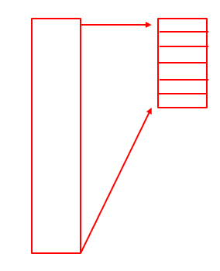
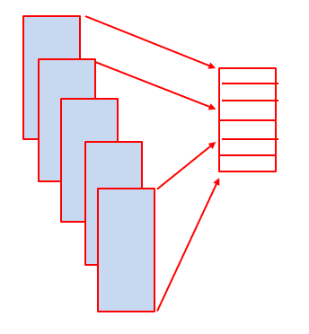
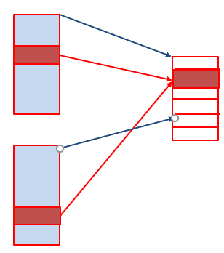
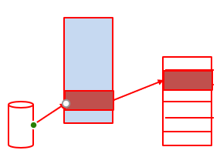
Versatile Virtual Memory
Allow VA space >> PA space
  Demand paging
  Exploiting locality
Enable multi-processing, multiprogramming
  Isolation
  Protection
Enable memory sharing
  Efficient Inter-Process Communication
  Data Sharing
Memory mapped I/O
  Memory mapped files

Slide 47
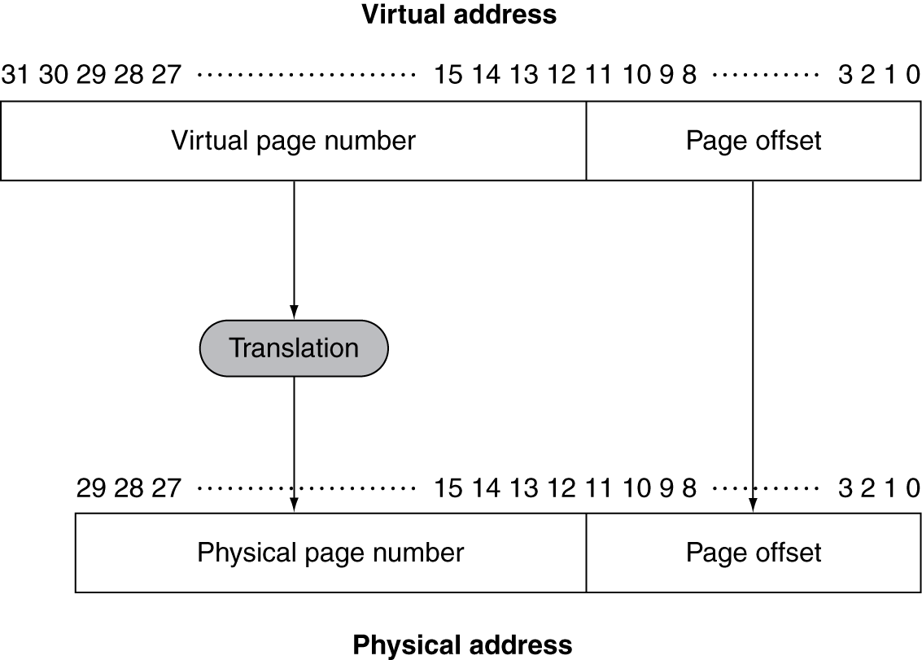
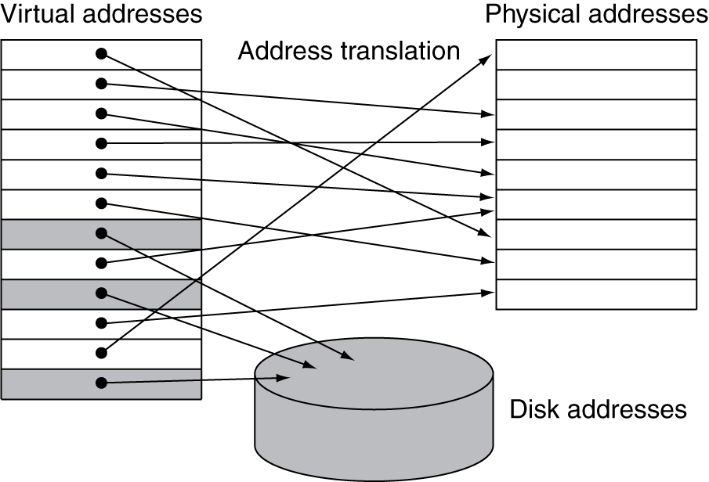
Address Translation (VA page# ➔ PA Page#)
Fixed-size pages (e.g., 4KB)
Notes:
在右边的这个例子中，虚拟地址支持2^32一共4GB，物理地址实际是2^30即1GB，

Slide 48
Page Tables, PTE, and Page faults
Stores mapping information
  Page table stored in main memory
  Array of page table entries, indexed by virtual page number, to find physical page
  Page table register in CPU points to the page table in physical memory (e.g. CR3)
Page Table Entry (PTE)
  Stores the mapped physical page number
  If not mapped to a physical page , its valid bit is off, and the entry points to a disk block in the swap space.
Page fault
  If a virtual page is not mapped yet, a reference to it will generated a page fault.
  This traps to the OS, and OS will move the page from the disk to memory.

Slide 49
Page Replacement
When the OS handles a page fault, it may have to replace an existing mapped page when there are no free pages available.
The page replacement is similar to the cache line replacement. However, the OS can afford to use more much complex algorithms because a disk operation (in handling a page fault) is much more expensive than fetching a cache line from the memory (in handling a cache miss).

Slide 50
Page Table Challenges
Page Table may be too large
  Consider the page table size for 48-bit virtual address: 2³⁶ PTE, 256GB table
  Three possible solutions:
    Multi-level indexing, such as the 4-level page table used by x86
    Hash table
    Inverted table
Page Table access is too slow; TLB comes to the rescue.
  Use a cache to capture frequently used PTE’s
  This cache is call TLB (Translation Lookaside Buffer)
  TLB is usually 16-512 entries, with sub-clock access time, and miss rate < 1%
Notes:
Virtual address space is very sparse; don’t address that as a single continuous segment. Divide the total space into 2MB segments, many indexes can be avoided.

Slide 51
TLB Miss Handling
Hardware Walker
  Called hardware table walker. It walks the page table (starting from the page table pointer, usually the CR3 in x86) to find the PTE for the TLB.
  This walking may find the PTE entry in caches, so the latency could be short. The walking is slow for the 4-level page table.
Software Miss Handler
  This is using a TLB miss handler. Resolving TLB misses in software could be more flexible in that the page table structure can be changed.

Slide 52
TLB Miss Reduction
Increase the TLB size
  However, the larger the TLB, the longer the access latency
Higher associativity
  TLBs are typically fully associative
Multi-level TLB
Large pages
Variable page sizes
Better page replacements
Prefetch page table entries

Slide 53
Virtual Indexed, Physically Tagged Cache
Caches are usually tagged with physical addresses.
  Virtual-addressed cache may need a flush at every context switch
  Even if we add a process ID (PID) or an address space ID (ASID) to the virtual address, we still have a virtual address aliasing problem to deal with.
  Physically tagged caches mean a tag match must wait until the virtual address is translated to the physical address. So a hit time would be address translation time + cache hit time.
If the set selection utilizes part of the page offset, it can be done in parallel with address translation because the page offset remains unchanged during this process. This approach may help reduce the cache hit time.

Slide 54
About Final Exam
    Time: 05/13, Tuesday, 13:30 to 15:30
    Room: TD 301, 304, 305, 307, 309
    Style: Open Book, Open Notes, No E-devices
    Follow the school rules (student id, ….)
    Scope: Textbook Chapters 1 to 5 and all lecture notes
      35% from Chapters 1-4, 65% from Chapter 5
    Format: Three sections:
      Single choice (20)
      Multiple choice (12)
      Short Answer Essays (5)

