Slide 1
CSC3050 – Computer Architecture
Chapter 4 The Processor Part II
Prof. Wei Chung Hsu
School of Data Science
Chinese University of Hong Kong, Shenzhen

Slide 2
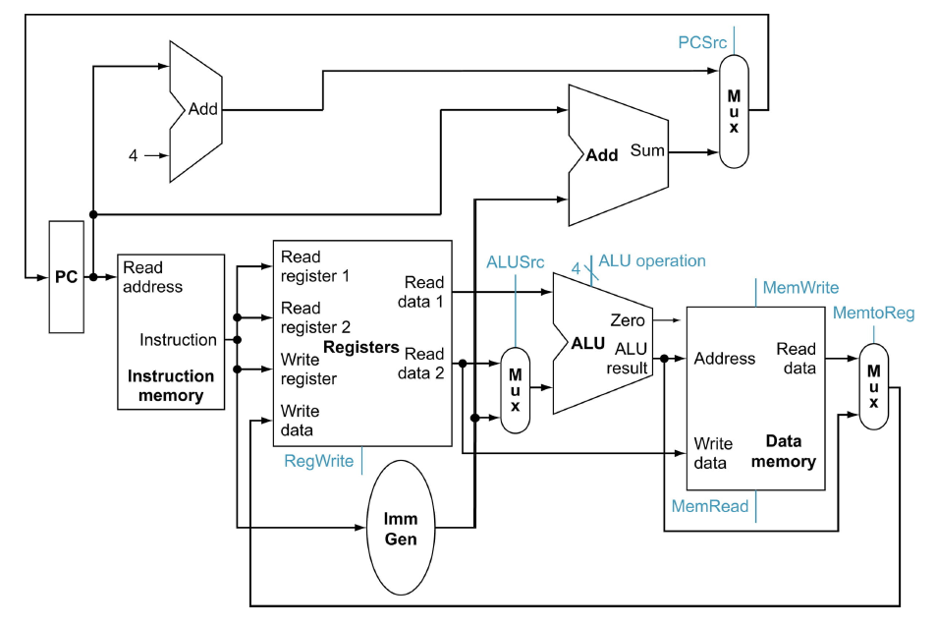
A Single Cycle Data Path
Add this path for JAL
WBsel

Slide 3
Control Points and Signals
Instruction<31:0>
Inst.
Memory
<12:14>
<15:19>
<20:24>
<7:11>
<20:31>
Addr
Op
Funct
Rs1
Rs2
Rd
Imm12
Control
PCsrc
RegWr
MemRd
ALUSrc
ALUctr
MemWr
WBsel
Equal
Datapath

Slide 4
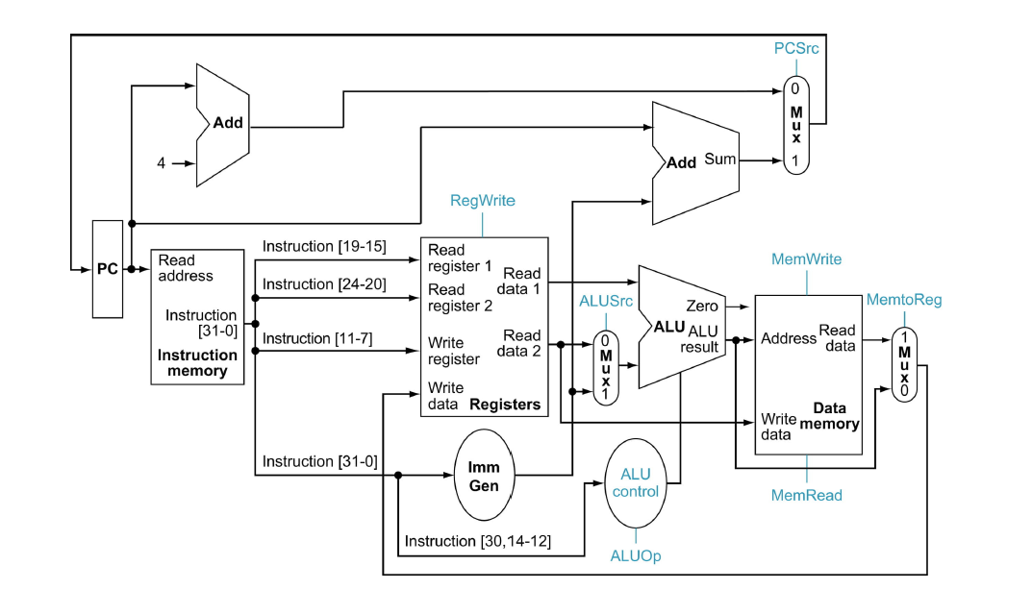
Step 4 - Control Points and Signals
Add this path for JAL
WBsel
Control point

Slide 5
High Level Control Signal Expressions
PCSrc = ((Branch or JAL) ? 1: 0)
RegWr = ( (Branch or Store)? 0: 1)
MemRd= (Load ? 1:0)
MemWr= (Store ? 1:0)
ALUSrc = (R-type? 0:1)
WBsel = (Load: 0 | R-type : 1 | JAL : 2)
HDL (Hardware Description Languages), such as Verilog and VHDL, can be used to specify the control signals. HDL codes are hardware-synthesizable. Feed them to a design compiler (Synopsis and Cadence tools) to get a netlist.
Designer’s perspective or the programmer’s perspective?
Notes:
Silicon compiler was the term, but less commonly used. It is probably too aggressive.
Chip logic design and IC design are now separated.

Slide 6
Step 5a - ALU Control
ALU used for
  Load/Store: F = add
  Branch: F = subtract
  R-type: F depends on the funct3 field
ALU control | Function
0000 | AND
0001 | OR
0010 | add
0110 | subtract
0111 | set-on-less-than
1100 | XOR

Slide 7
ALU Control (1)
ALUop is 2-bit wide to represent
  Load/store requires the ALU to perform add (00)
  Beq requires the ALU to perform sub (01)
  “R-type” needs to reference the funct3 field (10)
R-type
lw
sw
beq
jump
ALUop (Symbolic)
“R-type”
Add
Add
Subtract
xxx
ALUop<1:0>
10
00
00
01
xxx
Notes:
Shift is not included.

Slide 8
ALU Control (2)
Assume 2-bit ALUOp derived from opcode
  Combinational logic derives ALU control
opcode | ALUOp | Operation | funct3 | ALU function | ALU control
lw | 00 | load word | XXX | add | 0010
sw | 00 | store word | XXX | add | 0010
beq | 01 | branch equal | XXX | subtract | 0110
R-type | 10 | add | 000 | add | 0010
 |  | subtract | 000 | subtract | 0110
 |  | AND | 111 | AND | 0000
 |  | OR | 110 | OR | 0001
 |  | set-on-less-than | 010 | set-on-less-than | 0111
Notes:
Based on this table, we show how to set the ALU control inputs based on the 2-bit
ALUOp control and the 6-bit function code

Slide 9
Truth Table for ALUctr
ALUop |  | Funct3 |  |  | ALUControl
bit1 | bit0 | bit2 | bit1 | bit0 | bit3 | bit2 | bit1 | bit0
0 | 0 | x | x | x | 0 | 0 | 1 | 0
x | 1 | x | x | x | 0 | 1 | 1 | 0
1 | x | 0 | 0 | 0 | 0 | 0 | 1 | 0
1 | x | 0 | 0 | 0 | 0 | 1 | 1 | 0
1 | x | 1 | 1 | 1 | 0 | 0 | 0 | 0
1 | x | 1 | 1 | 0 | 0 | 0 | 0 | 1
1 | x | 0 | 1 | 0 | 0 | 1 | 1 | 1

Slide 10
Truth Table for ALUctr
ALUop |  | Funct3 |  |  | ALUControl
bit1 | bit0 | bit2 | bit1 | bit0 | bit3 | bit2 | bit1 | bit0
0 | 0 | x | x | x | 0 | 0 | 1 | 0
x | 1 | x | x | x | 0 | 1 | 1 | 0
1 | x | 0 | 0 | 0 | 0 | 0 | 1 | 0
1 | x | 0 | 0 | 0 | 0 | 1 | 1 | 0
1 | x | 1 | 1 | 1 | 0 | 0 | 0 | 0
1 | x | 1 | 1 | 0 | 0 | 0 | 0 | 1
1 | x | 0 | 1 | 0 | 0 | 1 | 1 | 1
Need Inst[30] to distinguish ADD from SUB
and SRA from SRL

Slide 11
From Truth Table to Logic Gate Expression
Target: to design circuit from truth table using very simple gate logic.
Truth table -> Logic expression -> simplified version -> gate circuit
  minterm: ABC+ABC'+AB'C+A'B'C'
  maxterm: (A+B+C)(A+B+C')(A+B'+C)(A'+B'+C')
  we usually prefer minterm

Slide 12
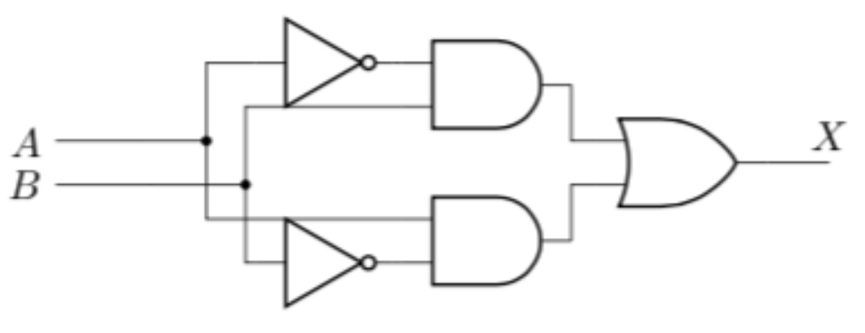
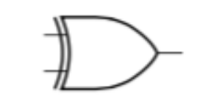
From Truth Table to Logic Gate Expression
Target: to design a circuit from a truth table using very simple gate logic.
Truth table -> Logic expression -> simplified version -> gate circuit
XOR
A | B | Z
0 | 0 | 0
0 | 1 | 1
1 | 0 | 1
1 | 1 | 0
A'B+AB'
A xor B
In logic design, we need to learn how to optimize (or simplify) the logic equations.
Now most ECAD tools have that work done automatically.

Slide 13
Logic Equation for ALUctr2 (1)
ALUop |  | Funct3 |  |  | ALUControl
bit1 | bit0 | bit2 | bit1 | bit0 | bit3 | bit2 | bit1 | bit0
0 | 0 | x | x | x | 0 | 0 | 1 | 0
x | 1 | x | x | x | 0 | 1 | 1 | 0
1 | x | 0 | 0 | 0 | 0 | 0 | 1 | 0
1 | x | 0 | 0 | 0 | 0 | 1 | 1 | 0
1 | x | 1 | 1 | 1 | 0 | 0 | 0 | 0
1 | x | 1 | 1 | 0 | 0 | 0 | 0 | 1
1 | x | 0 | 1 | 0 | 0 | 1 | 1 | 1

Slide 14
Logic Equation for ALUctr2 (2)
ALUop |  | Funct3
bit1 | bit0 | bit2 | bit1 | bit0 | bit2
x | 1 | x | x | x | 1
1 | x | 0 | 0 | 0 | 1
1 | x | 0 | 1 | 0 | 1
This makes funct3<1> a don’t care
ALUctr2 = ALUop0 + ALUop1‧funct3<2>’‧funct3<0>’
ALUctr0, ALUctr1 can be formulate in the same way.

Slide 15
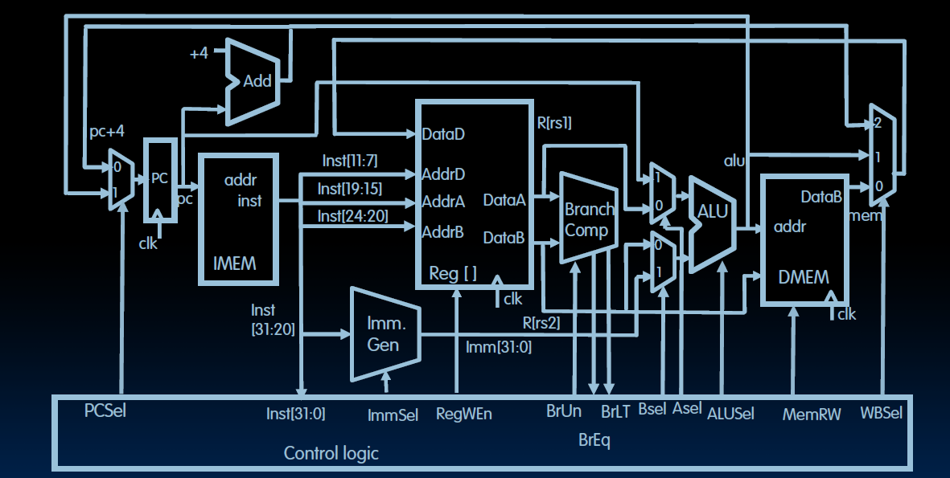
A More Complete RV32I Single Cycle Data Path
Notes:
This data path supports the RV32I core, including all user level instructions including JALR, Shift, and so on.

Slide 16
A More Complete RV32I Single Cycle Data Path
Wbsel:
0:? Which inst?
1:?
2:?
RegWen:
0:?
1:?
Bsel:
0:?
1:?
Asel:
0:?
1:?
Notes:
This data path supports the RV32I core, including all user level instructions including JALR, Shift, and so on.

Slide 17
A More Complete RV32I Single Cycle Data Path
WBsel:
0:? ld
1:? R-type
2:? Jal or jalr
RegWen:
0:sw or br
1:all others
Bsel:
0:rs2
1:imm
Asel:
0:rs1
1:pc
Notes:
This data path supports the RV32I core, including all user level instructions including JALR, Shift, and so on.

Slide 18
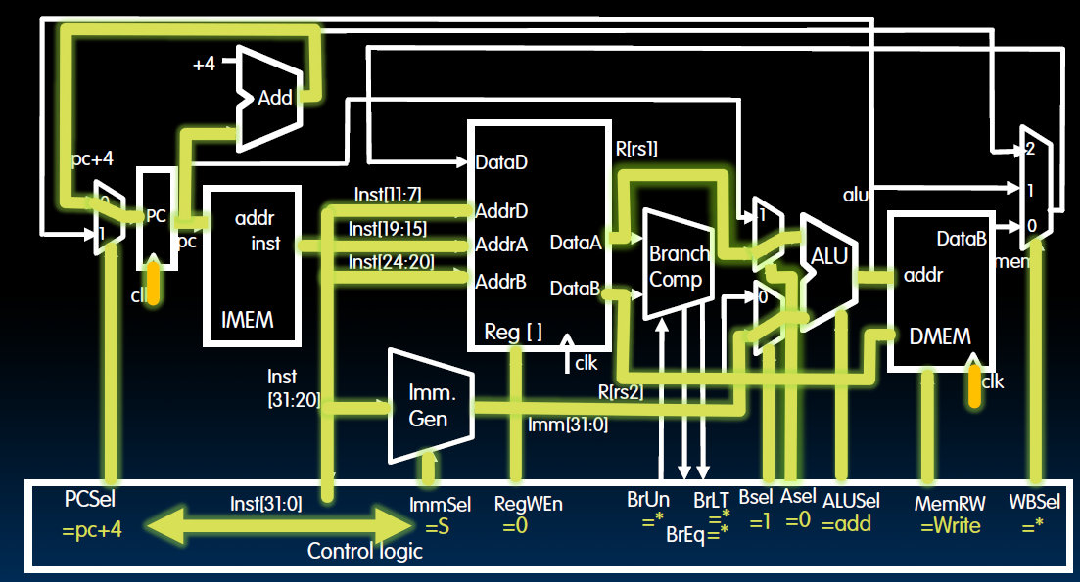
Example: SW X2, offset(X1)

Slide 19
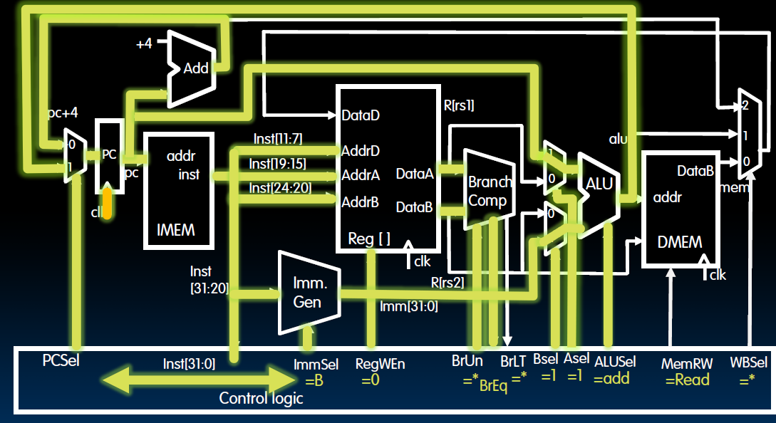
Example: BEQ X1,X2, immediate

Slide 20
A RV32I Single Cycle Processor
Data Path
Control
Notes:
This data path supports the RV32I core, including all user level instructions including JALR, Shift, and so on.

Slide 21
Questions Raised
Why ALUsel used 4 bits. Three bits should be sufficient!
  To support the subset (lw,sw,add,sub,and,or,beq,jal), three is sufficient. The textbook provides 4 bits also to include SETL, XOR, or shift operations.
Why the inst[30] bit is not included in the ALUsel control signal.
  This is an omission. This bit is in funct7, used to distinguish ADD from SUB, and SRA from SRL.
  This inst[30] bit is indeed used in ALUctl generation in the textbook.
Notes:
Having a long cycle time is a big problem but not the the only problem.
Another problem of this single cycle implementation is that this cycle time, which is long enough for the load instruction, is too long for all other instructions.
We will show you why this is bad and what we can do about it in the next few lectures.
That all for today.
+2 = 79 min (Y:59)

Slide 22
Truth Table for ALUctr
ALUop |  | Funct3 |  |  | ALUControl
bit1 | bit0 | bit2 | bit1 | bit0 | bit3 | bit2 | bit1 | bit0
0 | 0 | x | x | x | 0 | 0 | 1 | 0
x | 1 | x | x | x | 0 | 1 | 1 | 0
1 | x | 0 | 0 | 0 | 0 | 0 | 1 | 0
1 | x | 0 | 0 | 0 | 0 | 1 | 1 | 0
1 | x | 1 | 1 | 1 | 0 | 0 | 0 | 0
1 | x | 1 | 1 | 0 | 0 | 0 | 0 | 1
1 | x | 0 | 1 | 0 | 0 | 1 | 1 | 1
Need Inst[30] to distinguish ADD from SUB
and SRA from SRL

Slide 23
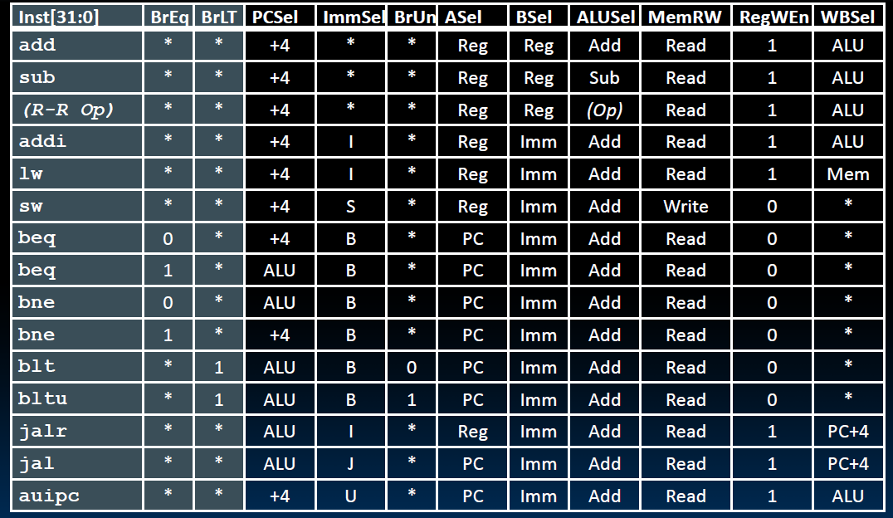
RV32I Control Logic Truth Table
PC = PC+4 or PC+immed?
Wbsel: ALU, Mem, or PC+4

Slide 24
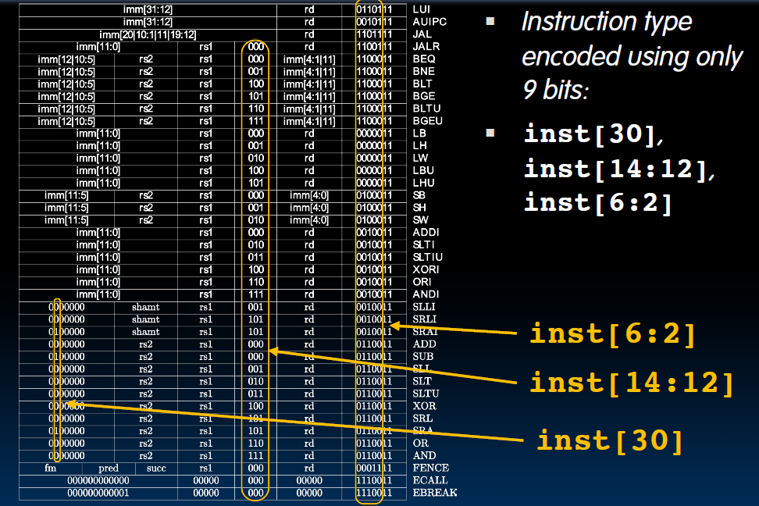
RV32I: 9 bits in Instruction drive the control
2 LSB of Opcode are 11 for
RV32I
funct3
Add/Sub, Logic/Arith Shift

Slide 25
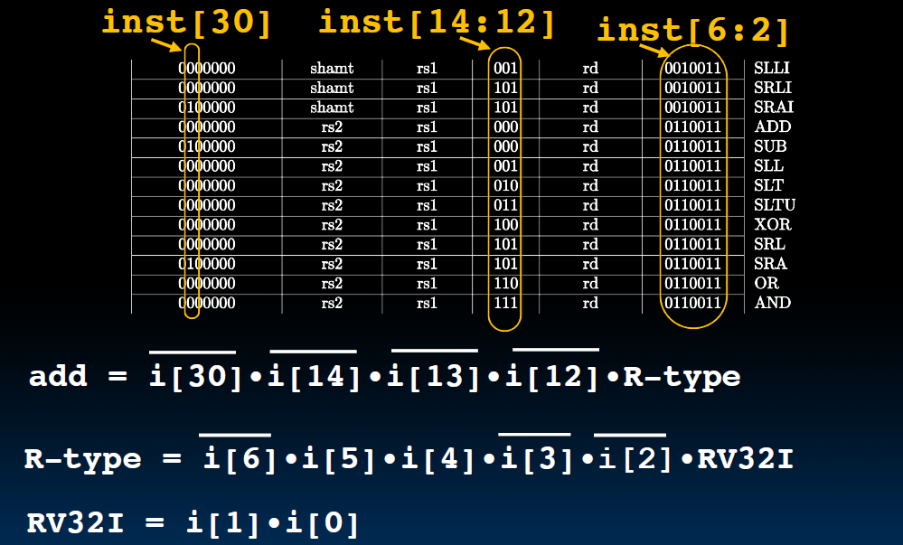
Example: How to decode the add instruction?

Slide 26
Drawback of Single-Cycle Design
Long cycle time
  Cycle time must be long enough for the load instruction (the one with longest cycle time)
    PC’s Clock-to-Q +
    Instruction Memory Access Time +
    Register File Access Time +
    ALU Delay (address calculation) +
    Data Memory Access Time +
    Register File Setup Time +
    Clock Skew
Cycle time for load is much longer than needed for all other instructions
Notes:
Well, the last slide pretty much illustrate one of the biggest disadvantage of the single cycle implementation: it has a long cycle time.
More specifically, the cycle time must be long enough for the load instruction which has the following components: Clock to Q time of the PC, ....
Having a long cycle time is a big problem but not the the only problem.
Another problem of this single cycle implementation is that this cycle time, which is long enough for the load instruction, is too long for all other instructions.
We will show you why this is bad and what we can do about it in the next few lectures.
That all for today.
+2 = 79 min (Y:59)

Slide 27
Summary of Single Cycle RV
Single cycle datapath means CPI=1, but
the clock cycle time is long
RISC-V simplifies control implementation
  Fixed size Instructions
  Regular format: source registers (rs1 and rs2) are always in the same places
  Immediates have the same size (12b or 20b)
  Operations are always computed on registers/immediates
RISC-V simplifies designs, lower the cost of design and test.

