Slide 1
CSC3050 – Computer Architecture
Chapter 4 The Processor
Prof. Wei Chung Hsu
School of Data Science
Chinese University of Hong Kong, Shenzhen

Slide 2
Computer Organization
CPU
Memory
I/O
Physical view
DataPath
Control
Memory
Input
Output
Functional view

Slide 3
The Processor: Datapath & Control
Data Path
  handles the actual processing of data (arithmetic operations, data movement, etc.)
Control
  manages the flow of instructions and signals within the processor
The separation makes the design more modular, easier to design, reusable, and scalable.

Slide 4
Simplified View: Datapath & Control
Data Path
  Manages data flow
Control
  Manages instruction flow

Slide 5
Simplified View: Datapath & Control
Data Path
  Manages data flow
    ALU, Register, Memory interface, buses
    Handles the actual data process
    The “brawn”
Control
  Manages instruction flow
    PC, instruction fetch, control signal generation
    Directs the operations of the data path
    The “brain”

Slide 6
RV32I Data Path and Control
We focus on the implementation of a subset of the RV32I core:
  Memory reference instructions: lw, sw
  Arithmetic/logical instructions: add, sub, and, or
  Control flow instructions: beq, jal
A subset, but sufficient to illustrate the key principles in creating a data path and designing the control.

Slide 7
Instruction Execution Cycle
Use the program counter (PC) to supply the instruction address and fetch the instruction from memory
Decode the instruction (and read registers)
Execute the instruction
  Use ALU to calculate
    Arithmetic result
    Memory address for load/store
    Branch target address
  Access data memory for load/store
  PC ← target address or PC + 4
Cycle:
Fetch-Decode-Execute
Fetch
PC=PC+4
Execute
Decode

Slide 8
Instruction Execution
Use the program counter (PC) to supply the instruction address and fetch the instruction from memory
Decode the instruction (and read registers)
Execute the instruction
  Use ALU to calculate
    Arithmetic result
    Memory address for load/store
    Branch target address
  Access data memory for load/store
  PC ← target address or PC + 4
Cycle:
Fetch-Decode-Execute
Fetch
PC=PC+4
Ld/St
Decode
Branch
ALU

Slide 9
Single Cycle vs. Multi-Cycles
Single cycle: Each instruction executes in a single clock cycle, meaning that all operations—fetching, decoding, executing, accessing memory, and writing back—occur within that one cycle. This requirement leads to a longer clock cycle to accommodate the slowest instruction, which often results in a lower clock frequency. The complexity of a given instruction can influence the cycle time. (This leads to the revolution of RISC architecture)
Multi-cycle: Instructions are broken down into multiple steps, each taking one clock cycle. This allows for a shorter clock cycle, higher clock frequency, and more efficient use of hardware resources.
By the way, before RISC, cycle time was about 1us in late 70’s
After RISC, MIPS(1985) cycle time 40 ns, SPARC(1987), 28ns

Slide 10
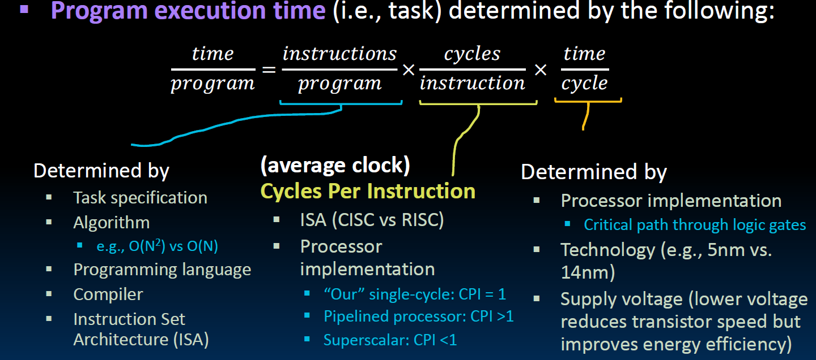
CPU Time = Inst count X CPI X Clock cycle time
Notes:
clock time： the time to complete a task

Slide 11
CISC vs RISC Examples
CPU Time = Inst count X CPI X Clock cycle time
CISC machines: Lower instruction count, higher CPI, longer cycle time
RISC machines: higher instruction count, lower CPI, shorter cycle time
How about modern x86 processors? Their cycle times are pretty short.
Modern x86 processors take x86 instructions in, translate in hardware into micro-operations for execution (and cached). Those micro-operations are RISC.

Slide 12
More Examples
CPU Time = Inst count X CPI X Clock cycle time
FMA X1, X2*X3+X4, Fused multiply and Add
Inst count CPI Clock cycle time
Micro-architectures:
Single cycle: CPI = 1, long cycle time
Multi-cycle: CPI = m, short cycle time
Pipelining: CPI = ~1, short cycle time
for single cycle
No change for multi-cycle
fma x1,x2,x3,x4 vs fmul x2, x2,x3
fadd x1, x2,x4
1 instr 2 insts
CPI=5 CPI=4
same clock cycle clk
1x5xclk 2x4xclk

Slide 13
CPU Time = Inst count X CPI X Clock cycle time
Assuming we have 4 instructions to execute, w,x,y, and z,:
Single cycle: CPI = 1, long cycle time
Multi-cycle: CPI = m, short cycle time
Pipelining: CPI = ~1, short cycle time
z
y
x
w
Z (4 cycle)
Y (3cycle)
X (2 cycle)
W (4 cycles)
W (4 cycles)
X (2 cycle)
Fully overlapped
Y (3cycle)
Z (4 cycle)

Slide 14
CPU Time = Inst count X CPI X Clock cycle time
Assuming we have 4 instructions to execute, w,x,y, and z,:
Single cycle: CPI = 1, long cycle time
Multi-cycle: CPI = m, short cycle time
Pipelining: CPI = ~1, short cycle time
Assume 1 long cycle = 4 short cycles
z
y
x
w
16 short cycles
Z (4 cycle)
Y (3cycle)
X (2 cycle)
W (4 cycles)
13 short cycles
W (4 cycles)
X (2 cycle)
Fully overlapped
7 short cycles
Y (3cycle)
Z (4 cycle)

Slide 15
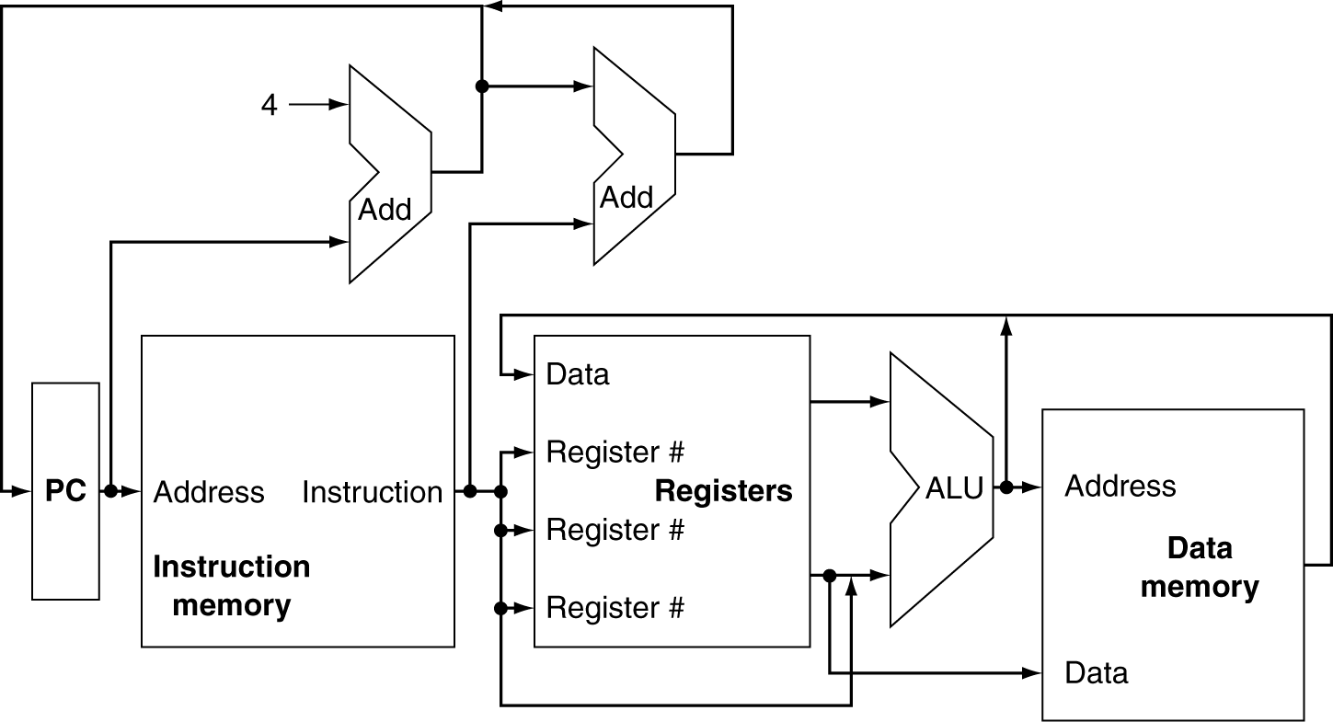
Abstract View of RV32I Subset
Notes:
在这个抽象图里面我 simplified 2 places，一个是多路输入

Slide 16
Multiplexers Required
Can’t just join wires together
  Must use multiplexers

Slide 17
Can’t just join wires together
  Must use multiplexers
What are these data?
immediates

Slide 18
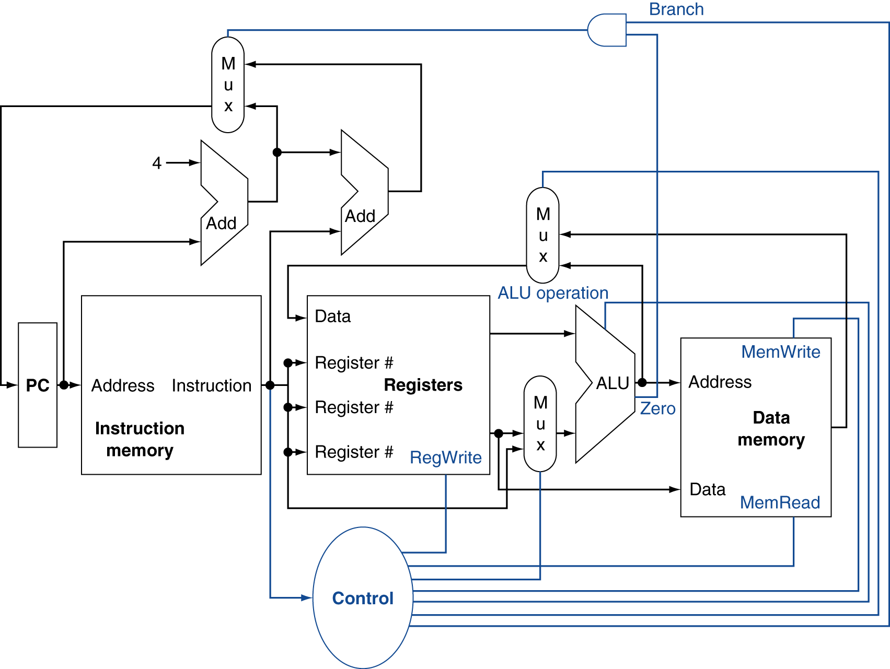
Control
Notes:
这个在前面的基础上增加了一个控制单元和3个多选器，
这里的控制单元决定功能单元和几个多选器的控制信号，其中第三个多选器决定是将PC+4还是分支的地址写入PC

Slide 19
Control Signals
Select PC+4 or PC+immediate
Select ALU output
or memory
Select register data
or immediates

Slide 20
Logic Design Basics
IF you have no background on logic designs, please read Appendix A
Information encoded in binary
  Low voltage = 0, High voltage = 1
  One wire per bit
  Multi-bit data encoded on multi-wire buses
Combinational element
  Operate on data
  Output is a function of input
State (sequential) elements
  Store information
Notes:
The datapath elements in the MIPS implementation consist of two different types of logic elements: elements that operate on data values and elements that contain state.
Recall the previous figure, The instruction and data memories, as well as the registers, are all examples of state elements.
Logic components that contain state are also called sequential element, because their outputs depend on both their inputs and the contents of the internal state.

Slide 21
Logic Design Basics
Information encoded in binary
  Low voltage = 0, High voltage = 1
  One wire per bit
  Multi-bit data encoded on multi-wire buses
Combinational element
  Operate on data
  Output is a function of input
State (sequential) elements
  Store information
What is the difference between combinational logic and sequential logic?
One is stateless, output purely depends on the inputs. e.g. ALU
The other has states, output depends on the inputs and the states, e.g. register
Notes:
The datapath elements in the RV implementation consist of two different types of logic elements: elements that operate on data values and elements that contain state.
Recall the previous figure, The instruction and data memories, as well as the registers, are all examples of state elements.
Logic components that contain state are also called sequential element, because their outputs depend on both their inputs and the contents of the internal state.

Slide 22
Combinational Elements
AND-gate
  Y = A & B
Adder
  Y = A + B
A
A
Y
+
Y
B
B
Multiplexer
  Y = S ? I1 : I0
Arithmetic/Logic Unit
  Y = F(A, B)
I0
M
u
x
A
Y
I1
ALU
Y
B
S
F

Slide 23
Sequential Elements（1）
Register: stores data in a circuit
  Use a clock signal to determine when to update the stored value
  Edge-triggered: update when Clk changes from 0 to 1
D
Q
Clk
D
Clk
Q
Notes:
这个是不带write control的

Slide 24
Sequential Elements（2）
Register with write control
  Only updates on clock edge when write control input is 1
  Used when stored value is required later
Write is 0 for what instructions?
Branches and Stores
Clk
D
Q
Write
Write
Clk
D
Q

Slide 25
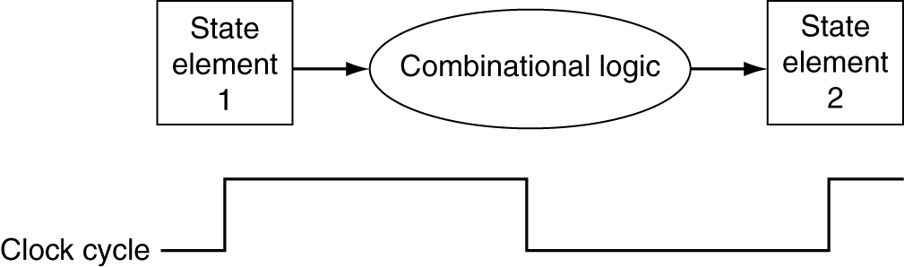
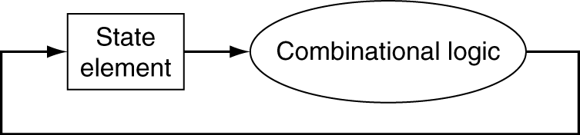
Clocking Methodology
Combinational logic transforms data during clock cycles
  Between clock edges, edge triggered clocking
  Input from state elements, output to state element
  Longest delay determines clock period
enable read and write in a same clock

Slide 26
How to Design a Processor
1. Analyze the required instruction set (data path requirements)
  The register transfers give the meaning of each instruction Datapath must include a storage element
  Datapath must support each register transfer
2. Select a set of data path components and establish a clocking methodology
3. Assemble data path meeting the requirements
4. Analyze the implementation of each instruction to determine the setting of control points affecting register transfers
5. Assemble the control logic

Slide 27
Step 1 - Analyze Instruction Set
Subset of RISC-V instructions are 32 bits long with 4 formats
  R-type
  I-type
  S-type/B-type
  J-type
The different fields are:
  opcode: Operation of the instruction
  rs1,rs2, rd: Source and destination registers
  funct3: Selects variant of the “opcode” field
  Immediate: for computing memory addresses (data and instruction)
7
5
5
3
5
7
funct7
rs2
rs1
funct3
rd
opcode
Subset:
Lw/Sw
Add/Sub
And/Or
Beq/Jal
12
5
3
5
7
imm[11:0]
rs1
funct3
rd
opcode
7
5
5
3
5
7
imm[11:5]
rs2
rs1
funct3
imm[4:0]
opcode
20
5
7
imm[31:12]
rd
opcode
Notes:
One of the most important thing you need to know before you start designing a processor is how the instructions look like.
Or in more technical term, you need to know the instruction format. One good thing about the RV instruction set is that it is very simple.
First of all, all RV instructions are 32 bits long.
The different fields of the R-type instructions are:
(a) OP specifies the operation of the instruction.
(b) Rs1, Rs2, and Rd are the source and destination register specifiers.
(c) Shamt specifies the amount you need to shift for the shift instructions.
(d) Funct selects the variant of the operation specified

Slide 28
Our Example: RV32I Subset
R-Type
  add rd, rs1, rs2
  sub rd, rs1, rs2
  and rd, rs1, rs2
  or rd, rs1, rs2
Load/Store
  lw rd,rs1,imm12
  sw rs2,rs1,imm12
Immediate operand
  addi rd,rs1,imm12
Branch
  beq rs1,rs2,imm12
Jump
  jal rd, target
7
5
5
3
5
7
funct7
rs2
rs1
funct3
rd
opcode
12
5
3
5
7
imm[11:0]
rs1
funct3
rd
opcode
7
5
5
3
5
7
imm[11:5]
rs2
rs1
funct3
imm[4:0]
opcode
1
6
5
5
3
4
1
7
imm[12]
imm[10:5]
rs2
rs1
funct3
imm[4:1]
imm[11]
opcode
1
10
1
8
5
7
imm[20]
imm[10:1]
imm
imm[19:12]
rd
opcode
Notes:
In today lecture, I will show you how to implement the following subset of RV32I instructions: add, subtract, and/or immediate, load, store, branch, and the jump instruction.
The Add and Subtract instructions use the R format. The Op together with the Func fields specified all the different kinds of add and subtract instructions.
Rs1 and Rs2 specifies the source registers. And the Rd field specifies the destination register.
The Or immediate instruction uses the I format. It only uses one source register, Rs1. The other operand comes from the immediate field. The Rd field is used to specified the destination register. (Note that dest is the Rt field!
The difference is that the load instruction will load the data from memory into Rd while the store instruction will store the data in Rs2 into the memory.
The branch on equal instruction also uses the I format. Here Rs and Rt are used to specified the registers we need to compare.
If these two registers are equal, we will branch to a location offset by the immediate field.
Finally, the jump instruction uses the J format and always causes the program to jump to a memory location specified in the address field.
I know I went over this rather quickly and you may have missed something. But don worry, this is just an overview. You will keep seeing these (point to the format) all day today.
+3 = 13 min. (X:53)

Slide 29
Logical Register Transfer
All start by fetching the instruction, reading registers, then use ALU => simplicity and regularity help
format = op | rs1 | rs2 | rd | funct
or = op | rs1 | rs2 | Imm12
or = op | Imm20
Inst Register transfers
ADD R[rd] <- R[rs1] + R[rs2]; PC <- PC + 4
SUB R[rd] <- R[rs1] - R[rs2]; PC <- PC + 4
LOAD R[rd] <- MEM[ R[rs1] + sign_ext(Imm12)]; PC <- PC + 4
STORE MEM[ R[rs1] + sign_ext(Imm12) ] <-R[rs2]; PC <- PC + 4
ADDI R[rd] <- R[rs1] + sign_ext(Imm12)]; PC <- PC + 4
BEQ if (R[rs1] == R[rs2]) then PC <- PC + sign_ext(Imm12)]
else PC <- PC + 4

Slide 30
Regularity in RISC-V Instruction Format
Opcode: The major opcode is always in bits 0-6.
Destination register (rd): when present, is always in bits 7-11.
First source register (rs1): when present, is always in bits 15-19.
Second source register (rs2): when present, is always in bits 20-24.
Instructions are fixed length: 16 or 32
Immediate values are placed in the high bits of the instructions (branch and store have some bits use the “rd” field)

Slide 31
Data Path Requirements
After checking the register transfers, we can see that data path needs the followings:
  Memory
    Store instructions and data (we have I-cache and D-cache)
  Registers (32 x 32b)
    Read RS1
    Read RS2
    Write RD
  PC
  Extender for zero- or sign-extension
  Add and sub register or extended immediate (ALU)
  Add 4 or extended immediate to PC

Slide 32
Step 2a - Combinational Components for Datapath
Basic building blocks of combinational logic elements
CarryIn
Select
A
32
A
Adder
Sum
32
32
MUX
Y
32
B
CarryOut
B
32
32
Adder
MUX
ALU control
4
A
32
ALU
Result
32
B
32
ALU
Notes:
Based on the Register Transfer Language examples we have so far, we know we will need the following combinational logic elements.
We will need an adder to update the program counter. We may end up with three adders!!
A MUX to select the results.
And finally, an ALU to do various arithmetic and logic operation.
+1 = 30 min. (Y:10)

Slide 33
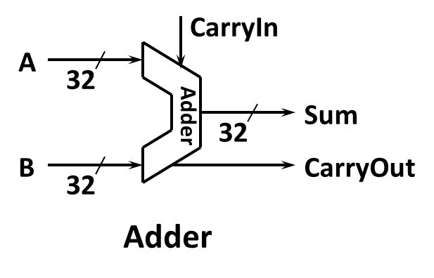
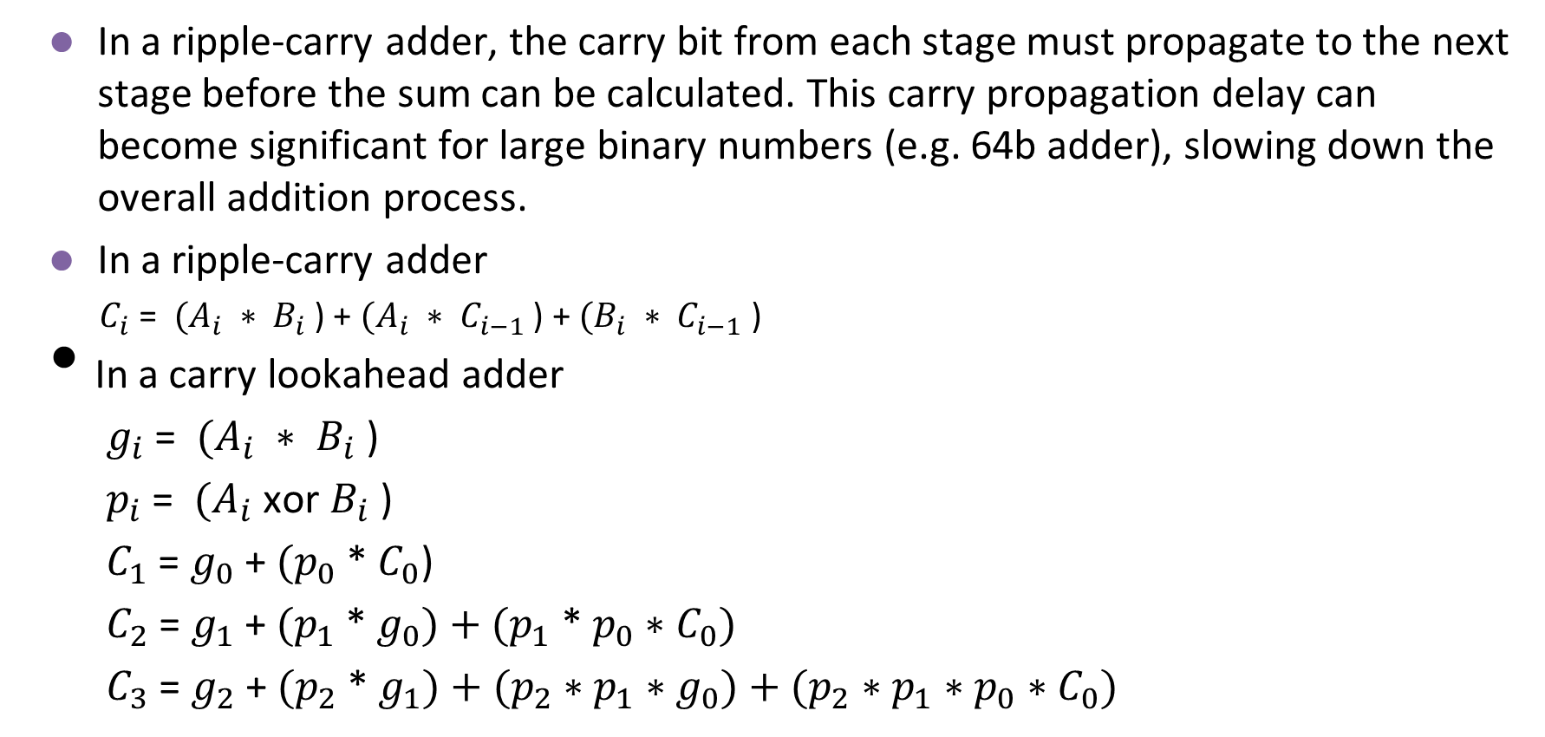
Carry Lookahead Adder
In a ripple-carry adder, the carry bit from each stage must propagate to the next stage before the sum can be calculated. This carry propagation delay can become significant for large binary numbers (e.g. 64b adder), slowing down the overall addition process.
In a ripple-carry adder
  $C_{i}$ = ${(A}_{i}$ $∗$ $B_{i}$ ) + ${(A}_{i}$ $∗$ $C_{i−1}$ ) + ${(B}_{i}$ $∗$ $C_{i−1}$ )
In a carry lookahead adder
${ g}_{i}$ = ${(A}_{i}$ $∗$ $B_{i}$ )
${ p}_{i}$ = ${(A}_{i}$ xor $B_{i}$ )
${ C}_{1}$ = $g_{0}$ + ${(p}_{0}$ * $C_{0}$)
${ C}_{2}$ = $g_{1}$ + ${(p}_{1}$ * ${g_{0})+(p_{1}\text{ * }{p_{0}∗C}_{0})}_{}$
${ C}_{3}$ = $g_{2}$ + ${(p}_{2}$ * ${g_{1})+(p_{2}\text{ ∗ }{p_{1}∗g}_{0})+(p_{2}\text{ ∗ }{p_{1}∗p}_{0}∗C_{0})}_{}$
Now, the carry propagation chain disappears

Slide 34
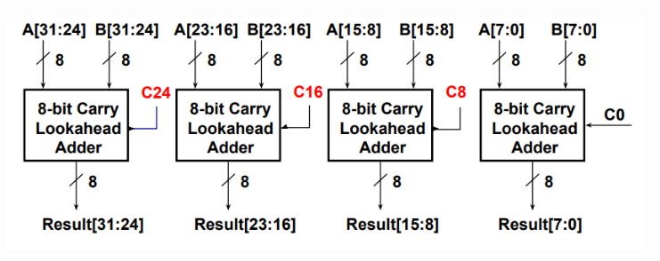
A Practical Carry Lookahead Adder

Slide 35
Step 2b - Sequential Components for Datapath
Register
  Similar to the D Flip Flop except
    N-bit input and output
    Write Enable input
  Write Enable
    negated (0): Data Out will not change
    asserted (1): Data Out will become Data In
Write Enable
Data In
Data Out
N
N
Clk
Notes:
As far as storage elements are concerned, we will need a N-bit register that is similar to the D flip-flop I showed you in class. （D触发器）
The significant difference here is that the register will have a Write Enable input.
That is the content of the register will NOT be updated if Write Enable is not asserted (0).
The content is updated at the clock tick ONLY if the Write Enable signal is asserted (1).
+1 = 31 min. (Y:11)

Slide 36
Storage Element - Register File
Consists of 32 registers
  Two 32-bit output buses (busA and busB)
  Two output buses are usually called two read ports
  One 32-bit input bus: busW (one write port)
Register is selected by
  RA selects the register to put on busA (data)
  RB selects the register to put on busB (data)
  RW selects the register to be written via busW (data) when Write Enable is 1
Clock input (CLK)
  The CLK input is a factor ONLY during write operation
  During read, behaves as a combinational circuit
RW
RA
RB
Write Enable
5
5
5
busA
busW
32-bit
Registers
32
32
Clk
busB
32
How many read ports needed for
a 2-wide superscalar processor?
How many read ports are needed for
fma (fused mul-add) instruction?
Notes:
register File: 寄存器堆，包含32个通用寄存器。 BusA和BusB是读两个寄存器的值，busW是写，RA、Rb、RW是寄存器的编号
We will also need a register file that consists of 32 32-bit registers with two output busses (busA and busB) and one input bus.
The register specifiers Ra and Rb select the registers to put on busA and busB respectively.
When Write Enable is 1, the register specifier Rw selects the register to be written via busW.
In our simplified version of the register file, the write operation will occurs at the clock tick.
Keep in mind that the clock input is a factor ONLY during the write operation.
During read operation, the register file behaves as a combinational logic block.
That is if you put a valid value on Ra, then bus A will become valid after the register file access time.
Similarly if you put a valid value on Rb, bus B will become valid after the register file access time. In both cases (Ra and Rb), the clock input is not a factor.
Intel can issue 4-6 instruction per clock cycle. This does not mean the registers should support 12 read ports. Because 4-6 are a mix of int/fp instructions.
Today’s high-end processors usually support 10-12 read ports.

Slide 37
Storage Element - Memory
Memory
  One input bus: Data In
  One output bus: Data Out
Word is selected by
  Address selects the word to put on Data Out
  Write Enable = 1: address selects the memory
  word to be written via the Data In bus
Mem Write
Address
Data In
DataOut
32
32
Mem Read
Notes:
The last storage element you will need for the datapath is the idealized memory to store your data and instructions.
This idealized memory block has just one input bus (DataIn) and one output bus (DataOut).
When Write Enable is 0, the address selects the memory word to put on the Data Out bus.
When Write Enable is 1, the address selects the memory word to be written via the DataIn bus at the next clock tick.
Once again, the clock input is a factor ONLY during the write operation.
During read operation, it behaves as a combinational logic block.
That is if you put a valid value on the address lines, the output bus DataOut will become valid after the access time of the memory

Slide 38
Step 3a - Datapath Assembly
Instruction fetch unit: common operations
  Fetch the instruction: mem[PC]
  Update the program counter
    Sequential code: PC <- PC + 4
    Branch and Jump: PC <- “Something else”

Slide 39
Step 3b - Branch Operations
beq rs1, rs2, imm12
  mem[PC] /*Fetch inst. from memory */
  Equal <- R[rs1] == R[rs2] /* Calculate branch condition */
  if (Equal) /* Calculate next inst. Address */
    PC <- PC + ( SignExt(imm12) x 2 )
  else
    PC <- PC + 4
1
6
5
5
3
4
1
7
imm[12]
imm[10:5]
rs2
rs1
funct3
imm[4:1]
imm[11]
opcode
Notes:
How does the branch on equal instruction work?
Well it calculates the branch condition by subtracting the register selected by the Rs2 field from the register selected by the Rs1 field.
If the result of the subtraction is zero, then these two registers are equal and we take a branch. Otherwise, we keep going down the sequential path (PC <- PC +4).
+1 = 65 min. (Y:45)

Slide 40
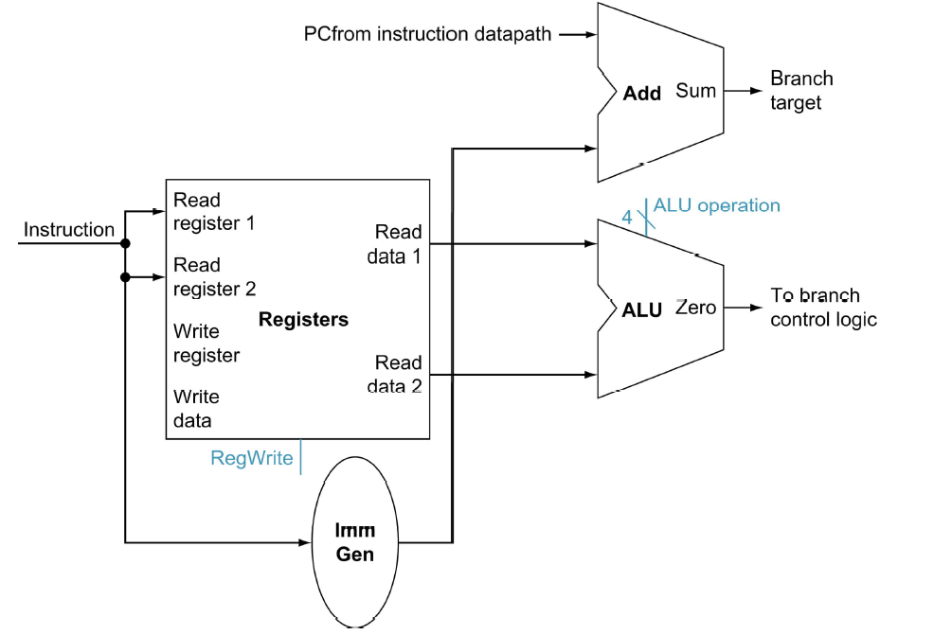
Datapath for Branch Operations
beq rs1, rs2, imm12
Why do we need two adders? Is one enough?
Notes:
The datapath for calculating the branch condition is rather simple.
All we have to do is feed the Rs and Rt fields of the instruction into the Ra and Rb inputs of the register file.
For the branch, usually a subtraction is performed, but what if the subtraction overflowed?
Bus A will then contain the value from the register selected by Rs.
And bus B will contain the value from the register selected by Rt.
The next thing to do is to ask the ALU to perform a subtract operation and feed the output Zero to the next address logic.
How does the next address logic block look like?
Well, before I show you that, let take a look at the binary arithmetics behind the program counter (PC).
+2 = 67 min. (Y:47)

Slide 41
Alert: Branch with Subtraction
Intuitively, a compare and branch instruction could be handled by a subtraction. The output condition is positive, 0, or negative. This output can be used to guide the branch direction.
The above implementation is cost-effective because we have the ALU to support ADD/SUB operations. The same ALU could be used.
The trouble is, what if the subtraction caused an overflow? So, the sign of the result is incorrect, and cannot be used to decide the branch outcome.
If overflow, the trap handler can handle this, but RISC-V does not support such hardware traps. It requires explicit software checks. Does that mean we always generate a check for overflow for each compare and branch?
One way to handle this correctly is to use a true comparison operation instead of the subtraction. However, this increases the cost and the complexity of the design. In practice, most RV processor implementations will include V (overflow) and C (Carry) flags in a temporary status register if they use subtraction to determine conditions.

Slide 42
Step 3b - Add and Subtract
R[rd] <- R[rs1] op R[rs2] Ex: add rd, rs1, rs2
  Ra, Rb, Rw come from instruction’s rs1, rs2, and rd fields
  ALU and RegWrite: control logic after decode
rs1
4
A
L
U
o
p
e
r
a
t
i
o
n
(funct)
R
e
a
d
r
e
g
i
s
t
e
r
1
R
e
a
d
rs2
R
e
a
d
d
a
t
a
1
I
n
s
t
r
u
c
t
i
o
n
r
e
g
i
s
t
e
r
2
Z
e
r
o
rd
R
e
g
i
s
t
e
r
s
A
L
U
A
L
U
W
r
i
t
e
r
e
s
u
l
t
r
e
g
i
s
t
e
r
R
e
a
d
W
r
i
t
e
d
a
t
a
2
d
a
t
a
R
e
g
W
r
i
t
e
Notes:
And here is the datapath that can do the trick.
First of all, we connect the register file Ra, Rb, and Rw input to the Rd, Rs1, and Rs2 fields of the instruction bus (points to the format diagram).
Then we need to connect busA and busB of the register file to the ALU.
Finally, we need to connect the output of the ALU to the input bus of the register file.
Conceptually, this is how it works.
The instruction bus coming out of the Instruction memory will set the Rs1 and Rs2 to the register specifiers Rs1 and Rs2.
This causes the register file to put the value of register Rs1 onto busA and the value of register Rs2 onto busB, respectively.
By setting the ALUctr appropriately, the ALU will perform either the Add and Subtract for us.
The result is then fed back to the register file where the register specifier Rw should already be set to the instruction bus Rd field.
Since the control, which we will design in our next lecture, should have already set the RegWr signal to 1, the result will be written back to the register file at the next clock tick (points to the Clk input).
+3 = 42 min. (Y:22)

Slide 43
Step 3c - Load/Store Operations
R[rd]<-Mem[R[rs1]+SignExt[imm12]] Ex: lw rd,rs1,imm12
rs1
4
rs2
rd
12
Notes:
Once again we cannot use the instruction Rd field for the Register File Rw input because load is a I-type instruction and there is no such thing as the Rd field in the I format.
So instead of Rd, the Rt field is used to specify the destination register through this two to one multiplexor.
The first operand of the ALU comes from busA of the register file which contains the value of Register Rs (points to the Ra input of the register file).
The second operand, on the other hand, comes from the immediate field of the instruction.
Instead of using the Zero Extender I used in datapath for the or immediate datapath, I have to use a more general purpose Extender that can do both Sign Extend and Zero Extend.
The ALU then adds these two operands together to form the memory address.
Consequently, the output of the ALU has to go to two places:
(a) First the address input of the data memory.
(b) And secondly, also to the input of this two-to-one multiplexer.
The other input of this multiplexer comes from the output of the data memory so we can place the output of the data memory onto the register file input bus for the load instruction.
For Add, Subtract, and the Or immediate instructions, the output of the ALU will be selected to be placed on the input bus of the register file.
In either case, the control signal RegWr should be asserted so the register file will be written at the end of the cycle.
+3 = 60 min. (Y:40)

Slide 44
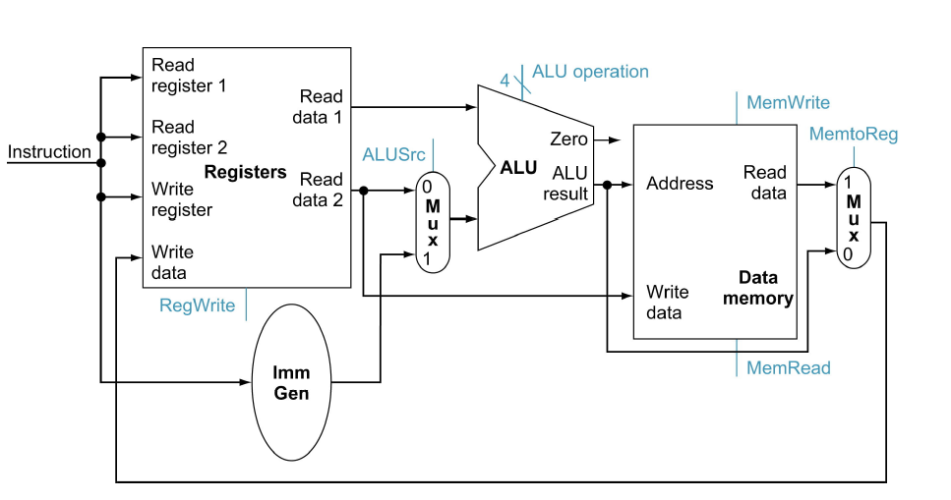
Combine Mem and R-type Instructions
Notes:
To create a datapath with only a single register fi le and a single ALU, we must
support two diff erent sources for the second ALU input, as well as two diff erent
sources for the data stored into the register fi le. Th us, one multiplexor is placed
at the ALU input and another at the data input to the register fi le.

Slide 45
Combinational vs. Sequential Logic
Sequential logic circuits have states and their output depends on both current inputs and states, while combinational logic circuits depend solely on the current inputs.
Combinational circuit examples:
Adder, Encoder/Decoder, Mux (multiplexer), Comparators, Parity generators.
Sequential circuit examples:
Registers, Counters, FSM (Finite State Machines): branch predictors, cache coherence protocols.

Slide 46
Architecture States
Processor registers
  PC
  Integer registers
  FP registers
  Vector registers
  Status registers (flags)
  Pointer to the page table
Memory
Cache
I/O device (status and buffers)
Control signals
At a context switch (thread switch or process switch), what state information must be saved?
  Processor registers for threads
  PCB (Process Control Block) for processes. PCB includes registers.
Other information, such as the cache or control signals, either stays the same, is maintained by the OS, or can be reproduced.
To resume a program, just restore its states.

Slide 47
Computer Simulation
Computer simulation is like creating a virtual version of a real-world process.
We may view computer simulation as the simulation of computer architecture state changes:
  States as the Foundation: registers, memory, …. define the current configuration and behavior of the system.
  Simulation as State Evolution: A computer simulation models how these states change over time in response to instructions, inputs, and internal events. The single stepping in your debugging process is observing the state changes!!
  Instruction Execution: Each instruction executed by the processor causes a change in the system's state. Registers are updated!
  External events: I/O and interrupts
  Micro-architectural modeling
Notes:
Programmer’s perspectives! Not designer’s perspective

Slide 48
A Single Cycle RISC-V Processor
On every tick of the clock, the processor executes one instruction
  Current outputs of the state elements drive the inputs to the combinational logic.
  The outputs of the combinational logic settle at the inputs to the state elements before the rising of the next clock edge.
At the next rising edge of the clock
  All state elements are updated with the combinational logic outputs
  The execution moves to the next clock cycle

Slide 49
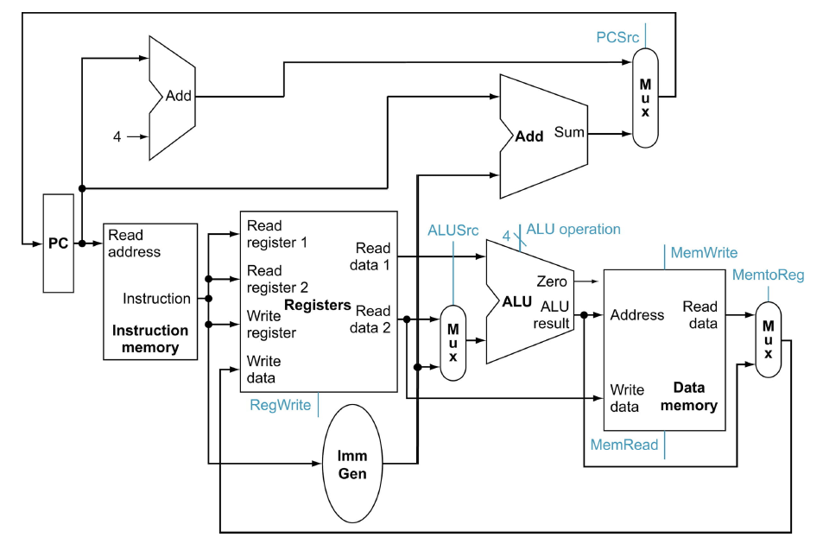
A Single Cycle Data Path
Add this path for JAL
WBsel

Slide 50
Limitations of a Single-Cycle Implementation
Resources cannot be reused. So there are multiple adders – for PC updates, and for ALU.
Instruction memory and data memory are separated. In a single cycle, you may not go through the same combinational logic or the state more than once.
Do we need duplicated register file? How to read two registers, and write one at the same time? We will need two read ports and one write port.
A single cycle design, registers are updated at the rise of the clock, and the registers are updated, and then the outputs from registers are send to the combinational logic.

Slide 51
Inefficiency in a Single Cycle Implementation
Some computations are iterative such as multiply and divide.
Multiply and divide may need to iterate through the same combinational logic resources many times. In a single-cycle implementation, the logic must be replicated many times.
The above implementation is way too expensive. So, one way to reduce the cost is to allow the implementation to iterate through the same resource using a counter. However, that means we need to use a faster clock to sync each step. Such instructions then become multi-cycle instructions.
Multi-cycle implementation is one step between single-cycle implementation and pipelined implementation.

Slide 52
Data Flow during add rd, rs1, rs2
1
Add this path for JAL
WBsel
100..0100
12

Slide 53
Clocking Methodology – Sequential Logic
Edge-triggered
  Values in storage (state) elements updated only on a clock edge
  => clock edge should arrive only after input signals stable
  Any combinational circuit must have inputs from and outputs to storage elements
  Clock cycle: Time for signals to propagate from one storage element, through combinational circuit, to reach the second storage element
  A register can be read, its value propagated through some combinational circuit, new value is written back to the same register, all in same cycle

Slide 54
The Critical Path
Register file and ideal data memory
  During read, behave as combinational logic
    Address valid => Output valid after access time
Critical Path (Load Operation) =
PC’s Clk-to-Q +
Instruction memory’s Access Time +
Register file’s Access Time +
ALU to Perform a 32-bit Add +
Data Memory Access Time +
Setup Time for Register File Write +
Clock Skew
Ideal
Instruction
Memory
Instruction
Rd
Rs1
Rs2
Imm
5
5
5
12
Instruction
Address
A
Data
Address
Rw
Ra
Rb
32
32
32
Ideal
Data
Memory
32 32-bit
Registers
ALU
PC
Next Address
Data In
B
Clk
Clk
Clk
32
Notes:
Now, with the clocking methodology back in your mind, we can consider what the critical path of our abstract datapath may look like.
One thing to keep in mind about the Register File and Ideal Memory (points to both Instruction and Data) is that the Clock input is a factor ONLY during the write operation.
For read operation, the CLK input is not a factor. The register file and the ideal memory behave as if they are combinational logic.
That is you apply an address to the input, then after certain delay, which we called access time, the output is valid.
We will come back to these points later in this lecture.
But for now, let look at this bstract?datapath critical path which occurs when the datapath tries to execute the Load instruction.
The time it takes to execute the load instruction are the sum of:
(a) The PC clock-to-Q time.
(b) The instruction memory access time.
(c) The time it takes to read the register file.
(d) The ALU delay in calculating the Data Memory Address.
(e) The time it takes to read the Data Memory.
(f) And finally, the setup time for the register file and clock skew.
+3 = 21 (Y:01)

Slide 55
Step 4 - Control Points and Signals
Instruction<31:0>
Inst.
Memory
<12:14>
<15:19>
<20:24>
<7:11>
<20:31>
Addr
Op
Funct
Rs1
Rs2
Rd
Imm12
Control
PCsrc
RegWr
MemRd
ALUSrc
ALUctr
MemWr
MemtoReg
Equal
Datapath

Slide 56
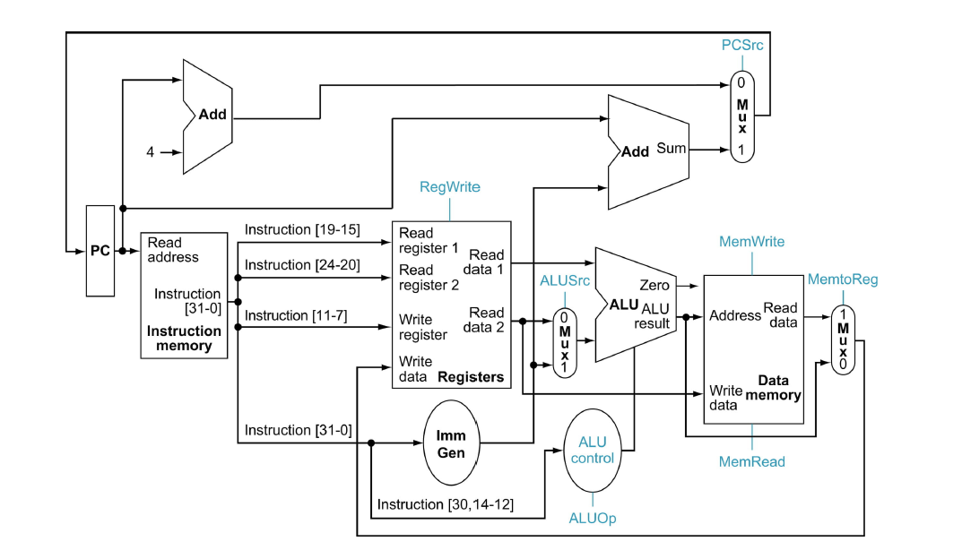
Step 4 - Control Points and Signals
Add this path for JAL
WBsel
Control point

