Slide 1
CSC3050 – Computer Architecture
Chapter 4 The Processor
Pipelining
Prof. Wei Chung Hsu
School of Data Science
Chinese University of Hong Kong, Shenzhen

Slide 2

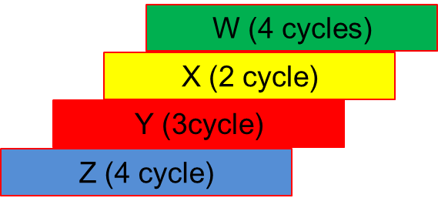
Pipelining
Pipelining is an implementation technique in which multiple instructions are overlapped in execution, much like an assembly line.
Single-cycle
4 X long cycles
(16 x short cycles)
Multi-cycle
13 X short cycles
Pipelined
7 X short cycles

Slide 3
Single-Cycle Disadvantages & Advantages
Clock inefficiency: the clock cycle must be timed to accommodate the slowest instruction path.
  Especially problematic for more complex instructions, e.g., floating-point division
Resource inefficiency: some functional units (e.g., adders) must be duplicated because they can not be reused during a clock cycle
Advantage: It is simple and easy to understand
Cycle 1
Cycle 2
Clk
lw
sw
waste

Slide 4
Five Stages of the Simple Data Path
Five stages, one step per stage
IF: Instruction fetch from (instruction) memory
ID: Instruction decode & register read
EX: Execute operation or calculate address
MEM: Access (data) memory operand
WB: Write the result back to register
Initially, this partition is for multi-cycle implementation:
an instruction can finish at stage 3, stage 4 or stage 5

Slide 5
Divide the Single Cycle Data Path into 5 Stages

Slide 6
Three Register Ports: One Write, Two Read
Three ports: 1 W, 2 R

Slide 7
Three Register Ports: One Write, Two Read
Three ports: 1 W, 2 R
What if the WB stage wants to write register X5, and the ID stage wants to read register X5?
This is called a “Data Hazard” or RAW (Read-After-Write) hazard and must be avoided via:
1) Stalling; 2) Data forwarding; and 3) Static or Dynamic code scheduling

Slide 8
Instruction Timing and Clock Cycle Time
Assume time for a stage is
  100 ps for register to read or write
  200 ps for other stages (Mem and ALU)
Instruction | IF = 200ps | ID=100ps | ALU=200ps | Mem=200ps | WB=100ps | Total
add | X | X | X |  | X | 600ps
beq | X | X | X |  |  | 500ps
jal | X | X | X |  | X | 600ps
lw | X | X | X | X | X | 800ps
sw | X | X | X | X |  | 700ps
Maximum clock frequency for single-cycle implementation= 1/800ps = 1.25 GHz
For multi-cycle implementation, 1/200ps = 5 GHz

Slide 9

Pipelining Analogy
Four students A, B, C, and D, each have one load of cloth to wash, dray, fold, and put away.
Washer takes 30 minutes
Dryer takes 30 minutes
Folder takes 30 minutes
Stasher takes 30 minutes to put folded cloth into drawer.
Notes:
1. Place one dirty load of clothes in the washer.
2. When the washer is fi nished, place the wet load in the dryer.
3. When the dryer is fi nished, place the dry load on a table and fold.
4. When folding is fi nished, ask your roommate to put the clothes away.

Slide 10
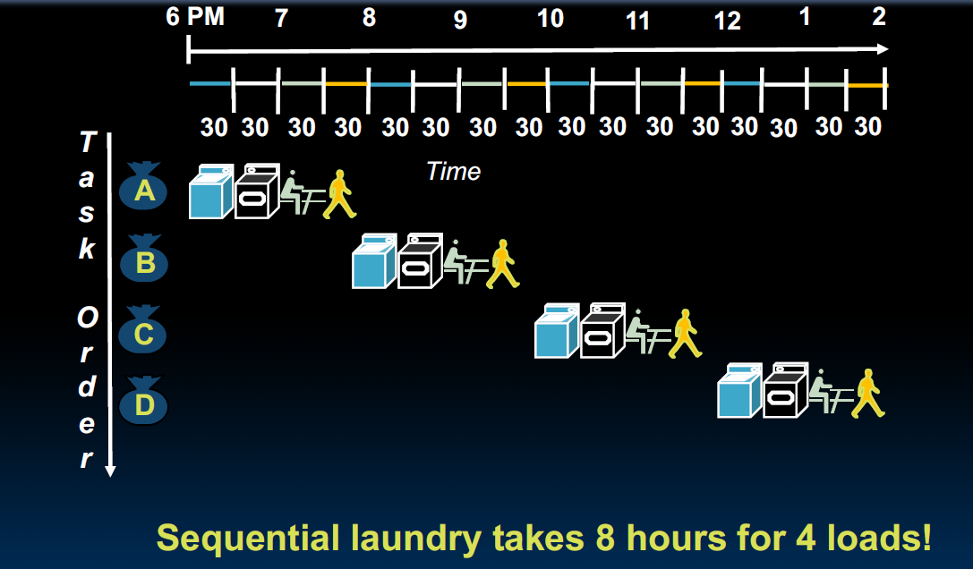
Sequential Laundry
Notes:
假设每个半小时
1. Place one dirty load of clothes in the washer.
2. When the washer is fi nished, place the wet load in the dryer.
3. When the dryer is fi nished, place the dry load on a table and fold.
4. When folding is fi nished, ask your roommate to put the clothes away.

Slide 11
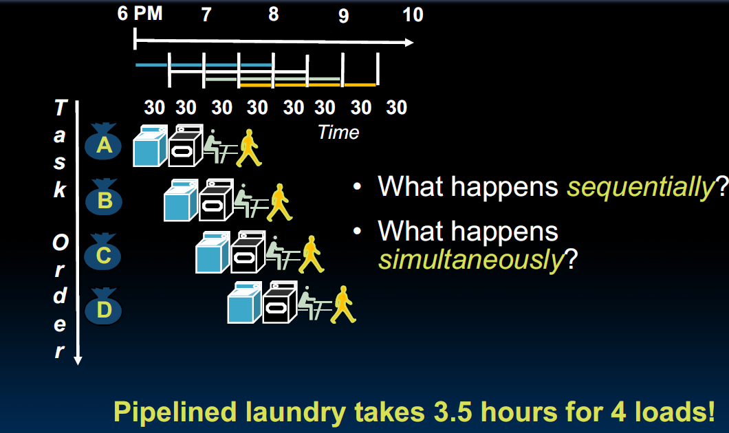
Pipelined Laundry
Notes:
假设每个半小时
1. Place one dirty load of clothes in the washer.
2. When the washer is fi nished, place the wet load in the dryer.
3. When the dryer is fi nished, place the dry load on a table and fold.
4. When folding is fi nished, ask your roommate to put the clothes away.

Slide 12
Pipelined Laundry
Notes:
假设每个半小时
1. Place one dirty load of clothes in the washer.
2. When the washer is fi nished, place the wet load in the dryer.
3. When the dryer is fi nished, place the dry load on a table and fold.
4. When folding is fi nished, ask your roommate to put the clothes away.

Slide 13
Yale Patt’s Analogy
An African tribe leader wants to have 10 children in one-two years. He calls upon his advisor, who suggests a plan:
Traditional Method (No Pipelining):
  The wife carries a child for 9 months (gestation period).
  This process is repeated 10 times to have 10 children, taking a total of 9 months/child * 10 children = 90 months (7.5 years).
Pipelined Method
  Start conception for child #1
  Begin conception for child #2 after 1 month.
  Repeat this process for all 10 children.
  This process takes 19 months (1.5 year).
This does not work!
There are structure hazards!
The tribe leader is required to have ten wives.

Slide 14



Slide 15
Single cycle vs. multi-cycle vs. pipeline
Cycle 1
Cycle 2
Clk
Single Cycle:
Load
Beq
Waste
Cycle 1
Cycle 2
Cycle 3
Cycle 4
Cycle 5
Cycle 6
Cycle 7
Cycle 8
Cycle 9
Cycle 10
Clk
Multi-cycle:
IF
ID
EX
MEM
WB
IF
ID
EX
Pipeline
Load
IF
ID
EX
MEM
WB
store
IF
ID
EX
MEM
WB
R-type
IF
ID
EX
MEM
WB

Slide 16
Pipeline Performance (1)
Assume time for stages is
  100 ps for register read or write
  200 ps for other stages (Mem and ALU)
Compare pipelined datapath with single-cycle datapath
Pipelined clock rate set by the slowest stage
Instruction | IF | Reg Read | ALU Op | Mem Access | Reg Write | Total
lw | 200 | 100 | 200 | 200 | 100 | 800
sw | 200 | 100 | 200 | 200 |  | 700
R-format | 200 | 100 | 200 |  | 100 | 600
beq | 200 | 100 | 200 |  |  | 500

Slide 17
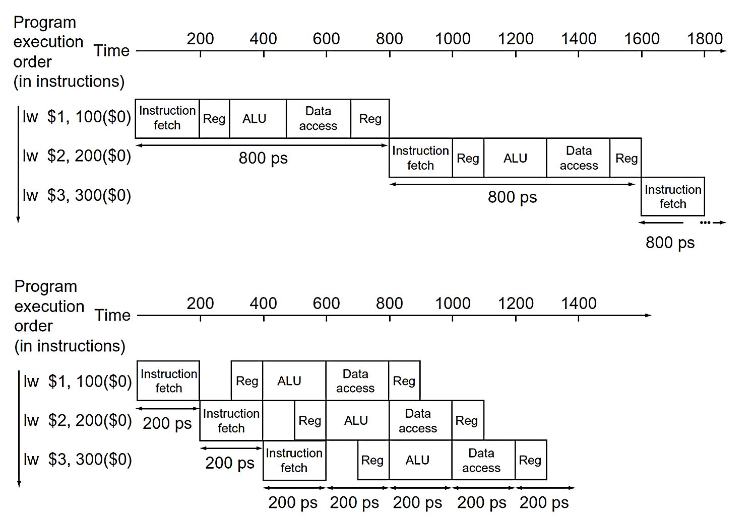
Pipeline Performance (2)
N cycles
each cycle 800ps
N +4 cycles
each cycle 200ps
When N is large
+4 can be ignored

Slide 18
Pipeline Speedup
If all stages are balanced, i.e., all take the same time, in an ideal situation
If not perfectly balanced, speedup would be less
The speedup is a result of increased throughput.
Instruction Latency, which refers to the time it takes for each instruction to be executed, does not decrease; in fact, it may even increase.
Time between instructions _{pipelined} = | Time between instructions _{nonpipelined}
 | Number of pipeline stages

Slide 19
Pipeline-oriented ISA Design
RISC-V ISA is designed for pipelining
  All instructions are fixed length: 32-bits (except for the C extension)
    Easier to fetch and decode in one cycle
    c.f. x86: 1- to 17-byte instructions
  Few and regular instruction formats
    Decode and read registers in one step
  Only load/store instructions accessing memory
    Calculate address in the 3rd stage, access memory in the 4th stage
    If the operand is in memory, additional execution stages are needed after stage 4.
  Instructions are simple and do not require a large number of steps

Slide 20
Pipeline Lessons
Does not help latency of a single task, but the throughput of the entire program
Pipeline rate limited by the slowest stage, unbalanced stage length limits the perfect speedup
Multiple tasks working at the same time using different resources
Potential speedup = Number of pipeline stages
Time to “fill” & “drain” the pipeline reduces speedup
  Need to reduce possible fill and drain (e.g., I-cache misses and branch
  misprediction)
Avoid pipeline bubbles from data and control dependencies

Slide 21
Pipeline Everywhere
Aside from the instruction pipeline, many other areas have implemented pipelined architectures.
  DRAM pipeline
    Row activation, column selection, data transfer
  Cache pipeline
    Address decoding, Way selection, tag match, data retrieval
  Floating point unit pipeline
    Exponent alignment, operation, normalization, rounding, …
  GPU pipeline
    vertex processing, rasterization, fragment processing
  Network pipeline
    packet header processing, routing table lookup, and packet forwarding
If you need to have a higher throughput, think about pipelining.

Slide 22
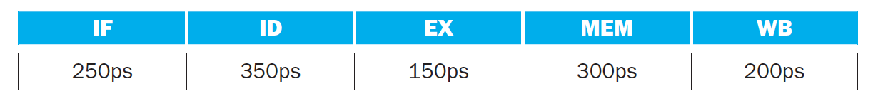
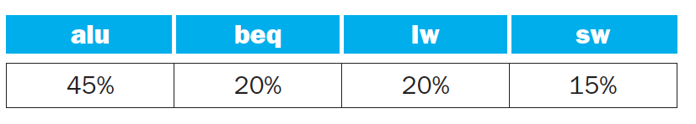
Exercise-1
Assume individual stages of the datapath have the following latencies:
Assume that instructions executed by the processor are broken down as follows:
What is the clock time for non-pipeline version and pipeline version ？
1250, 350

Slide 23
Exercise-1
Assume individual stages of the datapath have the following latencies:
Assume that instructions executed by the processor are broken down as follows:
What is the clock time for non-pipeline version and pipeline version ？
What is the total latency of an LW instruction in a pipelined and non-pipelined processor?
Non-pipelined: 1250, Pipelined: 1750 (350*5)

Slide 24
Exercise-1
Assume individual stages of the datapath have the following latencies:
Assume that instructions executed by the processor are broken down as follows:
What is the clock time for non-pipeline version and pipeline version ？
What is the total latency of an LW instruction in a pipelined and non-pipelined processor?
If we can split a stage, which stage should we split? What is the new cycle time?
1250, 350
1250, 350*5
ID, 300 ps

Slide 25
Exercise-1
Assume individual stages of the datapath have the following latencies:
Assume that instructions executed by the processor are broken down as follows:
What is the clock time for non-pipeline version and pipeline version ？
What is the total latency of an LW instruction in a pipelined and non-pipelined processor?
If we can split a stage, which stage should we split? What is the new cycle time?
Compare to multi-cycle implementation, assume lw needs 5 short cycles, other instructions need 4, compute the ideal speedup of Ex(single-cycle/pipeline) and Ex(multi-cycle/pipeline)?
1250, 350
1250, 350*5
ID, 300 ps
1250/350
(1250)/350
(0.2*350*5+0.8*350*4)/350

Slide 26
About Instruction Mix
In the above exercise, the load/store to ALU ratio is about 1:1. However,
critical applications are often memory intensive. Such applications include
Machine learning and AI
  Social network analysis can be as high as 20:1
  Recommender system can be as high as 10:1 or 20:1
  ML training is memory intensive, while inference may not be.
HPC and Scientific Computing
Databases and Data Analytics: 3:1 or 4:1
Media and Entertainment
VR/AR
Medical Image
Bioinformatics
  Could be as high as 5:1
Dot product:
3 loads, 1 store
2 operations: + and *
4/2 = 2
Notes:
There was a famous quote in USA president election campaign: Economics is the problem! Stupid! In CS, we often have a similar quote: Memory is the problem! Stupid!

Slide 27
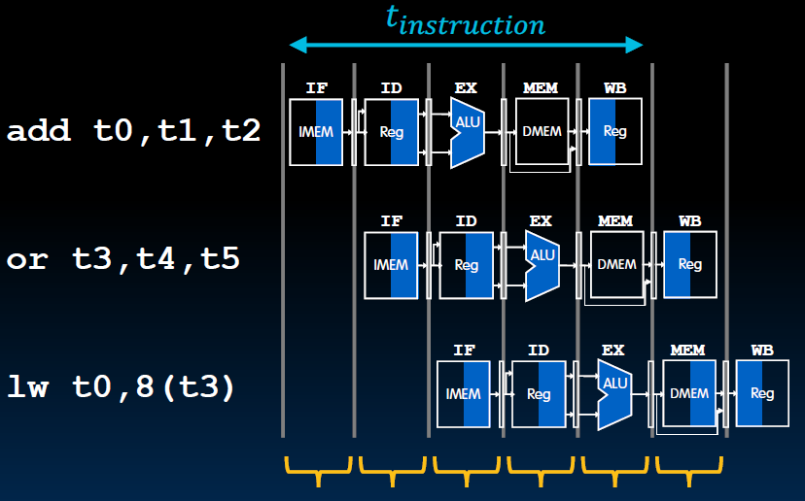

Pipelined RV32I Data Path
The label of each box
indicates its state element
e,g, IMEM, DMEM, Reg
Blue shade means
the element is active
Black shade means
the element is inactive
t$cycle$=200ps

Slide 28
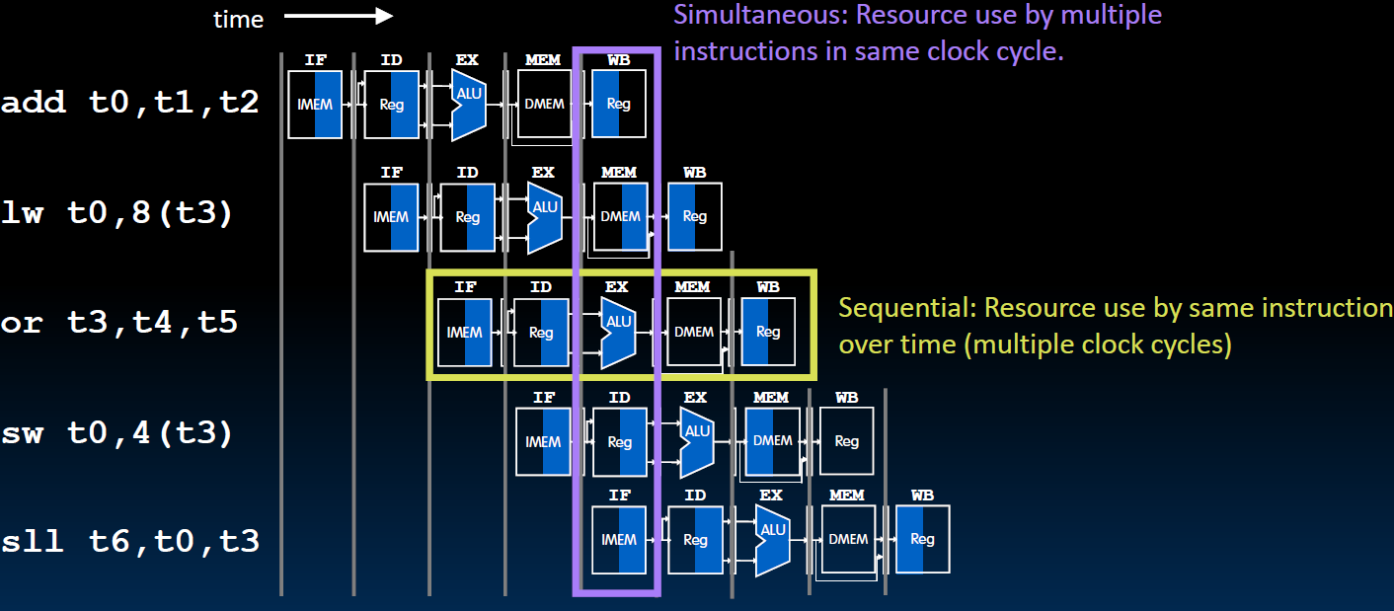
What happens Sequentially? Simultaneously?

Slide 29
Latency vs Throughput
Latency:
Single cycle data path: 800 ps
Pipelined: cycle time=200ps, one instruction takes 5 cycles
200ps x 5 = 1000 ps
Throughput:
Single cycle data path: one instruction every 800 ps
Pipelined: one inst per cycle ➔ one instruction every 200 ps
Pipelined throughput is 4X the single cycle data path method

Slide 30
What happens to long latency operations?
Two options:
Stall: the next instruction stalls
at the EXE stage
2) Have a separate long latency
pipeline. Subsequent instructions
can continue to proceed (such as
FP instructions).
Be aware, instructions are typically
retired at the WB stage in order.
So even if the later instructions are
completed sooner than this long
latency operation, they should wait
at the WB stage. This is due to the
possibility of traps.
RISC-V avoids arithmetic exceptions.
So, out-of-order retirement is viable.
DIV
Div execution →

Slide 31
Multiple Instructions On-the-Fly
Which Rd to write?
The Rd from the instruction at the WB stage
or the Rd from the instruction at the ID stage?
Which immediates to take from?
Which rs1/rs2 to take from?
From instruction at the EXE stage
or instruction from the ID stage?

Slide 32
Key to Pipelining: Inserting Pipeline Registers

Slide 33
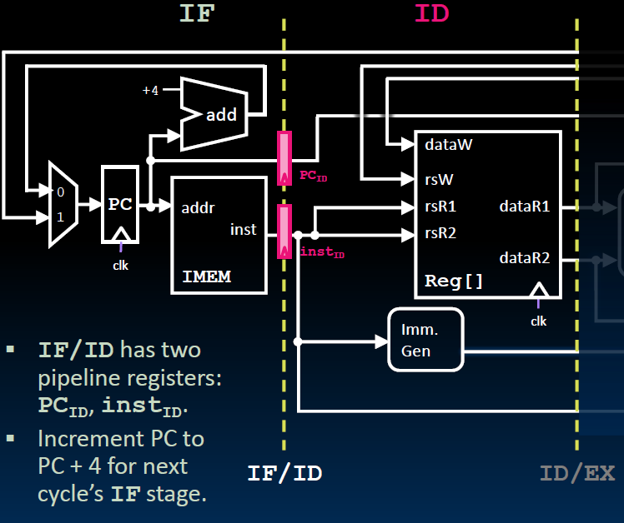
Instruction Fetch/Instruction Decode Pipeline Register

Slide 34
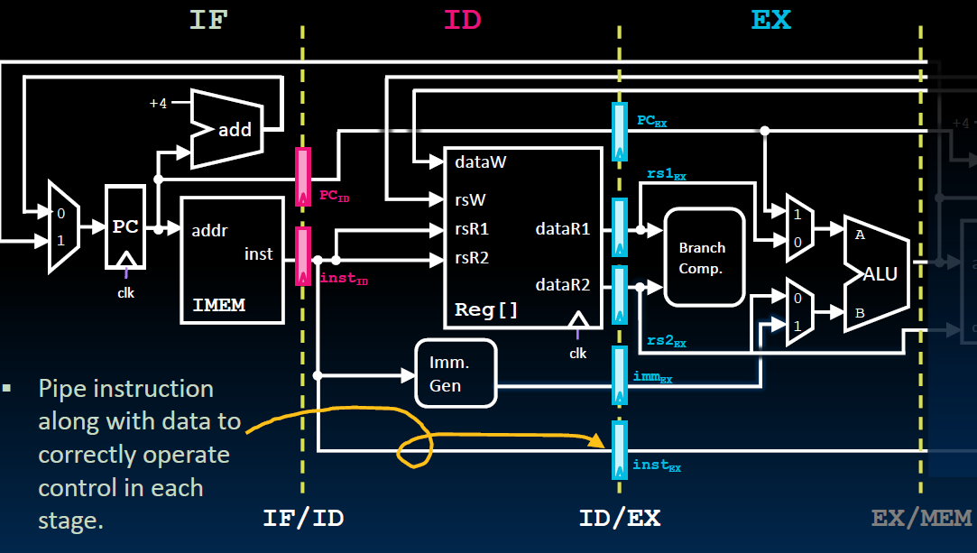
ID/EX Pipeline Register

Slide 35
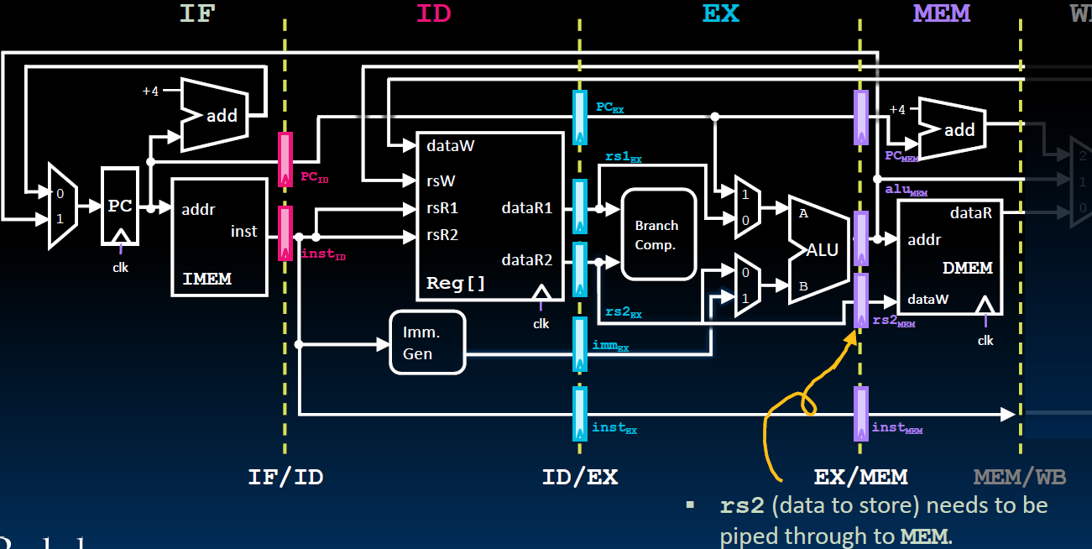
EX/MEM Pipeline Register
JAL

Slide 36
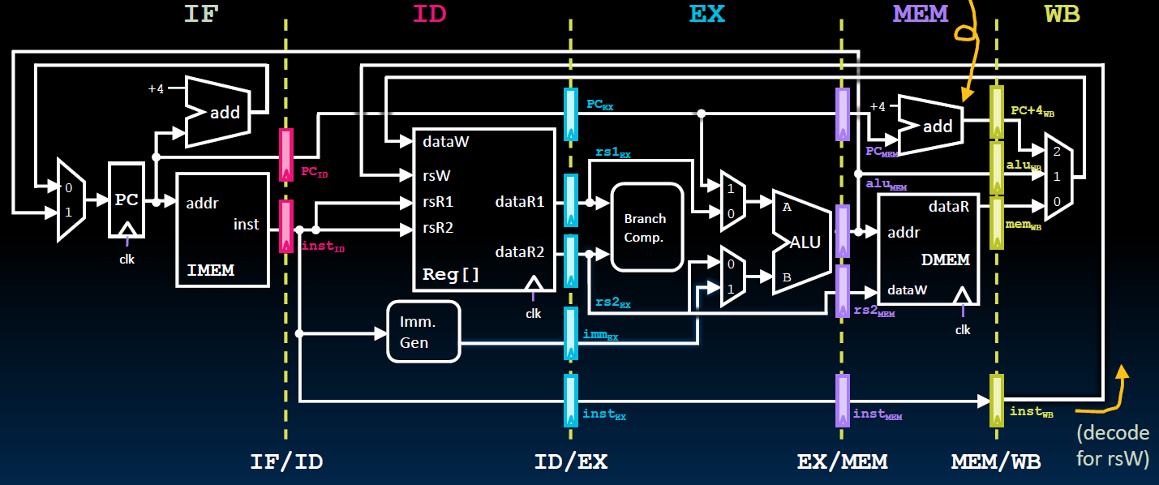
MEM/WB Pipeline Register

Slide 37
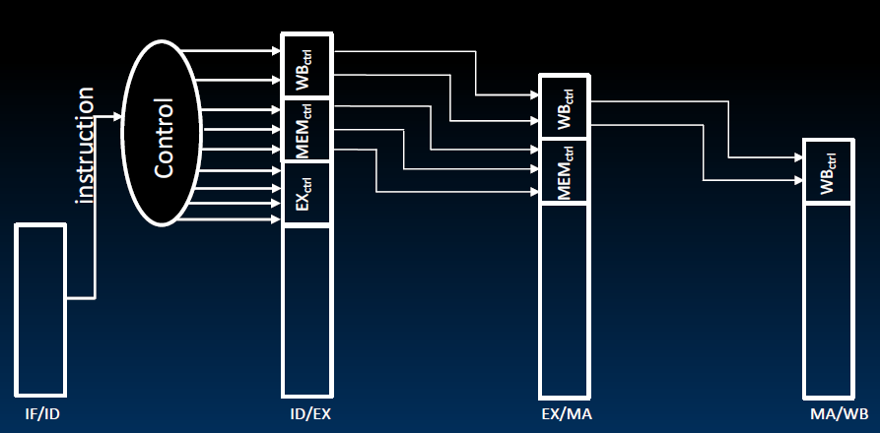
Control Signals in Pipelined Data Path
Control signals are derived from instruction bits, that is, after the ID stage.
Control information for later stages are also stored in the pipeline registers

