Slide 1
CSC3050 – Computer Architecture
Section 5.6 and 5.7
Virtual Machines and Virtual Memory
Prof. Wei Chung Hsu
School of Data Science
Chinese University of Hong Kong, Shenzhen

Slide 2
VM and VM
Why is “virtual” better than “real”?
  Why Virtual memory?
  Why Virtual machines?
  Why Java Virtual Machine?
  Why Virtual Private Network (VPN)?
  Why Virtual PC?
  Why Virtual reality?
  and Virtual money, Virtual friends, Virtual assistant, …
Notes:
Better in terms of accessibility, flexibility, efficiency, and security,
CS is built upon layers of abstraction
Virtual means adding a layer of abstraction and decouple from physical constraints
Two type of VM: Process VM and System VM. A process VM allows a process with a different ISA running on a machine with the same OS but different ISA.
A system VM allows multiple OS, with the same ISA, running on the physical machine simultaneously.
A system virtual machine allows multiple operating systems to run simultaneously on a single physical machine.
Flexibility and Customization
Innovation and pushing the boundaries

Slide 3
Mapping Virtual to Real
Why Virtual memory?
  Larger address space, Memory sharing, Protection, Isolation
Why Virtual Machines?
  Resource sharing, Protection, Migration, Isolation
Why Java virtual machine?
  Interoperability, Application sharing, Protection, …
Why Virtual Private Network (VPN)?
  Network sharing, secure communication over unsecure (public) network
  QoS – bandwidth guarantee

Slide 4
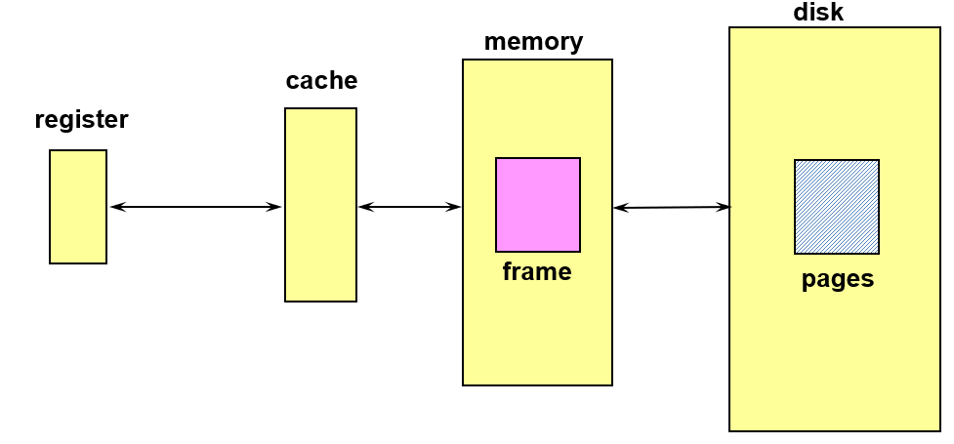
Virtual Memory
In 1950’s, computers had very limited main memory.
Programmers were burdened with complex techniques like overlays to try
and fit programs into this restricted space. Virtual memory was proposed as a way to
create an illusion of a much larger address space than the physical memory available.
First implementation of the Virtual Memory was in the Atlas computer in 1962. It had only 16K words of memory.
“Virtual memory was invented in a time of scarcity. Is it still a good idea?” – Charles Thacker, Turing Award Lecture. Charles Thacker was the chief designer of the Xerox Alto, considered the first true personal computer. He questioned whether, in 2004, with the large main memory sizes, we still needed the feature of virtual memory.
Today’s Virtual Memory is no longer your grandfather’s VM
  Enable memory sharing, memory protection, mmaped file, mmapped I/O, COW, DSM,…
4
Notes:
Typical memory of workstations: 32G-128G. Typical memory size for servers: 64G-1TB

Slide 5
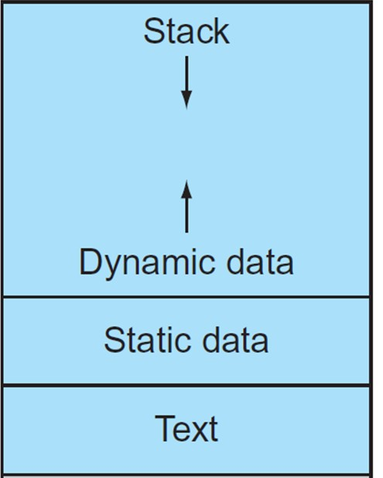
Virtual Address Space
Programs share main memory (Multi-programming and I/O)
  Program executed in a namespace (virtual address space) different from the memory space (physical address space)
  Each gets a private virtual address space holding its code and data, starting at address 0, only accessible to itself
    Yet, any program can run anywhere in physical memory
    Virtual memory maps the virtual address space to the physical memory
    Mapping is managed jointly by CPU hardware (MMU) and the OS
    OS provides a page table that translates Virtual Address (VA) to Physical Address (PA). Hardware (MMU) speeds up the translation.
  Protected from other programs
Virtual Address Space
Notes:
用virtual memory主要有两个考量，一个是由于不同程序都会用到主存，我们需要给不同的程序isolation，同时这也是一种protection
The second motivation for virtual memory is to allow a single user program to exceed the size of primary memory.
Formerly, if a program became too large
for memory, it was up to the programmer to make it fi t. Programmers divided
programs into pieces and then identifi ed the pieces that were mutually exclusive.
Th ese overlays were loaded or unloaded under user program control during
execution, with the programmer ensuring that the program never tried to access
an overlay that was not loaded and that the overlays loaded never exceeded the
total size of the memory.

Slide 6
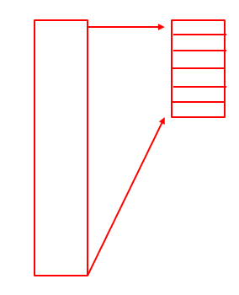
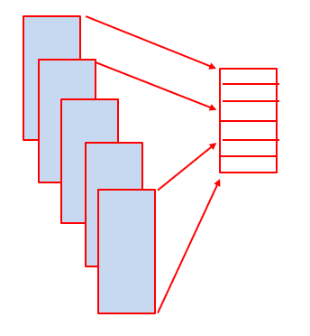
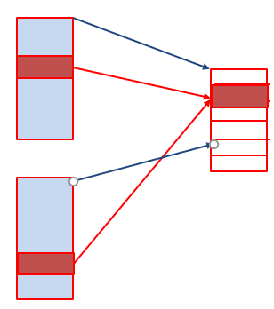
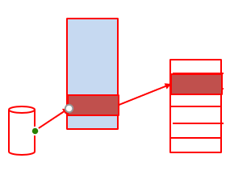
Versatile Virtual Memory
Allow VA space >> PA space
  Demand paging
  Exploiting locality
Enable multi-processing, multiprogramming
  Isolation
  Protection
Enable inter-process memory sharing
  Efficient Inter-Process Communication
  Data Sharing
Memory-mapped I/O
  Memory mapped files

Slide 7
Demand Paging
Demand paging:
Instead of loading entire programs into memory at once, demand paging loads only the necessary parts of a program as they are needed during execution.
Advantages:
  Efficient use of memory
    More programs to reside in memory (higher multi-programming degree), enable higher throughput
  Support larger virtual address space
  Fast start-up
  Reduced I/O
    Avoid loading pages never used
Similar to Caches!

Slide 8
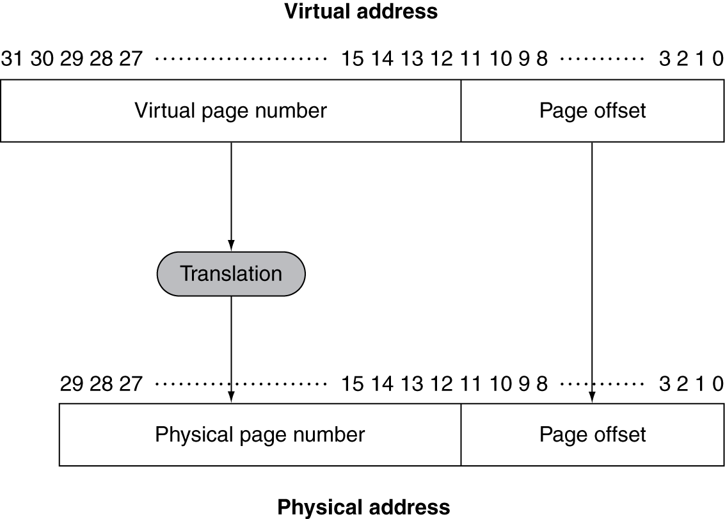
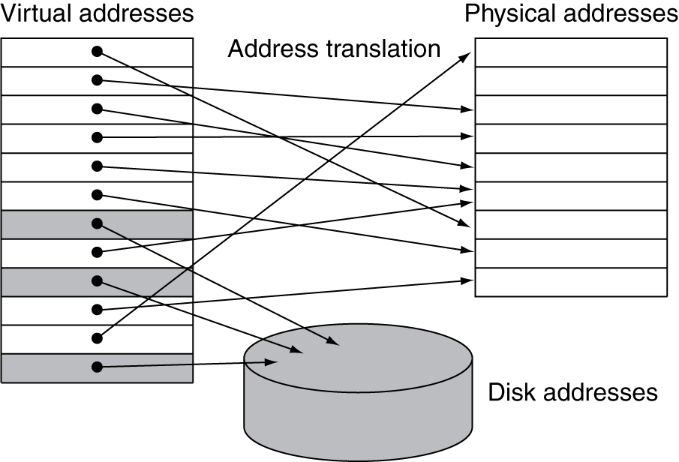
Address Translation
Fixed-size pages (e.g., 4KB)
Via a page table
Notes:
在右边的这个例子中，虚拟地址支持2^32一共4GB，物理地址实际是2^30即1GB，

Slide 9
Page Tables
Stores mapping information
  Page table stored in main memory
  An array of page table entries, indexed by virtual page number, to find physical page
  A page table register in the CPU points to the page table in physical memory (e.g. x86 CR3)
If the page is present in memory
  Page Table Entry (PTE) stores the physical page number
  Plus other status bits (referenced, dirty, …)
If the page is not present
  PTE can refer to a location in the swap space on disk
  swap space: the reserved disk space for all the virtual space of a process
Page Table: Virtual Page Number ⬅➔ Physical Page Number
Notes:
由于无法知道主存中的某一页什么时候会被替换出去，操作系统会在进程创建的时候为进程中所有的页创建空间，这个空间成为交换区

Slide 10
Page Tables
CR3
Physical page# | Valid | Dirty | Access rights | ref | flags
100 | V | F | 01110 | 1 | 01
All addresses generated by the program are virtual addresses
Table located in physical memory

Slide 11
Page Fault
Page hit, proceed normally
Page fault means that page is not in memory
Huge miss penalty
  A page fault may take millions of cycles to process (disk I/O involved)
Hardware must detect situation but it cannot remedy the situation
Page faults are handled by OS. The faulting process can be context switched out so that the CPU can be dispatched to other processes.

Slide 12
OS Handling Page Faults
Hardware must trap to the operating system so that it can remedy the situation
  Pick a page to discard (may write it back to disk if dirty)
  Load the page in from disk
  Update the page table
  Resume to program so HW will retry and resume execution!
In addition, OS must know where to find the page
  Create space on disk for all pages of process (swap space)
  Use a data structure to record where each valid page is on disk (may be part of page table)
  Use another data structure to track which process and virtual addresses use each physical page => for replacement purpose

Slide 13
OS Handling Page Faults
Hardware must trap to the operating system so that it can remedy the situation
  Pick a page to discard (may write it back to disk if dirty)
  Load the page in from disk
  Update the page table
  Resume to program so HW will retry and resume execution!
In addition, OS must know where to find the page
  Create space on disk for all pages of process (swap space)
  Use a data structure to record where each valid page is on disk (may be part of page table)
  Use another data structure to track which process and virtual addresses use each physical page => for replacement purpose
Remember why we have to maintain
precise architecture states in the pipelined,
out-of-order execution processor?
To ensure the processor can correctly
RESUME after the page fault is handled.

Slide 14
Page Replacement and Writes
To reduce page fault rate, prefer least-recently used (LRU) replacement
  Reference bit (aka use bit) in PTE set to 1 on access to page
  Periodically cleared to 0 by OS
  A page with reference bit = 0 has not been used recently
  Unlike the caches, which are managed by HW only, OS can afford more accurate page replacement algorithm
Disk writes take millions of cycles
  Block at once, not individual locations
  Write through is impractical
  Use write-back
  Dirty bit in PTE set when a page is written
Notes:
PTE是page table entry
写机制不可能用write through，只可能用write-back，因为写太耗时了
dirty bit是为了追踪主存中的页是否被写过，如果一个页被写过，那么把该页占用的主存让给其他页之前，必须得把这一页写回到磁盘，如果这个dirty bit被置用了，那么需要写回，
形象的讲究类似于这一页是脏了的

Slide 15
Problems of Page Table
Page table may be too big
  A one-level page table would take too much memory when we deal with a 64-bit virtual address. (can you imagine a table with 2^52 entries of PTE?)
Access to the page table is too slow
  one memory access to obtain the physical address
  a second memory access to get the data

Slide 16
Solutions to Problems of Page Table
Page table is too big
  Multi-level indexing
    Why does this work? Because virtual address space is very sparse.
    so the directories have lots of entries not used.
  Hash table approach (need to find the PTE with VA)
    How to handle collisions?
  Inverted tables
Access to the page table is too slow
  TLB (Translation Lookaside Buffer)

Slide 17
Quick Review
Virtual address space gives you the illusion that your program owns all the memory
The OS maps your VA (Virtual Address) space to the PA (Physical Address) via a page table
The page table is pointed to by a page table register (e.g., x86 CR3)
When a page is accessed but not in memory, the OS moves it from the disk (swap space) to the main memory. This is called demand paging.
If a reference to a page has not yet been mapped, this triggers a page fault. To bring a new page into the main memory, the OS must find a victim page to replace. Page replacement is similar to cache line replacement.
A one-level page table is often used for 32-bit addressing, but it does not work for 64-bit addressing.

Slide 18
Impact of Paging - Huge Page Table
Page table occupies storage
32-bit VA, 4KB page, 4bytes/entry => 2²⁰ PTE, 4MB table
64-bit VA, 4KB page, 4bytes/entry => 2⁵² PTE, 16EB (ExaByte)
Reality: we only need to use 48b of VA so far, => 2³⁶ PTE, 256GB table
It is still too expensive to implement a single-level page table.
A 4-level page table is used for 48-bit VA
  Three levels of page directory Indexing, leading to the final level of PTE, and PTE points to a physical memory frame. So the page table is no longer a large, consecutive table, but a collection of non-consecutive small tables.
  The virtual address space is very sparse, so many PDPT (Page Directory Pointer Table) are not required, so the last level PTE requires only a small number of pages.

Slide 19
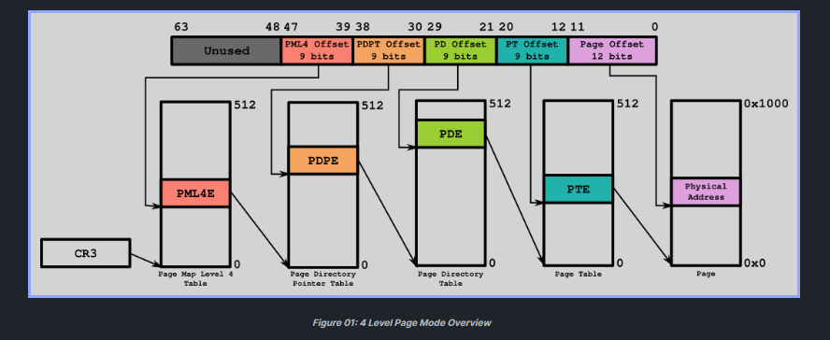
4-level page tables
Modern 64bit x86 based systems (including AMD64 and Intel64) typically
use 4-level page table structures. This has three levels of directory
and one level of PTE

Slide 20
Multi-Level Indexing Slices VA into Smaller Chunks
PTE
PML4E
PDPE
PDE
one
page
512
Entries
Not used
Not used
PDPE
PDE
One level Indexing
Multi-level Indexing
Notes:
Each chunk is 512*4K = 2MB

Slide 21

Three Levels of Directory & One Level of PTE
PML4E
Rarely Used
…..
PDPE
…..
PDE
PTE

Slide 22
Three Levels of Directory & One Level of PTE
PML4E
Rarely Used
…..
…..
Since most of the Virtual Address Space is
unused, each directory level is sparsely
populated. So, the PTE level does not require
a huge number of consecutive entries.
PDPE
PDE
PTE

Slide 23
Inverted Page Table
Rather than each process having a page table and keeping track of all possible logical pages, we may track all physical pages
One entry for each real page of memory
Entry consists of the virtual address of the page stored in that real memory location, with information about the process that owns that page
Decreases memory needed to store each page table, but increases time needed to search the table when a page reference occurs
Use hash table to limit the search to one — or at most a few — page-table entries
  TLB can accelerate access
But how to implement shared memory?
  If a physical page is mapped to by multiple virtual pages, the reference will trigger a trap, the OS will handle it (in different ways).

Slide 24
Inverted Page Table Structure
Traditional page table (per process): each virtual page number has an entry
Inverted page table: each physical page number has an entry
Physical page number
Physical page number
Physical page number
Indexed by Virtual Page Number
Physical page number
Virtual page number
(Pid, Virtual page number)
(Pid, Virtual page number)
0
Use (pid, VA) as a key to
search the table.
This table size is limited by
the number of real memory pages
1

Slide 25
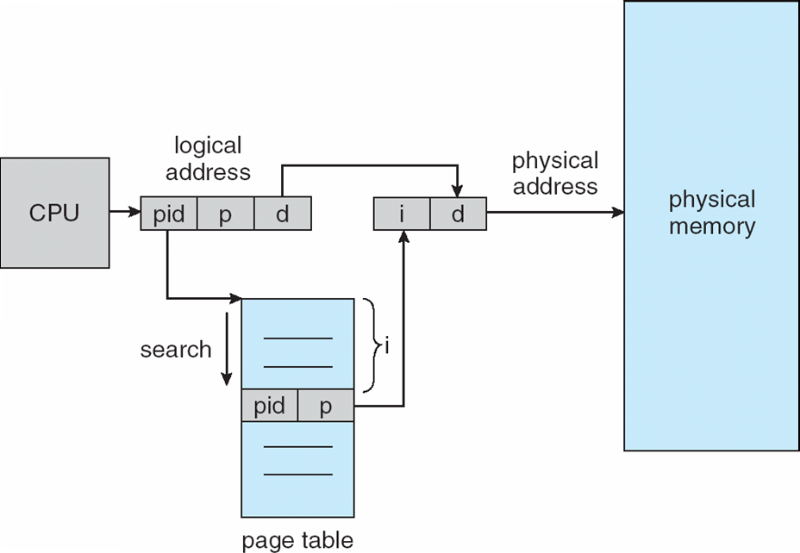
Inverted Page Table Structure
Assuming the real memory size is 4GB. Each page size is 4KB. So the inverted page table has 1M entries.
This table is shared by all processes.
Now process 1, with pid=1, wants to reference address 0x000000A8, the virtual page number is 0.
We search the inverted page table for the key with 0+0 (pid + virtual page number). If this entry is found in the 100th entry of the table. Then the mapping of virtual page 0 is physical memory page 100.
The search can be based on hashing.

Slide 26
Translation Lookaside Buffer (TLB)
Access to page tables has good locality
  Fast cache of PTEs within the CPU, the cache of the page table
  Called a Translation Look-aside Buffer (TLB): a special cache that keeps track of recently used PTE entries
Typical RISC processors have a memory management unit (MMU), which includes a TLB that does page table lookup
  TLB can be organized as fully associative, set associative, or direct mapped, but most TLBs are fully associative.
  TLBs are small, typically 16–512 PTEs, 0.5–1 cycle for hit, 10–500 cycles for miss, 0.01%–1% miss rate
  Misses could be handled by hardware or software
Notes:
因为TLB不在主存中，所以相当于可以省了一次memory access
TBL本质上就是一个集成在CPU中的小型的page table，先查它，查到了就可以直接访问主存的物理page，如果没查到，再去找主存中的page table，
If a miss in the TLB occurs, we must determine whether it is a page fault
or merely a TLB miss

Slide 27
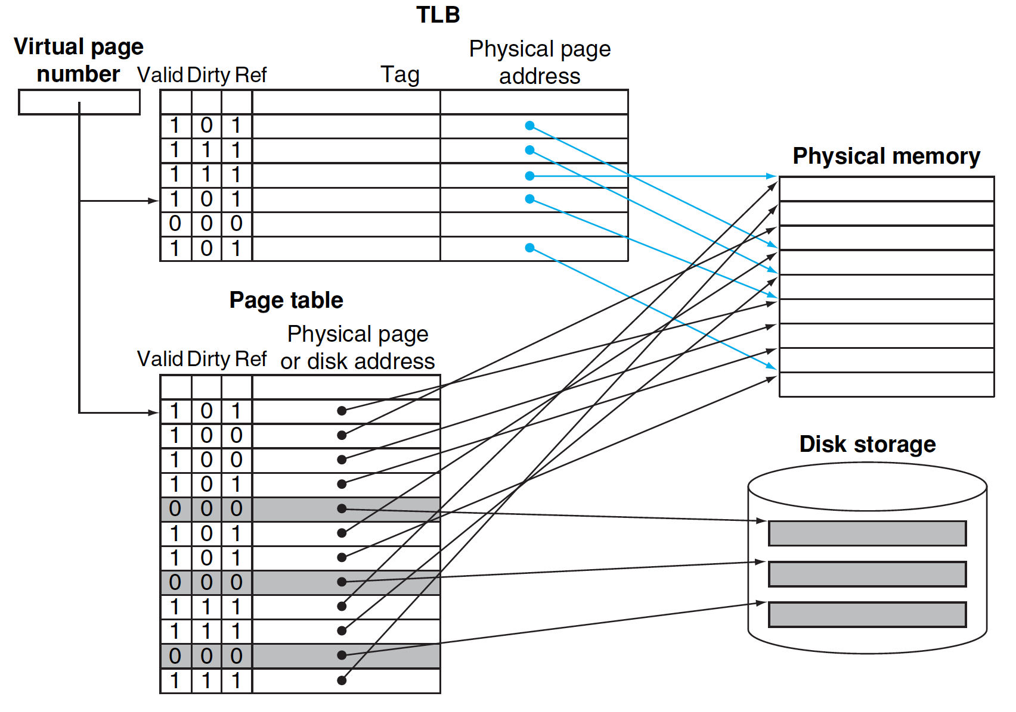
Fast VA->PA Translation Using TLB
Notes:
这里valid bit是表示这一页是否在main memory中
dirty bit表示这一页是否被写过，
reference bit表示这一页是否最近被访问过，主要用于替换策略

Slide 28
TLB Miss Handling
Hardware Walker
  Called hardware table walker. The hardware walks the page table (starting from the page table pointer, usually the CR3 in x86) to find the PTE to be inserted into the TLB.
  This walking may find the PTE entry in L1/L2/L3 caches so that the latency could be short. The walking is slower for the 4-level page table.
Software Miss Handler
  This is using a TLB miss handler. Resolving TLB misses in software could be more flexible because the page table structure can be changed. However, a software solution is considered slower than the HW walker.

Slide 29
TLB Misses and Page Faults
If the page is in memory
  Load the PTE from the page table and retry
  Could be handled in hardware
  Or in software
    Raise a special exception, with an optimized handler
If the page is not in memory (page fault)
  OS fetches the page and updates the page table (in software)
  Then resume the faulting instruction

Slide 30
Making Address Translation Practical
In VM, memory acts like a cache for disk
  Page table maps virtual page numbers to physical frames
  Use a page table cache for recent translations
  => Translation Lookaside Buffer (TLB)
hit
VA
TLB
Lookup
PA
Cache
miss
Main
Memory
CPU
Translation
with a TLB
miss
hit
Trans-
lation
data
1/2 t
t
20 t
Notes:
CPU访问的顺序这么看分为很多级了，首先是TLB，然后是cache，然后是main memory
注意cache里面是存data 的，而TLB里面是存page number
这里VA和PA应该是指代virtual address和physical address

Slide 31
Integrate TLB and Cache
TLB
Physical address
Cache

Slide 32
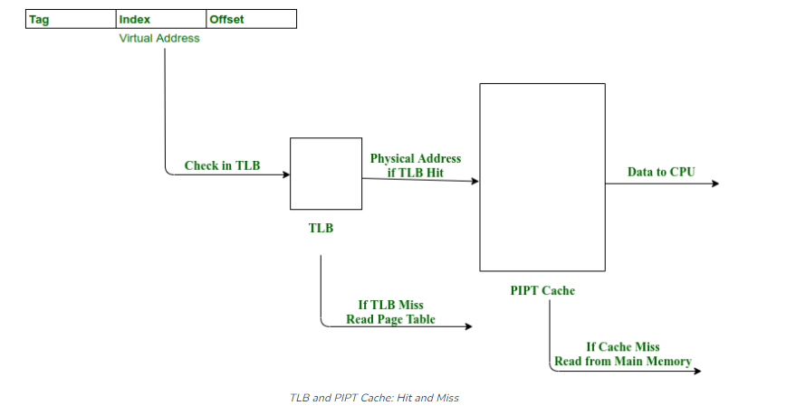
PIPT (Physically Indexed, Physically Tagged) Cache
Slow hit time
(TLB hit + Cache access)

Slide 33
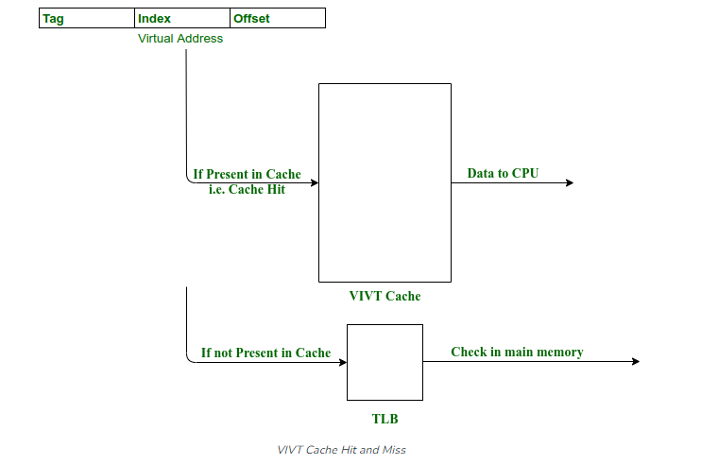
VIVT (Virtually Indexed, Virtually Tagged) Cache
Fast
  If hit, no need to go through TLB
Two issues need to be addressed.
  Synonym is also called aliasing, which means multiple VAs are mapped to the same PA. Synonyms can be created by using mmap()
  Homonym means the same VA maps to multiple PAs. This happens with multitasking.
  To solve homonyms, flush the cache at context switching or add PID/AID to the tag.

Slide 34
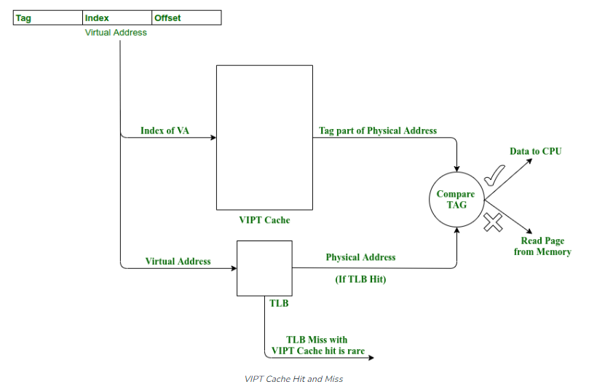
VIPT (Virtually Indexed, Physically Tagged) Cache
Cache size will be limited to multiple of page sizes, because the number of entries in a set is limited by the page size.
For example, 4-way set associative cache will have a size limitations of 4 pages (16KB), 8-way will have a size 8 pages (32KB).

Slide 35
System Virtual Machines
Virtual Machines
Prior to Virtual Machines, a computer system runs one OS at a time (for example, Unix or Windows, or Solaris). After adding a layer of software such as the VMM (Virtual Machine Monitor) or the hypervisor, a computer system can run multiple guest OS (called guest machines) at the same time.
Windows Apps
Linux Apps
MS Windows
Linux
VMM or Hypervisor
IA-32/IA-64 Physical Machine

Slide 36
Resource Consolidation
  Server consolidation
    Reduce number of servers
    Reduce space, power and cooling
    70-80% reduction numbers cited in industry
  Client consolidation
    Developers: test multiple OS versions, distributed application configurations on a single machine
    End user: Windows on Linux, Windows on Mac
    Reduce physical desktop space, avoid managing multiple physical computers
Notes:
Some historical, some relevant today, and some are likely to happen in the future

Slide 37
Virtualization Properties
Isolation
  Fault isolation
  Performance isolation
Encapsulation
  Cleanly capture all VM states
  Enables VM snapshots, clones
Migration
  Independent of physical hardware
  Enables migration of live VMs
Interposition
  The hypervisor has control and visibility over the operations performed by the guest OS.
  Enables transparent resource over-commitment, encryption, … etc

Slide 38
Virtualization and Cloud Computing
Cloud Computing
  IT environments that abstract, pool, and share scalable resources across a network.
  Let different companies/users access a single pool of automatically provisioned resources.
Virtualization has many benefits, such as server consolidation and improved hardware utilization, reduces the need for power, space, and cooling in a datacenter. Virtual machines are isolated environments, a good option for testing new applications or setting up a production environment. Virtualization technology is an enabler for efficient and effective cloud computing.

Slide 39
VM Applications
Server Consolidation
App
…
App
App
OS
OS
App
App
OS
OS
…
OS
VMM
HW
HW
HW
HW
VMM
HW
Work Isolation
Benefit: Cost Savings
R&D Production
App
OS
VMM
HW
Benefit: Business Agility and Productivity
Notes:
In the server environment, virtualization increase utilization by making it possible to host mixed operating systems on a platform. By migrating workloads from dedicated smaller servers to high-reliability enterprise platforms, administrators can increase efficiency, reduce energy costs, maintain high reliability, and reduce administration overhead.
By providing the ability to run development, test and production version of a software stack on the same machine, virtualization can reduce the number of machines need in the development environment. It can also speed deployment because the development and production platforms are guaranteed to be identical, the developer can plug into production workloads, and the promotion from test to production can be done in seconds. The isolation provided by the VMM ensures that test software cannot bring down the production applications.
Disaster recover is aided by virtualization because production software can be encapsulated in a virtual machine and moved as a unit from a failing machine to an alternate platform before the application fails. Or if the hardware does fail, the application can be quickly restored as a single VM, eliminating the sometimes long and laborious process of restore backup files and reconfiguring the OS and applications before the system can be restarted.
Extending the notion of VM migration, dynamic load balancing software monitors the performance of an application running in a VM and when the response falls below as target level the VM is given access to more resources on its current platform, or moved to a more powerful or less utilized platform. As a result, the average utilization of all the machines is higher and more consistent.

Slide 40
VM Applications
App
App
App
1
App
2
App
3
App
4
…
OS
OS
OS
OS
OS
OS
VMM
VMM
VMM
VMM
HW
HW
HW
HW
CPU Usage
CPU Usage
CPU Usage
Benefit: Business Continuity
CPU Usage
30%
90%
Disaster Recovery
App
1
App
2
App
3
App
4
Dynamic load balancing
OS
OS
OS
OS
VMM
Partitioning
HW
Notes:
In the server environment, virtualization increase utilization by making it possible to host mixed operating systems on a platform. By migrating workloads from dedicated smaller servers to high-reliability enterprise platforms, administrators can increase efficiency, reduce energy costs, maintain high reliability, and reduce administration overhead.
By providing the ability to run development, test and production version of a software stack on the same machine, virtualization can reduce the number of machines need in the development environment. It can also speed deployment because the development and production platforms are guaranteed to be identical, the developer can plug into production workloads, and the promotion from test to production can be done in seconds. The isolation provided by the VMM ensures that test software cannot bring down the production applications.
Disaster recover is aided by virtualization because production software can be encapsulated in a virtual machine and moved as a unit from a failing machine to an alternate platform before the application fails. Or if the hardware does fail, the application can be quickly restored as a single VM, eliminating the sometimes long and laborious process of restore backup files and reconfiguring the OS and applications before the system can be restarted.
Extending the notion of VM migration, dynamic load balancing software monitors the performance of an application running in a VM and when the response falls below as target level the VM is given access to more resources on its current platform, or moved to a more powerful or less utilized platform. As a result, the average utilization of all the machines is higher and more consistent.

Slide 41
System VMs
Support multiple guest OSes on a single hardware platform; all running the same ISA
Linux
Windows
OS/2
Application
Application
Application
Linux OS
Windows OS
OS/2 OS
Virtual Intel x86
Virtual Intel x86
Virtual Intel x86
Memory
I/O devices
Intel x86
Hardware
Notes:
Figs1/repvm

Slide 42
Multiple Identical Guest Systems
Support multiple guest OSes on a single hardware platform; all running the same ISA
Linux
Linux
Linux
Application
Application
Application
Linux OS
Linux OS
Linux OS
Virtual Intel x86
Virtual Intel x86
Virtual Intel x86
For Isolation,
Protection, Encapsulation,
Migration, ….
Memory
I/O devices
Intel x86
Hardware
Notes:
Figs1/repvm

Slide 43
Efficient Virtualization of System VM
Support multiple guest OSes on a single hardware platform; all running the same ISA
Linux
Windows
Application
Solaris
Application
Application
Linux OS
Windows
Solaris
Virtual Intel x86
Virtual Intel x86
Virtual Intel x86
traps
Hypervisor
Trap to hypervisor when privileged instructions, or system service requests are encountered.
Memory
I/O devices
Intel x86
Hardware
Notes:
Runs in native non-privileged code, when system calls/IO are encountered, traps to the hypervisor

Slide 44
Privileged Instructions, Definition:
Trap if executed in user mode; not in supervisor mode
Privileged instructions are required to trap
  No-op in user mode is not enough

Slide 45
Control Sensitive instructions:
All instructions that change the amount of (memory) resources (or the mapping)
  base/limit register
  page table in general
All instructions that change the processor mode
Instructions that provide control of resources
Examples:
  Load TLB (if TLB is architected)
  Load control register
  Return to user mode
Notes:
Resource control, not transfer control

Slide 46
Behavior Sensitive instructions:
All instructions whose results depend on the mapping of physical memory
All instructions whose behavior depends on the mode
Instructions whose behavior depends on configuration of specific resources (and who owns them)
Examples:
  Load physical address
  POPF (Intel x86): Interrupt-enable flag remains unaffected in user mode

Slide 47
CPU Virtualization Challenges
ISA Virtualizablity
Ideally, if an ISA has
privileged instructions
and non-privileged instructions
exclusively separated so that
all control-sensitive and
behavior-sensitive instructions
are privileged instructions, then
The trap-and-emulate model can
be efficiently implemented.
Non-privileged
Privileged
RISC-V ISA is Virtualizable!!!

Slide 48
Instruction Types -- Summary
Non-
Privileged
Innocuous
Privileged
Behavior-
Sensitive
Control-
Sensitive
sensitive
sensitive
Innocuous Instructions: Those that are not control or behavior sensitive

Slide 49
Non-
Privileged
Innocuous
Privileged
Behavior-
Sensitive
Control-
Sensitive
sensitive
sensitive
Ideally, we would like to trap those sensitive instructions.
Running guest OS in de-privileged mode has two problems
Trapping too many – no need to trap on all privileged instructions
Trapping too few -- some sensitive instructions are not trapped

Slide 50
Quick Review
  Why System Virtual Machines:
  want to run multiple OSes on the same machine at the same time
  server/client consolidation, isolation, encapsulation, migration, interposition, … many advantages
  How to implement System VM efficiently?
  De-privilege a guest OS, so system sensitive instructions should trap.
  Some instructions are sensitive, but not privileged, what to do for them? Many popular machines (x86, ARM, MIPS, …) have such instructions.
  Can we tell the hardware to trap these instructions? You may trap too many instructions, since they are ordinary instructions, and should not be trapped unless executing in kernel mode.
  Can we trap them when they are in kernel mode? but the guest OS is now in user mode.

Slide 51
How to Trap Sensitive Instructions
Red instructions should trap
If Guest OS in supervisor mode, no instructions trap
If Guest OS in user mode, only blue instructions trap
Non-
Privileged
Privileged
Behavior-
Sensitive
Control-
sensitive
sensitive
If Guest OS in user mode, with Para-virtualization, we could force red instructions to trap
If Full-virtualization is needed, we may have to use
  Interpretation
  or DBT
  or Hardware Support

Slide 52
How to Trap Sensitive Instructions
Red instructions should trap
Since Guest OS is now in user mode, some red instructions do not trap
With Para-virtualization, we could force them to trap
Non-
Privileged
Privileged
Behavior-
Sensitive
sensitive
Control-
sensitive
If Full-virtualization is needed, we may have to use
  Interpretation
  DBT
  Hardware Support
This is the technique used by VMWare when the hardware support was not available !

Slide 53
Para-Virtualization vs. Full Virtualization
Full Virtualization (FV)
  Transparent. Guest OSes are unmodified.
Para-Virtualization (PV)
  Special hooks to allow the guests and host to communicate.
  Simplifies VMM and reduce overhead
  Require the guest OS to be explicitly ported for the “Para-API”.
  The term was first used in the Denali VMM, and later used in Xen, L4, VMWare, Windriver.
Notes:
Denali: University of Washington, 2001, to support running untrusted apps…
What is the major challenges of para-virtualization? The Linux has 60-70 major releases, and may be 15 minor releases per major release. 900-1000 releases.

Slide 54
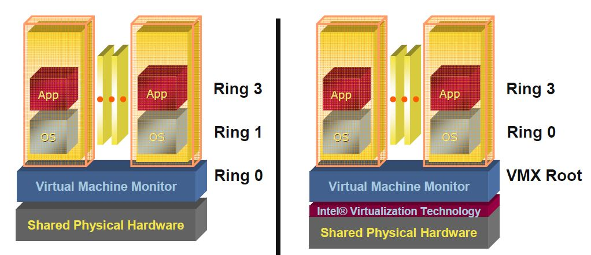
Pre VT-x Post VT-x
Hardware Assisted System VM: VT-x
VMM ring de-privileging of guest OS | VMM executes in the VMX root-mode
Guest OS aware it is not at Ring 0 | Guest OS de-privileging eliminated
 | Guest OS runs directly on hardware
Source: [2]
Notes:
Pre-VT-x: OS is deprivileged, privileged instructions will trap
Problem: sensitive but unprivileged instructions do not trap
To discover those instructions – DBT or para-virtualization
DBT for full virtualization: transparent
Para-virtualization: better performance
Check with students: what are the cases that para-virtualization works better than HW assisted virtualization.

