Slide 1
CSC3050 – Computer Architecture
Data Representations
Prof. Wei Chung Hsu
School of Data Science
Chinese University of Hong Kong, Shenzhen

Slide 2
Major Components of a Computer
Control
Input
Output
Data
Path
Memory

Slide 3
Memory are all bits
Memory consists of bits represented as 0s and 1s.
These bits can represent various types of information, including:
- Instructions
- Character strings
- Integer numbers
- Floating-point numbers
- Media data, such as colors and audio
- Structured data
- Arrays
Memory is usually addressed by bytes (8bits), though some machines may use word (32bits) or double word (64bits) addressing.
In artificial intelligence, quantization techniques can utilize sub-byte data types like 2-bit or 4-bit representations. However, the smallest addressable unit in memory remains the byte. To access individual bits, operations such as shifting and extraction must be employed.

Slide 4
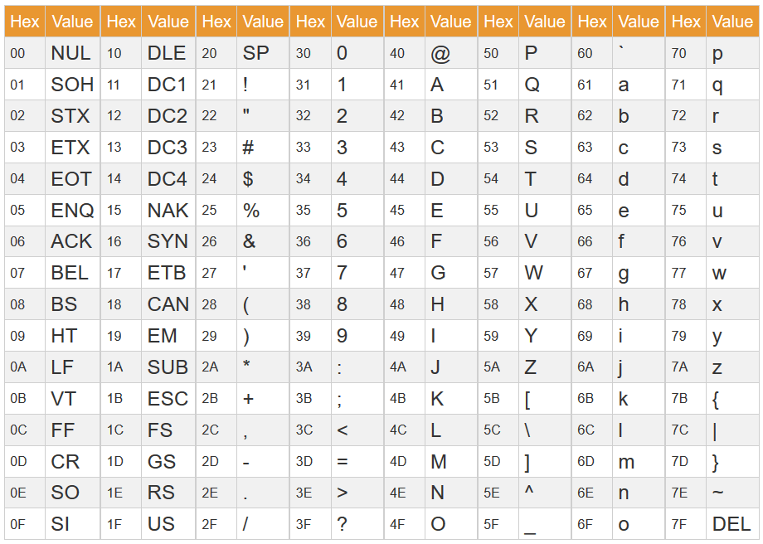

Bits can Represent Any Information (1)
Character
  Characters are represented in 7 bits (ASCII code), or 8 bits (extended ASCII)
  26 characters (upper and lower cases ➔ 52) + punctuations are represented in ASCII code
  Standard code to cover all the world’s languages: Unicode
Logical value
Colors/Audio
Memory locations (addresses)
Commands (Instructions)
Summary
N bits can represent $2^{N}$ different things
ABC → 0100 0001 0100 0010 0100 0011
41
42
43

Slide 5
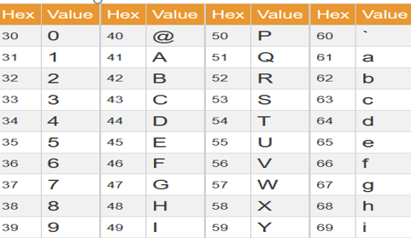
Bits can Represent Any Information (1)
A10 → 0100 0001 0011 0001 0011 0000
Character
  Characters are represented in 7 bits (ASCII code), or 8 bits (extended ASCII)
  26 characters (upper and lower cases ➔ 52) + punctuations are represented in ASCII code
  Standard code to cover all the world’s languages: Unicode
Logical value
Colors/Audio
Memory locations (addresses)
Commands (Instructions)
Summary
N bits can represent $2^{N}$ different things
ABC → 0100 0001 0100 0010 0100 0011
Difference between “ABC” and “ABC0”
Which one is ABC?
1) 01000001 01000010 01000011 00000000
2) 01000001 01000010 01000011 00110000
NULL

Slide 6
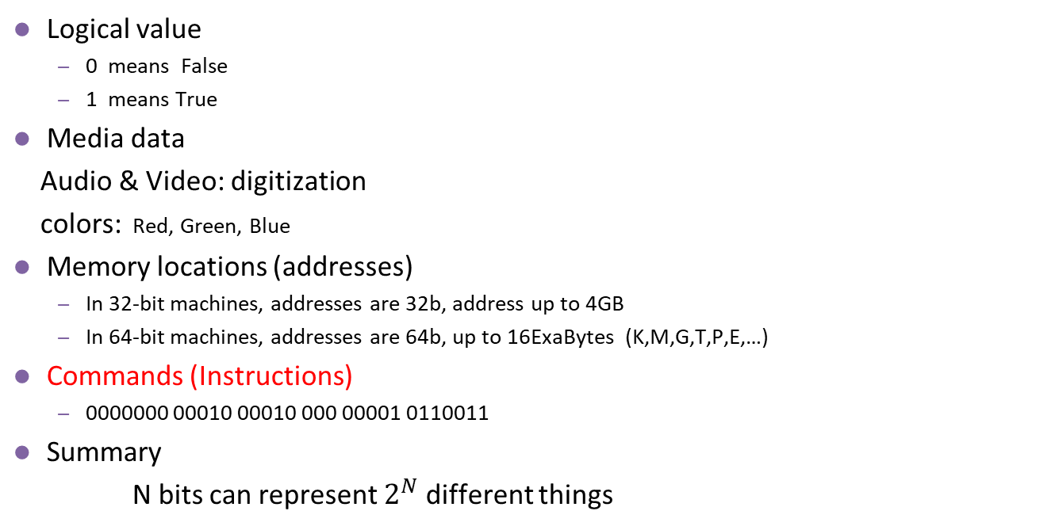
Bits can Represent Any Information (2)
Logical value
  0 means False
  1 means True
Media data
Audio & Video: digitization
colors: Red, Green, Blue
Memory locations (addresses)
  In 32-bit machines, addresses are 32b, address up to 4GB
  In 64-bit machines, addresses are 64b, up to 16ExaBytes (K,M,G,T,P,E,…)
Commands (Instructions)
  0000000 00010 00010 000 00001 0110011
Summary
N bits can represent $2^{N}$ different things
Notes:
In C, non-zero is true
This course only require students to do RVI32 machines

Slide 7
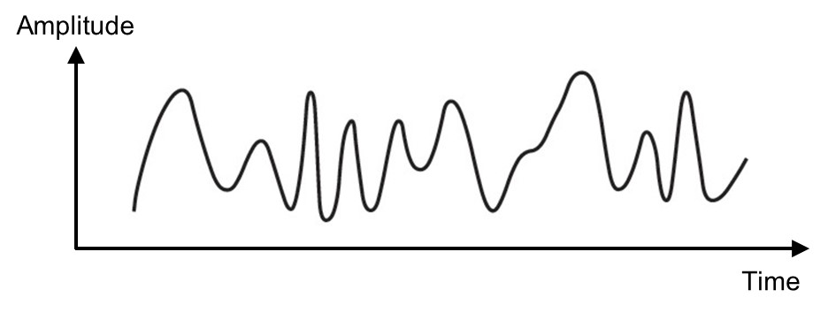
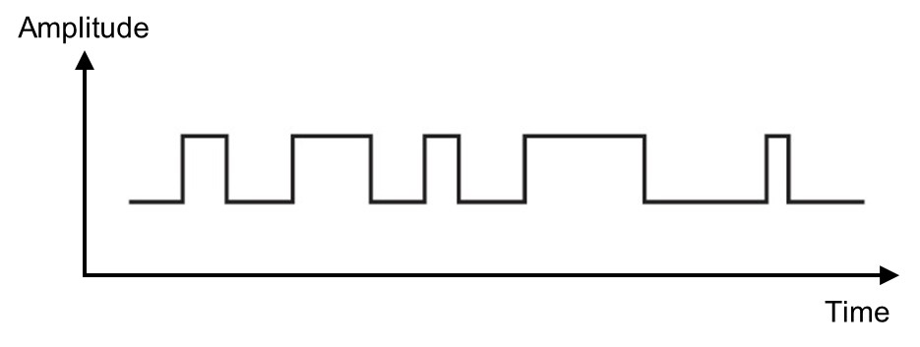
Digitization: From Analog to Digital
Analog Signal
  Vary in a smooth way over time
  Analog data are continuously valued
Example: audio, early-day video
Digital Signal
  Maintains a constant level, then switches to another constant level (typically operates in one of these two states)
  Digital data have discrete values
Example: computer data
Notes:
Digit music, video, audio, money,…VR, … digital world

Slide 8
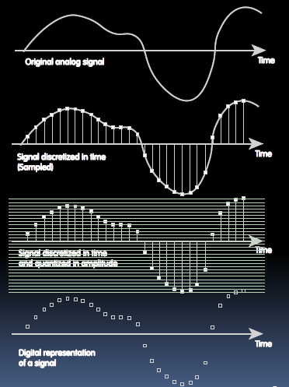
From Analog to Digital
The real world is analog.
Two steps to convert analog information to digital
  Sampling
  e.g. For every 1/100 second, we ask how loud the music signal is.
  Quantize
  For example, we figure out for each signal what value it is positioned in the 16-bit range.

Slide 9
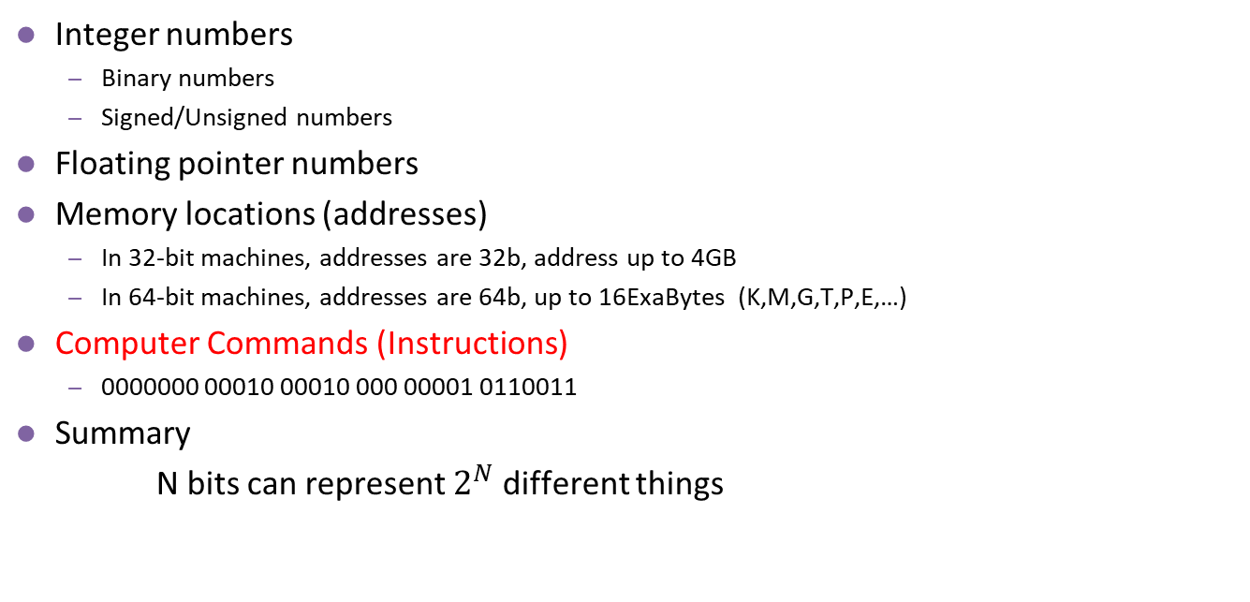
Bits can Represent Any Information (3)
Integer numbers
  Binary numbers
  Signed/Unsigned numbers
Floating pointer numbers
Memory locations (addresses)
  In 32-bit machines, addresses are 32b, address up to 4GB
  In 64-bit machines, addresses are 64b, up to 16ExaBytes (K,M,G,T,P,E,…)
Computer Commands (Instructions)
  0000000 00010 00010 000 00001 0110011
Summary
N bits can represent $2^{N}$ different things
Notes:
In C, non-zero is true
This course only require students to do RVI32 machines

Slide 10
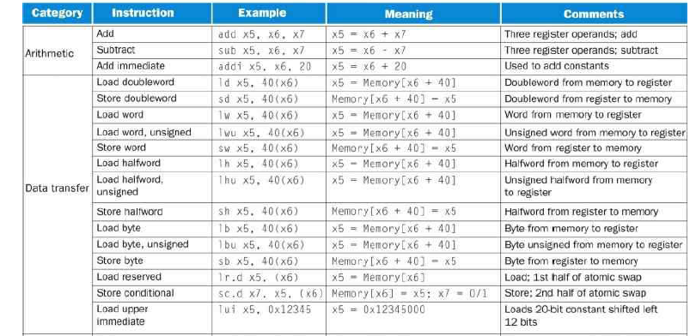
Sneak Preview of RVI64 (ALU and L/S)

Slide 11
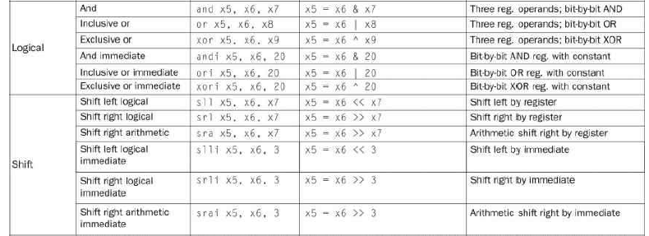
Logic and Shift Operations

Slide 12
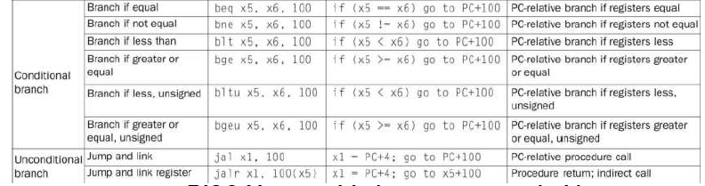
Branch Instructions

Slide 13
Instructions
Instructions are composed of the following:
OPcode : indicates what instruction it is, e.g. add, load, …
Operands: Register or Memory
Register: specify a register to designate which register is used as an operand.
Memory: usually a (base)+offset to specify the address of the memory operand
  data address: offset is relative to a base register
  instruction address: offset is relative to the PC or a register

Slide 14
Note
In Figure 2.1, please note
It is for RVI64, so there are double words (ld and sd). RVI32 instruction set would be even smaller.
A couple of instructions are missing in the table: slt, sltu, slti, sltui instructions. These instructions compute logical values, such as A = (B > C).
No subi instruction because subi can use addi with a negative immediate value.
No multiply/divide instructions. If needed, add the M extension.
No FP (Floating Point) instructions. If needed, add the F extension.

Slide 15
How to represent Integer Values
More than half of the RVI instructions need to specify immediate values in instructions.
Such as Addi x5,x6, immediate // x5 = x6 + immediate
Such as Ld x5, immediate(x6)
Such as Sd x5, immediate(x6)
Such as Jalr X1, immediate(X5)
computing addresses

Slide 16
Integer Representation: Radix or Base
An ordered set of symbols, called digits, with relations defined for addition, subtraction, multiplication and division
Radix or base of the number system is the total number of digits allowed in the number system
Notes:
Base two only allows 0 and 1 two digits, base 10 allows 0 to 9, 10 digits

Slide 17
Decimal, Binary, Octal and Hexadecimal
System Name | Decimal | Binary | Octal | Hexadecimal
Radix | 10 | 2 | 8 | 16
 | 0 | 0000 | 0 | 0
 | 1 | 0001 | 1 | 1
 | 2 | 0010 | 2 | 2
 | 3 | 0011 | 3 | 3
 | 4 | 0100 | 4 | 4
 | 5 | 0101 | 5 | 5
 | 6 | 0110 | 6 | 6
 | 7 | 0111 | 7 | 7
 | 8 | 1000 | 10 | 8
 | 9 | 1001 | 11 | 9
 | 10 | 1010 | 12 | A
 | 11 | 1011 | 13 | B
 | 12 | 1100 | 14 | C
 | 13 | 1101 | 15 | D
 | 14 | 1110 | 16 | E
 | 15 | 1111 | 17 | F
 | 16 | 10000 | 20 | 10

Slide 18
Number Systems
Decimal numbers
Binary numbers
1’s column
10’s column
100’s column
1000’s column
five
thousands
three
hundreds
seven
tens
four
ones
8’s column
4’s column
2’s column
1’s column
one
eight
one
four
zero
two
one
one
Notes:
10的3次幂： ten to the power of three
乘以： multiply

Slide 19
Exercise
Ex : What value is 36₁₆ and AA₁₆
36₁₆ = 3x16 + 6 = 54
AA₁₆ = 10x16 + 10 = 170
Ex : What value is 10000001₂ and 11110000₂
10000001₂ = 128 + 1 = 129
11110000₂ = F0₁₆ =15x16 + 0 = 240
Notes:
36₈=011 110₂
36₁₀=100100₂

Slide 20
Powers of Two
2⁰ = 1
2¹ = 2
2² = 4
2³ = 8
2⁴ = 16
2⁵ = 32
2⁶ = 64
2⁷ =128
2⁸ = 256
2⁹ = 512
2¹⁰ = 1024
2¹¹ = 2¹⁰ × 2¹ = 2048
2¹² = 2¹⁰ × 2² = 4096
2¹⁶ = 2¹⁰ 2⁶ = 65536
…
2²⁰ = 2¹⁰ × 2¹⁰ = 1048576
Handy to memorize up to 2¹²

Slide 21
Decimal vs Binary Numbers
Binary to decimal conversion:
  Convert 10011₂ to decimal
  16×1 + 8×0 + 4×0 + 2×1 + 1×1 = 19₁₀
Decimal to binary conversion:
  Convert 47₁₀ to binary
  32×1 + 16×0 + 8×1 + 4×1 + 2×1 + 1×1 = 101111₂
N-digit decimal number
  How many values? 10^{N} Range: [0, 10^{N}−1]
  Example: 3-digit decimal number:
  10³ = 1000 possible values Range: [000, 999]
N-digit binary number
  How many values? 2^{N} Range: [0, 2^{N}−1]
  Example: 3-digit binary number:
  2³ = 8 possible values Range: [000₂, 111₂]
  [ 0 , 7 ]
47 / 2 remainder 1
23 / 2 remainder 1
11 / 2 remainder 1
5 / 2 remainder 1
2 / 2 remainder 0
1 / 2 remainder 1
Decimal to binary conversion
Answer is 101111
If divide by 2 is too slow
try Octal or Hex
Notes:
Address range of 32b? 1-4GB

Slide 22
Hexadecimal Numbers
Hexadecimal to binary conversion
  4AF₁₆ (or 0x4AF)
  0100 1010 1111₂
Hexadecimal to decimal conversion
  4AF₁₆ (or 0x4AF)
  16²×4 + 16¹×10 + 16⁰×15
  = 1199₁₀

Slide 23
Exercise
Ex 1: Convert 36₈ to binary
Ex 2: Convert 36₁₀ to binary
Notes:
36₈=011 110₂
36₁₀=100100₂

Slide 24
Exercise
Ex 1: Convert 36₈ to binary
Ex 2: Convert 36₁₀ to binary
011110
100100
36 = 32 + 4 = 100000 + 000100
Notes:
36₈=011 110₂
36₁₀=100100₂

Slide 25
Unsigned and Signed Numbers
Signed magnitude : a simple representation for integer with two as base. The first bit is a sign bit.
  0001 -> positive number
  1001 -> negative number
Inverse form (1’s Complement): same as the signed magnitude for a positive number; for a negative number, keep the sign the same and inverse the rest
2’s Complement: same with the true form for positive number; for a negative number, keep the sign same, inverse the rest, and plus 1
2's Complement is the widely adopted standard for integer representation.
Notes:
two's complement representation: 二进制的补码表示法
原码Original code：原码表示法是整数的一种简单的表示法，符号位用0表示正号，用1表示负号，数值一般用二进制形式表示。
反码Inverse code：整数的反码可由原码得到，如果是正数，则反码与原码一样；如果是负数，则反码是对它的原码（符号位除外）各位取反而得到的。
补码Complement code：整数的补码可由原码得到。如果是正数，则补码与原码一样；如果是负数，则补码是在反码基础上，末位加1而得到。
二进制数的相反数规则是取反加1

Slide 26
Unsigned and Signed Numbers
Signed magnitude: a simple representation for integer with 2 as base. The first bit is sign bit.
  0001 -> positive number
  1001 -> negative number
Inverse form: same with signed magnitude for positive number; for negative number, keep the sign same and inverse the rest
2's Complement: same with true form for positive number; for negative number, keep the sign same, inverse the rest and plus 1
2:
0000 0010
0000 0010
0000 0010
-2:
1000 0010
1111 1101
1111 1110
true
inverse
2's complement
Notes:
two's complement representation: 二进制的补码表示法
原码Original code：原码表示法是整数的一种简单的表示法，符号位用0表示正号，用1表示负号，数值一般用二进制形式表示。
反码Inverse code：整数的反码可由原码得到，如果是正数，则反码与原码一样；如果是负数，则反码是对它的原码（符号位除外）各位取反而得到的。
补码Complement code：整数的补码可由原码得到。如果是正数，则补码与原码一样；如果是负数，则补码是在反码基础上，末位加1而得到。
二进制数的相反数规则是取反加1

Slide 27
Unsigned and Signed Numbers
Signed magnitude: a simple representation for integer with 2 as base. The first bit is sign bit.
  0001 -> positive number
  1001 -> negative number
Inverse form: same with signed magnitude for positive number; for negative number, keep the sign same and inverse the rest
2's Complement: same with true form for positive number; for negative number, keep the sign same, inverse the rest and plus 1
Remember:
In 2’s complement numbers,
Positive integer numbers have leading zero’s, 0000xxx
Negative integer numbers have leading one’s, 1111yyy
2:
0000 0010
0000 0010
0000 0010
-2:
1000 0010
1111 1101
1111 1110
true
inverse
2's complement
Notes:
two's complement representation: 二进制的补码表示法
原码Original code：原码表示法是整数的一种简单的表示法，符号位用0表示正号，用1表示负号，数值一般用二进制形式表示。
反码Inverse code：整数的反码可由原码得到，如果是正数，则反码与原码一样；如果是负数，则反码是对它的原码（符号位除外）各位取反而得到的。
补码Complement code：整数的补码可由原码得到。如果是正数，则补码与原码一样；如果是负数，则补码是在反码基础上，末位加1而得到。
二进制数的相反数规则是取反加1

Slide 28
Why not 1‘s complement
Inverse form (1’s complement) was not used widely
  They have two zero’s 000000…..000 and 111111…111, +0 and -0
  They have end carry out issues
    For example: 5 -3
    1’s complement 2’s complement
    5 is 0101 5 is 0101
    -3 is the inverse of 0011 -3 is 1101
    which is 1100
    0101 + 1100 = 1 0001 0101+1101 = 1 0010
    The end carry-out bit needs to add back the result is 2
Notes:
In 2’s complement, the carry out is not an overflow. Overflow is only considered when the two signs are equal.

Slide 29
Unsigned and Signed Numbers
Hexadecimal | Binary | Decimal (Unsigned) | Decimal (2’s Complement)
0x7F | 0111 1111 | 127 | 127
0x7E | 0111 1110 | 126 | 126
… | … | … | …
0x02 | 0000 0010 | 2 | 2
0x01 | 0000 0001 | 1 | 1
0x00 | 0000 0000 | 0 | 0
0xFF | 1111 1111 | 2⁸−1 = 255 | −1
0xFE | 1111 1110 | 254 | −2
… | … | … | …
0x82 | 1000 0010 | 130 | −126
0x81 | 1000 0001 | 129 | −127
0x80 | 1000 0000 | 128 | −128
Calculate the inverse value:
Complement all bits
1000 0000
Then add 1
1000 0001
Complement all bits
0000 0001
Then add 1
0000 0010
Notes:
two's complement representation: 二进制的补码表示法
原码Original code：原码表示法是整数的一种简单的表示法，符号位用0表示正号，用1表示负号，数值一般用二进制形式表示。
反码Inverse code：整数的反码可由原码得到，如果是正数，则反码与原码一样；如果是负数，则反码是对它的原码（符号位除外）各位取反而得到的。
补码Complement code：整数的补码可由原码得到。如果是正数，则补码与原码一样；如果是负数，则补码是在反码基础上，末位加1而得到。
二进制数的相反数规则是取反加1

Slide 30
Exercise
Ex 3: For a n-bit 2’s complement signed binary numeral system, what’s the largest positive number and the smallest negative number?
Ex 4: For a n-bit 2’s complement signed binary numeral system, what is decimal value of 1111 1111 1111 1010 ?
Notes:
_{最大的数是2的n次方-1，最小的数是-2的n次方}

Slide 31
Exercise L02-2
Ex 3: For a n-bit 2’s complement signed binary numeral system, what’s the largest positive number and the smallest negative number?
Ex 4: For a n-bit 2’s complement signed binary numeral system, what is decimal value of 1111 1111 1111 1010 ?
2^{n-1}-1 = 01111111…..1111
2^{n-1}-1, -2^{n-1}
-2^{n-1} = 10000000……0000
-6
Notes:
_{最大的数是2的n次方-1，最小的数是-2的n次方}

Slide 32
Sign Extension
Sign extension is a method to increase the number of bits of a binary number while preserving its sign (positive or negative) and value. When extending the number to a larger bit width, the sign bit is replicated in all the new higher-order bits.
Example:
  C allows 8b, 16b, 32b, 64b singed integers stored in memory.
  The registers are 32b/64b wide, in RV32/RV64, respectively.
  So when moving a 8b number to a register, sign extension must be applied.
  Assuming the number is +4 : 00000100
  When moving to a 32b register, the sign bit, 0, is replicated 24 times 000000…… 00000100
  2) Assuming the number is -4 : 11111100
  When moving to a 32b register, the sign bit, 1, is replicated 24 times 111111…… 11111100
  without sign extension, the value moved to the register would be incorrect
  It might be either 0000000……11111100 or 10000000 …. 1111110
Load instructions in RV have signed/unsigned versions. Signed loads require sign extensions.
Notes:
_{最大的数是2的n次方-1，最小的数是-2的n次方}

Slide 33
Right Shift of Signed Integer
Left Shift is straight forward
  Example
  5 << 2 00000101 << 2 00010100 → 20
  -5 << 2 11111011 << 2 11101100 → -20
How about right shift?
5 >> 2 00000101 >> 2 00000001
-5 >> 2 11111011 >> 2 00111110 ?? This is incorrect!
So right shift has two versions: Logical shift and Arithmetic shift
  Logical shift filled with 0
  Arithmetic shift filled with the sign bit.
Notes:
_{最大的数是2的n次方-1，最小的数是-2的n次方}

