Slide 1
CSC3050 – Computer Architecture
ALU Operations
Prof. Wei Chung Hsu
School of Data Science
Chinese University of Hong Kong, Shenzhen
Notes:
Group of bits (byte, word, double word) can encode char, numbers, color/audio, logic, instructions…..
This chapter will look at a more complex encoding: FP numbers.
How does HW do */div complex arithmetic?
How does HW handle overflows/underflows?

Slide 2
Arithmetic for Computers
Operations on integers
  Addition and subtraction
  Multiplication and division
  Dealing with overflow
Floating-point real numbers
  Representation and operations
Subword Parallelism
SIMD, Vector, and GPU Architecture
Notes:
Subword parallelism means a single word or double word can store 4 or 8 data items, they can compute 4/8 operations with one instruction.
SIMD is futher push to 128 bit or 512 bits wide SIMD registers. 16 SP numbers may be loaded into a SIMD register, and one instruction can do 16
computation at the same time.

Slide 3
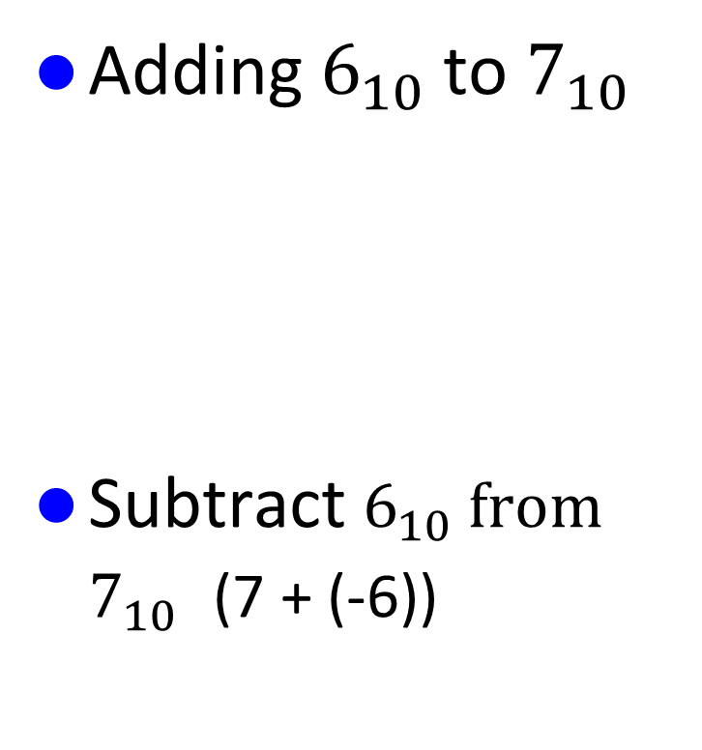
Addition and Subtraction
Adding $6_{10}$to $7_{10}$
Subtract $6_{10} from$ $7_{10}$ (7 + (-6))
00000110
00000111
Assuming 8bit signed integers
+
00001101
-6 (2’s complement)
11111010
00000111
+
00000001

Slide 4
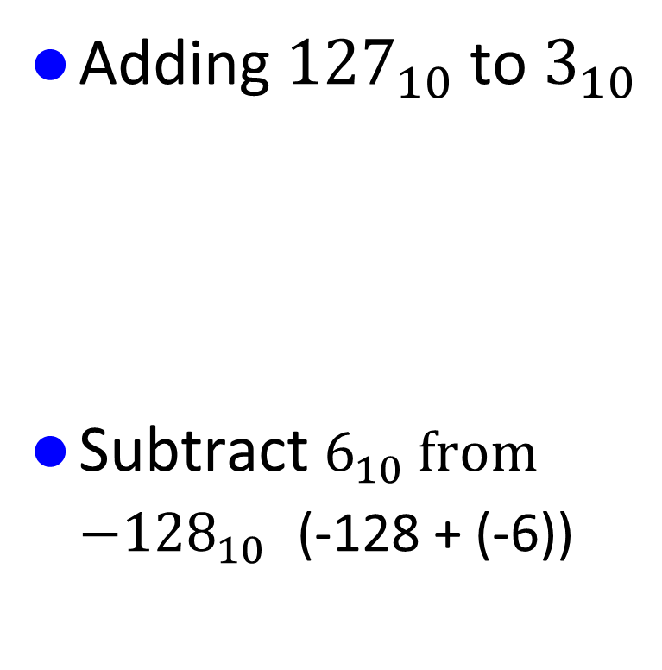
Addition and Subtraction
Adding ${127}_{10}$to $3_{10}$
Subtract $6_{10} from$ ${−128}_{10}$ (-128 + (-6))
01111111
00000011
Assuming 8bit signed integers
+
10000010
Overflowed, result is negative
-6 (2’s complement)
11111010
10000000
+
Overflowed, result is positive
Carry from the MSB is lost.
01111010

Slide 5
Overflow Detections
Overflow detection for 2’s complement numbers
Operation | Operand A | Operand B | Result indicating overflow
A + B | >= 0 | >= 0 | < 0
A + B | < 0 | < 0 | >= 0
A - B | >= 0 | < 0 | < 0
A - B | < 0 | >= 0 | >= 0
Overflow detection for unsigned numbers (need to use branch instructions)
  For addition, if the sum is less than either of the addends
  For subtraction, if the difference is greater than the minuends.

Slide 6
Overflow Detections
Overflow detection for 2’s complement numbers
Operation | Operand A | Operand B | Result indicating overflow
A + B | >= 0 | >= 0 | < 0
A + B | < 0 | < 0 | >= 0
A - B | >= 0 | < 0 | < 0
A - B | < 0 | >= 0 | >= 0
(NOT (sign_A XOR sign_B)) AND (sign_A XOR new_sign)
Overflow detection for unsigned numbers (need to use branch instructions)
  For addition, if the sum is less than either of the addends
  For subtraction, if the difference is greater than the minuends.

Slide 7
Dealing with Overflow
Some languages (e.g., C) ignore overflow
  Let compilers or programmers decide what to do
Other languages (e.g., Ada, Fortran) require an exception to be raised. If the hardware detects overflow/underflow, it raises an exception and invokes the exception handler.
    Save PC in exception program counter (mepc) register
    Save status in the CSR registers (e.g. mcause).
    Jump to a predefined handler address
    Return after corrective action (by jalr instruction)
    This requires precise exceptions, making out-of-order execution hard to implement
Notes:
C/C++ often leaves overflow as undefined behavior. Leaving the responsibility to programmers.
Some people think overflow rarely happens, can we have the HW to generate a trap? This introduces a challenging issue: precise interrupts
Early days, checking are expensive, so it was undefined behavior. Later this becomes a compatibility requirements.
Java defines overflow as wrapped around.

Slide 8
Why not HW traps on Overflow
Performance impact
  Checking for overflow incurs significant overhead
  Traps are expensive to handle
  Overflows are rare cases. Adding checking overhead slows down everyone.
Exception handling increases the complexity of high performance implementations (pipelining, out-of-order execution).
Flexibility
  Some applications want the wraparound behavior of the unsigned integers
The potential performance impact and added complexity of hardware traps have led to alternative approaches that rely on software or compiler support for overflow detection and handling.
Notes:
C/C++ often leaves overflow as undefined behavior. Leaving the responsibility to programmers.
Some people think overflow rarely happens, can we have the HW to generate a trap? This introduces a challenging issue: precise interrupts
Early days, checking are expensive, so it was undefined behavior. Later this becomes a compatibility requirements.
Java defines overflow as wrapped around.

Slide 9
Overflow Handling in RISC-V
RISC-V shifts the burden of arithmetic exception handling to software. It does not require the hardware to generate traps.
For signed/unsigned integer operations, the responsibility is shifted to software. If the program needs to check for overflows, the compiler should explicitly generate instructions to check for overflows.
For floating point operations, the hardware sets flags (fflags in fcsr) to inform that the overflow/underflow has occurred. The software must explicitly check the flags if it cares about such exceptions.
Shifting overflow/underflow detection responsibility to software is not new for RISC machines. However, MIPS/ARM/Power ISA still provides instructions to demand the hardware to trap. RISC-V simply does not support such instructions in the core set. (if you really want that, add them to some extensions)

Slide 10
Overflow Handling in RISC-V
RISC-V shifts the burden of arithmetic exception handling to software. It does not require the hardware to generate traps.
For signed/unsigned integer operations, the responsibility is shifted to software. If the program needs to check for overflows, the compiler should explicitly generate instructions to check for overflows.
For floating point operations, the hardware sets a flag to inform that the overflow/underflow has occurred. The software must explicitly check the flags if it cares about such exceptions.
Shifting overflow/underflow detection responsibility to software is not new for RISC machines. However, MIPS/ARM/Power ISA still provides instructions to demand the hardware to trap. RISC-V simply does not support such instructions in the core set. (if you really want that, add them to some extensions)
To support such traps, the hardware must have precise exceptions.
This necessitates that the execution pipeline retires instructions in order.
Such requirements limit the efficiency of pipeline implementation.

Slide 11
Instruction Execution Orders
Example code
1 LD X2, 4(X10)
2 ADD X3, X2, X4
3 DIV X5, X6, X7
4 ADD X8, X5, X9
5 AND X13, X11,X12
6 …
In order execution
Out of order execution
Architecture states are
updated in order:
X2
X3
X5
X8
X13
If any inst generates an
Exception, the updated
arch states are precise.
The execution order
might be
1 LD,
3 DIV,
5 AND
and, instruction 5
finished before inst 3.
If inst 3 generates a
trap, the updated arch
states are X13,
which is incorrect
(should be X2, and X3)
latency
latency

Slide 12
Precise Exception
A precise exception is a type of exception or interrupt that
allows a program to be stopped and then resumed in a
well-defined state.
Think of it like hitting "pause" on a movie—
you can resume from the exact frame where you stopped.
Precise
  Clean state
  Re-startable
    The program can be resumed from the exact instruction that caused
    the exception
  Consistent execution
    It is as if the exception never happened
Precise exception makes out-of-order execution difficult to implement.

Slide 13
RV Arithmetic and Logic Unit (ALU)
Must support the Arithmetic/Logic operations of the ISA
  add, addi,sub
  and, andi, or, ori, xor, xori
  beq, bne, slt, slti
Some ALUs must handle signs and zero extensions due to different operand sizes (such as addb, addh). RV does not need to do that.
  The potential overhead of processing extra bits on byte operations is often outweighed by the benefits of a simpler and more streamlined architecture.)
Detecting overflows in ALU?
  Some ALU may generate a trap on such overflows; RV does not. For FP exceptions, RV sets a flag but does not trap.
zero
overflow
32
A
ALU
32
result
32
B
4
m (operation)
Notes:
Once data is set up in registers, the ALU operates on the complete width. If specific byte is needed, masking and shifting operations can be used.

Slide 14
A 1-bit ALU – And, Or, and Add Operations
CarryIn
Operation
and
A
0
or
Result
1
Mux
1-bit
Full
Adder
add
2
B
CarryOut

Slide 15
A 4-bit ALU – And, Or, and Add Operations
1-bit ALU
4-bit ALU
CarryIn
CarryIn0
Operation
Operation
A0
1-bit
ALU
A
Result0
B0
CarryIn1
CarryOut0
A1
1-bit
ALU
Result1
Result
B1
Mux
CarryOut1
CarryIn2
A2
1-bit
ALU
Result2
B2
1-bit
Full
Adder
CarryOut2
CarryIn3
B
A3
1-bit
ALU
Result3
B3
CarryOut
CarryOut3
Notes:
Now that I have shown you how to build a 1-bit full adder, we have all the major components needed for this 1-bit ALU.
In order to build a 4-bit ALU, we simply connect four 1-bit ALUs in series to feed the CarryOut of one ALU to the CarryIn of the next ALU.
Adders have multiple different implementation, ripple carry or carry lookahead, or carry skip, parallel prefix adder. With sufficient transistors, adder can be faster.
Even though I called this an ALU, I actually lied a little. There is something missing about this ALU. This ALU can NOT perform the subtract operation.
Let see how can we fix this problem.
2 min = 35 min. (Y:15)

Slide 16
Subtraction Operation
2’s complement: Take inverse of every bit and add 1 (at c_{in} of first stage)
  A + B’ + 1 = A + (B’ + 1) = A + (-B) = A - B
  Bit-wise inverse of B is B’
Subtract
(Bnegate)
CarryIn
Operation
A
ALU
Result
Sel
B
0
Mux
1
B’
CarryOut
Notes:
Recalled something you learned from grade school that: A - B is the same as A plus (-B).
Also recall from earlier slides that in order to calculate the 2 complement representation of negative B, we simply take the inverse of very bit and add 1.
The bitwise inverse of B is easy to compute. Just pass them through the inverter.
In order to do the add 1 operation, we simply set the CarryIn to 1.
So for the subtract operation, we simply select the output of the inverter and set CarryIn to 1.
Then we will be adding A to the negative of B and whola, we have the A minus B operation.
这里Bnegate就是一个控制信号，选择是原码还是反码
+2 = 37 min. (Y:17)

Slide 17
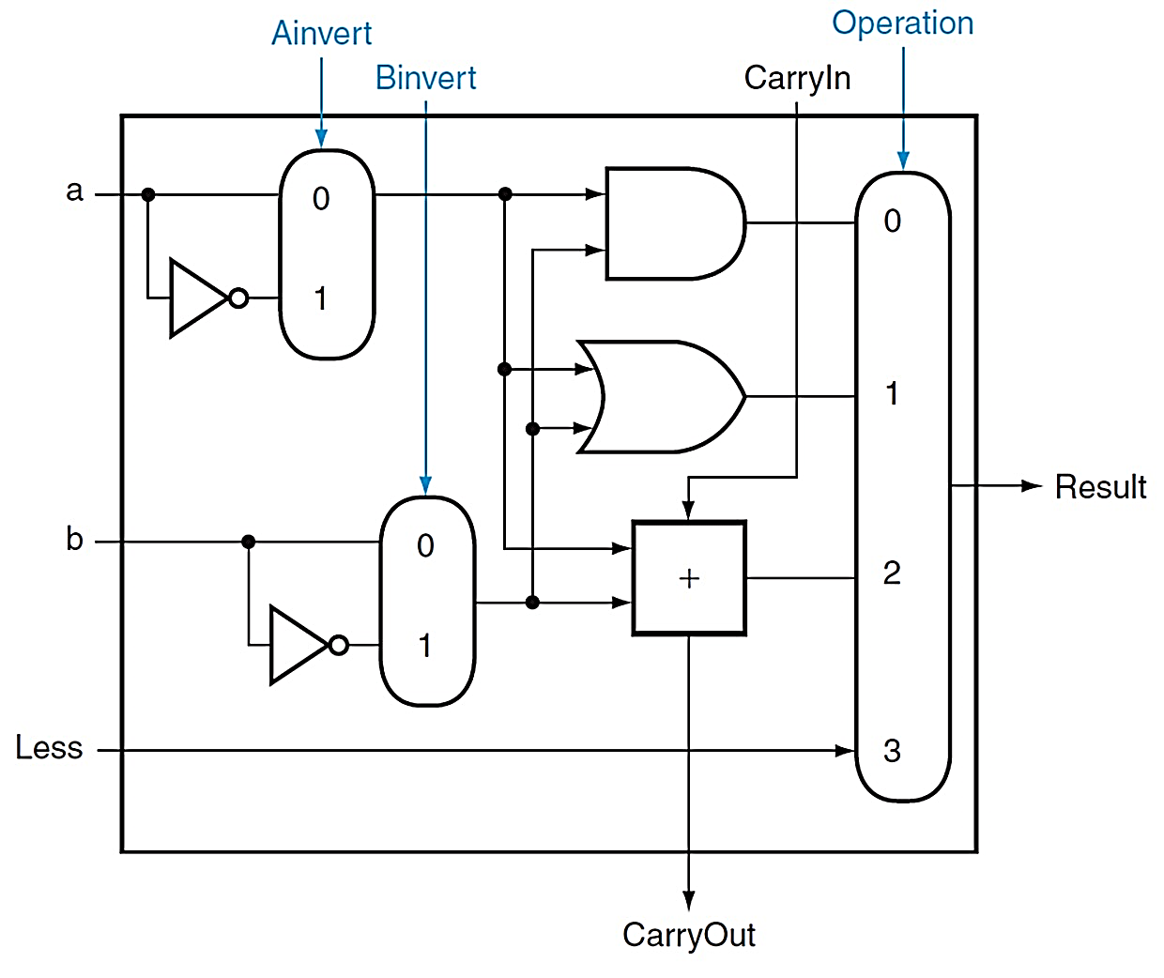
(Simplified) 1-bit RV ALU
and, or, add, sub, slt
A nor B = ~A and ~B
SLT A,B is computed as
taking the sign bit from
A-B

Slide 18
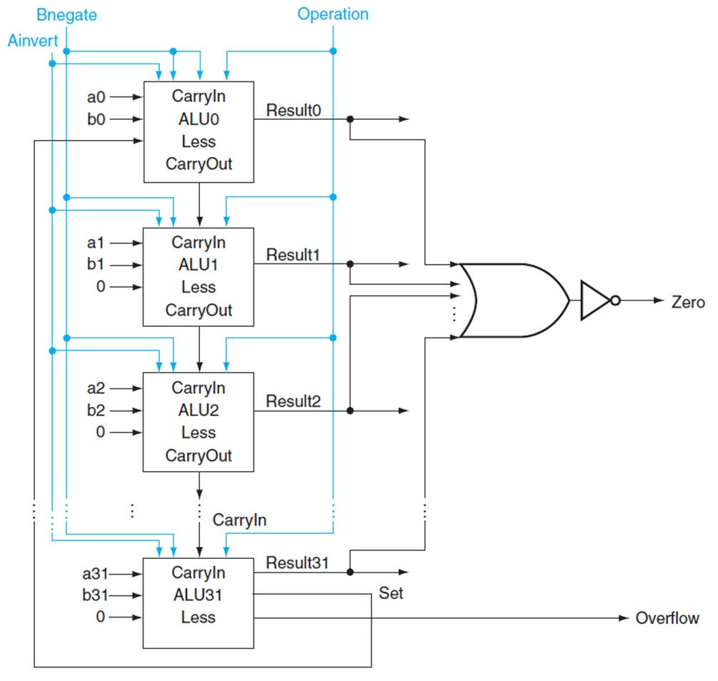
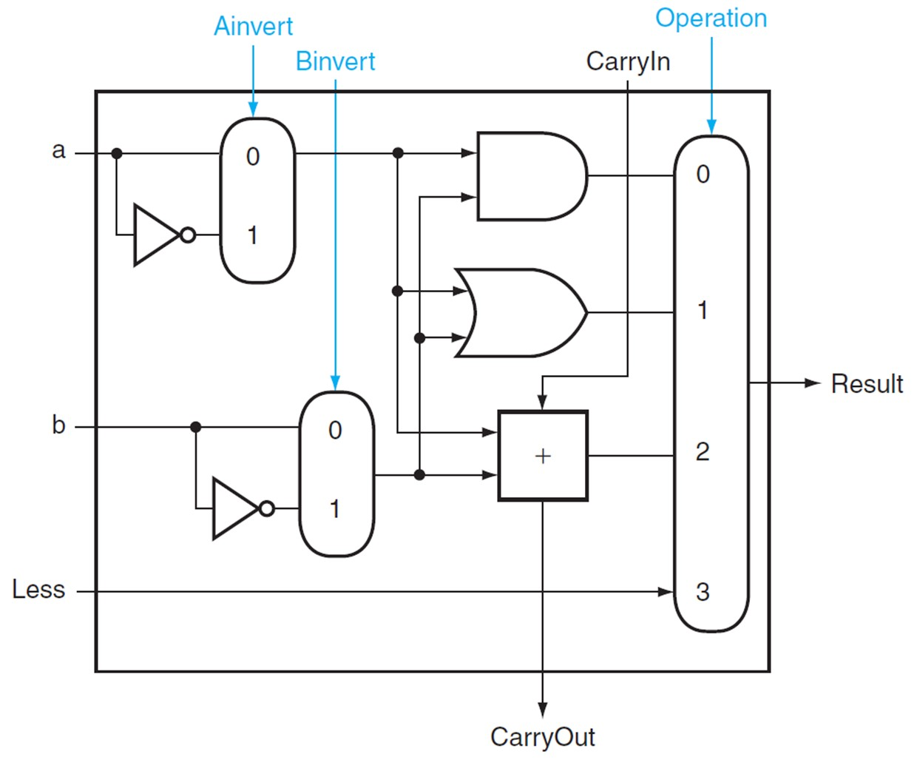
(Simplified) 32-bit ALU
1-bit ALU
Notes:
CLA: Carry Lookahead Adder. Just based on the previous four bits of a and b, I could know what would be the carry from the previous group.

Slide 19
Multiplication
More complicated than addition
  Can be accomplished via shifting and adding
Double precision product is produced
More time and more area are required
0010
× 1011
0010
00100
000000
0010000
00010110
(multiplicand)
(multiplier)
(partial product array)
(product)
Notes:
第一个数叫被乘数 multiplicand，第二个数是乘数multiplier，

Slide 20
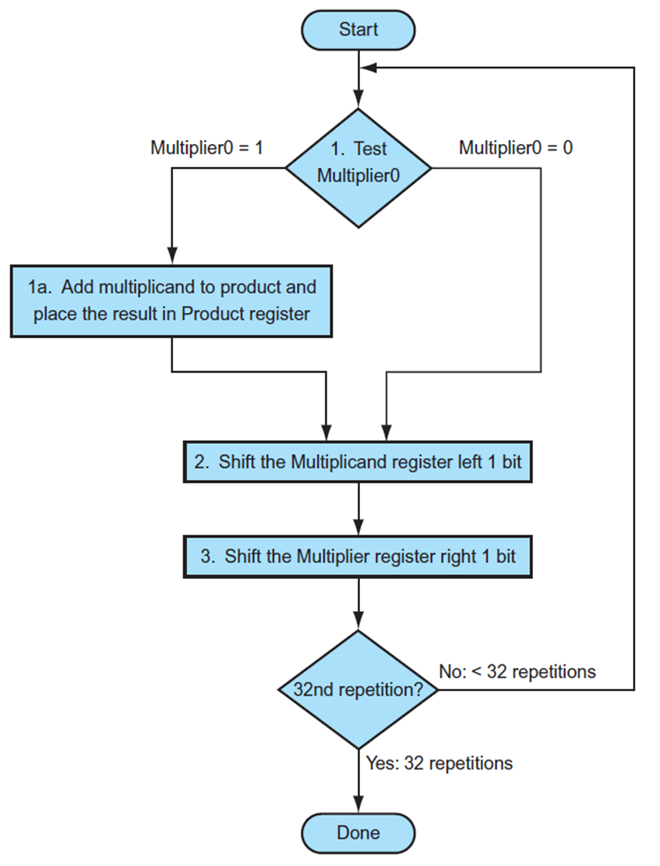
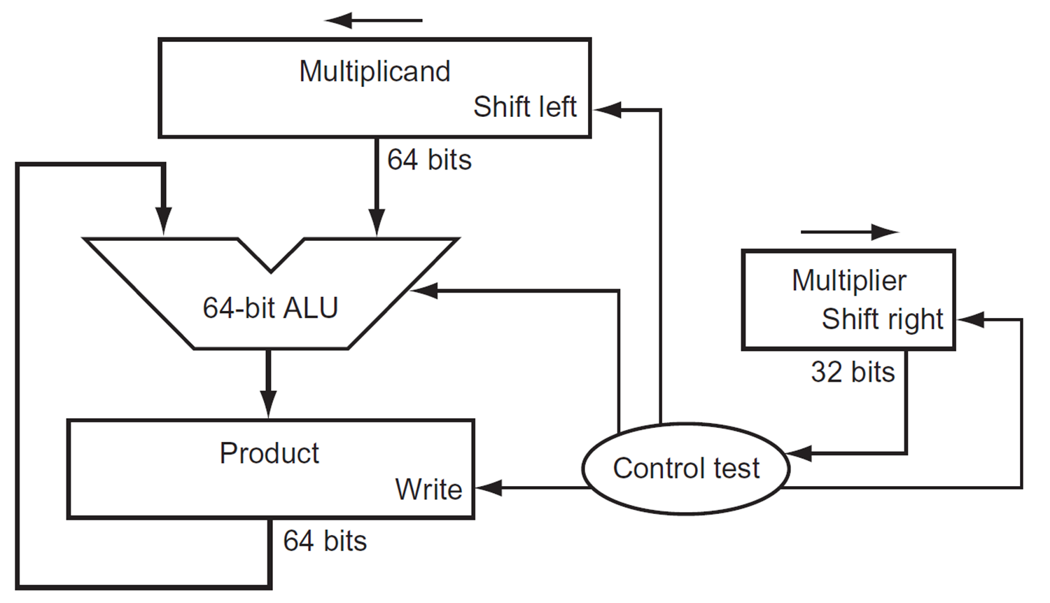
Multiplication Hardware (1st Version)

Slide 21
Multiplication Hardware (2nd Version)
32-bit Multiplicand register, 32 -bit ALU, 64-bit Product register, (0-bit Multiplier register)

Slide 22
Multiplication Hardware (2nd Version)
Start
0010 x 0011
Multiplicand Product
0010 0000 0011
0010 0011
0010 0001 0001
0011 0001
0010 0001 1000
0010 0000 1100
0010 0000 0110
Product0 = 1
1. Test
Product0
Product0 = 0
1a. Add multiplicand to left half of product and
place the result in left half of Product register
2. Shift Product register right 1 bit
32nd
repetition?
No: < 32 repetitions
Yes: 32 repetitions
Done

Slide 23
Signed Multiplication
Convert multiplier and multiplicand to positive numbers.
Remember their original signs.
Multiply as before, leaving the sign out of the calculation
We negate the product only if the original signs disagree.

Slide 24
RISC-V Multiply Instructions
For a standard 32-bit multiplication, the result fits within a single 32-bit register.
For a 64-bit multiplication, where the result could potentially be 64 bits, RISC-V handles it differently based on the specific instruction used:
MUL instruction: Returns the lower 32 bits of the product.
MULH, MULHSU, and MULHU instructions: These instructions are provided to obtain the higher 32 bits of the product for signed and unsigned multiplication
MUL: Multiplication
MULH: Multiply high (signed × signed)
MULHSU: Multiply high (signed × unsigned)
MULHU: Multiply high (unsigned × unsigned)

Slide 25
Shift and Add to replace Multiply
Compilers are clever at replacing multiplication with shifts and adds, especially when dealing with multiplication by constants.
Decompose the constant:
The compiler breaks down the constant into a sum of powers of 2.
For example:
10 = 8 + 2 (2^3 + 2^1)
13 = 8 + 4 + 1 (2^3 + 2^2 + 2^0)
So, x*13 = (x << 3) + (x << 2) + x
Exercise: X*1054 = (2^? + 2^? - 2^?)
So, x*1054 = (x << ?) + (x << ?) +…

Slide 26
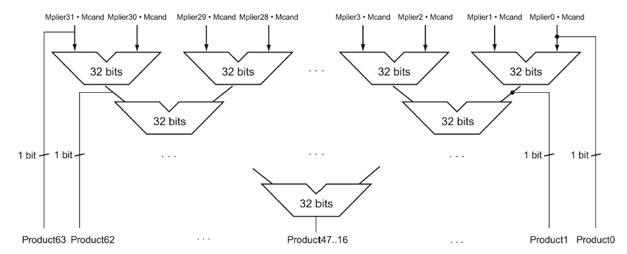
Faster Multiplication
With Moore’s law, we could use more transistors to make the multiplication go faster. Whether the multiplicand should be added at each step can be predetermined by looking at the respective bit in the multiplier. So 31 adders could be used in a pyramid. The delay could be reduced from 31 to 5 or even lower.
Notes:
In computer industry, this is often called the pyramid in a multiplier.

Slide 27
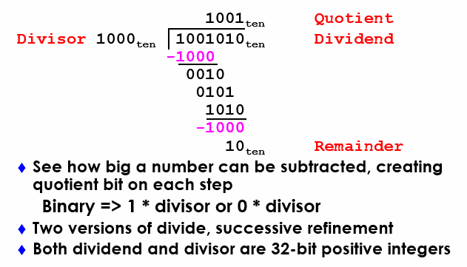
Divide: Paper & Pencil

Slide 28
Divide Hardware - Version 1 (1)
64-bit Divisor register (initialized with 32-bit divisor in left half), 64-bit ALU, 64-bit Remainder register (initialized with 64-bit dividend), 32-bit Quotient register
Divisor
Shift Right
64 bits
Quotient
Shift Left
64-bit ALU
32 bits
Remainder
Write
Control
64 bits

Slide 29
Divide Hardware - Version 1 (2)
0111 / 0010
Quot. Divisor Rem.
0000 00100000 00000111
11100111
00000111
0000 00010000 00000111
11110111
00000111
0000 00001000 00000111
11111111
00000111
0000 00000100 00000111
00000011
0001 00000011
0001 00000010 00000011
00000001
0011 00000001
0011 00000001 00000001
Start: Place Dividend in Remainder
1. Subtract Divisor register from
Remainder register, and place the
result in Remainder register
Remainder ≥ 0
Test
Remainder
Remainder < 0
2a. Shift Quotient register to left, setting new rightmost bit to 1
2b. Restore original value by adding Divisor to Remainder, place sum in Remainder, shift Quotient to the left, setting new least significant bit to 0
3. Shift Divisor register right 1 bit
33rd
repetition?
No: < 33 repetitions
Yes: 33 repetitions
Done
Notes:
Q: 0000 D: 0010 0000 R: 0000 0111  = 1110 0000
1: R = R Q: 0000 D: 0010 0000 R: 1110 0111
2b: +D, sl Q, 0 Q: 0000 D: 0010 0000 R: 0000 0111
3: Shr D Q: 0000 D: 0001 0000 R: 0000 0111  = 1111 0000
1: R = R Q: 0000 D: 0001 0000 R: 1111 0111
2b: +D, sl Q, 0 Q: 0000 D: 0001 0000 R: 0000 0111
3: Shr D Q: 0000 D: 0000 1000 R: 0000 0111  = 1111 1000
1: R = R Q: 0000 D: 0000 1000 R: 1111 1111
2b: +D, sl Q, 0 Q: 0000 D: 0000 1000 R: 0000 0111
3: Shr D Q: 0000 D: 0000 0100 R: 0000 0111  = 1111 1100
1: R = R Q: 0000 D: 0000 0100 R: 0000 0011
2a: sl Q, 1 Q: 0001 D: 0000 0100 R: 0000 0011
3: Shr D Q: 0000 D: 0000 0010 R: 0000 0011  = 1111 1110
1: R = R Q: 0000 D: 0000 0010 R: 0000 0001
2a: sl Q, 1 Q: 0011 D: 0000 0010 R: 0000 0001
3: Shr D Q: 0011 D: 0000 0001 R: 0000 0001
Recommend show 2 comp of divisor, show lines for subtract divisor and restore remainder

Slide 30
Observations - Version 1
Half of the bits in divisor register always 0
=> 1/2 of 64-bit adder is wasted
=> 1/2 of divisor is wasted
Instead of shifting divisor to right,
shift remainder to left?
1st step cannot produce a 1 in quotient bit
=> switch order to shift first and then subtract
=> save 1 iteration
Eliminate Quotient register by combining with Remainder register as shifted left

Slide 31
Divide Hardware - Version 2 (1)
32-bit Divisor register, 32 -bit ALU, 64-bit Remainder register, (0-bit Quotient register)
Divisor
32 bits
32-bit ALU
Shift Left
Remainder
(Quotient)
Control
64 bits
Write

Slide 32
Divide Hardware - Version 2 (2)
Start: Place Dividend in Remainder
0111 / 0010
Step Remainder Div.
0 0000 0111 0010
1.1 0000 1110
1.2 1110 1110
1.3b 0001 1100
2.2 1111 1100
2.3b 0011 1000
3.2 0001 1000
3.3a 0011 0001
4.2 0001 0001
4.3a 0010 0011
0001 0011
1. Shift Remainder register left 1 bit
2. Subtract Divisor register from the
left half of Remainder register, and place the
result in the left half of Remainder register
Remainder ≥ 0
Test
Remainder
Remainder < 0
3b. Restore original value by adding Divisor to left half of Remainder, and place sum in left half of Remainder. Also shift Remainder to left, setting the new least significant bit to 0
3a. Shift Remainder to left, setting new rightmost bit to 1
32nd
repetition?
No: < 32 repetitions
Yes: 32 repetitions
Done. Shift left half of Remainder right 1 bit
Notes:
D: 0010 R: 0000 0111
0: Shl R D: 0010 R: 0000 1110
1: R = R D: 0010 R: 1110 1110
2b: +D, sl R, 0 D: 0010 R: 0001 1100
1: R = R D: 0010 R: 1111 1100
2b: +D, sl R, 0 D: 0010 R: 0011 1000
1: R = R D: 0010 R: 0001 1000
2a: sl R, 1 D: 0010 R: 0011 0001
1: R = R D: 0010 R: 0001 0001
2a: sl R, 1 D: 0010 R: 0010 0011
Shr R(rh) D: 0010 R: 0001 0011

Slide 33
RV Division Instruction
Instruction
div $t1, $t2, $t3 # t1 = t2/ t3
divu $t1, $t2
rem $t1, $t2, $t3 # t1 = t2 % t3
remu $t1, $t2, $t3
RISC-V handle quotient and remainder with different instructions:
  DIV and DIVU instructions: Return the quotient of the division.
  REM and REMU instructions: Return the remainder of the division.
No overflow or divide-by-0 checking
  Software must perform checks if required

Slide 34
Signed Division
Dividend = Quotient X Divisor + Remainder
+7 div +2 = +3 , remainder +1
-7 div +2 = -3, remainder -1 ➔ why not quotient -4, remainder +1
Rule: the dividend and the remainder must have the same sign
Division steps:
  Remember signs, make positive, complement quotient and remainder if necessary
  Let Dividend and Remainder have same sign and negate Quotient if Divisor sign & Dividend sign disagree.

Slide 35
Observations: Multiply and Divide
Same hardware as multiply: Just need ALU to add or subtract, and 64-bit register to shift left (multiply: shift right)
Divisor
32 bits
32-bit ALU
Shift Left
Remainder
(Quotient)
Control
64 bits
Write
Notes:
Multiply和Divide用完全相同的结构

Slide 36
Multiply/Divide Hardware
32-bit Multiplicand/Divisor register, 32 -bit ALU, 64-bit Product/Remainder register, (0-bit Multiplier/Quotient register)
Multiplicand/
Divisor
32 bits
32-bit ALU
Shift Right
Product/
Remainder
Multiplier/
Quotient
Shift Left
Control
Write
64 bits

Slide 37
Multiply/Divide by Power of 2
Multiply by power of 2 can use shift left
X * 2 = X << 1, X * 4 = X << 2, …
-X *2 = (-X) << 1, -X *4 = (-X) << 2
How about division?
X div 2 = X >> 1. This works for positive numbers
How about negative number such as -7/2?
Assume 8bit integer, 7 is 00000111 and -7 is 11111001
11111001 >> (SRA) 1 = 1111100 -4, this quotient is wrong, it should be -3
The correct way to use >> for X div N, where X is a negative number, and N is a power of 2, is as follows:
(X+(N−1)) ≫ log2​(N)
For example, -7/2, should use (-7+1) >> 1
-9/4 ?
(-9+3)>> 2
Is -2

