Slide 1
CSC3050 – Computer Architecture
FP Numbers and Computation
Prof. Wei Chung Hsu
School of Data Science
Chinese University of Hong Kong, Shenzhen
Notes:
Group of bits (byte, word, double word) can encode char, numbers, color/audio, logic, instructions…..
This chapter will look at a more complex encoding: FP numbers.
How does HW do */div complex arithmetic?
How does HW handle overflows/underflows?

Slide 2
Floating-Point Numbers
Representation for non-integral (real) numbers
  Include very small and very large numbers
Like scientific notation (i.e. single digit to the left of the decimal point)
  –2.34 × 10⁵⁶
  +0.002 × 10^{–4}
In binary, normalized numbers are represented as
  ±1.xxxxxxx₂ × 2^{yyyy}
Types float and double in C
Why normalization?
Unique representation
Maximize precision
Standards
(normalized: has no leading zeros)
(not normalized) ➔ normalized to 2.0 X 10^{–7}
0.0001₂ x 2¹⁰
1.0₂ x 2⁶
Notes:
Real numbers as opposed to “imaginary numbers”
小数点左边只有一位非0数字的，叫做normalized number. 2.0x10^{–7} = 0.002x10^{–4}
Scientific notation allows the decimal point to float. The Exponent value determines the decimal point.

Slide 3
FP to Decimal conversion
Convert 1.1011 to decimal
  1 x 2⁰ + 1 x 2⁻¹ + 0 x 2⁻² + 1 x 2⁻³ + 1 x 2⁻⁴
  ^{= 1.6875}
Convert 0.5 to binary
  0.1
  = 1.0 x 2^{-1 (normalized)}
Convert 0.7 to binary
  0.1011001….
  Getting close to 0.7 (0.6953125..)
How about
0.11111
1.000001
0.11111
= 31/32
1.000001
= 1+1/64
0.7 x 2 | 1.4 | 1
0.4 x 2 | 0.8 | 0
0.8 x 2 | 1.6 | 1
0.6 x 2 | 1.2 | 1
0.2 x 2 | 0.4 | 0
0.4 x 2 | 0.8 | 0
0.8 x 2 | 1.6 | 1

Slide 4
Floating-Point Standard
Defined by IEEE 754-1985 standard
Developed in response to divergence of representations
  Portability issues for scientific code and data
Now almost universally adopted
Two representations
  Single precision (32-bit)
  Double precision (64-bit)

Slide 5
IEEE Floating-Point Format
±1.xxxxxxx₂ × 2^{yyyy}
Hidden 1
1 bit
8 bits
23 bits
s
exponent
fraction/mantissa
Single-Precision
x = (−1)^{s} × (1+fraction) × 2^{(exponent−127)}
exponent | fraction | Value represented
00000000 | 0 | 0
00000000 | nonzero | denormalized
1111 1111 | 0 | ±∞
1111 1111 | non-zero | NaN
For denormalized numbers,
there is no hidden 1.
Special values
1 bit
11 bits
52 bits
s
exponent
fraction/mantissa
Double-Precision
x = (−1)^{s} × (1+fraction) × 2^{(exponent−1023)}
Notes:
IEEE 754 uses a bias of 127 for single precision, double precision的bias是1023

Slide 6
IEEE Single Precision Floating-Point Numbers
1 bit
8 bits
23 bits
s
exponent
fraction/mantissa
Single-Precision
x = (−1)^{s} × (1+fraction) × 2^{(exponent−127)}
(1+fraction) is called the significand
The largest SP number is (1+0.111111…) x 2⁽²⁵⁴⁻¹²⁷⁾
which is 2¹²⁷×(2−ϵ) ~ 3.4028235 × 10³⁸
The bit pattern is 0 11111110 11111111111111111111111
The smallest SP number (normalized) is (1+0.00000…) x 2⁽¹⁻¹²⁷⁾
which is 2⁻¹²⁶
The bit pattern is 0 00000001 00000000000000000000000
However, smaller values can be represented using denormalized numbers, where the exponent is 0, and the leading bit of the mantissa is no longer assumed to be 1,
so the smallest number would be 2⁻¹⁴⁹
Notes:
IEEE 754 uses a bias of 127 for single precision, double precision的bias是1023

Slide 7
Exponents in Biased Form
The biased representation simplifies comparisons. We can sort floating-point numbers like integers. A number with a larger exponent will be greater than a number with a smaller exponent (i.e. just call an integer sort routine to sort a group of floating point numbers)
If the exponent is represented in 2’s complement numbers, then a comparison of the exponents must be separated out, not as part of an integer number. Since if treated as part of an integer number, the exponents will be compared like unsigned numbers.
Notes:
Real numbers as opposed to “imaginary numbers”
小数点左边只有一位非0数字的，叫做normalized number. 2.0x10^{–7} = 0.002x10^{–4}
Scientific notation allows the decimal point to float. The Exponent value determines the decimal point.

Slide 8
Why not Fixed-Point Numbers
The largest SP number is ~ 3.4028235 × 10³⁸
The bit pattern is 0 11111110 11111111111111111111111
The smallest SP number (normalized) is 2⁻¹²⁶
The bit pattern is 0 00000001 00000000000000000000000
denormalized numbers, where the exponent is 0, and the leading bit of the mantissa is no longer assumed to be 1, the smallest denorm would be 2⁻¹⁴⁹
Notes:
Real numbers as opposed to “imaginary numbers”
小数点左边只有一位非0数字的，叫做normalized number. 2.0x10^{–7} = 0.002x10^{–4}
Scientific notation allows the decimal point to float. The Exponent value determines the decimal point.

Slide 9
Why not Fixed-Point Numbers
The largest SP number is ~ 3.4028235 × 10³⁸
The bit pattern is 0 11111110 11111111111111111111111
The smallest SP number (normalized) is 2⁻¹²⁶
The bit pattern is 0 00000001 00000000000000000000000
denormalized numbers, where the exponent is 0, and the leading bit of the mantissa is no longer assumed to be 1, the smallest denorm would be 2⁻¹⁴⁹
The range of real numbers we can represent in floating point numbers is
10³⁸ to 10⁻³⁸
What if we use a fixed point representation:
xxxxx.yyyyy where the binary point is fixed.
Assume 32 bit are divided into two parts: the integer part (xxxxx) and the fraction part yyyyy. Each takes 16 bits. What range can this number system cover?
Notes:
Real numbers as opposed to “imaginary numbers”
小数点左边只有一位非0数字的，叫做normalized number. 2.0x10^{–7} = 0.002x10^{–4}
Scientific notation allows the decimal point to float. The Exponent value determines the decimal point.

Slide 10
Why not Fixed-Point Numbers
The largest SP number is ~ 3.4028235 × 10³⁸
The bit pattern is 0 11111110 11111111111111111111111
The smallest SP number (normalized) is 2⁻¹²⁶
The bit pattern is 0 00000001 00000000000000000000000
denormalized numbers, where the exponent is 0, and the leading bit of the mantissa is no longer assumed to be 1, the smallest denorm would be 2⁻¹⁴⁹
The range of real numbers we can represent in floating point numbers is
10³⁸ to 10⁻³⁸
What if we use a fixed point representation:
xxxxx.yyyyy where the binary point is fixed.
Assume 32 bit are divided into two parts: the integer part (xxxxx) and the fraction part yyyyy. Each takes 16 bits. What range can this number system cover?
~2¹⁵ to ~2⁻¹⁶
~10⁵ to 10⁻⁵
Floating point number system can cover a much more extensive range!!
Notes:
Real numbers as opposed to “imaginary numbers”
小数点左边只有一位非0数字的，叫做normalized number. 2.0x10^{–7} = 0.002x10^{–4}
Scientific notation allows the decimal point to float. The Exponent value determines the decimal point.

Slide 11
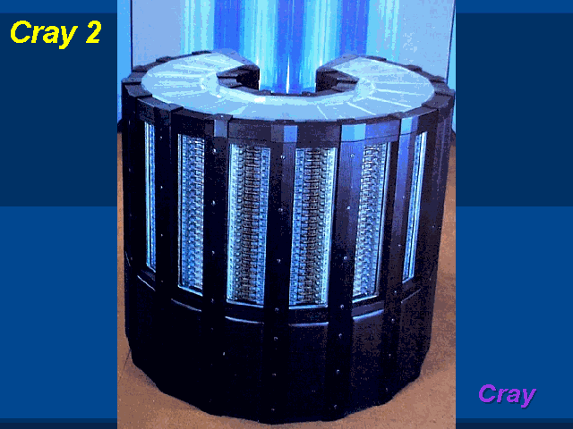
Traditional Supercomputers Are FP Machines
Notes:
Binary: [0][100 0000 1][100 0000 0000 0000 0000 0000]
Sign: +
Exponent: 129 – 127 = +2
Mantissa: 0b1.1
x = +0b1.1 x 2^(2) = +0b110 = +6

Slide 12
Exercise 1
What is the IEEE single precision number 0x40C00000 representing in decimal?
0x40C00000 = 0100 0000 1100 0000 0000 0000 0000 0000
x = (−1)^{s} × (1+fraction) × 2^{(exponent−127)}
0x40C00000 = 0 100 0000 1 100 0000 0000 0000 0000 0000
= (−1)⁰ × (1+0.100…000) × 2⁽¹²⁹⁻¹²⁷⁾
= 1.100…000 × 2²
= 1102
Notes:
Binary: [0][100 0000 1][100 0000 0000 0000 0000 0000]
Sign: +
Exponent: 129 – 127 = +2
Mantissa: 0b1.1
x = +0b1.1 x 2^(2) = +0b110 = +6

Slide 13
Exercise 2
How to represent –0.5 in IEEE single precision binary floating-point format?
–0.5 = (−1)¹ × 0.5 (decimal)
= (−1)¹ × 1/2 (decimal)
= (−1)¹ × 1.0 × 2⁻¹ (binary)
x = (−1)^{s} × (1+fraction) × 2^{(exponent−127)}
1 011 1111 0 000 0000 0000 0000 0000 0000
Notes:
0.5 = 0b0.1 = 0b1 x 2^(-1)
Exponent: (-1)+127 = 126 = 0b01111110
Sign = 1
Mantissa: 0000 … 0000
Answer:
1 01111110 000 0000 0000 0000 0000 0000

Slide 14
Exercise 3
How to represent –0.75 in IEEE single precision binary floating-point format?
–0.75 = (−1)¹ × 0.75 (decimal)
= (−1)¹ × 3/4 (decimal)
= (−1)¹ × 1.1 × 2⁻¹ (binary)
x = (−1)^{s} × (1+fraction) × 2^{(exponent−127)}
1 011 1111 0 100 0000 0000 0000 0000 0000
Notes:
0.5 = 0b0.1 = 0b1 x 2^(-1)
Exponent: (-1)+127 = 126 = 0b01111110
Sign = 1
Mantissa: 0000 … 0000
Answer:
1 01111110 000 0000 0000 0000 0000 0000

Slide 15
Exercise 4
How to represent 1/3 in IEEE single precision binary floating-point format?
Notes:
0.5 = 0b0.1 = 0b1 x 2^(-1)
Exponent: (-1)+127 = 126 = 0b01111110
Sign = 1
Mantissa: 0000 … 0000
Answer:
1 01111110 000 0000 0000 0000 0000 0000

Slide 16
Exercise 4
How to represent 1/3 in IEEE single precision binary floating-point format?
Multiply by 2, then fetch the integral part
0.3333 x 2 = 0.6666 0
0.6666 x 2 = 1.3332 1
0.3332 x 2 = 0.6664 0
0.6664 x 2 = 1.3328 1
0.3328 x 2 = 0.6656 0
0.6656 x 2 = 1.3312 1
0.010101…. Normalize to 1.0101… x 2⁻²
Final bit pattern is
0 01111101 01010101010101010101010
x = (−1)^{s} × (1+fraction) × 2⁽¹²⁵⁻¹²⁷⁾
Notes:
We cannot represent 1/3 exactly, we only get an approximation
Exponent: (-1)+127 = 126 = 0b01111110
Sign = 1
Mantissa: 0000 … 0000
Answer:
1 01111110 000 0000 0000 0000 0000 0000

Slide 17
Exercise 5
What are the SP FP values of the following binary numbers
0 00000000 00000000000000000000000
0 00000000 00000000000000000000001
0 00000000 10000000000000000000000
0 00000001 00000000000000000000000
0 10000000 00000000000000000000000
0 01111111 00000000000000000000000
0 11111111 10000000000000000000000
1 11111111 00000000000000000000000
Notes:
0.5 = 0b0.1 = 0b1 x 2^(-1)
Exponent: (-1)+127 = 126 = 0b01111110
Sign = 1
Mantissa: 0000 … 0000
Answer:
1 01111110 000 0000 0000 0000 0000 0000

Slide 18
Exercise 5
What are the SP FP values of the following binary numbers
0 00000000 00000000000000000000000
0 00000000 00000000000000000000001
0 00000000 10000000000000000000000
0 00000001 00000000000000000000000
0 10000000 00000000000000000000000
0 01111111 00000000000000000000000
0 11111111 10000000000000000000000
1 11111111 00000000000000000000000
0.0
2⁻¹⁴⁹
For denormalized
values, the exponent
is always set to -126
denom
2⁻¹²⁷
2⁻¹²⁶
2.0
1.0
NaN
-∞
Notes:
0.0 is neither a normalized nor a denormalized number
Exponent: (-1)+127 = 126 = 0b01111110
Sign = 1
Mantissa: 0000 … 0000
Answer:
1 01111110 000 0000 0000 0000 0000 0000

Slide 19
Floating-Point Addition (1)
Consider a 4-digit decimal example
  9.999 × 10¹ + 1.610 × 10^{–1}
1. Align decimal points
  Shift number with smaller exponent
  9.999 × 10¹ + 0.016 × 10¹
2. Add significands
  9.999 × 10¹ + 0.016 × 10¹ = 10.015 × 10¹
3. Normalize result & check for over/underflow
  1.0015 × 10²
4. Round and renormalize if necessary
  1.002 × 10²

Slide 20
Floating-Point Addition (2)
Now consider a 4-digit binary example
  1.000₂ × 2^{–1} + –1.110₂ × 2^{–2} (0.5 + –0.4375)
1. Align binary points
  Shift number with smaller exponent
  1.000₂ × 2^{–1} + –0.111₂ × 2^{–1}
2. Add significands
  1.000₂ × 2^{–1} + –0.111₂ × 2^{–1} = 0.001₂ × 2^{–1}
3. Normalize result & check for over/underflow
  1.000₂ × 2^{–4}, with no over/underflow
4. Round and renormalize if necessary
  1.000₂ × 2^{–4} (no change) = 0.0625

Slide 21
FP Adder Hardware (1)
Much more complex than integer adder
Doing it in one clock cycle would take too long
  Much longer than integer operations
  Slower clock would penalize all instructions
FP adder usually takes several cycles
  Can be pipelined

Slide 22
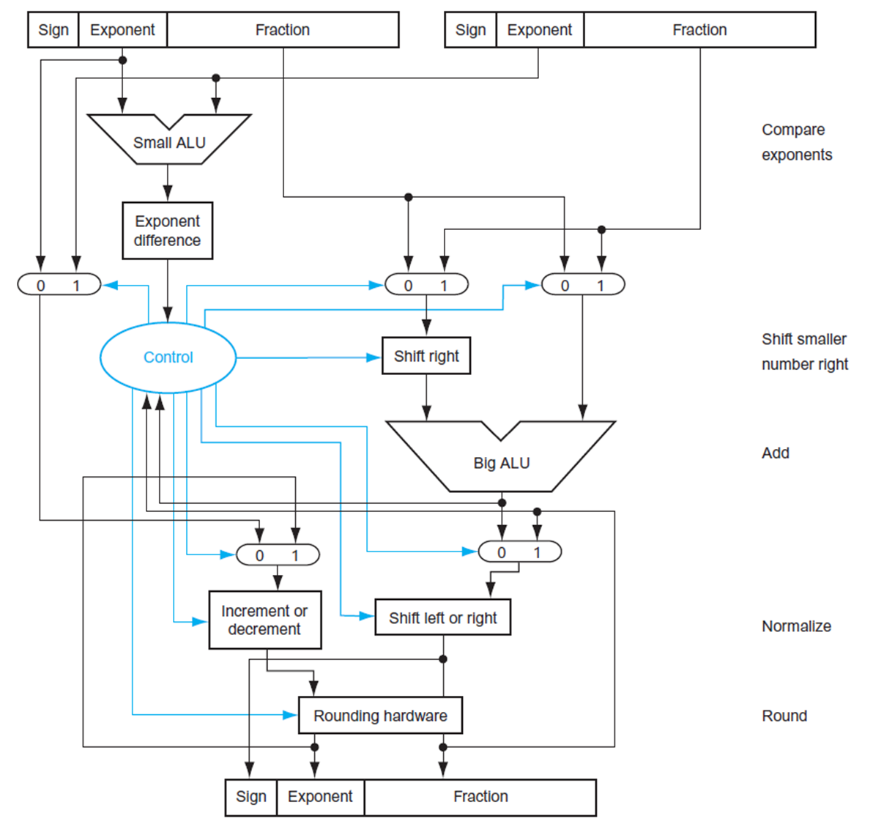
FP Adder Hardware (2)
Step 1
Step 2
Step 3
Step 4

Slide 23
FP Arithmetic Hardware
FP multiplier is of similar complexity to FP adder
  But uses a multiplier for significands instead of an adder
FP arithmetic hardware usually does
  Addition, subtraction, multiplication, division, reciprocal, square-root
  FP ↔ integer conversion
  (conversion is a relatively expensive operation partly due to the separate FP and Int register files)
Operations usually takes several cycles
  Can be pipelined (the conversion unit may be not)
Notes:
reciprocal

Slide 24
Quadruple Precision, Half-float and minifloat
Quad-precision float and half float format were defined in IEEE 754-2008.
  Quad precision: 1, 15, 112
  Double precision: 1, 11, 52
  Single precision: 1, 8, 23
  Half precision: 1, 5, 10 (fp16),
    bfloat16 (1,8,7) has the same range as fp32
  Mini-float: 1, 4, 3 (fp8)
  FP4: 1,2,1
  Half-float, mini-float, and fp4, are defined to support AI applications.
Defined by IEEE 754 standard
Notes:
reciprocal

Slide 25
Example of FP8 (minifloat) numbers
1 bit
4 bits
3 bits
s
exponent
fraction
FP8
x = (−1)^{s} × (1+fraction) × 2^{(exponent−7)}
 | Exponent | Fraction | Number | Decimal number
Largest number | 1110 | 111 | 1.111 x 2⁽¹⁴⁻⁷⁾ | 240
Smallest number | 0000 | 001 | 0.001 x 2⁻⁷ | 0.00097656
Next to largest | 1110 | 110 | 1.11 x 2⁷ | 224
Next | 1110 | 101 | 1.101 x 2⁷ | 208
Next to smallest | 0000 | 010 | 0.01 x 2⁻⁷ | 0.00195312
Overflow | 1111 | 000
NaN | 1111 | Non-zero
Notes:
IEEE 754 uses a bias of 127 for single precision, double precision的bias是1023

Slide 26
Sub-word Parallelism
In the 1990s, advancements in PC (Personal Computing) increased the demand for handling multi-media applications, including audio, video, and graphics content.
Media data are usually 8 or 16 bits. This means one word can store multiple such data. It is not hard to partition the carry chain to allow integer ALU to carry out multiple sub-word computations in parallel. So MMX (Multi-media) extensions in Intel x86 started. Many companies are doing this support at the same time; for example, SUN’s VIS ISA, HP’s MAX-2, and IBM’s AltiVec are doing the same.
Hardware accelerators such as sound cards, graphics cards, and MPEG-2 decoders initially took over the market. After software developers started to catch up with MMX, media acceleration using sub-word parallelism eventually became more cost-effective.
Intel started extending parallel processing to floating point computation, called SSE (Streaming SIMD Extension), and introduced the 128-bit SIMD registers (XMM). SIMD registers have been kept expanding; now, the ZMM registers are 512 bits wide.
Notes:
reciprocal

Slide 27
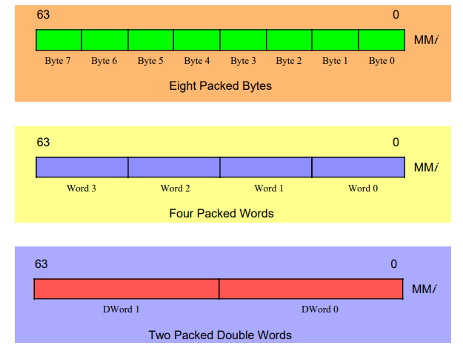
MMX in Intel Pentium II
MMX data types
Notes:
reciprocal

Slide 28
Example: PADDB
PADDB
PADDW: parallel add 4 16bit words.
Byte 7
Byte 6
Byte 5
Byte 4
Byte 3
Byte 2
Byte 1
Byte 0
Byte 7
Byte 6
Byte 5
Byte 4
Byte 3
Byte 2
Byte 1
Byte 0
+
+
+
+
+
+
+
+
Byte 7
Byte 6
Byte 5
Byte 4
Byte 3
Byte 2
Byte 1
Byte 0
Carry chain needs to be partitioned so that the result of one byte add will not be propagated
to the next. This implements so called saturation math (overflows chopped at the bounds).
Notes:
reciprocal

Slide 29
Extension to SSE/AVX (128/256 bit) SIMD
255
0
ADDPS
SP 7
SP 6
SP 5
SP 4
SP 3
SP 2
SP 1
SP 0
SP 7
SP 6
SP 5
SP 4
SP 3
SP 2
SP 1
SP 0
+
+
+
+
+
+
+
+
SP 7
SP 6
SP 5
SP 4
SP 3
SP 2
SP 1
SP 0
ADDPS means parallel add packed (P) single precision floating point (S) data. With 256bit wide
SIMD registers, one instruction can compute 8 single precision floating point data.
With the newly introduced FP8 format, one instruction can compute 32 minifloat results.
Notes:
reciprocal

Slide 30
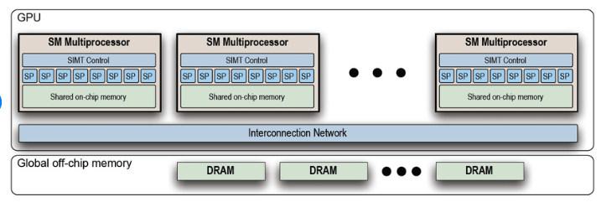
Nvidia GPU Architecture
Notes:
reciprocal

Slide 31
A Sample CUDA Kernel
CPU Code
Kernel Launch
for (i=0; i< N; i++) {
a[i] = b[i]+c[i];
}
One Thread block (TB).
N threads in the TB
kernelvadd<<< 1, N >>>(a,b,c)
GPU Code
__global__ void kernelvadd(…) {
int tid= blockDim.x * blockIdx.x + threadIdx.x;
c[tid] = a[tid] + b[tid];
}

Slide 32
GPGPU Architecture (with caches)
L1 Dcache
L1 Dcache
L1 Dcache
L2 Dcache

Slide 33
Memory Latency/Bandwidth Comparisons for A100
Latency (based on 1-1.4 GHz)
Shared Memory: ~10-20 cycles
L1 Cache: ~30-50 cycles
L2 Cache: ~100-200 cycles
HBM Global Memory: ~200-400 cycles
CPU DRAM Memory (via PCIe): ~1000+ cycles
Bandwidth (GB/s)
Shared Memory: ~ 10000
L1 Cache: ~5000
L2 Cache: ~2000
HBM Global Memory: ~1555
CPU DRAM Memory (via PCIe): ~100-200
DDR5 SDRAM ~80-100

Slide 34
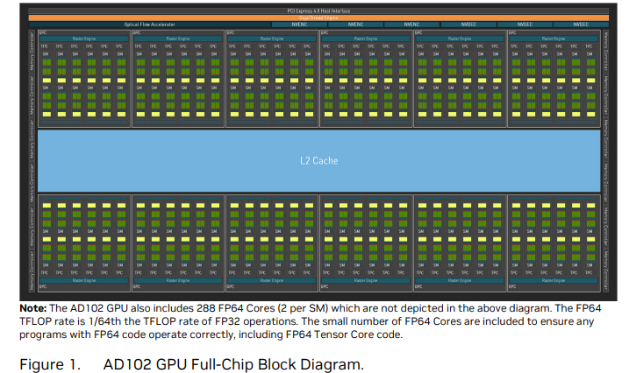
NVidia Ada GPU Architecture
GPC
12 Graphics Processing Clusters (GPCs)
72 Texture Processing Clusters (TPCs)
144 Streaming Multiprocessors (SMs)
4 SP per SM
Warp size 32
Peak Performance:
144x32x4 = 18432 FP/clock
18432x2.56Gx2 (fma)
= 94.3 tera FLOPs.

Slide 35
Nvidia GPU Architectures
Data center GPGPU Graphics GPU | Tesla (T4) Turing (RTX 20xx) | Amphere (A100) Amphere (RTX30xx) | Hopper (H100) Ada Lovelace (RTX 40xx) | Blackwell (B100) Blackwell (RTX 50xx)
Number of SMs per chip | 40 | 108 (128) | 132 (144) | 144-192
CUDA core per SM (SP) | 64 | 64 | 128 (4) | 128 (4)
Shared memory per SM | 96KB | 164KB | 256KB | 256KB
L1 cache size | 64KB | 192KB | 256KB | 256KB
L2 cache size | 4MB (shared by all 40 SM) | 40MB (shared by all) | 50MB (shared by all) | 60-80MB (shared by all)
Notes:
reciprocal

Slide 36
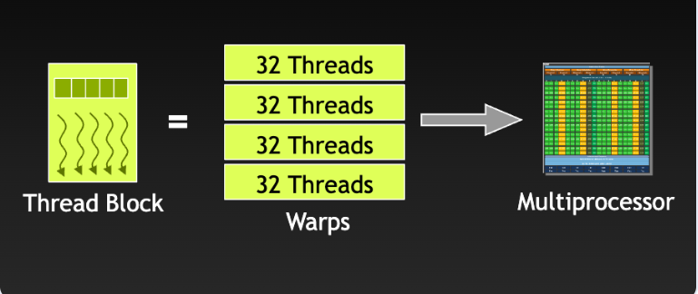
WARP Execution
Warp: The basic execution unit on Nvidia GPUs is a group of 32 threads. A TB (Thread Block) is dispatched to an SM, and the TB is further divided into warps for execution.
All threads in a warp run on the same SM. Modern GPU architectures typically have a warp size of 32 threads. The number of warps in a thread block depends on the thread block size configured by the CUDA programmer. For example, if the thread block size is 96 threads and the warp size is 32 threads, the number of warps per thread block would be 96 threads/ 32 threads per warp = 3 warps per thread block. When a warp is running into an interlock (e.g. due to memory latency), the warp scheduler will switch the execution to another warp. Warp interleaving is the major technique to hide memory latency on GPU.
Notes:
reciprocal

Slide 37
SIMD vs SIMT
SIMD
Single instruction operates on multiple data items
Less flexible.
Typically in the CPU
Works for vectorizable code
Requires more explicit management of vector registers.
SIMT
Single instruction operates across multiple threads
Used to run in lockstep – just like SIMD
More flexible, as threads can follow different execution paths
Typically in the GPU
Works for data parallel code

Slide 38
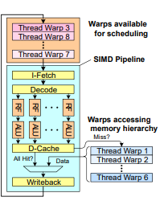
Warp Interleaving to Hide Latency
Warp: A set of threads that executes the
same instruction on different data elements
Fine-grained multi-threading
  Interleave warp execution to hide latency
  Similar to vertical threading in Intel x86
  and Sun Niagara processors.
  Light-weight thread switching, each warp has its own registers.
A SP can hold 8-16 warps at the same time

Slide 39
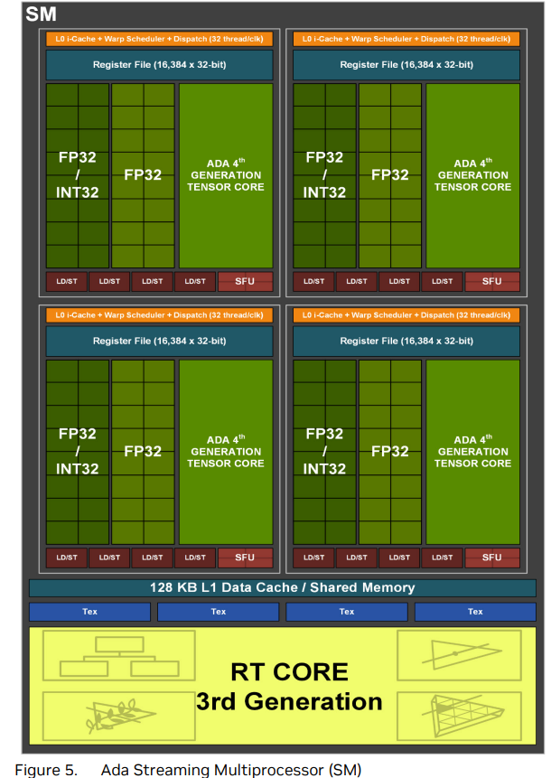
Inside the SM
Streaming Multiprocessors (SM)
Each SM has 4 SP (Steaming Processor)
Each SP can handle one warp per clock cycle. Each SP has 16K registers (32b). One warp bundles 32 threads, so 16K/32=512 simd registers are available to multiple warps. If we have 8 warps to be interleaved on this SP, each warp can get 64 simd registers. If you like to have 16 warps to interleave, then each warp can get only 32 simd registers.
There are tradeoffs to be made between the number of warps to interleave and the number of registers for each warp.

Slide 40
Sub-word Parallelism Support in RV
The development of the Packed-SIMD (sub-word parallelism) extension (known as P-extension) of RISC-V is ongoing and has not yet concluded.
On the other hand, the vector extension (VE) RVV has made very good progress; version 1.0 is already out. Multiple implementations of RVV are available now (e.g., SiFive, Alibaba Damo, T-head, AndesTech).
Since RVV's vector registers must support 8-bit/16-bit data types (for AI applications), many architects think RVV may subsume the P extension.
Notes:
reciprocal

Slide 41
Vector Architectures
Basic idea:
  Read sets of data elements into “vector registers”
  Operate on those vector registers
  Write the results in vector register back into memory
Vector registers are controlled/allocated by the compiler
  Used to hide memory latency
  Leverage memory bandwidth
  Vector loads/stores are excellent architecture features (they communicate memory reference patterns to the memory system)

Slide 42
RISC-V VE (Vector Extension), RVV
  Loosely based on Cray-1 Architecture
  32 64-bit vector registers (v0 – v31) //SiFive latest implementation has 512b elem
  The width of the vector register is implementation dependent
  Vector functional units
    Fully pipelined
    Accommodate varying data sizes (Double, Single, Half, ..)
  Vector load-store unit
    Fully pipelined, one word per clock cycle after initial latency
  Scalar registers
    31 general-purpose registers (x1-x31), 32 fp registers (f0 – f31)

Slide 43
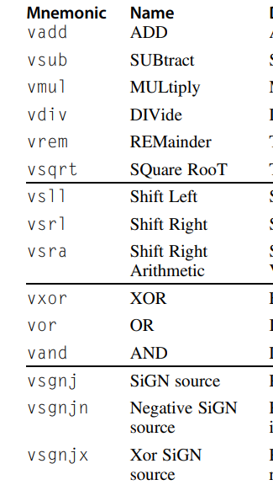
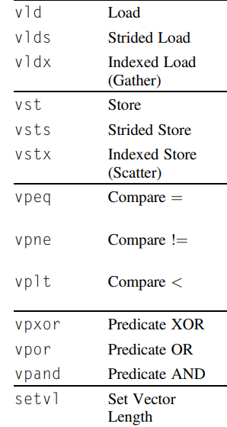
RISC-V VE Instructions (from HennesSy & Patterson textbook)
VE 2.0 adds in support for
Vector mask
Vmin, Vmax
Vshuf, Vperm
LMUL (Vreg reconfigure)

Slide 44
.vv: two vector operands
.vs and .sv: vector and scalar operands
LV/SV: vector load and vector store from address
Example: DAXPY (i.e. Double-precision a*X + Y )
  vsetdcfg 4*fp64 #1:Enable 4 double-precision vregs
  fld f0,a #2: Load scalar a
  vld v0,x5 #3: Load vector X
  vmul v1,v0,f0 #4: Vector-scalar multiply – vmul.vs
  vld v2,x6 #5: Load vector Y
  vadd v3,v1,v2 #6: Vector-vector add - vadd.vv
  vst v3,x6 #7: Store the sum
  vdisable #8: Disable vector regs
8 vector instructions vs. 258 scalar instructions on RV64V

Slide 45
Dynamic Vector Data Typing
RV64V associates data type and data size with each vector register, rather than with each instruction.
  Integer 8, 16, 32, and 64 bits
  Floating point 16, 32, and 64 bits (minifloat FP8 may be coming)
Dynamic typing reduces lots of vector instructions.
Dynamic typing also lets programs disable unused vector registers
  Reduce context switch overhead
Type conversions can be implicit rather than explicit
Example:
vsetvli V0-V7, x1, e32, vl=32 // x1 contains the information of e32 and vl=32

