Slide 1
CSC3050 – Computer Architecture
Chapter 4 The Processor
Pipeline Hazards
Prof. Wei Chung Hsu
School of Data Science
Chinese University of Hong Kong, Shenzhen

Slide 2
Hazards: Pipeline Challenges
Our introduction to pipelining may present an overly optimistic perspective. You might expect that a pipelined implementation will enhance performance by a factor equal to the number of pipeline stages.
In addition to the imperfect work distribution at each stage and the overhead caused by "fill" and "drain," a pipelined implementation must address three major challenges: data hazards, structural hazards, and control hazards.
These hazards prevent the subsequent instructions from overlapping with previously issued instructions. They are typically blocked (stalled) at the ID stage. Such “stalls” significantly decrease the efficiency of the pipeline.
Notes:
Throughput vs response time
13 logic levels may not be evenly divided by 4, 3—3—3--4

Slide 3
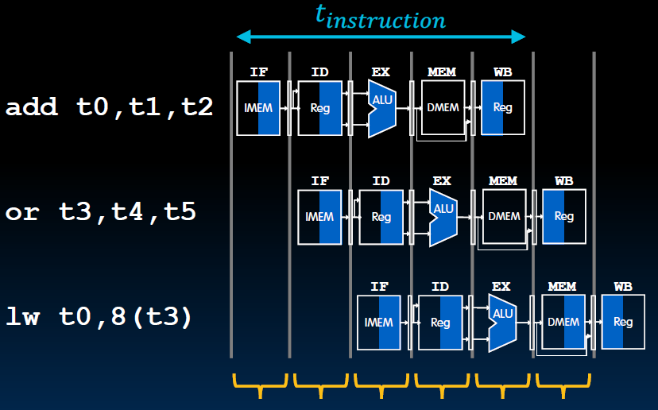
Fill and Drain of a Pipeline
Pipe Full
Drain
Fill

Slide 4
Structure Hazards
This refers to a conflict arising due to hardware resource limitations within the pipeline.
For instance, in a pipelined data path, we require both an instruction memory and a data memory. If we utilize the Von Neumann architecture, a conflict occurs when one instruction is accessing data during the MEM stage, preventing the instruction fetch from proceeding in the IF stage. This results in two instructions competing for the same resource simultaneously.
Another example of such a conflict is when two division instructions are placed next to each other in the pipeline.

Slide 5
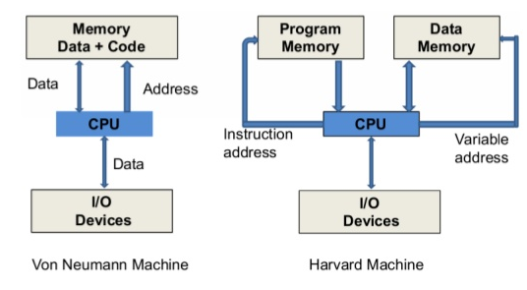
Structure Hazards
Structure hazards are less
frequent in scalar architectures,
since registers have sufficient
number of ports, functional units
are either single-cycle execution
or are pipelined (except for divide),
instruction and data memory are
separated. We may need two adders since each instruction needs to increment PC and calculate arithmetic.
Notes:
Harvard architecture was named because Harvard had Mark I, II, III computers developed. They used separate instruction and data memory. Originally not an architecture choice, but limited to technology.

Slide 6
Avoiding Structure Hazards
Pipeline stalls:
The hardware checks for structural hazards and stalls the pipeline. The newer instruction must wait at the ID stage until the previous one completes its work, causing pipeline bubbles.
Multiple resources:
Adding resources, such as we use I-cache and D-cache. We can add multiple multiply/divide units (It would be better if the unit could be pipelined) to avoid structured hazards.
Instruction Reordering: by compiler (static scheduling) or by hardware (dynamic scheduling)
ISA design: for example, the post-increment instructions will require more register write ports. Another example is disallowing memory operands in ALU operations.

Slide 7
Related Example: R-type instruction
IF: fetch the instruction from the Instruction Memory
ID: registers fetch and instruction decode
EX: ALU operates on the two register operands
WB: write ALU output back to the register file
R-type instructions do not access data memory, so can they write back to register early?
Cycle 1
Cycle 2
Cycle 3
Cycle 4
R-type
IF
ID
Exec
WB
Notes:
The R-type instruction does NOT access data memory so it only takes four clock cycles, or in our new pipeline terminology, four stages to complete.
The Ifetch and Reg/Dec stages are identical to the Load instructions. Well they have to be because at this point, we do not know we have a R-type instruction yet.
Instead of calculating the effective address during the Exec stage, the R-type instruction will use the ALU to operate on the register operands.
The result of this ALU operation is written back to the register file during the Wr back stage.
+1 = 15 min. (55)

Slide 8
Early WB Causes Structural Hazards
Cycle 1
Cycle 2
Cycle 3
Cycle 4
Cycle 5
Cycle 6
Cycle 7
Cycle 8
Cycle 9
Clock
R-type
IF
ID
Exec
WB
Ops! We have a problem!
R-type
IF
ID
Exec
WB
Load
IF
ID
Exec
Mem
WB
R-type
IF
ID
Exec
WB
R-type
IF
ID
Exec
WB
Notes:
Well, we have a problem here!!!
We end up having two instructions trying to write to the register file at the same time!
Why do we have this problem (the write ubble??
Well, the reason for this problem is that there is something I have not yet told you.
+1 = 16 min. (X:56)

Slide 9
Data Hazards
Data hazards happen when the pipeline must stall because previous instructions in the pipeline have not yet generated the data needed for the current instruction.
Data hazards arise from data dependencies. For example,
  Add X9, X0, X1 // results are ready at the end of the EXE stage, and write back to reg X9 at WB
  Sub X10, X9,X3 // needs to read data at the ID stage (stage 2)
In the worst-case scenario, the pipeline may be stalled until the previous instruction writes back the data to register X9. Only then can the new instruction begin to read during the Instruction Decode (ID) stage. This would result in three wasted cycles, creating three pipeline bubbles.
Three cases to discuss further:
  Register accesses
  ALU results
  Load data hazards

Slide 10
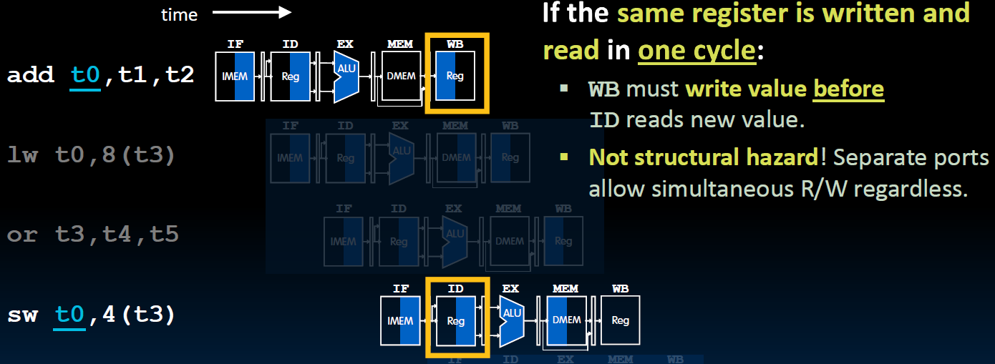
Register Access Issues
Register file should write-then-read
in the same cycle. (indicated by
Shading in the diagram)

Slide 11
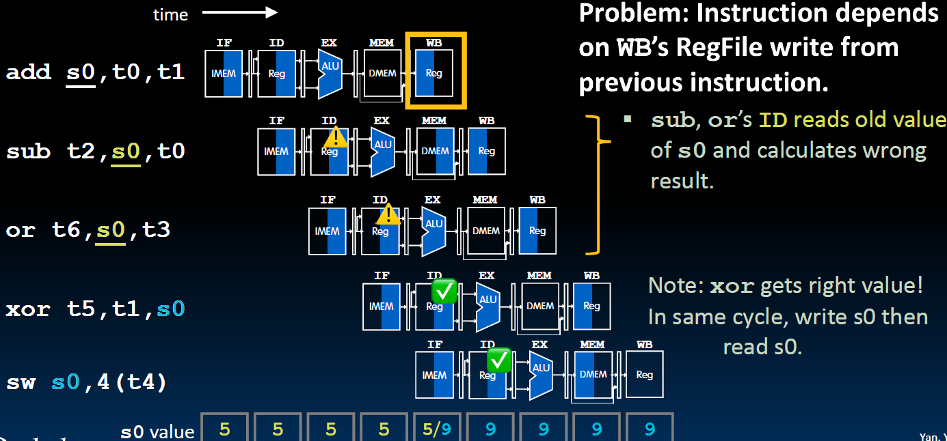
ALU Result Access Issue

Slide 12
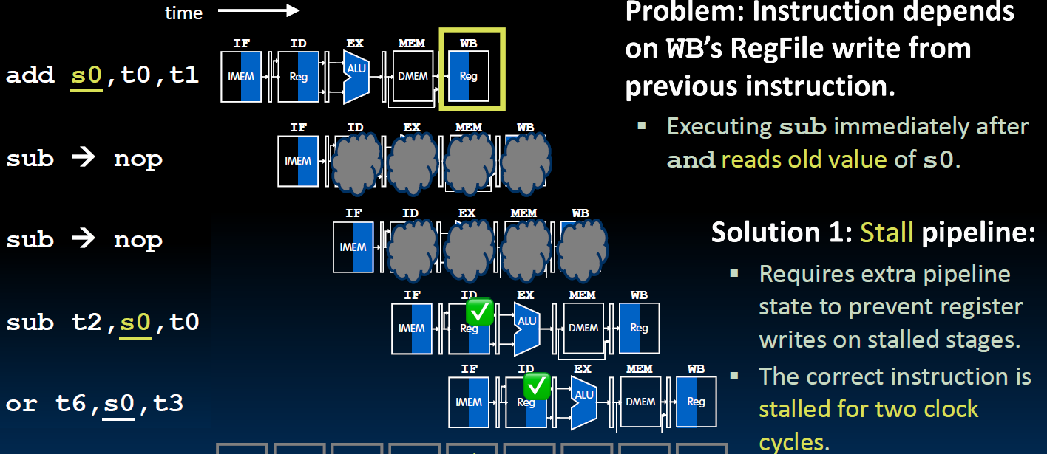
Solution 1: Pipeline Stall at ID stage
Delayed by two clock cycles

Slide 13
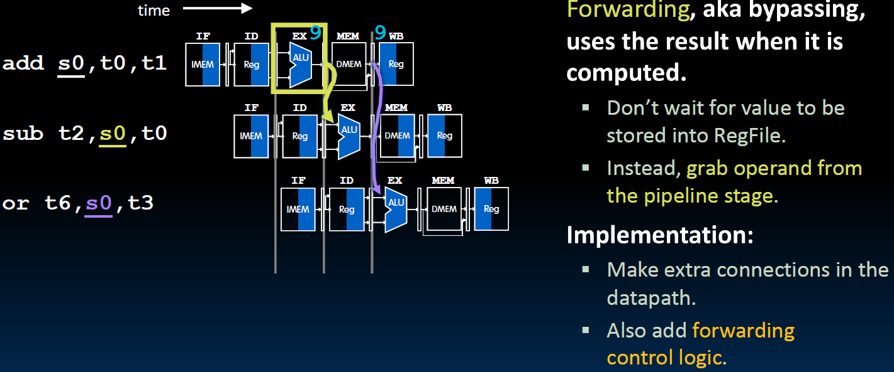
Solution 2: Data Forwarding (Bypassing)

Slide 14
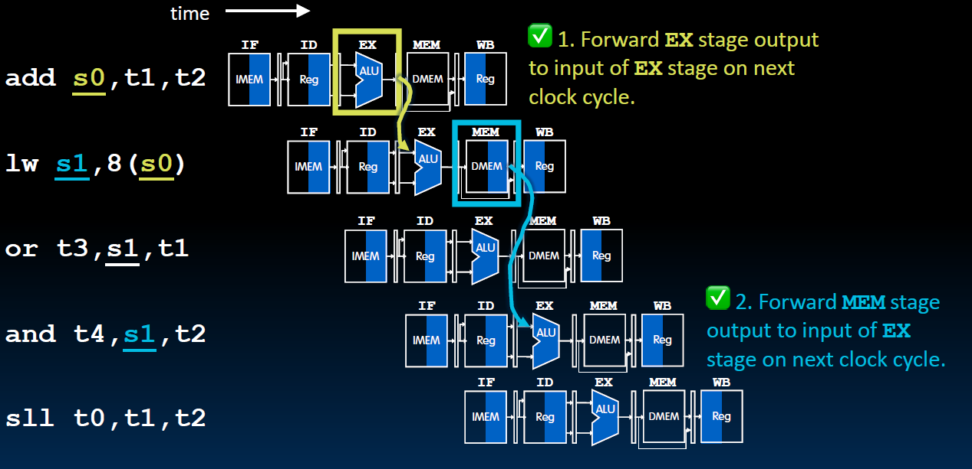
Data Forwarding for Load Instructions

Slide 15
Data Forwarding for Load Instructions
This forwarding does not work!
Must stall !

Slide 16
Detect Data Hazards (1)
Hazard conditions
  1a. EX/MEM.RegRd = ID/EX.RegRs1
  1b. EX/MEM.RegRd = ID/EX.RegRs2
  2a. MEM/WB.RegRd = ID/EX.RegRs1
  2b. MEM/WB.RegRd = ID/EX.RegRs2
Some corner cases
  Do not forward if instruction does not write register
  => check if RegWr is asserted
  Do not forward if destination register is $0
  => check if RegRd = 0
IF
ID
Exec
MEM
WB
Forward from
EX/MEM pipeline
registers
Forward from
MEM/WB pipeline
registers

Slide 17
Solution 3: Compiler Code Transformations
MIPS (Micro-Processor without Interlocked Pipe Stages) implemented a micro-processor with no pipelined interlocks. To deal with data hazards, the compiler must reorder instructions to avoid data hazards. If no instructions to be placed between a generate-and-use gap, NOPs must be inserted.
Most pipelined microprocessors do have hardware interlocks. So the compiler reorders instructions to reduce the number of interlocks (or stalls) occur at runtime.
Reordering at compile time is very cost effective, except for
  Memory dependences are often unknown
  Scheduling (reordering) scope is often limited by branches, indirect branches, and call/ret.

Slide 18
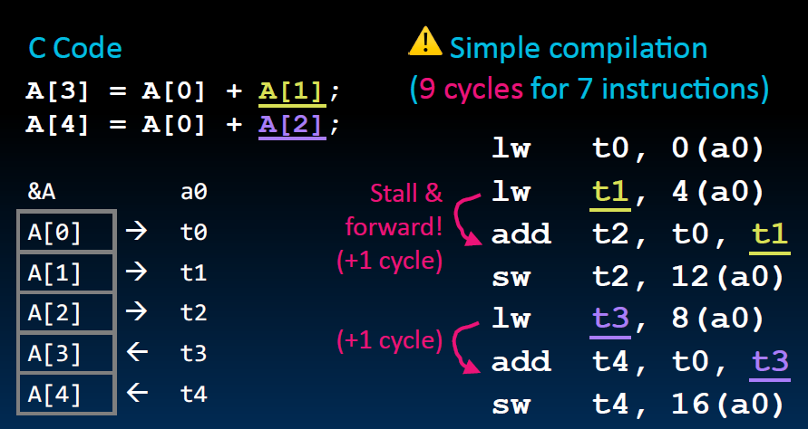
Compiler Code Scheduling Example (1)

Slide 19
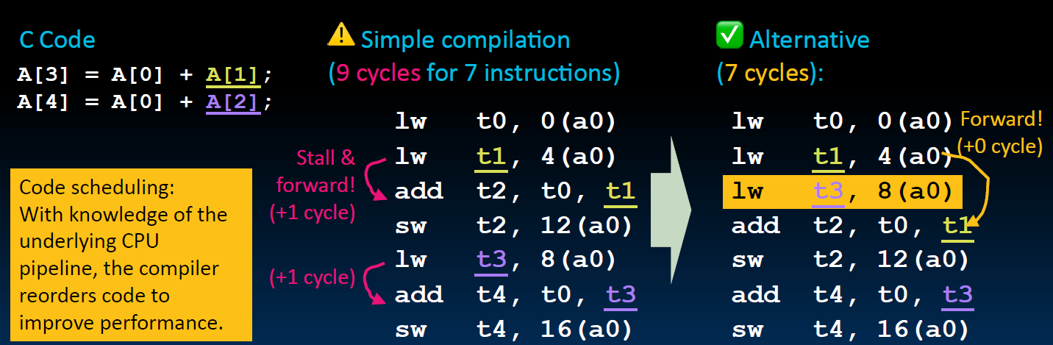
Compiler Code Scheduling Example (2)

Slide 20
Control Hazards
Control hazards are due to branch instructions (conditional jumps) and JALR instructions. Branch instructions alter the normal flow of the program execution by jumping to a different set of instructions.
The pipeline can't know for sure which instruction will be executed next until the branch condition is evaluated. This can lead to the pipeline fetching and processing incorrect instructions.
Control hazards are crucial because branch instructions occur frequently, ranging from 15% to 30%. Historical studies indicated that there is one branch for every 4 to 5 instructions.

Slide 21
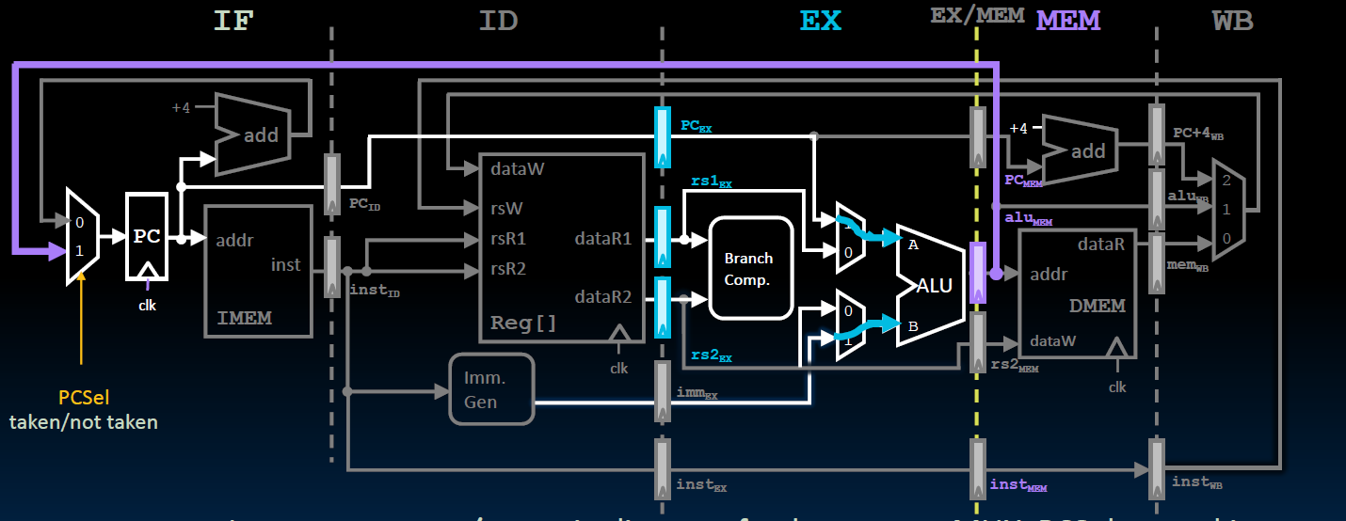
Branch Outcome Available at MEM stage

Slide 22
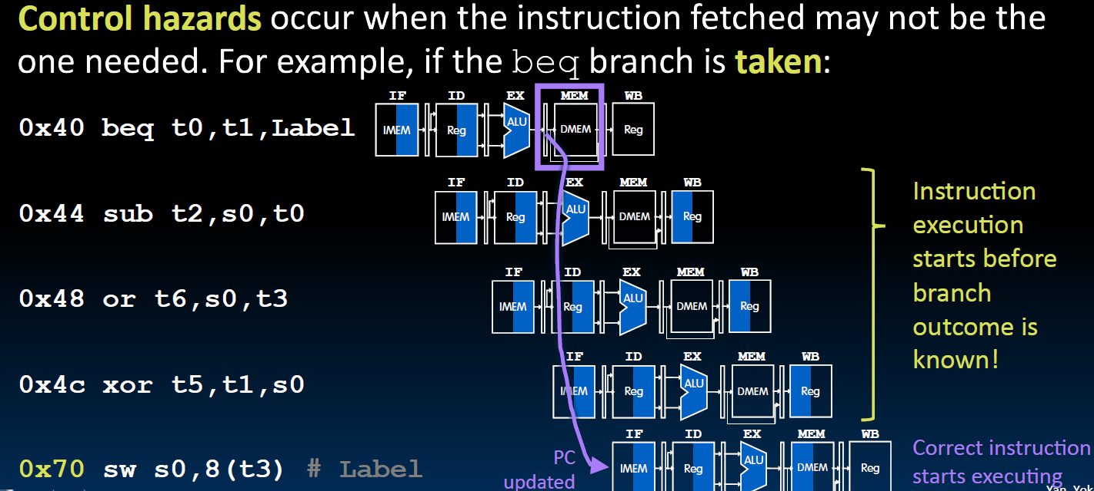
Branch Instruction in the Pipelined DataPath

Slide 23
Flush All Incorrectly Executed Instructions
Notes:
Suppose 20% of instructions are branches, and CPI is 1. This flushed instruction may account for 60% of penalty. 0.2*3 = 0.6
Well, say 50% of the branches are fall through, then the penalty is down to 30%

Slide 24
Flush All Incorrectly Executed Instructions
Performance penalty could be as high as 30-60%
Assuming:
20% of branches
50% of the branches taken
Average CPI = 1
Penalty = 3 (flushed inst) * 0.2 * 0.5 = 0.3 CPI
So the penalty would be 30%
Notes:
Suppose 20% of instructions are branches, and CPI is 1. This flushed instruction may account for 60% of penalty. 0.2*3 = 0.6
Well, say 50% of the branches are fall through, then the penalty is down to 30%

Slide 25
What If Branch Outcome Available at EXE stage

Slide 26
Flush All Incorrectly Executed Instructions
Performance penalty could be as high as 20-50%
Assuming:
20% of branches
50% of the branches taken
Average CPI = 1
Penalty = 2 (flushed inst) * 0.2 * 0.5 = 0.2 CPI
So the penalty would be 20%
Notes:
Suppose 20% of instructions are branches, and CPI is 1. This flushed instruction may account for 60% of penalty. 0.2*3 = 0.6
Well, say 50% of the branches are fall through, then the penalty is down to 30%

Slide 27
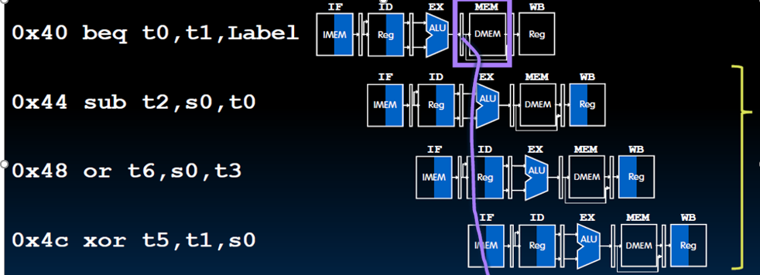
Simply Predict the Branch is Not Taken
Guess the next PC would be PC+4
Evaluate if the guess is right
All the three
instructions
executed would
be correct if the
guess is right
Notes:
Compiler tries to place the more likely target in the fall-through path

Slide 28
Static Branch Prediction
Branch prediction could be determined at compile time.
Compiler sets the prediction
Hardware can assist, for example
  Predict a backward branch as taken (because loop back branches are likely to take)
  Predict a forward branch as fall-through (because the compiler always puts the then part in the fall-through path).
The ISA may reserve a bit in branch instructions as a prediction bit
HP (Hewlett Packard) used the register order to indicate prediction.
  Example: (beq r3,r4,8 → predict not taken) (beq r4,r3,8 → predict taken)

Slide 29
Dynamic Branch Prediction
Dynamic Branch Predictions are made at Runtime
Static predictions typically have low accuracy, ranging from 65% to 85%, while dynamic predictions can achieve accuracy levels as high as 90% to 99%.
One common approach is to have a branch history table
  Indexed by recent branch instruction addresses
  Stores branch outcomes (taken/not taken)
  To execute a branch
    Check the prediction table; expect the same outcome
    Start fetching from fall-through or target
    If wrong, flush the pipeline and change the prediction
Notes:
Graduate students researching on predictors
This is the conversation we often heard:
What is your research
Branch prediction
How accurate can you predict now?
From 98% increased to 99%
Only 1%?
No, miss rate dropped from 2% to 1%, that is 2X improvement.

Slide 30
A Simple Branch History Table
Tag / Key
000001110010
000001110110
000001111000
Branch History
0
1
Program
bne
beq
ld
sw
Predict not taken
PC addresses
Predict taken
One bit history here, but could be multi-bits
Branch prediction table may not have tag/key: history data has only 1 or 2 bits, but tag takes 30-46 bits !!
In practice, the lower several bits of the PC address are used to index the BHT !
Notes:
Graduate students researching on predictors
This is the conversation we often heard:
What is your research
Branch prediction
How accurate can you predict now?
From 98% increased to 99%
Only 1%?
No, miss rate dropped from 2% to 1%, that is 2X improvement.

Slide 31
Branch Prediction at IF Stage
Branch prediction should occur at the instruction fetch (IF) stage.
But the instruction fetched at the IF stage may not be a branch
Cannot wait until the instruction is decoded – too late
At the IF stage, the instruction address (i.e. PC) is used to index the BHT
  If the BHT entry lacks history, predict NT (Not Taken).
  For a branch instruction, the branch outcome updates the BHT entry.
If the BHT is not tagged, “aliased” entries could result in higher branch mispredictions.
Untagged BHT is simple, fast, has low power consumption, and is less costly.
However, high-performance microprocessors tend to use tagged BHT
Notes:
Graduate students researching on predictors
This is the conversation we often heard:
What is your research
Branch prediction
How accurate can you predict now?
From 98% increased to 99%
Only 1%?
No, miss rate dropped from 2% to 1%, that is 2X improvement.

Slide 32
1-bit Predictor
Inner loop branches mispredicted twice!
outer: …
…
inner: …
…
beq …, …, inner
…
beq …, …, outer
Loop exit
11111110 111111110
Mispredict as taken on the last iteration of the inner loop
Then mispredict as not taken on the first iteration of the inner loop next time around

Slide 33
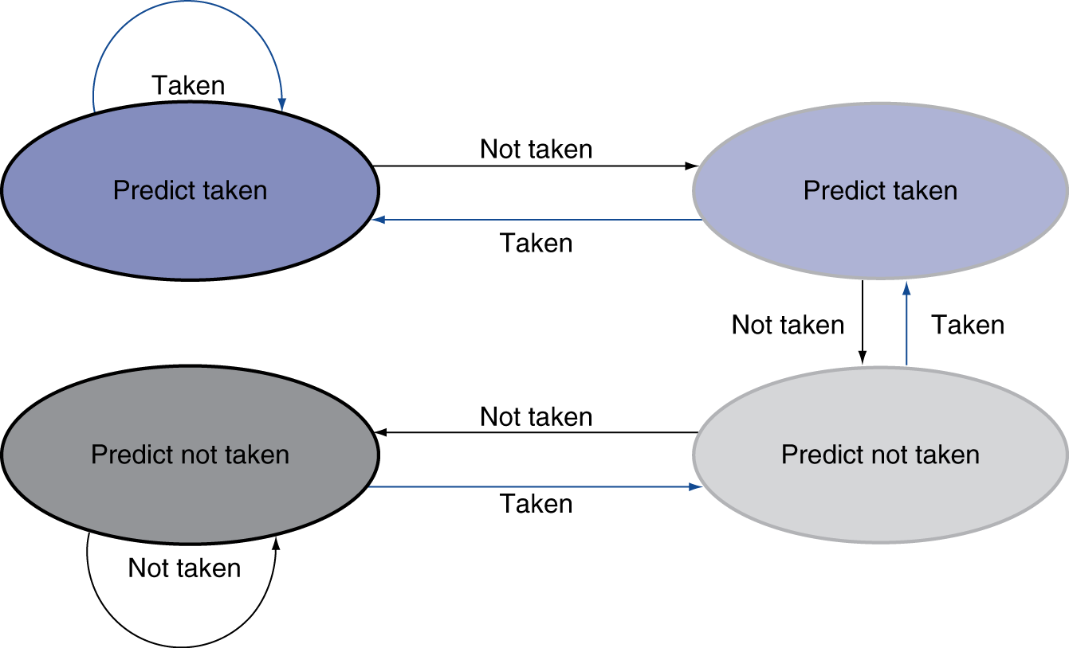
2-bit Predictor (FSM)
Only change prediction on two successive mispredictions
11
10
A finite state
transition
00
01

Slide 34
Correlated Prediction
Correlated Branch Prediction is also called 2-level adaptive branch prediction.
Global Branch History Register
  Shift Register: A global branch history register (GHB) tracks the recent outcomes of several branches. It's typically implemented as a shift register, where each bit represents a recent branch's outcome (taken or not taken).
  Shifting on Branch: Whenever a branch is executed, its outcome is shifted into the GHB, pushing out the oldest history bit.
Pattern History Table (PHT)
  Indexed by GHB: The PHT is a table of 2-bit saturating counters. Each entry corresponds to a unique pattern of recent branch outcomes captured by the GHB.
  Indexing: The GHB's contents are used to index the PHT.
  Counter Update: The 2-bit counter at the indexed entry is incremented if the branch is taken and decremented if it's not taken. This counter effectively tracks the branch's behavior for that specific pattern of recent branch history.

Slide 35
2-level adaptive branch prediction
GHB
Branch History
00
10
Global branch history
0
1
1
1
0
0
1
0
hash
Program
bne
ld
sw
beq
PC addresses
Notes:
Graduate students researching on predictors
This is the conversation we often heard:
What is your research
Branch prediction
How accurate can you predict now?
From 98% increased to 99%
Only 1%?
No, miss rate dropped from 2% to 1%, that is 2X improvement.

Slide 36
Why Correlated Prediction Works
Example 1:
if (a==2) a=0; Branch 1
if (b==2) b=0; Branch 2
if (a!=b) {…}; Branch 3
If Branch 1 is taken and Branch 2 is taken
Then Branch 3 is NOT taken
GHB 11 → Branch 3 will fall through
GHB 00/01/10 → needs prediction
Example 2
Branch
Branch
Branch

Slide 37
Prediction: Whether and Where
Whether: need to predict the branch is taken or not
Where: need to know where does the branch jump to?
Even with predictor, still need to calculate the target address
  1-cycle or 2-cycle penalty for a taken branch (depends on whether the target address is calculated in the ID or in the EXE stage)
Branch Target Buffer (BTB)
  Cache of target addresses
  Target addresses are usually unchanged (immediate is not changed)
  Indexed by PC when instruction fetched
    If hit and instruction is branch predicted taken, it can fetch the target immediately
How about indirect branch? Function returns? Function pointers?

Slide 38
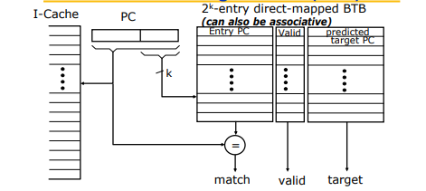
Branch Target Buffer

Slide 39
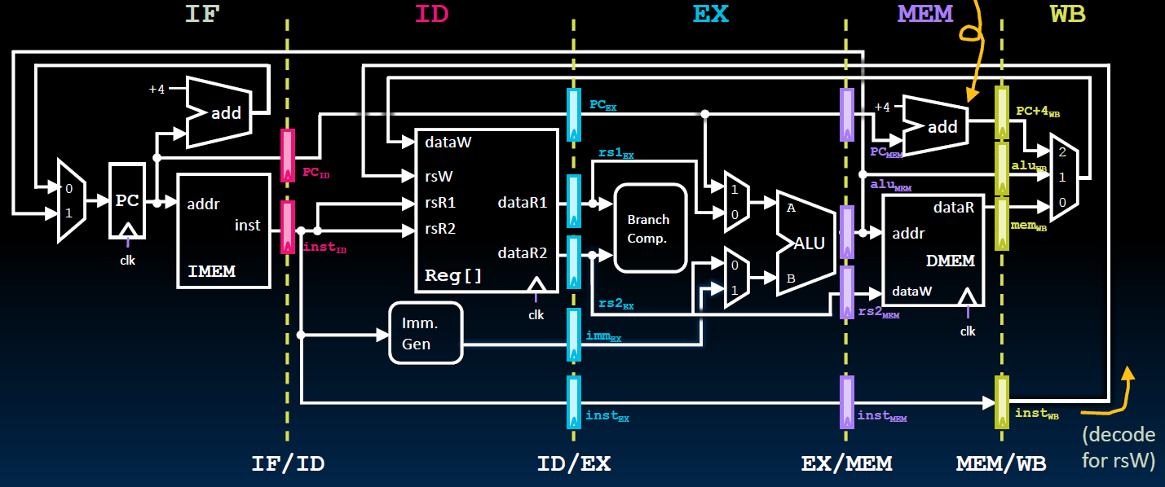
Control Signals Used at Each Stage
ID stage
  Data path: rs1, rs2 designators
  Control: immed_sel,
  Rd, and WRen, are actually from the WB stage (Unlike the single cycle data path !!)
EX stage
  Data Path: rs1, rs2 contents, PC, immed value,
  Control: Asel, Bsel, ALUsel
MEM stage
  Data path: ALUout(Address), rs2 content,
  Control: MemRW (read/write),BrLt,Breq
WB stage
  Data path: ALUout, PC+4(for link reg), MEMout,
  Control: Wbsel, rd designator, WRen

Slide 40
Control Signals at Each Stage
Signals for EX (ALUOp, A/Bsel, ALUctl...) are used 1 cycle later
Signals for MEM (MemWr, Branch) are used 2 cycles later
Signals for WB (MemtoReg, MemWr) are used 3 cycles later
RedDst (rd) will also be passed along to the WB stage
ID
EX
MEM
WB
ALUctl
ALUSrc
A/Bsel
ALUOp
ALUOp
Main
Control
MemRd
MemRd
MemRd
MemWr
ID/Ex Register
MemWr
Ex/MEM Register
MEM/WB Register
IF/ID Register
MemWr
Branch
Branch
Branch
MemtoReg
MemtoReg
MemtoReg
MemtoReg
RegWr
RegWr
RegWr
RegWr
RegDst
RegDst
RegDst
RegDst
Notes:
The main control here is identical to the one in the single cycle processor. It generate all the control signals necessary for a given instruction during that instruction Reg/Decode stage.
All these control signals will be saved in the ID/Exec pipeline register at the end of the Reg/Decode cycle.
The control signals for the Exec stage (ALUSrc, ... etc.) come from the output of the ID/Exec register. That is they are delayed ONE cycle from the cycle they are generated.
The rest of the control signals that are not used during the Exec stage is passed down the pipeline and saved in the Exec/Mem register.
The control signals for the Mem stage (MemWr, Branch) come from the output of the Exec/Mem register. That is they are delayed two cycles from the cycle they are generated.
Finally, the control signals for the Wr stage (MemtoReg & RegWr) come from the output of the Exec/Wr register: they are delayed three cycles from the cycle they are generated.
+2 = 45 min. (Y:45)

