Slide 1
Pipelining and Vector Processing
How to achieve maximum efficiency of pipelining?
  Free from Data hazards
  Free from Control hazards
  Free from structural hazards
Vector Instruction Execution is data hazard-free and control hazard-free.
Future AI accelerators, especially for inferences, are likely to incorporate more vector/SIMD instructions and data streaming execution.

Slide 2

Predictions
Branch predictions, Value predictions, Data prefetching, …
Most predictions are based on past behavior.
  Branch predictions are based on branch history
  Page/Block replacements are based on past reference behavior
  AI predictions are based on pre-training
Could we use the future to make predictions?
  Scout threads
    To create separate software threads that "scout ahead" in the program's execution to pre-compute or prefetch data that the main thread will likely need.
    This lightweight thread is a backward slice of code extracted at compile time from the point at which you would like to make a prediction.
Notes:
Back to the future
A scout is someone who gathers information

Slide 3
Scout Thread Prediction
☺
First Core
time
First
Core
Main thread
Event
Miss
Cache miss avoided
Trigger to activate (About x cycles delay)
Second core
Second
Core
Scout thread
Advance to the point for prediction
Spin Waiting
Spin again waiting for the next trigger
Dynamic Scout thread Implemented on SUN Panther processors

Slide 4
CSC3050 – Computer Architecture
Large and Fast
Exploiting Memory Hierarchy
Prof. Wei Chung Hsu
School of Data Science
Chinese University of Hong Kong, Shenzhen

Slide 5
Processor/Memory Latency Gap
1000
Proc
60%/yr.
(2X/1.5 yr)
Moore’s Law
100
Processor-memory
performance gap:
(grows 50% / year)
Performance
10
DRAM (main memory)
9%/yr.
(2X/10 yrs)
1
1980
Year
1981
1982
1983
1984
1985
1986
1987
1988
1989
1990
1991
1992
1993
1994
1995
1996
1997
1998
1999
2000
Notes:
Y-axis is performance
X-axis is time
Latency
Clich?
Not e that x86 didn have cache on chip until 1989

Slide 6
Impact from the Power Wall
1000
Proc
60%/yr.
(2X/1.5 yr)
Moore’s Law
100
Processor-memory
performance gap:
(grows 50% / year)
Performance
10
DRAM (main memory)
9%/yr.
(2X/10 yrs)
1
1980
Year
1981
1982
1983
1984
1985
1986
1987
1988
1989
1990
1991
1992
1993
1994
1995
1996
1997
1998
1999
2000
Notes:
Y-axis is performance
X-axis is time
Latency
Clich?
Not e that x86 didn have cache on chip until 1989

Slide 7
Clock Frequency Stays Flat, But …
Processors are still getting more powerful:
  Super-scalar
  Out-of-order
  SIMD/Vector
  Multi-core
  GPU
Memory Wall remains a challenge.
Memory is far away
Memory bandwidth is insufficient
1000
Proc
60%/yr.
(2X/1.5 yr)
Moore’s Law
100
Processor-memory
performance gap:
(grows 50% / year)
Performance
10
DRAM (main memory)
9%/yr.
(2X/10 yrs)
1
1980
Year
1981
1982
1983
1984
1985
1986
1987
1988
1989
1990
1991
1992
1993
1994
1995
1996
1997
1998
1999
2000
Notes:
Y-axis is performance
X-axis is time
Latency
Clich?
Not e that x86 didn have cache on chip until 1989

Slide 8
Memory Wall
In computer architecture, the "memory wall" refers to the growing gap between the speed of processors and the speed of main memory (DRAM).
  Latency
    Reduction: Local Memory, NUMA, PIM
    Hiding: Multi-threading/Hyper-threading, WARP interleaving, chip-multithreading
  Bandwidth
    Memory bandwidth: Multi-banks and interleaved memory, SDRAM, HBM
    Communication bandwidth: wider bus, interconnection network
In HPC (High-Performance Computing), including ML/LLM, memory performance is often the primary bottleneck.
GPUs excel at parallel processing, and HBM gives the needed high memory bandwidth. But due to its limited HBM size, data transfers still pose a challenge.

Slide 9

Memory Hierarchy
From the earliest days of computing, programmers have sought unlimited amounts of fast memory at a low cost. Computer architects have created that illusion with
  Memory Hierarchy
  Virtual Memory
Such an illusion works due to the principle of locality
  Temporal locality (locality in time)
  Spatial locality (locality in space)
A memory hierarchy consists of multiple levels of memory with varying speeds and capacities. The faster memory is more expensive per bit, and thus smaller in size.
Notes:
8 great ideas: design for moore’s law, common case fast, memory hierarchy, parallelism, pipelining, prediction, redundancy, abstraction
Memory hierarchy gives you a fast, large, and cheap memory. Give them the example of 360/91 and 360/85
Virtual memory gives you illusion that you have a huge memory address space

Slide 10
Levels of Memory Hierarchy
Upper Level
Staging
Transfer Unit
faster
Registers
Instruction Operands
Programmer/Compiler
Cache Hierarchy
Cache / LM
Blocks/Lines
Cache Controller
Memory
Virtual Memory
Pages
Operating System
Disk
Files
User/Operator
Larger
Tape
Lower Level
Notes:
LM is programmable cache
How about vector registers?

Slide 11
Adding Vector Registers
Upper Level
Staging
Transfer Unit
Registers
V Registers
faster
Instruction Operands
Programmer/Compiler
Cache Hierarchy
Cache / LM
Blocks/Lines
Cache Controller
Memory
Pages
Operating System
Virtual Memory
Disk
Files
User/Operator
Tape
Larger
Lower Level
Notes:
LM is programmable cache.
How about vector registers?

Slide 12
Why Memory Hierarchy Works
Upper Level
Staging
Transfer Unit
The Upper Levels
are Fast but Small
faster
Majority of
References
are here
Registers
V Registers
Instruction Operands
Programmer/Compiler
Cache / LM
Blocks/Lines
Cache Controller
Memory
Your
Program and Data
Stored here
Pages
The Lower Levels
are Slow but Large
and Cheap
Operating System
Disk
Files
User/Operator
Tape
Larger
Lower Level
This gives you Large, Cheap memory, but Fast access
Notes:
LM is programmable cache.
How about vector registers?

Slide 13
Memory Technology
Random access memory
  Access time is the same for all locations
  SRAM (Static Random Access Memory)
    Low density, high power, expensive, fast
    Static: content will last forever until it loses power
    Address not divided
    Use for caches, local memory
  DRAM (Dynamic Random Access Memory)
    High density, low power, cheap, slow
    Dynamic: need to be refreshed regularly
    Addresses in 2 halves (memory as a 2D matrix)
      RAS/CAS (Row/Column Access Strobe)
    Use for main memory
Typically 4-8 transistors and 2 resistors as one cell
The switch state of the resistor to represent a bit
No need to refresh
Expensive due to more transistors
1 transistor and 1 capacitor as a cell
Charge of the capacitor represent a bit
need periodically refreshed after access
Much denser and cheaper
Notes:
The technology we used to build our memory hierarchy can be divided into two categories: Random Access and Non-so-Random Access.
Unlike all other aspects of life where the word random usually associates with bad things, random, when associates with memory access, for the lack of a better word, is good!
Because random access means you can access any random location at any time and the access time will be the same as any other random locations.
Which is NOT the case for disks or tape where the access time for a given location at any time can be quite different from some other random locations at some other random time.
As far as Random Access technology is concerned, we will concentrate on two specific technologies: Dynamic RAM and Static RAM.
The advantages of Dynamic RAMs are high density, low cost, and low power so we can have a lot of them without burning a hole in our budget or our desktop.
The disadvantages of DRAM are they are slow. Also they will forget what you tell them if you don remind them constantly (Refresh). We will talk more about refresh later today.
SRAM only has one redeeming feature: it is fast. Other than that, they have low density, expensive, and burn a lot of power. Oh, SRAM actually has another redeeming feature. They will not forget what you tell them. They will keep whatever you write to them forever.
Well orever?is a long time. So lets just say it will keep your data as long as you don pull the plug on your computer.
In the next two lectures, we will be focusing on DRAMs and SRAMs.
Register is also one. One bit

Slide 14
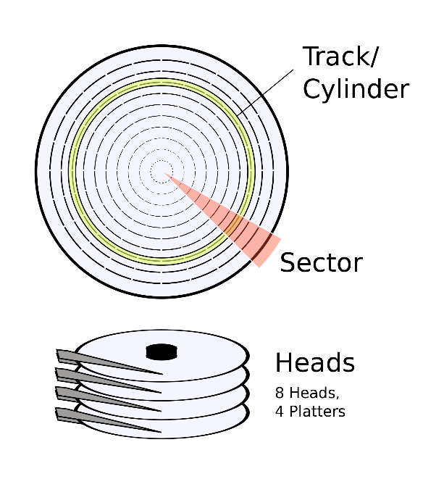
Memory Technology
SDRAM (Synchronous DRAM)
    means the read/write needs synchronization
    Use a clock to eliminate the time for the memory and processor to synchronize.
DDR SDRAM (Dual Data Rate SDRAM)
    data transfers on both the rising and falling edges of the clock
    double the bandwidth
    e.g., DDR4-3200 DRAM can do 3200 million transfers per second
    Latest version is DDR5, DDR6 is in development.
Embedded DRAM (eDRAM) – new technology bridges the gap
Flash Memory (NV memory)
  Will not lose data when the power is cut
  electrically erasable programmable read-only memory (EEPROM)
  Flash memory card, USB device, etc
Magnetic Disk and Tape
  For long-term storage
DDR SDRAM dominates Computer
Memory market today
Notes:
The technology we used to build our memory hierarchy can be divided into two categories: Random Access and Non-so-Random Access.
Unlike all other aspects of life where the word random usually associates with bad things, random, when associates with memory access, for the lack of a better word, is good!
Because random access means you can access any random location at any time and the access time will be the same as any other random locations.
Which is NOT the case for disks or tape where the access time for a given location at any time can be quite different from some other random locations at some other random time.
As far as Random Access technology is concerned, we will concentrate on two specific technologies: Dynamic RAM and Static RAM.
The advantages of Dynamic RAMs are high density, low cost, and low power so we can have a lot of them without burning a hole in our budget or our desktop.
The disadvantages of DRAM are they are slow. Also they will forget what you tell them if you don remind them constantly (Refresh). We will talk more about refresh later today.
SRAM only has one redeeming feature: it is fast. Other than that, they have low density, expensive, and burn a lot of power. Oh, SRAM actually has another redeeming feature. They will not forget what you tell them. They will keep whatever you write to them forever.
Well orever?is a long time. So lets just say it will keep your data as long as you don pull the plug on your computer.
In the next two lectures, we will be focusing on DRAMs and SRAMs.
We will not get into disk until the Virtual Memory lecture a week from now.
+3 = 19 min. (X:59)

Slide 15
Comparisons of Various Technologies
Memory
technology
Typical access
time
$USD per GB
SRAM
0.5 – 2.5 ns
$1000 – $5,000
DRAM
50 – 70 ns
$2,$3 – $20
Magnetic
disk
5,000,000 –
20,000,000 ns
HDD: $0.02 – $0.05
SSD: $0.06 – $0.20
Why is SRAM disproportionately more expensive than DRAM?
Yields, volume, design complexity, …

Slide 16
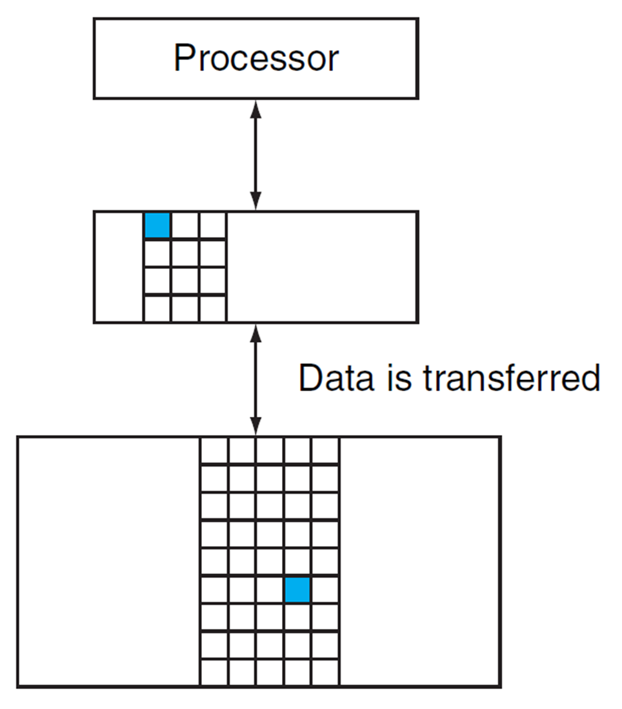
Levels of Memory Hierarchy - Terminology
Block (aka line): unit of copying
  May be multiple words
If accessed data is present in the upper-level
  Hit: access satisfied by upper level
  Hit ratio: hits/accesses
If accessed data is absent
  Miss: block copied from lower level
  Miss penalty: extra time taken
  Miss ratio: misses/accesses = (1 – hit ratio)
Then accessed data supplied from the upper-level
Hit time << Miss penalty

Slide 17
How Is the Memory Hierarchy Managed
Registers <-> Memory
  By compiler (programmer?)
Cache <-> Memory / Local memory <-> Memory
  By the hardware / by the compiler/programmer
Memory <-> Disks
  By the hardware and operating system (virtual memory)
  By the programmer (files)
Disks <-> Tapes
  By the hardware
  By the operator/programmer
Notes:
注意通常数据的访问不会跨太多级别，比如cache不会直接访问disk上的data。But a TLB miss may trigger a page fault…

Slide 18
Summary of Memory Hierarchy (1)
Memory wall
  Latency: getting longer
  Bandwidth: insufficient
Solution:
  Memory Hierarchy
  A small, fast memory close to the CPU
    low latency
    high bandwidth (not limited by refresh cycles, pin-bandwidth)
  Transparent solution
    Caches
  Explicit management
    Local memory (e.g. ARM scratch-pad memory or NVIDIA’s shared memory)
Story about
IBM 360/91 and 360/85
Notes:
Example: IBM 360/91 vs 360/85

Slide 19
Summary of Memory Hierarchy (2)
DRAM is slow but cheap and dense
  Good for presenting users with a BIG memory system
SRAM is fast but expensive, not very dense
  Good choice for on-chip memory
  Good for providing FAST access and high bandwidth
Two different types of locality
  Temporal Locality (Locality in Time)
  Spatial Locality (Locality in Space)
Use the principle of locality
  Present the user with as much memory as is available in the cheapest technology (keep the cost low)
  Provide access at the speed offered by the fastest technology
Notes:
Let summarize today lecture. The first thing we covered is the principle of locality.
There are two types of locality: temporal, or locality of time and spatial, locality of space.
We talked about memory system design.
The key idea of memory system design is to present the user with as much memory as possible in the cheapest technology while by taking advantage of the principle of locality, create an illusion that the average access time is close to that of the fastest technology.
As far as Random Access technology is concerned, we concentrate on 2: DRAM and SRAM.
DRAM is slow but cheap and dense so is a good choice for presenting the use with a BIG memory system.
SRAM, on the other hand, is fast but it is also expensive both in terms of cost and power, so it is a good choice for providing the user with a fast access time.
I have already showed you how DRAMs are used to construct the main memory for the SPARCstation 20.
On Friday, we will talk about caches.

Slide 20
Outline
Memory hierarchy
The basics of caches
  Direct-mapped cache
  Address sub-division
  Cache hit and miss
  Memory support
Measuring cache performance
Improving cache performance
  Set associative cache
  Multiple level cache

Slide 21
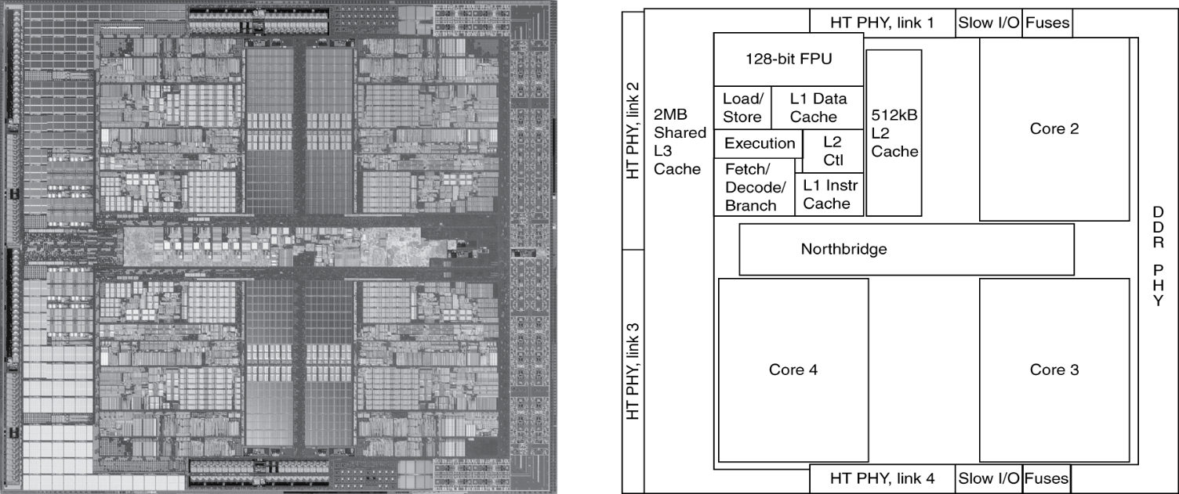
Inside the Processor
AMD Barcelona: 4 processor cores

Slide 22
Four Questions for Memory Hierarchy Design
Q1: Where can a block be placed in the upper level?
=> Block placement
Q2: How is a block found if it is in the upper level?
=> Block finding
Q3: Which block should be replaced on a miss?
=> Block replacement
Q4: What happens on a write?
=> Write strategy
Notes:
Same questions we ask for accessing a table structure
Difference: this is cache: temporary space, data come and goes. It is a fix, small space. If no room for a new one, replace the old one.

Slide 23
Two Simple Caches
0101
tag
01
tag
0001
0101
0101
Cache 1
Cache 2
00
01
10
11
0001
Where do I place this yellow block?
00
In cache 1, I can place the yellow block in any one
of the four blocks?
In cache 2, I can place the yellow block only at
the cache block with identical lower two bits
Cache1 is fully associative?
Cache2 is direct-mapped
0000
0001
0010
0011
0100
0101
0110
0111

Slide 24
Which one is better?
0001
0101
0101
Cache 1
Cache 2
00
01
10
11
0001
Where do I place this yellow block?
In cache 1, I can place the yellow block in any one
of the four blocks?
In cache 2, I can place the yellow block only at
the cache block with identical lower two bits
Cache1 is fully associative?
Cache2 is direct-mapped
Hit better, fewer misses
Faster to find, cheaper
0000
0001
0010
0011
0100
0101
0110
0111

Slide 25
Tags and Valid Bits - Block Finding
How do we know which particular block is stored in a cache location
  Store the block address as well as the data
  Actually, only need the high-order bits
  Called the tag
What if there is no data in a location
  Valid bit: 1 = present, cache line valid
  Valid bit = 0
    When a cache line of data has not come back from memory yet
    Cache line is currently being replaced
    Cache is flushed
Notes:
tag用来标识地址信息，valid表示用来标识当前的数据是否有效

Slide 26
Cache Example (1)
8-blocks, 1 word/block, direct mapped
Initial state of cache
A set is a group of lines that can hold memory blocks.
Index | V | Tag | Data
000 | N
001 | N
010 | N
011 | N
100 | N
101 | N
110 | N
111 | N
8 sets

Slide 27
Cache Example (2)
Step 1
Check hit/miss
determine the set #
Address (decimal) | Address (binary) | Hit/miss | Cache block
22 | 10 110 | Miss | 110
Index | V | Tag | Data
000 | N
001 | N
010 | N
011 | N
100 | N
101 | N
110 | N
111 | N
Step 2
Check tag
Determine hit/miss
Step 3
If miss
Copy from Mem to $
Setting Valid bit
Setting tag
110 | Y | 10 | Memory[10110₂]

Slide 28
Cache Example (3)
Address (decimal) | Address (binary) | Hit/miss | Cache block
26 | 11 010 | Miss | 010
Index | V | Tag | Data
000 | N
001 | N
010 | N
011 | N
100 | N
101 | N
110 | Y | 10 | Memory[10110₂]
111 | N
010 | Y | 11 | Memory[11010₂]

Slide 29
Cache Example (4)
Address (decimal) | Address (binary) | Hit/miss | Cache block
22 | 10 110 | Hit | 110
26 | 11 010 | Hit | 010
Index | V | Tag | Data
000 | N
001 | N
010 | Y | 11 | Memory[11010₂]
011 | N
100 | N
101 | N
110 | Y | 10 | Memory[10110₂]
111 | N

Slide 30
Cache Example (5)
Address (decimal) | Address (binary) | Hit/miss | Cache block
16 | 10 000 | Miss | 000
16 | 10 000 | Hit | 000
3 | 00 011 | Miss | 011
Index | V | Tag | Data
000 | N
001 | N
010 | Y | 11 | Memory[11010₂]
011 | N
100 | N
101 | N
110 | Y | 10 | Memory[10110₂]
111 | N
000 | Y | 10 | Memory[10000₂]
011 | Y | 00 | Memory[00011₂]

Slide 31
Cache Example (6)
Address (decimal) | Address (binary) | Hit/miss | Cache block
18 | 10 010 | Miss | 010
Index | V | Tag | Data
000 | Y | 10 | Memory[10000₂]
001 | N
010 | N
011 | Y | 00 | Memory[00011₂]
100 | N
101 | N
110 | Y | 10 | Memory[10110₂]
111 | N
010 | Y | 10 | Memory[10010₂]

Slide 32
Set Associative Caches
Cache Structure: Sets and Ways
  A cache is divided into a fixed number of Sets.
  Each Set contains a fixed number of cache lines (i.e. blocks). This number is known as the associativity or the number of Ways.
  So, a cache described as "N-way set-associative" means there are N cache lines within each set.
  Example: A 4-way set-associative cache has 4 cache lines in every set.
  A direct-mapped cache is a one-way cache: each set has only one line
  A fully associative cache is a one-set cache. All lines are kept in one set.
Notes:
tag用来标识地址信息，valid表示用来标识当前的数据是否有效

Slide 33
Associativity Structures
Example: An 8-block cache
Direct-Mapped
Two-Way
Set-Associative
Four-Way
Set-Associative
Fully
Associative
Notes:
这里就是一个illustration，跟后面的那个example没有关系。

Slide 34
Address Subdivision for Set Associative Caches (1)
Assume a 16KB cache, line (block) size is 64B.
Case 1: direct mapped
31
14
13
6
5
0
256 sets
Tag
Set selection
Byte offset
Case 2: Fully associative
31
6
5
0
1 set
Tag
Byte offset
Case 3: Two-way set associative
31
13
12
6
5
0
128 sets
Tag
Set selection
Byte offset
Case 4: Four-way set associative
31
12
11
6
5
0
64 sets
Tag
Set selection
Byte offset

Slide 35
Address Subdivision for Set Associative Caches (2)
Assume a 64KB cache, line (block) size is 128 B.
Case 1: direct mapped
31
?
?
?
?
0
? sets
Tag
Set selection
Byte offset
Case 2: Fully associative
31
?
?
0
1 set
Tag
Byte offset
Case 3: Two-way set associative
31
?
?
?
?
0
? sets
Tag
Set selection
Byte offset
Case 4: Four-way set associative
31
?
?
?
?
0
? sets
Tag
Set selection
Byte offset

Slide 36
Address Subdivision for Set Associative Caches (2)
Assume a 64KB cache, line (block) size is 128 B.
Case 1: direct mapped
31
16
15
7
6
0
512 sets
Tag
Set selection
Byte offset
Case 2: Fully associative
31
7
6
0
1 set
Tag
Byte offset
Case 3: Two-way set associative
31
15
14
7
6
0
256 sets
Tag
Set selection
Byte offset
Case 4: Four-way set associative
31
14
13
7
6
0
128 sets
Tag
Set selection
Byte offset

Slide 37
Exercise 1
We have a 16KB direct mapped cache, the line (block) size is 64B, indicate how each part of the address bits are used in reading the cache.
Basic information:
The cache is direct mapped.
It has 16KB/64B = 256 sets
31
14
13
6
5
0
Tag
Set selection
Byte offset
Valid | Tag | Data
Set 0
Set 1
…….
Set 255

Slide 38
Exercise 2
How many total bits are required for a direct-mapped cache with 16 KB of data and 16-word blocks?
A block size of 16 words means the line size is 64B, so 16K/64 = 256. There are 256 blocks:
For each block
Data part: 64x8 bits (i.e. 64B)
Tag part: 32-8-6 = 18 bits
Valid bit: 1 bit
Total: 256 * (64x8 + 18 + 1) = 136 Kb
Tag
Set
Byte offet

Slide 39
Exercise 3: A Case for Direct Mapped Cache
Assuming 32b addresses, how many a) tag bits and b) number of sets are used for the following direct-mapped caches?
Cache Size | Block (Line) size | Tag bits | Number of Sets
16KB | 64B
32KB | 64B
32KB | 32B
1MB | 64B
1MB | 32B
4MB | 64B
8MB | 64B
18
256
17
512
17
1024
12
16K
12
32K
10
64K
8
256K

Slide 40
Fast Review
Basic Information about a cache
  Cache size
  Line size
  Number of Sets
    Direct mapped
    Full associative
    Set associative
  Tag bits
  Valid bit
Notes:
Intrinsity is a company, it was acquired by Apple in 2010
Designed for signal processing, graphics, and scientific computing

Slide 41
Practical Example - Intrinsity FastMATH (1)
Embedded MIPS processor (like a co-processor, but highly integrated with MIPS core.
  12-stage pipeline
  Instruction and data access on each cycle
Split cache: Separate I-cache and D-cache
  Each cache: 16KB: 256 blocks × 64B/block
Notes:
Intrinsity is a company, it was acquired by Apple in 2010
Designed for signal processing, graphics, and scientific computing

Slide 42
Example: Intrinsity FastMATH Caches
  Cache size:
  Line size:
  Number of Sets
    Direct mapped:
    If Fully associative:
    Set associative
  Tag bits:
  Valid bit:
16KB
64B
256
1
32 – 6 – 8 = 18
1
Question: How to reduce the cost of the tag?
Answer: Increase the line size and the number of sets
Notes:
Intrinsity is a company, it was acquired by Apple in 2010
Designed for signal processing, graphics, and scientific computing

Slide 43
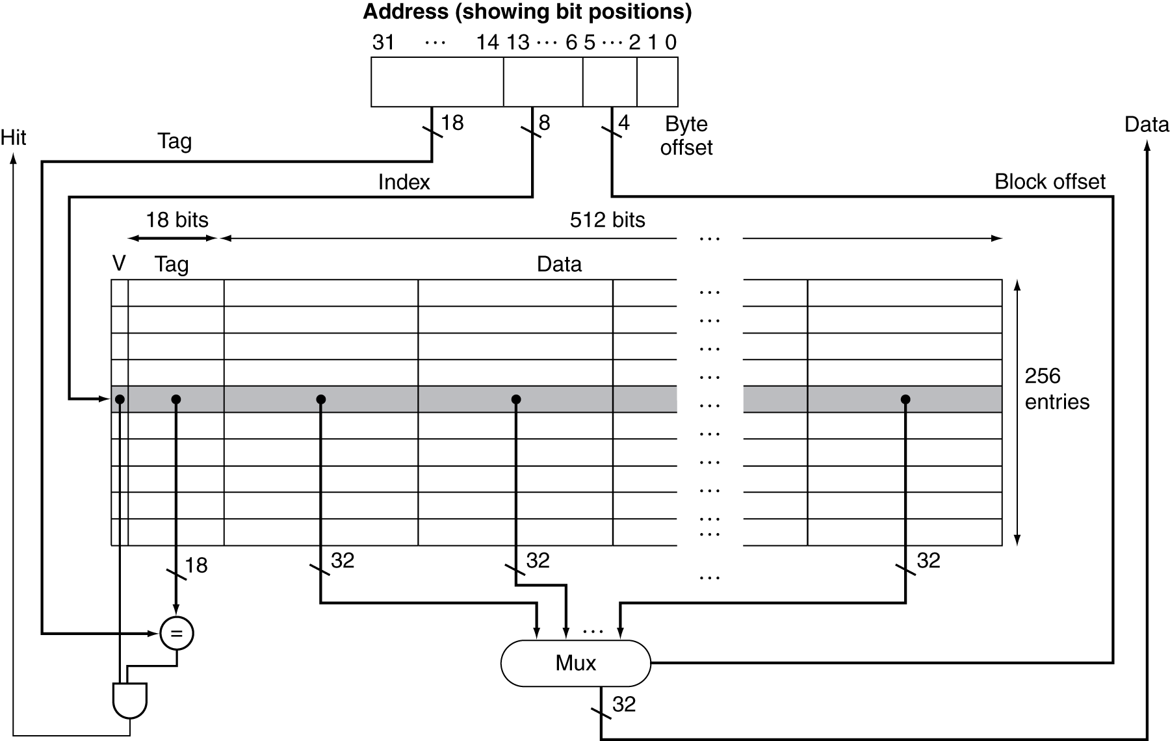
Example - Intrinsity FastMATH (2)
  Cache: 16KB
  256 blocks × 16 words/block

Slide 44
Block Size Considerations
Larger blocks should reduce miss rate
  Higher spatial locality
  Also reduce tag cost
But in a fixed-sized cache
  Larger blocks ⇒ fewer blocks
    More competition ⇒ increased the miss rate
    Lower temporal locality
Larger miss penalty
  Larger blocks ⇒ pollution
  Transfer overhead (multiple bus cycles)
  Can override the benefit of reduced miss rate
  Early restart and critical-word-first can help to reduce transfer latency.
Small caches
Need balance
Large caches
like larger lines
Notes:
Lower temporal locality
Common bus widths are 64-128b
GPU has wider bus: 256-512

Slide 45
Cache Hit and Miss
Question: How do we know when to use
write-allocate? when to use no-write-allocate?
For example:
In strcpy(), memset(), memcpy(),
initialization of arrays, … no-allocate
In local variable updates
In array element updates write-allocate
….
Cache read
  Read hit
  Read miss
Cache write
  Write hit
    Write-through
    Write-back
  Write miss
    Write allocate
    No-write allocate
Most caches today are using write-back and
write-allocation policy

Slide 46
Cache Read
Read Hit
On a cache hit, CPU proceeds normally
Read Miss
On a cache miss
  Stall the CPU pipeline (older blocking or lockup cache)
  Fetch block from next level of hierarchy
  Instruction cache miss
    Restart instruction fetch
  Data cache miss
    Complete data access
Notes:
Modern caches are non-blocking: stall on miss or stall-on use

Slide 47
Non-Blocking Cache
On a blocking cache
  A cache miss stalls the CPU pipeline.
  Called Stall-on-Miss
Non-blocking cache
  On a cache miss, the CPU doesn't stall; it can continue working on other instructions while the data is being fetched. Stall happens only when the data fetched is required.
  Use the Miss Status Holding Register (MSHR) to track outstanding misses
  Called Stall-on-Use
    Two common models: Hit-under-miss and Miss-under-miss
  Non-block caches (also called lockup-free caches) support MLP (Memory Level Parallelism)
Notes:
Modern caches are non-blocking: stall on miss or stall-on use

Slide 48
Instruction Cache Miss Handling
On instruction cache miss
  Send the original PC value (current PC – 4) to the memory.
  Instruct main memory to perform a read and wait for the memory to complete its access.
  Write the cache entry, putting the data from memory in the data portion of the entry, writing the upper bits of the address into the tag field, and turning the valid bit on.
  Restart the instruction execution at the first step, which will re-fetch the instruction, this time finding it in the cache.
Instruction cache prefetching is a commonly used optimization to reduce instruction cache misses.
Question: Can you prefetch for
instruction cache in software?
Notes:
GPU would prefetch for the next 10-12 instruction cache lines

Slide 49
Write Hit - Write-Through Policy
Write through: Also update data in memory
  Advantage: Ensure fast retrieval while making sure the data is in the backing store and is not lost in case the cache is disrupted
  Disadvantage: Writing data will experience latency as you have to write to two places every time
    Increase the traffic to memory
    Writes become longer
      If base CPI = 1, 10% of instructions are stores, write to memory takes 100 cycles, e.q., Effective CPI = 1 + 0.1×100 = 11
Solution: Write buffer
  Hold data waiting to be written to memory
  CPU continues immediately
    Only stalls on write if write buffer is already full
Notes:
分为直写法 write through和 写缓冲 write buffer

Slide 50
Avoid Waiting for Memory in Write Through
Use a write buffer (WB)
  Processor: Writes data into cache and WB
  Memory controller: Write WB data to memory
Write buffer is just a FIFO
  Typical number of entries: 4
Memory system designer’s nightmare
  Store frequency > 1 / DRAM write cycle
  Write buffer saturation => CPU stalled
  Write buffer allows write-coalescing to reduce traffic to memory
Yet another reason to go for
write-back cache
Processor
Cache
DRAM
Memory controller
Write Buffer
Notes:
一个比较麻烦的情况是store instruction的频率要比写进主存的频率要快，那么这个时候write buffer就会填满，这个时候CPU发生阻塞， stalled
You are right, memory is too slow. We really didn't write to the memory directly. We are writing to a write buffer.
Once the data is written into the write buffer and assuming a cache hit, the CPU is done with the write. The memory controller will then move the write buffer contents to the real memory behind the scene.
The write buffer works as long as the frequency of store is not too high. Notice here, I am referring to the frequency with respect to time, not with respect to number of instructions.
Remember the DRAM cycle time we talked about last time. It sets the upper limit on how frequent you can write to the main memory.
If the store are too close together or the CPU time is so much faster than the DRAM cycle time, you can end up overflowing the write buffer and the CPU must stop and wait.
+2 = 60 min. (Y:40)

Slide 51
Write Hit - Write-Back Policy
Just update the block in cache
  Keep track of whether each block is dirty, one dirty bit is required
When a dirty block is replaced
  Write it back to memory
  Can use a write buffer to allow a replacing block to be read first
Data in cache and memory is inconsistent (what if the other processor wants to read the shared data)
Advantage: Low latency and high throughput for write-intensive applications. Much lower memory traffic (Particularly important for multi-processor systems).
Disadvantage: There is a data availability risk because the cache could fail (and so suffer from data loss) before the data is persisted to the backing store (This is why caches are often enhanced with ECC for protection against errors)
Notes:
Some existing solutions: ECC, battery backup, duplicated cache, NVM as cache

Slide 52
Write Hit - Write-Back Policy
Just update the block in cache
  Keep track of whether each block is dirty, one dirty bit is required
When a dirty block is replaced
  Write it back to memory
  Can use a write buffer to allow a replacing block to be read first
Data in cache and memory is inconsistent (what if the other processor wants to read the shared data)
Advantage: Low latency and high throughput for write-intensive applications. Much lower memory traffic (Particularly important for multi-processor systems).
Disadvantage: There is a data availability risk because the cache could fail (and so suffer from data loss) before the data is persisted to the backing store (This is why caches are often enhanced with ECC for protection against errors)
What is the total bits required for a data cache?
data bits per line
tag per line
one valid bit
one dirty bit
ECC bits (usually 8/64)
Notes:
Some existing solutions: ECC, battery backup, duplicated cache, NVM as cache

Slide 53
Write Miss - Write Allocation
What should happen on a write miss?
For write-through cache
  Write allocate: Allocate a block in the cache. The block is fetched from memory, and then the appropriate portion of the block is overwritten
  No write allocate: only update the portion of the block in memory, but not put it in the cache
    Since programs often write a whole block before reading it (e.g., initialization)
    Can combine with a write buffer to coalesce multiple writes.
For write-back cache
  Usually fetch the block, use write allocate
Notes:
We usually do not worry about write-allocate or no-allocate. The commonly used cache is copy back cache.

Slide 54
Example - Intrinsity FastMATH
Embedded MIPS processor
  12-stage pipeline
  Instruction and data access on each cycle
Split cache: Separate I-cache and D-cache
  Each 16KB: 256 blocks × 16 words/block
  D-cache: Write-through or write-back
SPEC2000 miss rates
  I-cache: 0.4%
  D-cache: 11.4%
  Weighted average: 3.2%
SPEC2000 benchmarks are desktop apps
Instruction locality is higher
DBMS apps, Virtual machines, Interpreters,
JIT compilers, and object-oriented programs
tend to have more I-cache misses
Notes:
This is for vector/matrix operations. So I-cache miss rate is extremely low. This is not true for DBMS such as oracle. In HP PA-RISC processor, I-cache is 1MB.

Slide 55
Outline
Memory hierarchy
The basics of caches
  Direct-mapped cache
  Address sub-division
  Cache hit and miss
  Memory support
Measuring cache performance
Improving cache performance
  Set associative cache
  Multiple level cache

Slide 56
Memory Design to Support Cache
How to increase memory bandwidth to reduce miss penalty?
CPU
CPU
CPU
Cache
Multiplexer
Cache
BUS
Cache
BUS
BUS
Memory
Assume a cache line 64B, and bus is 32b wide
Memory
Bank 0
Memory
Bank 1
Memory
Bank 2
Memory
Bank 3
Memory
One-word wide memory organization
Wide memory organization
Interleaved memory organization

Slide 57
Issues with a Wider Bus
How to increase memory bandwidth to reduce miss penalty?
CPU
CPU
CPU
L1
Cache
L2
Pin limitation
L3
Cache
BUS
BUS
Memory
Signal integrity challenge
Memory
Memory
Bank 0
Memory
Bank 1
Memory
Bank 2
Memory
Bank 3
Manufacturing cost and design complexity
One-word wide memory organization
Interleaved memory organization

Slide 58
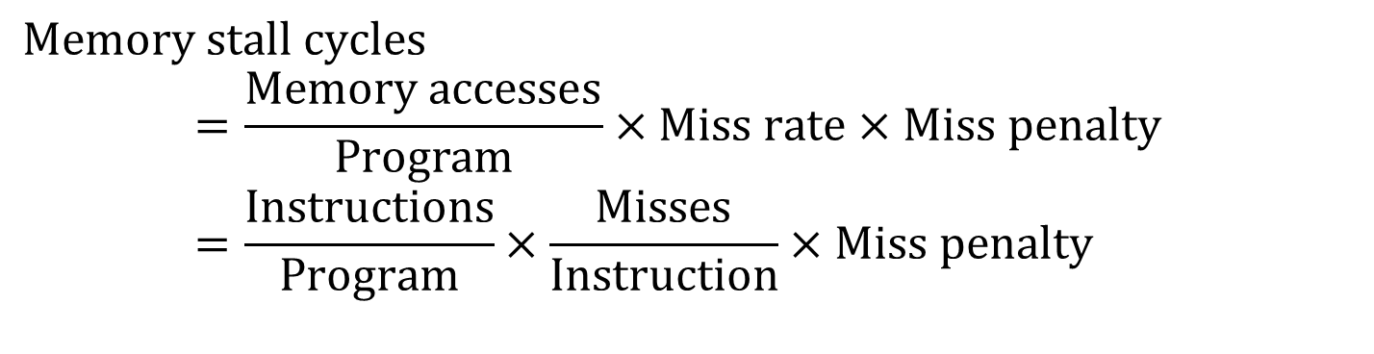
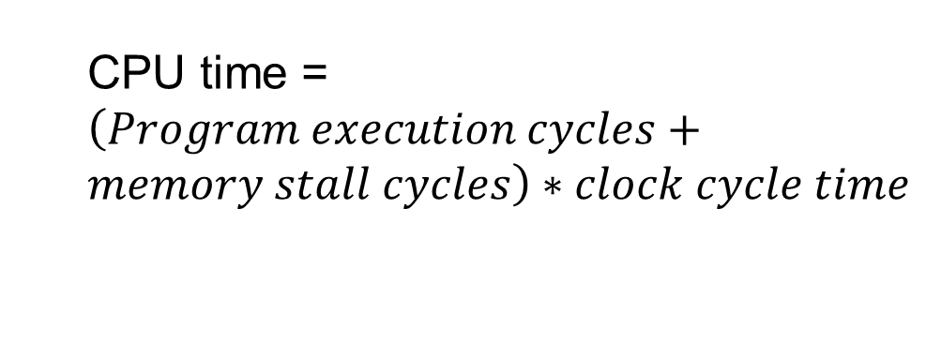
Measuring Cache Performance
Components of CPU time
  Program execution cycles
    Includes cache hit time
  Memory stall cycles
    Mainly from cache misses
With simplified assumptions (equal penalty for read/write)
CPU time = $\left(Program execution cycles+memory stall cycles\right)∗clock cycle time$
$$Memory stall cycles \\ =\frac{Memory accesses}{Program}×Miss rate×Miss penalty \\ =\frac{Instructions}{Program}×\frac{Misses}{Instruction}×Miss penalty$$
Notes:
Miss penalty may be different

Slide 59
Cache Performance Exercise
Given
  I-cache miss rate = 2%
  D-cache miss rate = 4%
  Miss penalty = 100 cycles
  Base CPI (ideal cache) = 2
  Load & stores are 36% of instructions
  Compute the actual CPI and how many times faster if with perfect cache?
Notes:
36% is conservative
CPI = 2 is probably too high. Typical ratio is 1.1 to 1.5

Slide 60
Cache Performance Exercise
Given
  I-cache miss rate = 2%
  D-cache miss rate = 4%
  Miss penalty = 100 cycles
  Base CPI (ideal cache) = 2
  Load & stores are 36% of instructions
  Compute the actual CPI and how many times faster if with perfect cache?
Miss cycles per instruction
  I-cache: 0.02 × 100 = 2
  D-cache: 0.36 × 0.04 × 100 = 1.44
Actual CPI = 2 + 2 + 1.44 = 5.44
  5.44/2 =2.72 times faster
Typical CPI of a pipelined processor with
perfect caches may be 1.1 – 1.5.
If you see a benchmark reporting a CPI of 10,
What would be the performance bottleneck?
Notes:
这是书上的一个例子

Slide 61
Average Memory Access Time
Hit time is also important for performance (hit may take > 1 cycle)
Average memory access time (AMAT)
  Data Cache AMAT = Hit time + Miss rate × Miss penalty
  Overall AMAT = %instr x (Instruction cache AMAT) + %data x (Data Cache AMAT)
Example
  CPU with 1ns clock, hit time = 1 cycle, miss penalty = 20 cycles, cache miss rate = 5%
  AMAT = 1 + 0.05 × 20 = 2ns
    2 cycles per instruction
Typical L1D hit latency
Intel Skylake/Ice lake | 4-5 cycles
AMD Zen | 4-5 cycles
ARM | 3-4 cycles

Slide 62
Average Memory Access Time
Hit time is also important for performance
Average memory access time (AMAT)
  Data Cache AMAT = Hit time + Miss rate × Miss penalty
  Overall AMAT = %instr x (Instruction cache AMAT) + %data x (Data Cache AMAT)
  %instr refers to the percentage of instruction accesses in relation to the total memory accesses, while %data represents the percentage of data accesses compared to the total memory accesses.
  Usually, %instr is higher than %data.
  With SIMD/Vector loads/stores, %data could be higher than %instr

Slide 63
Cache Performance Matters
When CPU performance increased
  Miss penalty becomes more significant
Decreasing base CPI
  Greater proportion of time spent on memory stalls
Increasing clock rate
  Memory stalls account for more CPU cycles
Cannot neglect cache behavior when evaluating system performance

Slide 64
Improving Cache Performance
Reduce the cache hit time
Decrease the cache miss ratio
Decrease the cache miss penalty
Average memory access time =
hit time + miss-rate X miss-penalty
If cache accesses can be overlapped, such as the split I/D cache or the non-blocking cache, then the AMAT formula is no longer accurate. Other cases: cache prefetching
and OOO (Out-Of-Order) processors, AMAT is also not applicable.
Notes:
small, Direct mapped,
Associative,
Multi-level

Slide 65
Low Hit Latency
Small and Simple
small is fast
Direct-map or low associativity
Prediction (predict which way to compare first)
Virtual address cache or virtual index and physical tagged cache
avoid or overlap with address translation delay
Cache layout closer to CPU to minimize signal delay.
Notes:
small, Direct mapped,
Associative,
Multi-level

Slide 66
Associative Caches
Fully associative
  Allow a given block to go in any cache entry
  Requires all entries to be searched at once
  Comparator per entry (expensive and slow)
n-way set associative
  Each set contains n entries
  Block number determines which set
    (Block number) modulo (#Sets in cache)
  Search all entries in a given set at once
  n comparators (less expensive and fast)
Set number
Cache block (line) number
Byte offset
Address
Notes:
fully associative is 1-set set-associative
Direct mapped is 1-way set associative

Slide 67
Pop Quiz
Which of the following statements are true?
A fully associative cache is a 1-way cache
A Direct-mapped cache is a 1-set cache
A 2-way set associative cache has more sets than a 4-way one.
A direct mapped cache has the least tag overhead
A fully associative cache has more cache lines than a direct mapped cache.
3,4
Notes:
fully associative is 1-set set-associative
Direct mapped is 1-way set associative

Slide 68
Pop Quiz on set associative caches
Which of the following statements are true?
A fully associative cache is a 1-way cache
A Direct-mapped cache is a 1-set cache
A 2-way set associative cache has more sets than a 4-way one.
A direct mapped cache has the least tag overhead
A fully associative cache has more cache lines than a direct mapped cache.
N-way cache,
N is the number of cache line
1-way cache,
It has N sets
One tag per cache line
Least number of tag bits
Same number
Number of cache lines is
determined by the cache size
and the line size
Notes:
fully associative is 1-set set-associative
Direct mapped is 1-way set associative

Slide 69
Associativity Example (1)
Compare 4-block caches
  Direct mapped (1-way), 2-way set associative, fully associative (4-way)
  Assume block access sequence: 0, 8, 0, 6, 8
Direct mapped
Compulsory miss
Conflict miss
Block address | Cache index | Hit/miss | Cache content after access
 |  |  | 0 | 1 | 2 | 3
0 (0000) | 0 | miss | Mem[0]
8 (1000) | 0 | miss | Mem[8]
0 (0000) | 0 | miss | Mem[0]
6 (0110) | 2 | miss | Mem[0] |  | Mem[6]
8 (1000) | 0 | miss | Mem[8] |  | Mem[6]
time

Slide 70
Associativity Example (2)
2-way set associative (0, 8, 0, 6, 8)
Block address | Cache index | Hit/miss | Cache content after access
 |  |  | Set 0 |  | Set 1
0 (0000) | 0 | miss | Mem[0]
8 (1000) | 0 | miss | Mem[0] | Mem[8]
0 (0000) | 0 | hit | Mem[0] | Mem[8]
6 (0110) | 0 | miss | Mem[0] | Mem[6]
8 (1000) | 0 | miss | Mem[8] | Mem[6]
time
Fully associative (0, 8, 0, 6, 8)
Block address |  | Hit/miss | Cache content after access
0 |  | miss | Mem[0]
8 |  | miss | Mem[0] | Mem[8]
0 |  | hit | Mem[0] | M[em8]
6 |  | miss | Mem[0] | Mem[8] | Mem[6]
8 |  | hit | Mem[0] | Mem[8] | Mem[6]
time

Slide 71
Conflicts in set-associative caches
In the above example, the cache has only 4 blocks.
For a direct-mapped cache, the following sequence of block addresses will run into intensive conflict misses.
  0, 4, 8, 12, 16, 20… or 1,5,9,13,17,21… or 2,6,10, 14, 18….
  As long as the distance is a multiple of the cache size in blocks
For set-associative caches, each set can accommodate more lines, so that misses would reduce.
Notes:
关联度：associativity
边际递减效应

Slide 72
Pop Quiz
My application experiences intensive conflict misses. After reviewing the computer configuration, I discovered that the L1 cache is direct-mapped. Which of the following may reduce the cache misses in my application?
Get a larger L1 cache
Get a higher associative L1 cache
Get a larger line size
Get a larger tag size
Redesign the algorithm of the application
1,2,5
Notes:
fully associative is 1-set set-associative
Direct mapped is 1-way set associative

Slide 73
Pop Quiz
Assume the L1 cache is 4KB, and the line size is 64B
Array A and B are defined as double int A[4096], B[4096];
Which loops will encounter frequent conflict misses if the cache is direct-mapped?
for (i=0; i<n; i++) A[i]=B[i];
for (i=0; i<n; i++) A[i]=A[i-1]+A[i+1];
for (i=0;i<n;i++) A[i] = 0;
for (j=0; j<m; j++)
for (i=0; i<2048; i++) A[i] += A[i+1024]*100;
1,4
Notes:
fully associative is 1-set set-associative
Direct mapped is 1-way set associative

Slide 74
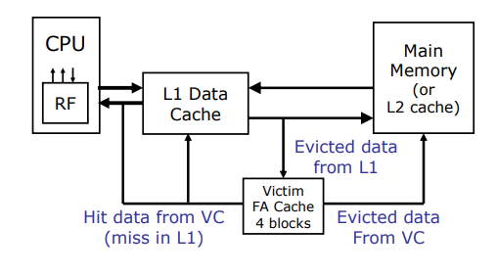
Victim Cache
A small fully-associative back up cache, called victim cache, could be added to a direct-mapped L1 cache to hold recently evicted cache lines.
To defend for cases where some repeated access patterns incur multiple power-of-two addresses and cause intensive conflict misses.
The victim cache is small, usually 4-8 lines, so can be accessed quickly.
Consider a sequence:
0, 4, 8, 2, 3, 12, 4, 8, 0, 12, 4, 0, 5,6,……
0, 4, 8, 12 may be mapped to the same set,
so the hit rate is low, but all of them could be
sitting in the victim cache.

Slide 75
Victim Cache
A small fully-associative back up cache, called victim cache, could be added to a direct-mapped L1 cache to hold recently evicted cache lines.
To defend for cases where some repeated access patterns incur multiple power-of-two addresses and cause intensive conflict misses. Note that such conflict misses are often occur within a small number of sets
The victim cache is small, usually 4-8 lines, so can be accessed quickly.
Combining the advantages of a direct
mapped cache and the benefit of a fully
associative cache.

Slide 76
Associativity and Miss Rates
In general, increased associativity decreases miss rate
  But with diminishing returns
Simulation of a system with 64KB
D-cache, 16-word blocks, SPEC2000
  1-way: 10.3%
  2-way: 8.6%
  4-way: 8.3%
  8-way: 8.1%
Notes:
关联度：associativity
边际递减效应

Slide 77
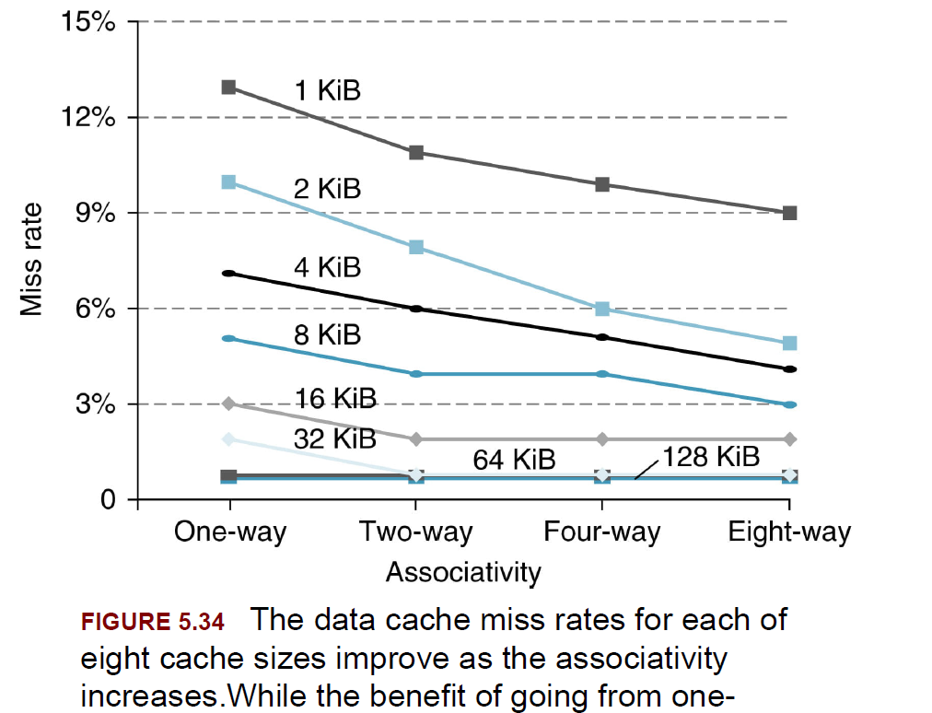
Cache Sizes and Associativity
Notes:
关联度：associativity
边际递减效应

Slide 78
Classifying Cache Misses (3 C’s or 4 C’s)
Compulsory (or Cold) Miss
when a piece of data is requested for the very first time
and needs to be brought into the cache
1,4,3,5,7
Conflict (or Collision) Miss
Multiple references are mapping to the same set, and
The set is not large enough to hold them. “collision”
Caused misses.
3,4,8,11,12,19, 4
0 | 1 | 2 | 3 | 4 | 5 | 6 | 7
0 | 1 | 2 | 3 | 4 | 5 | 6 | 7
Capacity Miss
Cache is not large enough to hold needed
Blocks
1,2,3,4,5,6,7,8,9,1,2,3,4,5,6,7,8,9
Coherency Miss
Occurs when invalidation requests are issued by other processors in a multiprocessor system to maintain coherence of cached data
0 | 1 | 2 | 3 | 4 | 5 | 6 | 7

Slide 79
A 4-Way Set-Associative Cache
Increasing associativity shrinks index, expands tag

Slide 80
Conflict Misses
Conflict misses occur when multiple lines are mapped to the same set
  Their set select bits are identical !!
  When the address distance between two lines is multiple of the cache size, the set selection bit will be identical.
  Example: 4KB direct mapped cache, with 64B cache line. There are 64 sets
  If the distance to another line address is +4096
31
12
11
6
5
0
Tag
0
Set selection
Byte offset
Identical
31
12
11
6
5
0
Tag
1
Set selection
Byte offset

Slide 81
Conflict Misses
Conflict misses occur when multiple lines are mapped to the same set
  Their set select bits are identical !!
  When the address distance between two lines is multiple of the cache size, the set selection bit will be identical.
  Example: 4KB direct mapped cache, with 64B cache line. There are 64 sets
  If the distance to another line address is +8192
31
12
11
6
5
0
Tag
00
Set selection
Byte offset
Identical
31
12
11
6
5
0
Tag
10
Set selection
Byte offset

Slide 82
Common Cases for Conflict Misses
Assuming direct-mapped caches, cache size 4KB, line size 64B.
Scenario 1
  I-cache:
  Procedure A calls Procedure B, the distance between A and B is a multiple of 4K
Scenario 2
D-cache
Float A[1024][1024];
loop on j
{B[i] =A[i][j] + A[i+1][j];}
Scenario 3
D-cache
Double A[1024], B[1024], C[1024];
for(i) {C[i] = A[i] + B[i];}

Slide 83
Common Cases for Conflict Misses
Assuming direct-mapped caches, cache size 4KB, line size 64B.
Scenario 1
  Icache:
  Procedure A calls Procedure B, the distance between A and B is multiple of 4K
Scenario 2
Dcache
Float A[1024][1024];
loop
{B[i] =A[i][j] + A[i+1][j];}
Scenario 3
Dcache
Double A[1024], B[1024], C[1024];
for(i) {C[i] = A[i] + B[i];}
Code Repositioning: Layout B next to A
A[1024][1040]
A[1024], Dummy0[8], B[1024], Dummy1[8], C[1024]
However, this may not always work, since the compiler may
remove dummy[] because they are not used.

Slide 84
DM+VC or Two-way Associative Cache?
Both Direct-mapped cache enhanced with a Victim cache and a two-way set-associative cache can reduce conflict misses. Which one is better?
Victim cache
  Good at handling repetitive references to clustered conflict misses
  Higher temporal locality
  For example: 4,8,12,16, 20, 24, 4,8,12,16,20, …..
Two-way set-associative cache
  Good at handling evenly distributed conflict misses from many sets.
  Lower temporal locality
  For example: 4,8,4,7, 11,15, 8, 6, 10, 8, 6, 7, 8, 11, 10, 15…..
In general-purpose systems (e.g., desktops, servers, laptops), two-way set associative caches are far more common. Direct-mapped caches + victim cache are more specialized and are typically found in embedded systems, older designs, or cost-driven applications.
Here, we assume the cache has
4 lines. 4, 8, 12 are cache line (block)
Address. Line 4 and line 8 map to the
same set.
Line 7, 11, 15 map to the same set.
Line 6, 10 map to the same set.

Slide 85
Data Placement Policy
Direct mapped cache
  Each memory block mapped to one location
  No need to make any decision
  Current item replaces previous one in location
N-way set associative cache
  Each memory block has choice of N locations
Fully associative cache
  Each memory block can be placed in ANY cache location
Misses in N-way set-associative or fully associative cache
  Bring in new block from memory
  Throw out a block to make room for new block
  Need to decide on which block to throw out (Replacement)

Slide 86
Cache Block Replacement
Direct mapped: No choice; each set has only one line
Set associative or fully associative
  Random
  LRU (Least Recently Used)
    Hardware keeps track of the access history and replaces the block that has not been used for the longest time
  An example of a pseudo LRU (for a two-way set associative)
    Use a pointer to point at each block in turn
    Whenever access to the block the pointer is pointing at, move the pointer to the next block
    When need to replace, replace the block currently pointed at
  FIFO (First-In First Out)
    Replacing older data
True LRU needs to use a stack, but stack ops
are expensive
Assume a set has 3 blocks. A calls B, B returns, A calls C, C calls D.
The cache set now has A, B, and C blocks. When D is referenced, which block should be replaced? LRU → B, FIFO → A

Slide 87
Cache Block Replacement
General LRU Strategy Implementation:
  e.g. for a 4-block/set cache, use a log_2(4) = 2 bit counter for each block
  Reset the counter to 0 whenever the block is accessed
  Counters of other blocks in the same set should be incremented
  On cache miss, replace/ uncache a block with a counter reaching 3
Optimal Replacement
  Belady’s algorithm
    Replace the block that will be referenced in the farthest future
    (or Replace the item not needed for the longest time)
    This gives the optimal hit rate, but not the least memory traffic (because replacing a clean block is cheaper)
  Not implementable because we do not know the future.

Slide 88
A Case that DM is better than FA
If a loop has 5 cache lines, line 0, line 1, line 2, line 3, line 4.
the cache is a Direct-Mapped (DM) with 4 blocks. So line 0 and line 4 will be mapped to the same set, and line 1,2,3 each map to a different set. The loop will have 60% of hit rate – line 1, line 2 and line 3 will hit, and line 0 and line 4 will conflict all the time.
If the cache is Fully Associative (FA), and the replacement algorithm is LRU, then the loop will have 0% of hit. All lines will be missed in the cache. 0,1,2,3,4 (line4 misses, will replace 0), 0 misses, will replace 1, 1 misses, will replace 2, 2 misses, will replace 3…
Why not consider using random replacement?
What could be a better combination? Some adaptive approach?

Slide 89
Improving Cache Performance
Reduce the cache hit time
Decrease the cache miss ratio
Decrease the cache miss penalty
Average memory access time =
hit time + miss-rate X miss-penalty
Notes:
small, Direct mapped,
Associative,
Multi-level

Slide 90
Multilevel Caches
Primary cache attached to the CPU
  Small, but fast
Level-2 cache services misses from the primary cache
  Larger, slower, but still faster than main memory
Main memory services L2 cache misses
High-end systems often include an L3 cache, L3 cache is usually shared by multiple cores on the same chip.
Still need to keep consistency between different cache levels

Slide 91
Multilevel Cache AMAT
AMAT = L1 hit time + L1 miss rate * L1 miss penalty
L1 miss penalty = L2 hit time + L2 miss rate * L2 miss penalty
So in total:
  AMAT = L1 hit time + L1 miss rate * (L2 hit time + L2 miss rate * L2 miss penalty )
Beware the L2 miss rate here is a relative miss rate: the ratio of L1 misses that miss the L2.
Typical Hit Rates (Approximate):
  L1 Cache: 80-95%
  L2 Cache: 50-80% (L2 accesses are L1 misses)
  L3 Cache: 20-40% (L3 accesses are L2 misses, the references to L3 are tough memory references)

Slide 92
Multilevel Cache Example (1)
Given
  CPU base CPI = 1, clock rate = 4GHz
  Miss rate/instruction = 2%
  Main memory access time = 100ns
With just primary cache (L1)
  Miss penalty = 100ns/0.25ns = 400 cycles
  Effective CPI = 1 + 0.02 × 400 = 9

Slide 93
Multilevel Cache Example (2)
Once again, AMAT is only an approximation,
It is not accurate when the cache miss penalty
can be overlapped with other instruction executions
Now add L2 cache
  L1 miss rate to L2 = 2%
  L2 access time = 5ns (to M: 100ns)
  L2 miss rate to main memory = 50%
Primary miss with L2 hit (2%)
  Penalty to access L2 = 5ns/0.25ns = 20 cycles
Primary miss with L2 miss (20%) // assuming 80% hit in L2
  Penalty to access memory = 400 cycles
CPI = 1 + 0.02 × 20 + 0.02x0.2 × 400 = 1.4+1.6
Performance ratio = 9/3 = 3
Notes:
这个是书上的计算公式，可能是错的，

Slide 94
Multilevel Cache Considerations
L1 cache
  Focus on minimal hit time, must be fast
  Spatial locality more important
  Write-through to L2 is one option.
L2 cache
  Focus on low miss rate to avoid going to main memory (reduce latency as well as both memory and bus traffic)
  Hit time has less overall impact
  Temporal locality more important
  Write back is more common

Slide 95
Alternatives to Reduce Cache Miss Penalty
Critical word first and early restart
  Fetch the requested (critical word) from memory before the rest of the cache line, and resume execution immediately after receiving the critical word.
Non-blocking caches
  Allow multiple misses to overlap
Cache prefetching
  Trigger the miss to occur earlier
Write buffer for copy-back cache
Cache-aware code scheduling
  Attempt to hide the miss penalty

Slide 96
Cache Coherence in Multiprocessors
Processor
Processor
Processor
Processor
Cache
Cache
Cache
Cache
Memory
With a write-back cache policy

Slide 97
Processor
Processor
Processor
Processor
2
1
Cache
Cache
Cache
Cache
u
:5
u
:5
Memory
u
:5
With a write-back cache policy

Slide 98
Potential Problem (Data Coherence)
Processor
Processor
Processor
Processor
P
3
u
= ?
u
= ?
u
= 7
Cache
Cache
5
Cache
Cache
4
3
u
:5
u
:7
Memory
With a write-back cache policy
u
:5

Slide 99
Incoherent Data
Processor
Processor
Processor
Processor
P
3
u
= ?
u
= ?
u
= 7
Cache
Cache
5
Cache
Cache
4
3
u
:5
u
:7
Memory
Write through doesn’t help!
u
:7

Slide 100

Snoopy Cache Coherence Schemes
Basic Idea:
  All coherence-related activities are broadcast to all processors
    e.g., on a global bus
  Each processor (i.e. cache controller) monitors (aka“snoops”) these actions and reacts to those relevant to current contents of its cache
    Examples:
      If one processor wishes to write to a cache line, it needs to“invalidate” all copies in other caches
      If another processor wishes to read a line for which this cache has a dirty copy, it needs to supply and share the copy
Example machines:
  SGI Challenge, SUN Enterprise, multiprocessor PCs, etc.
Notes:
My advisor: James Goodman

Slide 101
Implementing a Snoopy Protocol
MESI protocol
four states:
M: Modify state
E: Exclusive
S: shared
I: invalid
Cache controller receives inputs from both sides:
  Requests from processor,
  Bus requests/responses from snooper in cache controller
In either case, takes zero or more actions
  Updates state, responds with data, generates new bus transactions
Protocol is a distributed algorithm: cooperating state machines
  Set of states, state transition diagram, actions
Granularity of coherence is a cache block
  Similar to allocation in cache and transfer to/from cache

Slide 102
Directory Based Cache Coherency
Snoopy cache protocol is not scalable
  Because they rely on a global bus
For a larger system with hundreds or thousands of processors
  A centralized or distributed directory keeps track of which processors have copies of a particular cache line. When a processor wants to access a cache line, it consults the directory to determine the line's state and the location of other copies.
Advantages:
  Scalability: More scalable than snoopy protocols for large systems.
  Reduced traffic: Avoids broadcasts, leading to lower network contention.
  Flexibility: Can be adapted to different system architectures and memory organizations.
Disadvantages:
  Complexity, potential longer latency, directory overhead (more memory bits)

Slide 103
Exclusive/Inclusive Caches
Inclusive caches (assuming L1/L2)
Every line in L1 must be presented in L2
Exclusive caches
  If a line, A, is in L1, it must NOT be presented in L2 (L1/L2 exclusive)

Slide 104
Advantages of Exclusive/Inclusive Caches
Inclusive caches (assuming L1/L2)
In a multiprocessor architecture with private L1 caches, when a processor issues a write request to its L1 cache, it must invalidate the corresponding cache lines in the L1 caches of other processors. With an inclusive L2 cache, the invalidation check can be performed in the L2 cache, which usually has more cycles available to manage coherence traffic effectively.
Exclusive caches
Inclusion property will cause duplications of lines. L1 lines must be duplicated in L2. So if L1 is 16KB, and L2 is 64KB, then 25% of cache space in L2 is wasted.
More modern processors are using inclusive caches than exclusive caches.

Slide 105
Special Operations of Exclusive/Inclusive Caches
Inclusive caches (assuming L1/L2)
  If L2 evicts a line, it must invalidate the respective line in L1.
Exclusive caches
  If L1 evicts a line, this line moves to L2
  If both L1 and L2 misses, the new line moves from the main memory, and placed in L1 only.
  If L1 miss, but hit in L2, the L2 line migrates to L1
Inclusive caches allow lower level caches to have larger line sizes.
Exclusive caches usually have the same cache line size

Slide 106
Operations of Inclusive Caches
X
X
L1
L1
L1
L1
L1
Y
Y
Back-invalidated
X
X
X
X
Y
Y
L2
L2
L2
L2
L2
Case 1: Initial state
Case 2: X miss in L1
Case 4: X evicted from L1
Case 3: Y miss in L1
Case 5: Y evicted from L2

Slide 107
Operations of Exclusive Caches
X
X
L1
L1
L1
L1
Y
Y
X
L2
L2
L2
L2
Case 1: Initial state
Case 2: X miss in L1,
moved from memory
to L1 directly
Case 4: X evicted from L1,
must be placed in L2.
Case 3: Y miss in L1

Slide 108
Interactions with Advanced CPUs
Out-of-order (OOO) CPUs can execute instructions during a cache miss
  Independent instructions continue
  With non-blocking caches, OOO can trigger multiple cache misses to overlap
The effect of a cache miss depends on the program data flow
  Much harder to analyze
  Use system simulations – this is why you need to know how to write $-simulator
  Collect cache miss profiles
  Cache misses are likely to be correlated – imagine an AI-based cache prefetcher! Is it possible to use ML to detect such correlations?

Slide 109
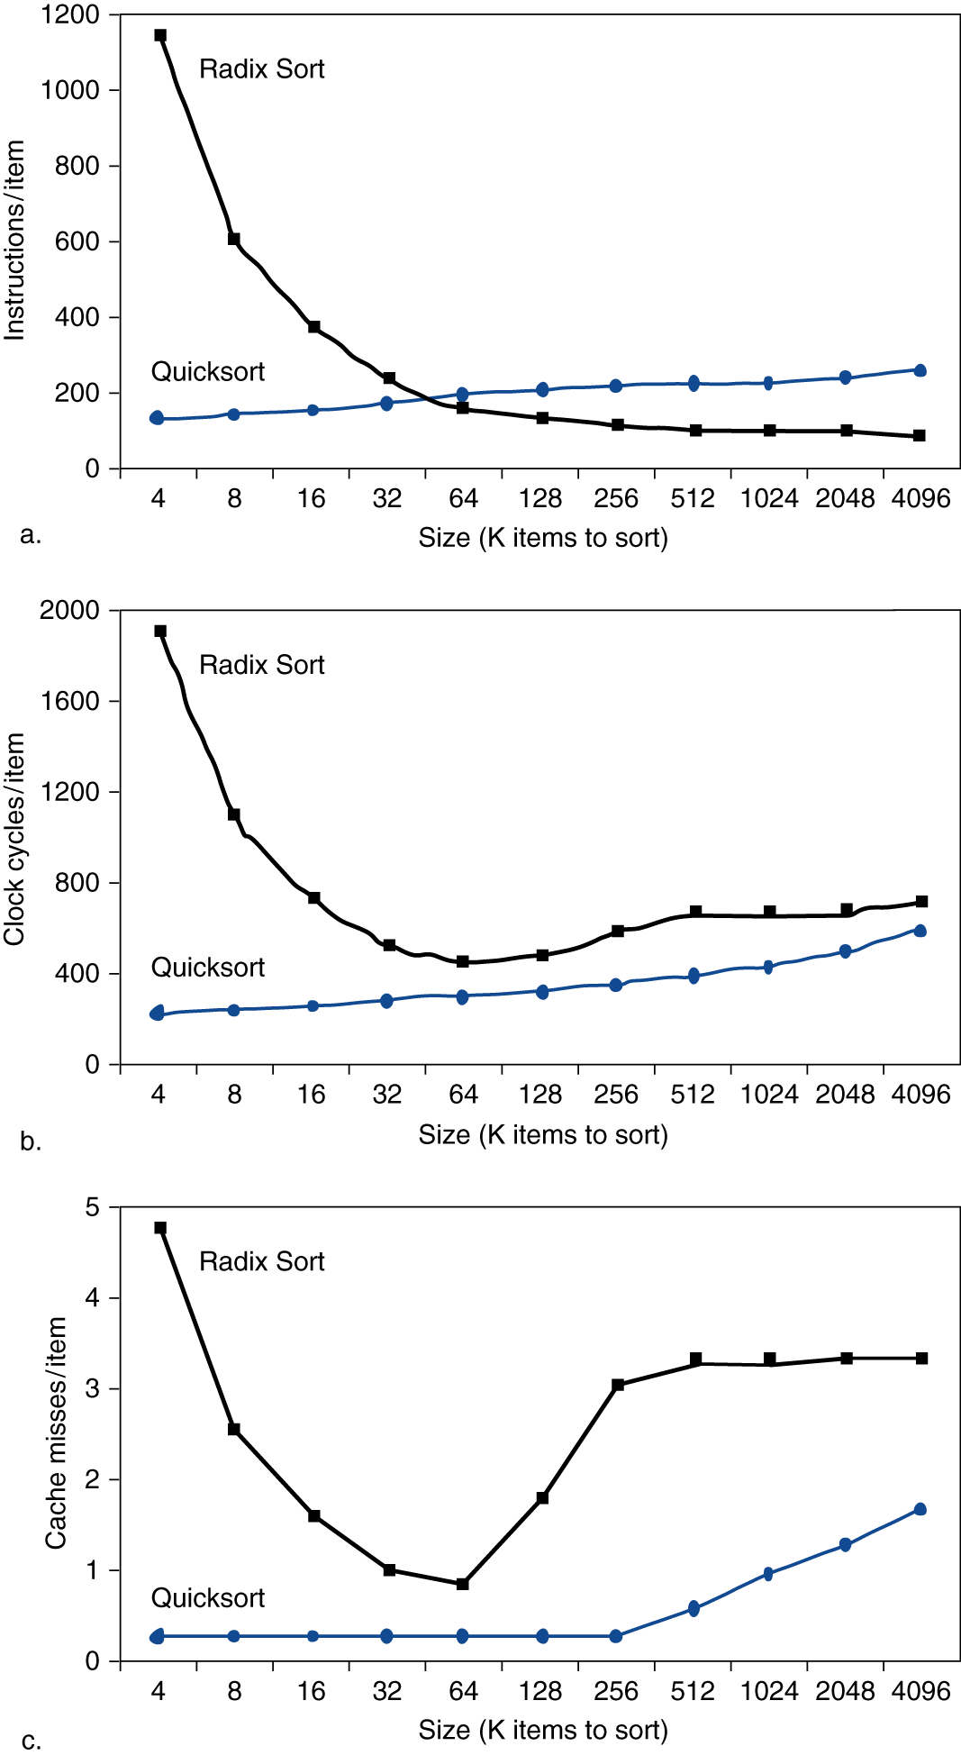
Interactions with Software
Figure a shows that when the size of data is large, Radix sort needs fewer operations than the quicksort!
Figure b shows when the size of data is large, the runtime of Radix sort is not faster!
Figure c shows, when the size of data is large, Radix sort would suffer from more cache misses.
a
b
c

Slide 110
Interactions with Software
Figure a shows that when the size of data is large, Radix sort needs fewer operations than the quicksort!
Figure b shows when the size of data is large, the runtime of Radix sort is not faster!
Figure c shows, when the size of data is large, Radix sort would suffer from more cache misses.
Locality matters!!
a
b
c

Slide 111
Application of Caches
Akamai is a global content delivery network (CDN) provider that delivers content quickly and reliably to users. Due to rapid growth, they encountered a scale-up problem in late 90’s that the network traffic jam caused serious performance impact for customers. How did they solve that problem?
Cache: contents are cached at distribution stations
GPU tend to have a very large register file. For example, Nvidia 4090 has 144SMs, each SM has 4 SP (Streaming Processor), each SP has 16K registers. The16K registers are shared by multiple warps, each warp is a group of 32 threads. So if 8 warps to interleave, then 16K/32/8 = 64, meaning each thread can have only 64 registers. If you want more warps to interleave and more threads per warp, you need to have even more registers. With such a large register file, the register access time will increase. What should you do if the access time is increased to 10 clock cycles?
Cache: Use a cache to speed up register accesses!
The register number is the address of the each cache reference

