Slide 1
Tutorial 1 Run Your First Java Program
Zheng Hanjun (USTF)
(SDS, 122090797)

Slide 2
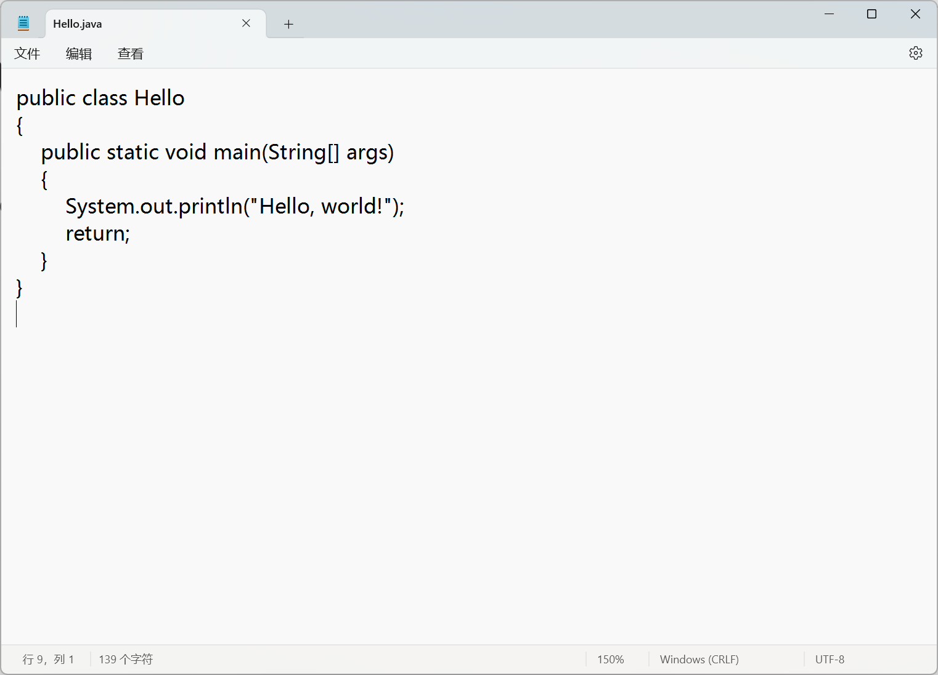
Write your first java program
To write your first java program, you will need an editor.
Technically, you can use any editor, even the notepad to do the job:
But clearly, it’s not a good idea.

Slide 3
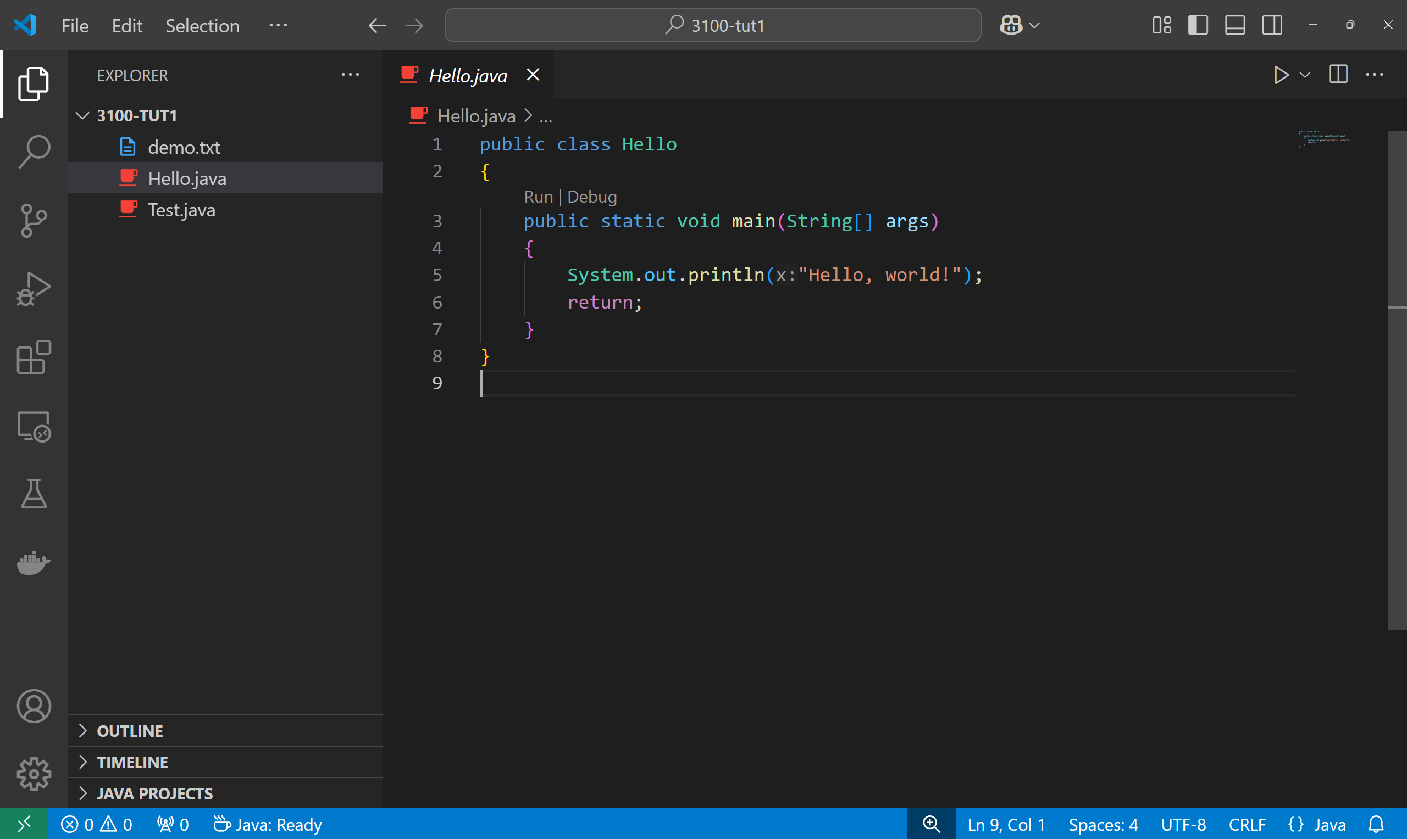
Write your first java program
One of the most popular code editor is VS Code (Recommended)
You can download it from their official website: https://code.visualstudio.com/download
Note: VS Code stands for Visual Studio Code. Don’t mess it up with Visual Studio. They are two different thing.

Slide 4
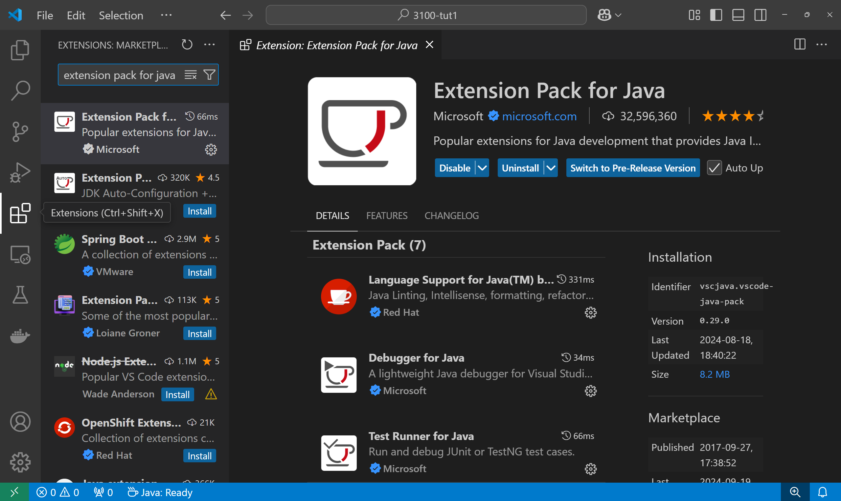
Write your first java program
VS Code has the support of various powerful extensions.
That means you can modify its functionalities and add features you want.
For Java programming, we highly recommend you to install “Extension Pack for Java”.
Click the Extensions button on the left bar, and search to find and install it.

Slide 5
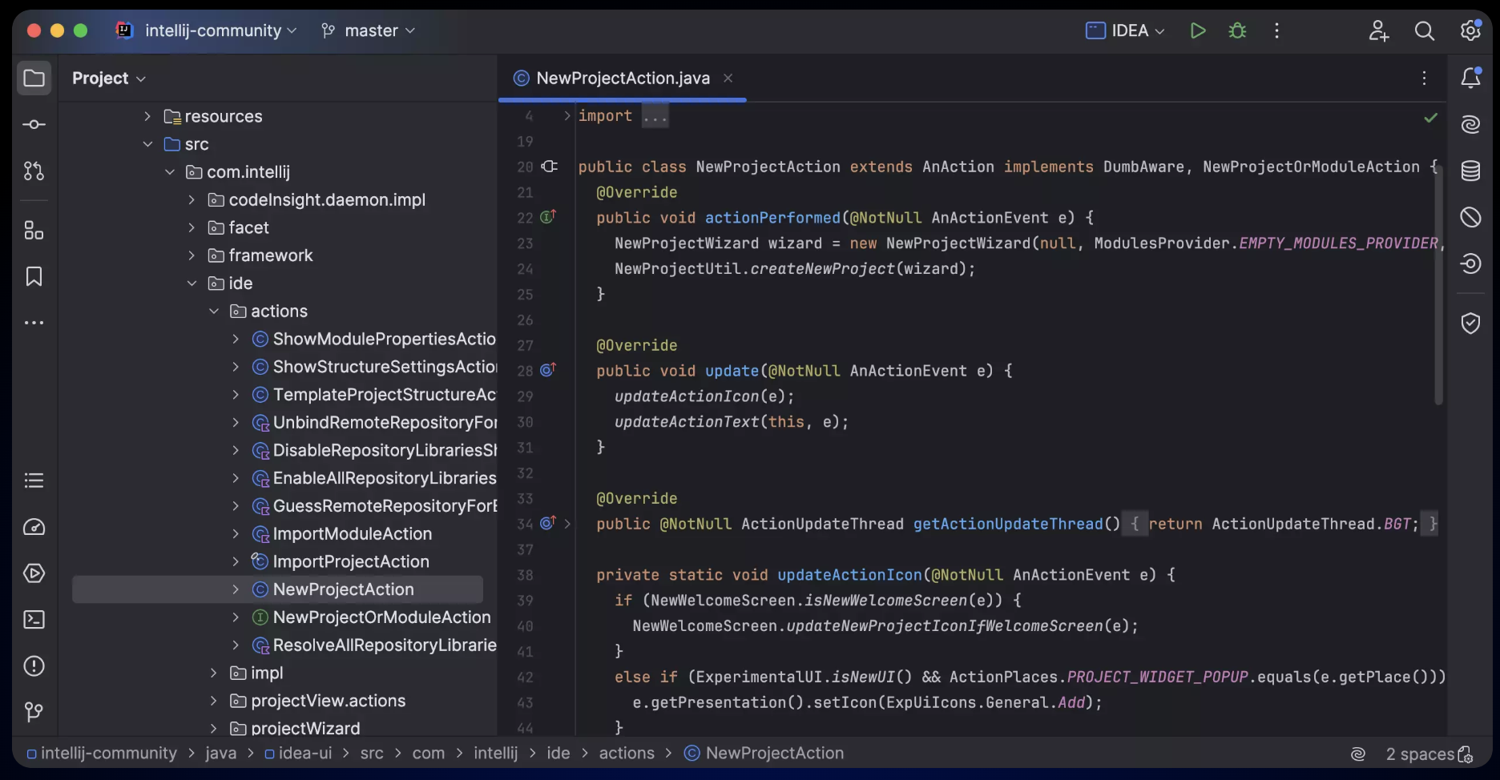
Write your first java program
You can also try IntelliJ IDEA from JetBrains if you prefer more powerful IDE (not recommended)

Slide 6
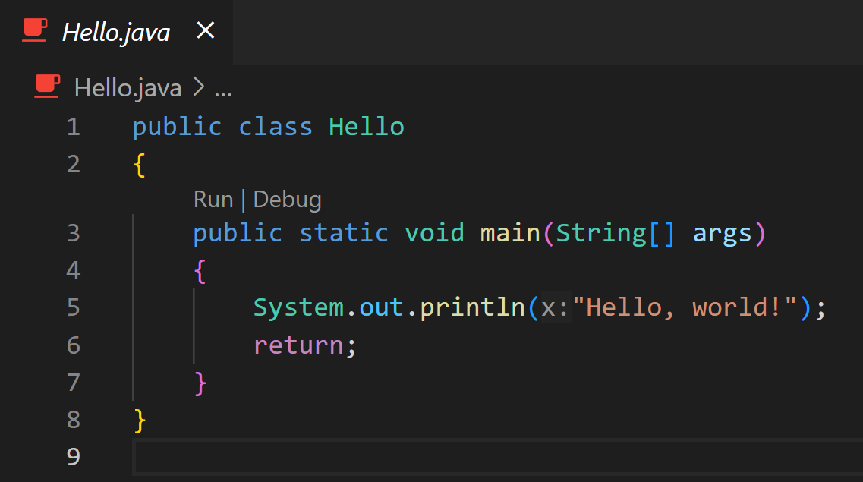
Write your first java program
Then you can write your first “hello, world” program in Java. It should look like this:
It looks much more complicated than the “hello, world” in Python. But you will understand why these are necessary once you get more familiar with Java and OOP.
Note: the name of the public class should be the same as the filename

Slide 7
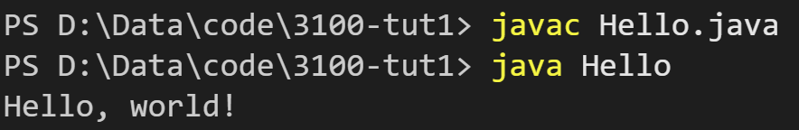
Compile and run your first Java program
In the command line, type “javac Hello.java” to compile the Hello.java source code.
After compilation, you will get a Hello.class output file.
It’s not an executable file. You still need a Java Virtual Machine (JVM) to run it.
Type “java Hello” to run it in the JVM.
Note: Do not mess it up with “java Hello.class” or “java Hello.java”

Slide 8
Install JDK
Basically, to compile java code into .class files, you need a compiler. And to execute the compiled files, you need a JVM. They are shipped together in the Java Development Kit (JDK).
JDK has many different versions and this course does not require specific version. This tutorial use Microsoft OpenJDK 21.0.5 LTS as an example.
Download:
Windows (x64): https://aka.ms/download-jdk/microsoft-jdk-21.0.5-windows-x64.msi
Mac (Intel x64): https://aka.ms/download-jdk/microsoft-jdk-21.0.5-macos-x64.pkg
Mac (Apple Silicon): https://aka.ms/download-jdk/microsoft-jdk-21.0.5-macos-aarch64.pkg

Slide 9
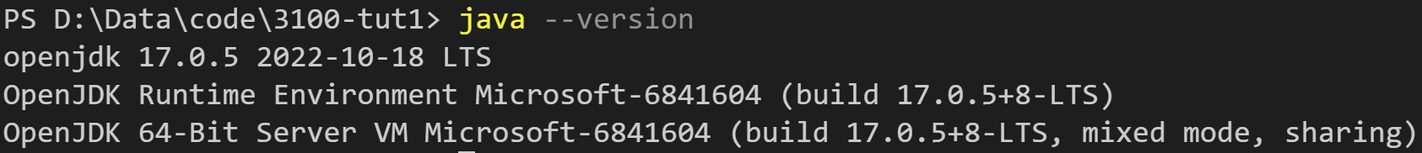
Install JDK
Installation:
Just follow the installer step by step, it should be easy.
If you use older versions of JDK installer, you may need to configure the environment variables manually.
Check your installation:
Type “java –version” in your terminal. You should see something like this:
(I’m using an older version)

Slide 10
Install JDK
Installation:
Just follow the installer step by step, it should be easy.
If you use older versions of JDK installer, you may need to configure the environment variables manually.
Check your installation:
Type “java –version” in your terminal. You should see something like this:
(I’m using an older version)

Slide 11
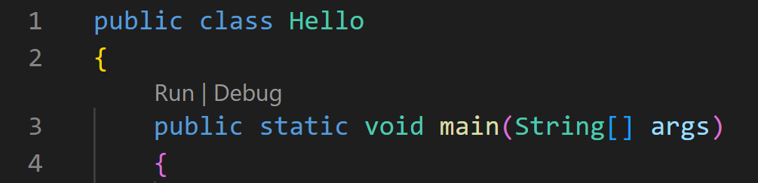
Easier ways to compile and run
Besides manually compile and run your java codes every time, There are more convenient ways to do it.
Alternative 1:
Type “java Hello.java” to combine the two steps together.
Alternative 2:
Use GUI. If you installed the extensions successfully in VS Code. You should be able to see a “run | debug” button above the main function. Click “run” to compile and run the java program.

