Slide 1

Summary of Sorting Algorithms
（ Practice makes perfect！）
CSC 3100: Data Structures
Tutorial 2
Zeyuan He(USTF)

Slide 2
Outline
Bubble Sort
Selective Sort
Insertion Sort
Merge Sort
Coding Practice

Slide 3
What do we concern when we talk about Sort Algorithms?
How does the algorithm work?
Under what conditions does this algorithm run fast?
Under what conditions does this algorithm run slowly?
What’s the time&space complexity of this algorithm?
Is it a stable sorting? (Stable: The order of the 2 equal keys after sorting is the same as the order they were in before sorting)

Slide 4
Bubble Sort
1. Compare adjacent elements. If the first is larger than the second, swap them.
2. Do the same for each pair of adjacent elements, from the first pair to the last pair. When this step is done, the last element will be the largest number.
3. Keep repeating the above until there are no more pairs to compare.

Slide 5
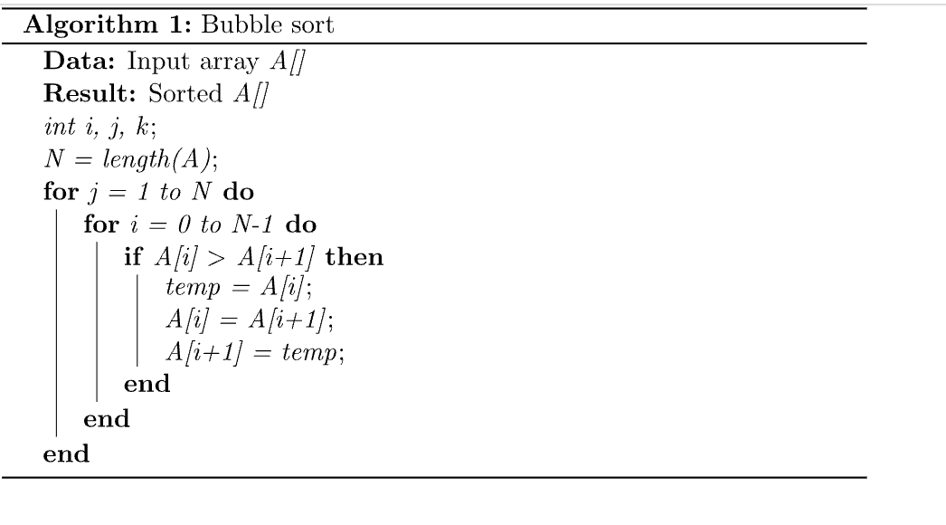
Bubble Sort

Slide 6
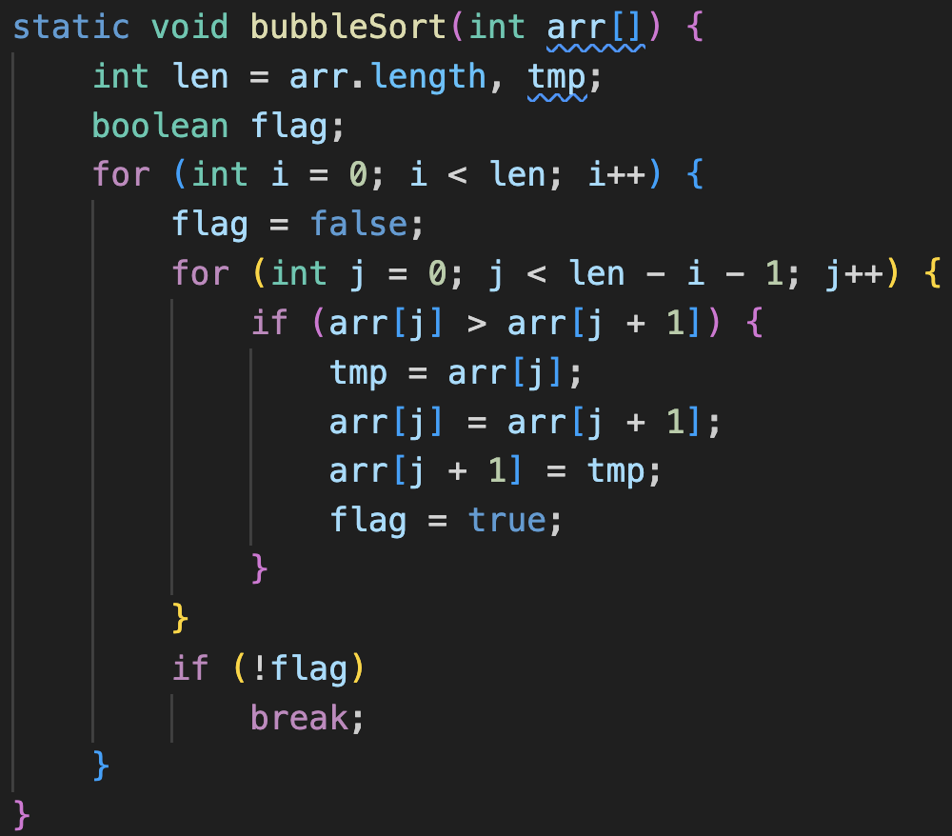
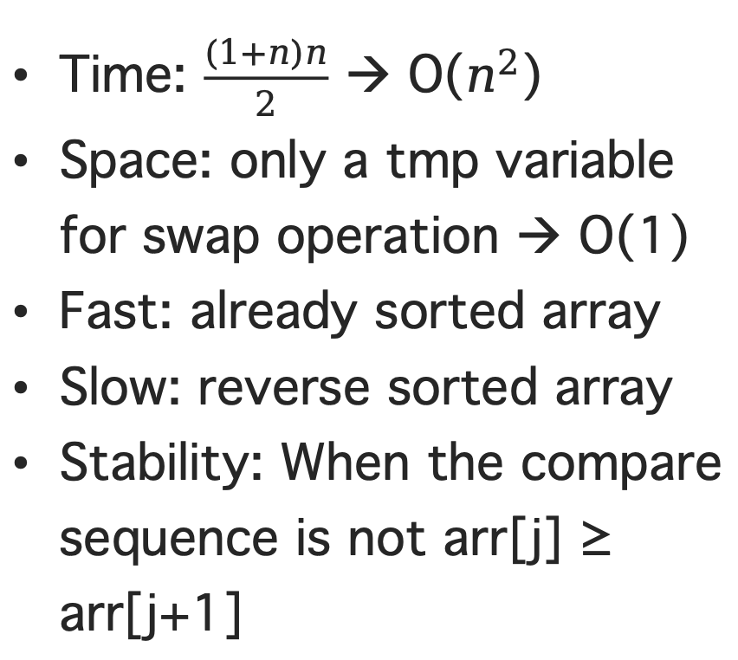
Bubble Sort
Time: $\frac{(1+n)n}{2}$ → O($n^{2}$)
Space: only a tmp variable for swap operation → O(1)
Fast: already sorted array
Slow: reverse sorted array
Stability: When the compare sequence is not arr[j] ≥ arr[j+1]

Slide 7
Selection Sort
1. Find the smallest (largest) element in the unsorted sequence and put it at the beginning of the sorted sequence
2. Find the smallest (largest) element from the remaining unsorted elements and put it at the end of the sorted sequence.
3. Repeat the second step until all elements are sorted.

Slide 8
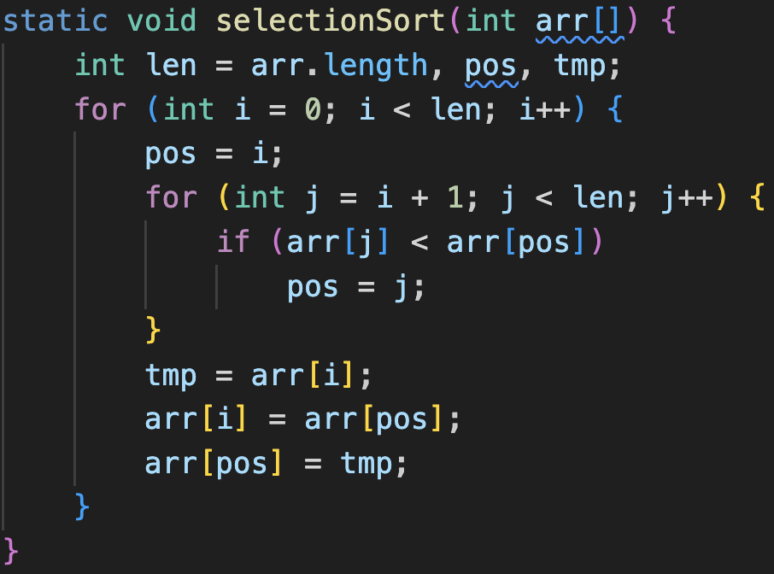
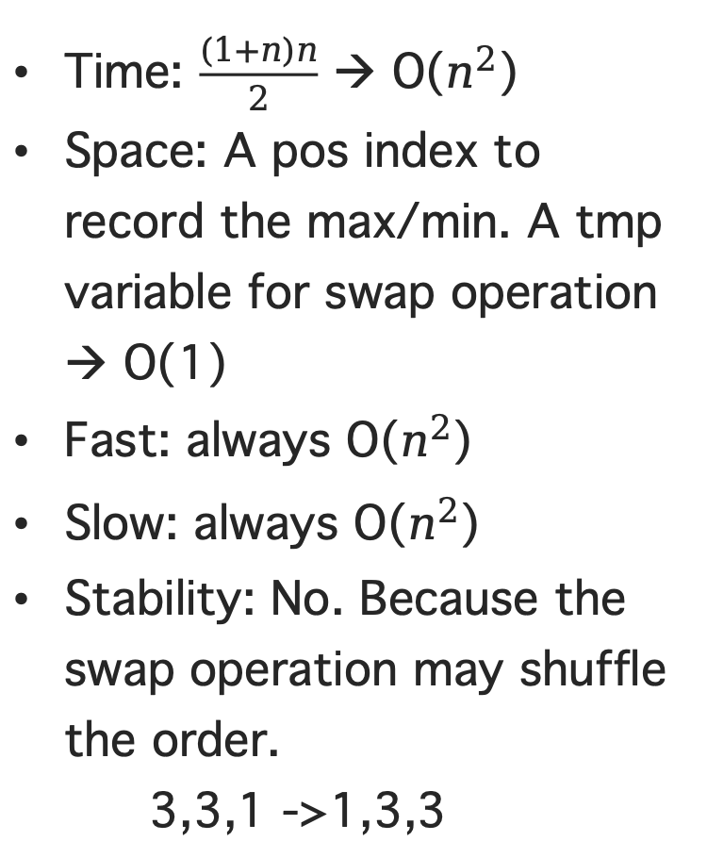
Selection Sort
Time: $\frac{(1+n)n}{2}$ → O($n^{2}$)
Space: A pos index to record the max/min. A tmp variable for swap operation → O(1)
Fast: always O($n^{2}$)
Slow: always O($n^{2}$)
Stability: No. Because the swap operation may shuffle the order.
3,3,1 ->1,3,3

Slide 9
Insertion Sort
1. Consider the first element of the input sequence as an sorted sequence. Consider the remaining as an unsorted sequence.
2. Scan the unsorted sequence, and insert each element scanned into the appropriate position in the sorted sequence. (If the insert element is equal to one in the ordered sequence, put it after the equal element.)

Slide 10
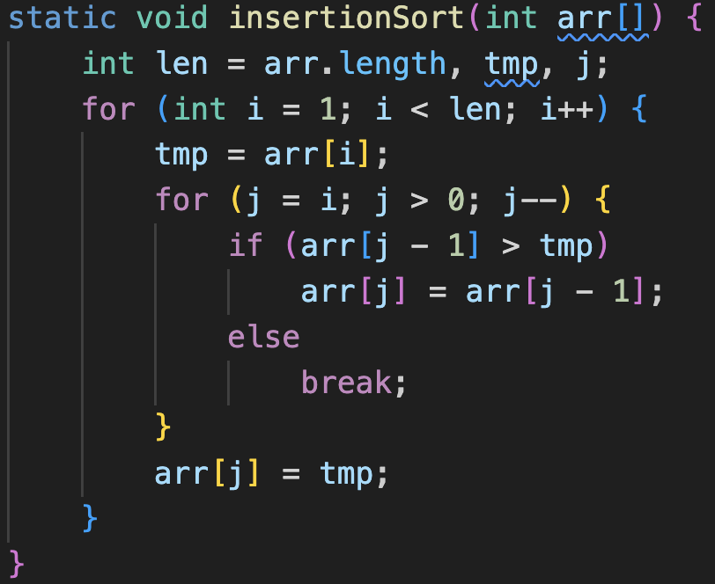
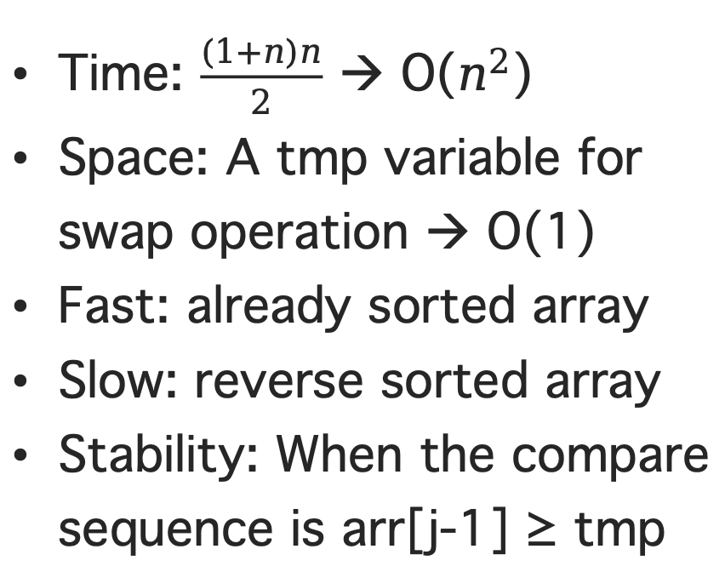
Insertion Sort
Time: $\frac{(1+n)n}{2}$ → O($n^{2}$)
Space: A tmp variable for swap operation → O(1)
Fast: already sorted array
Slow: reverse sorted array
Stability: When the compare sequence is arr[j-1] ≥ tmp

Slide 11
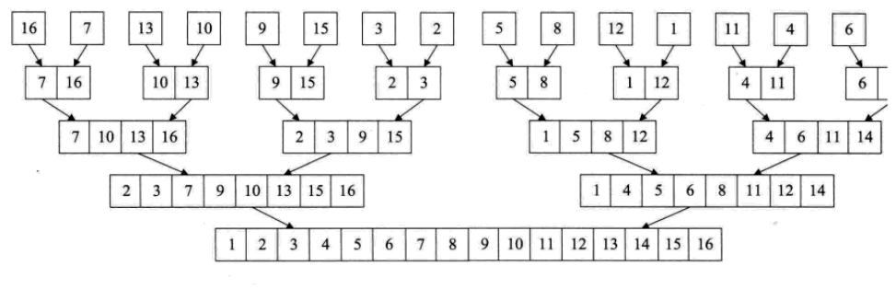
Merge Sort
Notes:
And when it encounters with a right bracket, it will check if the right bracket and the top of the stack is a pair. If yes, then it keeps going

Slide 12
Merge Sort

Slide 13
Merge Sort
Core Idea: Merge two sorted lists into one sorted list.
Request an array whose size is the sum of the two already sorted array, which is used to store the merged sequence;
Set two pointers whose initial positions are the starting positions of each of the two already sorted array;
Compare the elements pointed by the two pointers, select the smaller element to be put into the new array, and move the pointer to the next position;
Repeat step 3 until a pointer reaches the end of the array;
Copy all the remaining elements of the other array to the end of the new array.

Slide 14
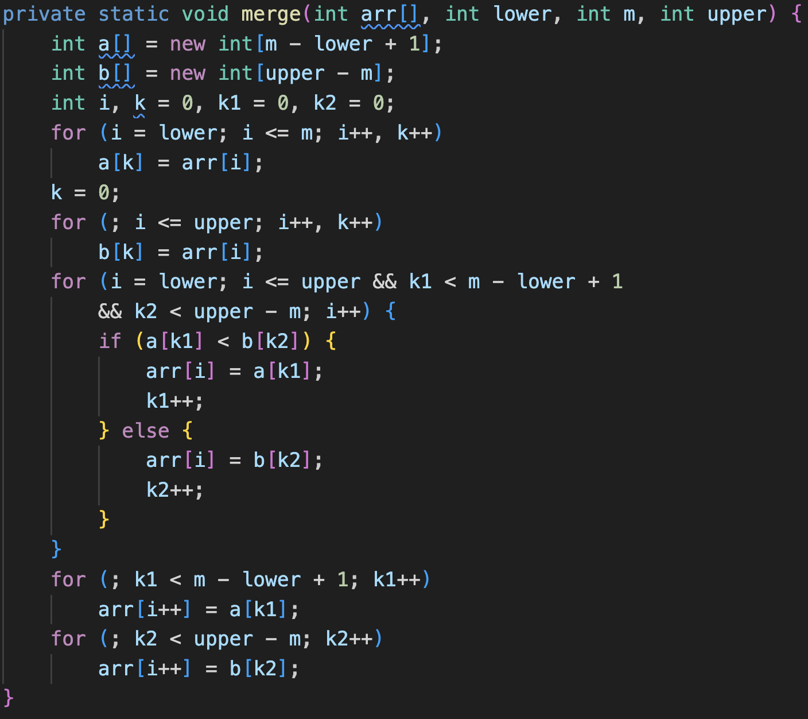
Merge
Each merge:
Time: iterate arrays → O(n)
Space: Auxiliary array → O(n)

Slide 15
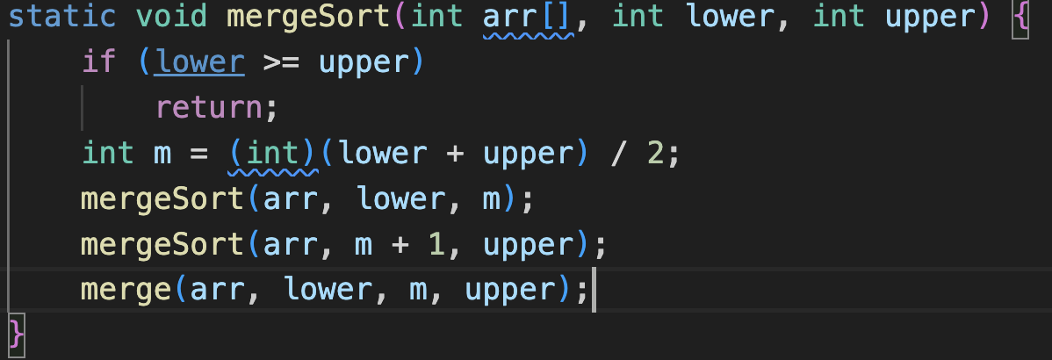
Merge Sort – Recursive implementation
Question:
Does it perform well?
Heavy overhead:
Cost much stack space

Slide 16
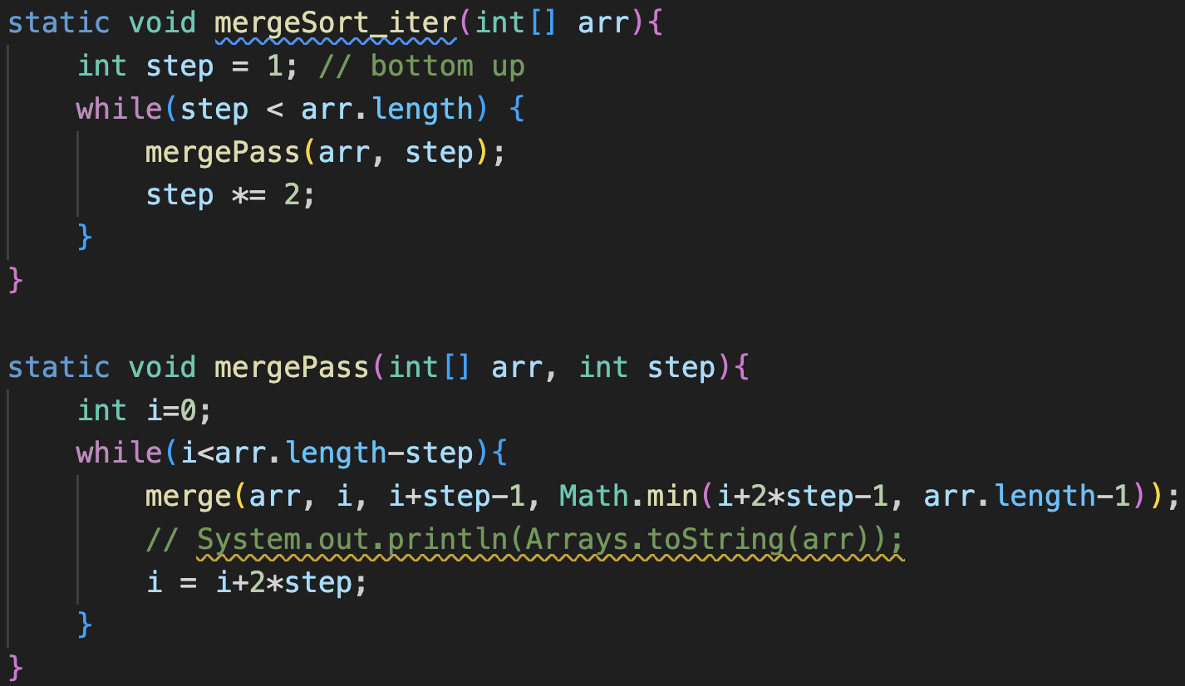
Merge Sort – Iterative implementation
It doesn’t speedup much but is more memory efficient.
Merge sort is stable.

Slide 17
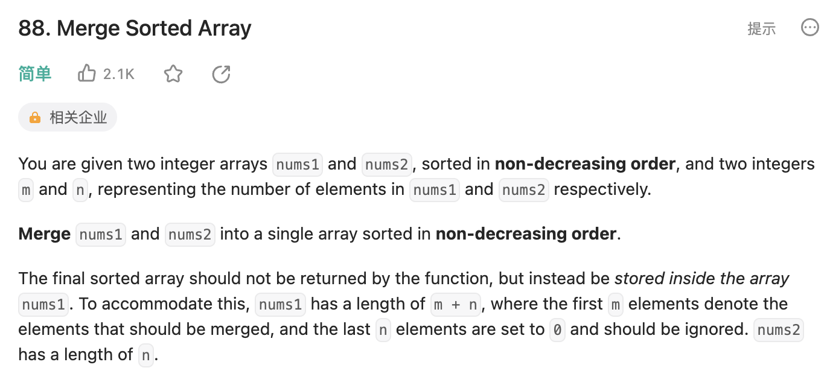
Coding Practice (In-class)
In Chinese:
https://leetcode.cn/problems/merge-sorted-array/description/
In English:
https://leetcode.com/problems/merge-sorted-array/
Implement the MERGE process we mentioned by yourself (Both iterative and recursive is OK)

Slide 18
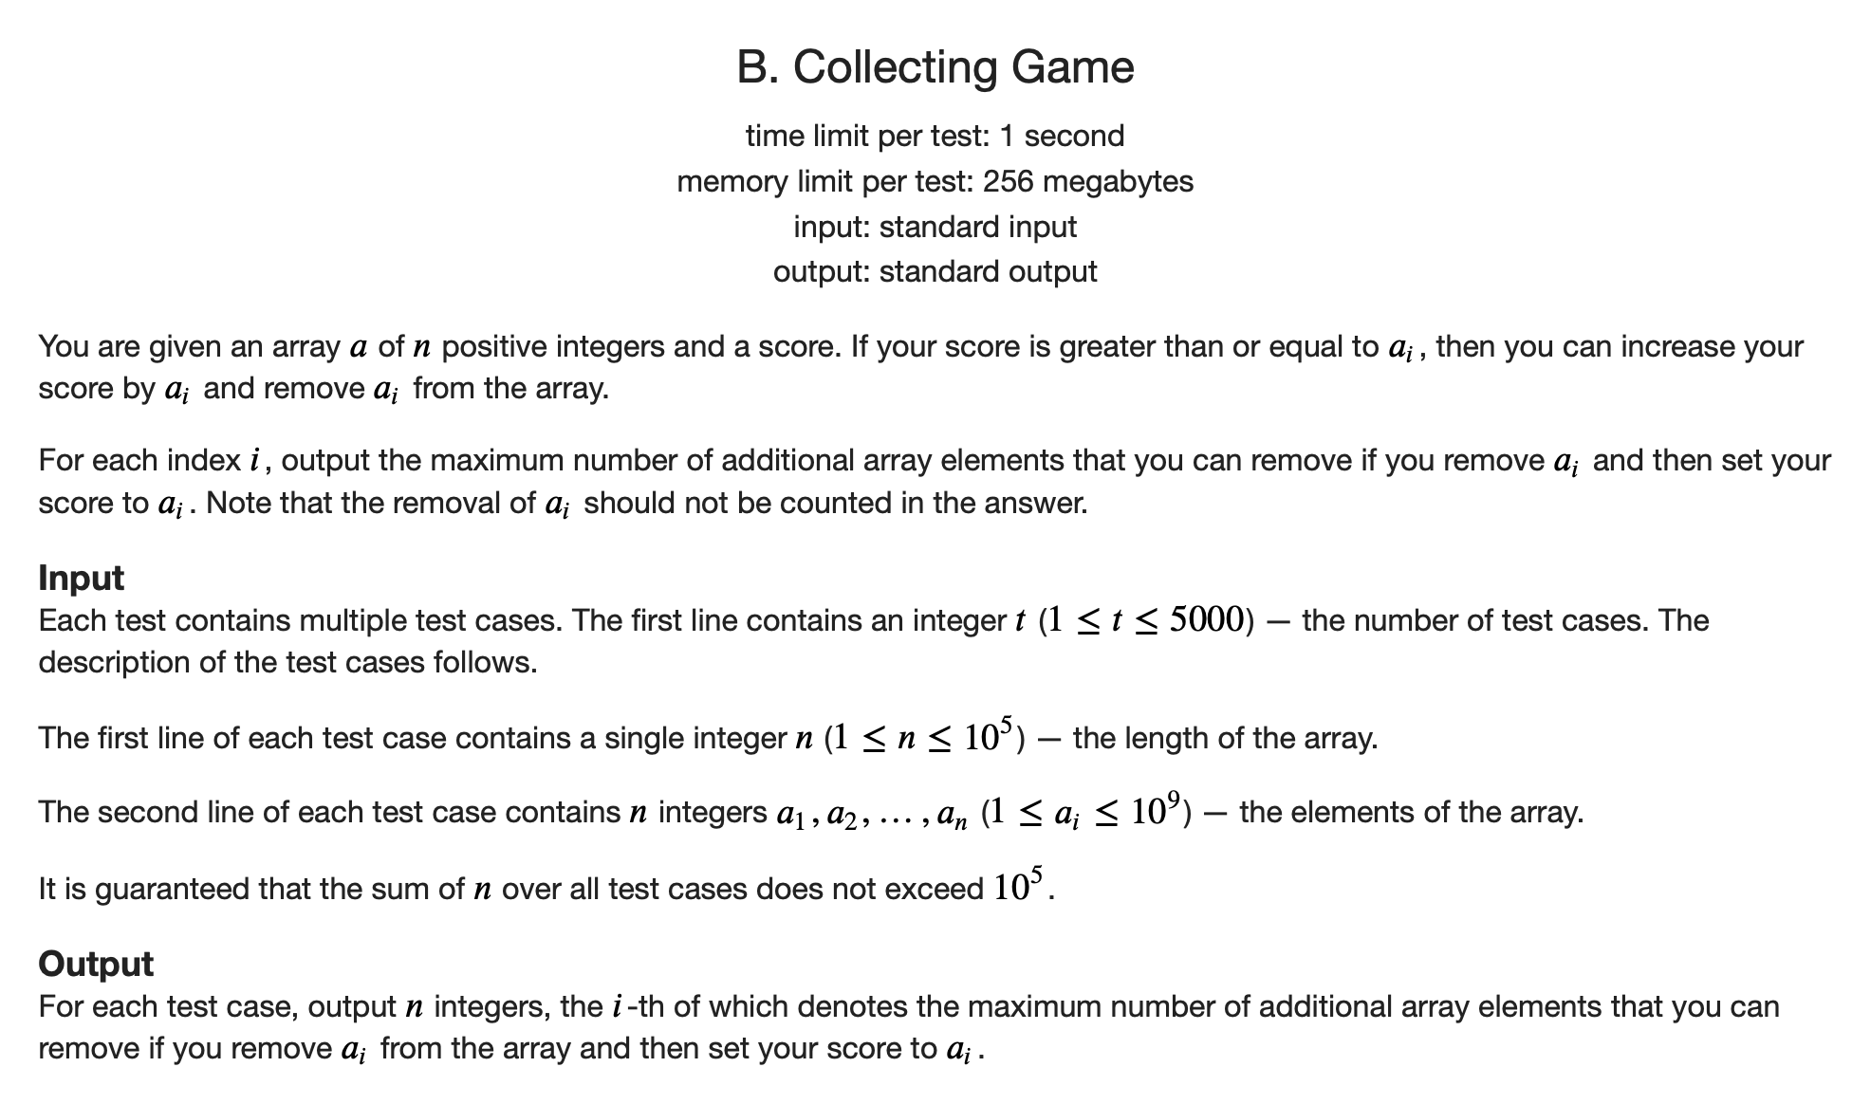
Coding Practice (takehome)
The submission link and the tutorial of this problem could be found here:
https://codeforces.com/problemset/problem/1904/B

Slide 19
Acknowledgement: Thanks Yige Jiang for providing the tutorial materials.

