Slide 1
Chapter 10 Virtual Memory (2)

Slide 2
What Happens if There is no Free Frame?
Used up by process pages
Also on demand from the kernel, I/O buffers, etc
How much to allocate to each?
Page replacement – find some page in memory, but not really in use, page it out
Algorithm – terminate? swap out? replace the page?
Performance – want an algorithm which will result in minimum number of page faults
Same page may be brought into memory several times

Slide 3
Page Replacement
Prevent over-allocation of memory by modifying page-fault service routine to include page replacement
Use modify (dirty) bit to reduce overhead of page transfers – only modified pages are written to disk
Page replacement completes separation between logical memory and physical memory – large virtual memory can be provided on a smaller physical memory

Slide 4
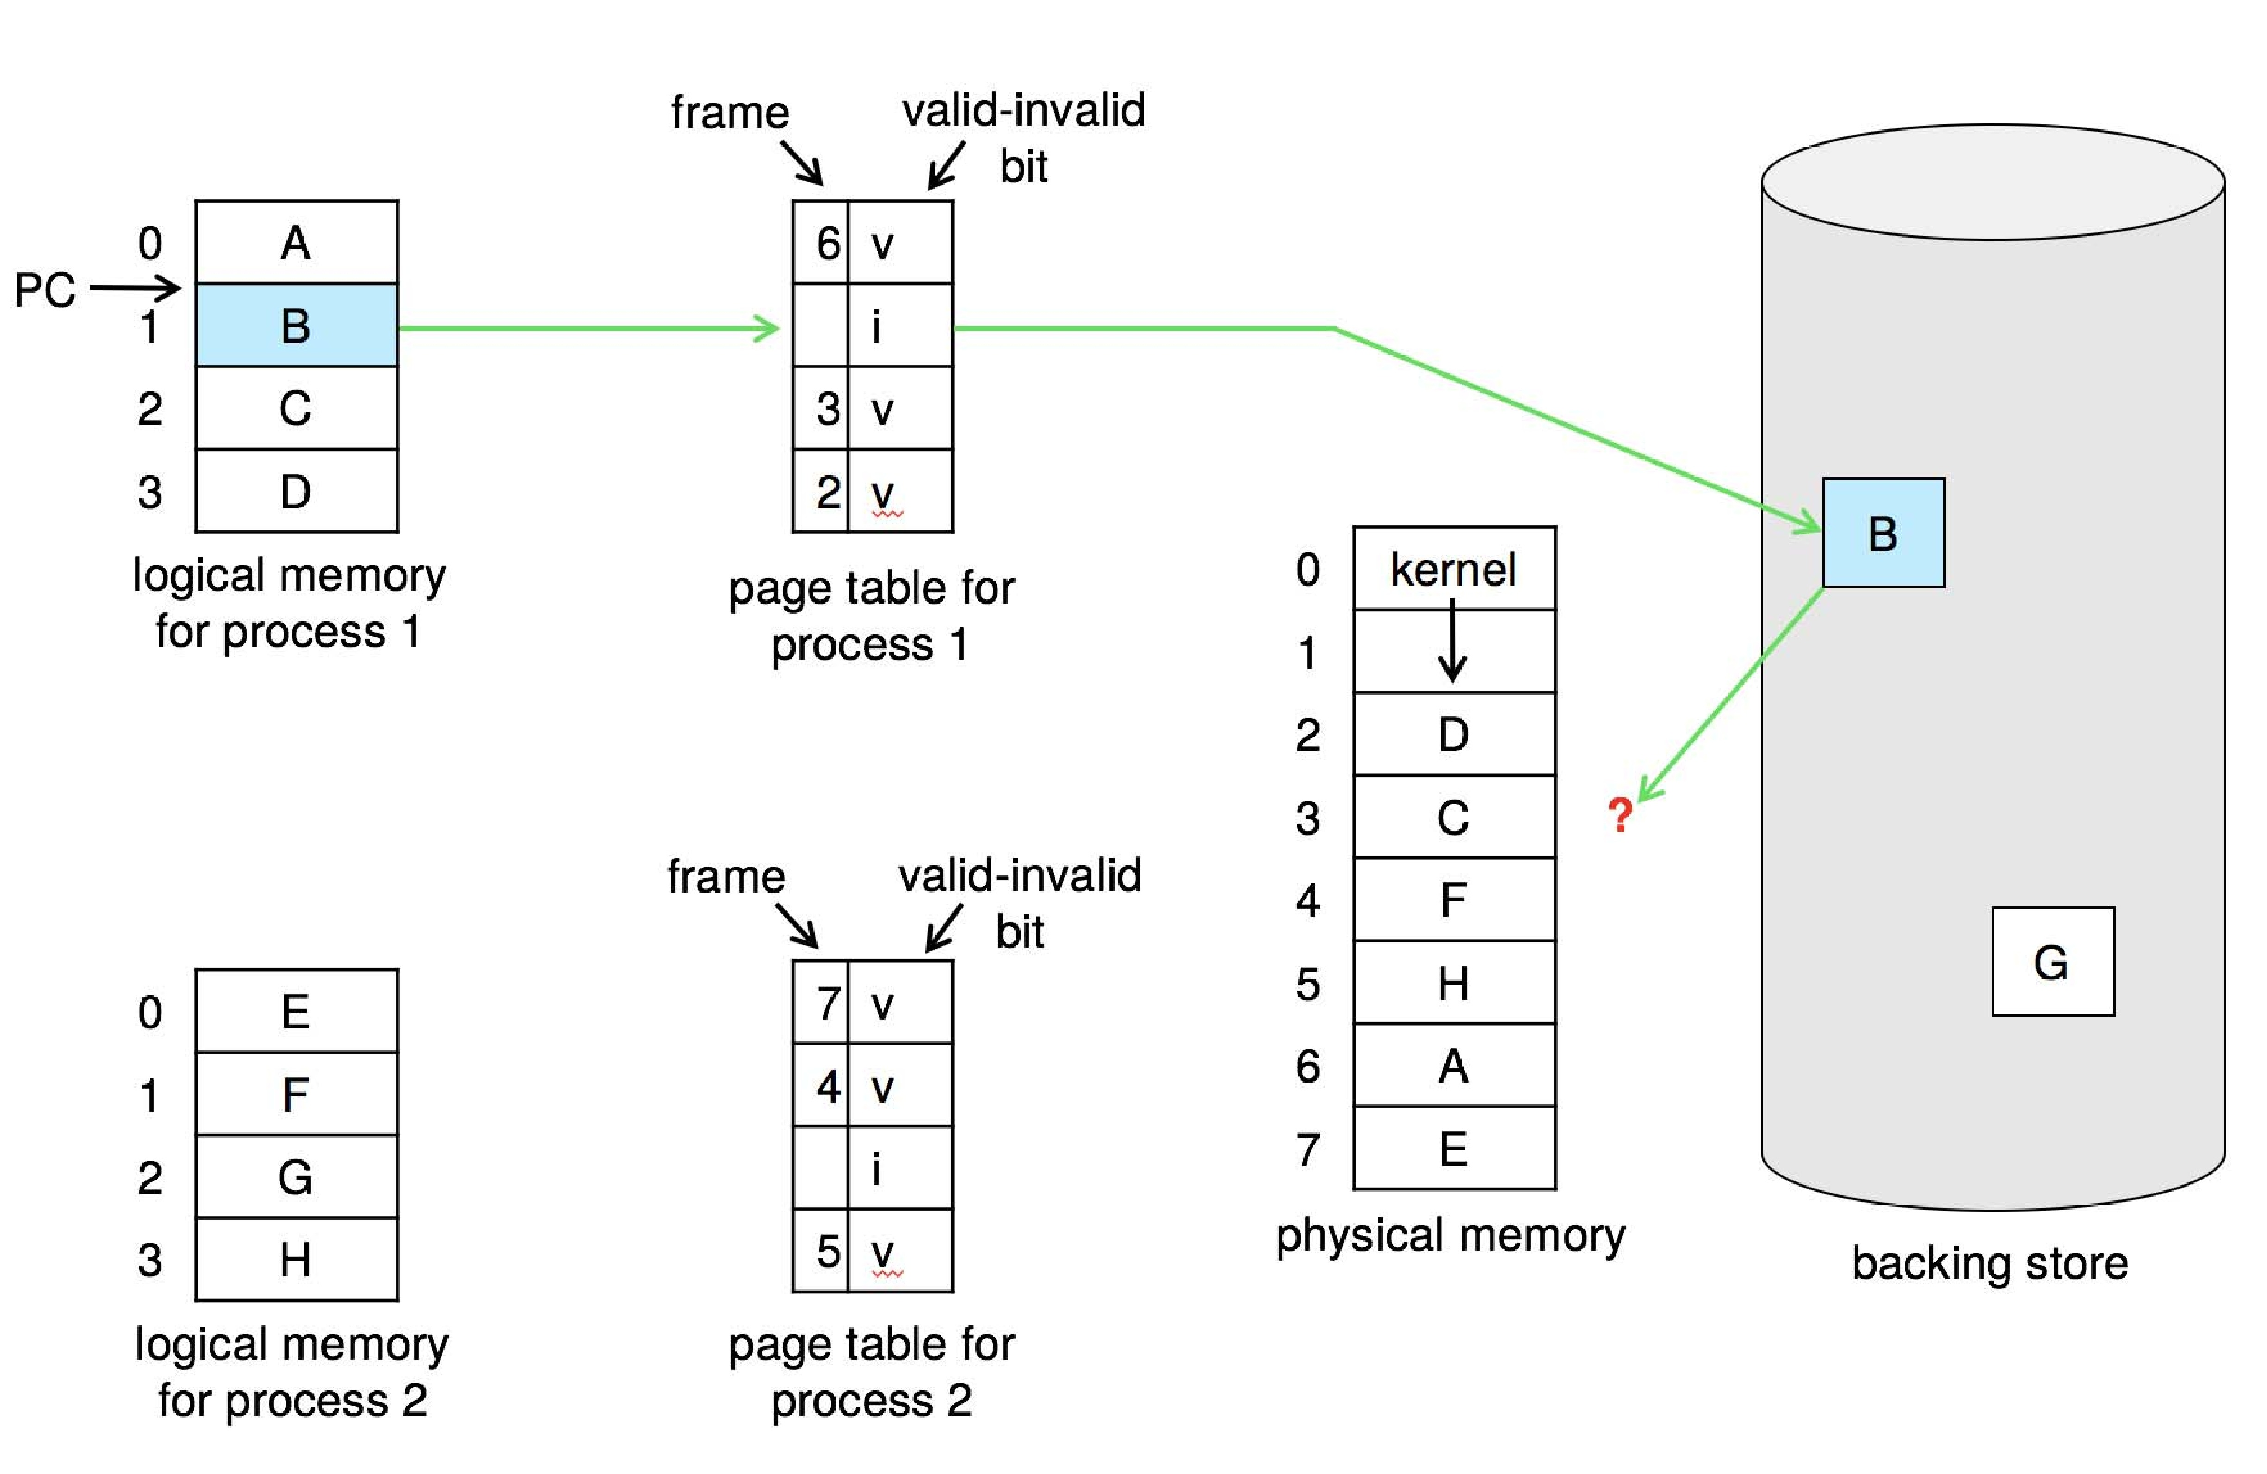
Need For Page Replacement

Slide 5
Basic Page Replacement
1. Find the location of the desired page on disk
2. Find a free frame - If there is a free frame, use it - If there has no free frame, use a page replacement
algorithm to select a victim frame - Write victim frame to disk if dirty
3. Bring the desired page into the (newly) free frame; update the page and frame tables
4. Continue the process by restarting the instruction that caused the trap
Note now potentially 2 pages transfer for page fault – increasing EAT

Slide 6
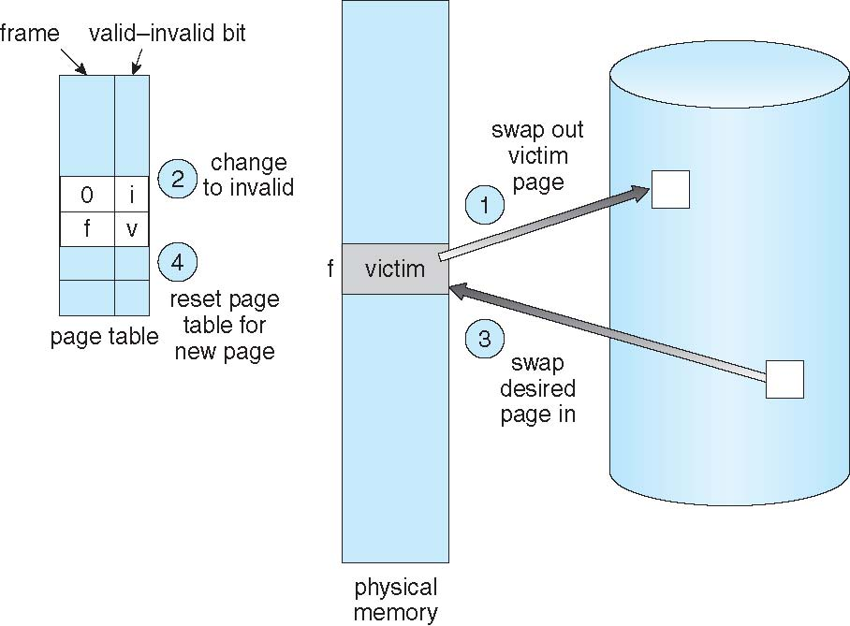
Page Replacement

Slide 7
Page and Frame Replacement Algorithms
Frame-allocation algorithm determines
How many frames to give each process
Which frames to replace
Page-replacement algorithm
Want lowest page-fault rate on both first access and re-access
Evaluate algorithm by running it on a particular string of memory references (reference string) and computing the number of page faults on that string
String is just page numbers, not full addresses
Repeated access to the same page does not cause a page fault
Results depend on number of frames available
In all our examples, the reference string of referenced page numbers is
7,0,1,2,0,3,0,4,2,3,0,3,0,3,2,1,2,0,1,7,0,1

Slide 8
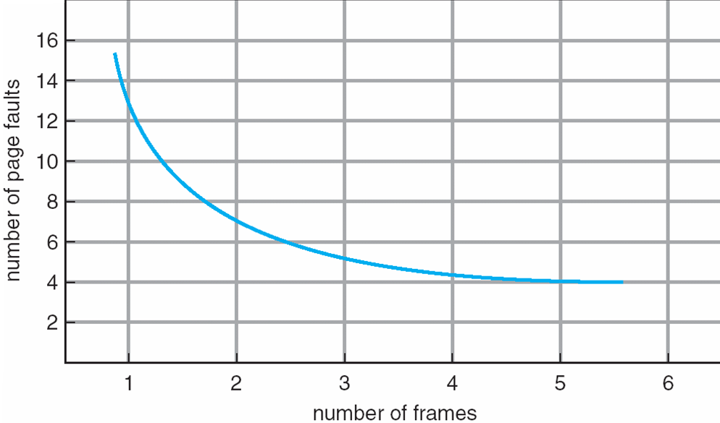
Page Faults Versus the Number of Frames

Slide 9
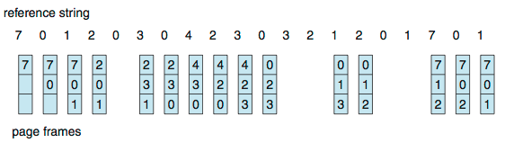
First-In-First-Out (FIFO) Algorithm
Reference string: 7,0,1,2,0,3,0,4,2,3,0,3,0,3,2,1,2,0,1,7,0,1
3 frames (3 pages can be in memory at a time per process)
Can vary by reference string: consider 1,2,3,4,1,2,5,1,2,3,4,5
Adding more frames can cause more page faults!
Belady’s Anomaly
How to track ages of pages?
Just use a FIFO queue
15 page faults

Slide 10
FIFO Illustrating Belady’s Anomaly

Slide 11
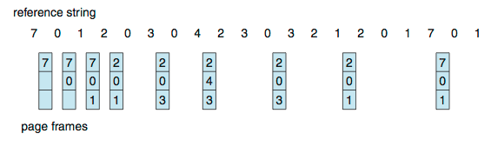
Optimal Algorithm
Replace page that will not be used for longest period of time
9 is optimal for the example
How do you know this?
Can’t read the future
Used for measuring how well your algorithm performs

Slide 12
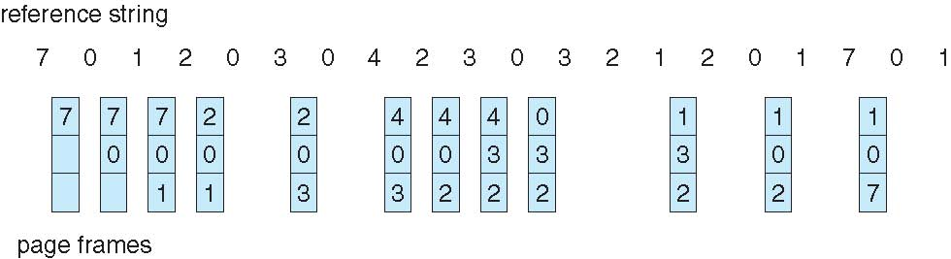
Least Recently Used (LRU) Algorithm (1)
Use past knowledge rather than future
Replace page that has not been used in the most amount of time
Associate time of last use with each page
12 faults – better than FIFO but worse than OPT
Generally good algorithm and frequently used
But how to implement?
Time 1 2 3 4 5 6 7 8 9 10 11 12 13 14 15 16 17 18 19 20

Slide 13
Least Recently Used (LRU) Algorithm (2)
Counter implementation
Every page entry has a counter; every time page is referenced through this entry, copy the clock into the counter
When a page needs to be changed, look at the counters to find smallest value
Search through table needed
Stack implementation
Keep a stack of page numbers in a double link form:
Page referenced:
move it to the top
requires 6 pointers to be changed
But each update more expensive
No search for replacement

Slide 14
Least Recently Used (LRU) Algorithm (3)
LRU and OPT are cases of stack algorithms that don’t have Belady’s Anomaly
Use of a stack to record most recent page references
Reference string
Stack before a
Stack after b

Slide 15
LRU Approximation Algorithms (1)
LRU needs special hardware and still slow
Reference bit
With each page associate a bit, initially = 0
When page is referenced bit set to 1
Replace any with reference bit = 0 (if one exists)
We do not know the order, however

Slide 16
LRU Approximation Algorithms (2)
Second-chance algorithm
Generally FIFO, plus hardware-provided reference bit
Clock replacement
If page to be replaced has
Reference bit = 0 -> replace it
Reference bit = 1 then:
Set reference bit 0, leave page in memory
Replace next page, subject to same rules

Slide 17
Second-Chance Algorithm

Slide 18
Enhanced Second-Chance Algorithm
Improve algorithm by using reference bit and modify bit (if available) in concert
Take ordered pair (reference, modify):
(0, 0) neither recently used not modified – best page to replace
(0, 1) not recently used but modified – not quite as good, must write out before replacement
(1, 0) recently used but clean – probably will be used again soon
(1, 1) recently used and modified – probably will be used again soon and need to write out before replacement
When page replacement called for, use the clock scheme but use the four classes replace page in lowest non-empty class
Might need to search circular queue several times

Slide 19
Counting Algorithms
Keep a counter of the number of references that have been made to each page
Not common
Lease Frequently Used (LFU) Algorithm
Replaces page with smallest count
Most Frequently Used (MFU) Algorithm
Based on the argument that the page with the smallest count was probably just brought in and has yet to be used

Slide 20
Page-Buffering Algorithms
Keep a pool of free frames, always
Then frame available when needed, not found at fault time
Read page into free frame and select victim to evict and add to free pool
When convenient, evict victim
Possibly, keep list of modified pages
When backing store otherwise idle, write pages there and set to non-dirty
Possibly, keep free frame contents intact and note what is in them
If referenced again before reused, no need to load contents again from disk
Generally useful to reduce penalty if wrong victim frame selected

Slide 21
Applications and Page Replacement
All of these algorithms have OS guessing about future page access
Some applications have better knowledge – i.e. databases
Memory intensive applications can cause double buffering
OS keeps copy of page in memory as I/O buffer
Application keeps page in memory for its own work
Operating system can given direct access to the disk, getting out of the way of the applications
Raw disk mode
Bypasses buffering, locking, etc.

Slide 22
Allocation of Frames
Each process needs minimum number of frames
Example: IBM 370 – 6 pages to handle SS MOVE instruction:
instruction is 6 bytes, might span 2 pages
2 pages to handle from
2 pages to handle to
Maximum of course is total frames in the system
Two major allocation schemes
fixed allocation
priority allocation
Many variations

Slide 23
Fixed Allocation
Equal allocation – For example, if there are 100 frames (after allocating frames for the OS) and 5 processes, give each process 20 frames
Keep some as free frame buffer pool
Proportional allocation – Allocate according to the size of process
Dynamic as degree of multiprogramming, process sizes change

Slide 24
Global vs. Local Allocation
Global replacement – process selects a replacement frame from the set of all frames; one process can take a frame from another
But then process execution time can vary greatly
But greater throughput so more common
Local replacement – each process selects from only its own set of allocated frames
More consistent per-process performance
But possibly underutilized memory

Slide 25
Reclaiming Pages
A strategy to implement global page-replacement policy
All memory requests are satisfied from the free-frame list, rather than waiting for the list to drop to zero before we begin selecting pages for replacement,
Page replacement is triggered when the list falls below a certain threshold.
This strategy attempts to ensure there is always sufficient free memory to satisfy new requests.

Slide 26
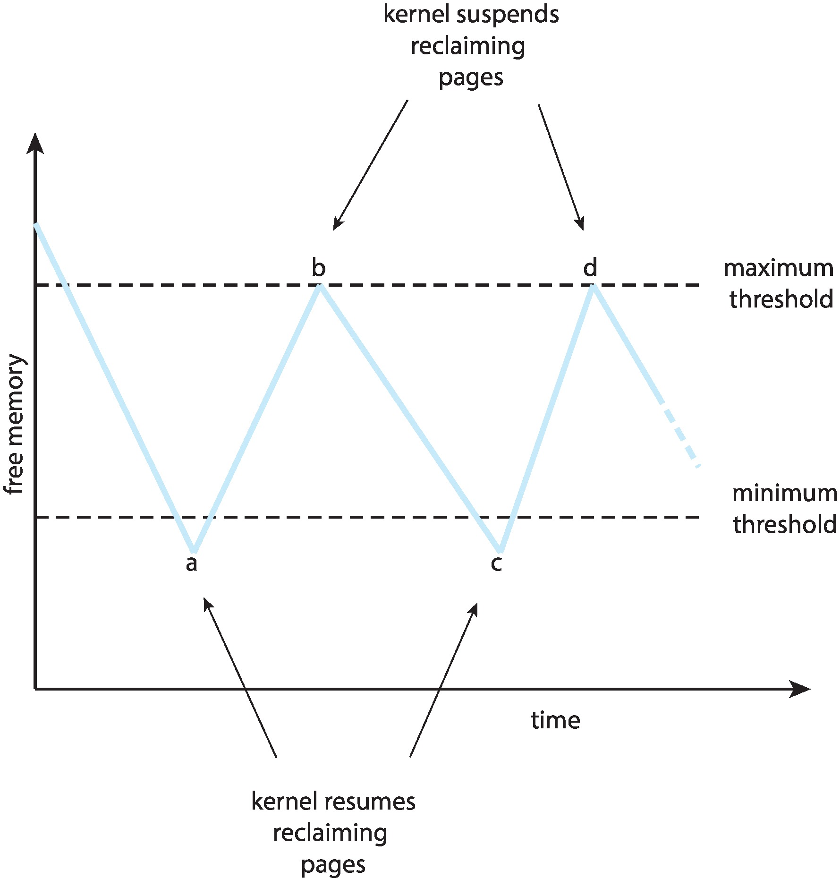
Reclaiming Pages Example

Slide 27
Take a Break

