Slide 1
Chapter 10 Virtual Memory (3)

Slide 2
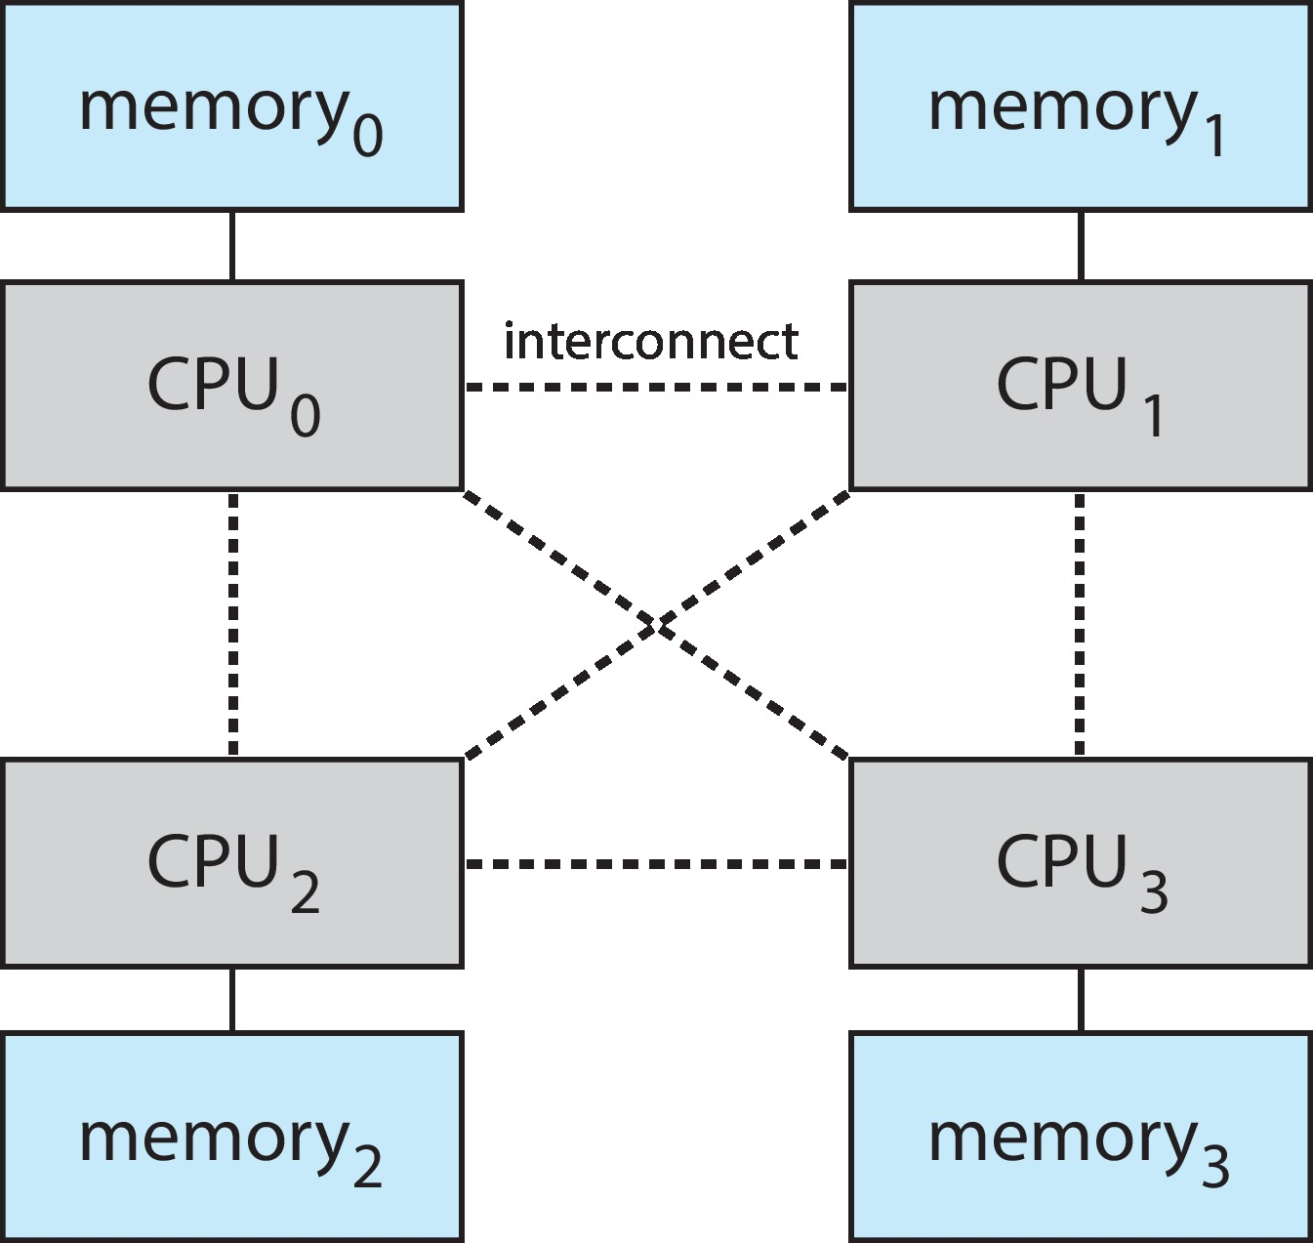
Non-Uniform Memory Access (1)
So far, we assumed that all memory accessed equally
Many systems are NUMA – speed of access to memory varies
Consider system boards containing CPUs and memory, interconnected over a system bus
NUMA multiprocessing architecture

Slide 3
Non-Uniform Memory Access (2)
Optimal performance comes from allocating memory “close to” the CPU on which the thread is scheduled
And modifying the scheduler to schedule the thread on the same system board when possible
Solved by Solaris by creating lgroups
Structure to track CPU / Memory low latency groups
Used my schedule and pager
When possible schedule all threads of a process and allocate all memory for that process within the lgroup

Slide 4
Thrashing (1)
If a process does not have “enough” pages, the page-fault rate is very high
Page fault to get page
Replace existing frame
But quickly need replaced frame back
This leads to
Low CPU utilization
Operating system thinking that it needs to increase the degree of multiprogramming
Another process added to the system

Slide 5
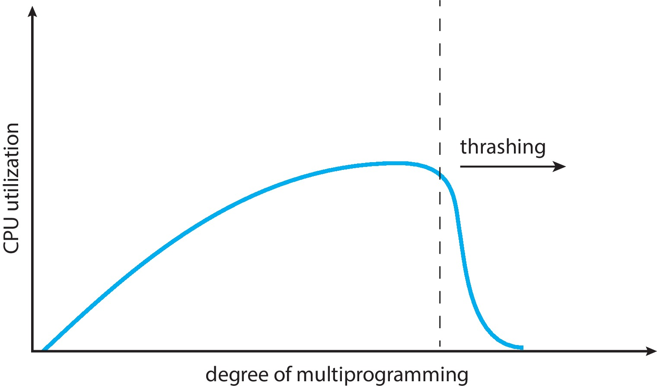
Thrashing (2)
Thrashing. A process is busy swapping pages in and out

Slide 6
Demand Paging and Thrashing
Why does demand paging work?
Locality model
Process migrates from one locality to another
Localities may overlap
Why does thrashing occur?
Σ size of locality > total memory size
Limit effects by using local or priority page replacement

Slide 7
Locality In Memory-Reference Pattern

Slide 8
Working-Set Model (1)
Δ ≡ working-set window ≡ a fixed number of page references Example: 10,000 instructions
WSS_{i} (working set of Process P_{i}) = total number of pages referenced in the most recent Δ (varies in time)
if Δ too small will not encompass entire locality
if Δ too large will encompass several localities
if Δ = ∞ ⇒ will encompass entire program
D = Σ WSS_{i} ≡ total demand frames
Approximation of locality

Slide 9
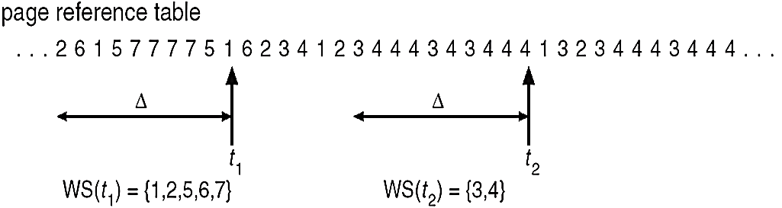
Working-Set Model (2)
if D > m ⇒ Thrashing
Policy if D > m, then suspend or swap out one of the processes

Slide 10
Keeping Track of the Working Set
Approximate with interval timer + a reference bit
Example: Δ = 10,000
Timer interrupts after every 5000 time units
Keep in memory 2 bits for each page
Whenever a timer interrupts copy and sets the values of all reference bits to 0
If one of the bits in memory = 1 ⇒ page in working set
Why is this not completely accurate?
Improvement = 10 bits and interrupt every 1000 time units

Slide 11
Page-Fault Frequency
More direct approach than working set model
Establish “acceptable” page-fault frequency (PFF) rate and use local replacement policy
If actual rate too low, process loses frame
If actual rate too high, process gains frame

Slide 12
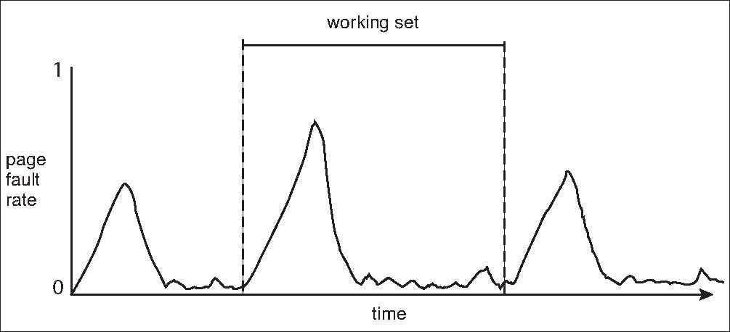
Working Sets and Page Fault Rates
Direct relationship between working set of a process and its page-fault rate
Working set changes over time
Peaks and valleys over time

Slide 13
Allocating Kernel Memory
Treated differently from user memory
Often allocated from a free-memory pool
Kernel requests memory for structures of varying sizes
Some kernel memory needs to be contiguous
i.e., for device I/O

Slide 14
Buddy System
Allocates memory from fixed-size segment consisting of physically-contiguous pages
Memory allocated using power-of-2 allocator
Satisfies requests in units sized as power of 2
Request rounded up to next highest power of 2
When smaller allocation needed than is available, current chunk split into two buddies of next-lower power of 2
Continue until appropriate sized chunk available
For example, assume 256KB chunk available, kernel requests 21KB
Split into A_{L} _{and} A_{R} of 128KB each
One further divided into B_{L} and B_{R} of 64KB
One further into C_{L} and C_{R} of 32KB each – one used to satisfy request
Advantage – quickly coalesce unused chunks into larger chunk
Disadvantage - fragmentation

Slide 15
Buddy System Allocator

Slide 16
Slab Allocator (1)
Alternate strategy
Slab is one or more physically contiguous pages
Cache consists of one or more slabs
Single cache for each unique kernel data structure
Each cache filled with objects – instantiations of the data structure
When cache created, filled with objects marked as free
When structures stored, objects marked as used
If slab is full of used objects, next object allocated from empty slab
If no empty slabs, new slab allocated
Benefits include no fragmentation, fast memory request satisfaction

Slide 17
Slab Allocation (2)

Slide 18
Slab Allocator in Linux (1)
For example process descriptor is of type struct task_struct
Approx 1.7KB of memory
New task -> allocate new struct from cache
Will use existing free struct task_struct
Slab can be in three possible states
Full – all used
Empty – all free
Partial – mix of free and used
Upon request, slab allocator
Uses free struct in partial slab
If none, takes one from empty slab
If no empty slab, create new empty

Slide 19
Slab Allocator in Linux (2)
Slab started in Solaris, now wide-spread for both kernel mode and user memory in various OSes
Linux 2.2 had SLAB, now has both SLOB and SLUB allocators
SLOB for systems with limited memory
Simple List of Blocks – maintains 3 list objects for small, medium, large objects
SLUB is performance-optimized SLAB removes per-CPU queues, metadata stored in page structure

Slide 20
Other Considerations
Prepaging
Page size
TLB reach
Inverted page table
Program structure
I/O interlock and page locking

Slide 21
Prepaging
To reduce the large number of page faults that occurs at process startup
Prepage all or some of the pages a process will need, before they are referenced
But if prepaged pages are unused, I/O and memory was wasted
Assume s pages are prepaged and α of the pages is used
Is cost of s * α save pages faults > or < than the cost of prepaging s * (1- α) unnecessary pages?
α near zero ⇒ prepaging loses

Slide 22
Page Size
Sometimes OS designers have a choice
Especially if running on custom-built CPU
Page size selection must take into consideration
Fragmentation
Page table size
Resolution
I/O overhead
Number of page faults
Locality
TLB size and effectiveness
Always power of 2, usually in the range 2¹² (4,096 bytes) to 2²² (4,194,304 bytes)
On average, growing over time

Slide 23
TLB Reach
TLB Reach - The amount of memory accessible from the TLB
TLB Reach = (TLB Size) X (Page Size)
Ideally, the working set of each process is stored in the TLB
Otherwise there is a high degree of page faults
Increase the Page Size
This may lead to an increase in fragmentation as not all applications require a large page size
Provide Multiple Page Sizes
This allows applications that require larger page sizes the opportunity to use them without an increase in fragmentation

Slide 24
Program Structure
Program structure
int[128,128] data;
Each row is stored in one page
Program 1
for (j = 0; j <128; j++) for (i = 0; i < 128; i++) data[i,j] = 0;
128 x 128 = 16,384 page faults
Program 2
for (i = 0; i < 128; i++) for (j = 0; j < 128; j++) data[i,j] = 0;
128 page faults

Slide 25
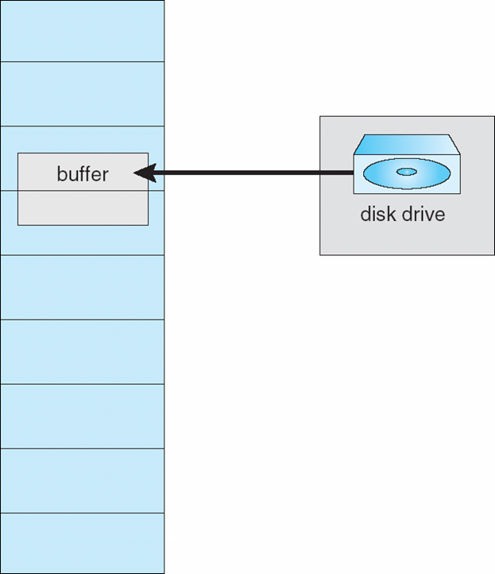
I/O Interlock
I/O Interlock – Pages must sometimes be locked into memory
Consider I/O - Pages that are used for copying a file from a device must be locked from being selected for eviction by a page replacement algorithm
Pinning of pages to lock into memory

Slide 26
Operating System Examples - Windows
Uses demand paging with clustering. Clustering brings in pages surrounding the faulting page
Processes are assigned working set minimum and working set maximum
Working set minimum is the minimum number of pages the process is guaranteed to have in memory
A process may be assigned as many pages up to its working set maximum
When the amount of free memory in the system falls below a threshold, automatic working set trimming is performed to restore the amount of free memory
Working set trimming removes pages from processes that have pages in excess of their working set minimum

Slide 27
Operating System Examples - Solaris
Maintains a list of free pages to assign faulting processes
Lotsfree – threshold parameter (amount of free memory) to begin paging
Desfree – threshold parameter to increasing paging
Minfree – threshold parameter to being swapping
Paging is performed by pageout process
Pageout scans pages using modified clock algorithm
Scanrate is the rate at which pages are scanned. This ranges from slowscan to fastscan
Pageout is called more frequently depending upon the amount of free memory available
Priority paging gives priority to process code pages

Slide 28
Solaris 2 Page Scanner

Slide 29
End of Chapter 10

