Slide 1
Chapter 3 : Processes (2)

Slide 2
What about Filling all the Buffers?
Suppose that we wanted to provide a solution to the consumer-producer problem that fills all the buffers.
We can do so by having an integer counter that keeps track of the number of full buffers.
Initially, counter is set to 0.
The integer counter is incremented by the producer after it produces a new buffer.
The integer counter is and is decremented by the consumer after it consumes a buffer.

Slide 3
Producer
while (true) { /* produce an item in next produced */
while (counter == BUFFER_SIZE)
; /* do nothing */
buffer[in] = next_produced;
in = (in + 1) % BUFFER_SIZE;
counter++;
}

Slide 4
Consumer
while (true) {
while (counter == 0)
; /* do nothing */
next_consumed = buffer[out];
out = (out + 1) % BUFFER_SIZE;
counter--;
/* consume the item in next consumed */
}

Slide 5
Race Condition (1)
counter++ could be implemented as register1 = counter register1 = register1 + 1 counter = register1
counter-- could be implemented as register2 = counter register2 = register2 - 1 counter = register2
Consider this execution interleaving with “count = 5” initially:
S0: producer execute register1 = counter {register1 = 5}
S1: producer execute register1 = register1 + 1 {register1 = 6}
S2: consumer execute register2 = counter {register2 = 5}
S3: consumer execute register2 = register2 – 1 {register2 = 4}
S4: producer execute counter = register1 {counter = 6}
S5: consumer execute counter = register2 {counter = 4}

Slide 6
Race Condition (2)
Question – why was there no race condition in the first solution (where at most N – 1) buffers can be filled?
More in Chapter 6
item next_produced;
while (true) {
/* produce an item in next produced */
while (((in + 1) % BUFFER_SIZE) == out)
; /* do nothing */
buffer[in] = next_produced;
in = (in + 1) % BUFFER_SIZE;
}
item next_consumed;
while (true) { while (in == out)
; /* do nothing */ next_consumed = buffer[out];
out = (out + 1) % BUFFER_SIZE;
/* consume the item in next consumed */
}

Slide 7
IPC – Message Passing (1)
Processes communicate with each other without resorting to shared variables
IPC facility provides two operations:
send(message)
receive(message)
The message size is either fixed or variable

Slide 8
IPC – Message Passing (2)
If processes P and Q wish to communicate, they need to:
Establish a communication link between them
Exchange messages via send/receive
Implementation issues:
How are links established?
Can a link be associated with more than two processes?
How many links can there be between every pair of communicating processes?
What is the capacity of a link?
Is the size of a message that the link can accommodate fixed or variable?
Is a link unidirectional or bi-directional?

Slide 9
Implementation of Communication Link
Physical:
Shared memory
Hardware bus
Network
Logical:
Direct or indirect
Synchronous or asynchronous
Automatic or explicit buffering

Slide 10
Direct Communication
Processes must name each other explicitly:
send (P, message) – send a message to process P
receive(Q, message) – receive a message from process Q
Properties of communication link
Links are established automatically
A link is associated with exactly one pair of communicating processes
Between each pair there exists exactly one link
The link may be unidirectional, but is usually bi-directional

Slide 11
Indirect Communication (1)
Messages are directed and received from mailboxes (also referred to as ports)
Each mailbox has a unique id
Processes can communicate only if they share a mailbox
Properties of communication link
Link established only if processes share a common mailbox
A link may be associated with many processes
Each pair of processes may share several communication links
Link may be unidirectional or bi-directional

Slide 12
Indirect Communication (2)
Operations
Create a new mailbox (port)
Send and receive messages through mailbox
Delete a mailbox
Primitives are defined as:
send(A, message) – send a message to mailbox A
receive(A, message) – receive a message from mailbox A

Slide 13
Indirect Communication (3)
Mailbox sharing
P₁, P₂, and P₃ share mailbox A
P₁, sends; P₂ and P₃ receive
Who gets the message?
Solutions
Allow a link to be associated with at most two processes
Allow only one process at a time to execute a receive operation
Allow the system to select arbitrarily the receiver. Sender is notified who the receiver was.

Slide 14
Synchronization
Message passing may be either blocking or non-blocking
Blocking is considered synchronous
Blocking send -- the sender is blocked until the message is received
Blocking receive -- the receiver is blocked until a message is available
Non-blocking is considered asynchronous
Non-blocking send -- the sender sends the message and continue
Non-blocking receive -- the receiver receives:
A valid message, or
Null message
Different combinations possible
If both send and receive are blocking, we have a rendezvous

Slide 15
Producer-Consumer: Message Passing
Producer
message next_produced; while (true) { /* produce an item in next_produced */
send(next_produced);
}
Consumer
message next_consumed; while (true) { receive(next_consumed) /* consume the item in next_consumed */ }

Slide 16
Buffering
Queue of messages attached to the link.
Implemented in one of three ways
1. Zero capacity – no messages are queued on a link. Sender must wait for receiver (rendezvous)
2. Bounded capacity – finite length of n messages Sender must wait if link full
3. Unbounded capacity – infinite length Sender never waits

Slide 17
Examples of IPC Systems - POSIX
POSIX Shared Memory
Process first creates shared memory segment shm_fd = shm_open(name, O CREAT | O RDWR, 0666);
Also used to open an existing segment
Set the size of the object
ftruncate(shm_fd, 4096);
Use mmap() to memory-map a file pointer to the shared memory object
Reading and writing to shared memory is done by using the pointer returned by mmap().

Slide 18
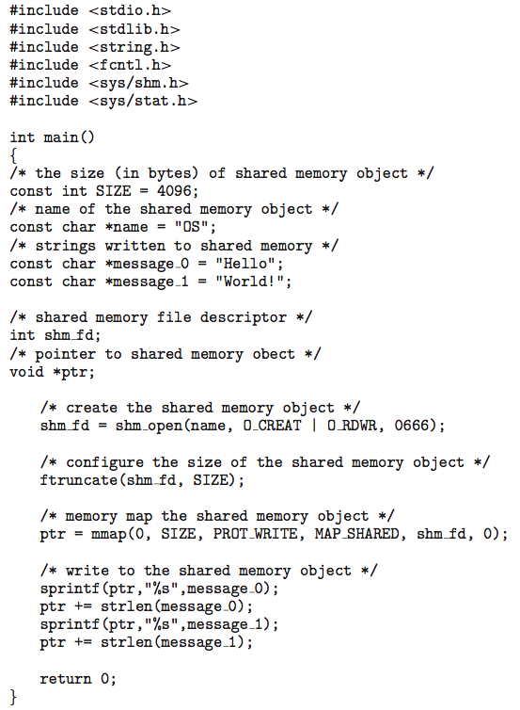
IPC POSIX Producer

Slide 19
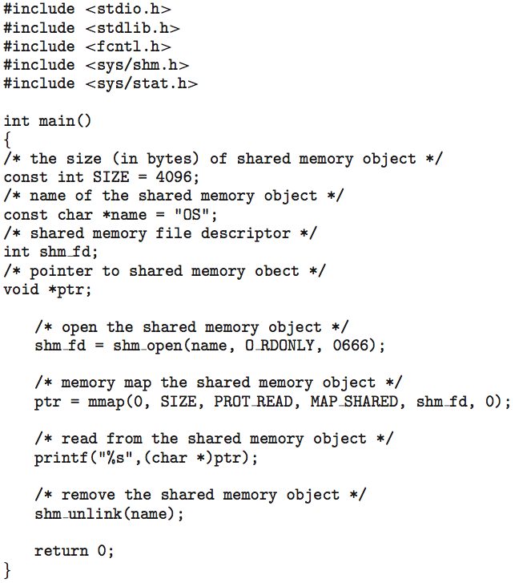
IPC POSIX Consumer

Slide 20
Examples of IPC Systems - Mach
Mach communication is message based
Even system calls are messages
Each task gets two ports at creation - Kernel and Notify
Messages are sent and received using the mach_msg() function
Ports needed for communication, created via
mach_port_allocate()
Send and receive are flexible; for example four options if mailbox full:
Wait indefinitely
Wait at most n milliseconds
Return immediately
Temporarily cache a message

Slide 21
Mach Messages
#include<mach/mach.h>
struct message { mach_msg_header_t header;
int data;
}; mach port t client;
mach port t server;

Slide 22
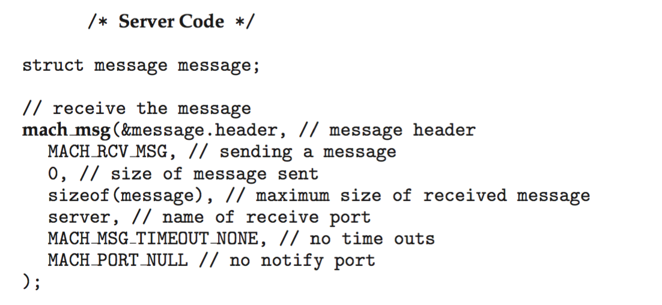
Mach Message Passing - Server

Slide 23
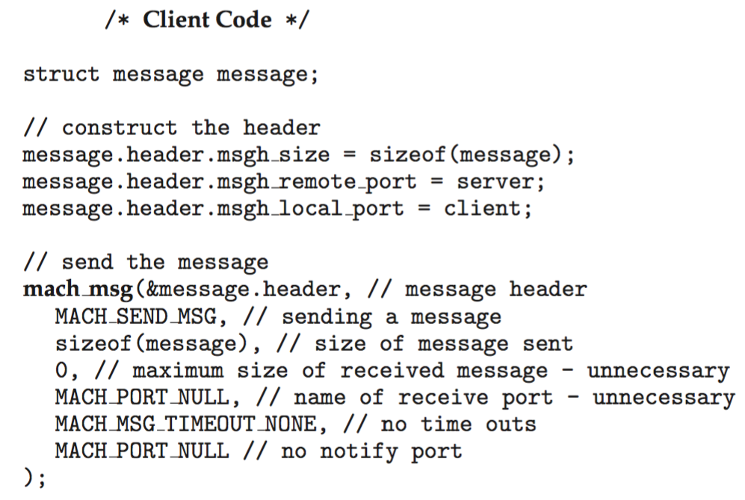
Mach Message Passing - Client

Slide 24
Examples of IPC Systems – Windows
Message-passing centric via advanced local procedure call (LPC) facility
Only works between processes on the same system
Uses ports (like mailboxes) to establish and maintain communication channels
Communication works as follows:
The client opens a handle to the subsystem’s connection port object.
The client sends a connection request.
The server creates two private communication ports and returns the handle to one of them to the client.
The client and server use the corresponding port handle to send messages or callbacks and to listen for replies.

Slide 25
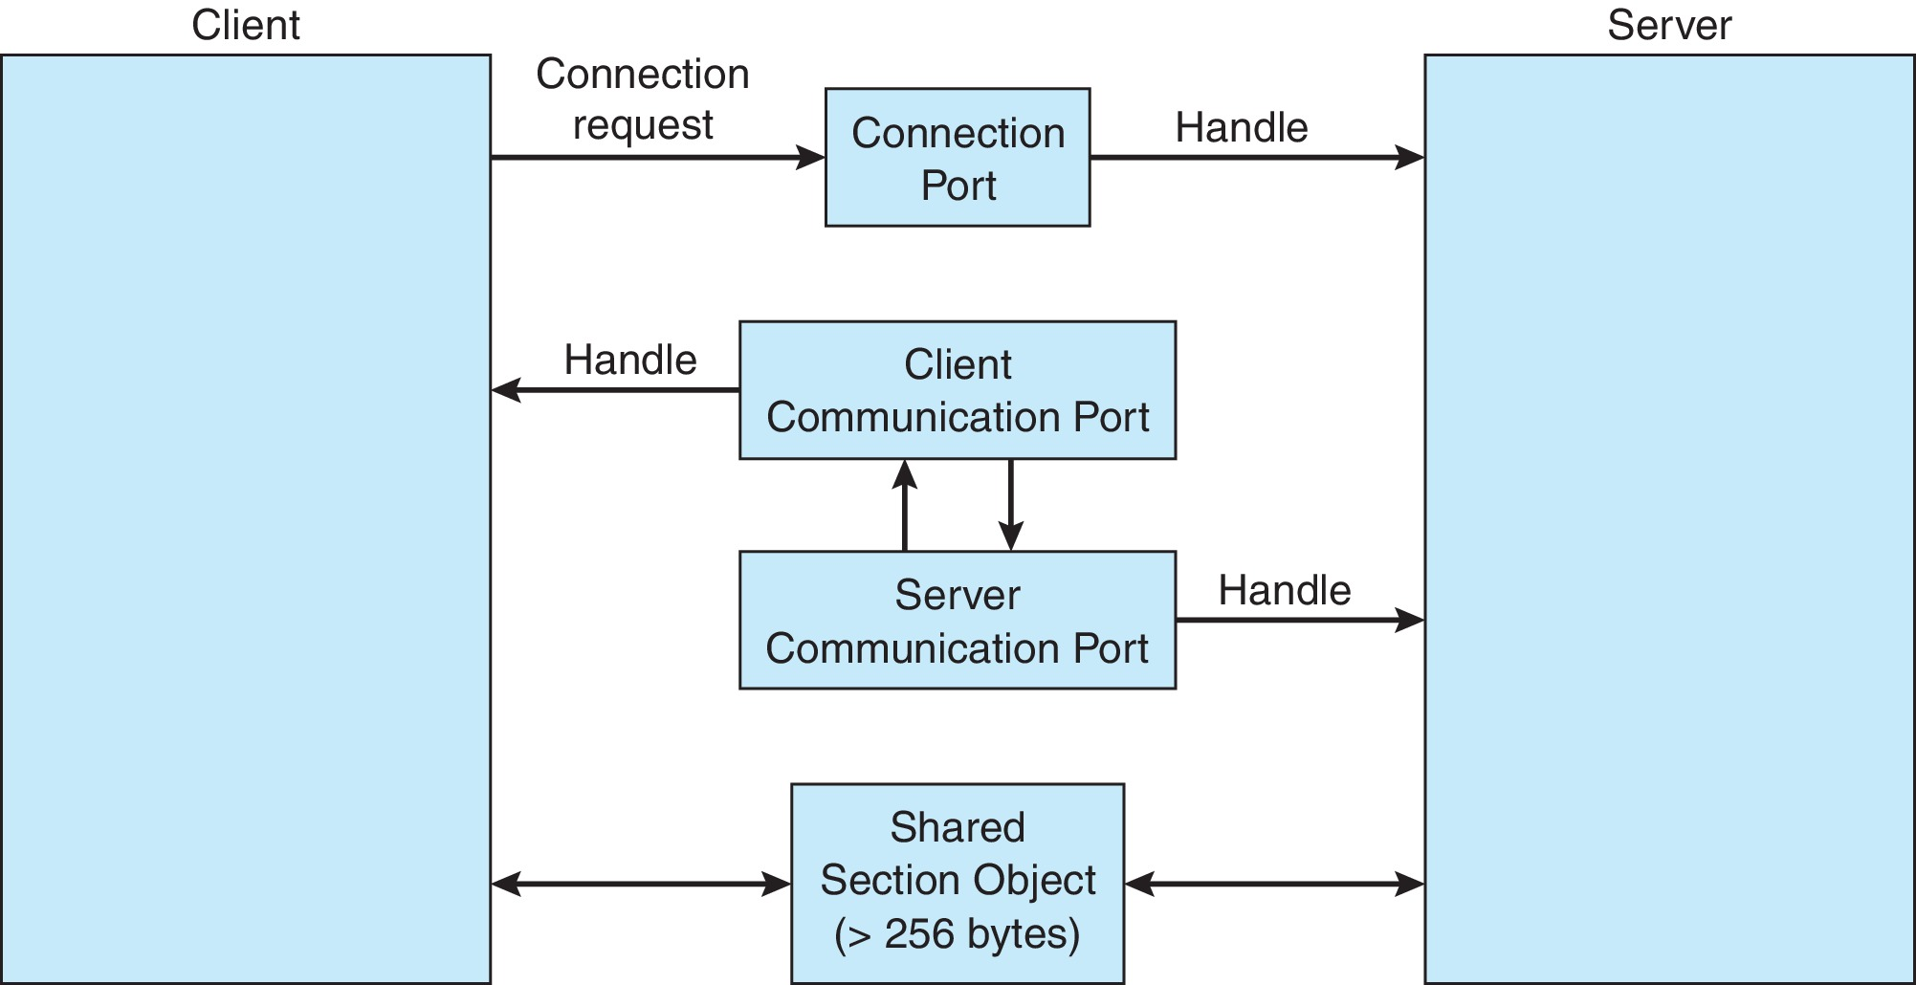
Local Procedure Calls in Windows

Slide 26
Pipes
Acts as a conduit allowing two processes to communicate
Issues:
Is communication unidirectional or bidirectional?
In the case of two-way communication, is it half or full-duplex?
Must there exist a relationship (i.e., parent-child) between the communicating processes?
Can the pipes be used over a network?
Ordinary pipes – cannot be accessed from outside the process that created it. Typically, a parent process creates a pipe and uses it to communicate with a child process that it created.
Named pipes – can be accessed without a parent-child relationship

Slide 27
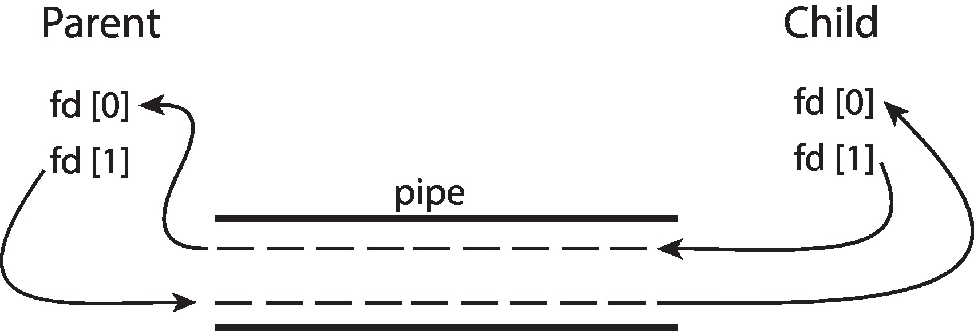
Ordinary Pipes
Ordinary Pipes allow communication in standard producer-consumer style
Producer writes to one end (the write-end of the pipe)
Consumer reads from the other end (the read-end of the pipe)
Ordinary pipes are therefore unidirectional
Require parent-child relationship between communicating processes
Windows calls these anonymous pipes

Slide 28
Named Pipes
Named Pipes are more powerful than ordinary pipes
Communication is bidirectional
No parent-child relationship is necessary between the communicating processes
Several processes can use the named pipe for communication
Provided on both UNIX and Windows systems

Slide 29
Communications in Client-Server Systems
Sockets
Remote Procedure Calls

Slide 30
Sockets
A socket is defined as an endpoint for communication
Concatenation of IP address and port – a number included at start of message packet to differentiate network services on a host
The socket 161.25.19.8:1625 refers to port 1625 on host 161.25.19.8
Communication consists between a pair of sockets
All ports below 1024 are well known, used for standard services
Special IP address 127.0.0.1 (loopback) to refer to system on which process is running

Slide 31
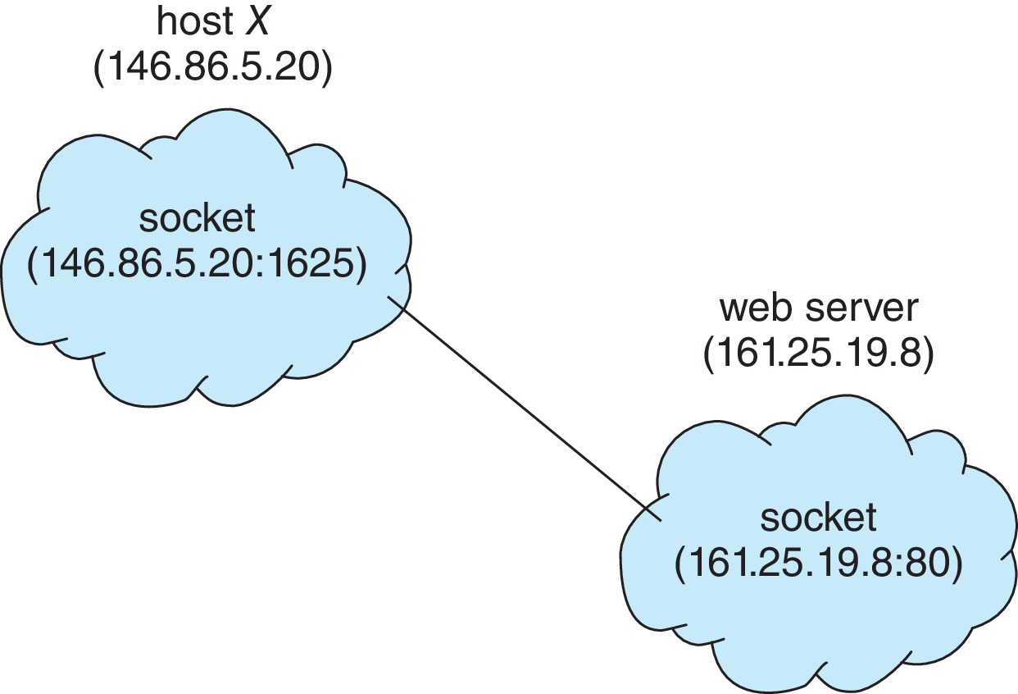
Socket Communication

Slide 32
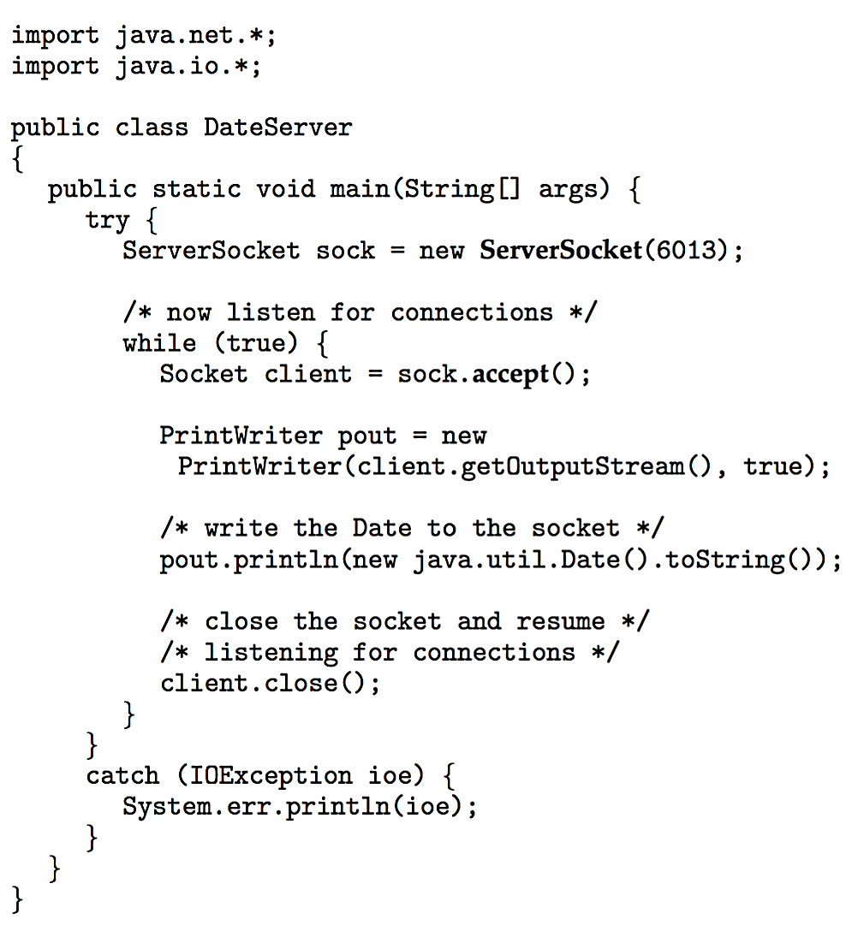
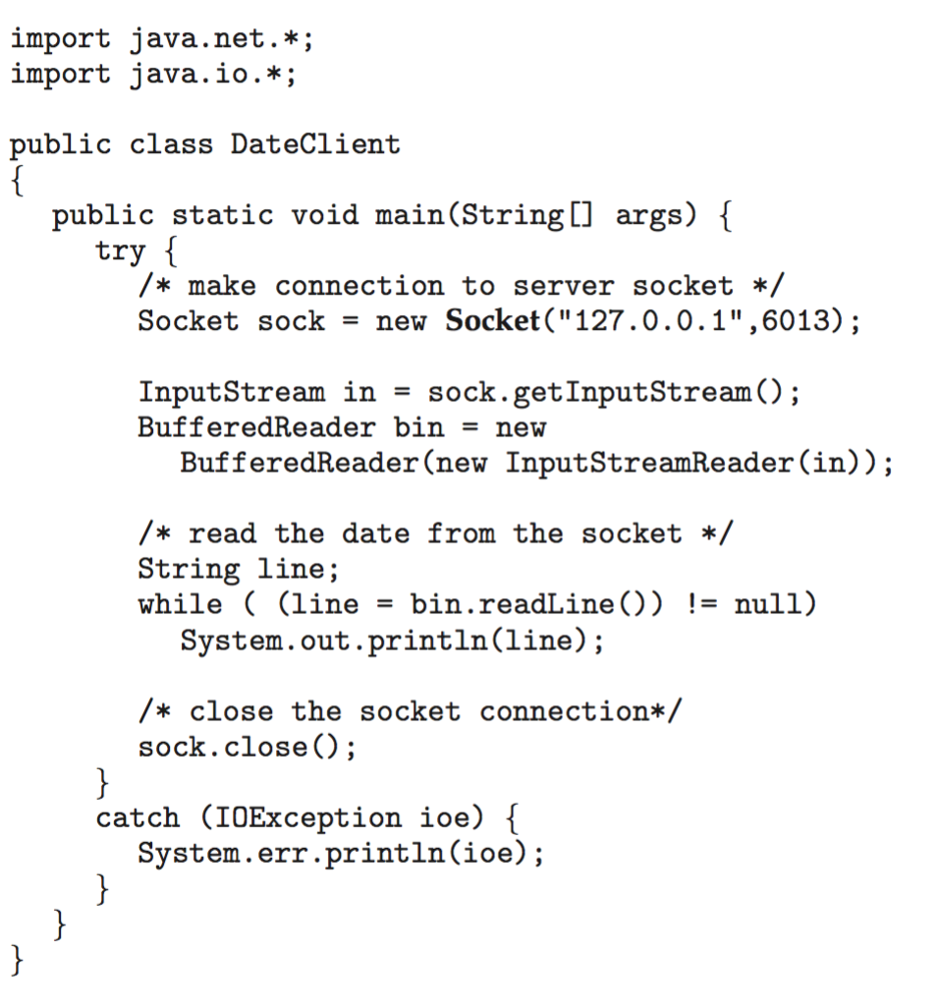
Sockets in Java
Three types of sockets
Connection-oriented (TCP Transmission Control Protocol)
Connectionless (UDP User Datagram Prorocal )
MulticastSocket class – data can be sent to multiple recipients

Slide 33
Remote Procedure Calls (1)
Remote procedure call (RPC) abstracts procedure calls between processes on networked systems
Again uses ports for service differentiation
Stubs – client-side proxy for the actual procedure on the server
The client-side stub locates the server and marshalls the parameters
The server-side stub receives this message, unpacks the marshalled parameters, and performs the procedure on the server
On Windows, stub code compile from specification written in Microsoft Interface Definition Language (MIDL)

Slide 34
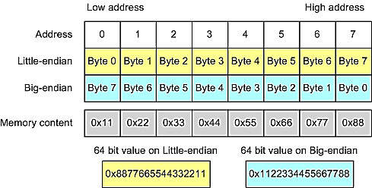
Remote Procedure Calls (2)
Data representation handled via External Data Representation (XDL) format to account for different architectures
Big-endian and little-endian
Remote communication has more failure scenarios than local
Messages can be delivered exactly once rather than at most once
OS typically provides a rendezvous (or matchmaker) service to connect client and server

Slide 35
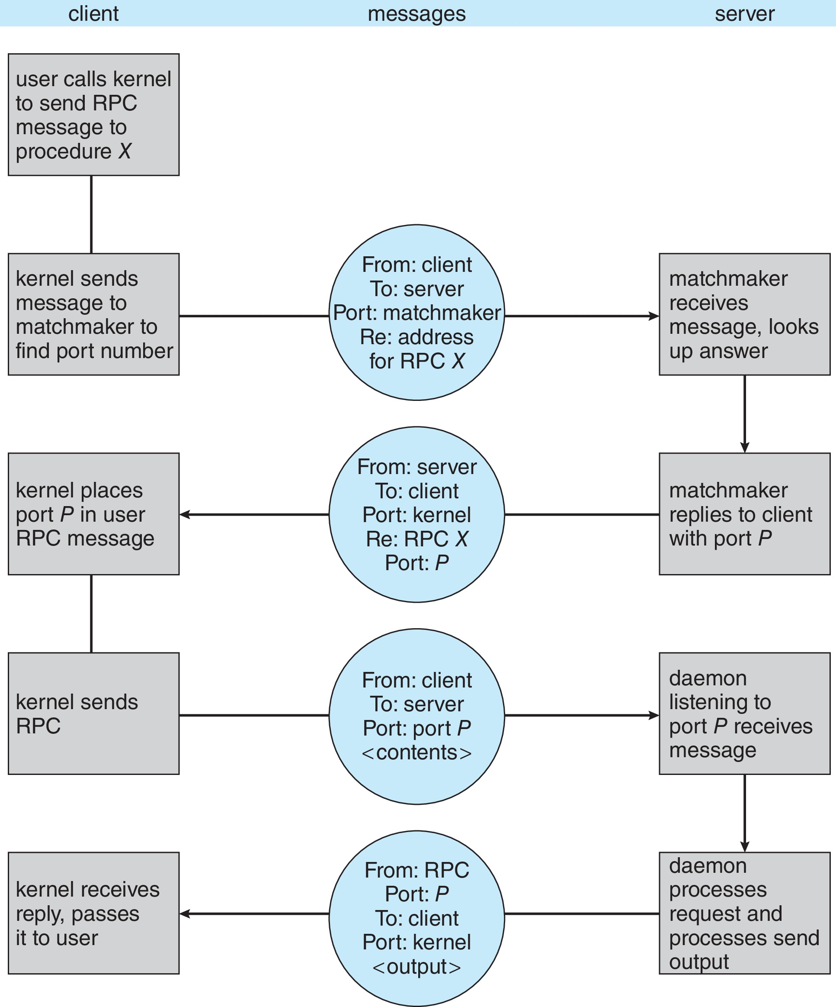
Execution of RPC

Slide 36
End of Chapter 3

