Slide 1
Chapter 4 Threads & Concurrency (1)

Slide 2
Outline
Overview
Multicore Programming
Multithreading Models
Thread Libraries
Implicit Threading
Threading Issues
Operating System Examples

Slide 3
Objectives
Identify the basic components of a thread, and contrast threads and processes
Describe the benefits and challenges of designng multithreaded applications
Illustrate different approaches to implicit threading including thread pools, fork-join, and Grand Central Dispatch
Describe how the Windows and Linux operating systems represent threads
Designing multithreaded applications using the Pthreads, Java, and Windows threading APIs

Slide 4
Motivation
Most modern applications are multithreaded
Threads run within application
Multiple tasks with the application can be implemented by separate threads
Update display
Fetch data
Spell checking
Answer a network request
Process creation is heavy-weight while thread creation is light-weight
Can simplify code, increase efficiency
Kernels are generally multithreaded

Slide 5
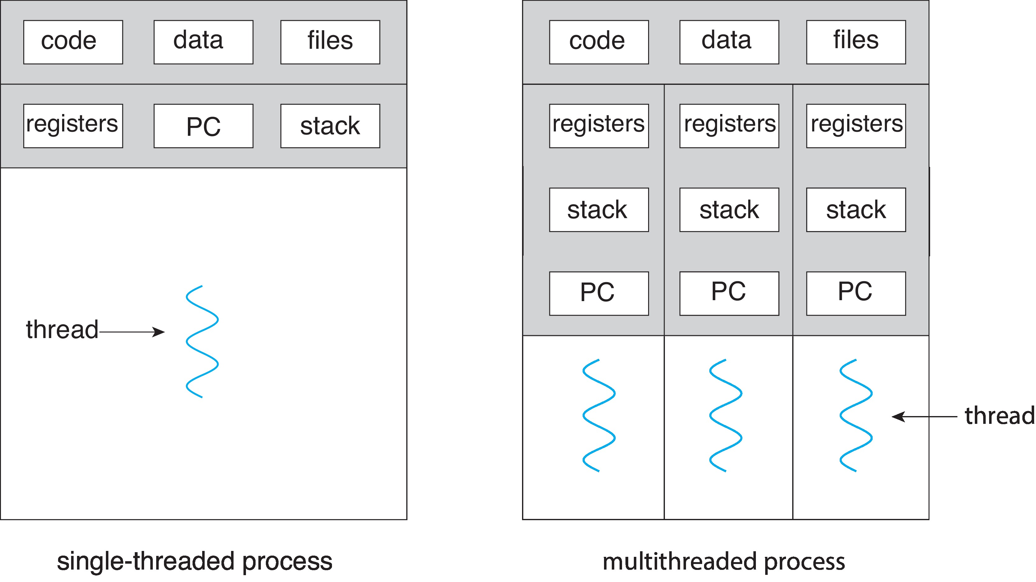
Single and Multithreaded Processes

Slide 6
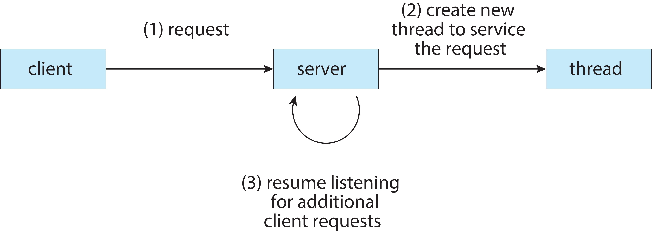
Multithreaded Server Architecture

Slide 7
Benefits
Responsiveness – may allow continued execution if part of process is blocked, especially important for user interfaces
Resource Sharing – threads share resources of process, easier than shared memory or message passing
Economy – cheaper than process creation, thread switching lower overhead than context switching
Scalability – process can take advantage of multicore architectures

Slide 8
Multicore Programming
Multicore or multiprocessor systems puts pressure on programmers, challenges include:
Dividing activities
Balance
Data splitting
Data dependency
Testing and debugging
Parallelism implies a system can perform more than one task simultaneously
Concurrency supports more than one task making progress
Single processor / core, scheduler providing concurrency

Slide 9

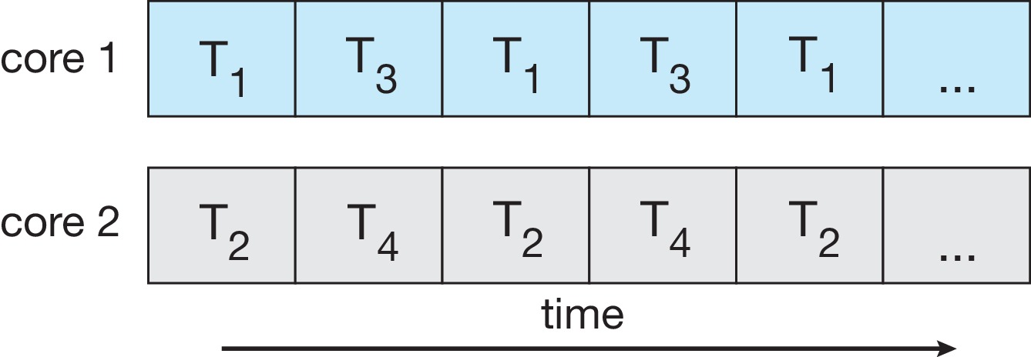
Concurrency vs. Parallelism
Concurrent execution on single-core system:
Parallelism on a multi-core system:

Slide 10
Multicore Programming
Types of parallelism
Data parallelism – distributes subsets of the same data across multiple cores, same operation on each
Task parallelism – distributing threads across cores, each thread performing unique operation

Slide 11
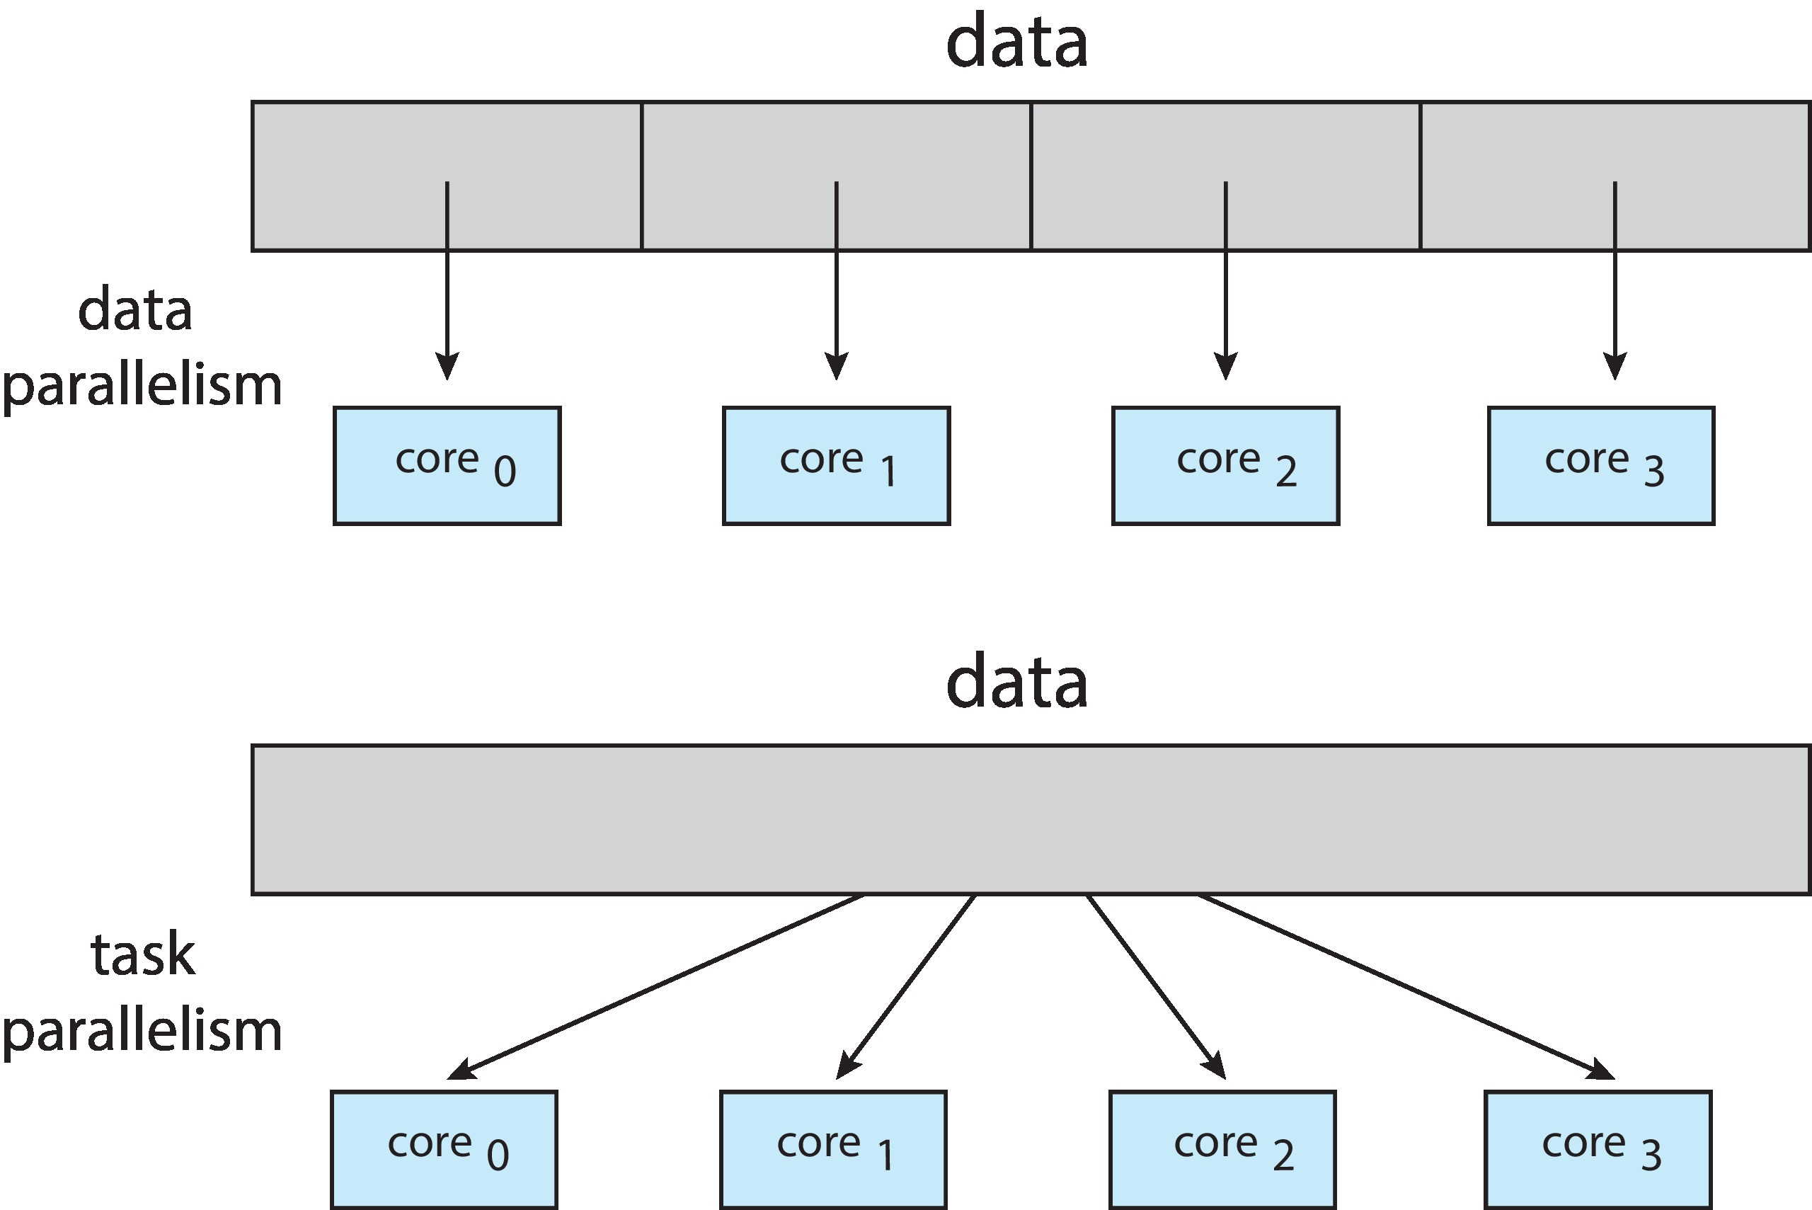
Data and Task Parallelism

Slide 12
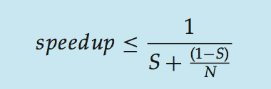
Amdahl’s Law
Identifies performance gains from adding additional cores to an application that has both serial and parallel components
S is serial portion
N processing cores
That is, if application is 75% parallel / 25% serial, moving from 1 to 2 cores results in speedup of 1.6 times
As N approaches infinity, speedup approaches 1 / S
Serial portion of an application has disproportionate effect on performance gained by adding additional cores
But does the law take into account contemporary multicore systems?

Slide 13
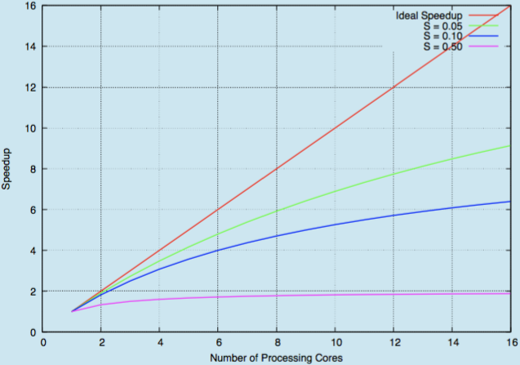
Amdahl’s Law

Slide 14
User Threads and Kernel Threads
User threads - management done by user-level threads library
Three primary thread libraries:
POSIX Pthreads
Windows threads
Java threads
Kernel threads - Supported by the Kernel
Examples – virtually all general-purpose operating systems, including:
Windows
Linux
Mac OS X
iOS
Android

Slide 15
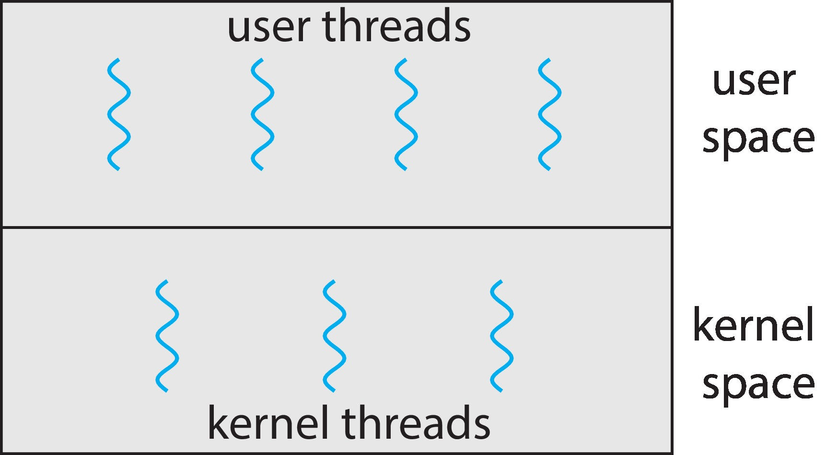
User and Kernel Threads

Slide 16
Multithreading Models
Many-to-One
One-to-One
Many-to-Many

Slide 17
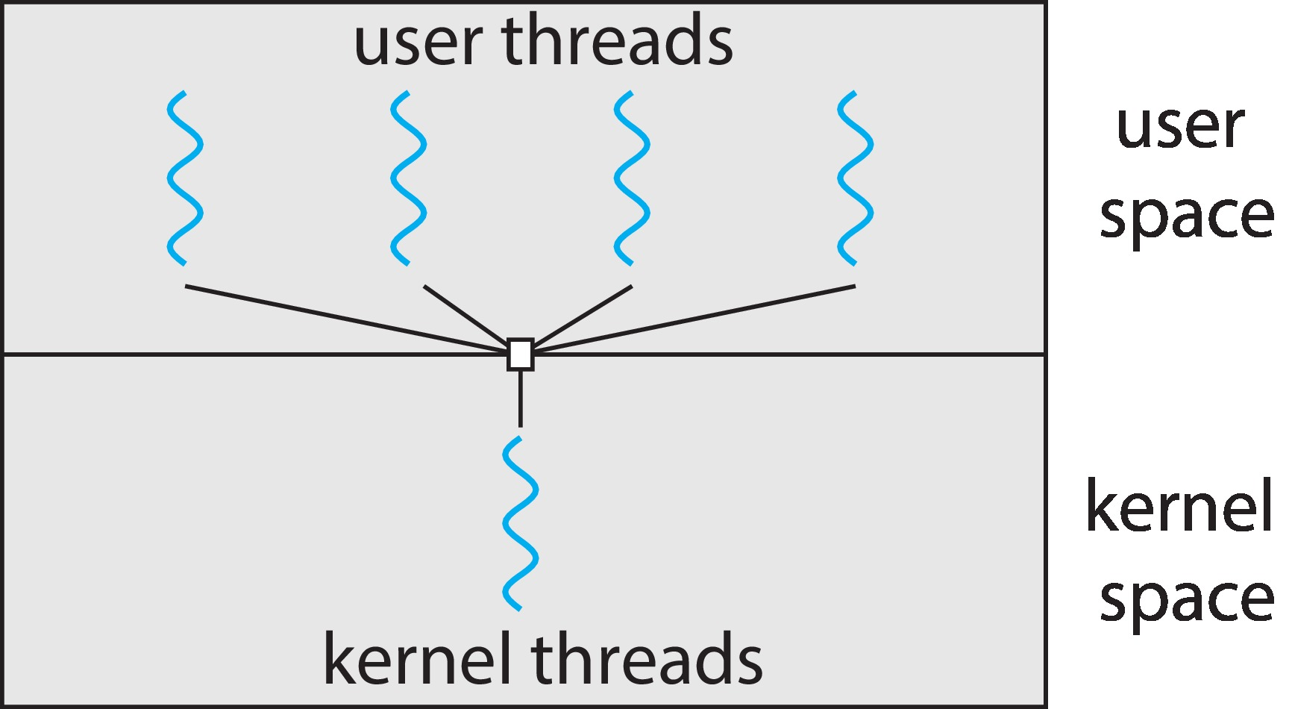
Many-to-One
Many user-level threads mapped to single kernel thread
One thread blocking causes all to block
Multiple threads may not run in parallel on multicore system because only one may be in kernel at a time
Few systems currently use this model
Examples:
Solaris Green Threads
GNU Portable Threads

Slide 18
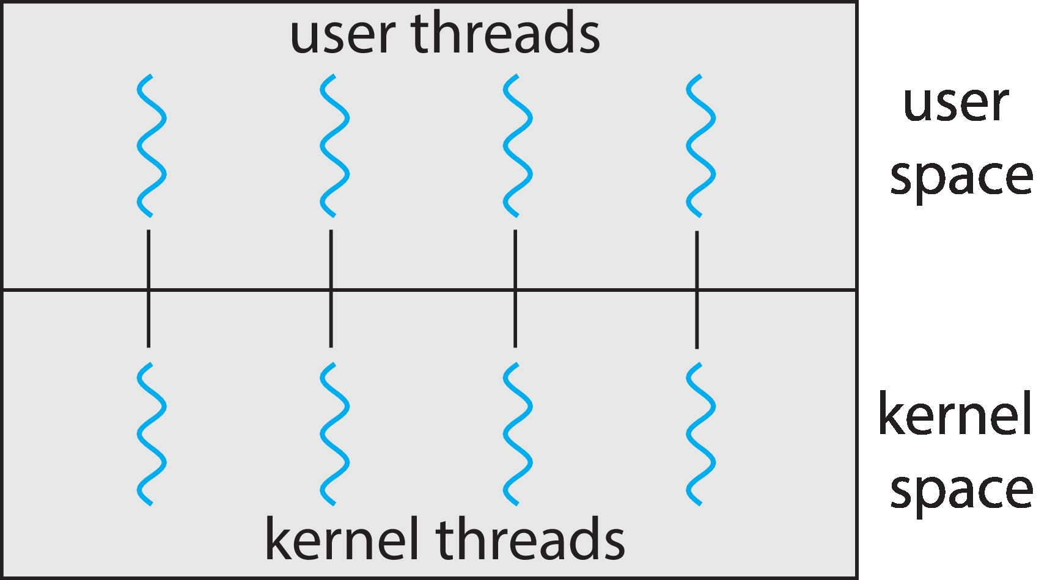
One-to-One
Each user-level thread maps to kernel thread
Creating a user-level thread creates a kernel thread
More concurrency than many-to-one
Number of threads per process sometimes restricted due to overhead
Examples
Windows
Linux

Slide 19
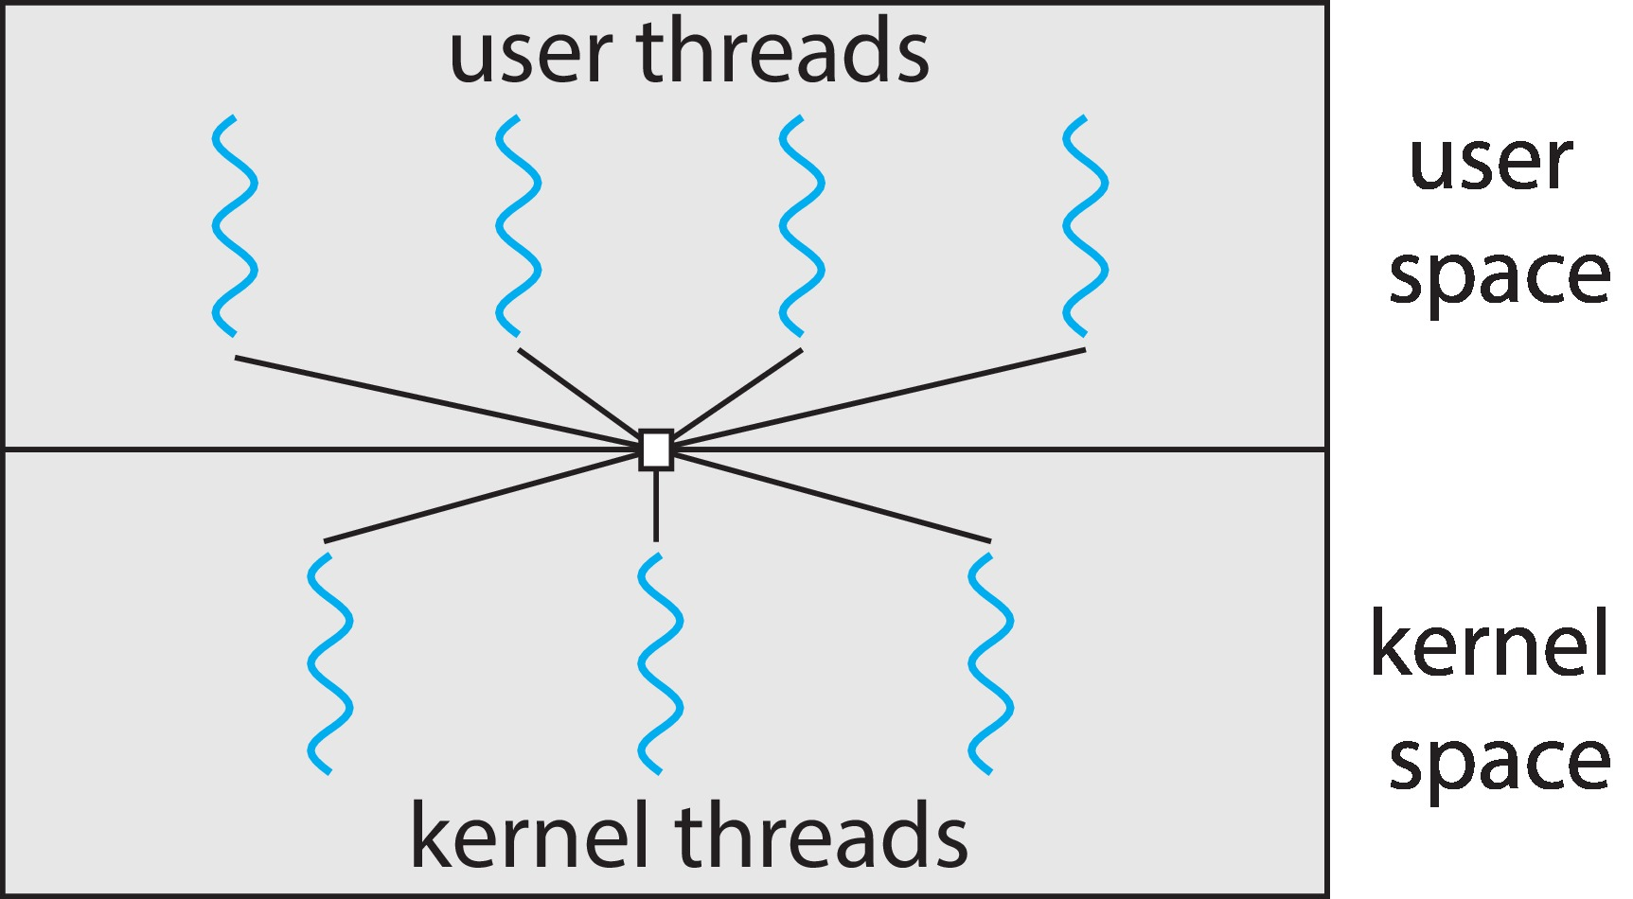
Many-to-Many Model
Allows many user level threads to be mapped to many kernel threads
Allows the operating system to create a sufficient number of kernel threads
Windows with the ThreadFiber package
Otherwise not very common

Slide 20
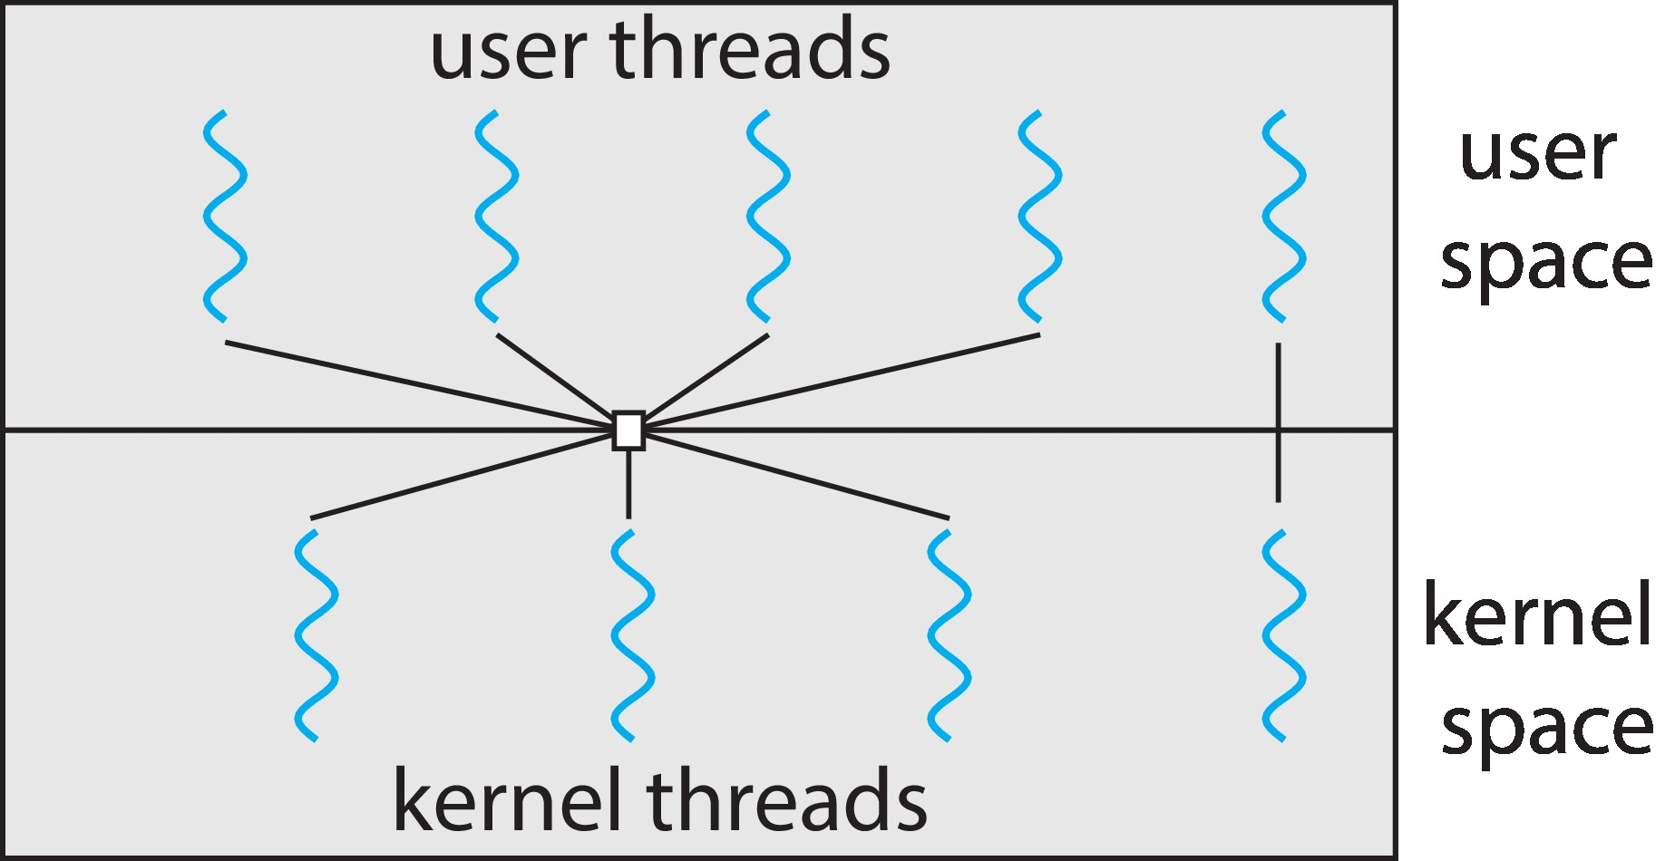
Two-level Model
Similar to M:M, except that it allows a user thread to be bound to kernel thread

Slide 21
Thread Libraries
Thread library provides programmer with API for creating and managing threads
Two primary ways of implementing
Library entirely in user space
Kernel-level library supported by the OS

Slide 22
Pthreads
May be provided either as user-level or kernel-level
A POSIX standard (IEEE 1003.1c) API for thread creation and synchronization
Specification, not implementation
API specifies behavior of the thread library, implementation is up to development of the library
Common in UNIX operating systems (Linux & Mac OS X)

Slide 23
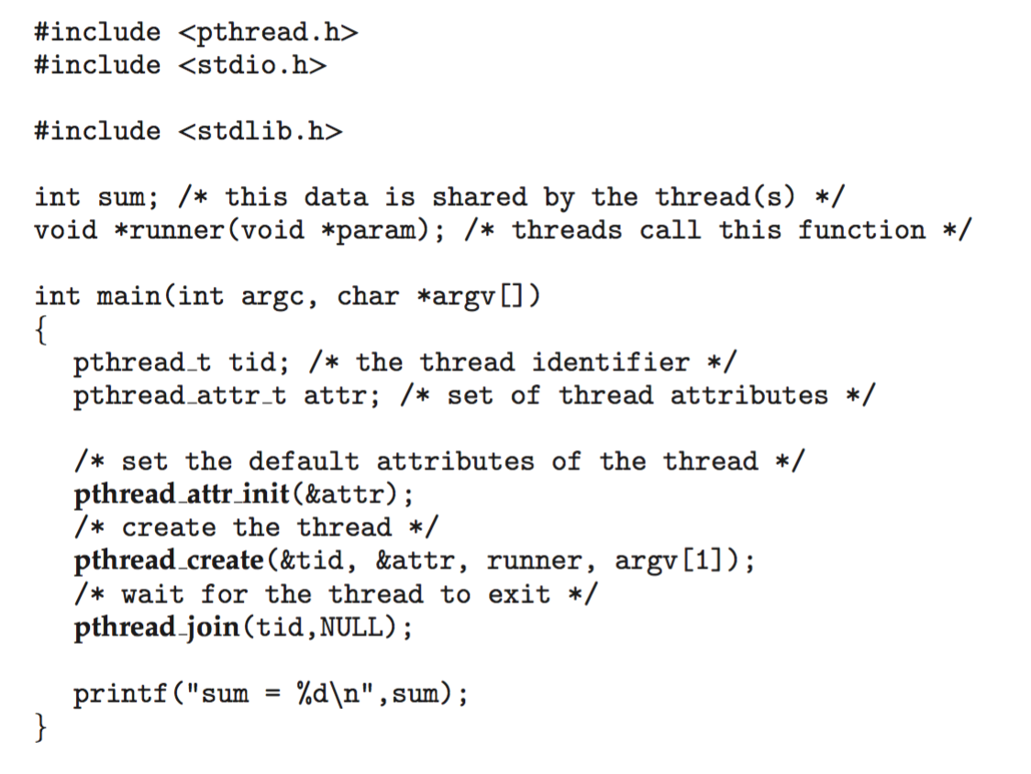
Pthreads Example

Slide 24
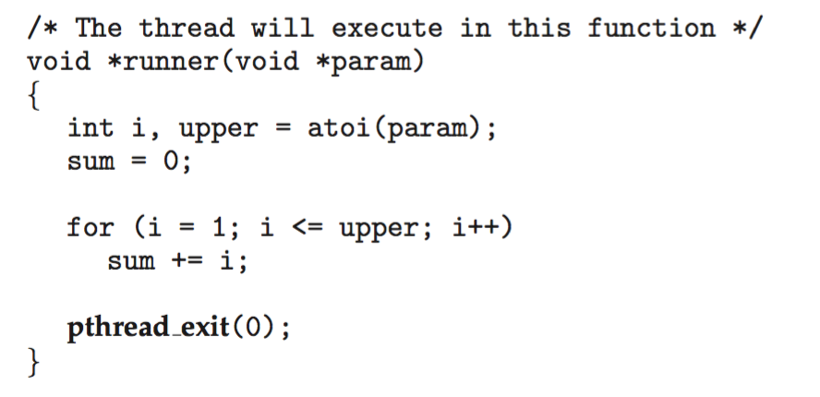
Pthreads Example (Cont.)

Slide 25
Pthreads Code for Joining 10 Threads

Slide 26
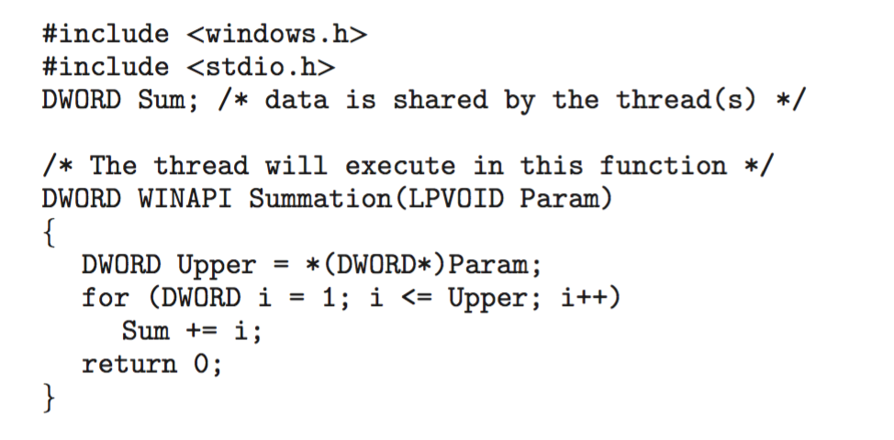
Windows Multithreaded C Program (1)

Slide 27
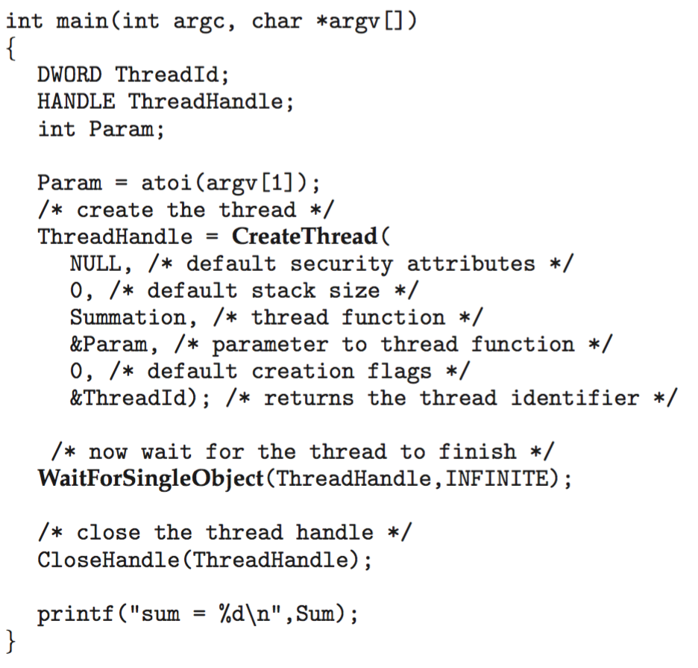
Windows Multithreaded C Program (2)

Slide 28
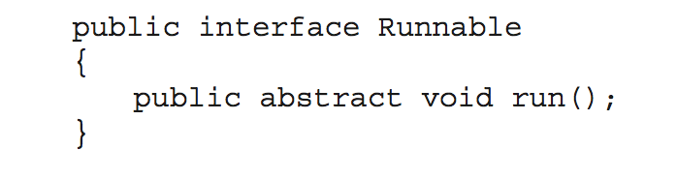
Java Threads
Java threads are managed by the JVM
Typically implemented using the threads model provided by underlying OS
Java threads may be created by:
Extending Thread class
Implementing the Runnable interface
Standard practice is to implement Runnable interface

Slide 29
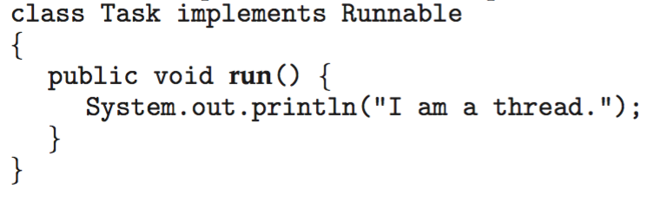
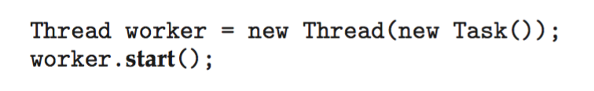
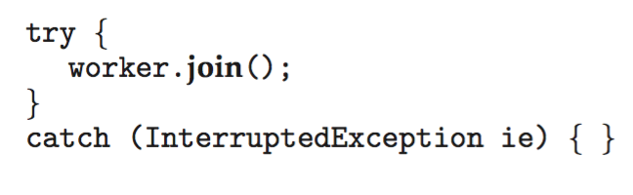
Java Threads
Implementing Runnable interface:
Creating a thread:
Waiting on a thread:

Slide 30
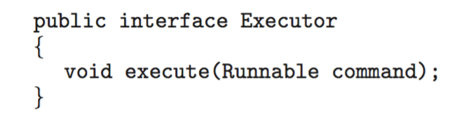
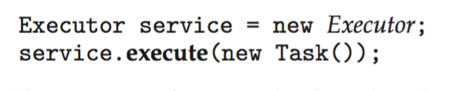
Java Executor Framework (1)
Rather than explicitly creating threads, Java also allows thread creation around the Executor interface:
The Executor is used as follows:

Slide 31
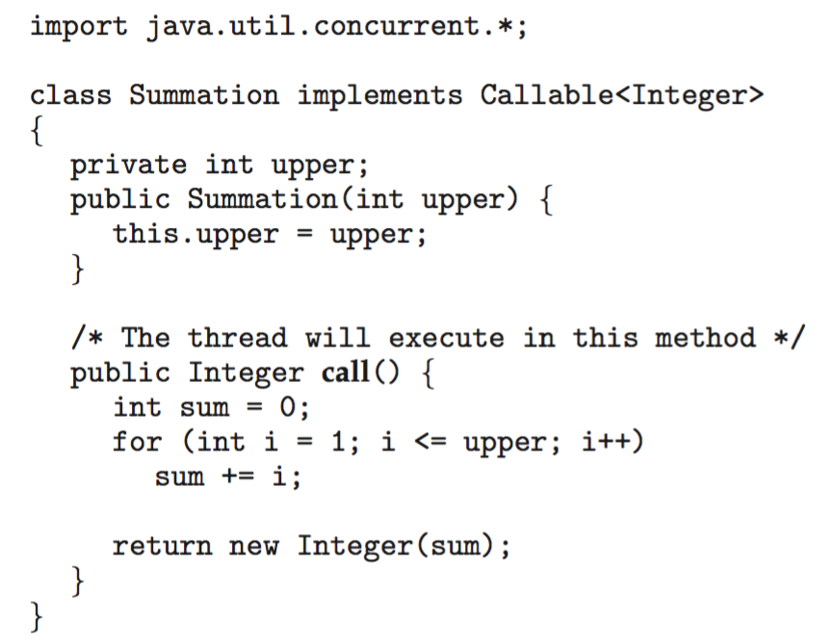
Java Executor Framework (2)

Slide 32
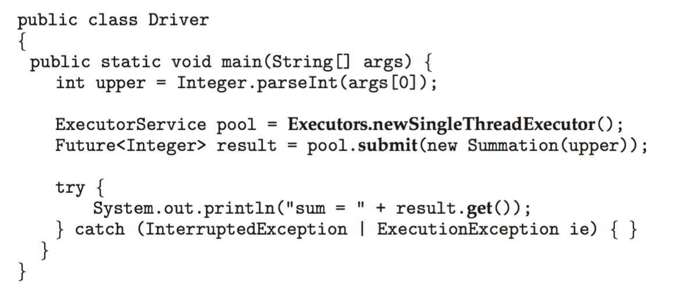
Java Executor Framework (3)

Slide 33
Take a Break

