Slide 1
Chapter 4 Threads & Concurrency （2）

Slide 2
Implicit Threading
Growing in popularity as numbers of threads increase, program correctness more difficult with explicit threads
Creation and management of threads done by compilers and run-time libraries rather than programmers
Five methods explored
Thread Pools
Fork-Join
OpenMP
Grand Central Dispatch
Intel Threading Building Blocks

Slide 3
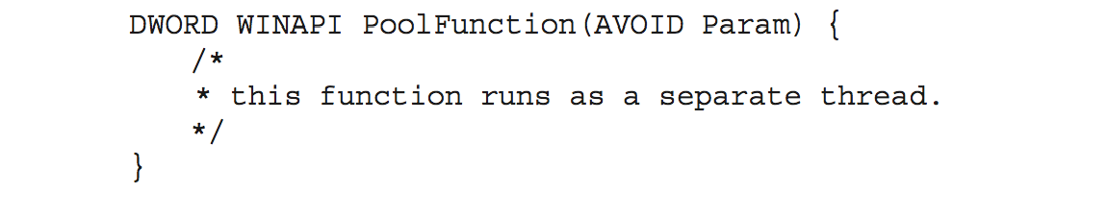
Thread Pools
Create a number of threads in a pool where they await work
Advantages:
Usually slightly faster to service a request with an existing thread than create a new thread
Allows the number of threads in the application(s) to be bound to the size of the pool
Separating task to be performed from mechanics of creating task allows different strategies for running task
i.e,Tasks could be scheduled to run periodically
Windows API supports thread pools:

Slide 4
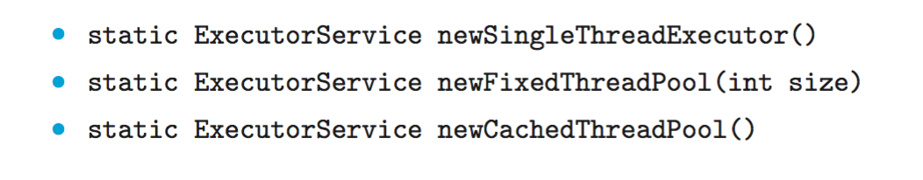
Java Thread Pools (1)
Three factory methods for creating thread pools in Executors class:

Slide 5
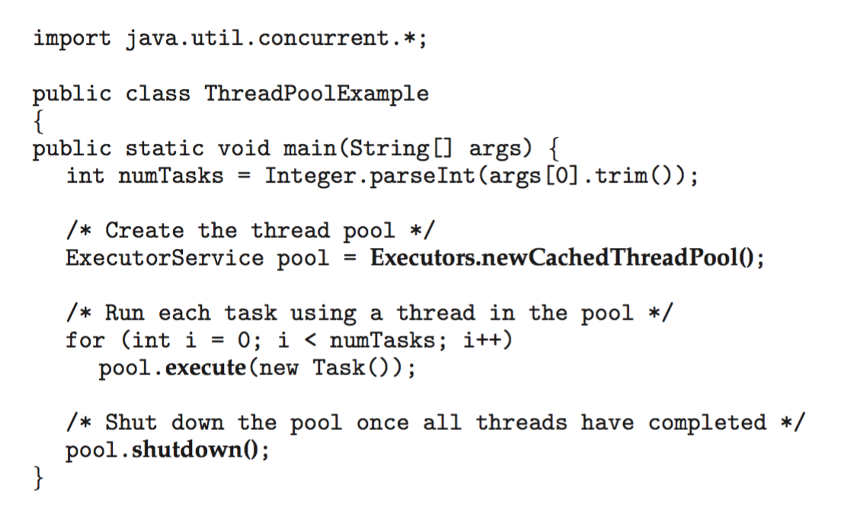
Java Thread Pools (2)

Slide 6
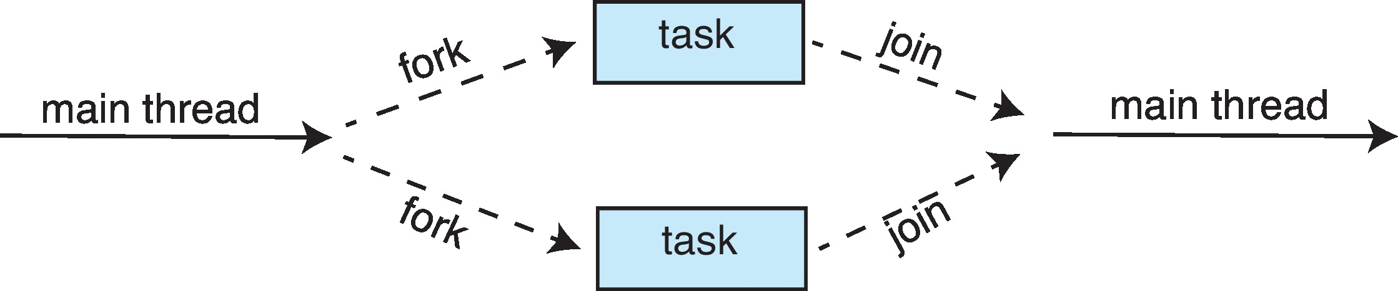
Fork-Join Parallelism (1)
Multiple threads (tasks) are forked, and then joined.

Slide 7
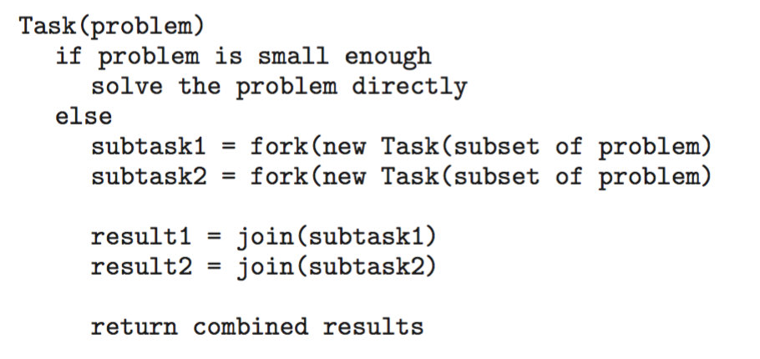
Fork-Join Parallelism (2)
General algorithm for fork-join strategy:

Slide 8
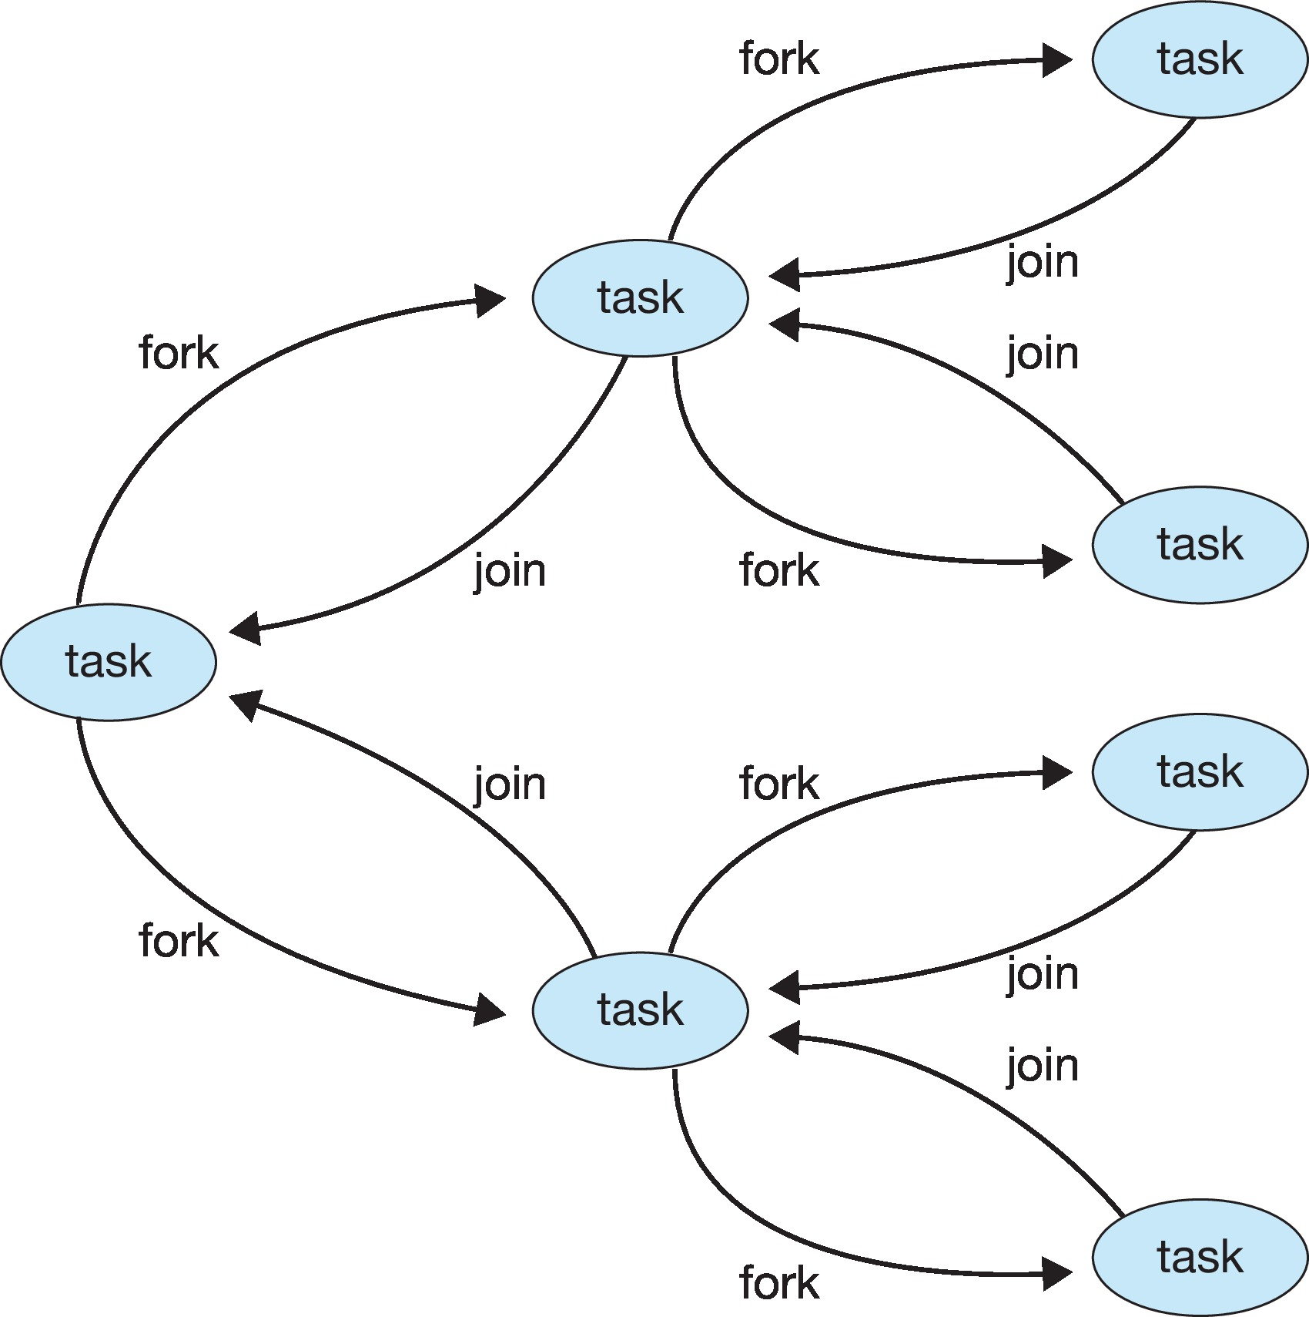
Fork-Join Parallelism (3)

Slide 9
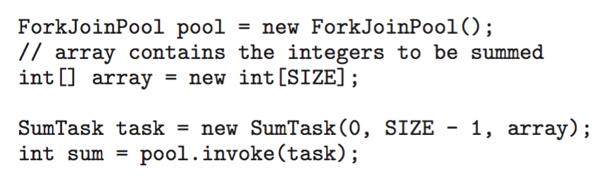
Fork-Join Parallelism in Java (1)

Slide 10
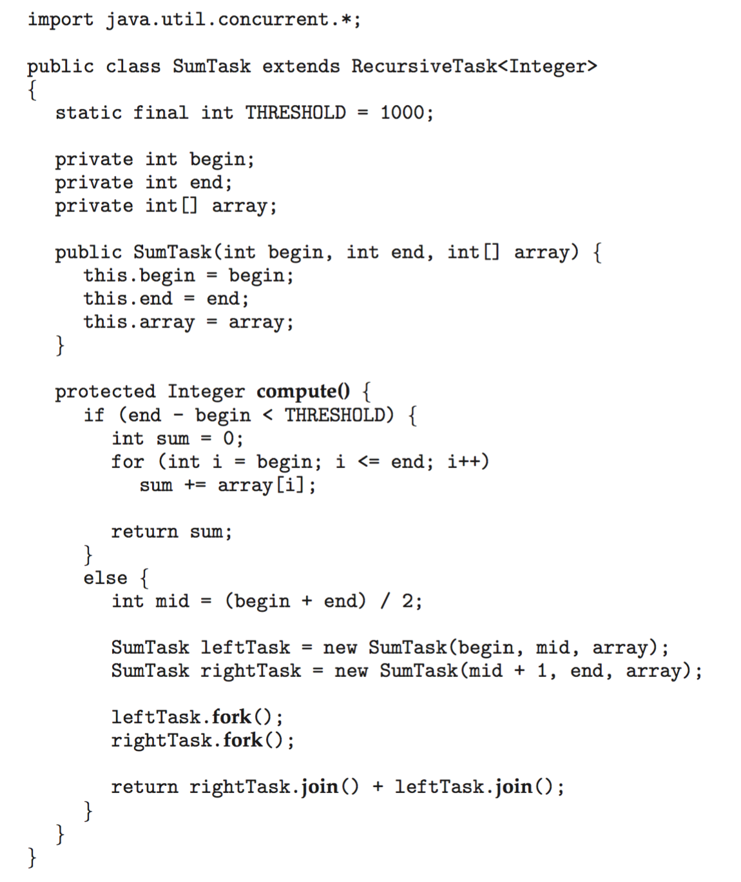
Fork-Join Parallelism in Java (2)

Slide 11
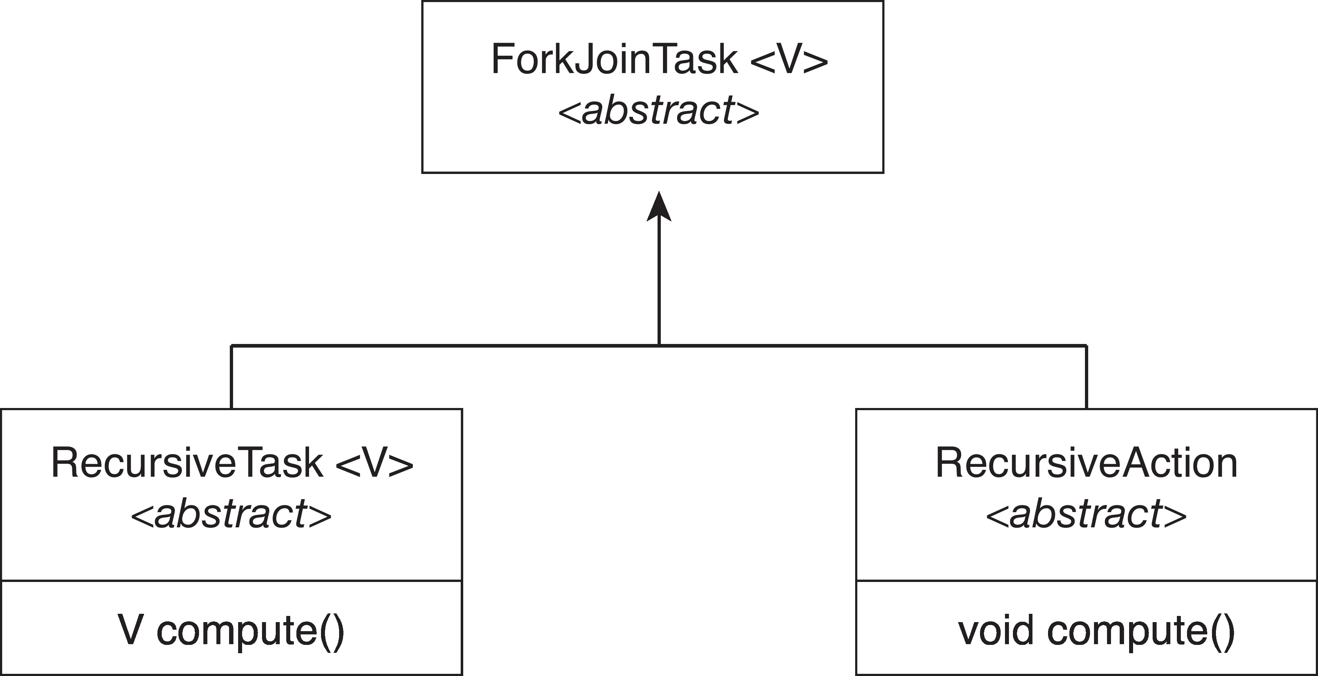
Fork-Join Parallelism in Java (3)
The ForkJoinTask is an abstract base class
RecursiveTask and RecursiveAction classes extend ForkJoinTask
RecursiveTask returns a result (via the return value from the compute() method)
RecursiveAction does not return a result

Slide 12
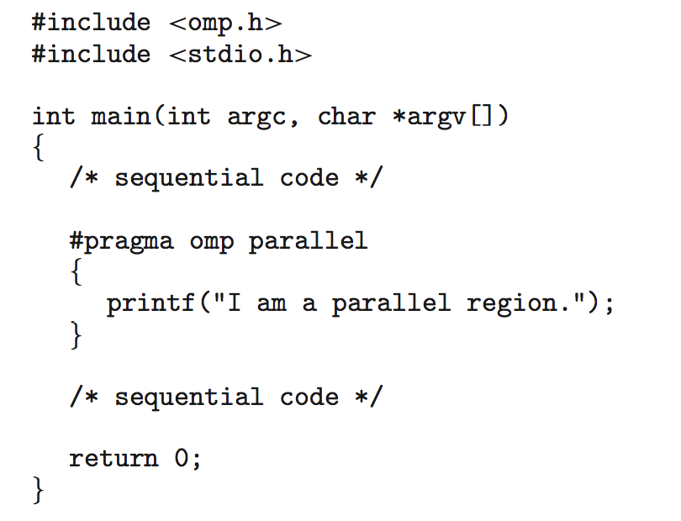
OpenMP (1)
Set of compiler directives and APIs for C, C++, FORTRAN
Provides support for parallel programming in shared-memory environments
Identifies parallel regions – blocks of code that can run in parallel
#pragma omp parallel
Create as many threads as there are cores

Slide 13
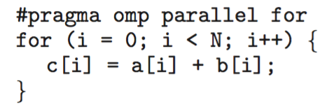
OpenMP (2)
Run the for loop in parallel

Slide 14
Grand Central Dispatch (1)
Apple technology for macOS and iOS operating systems
Extensions to C, C++ and Objective-C languages, API, and run-time library
Allows identification of parallel sections
Manages most of the details of threading
Block is in “^{ }” : ˆ{ printf("I am a block"); }
Blocks placed in dispatch queue
Assigned to available thread in thread pool when removed from queue

Slide 15
Grand Central Dispatch (2)
Two types of dispatch queues:
serial – blocks removed in FIFO order, queue is per process, called main queue
Programmers can create additional serial queues within program
concurrent – removed in FIFO order but several may be removed at a time
Four system wide queues divided by quality of service:
QOS_CLASS_USER_INTERACTIVE
QOS_CLASS_USER_INITIATED
QOS_CLASS_USER_UTILITY
QOS_CLASS_USER_BACKGROUND

Slide 16
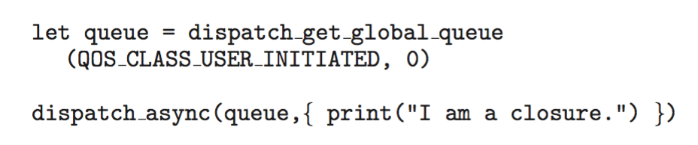
Grand Central Dispatch (3)
For the Swift language a task is defined as a closure – similar to a block, minus the caret
Closures are submitted to the queue using the dispatch_async() function:

Slide 17
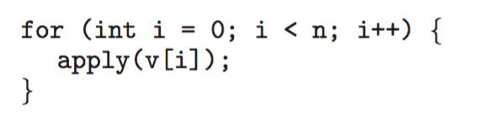
Intel Threading Building Blocks (TBB)
Template library for designing parallel C++ programs
A serial version of a simple for loop
The same for loop written using TBB with parallel_for statement:

Slide 18
Threading Issues
Semantics of fork() and exec() system calls
Signal handling
Synchronous and asynchronous
Thread cancellation of target thread
Asynchronous or deferred
Thread-local storage
Scheduler Activations

Slide 19
Semantics of fork() and exec()
Does fork()duplicate only the calling thread or all threads?
Some UNIXes have two versions of fork
exec() usually works as normal – replace the running process including all threads

Slide 20
Signal Handling (1)
Signals are used in UNIX systems to notify a process that a particular event has occurred.
A signal handler is used to process signals
Signal is generated by particular event
Signal is delivered to a process
Signal is handled by one of two signal handlers:
default
user-defined
Every signal has default handler that kernel runs when handling signal
User-defined signal handler can override default
For single-threaded, signal delivered to process

Slide 21
Signal Handling (2)
Where should a signal be delivered for multi-threaded?
Deliver the signal to the thread to which the signal applies
Deliver the signal to every thread in the process
Deliver the signal to certain threads in the process
Assign a specific thread to receive all signals for the process

Slide 22
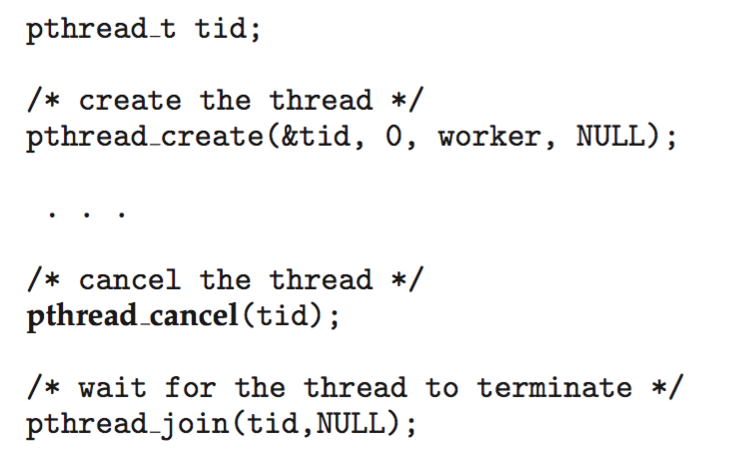
Thread Cancellation (1)
Terminating a thread before it has finished
Thread to be canceled is target thread
Two general approaches:
Asynchronous cancellation terminates the target thread immediately
Deferred cancellation allows the target thread to periodically check if it should be cancelled
Pthread code to create and cancel a thread:

Slide 23
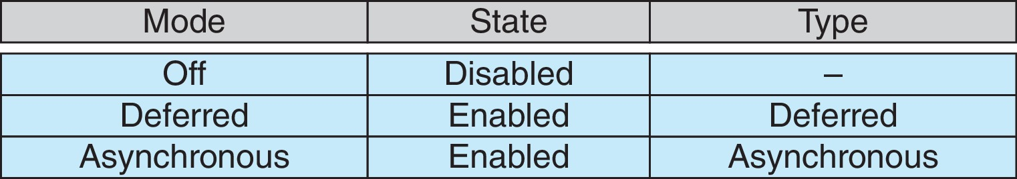
Thread Cancellation (2)
Invoking thread cancellation requests cancellation, but actual cancellation depends on thread state
If thread has cancellation disabled, cancellation remains pending until thread enables it
Default type is deferred
Cancellation only occurs when thread reaches cancellation point
i.e., pthread_testcancel()
Then cleanup handler is invoked
On Linux systems, thread cancellation is handled through signals

Slide 24
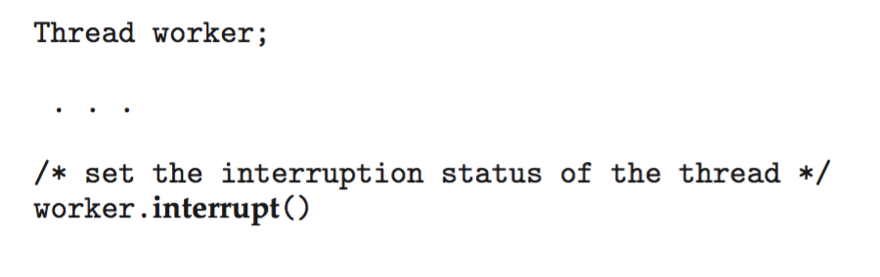
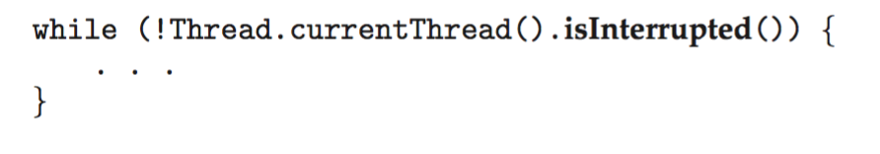
Thread Cancellation in Java
Deferred cancellation uses the interrupt() method, which sets the interrupted status of a thread.
A thread can then check to see if it has been interrupted:

Slide 25
Thread-Local Storage
Thread-local storage (TLS) allows each thread to have its own copy of data
Useful when you do not have control over the thread creation process (i.e., when using a thread pool)
Different from local variables
Local variables visible only during single function invocation
TLS visible across function invocations
Similar to static data
TLS is unique to each thread

Slide 26
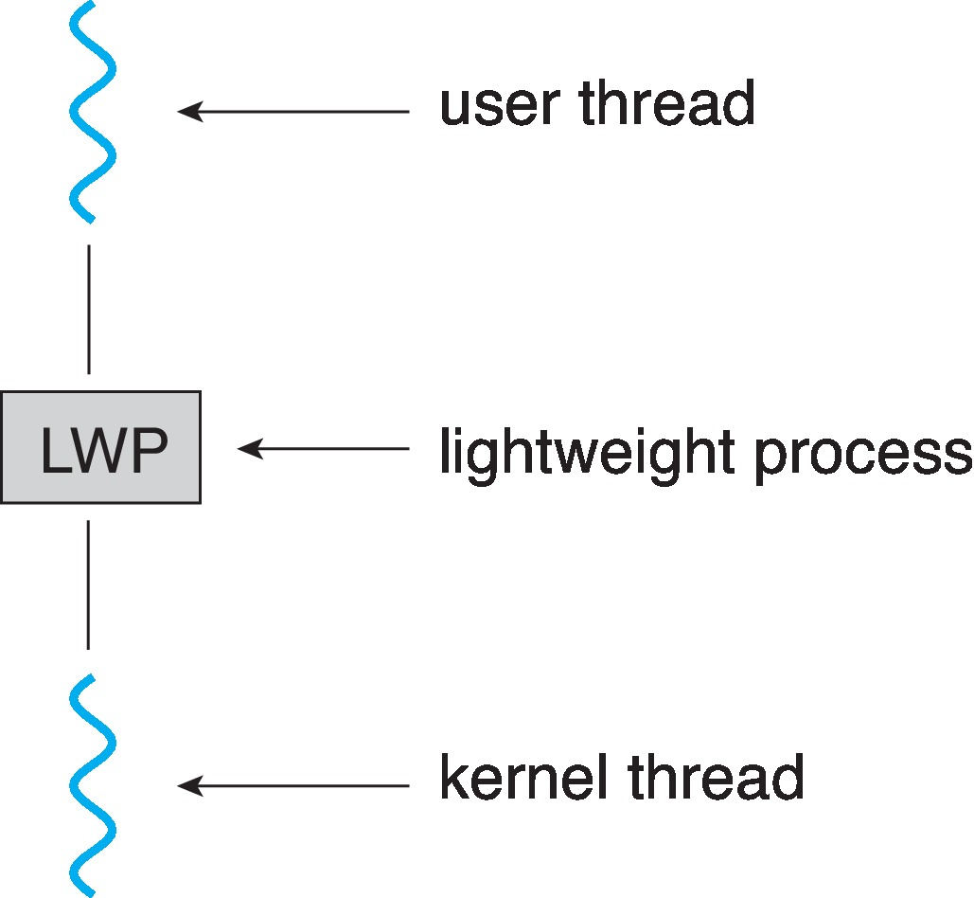
Scheduler Activations
Both M:M and Two-level models require communication to maintain the appropriate number of kernel threads allocated to the application
Typically use an intermediate data structure between user and kernel threads – lightweight process (LWP)
Appears to be a virtual processor on which process can schedule user thread to run
Each LWP attached to kernel thread
How many LWPs to create?
Scheduler activations provide upcalls - a communication mechanism from the kernel to the upcall handler in the thread library
This communication allows an application to maintain the correct number kernel threads

Slide 27
Operating System Examples
Windows Threads
Linux Threads
Notes:
27

Slide 28
Windows Threads (1)
Windows API – primary API for Windows applications
Implements the one-to-one mapping, kernel-level
Each thread contains
A thread id
Register set representing state of processor
Separate user and kernel stacks for when thread runs in user mode or kernel mode
Private data storage area used by run-time libraries and dynamic link libraries (DLLs)
The register set, stacks, and private storage area are known as the context of the thread

Slide 29
Windows Threads (2)
The primary data structures of a thread include:
ETHREAD (executive thread block) – includes pointer to process to which thread belongs and to KTHREAD, in kernel space
KTHREAD (kernel thread block) – scheduling and synchronization info, kernel-mode stack, pointer to TEB, in kernel space
TEB (thread environment block) – thread id, user-mode stack, thread-local storage, in user space

Slide 30
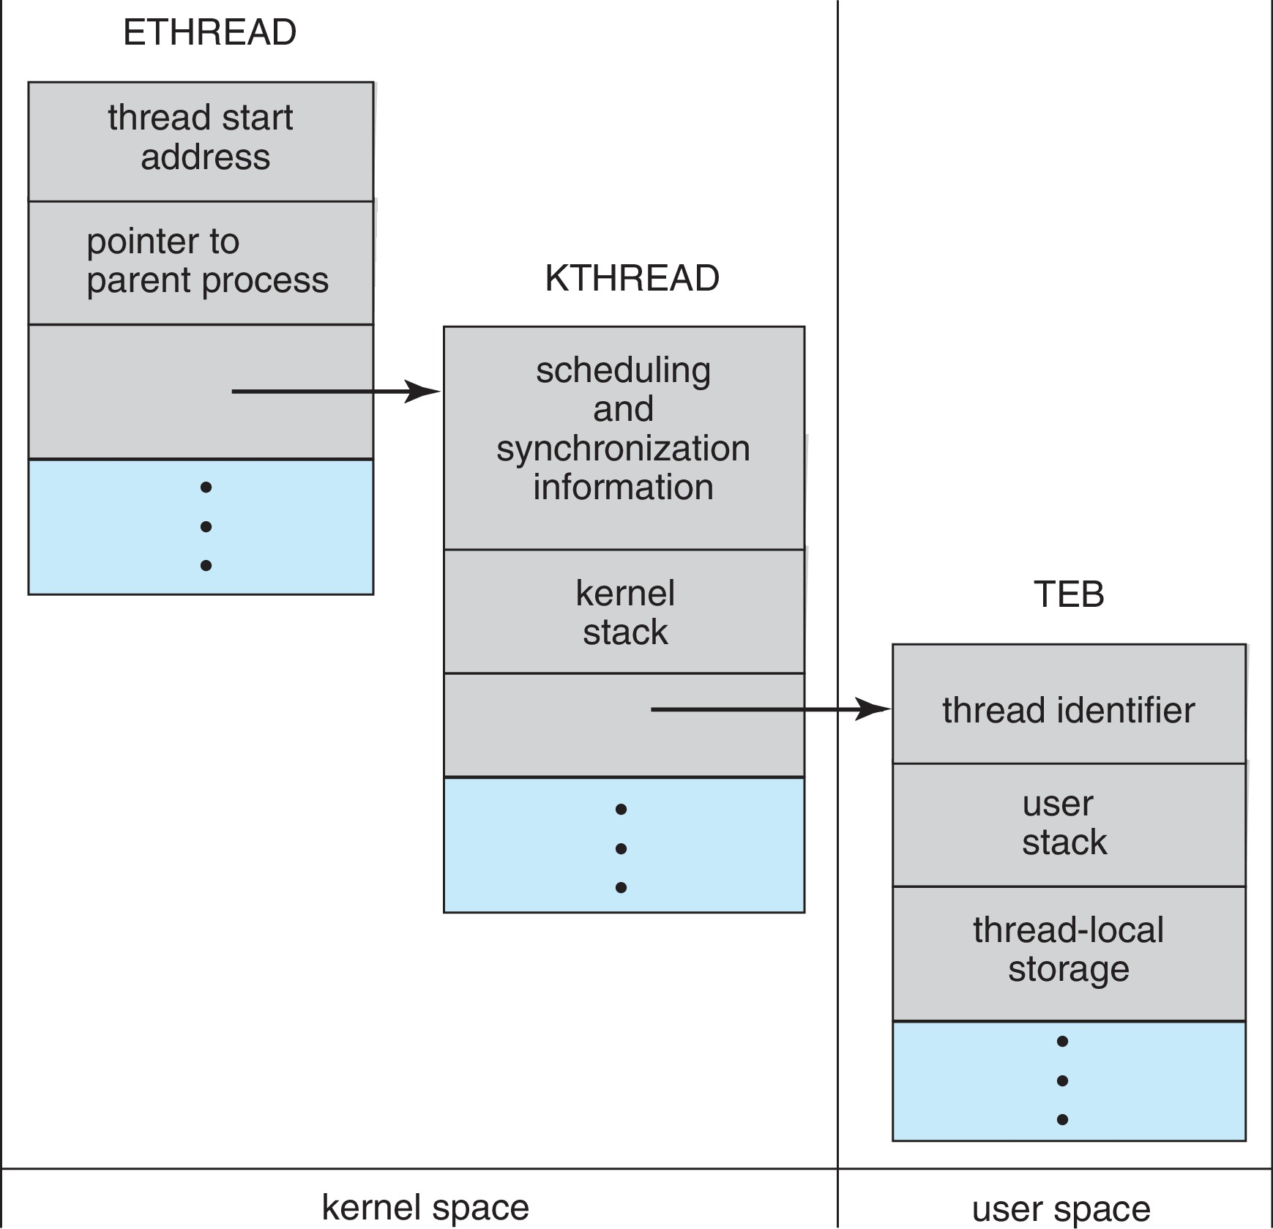
Windows Threads Data Structures

Slide 31
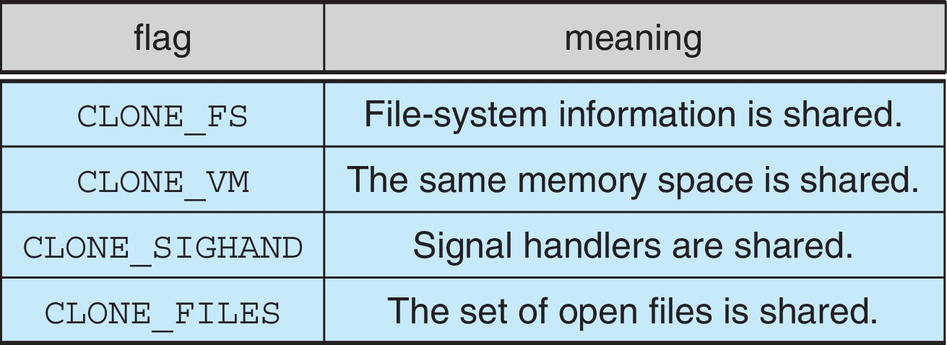
Linux Threads
Linux refers to them as tasks rather than threads
Thread creation is done through clone() system call
clone() allows a child task to share the address space of the parent task (process)
Flags control behavior
struct task_struct points to process data structures (shared or unique)

Slide 32
End of Chapter 4

