Slide 1
Chapter 5 CPU Scheduling (2)

Slide 2
Multilevel Queue
The ready queue consists of multiple queues
Multilevel queue scheduler defined by the following parameters:
Number of queues
Scheduling algorithms for each queue
Method used to determine which queue a process will enter when that process needs service
Scheduling among the queues

Slide 3
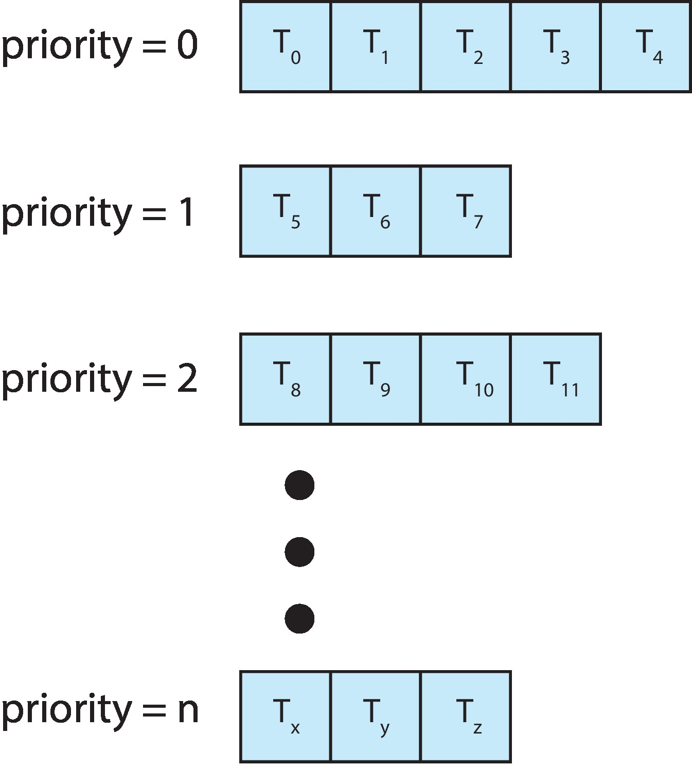
Multilevel Queue
With priority scheduling, have separate queues for each priority.
Schedule the process in the highest-priority queue!

Slide 4
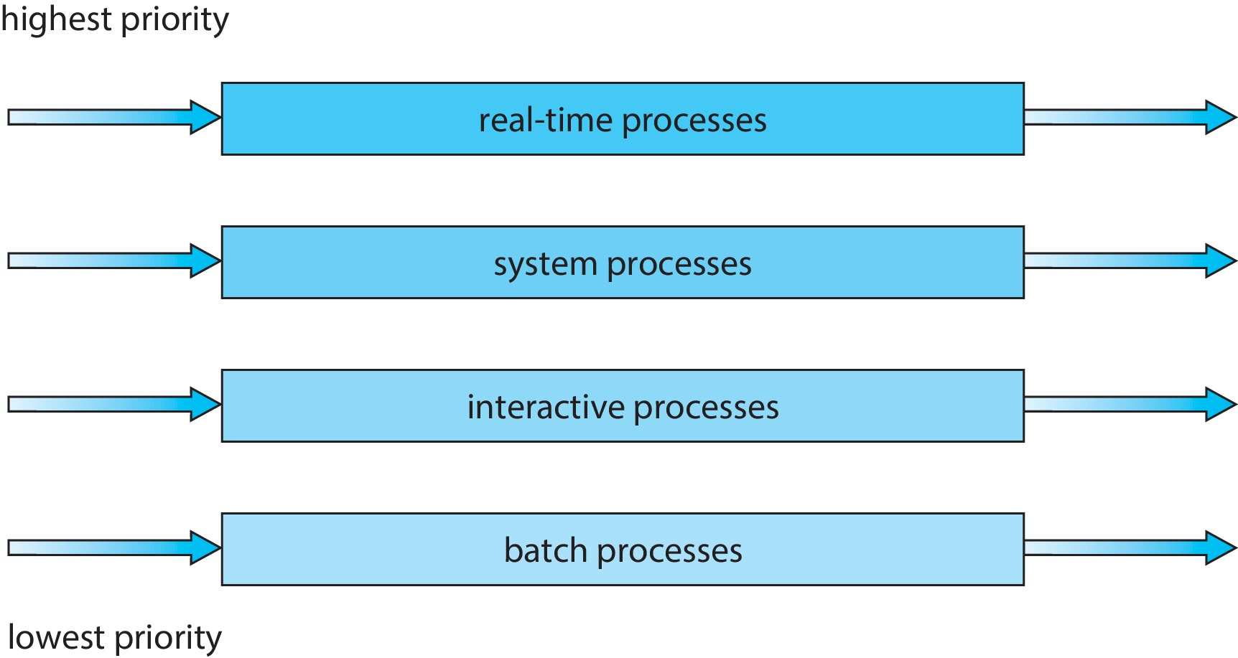
Multilevel Queue
Prioritization based upon process type

Slide 5
Multilevel Feedback Queue
A process can move between the various queues.
Multilevel-feedback-queue scheduler defined by the following parameters:
Number of queues
Scheduling algorithms for each queue
Method used to determine when to upgrade a process
Method used to determine when to demote a process
Method used to determine which queue a process will enter when that process needs service
Aging can be implemented using multilevel feedback queue

Slide 6

Example of Multilevel Feedback Queue
Three queues:
Q₀ – RR with time quantum 8 milliseconds
Q₁ – RR time quantum 16 milliseconds
Q₂ – FCFS
Scheduling
A new process enters queue Q₀ which is served in RR
When it gains CPU, the process receives 8 milliseconds
If it does not finish in 8 milliseconds, the process is moved to queue Q₁
At Q₁ job is again served in RR and receives 16 additional milliseconds
If it still does not complete, it is preempted and moved to queue Q₂

Slide 7
Thread Scheduling
Distinction between user-level and kernel-level threads
When threads supported, threads scheduled, not processes
Many-to-one and many-to-many models, thread library schedules user-level threads to run on LWP
Known as process-contention scope (PCS) since scheduling competition is within the process
Typically done via priority set by programmer
Kernel thread scheduled onto available CPU is system-contention scope (SCS) – competition among all threads in system

Slide 8
Pthread Scheduling
API allows specifying either PCS or SCS during thread creation
PTHREAD_SCOPE_PROCESS schedules threads using PCS scheduling
PTHREAD_SCOPE_SYSTEM schedules threads using SCS scheduling
Can be limited by OS – Linux and macOS only allow PTHREAD_SCOPE_SYSTEM

Slide 9
Pthread Scheduling API
#include <pthread.h>
#include <stdio.h>
#define NUM_THREADS 5
int main(int argc, char *argv[]) {
int i, scope; pthread_t tid[NUM THREADS];
pthread_attr_t attr;
/* get the default attributes */
pthread_attr_init(&attr);
/* first inquire on the current scope */ if (pthread_attr_getscope(&attr, &scope) != 0)
fprintf(stderr, "Unable to get scheduling scope\n");
else {
if (scope == PTHREAD_SCOPE_PROCESS)
printf("PTHREAD_SCOPE_PROCESS");
else if (scope == PTHREAD_SCOPE_SYSTEM)
printf("PTHREAD_SCOPE_SYSTEM");
else fprintf(stderr, "Illegal scope value.\n");
}

Slide 10
Pthread Scheduling API
/* set the scheduling algorithm to PCS or SCS */
pthread_attr_setscope(&attr, PTHREAD_SCOPE_SYSTEM);
/* create the threads */ for (i = 0; i < NUM_THREADS; i++)
pthread_create(&tid[i],&attr,runner,NULL);
/* now join on each thread */ for (i = 0; i < NUM_THREADS; i++)
pthread_join(tid[i], NULL);
}
/* Each thread will begin control in this function */
void *runner(void *param) {
/* do some work ... */
pthread_exit(0);
}

Slide 11
Multiple-Processor Scheduling (1)
CPU scheduling more complex when multiple CPUs are available
Multiprocessor may be any one of the following architectures:
Multicore CPUs
Multithreaded cores
NUMA systems
Heterogeneous multiprocessing

Slide 12
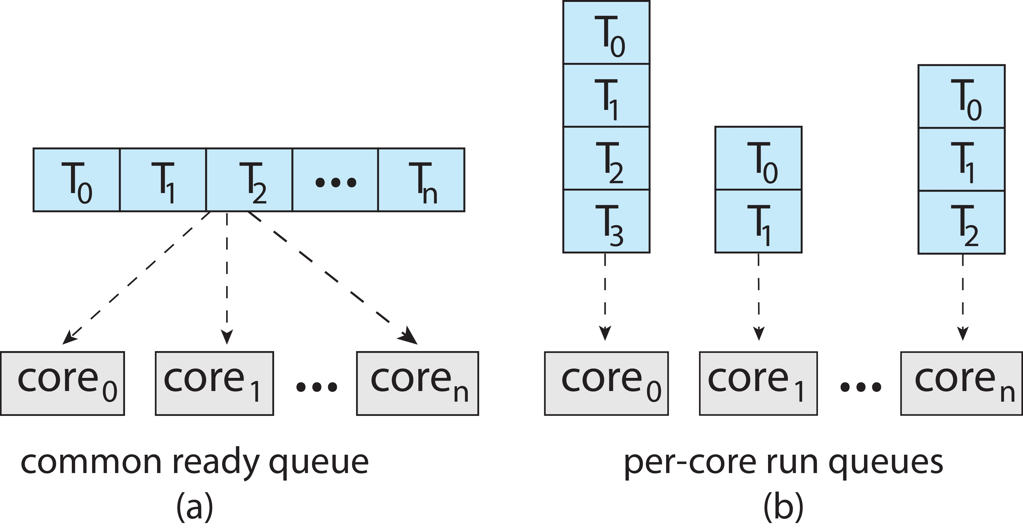
Multiple-Processor Scheduling (2)
Symmetric multiprocessing (SMP) is where each processor is self scheduling
All threads may be in a common ready queue (a)
Each processor may have its own private queue of threads (b)

Slide 13
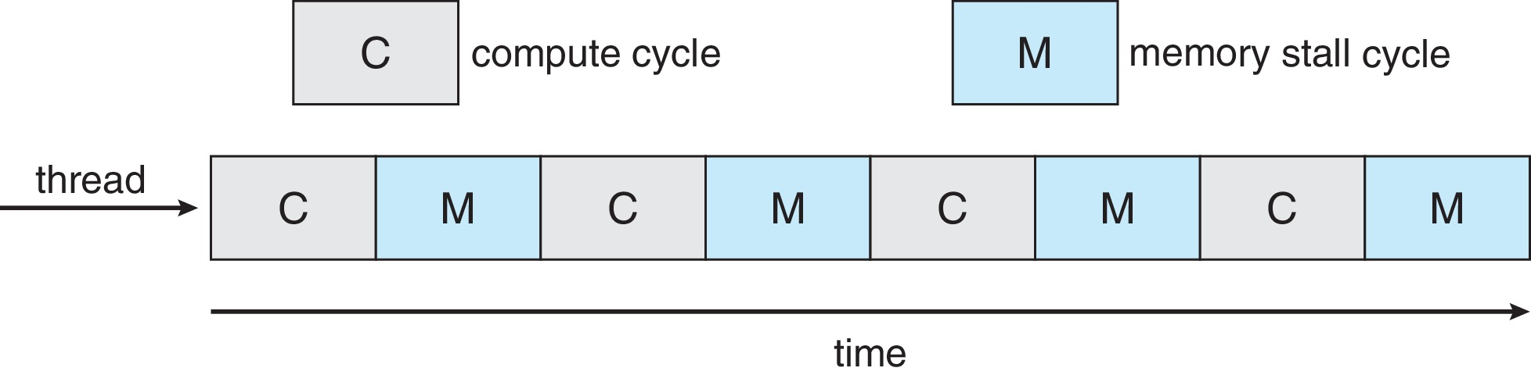
Multicore Processors
Recent trend to place multiple processor cores on same physical chip
Faster and consumes less power
Multiple threads per core also growing
Takes advantage of memory stall to make progress on another thread while memory retrieve happens
Figure

Slide 14
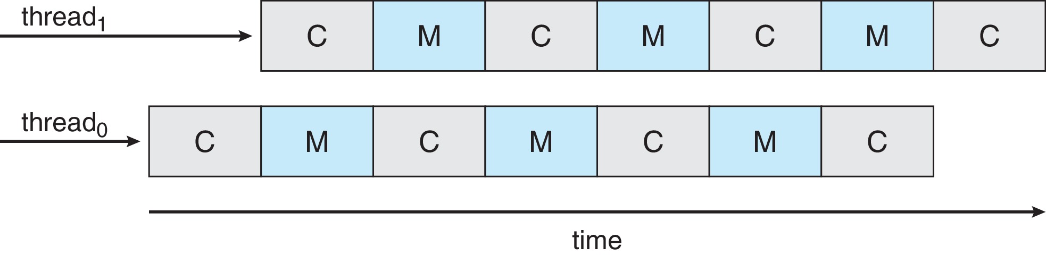
Multithreaded Multicore System (1)
Each core has > 1 hardware threads.
If one thread has a memory stall, switch to another thread!
Figure

Slide 15
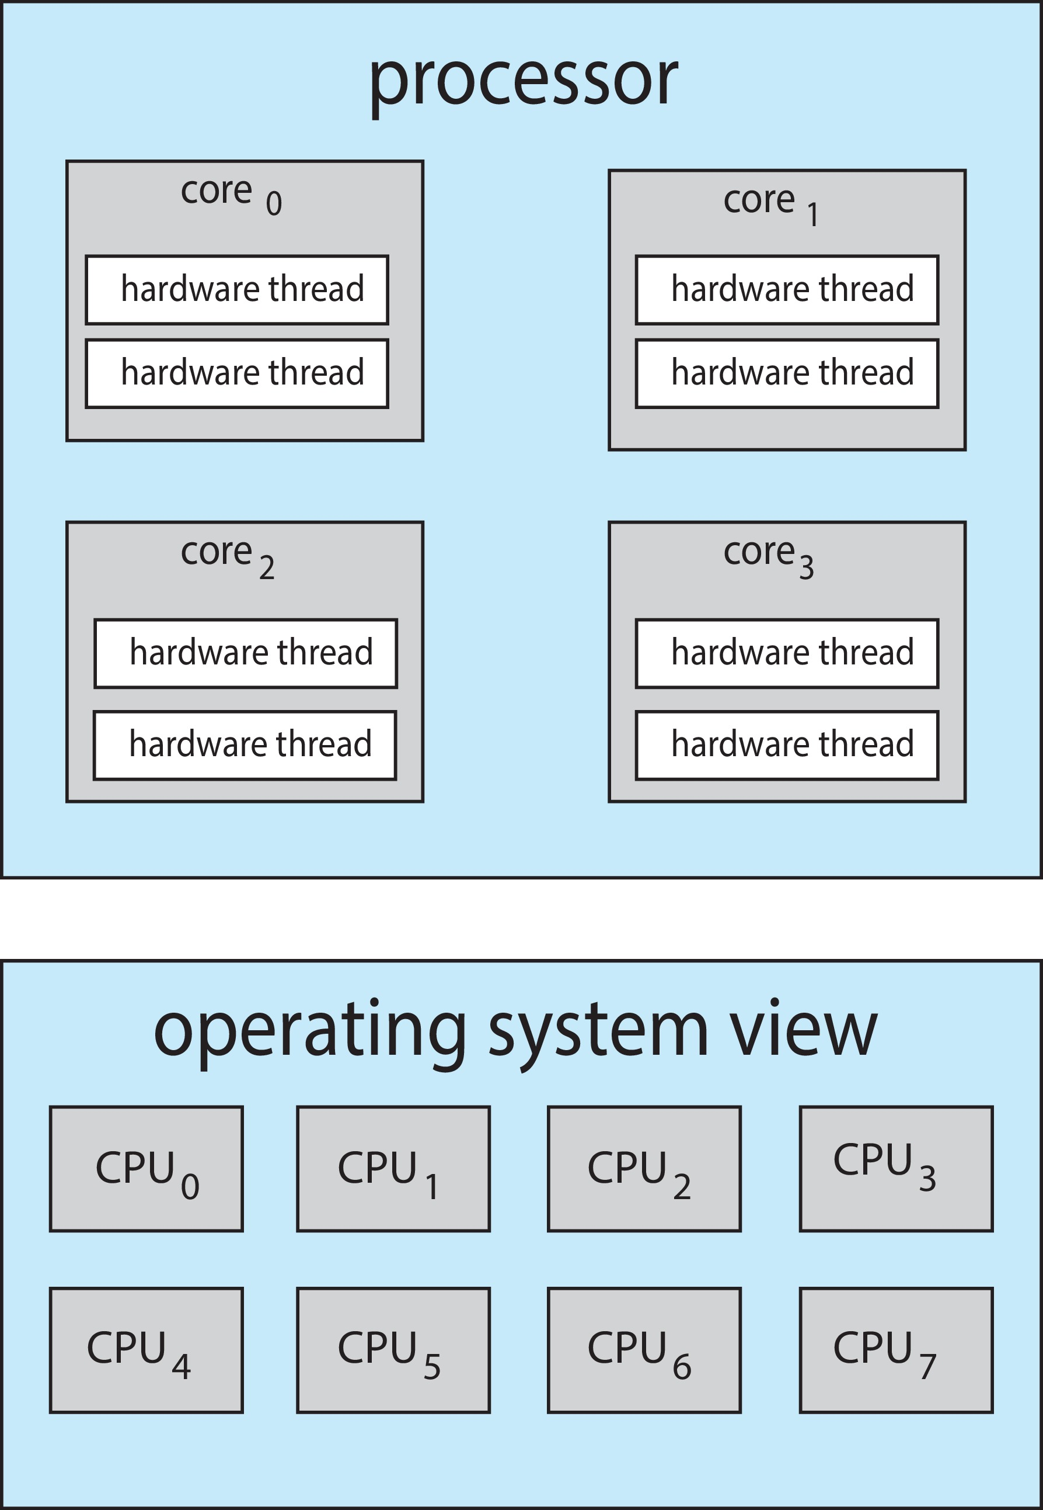
Multithreaded Multicore System (2)
Chip-multithreading (CMT) assigns each core multiple hardware threads. (Intel refers to this as hyperthreading.)
On a quad-core system with 2 hardware threads per core, the operating system sees 8 logical processors.

Slide 16
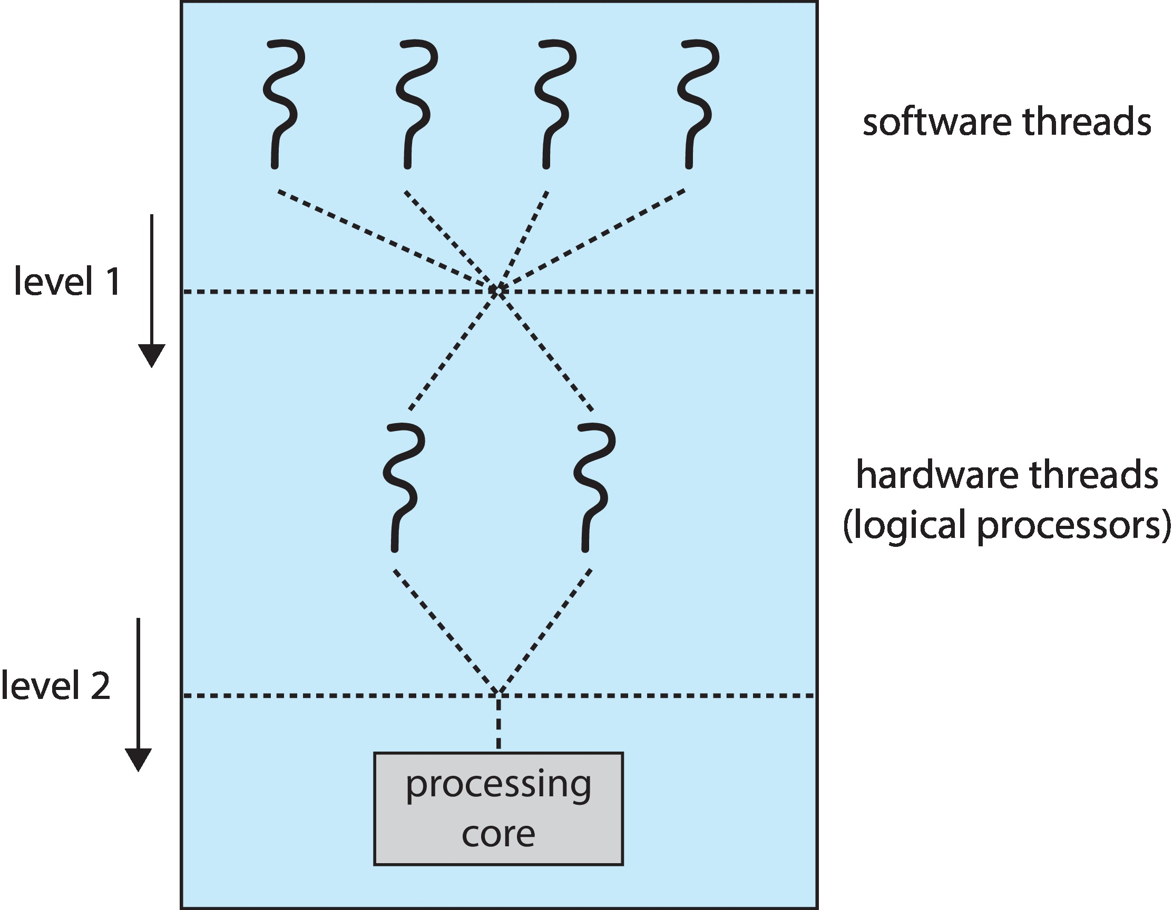
Multithreaded Multicore System (3)
Two levels of scheduling:
The operating system deciding which software thread to run on a logical CPU
How each core decides which hardware thread to run on the physical core.

Slide 17
Multiple-Processor Scheduling (1)
In SMP, it needs to keep all CPUs loaded for efficiency
Load balancing attempts to keep workload evenly distributed
Push migration – periodic task checks load on each processor, and if found pushes task from overloaded CPU to other CPUs
Pull migration – idle processors pulls waiting task from busy processor

Slide 18
Multiple-Processor Scheduling (2)
When a thread has been running on one processor, the cache contents of that processor stores the memory accesses by that thread.
We refer to this as a thread having affinity for a processor (i.e., “processor affinity”)
Load balancing may affect processor affinity as a thread may be moved from one processor to another to balance loads, yet that thread loses the contents of what it had in the cache of the processor it was moved off of.
Soft affinity – the operating system attempts to keep a thread running on the same processor, but no guarantees.
Hard affinity – allows a process to specify a set of processors it may run on.

Slide 19
NUMA and CPU Scheduling
If the operating system is NUMA-aware, it will assign memory closes to the CPU the thread is running on.

Slide 20
Real-Time CPU Scheduling (1)
Can present obvious challenges
Soft real-time systems – Critical real-time tasks have the highest priority, but no guarantee as to when tasks will be scheduled
Hard real-time systems – task must be serviced by its deadline

Slide 21
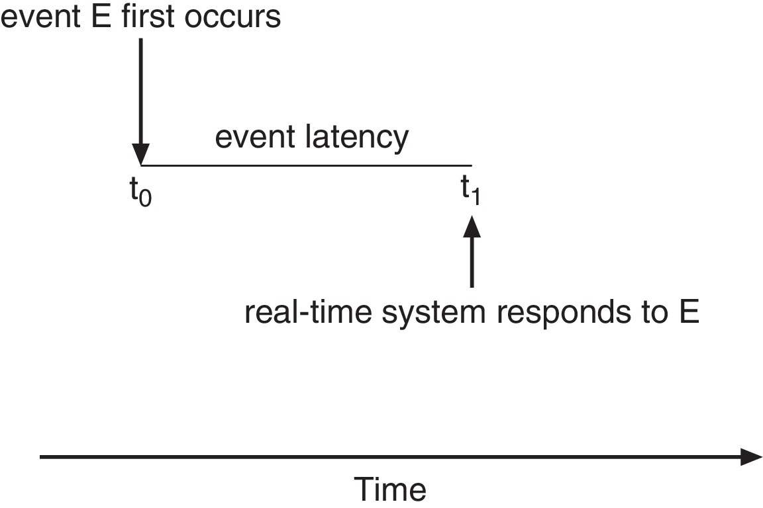
Real-Time CPU Scheduling (2)
Event latency – the amount of time that elapses from when an event occurs to when it is serviced.
Two types of latencies affect performance
Interrupt latency – time from arrival of interrupt to start of routine that services interrupt
Dispatch latency – time for schedule to take current process off CPU and switch to another

Slide 22
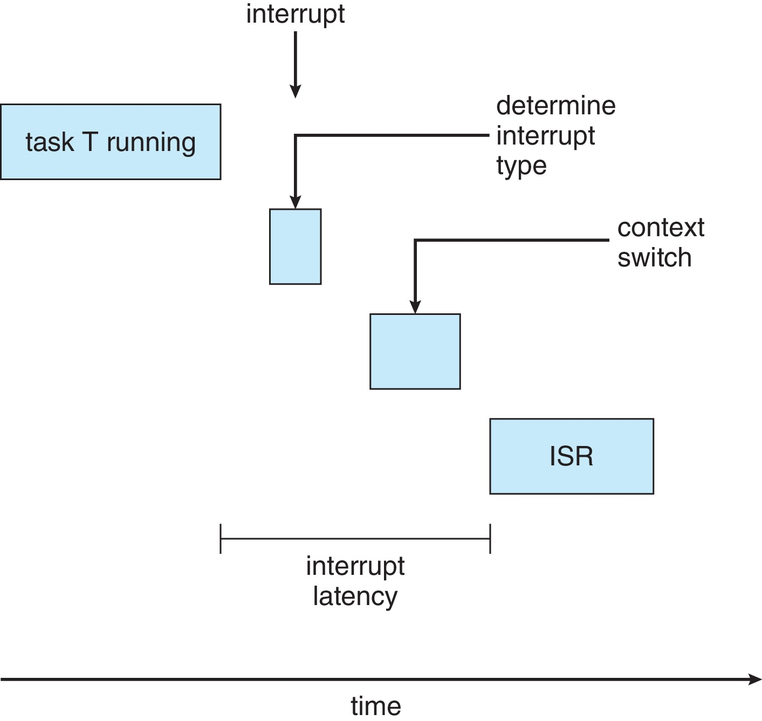
Interrupt Latency

Slide 23
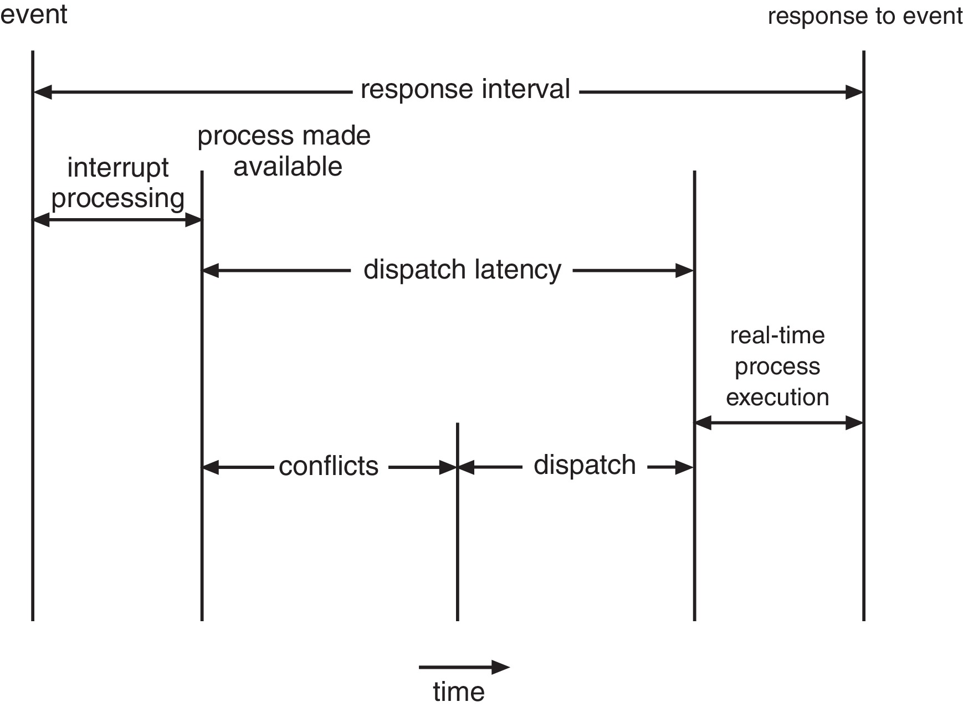
Dispatch Latency
Conflict phase of dispatch latency:
Preemption of any process running in kernel mode
Release by low-priority process of resources needed by high-priority processes

Slide 24
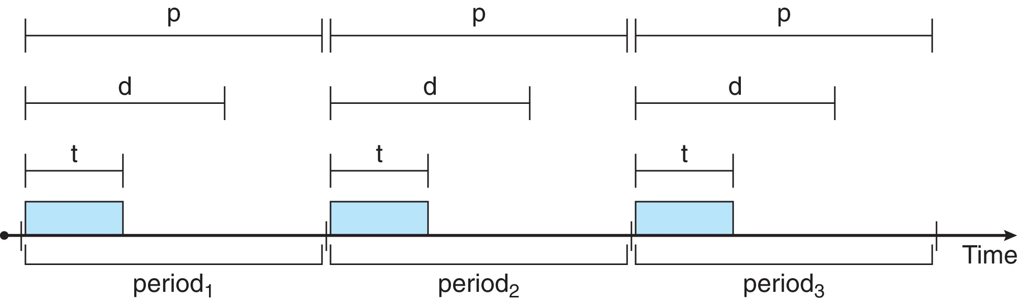
Priority-based Scheduling
For real-time scheduling, scheduler must support preemptive, priority-based scheduling
But only guarantees soft real-time
For hard real-time must also provide ability to meet deadlines
Processes have new characteristics: periodic ones require CPU at constant intervals
Has processing time t, deadline d, period p
0 ≤ t ≤ d ≤ p
Rate of periodic task is 1/p

Slide 25
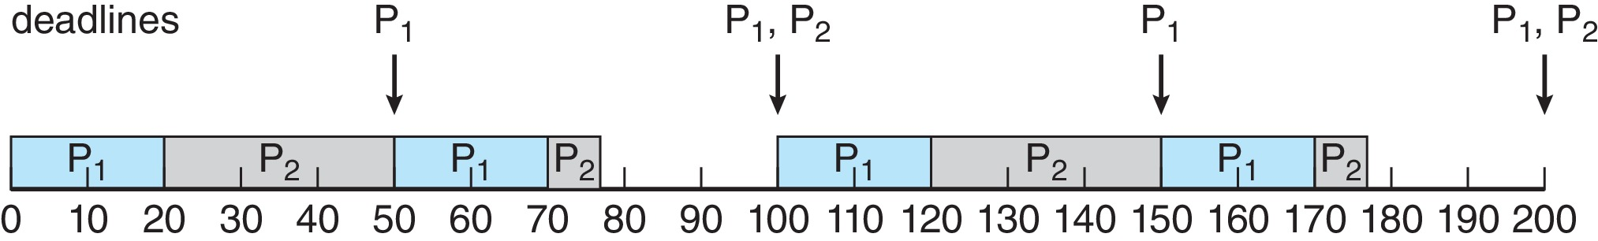
Rate Monotonic Scheduling
A priority is assigned based on the inverse of its period
Shorter periods = higher priority;
Longer periods = lower priority
P₁ is assigned a higher priority than P₂.

Slide 26
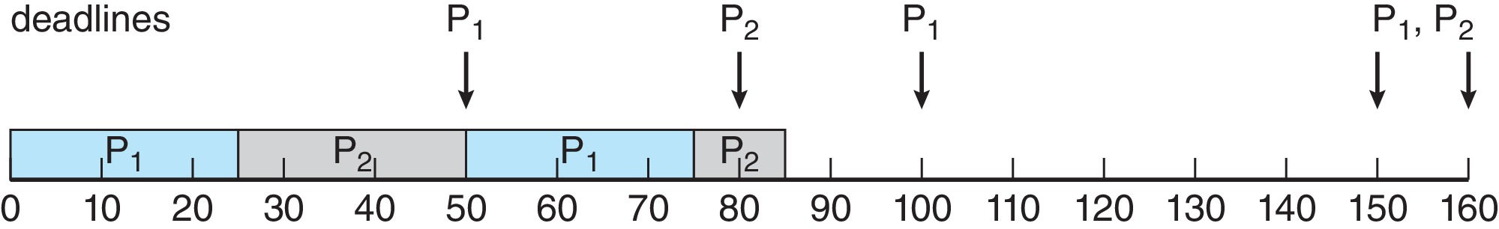
Missed Deadlines with Rate Monotonic Scheduling
Process P₂ misses finishing its deadline at time 80
Figure

Slide 27
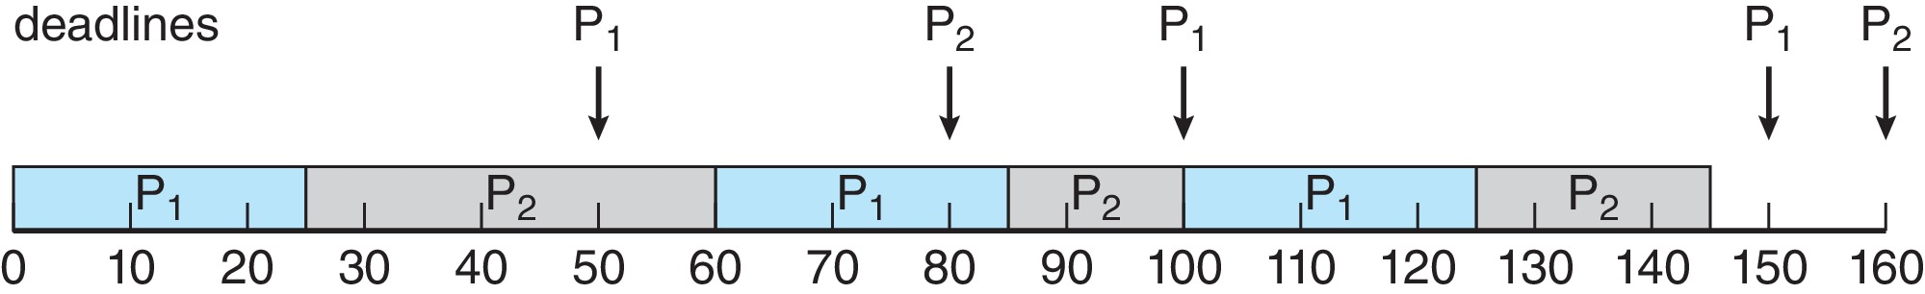
Earliest Deadline First Scheduling (EDF)
Priorities are assigned according to deadlines:
The earlier the deadline, the higher the priority
The later the deadline, the lower the priority
Figure

Slide 28
Take a Break

