Slide 1
Chapter 9 Main Memory (2)

Slide 2
Memory Protection
Memory protection implemented by associating protection bit with each frame to indicate if read-only or read-write access is allowed
Can also add more bits to indicate page execute-only, and so on
Valid-invalid bit attached to each entry in the page table:
“valid” indicates that the associated page is in the process’ logical address space, and is thus a legal page
“invalid” indicates that the page is not in the process’ logical address space
Or use page-table length register (PTLR)
Any violations result in a trap to the kernel

Slide 3

Valid (v) or Invalid (i) Bit In A Page Table

Slide 4
Shared Pages
Shared code
One copy of read-only (reentrant) code shared among processes (i.e., text editors, compilers, window systems)
Similar to multiple threads sharing the same process space
Also useful for interprocess communication if sharing of read-write pages is allowed
Private code and data
Each process keeps a separate copy of the code and data
The pages for the private code and data can appear anywhere in the logical address space

Slide 5

Shared Pages Example

Slide 6
Structure of the Page Table
Memory structures for paging can get huge using straight-forward methods
Consider a 32-bit logical address space as on modern computers
Page size of 4 KB (2¹²)
Page table would have 1 million entries (2³² / 2¹²)
If each entry is 4 bytes ➔ each process 4 MB of physical address space for the page table alone
Don’t want to allocate that contiguously in main memory
One simple solution is to divide the page table into smaller units
Hierarchical Paging
Hashed Page Tables
Inverted Page Tables

Slide 7

Hierarchical Page Tables
Break up the logical address space into multiple page tables
A simple technique is a two-level page table
We then page the page table

Slide 8
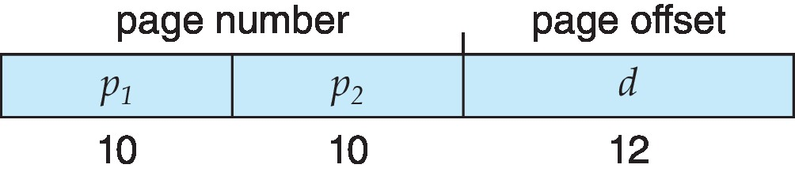
Two-Level Paging Example
A logical address (on 32-bit machine with 4K page size) is divided into:
a page number consisting of 20 bits
a page offset consisting of 12 bits
Since the page table is paged, the page number is further divided into:
a 10-bit page number
a 10-bit page offset
Thus, a logical address is as follows:
where p₁ is an index into the outer page table, and p₂ is the displacement within the page of the inner page table
Known as forward-mapped page table

Slide 9

Address-Translation Scheme

Slide 10
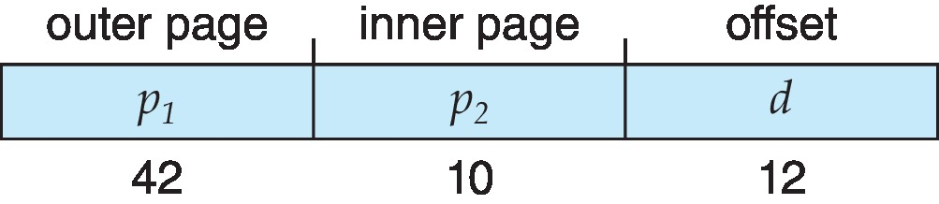
64-bit Logical Address Space
Even two-level paging scheme not sufficient
If page size is 4 KB (2¹²)
Then page table has 2⁵² entries
If two level scheme, inner page tables could be 2¹⁰ 4-byte entries
Address would look like
Outer page table has 2⁴² entries or 2⁴⁴ bytes
One solution is to add a 2nd outer page table
But in the following example the 2nd outer page table is still 2³⁴ bytes in size
And possibly 4 memory access to get to one physical memory location

Slide 11


Three-level Paging Scheme

Slide 12
Hashed Page Tables (1)
Common in address spaces > 32 bits
The virtual page number is hashed into a page table
This page table contains a chain of elements hashing to the same location
Each element contains (1) the virtual page number (2) the value of the mapped page frame (3) a pointer to the next element
Virtual page numbers are compared in this chain searching for a match
If a match is found, the corresponding physical frame is extracted
Variation for 64-bit addresses is clustered page tables
Similar to hashed but each entry refers to several pages (such as 16) rather than 1
Especially useful for sparse address spaces (where memory references are non-contiguous and scattered)

Slide 13

Hashed Page Table (2)

Slide 14
Inverted Page Table
Rather than each process having a page table and keeping track of all possible logical pages, track all physical pages
One entry for each real page of memory
Entry consists of the virtual address of the page stored in that real memory location, with information about the process that owns that page
Decreases memory needed to store each page table, but increases time needed to search the table when a page reference occurs
Use hash table to limit the search to one — or at most a few — page-table entries
TLB can accelerate access
But how to implement shared memory?
One mapping of a virtual address to the shared physical address

Slide 15

Inverted Page Table Architecture

Slide 16
Oracle SPARC Solaris (1)
Consider modern, 64-bit operating system example with tightly integrated HW
Goals are efficiency, low overhead
Based on hashing, but more complex
Two hash tables
One kernel and one for all user processes
Each maps memory addresses from virtual to physical memory
Each entry represents a contiguous area of mapped virtual memory,
More efficient than having a separate hash-table entry for each page
Each entry has base address and span (indicating the number of pages the entry represents)

Slide 17
Oracle SPARC Solaris (2)
TLB holds translation table entries (TTEs) for fast hardware lookups
A cache of TTEs reside in a translation storage buffer (TSB)
Includes an entry per recently accessed page
Virtual address reference causes TLB search
If miss, hardware walks the in-memory TSB looking for the TTE corresponding to the address
If match found, the CPU copies the TSB entry into the TLB and translation completes
If no match found, kernel interrupted to search the hash table
The kernel then creates a TTE from the appropriate hash table and stores it in the TSB, Interrupt handler returns control to the MMU, which completes the address translation.

Slide 18
Swapping (1)
A process can be swapped temporarily out of memory to a backing store, and then brought back into memory for continued execution
Total physical memory space of processes can exceed physical memory
Backing store – fast disk large enough to accommodate copies of all memory images for all users; must provide direct access to these memory images
Roll out, roll in – swapping variant used for priority-based scheduling algorithms; lower-priority process is swapped out so higher-priority process can be loaded and executed
Major part of swap time is transfer time; total transfer time is directly proportional to the amount of memory swapped
System maintains a ready queue of ready-to-run processes which have memory images on disk

Slide 19
Swapping (2)
Does the swapped out process need to swap back in to same physical addresses?
Depends on address binding method
Plus consider pending I/O to / from process memory space
Modified versions of swapping are found on many systems (i.e., UNIX, Linux, and Windows)
Swapping normally disabled
Started if more than threshold amount of memory allocated
Disabled again once memory demand reduced below threshold

Slide 20

Schematic View of Swapping

Slide 21
Context Switch Time and Swapping (1)
If next processes to be put on CPU is not in memory, need to swap out a process and swap in target process
Context switch time can then be very high
100MB process swapping to hard disk with transfer rate of 50MB/sec
Swap out time of 2000 ms
Plus swap in of same sized process
Total context switch swapping component time of 4000ms (4 seconds)
Can reduce if reduce size of memory swapped – by knowing how much memory really being used
System calls to inform OS of memory use via request_memory() and release_memory()

Slide 22
Context Switch Time and Swapping (2)
Other constraints as well on swapping
Pending I/O – can’t swap out as I/O would occur to wrong process
Or always transfer I/O to kernel space, then to I/O device
Known as double buffering, adds overhead
Standard swapping not used in modern operating systems
But modified version common
Swap only when free memory extremely low

Slide 23
Swapping on Mobile Systems
Not typically supported
Flash memory based
Small amount of space
Limited number of write cycles
Poor throughput between flash memory and CPU on mobile platform
Instead use other methods to free memory if low
iOS asks apps to voluntarily relinquish allocated memory
Read-only data thrown out and reloaded from flash if needed
Failure to free can result in termination
Android terminates apps if low free memory, but first writes application state to flash for fast restart
Both OSes support paging as discussed below

Slide 24
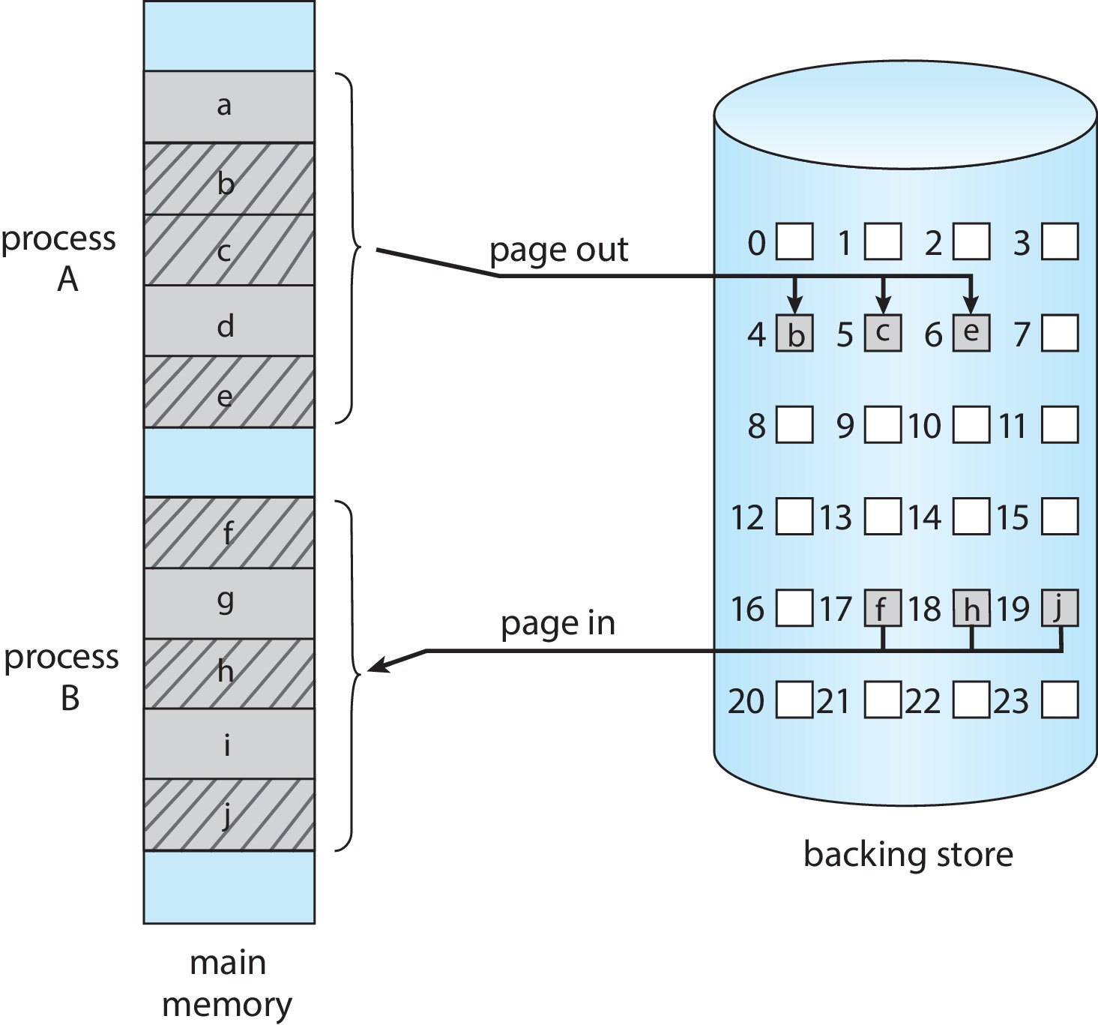
Swapping with Paging

Slide 25
The Intel 32 and 64-bit Architectures
Dominant industry chips
Pentium CPUs are 32-bit and called IA-32 architecture
Current Intel CPUs are 64-bit and called IA-64 architecture
Many variations in the chips, cover the main ideas here

Slide 26
The Intel IA-32 Architecture (1)
Supports both segmentation and segmentation with paging
Each segment can be 4 GB
Up to 16 K segments per process
Divided into two partitions
First partition of up to 8 K segments are private to process (kept in local descriptor table (LDT))
Second partition of up to 8K segments shared among all processes (kept in global descriptor table (GDT))

Slide 27

The Intel IA-32 Architecture (2)
CPU generates logical address
Selector given to segmentation unit
Which produces linear addresses
Linear address given to paging unit
Which generates physical address in main memory
Paging units form equivalent of MMU
Pages sizes can be 4 KB or 4 MB

Slide 28
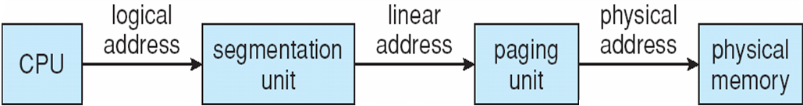
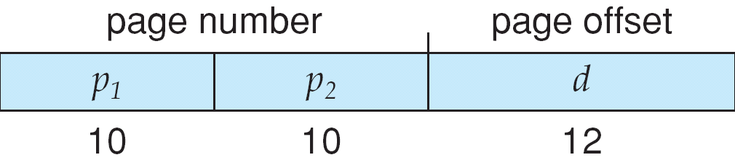
Logical to Physical Address Translation in IA-32

Slide 29
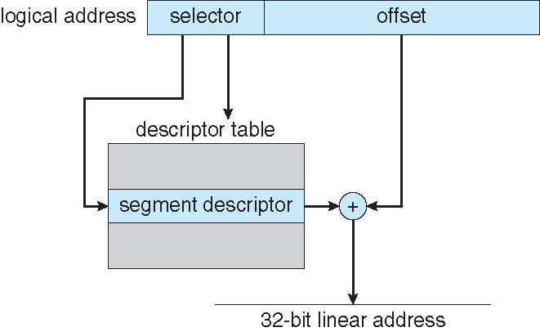
Intel IA-32 Segmentation

Slide 30
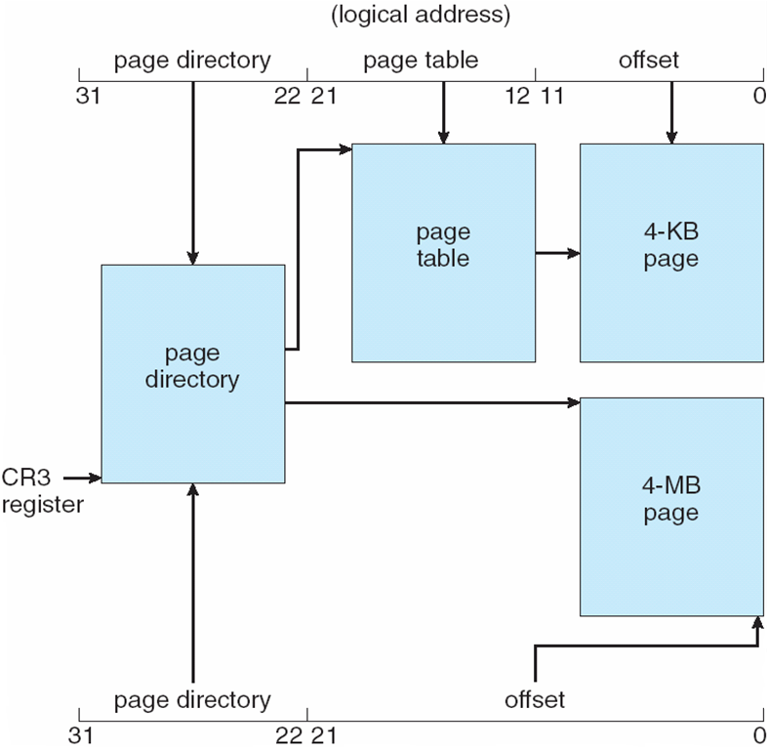
Intel IA-32 Paging Architecture

Slide 31
Intel IA-32 Page Address Extensions
32-bit address limits led Intel to create page address extension (PAE)
allowing 32-bit apps access to more than 4GB of memory space
Paging went to a 3-level scheme
Top two bits refer to a page directory pointer table
Page-directory and page-table entries moved to 64-bits in size
Net effect is increasing address space to 36 bits – 64GB of physical memory

Slide 32
Intel x86-64
Current generation Intel x86 architecture
64 bits is ginormous (> 16 exabytes)
In practice only implement 48 bit addressing
Page sizes of 4 KB, 2 MB, 1 GB
Four levels of paging hierarchy
Can also use PAE so virtual addresses are 48 bits and physical addresses are 52 bits

Slide 33
Example: ARM Architecture
Dominant mobile platform chip (Apple iOS and Google Android devices for example)
Modern, energy efficient, 32-bit CPU
4 KB and 16 KB pages
1 MB and 16 MB pages (termed sections)
One-level paging for sections, two-level for smaller pages
Two levels of TLBs
Outer level has two micro TLBs (one data, one instruction)
Inner is single main TLB
First inner is checked, on miss outers are checked, and on miss page table walk performed by CPU

Slide 34
End of Chapter 9

