Slide 1





Slide 2
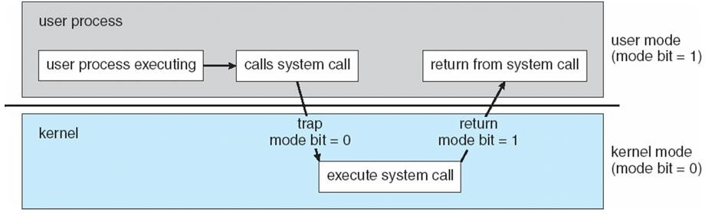
Process
User Mode
Kernel Mode
Complete access to hardware

Slide 3
Process
Process: Program in execution
Multiple processes: Concurrent vs Parallel. Processor vs CPU vs Core
In multitasking operating systems, processes (running programs) need a way to create new processes, e.g. to run a program.
Process state:
new: The process is being created
running: Instructions are being executed
waiting: The process is waiting for some event to occur
ready: The process is waiting to be assigned to a processor
terminated: The process has finished execution

Slide 4
Process
Each process is named by a process ID number. Generally, process is identified and managed via a process identifier (pid)
A unique process ID is allocated to each process when it is created.
The lifetime of a process ends when its termination is reported to its parent process. At that time, all of the process resources, including its process ID, are freed.

Slide 5
Process Creation
Processes are created with the fork system call (so the operation of creating a new process is sometimes called forking a process).
The child process created by fork is an exact clone of the original parent process, except that it has its own process ID.

Slide 6
Process Creation
Functions (Unix-like system):
pid_t fork(void) system call creates new process
Return value
fork() returns -1, the creation of a child process was unsuccessful.
fork() returns a zero to the newly created child process.
fork() returns a positive value, the process ID of the child process, to the parent.
The returned process ID is of type pid_t defined in ”sys/types.h”.

Slide 7
Parent and Child Process
If the call to fork() is executed successfully, Unix will
make two identical copies of address spaces, one for the parent and the other for the child.
Both processes will start their execution at the next statement following the fork() call.

Slide 8
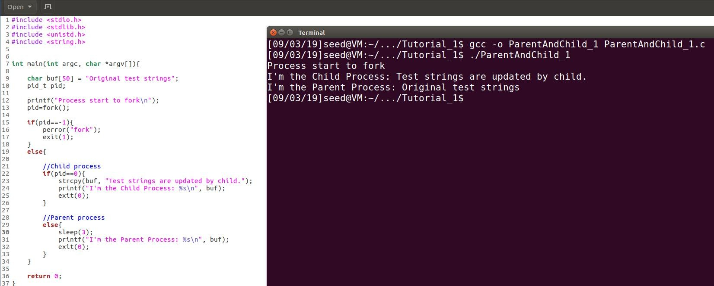
Parent and Child Process 1 - pid
Both parent and child process start execution from next statement after fork call.

Slide 9
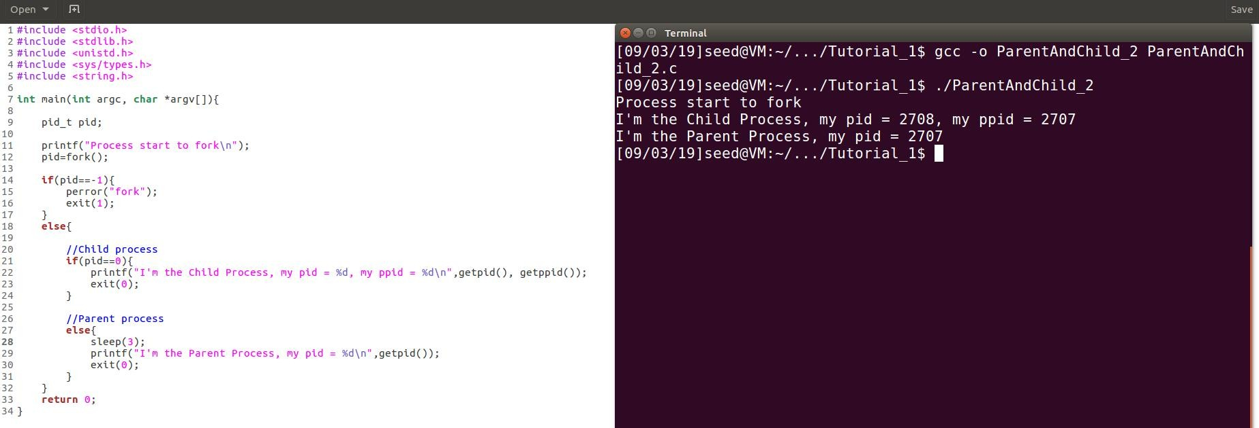
Parent and Child Process 2
getpid() returns PID of calling system.
getppid() returns PID of the parent of calling
system.
Let parent process to sleep for 3s, and then print messages.

Slide 10
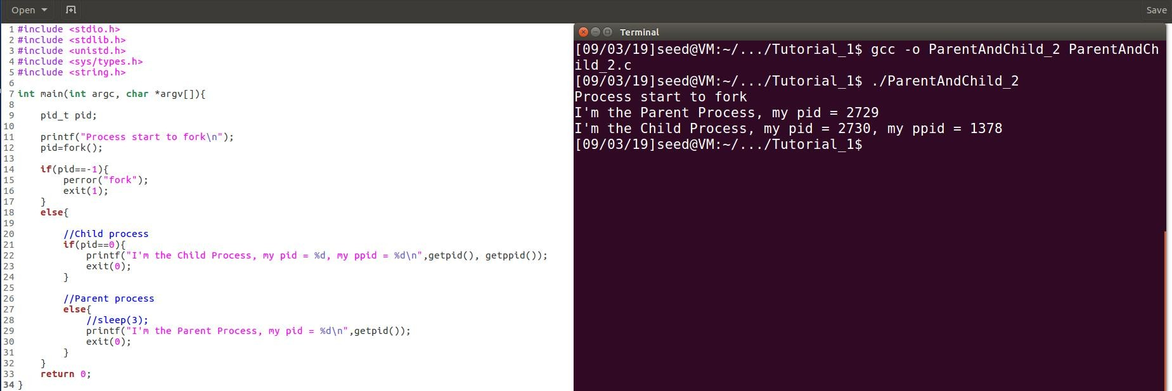

Parent and Child Process 2
Why?
Parent process terminates, and the child process is inherited by init process, whose pid is 1378 in my example. It may change every time rebooting the OS.
When testing in Mac OS, it might be
-1.
Parent and child process runs concurrently after forking.

Slide 11
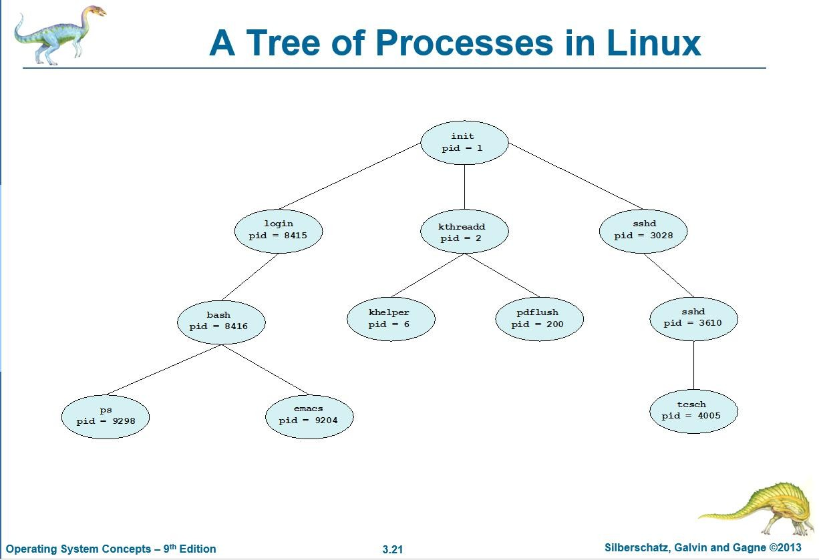
Parent and Child Process

Slide 12
Executing a file
exec is a functionality of an operating system that runs an executable file in the context of an already existing process, replacing the previous executable. This act is also referred to as an overlay.
Exec function family
int execl (const char *filename, const char *arg0, ...)
int execve (const char *filename, char *const argv[], char *const env[])
int execle (const char *filename, const char *arg0, char *const env[], ...)
int execvp (const char *filename, char *const argv[])
int execlp (const char *filename, const char *arg0, ...)

Slide 13
Executing a file
New process will not be created, the original PID does not change, but the machine code, data, heap and stack of the process are replaced by those of the new program.
Return value
A successful exec replaces the current process image, so it cannot return anything to the program that made the call.
If an exec function does return to the calling program, an error occurs, the return value is −1

Slide 14
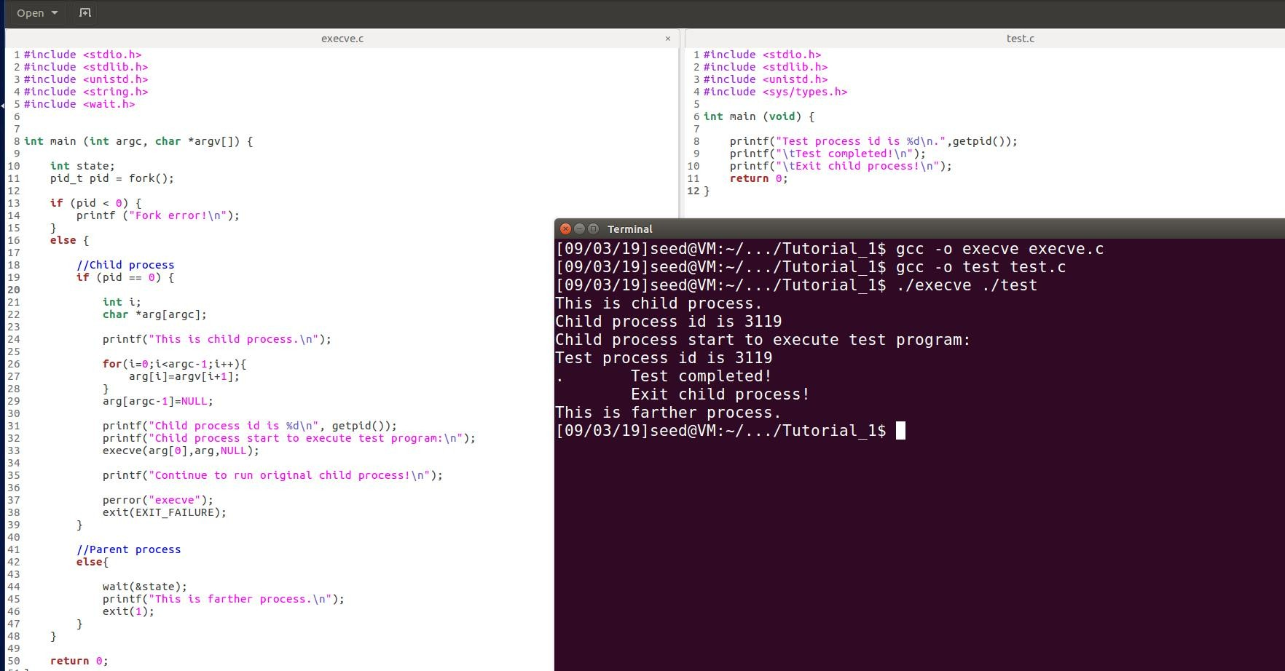
Executing a file – execve()
Check if the test program is replacing child process but will not create new process
path of the executed file
In child process, execute a new file.
Check if the child process is replaced by new program

Slide 15
Process Termination
Process executes last statement and asks the operating system to delete it (exit())
Output data from child to parent (via wait())
Process’ resources are deallocated by operating system
If no parent is waiting when process terminates, then terminated process is a zombie
If the parent process terminates before the child processes, then terminated process is an orphan

Slide 16
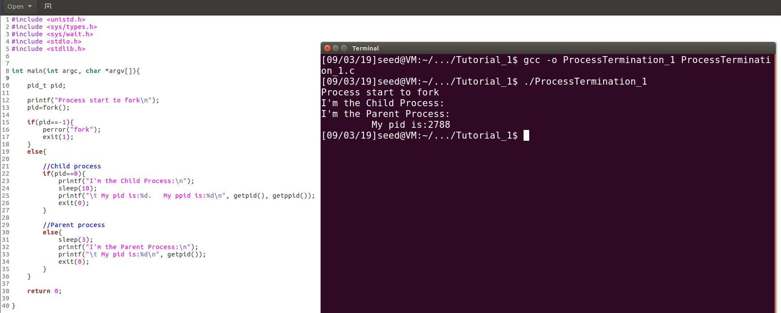
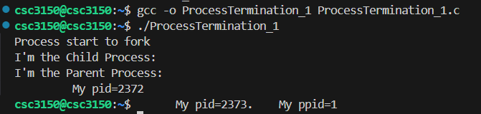
Process Termination 1 - orphan
Let parent process to terminate ahead of child process
Parent process terminates, and the child process becomes orphans, and will be adopted by init process.

Slide 17
Process Termination 2
Functions: (defined in “sys/wait.h”)
0 / WNOHANG / WUNTRACED
0 skips the option, and keeps waiting until the specified child process terminates.
pid_t wait (int *status_ptr)
pid_t waitpid (pid_t pid, int *status_ptr, int option• s) WNOHANG demands status information immediately.
If status information is immediately available on an appropriate child process, waitpid() returns this information. Otherwise, waitpid() returns immediately with an error code indicating that the information was not available. In other words, it checks child processes without causing the caller to be suspended.
Differences
wait() requests status for any child process
WUNTRACED reports on stopped child processes as
waitpid() requests status for specific child process. well as terminated ones.
The waitpid() function behaves the same as wait() if the pid argument is (pid_t) -1 and the options argument is 0.
https://stackoverflow.com/questions/33508997/waitp id-wnohang-wuntraced-how-do-i-use- these/34845669
https://linux.die.net/man/2/waitpid

Slide 18
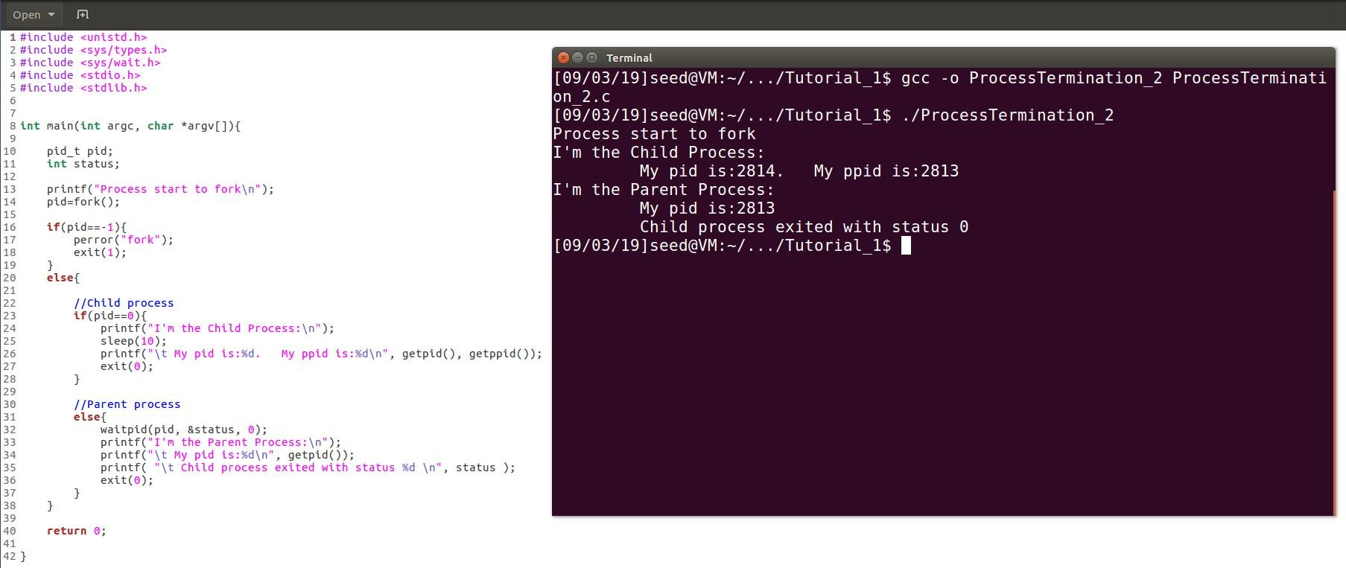
Process Termination 2 – waitpid()
Child process sleeps 10s and parent process will suspend until status information of child process is available.

Slide 19
Process Termination 2
pid_t wait (int *status_ptr)
pid_t waitpid (pid_t pid, int *status_ptr, int option• s)
Return value
wait() or waitpid() returns PID of child process when the status of a child process is available.
If unsuccessful, wait() or waitpid() returns -1.
When waitpid() returns with a valid process ID (pid), below macros can analyze the status referenced by the status argument.
int WIFEXITED (int status)
int WIFSIGNALED (int status)
int WIFSTOPPED (int status)
etc.

Slide 20
Process Signals
Linux supports the standard signals listed below.
SIGQUIT 3
SIGKILL 9
SIGTERM 15
SIGSTOP 19
etc.
https://stackoverflow.com/questions/50299429/c-reporting-which-signal-terminated-a- child

Slide 21
Process Signals
Send a signal to caller
int raise (int sig)
Evaluate child process’s status (zero or non-zero)
int WIFEXITED (int status)
int WIFSIGNALED (int status)
int WIFSTOPPED (int status)
Evaluate child process’s returned value of status argument(exact values)
int WEXITSTATUS (int status)
int WTERMSIG (int status)
int WSTOPSIG (int status)

Slide 22
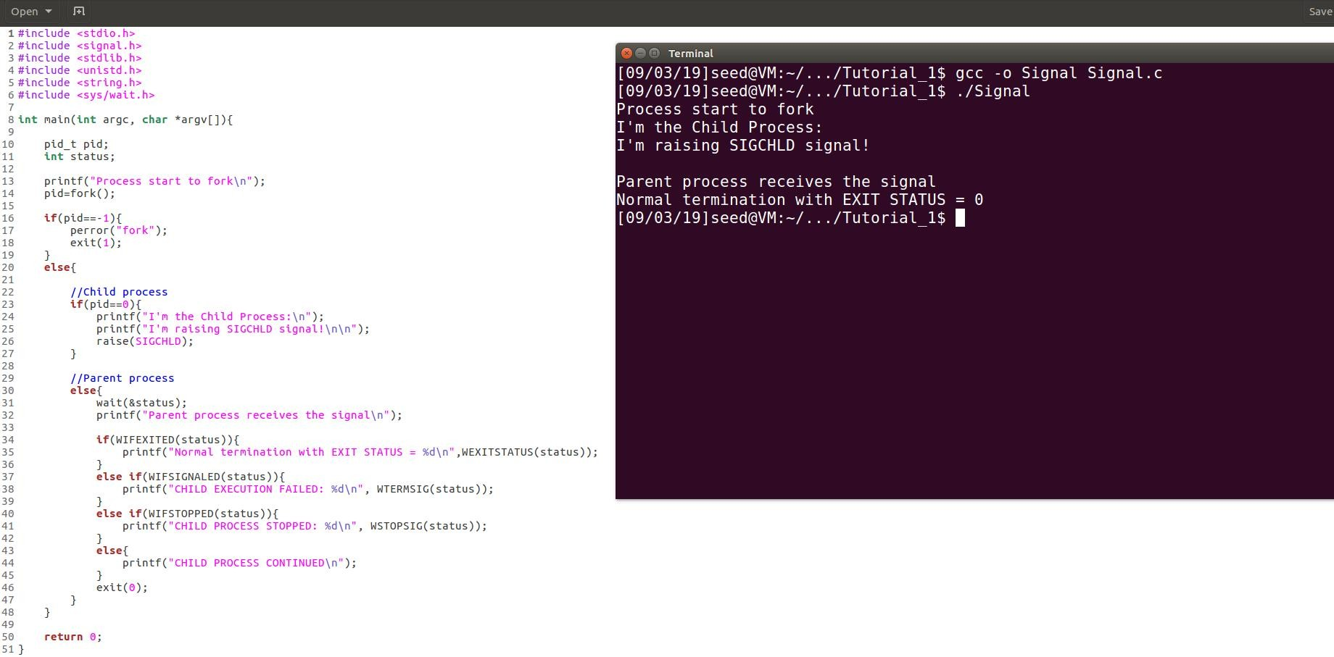
Process Signals 1 – wait()
Raise SIGCHLD in child process
Check if child process exits normally
Get status value of child process

Slide 23
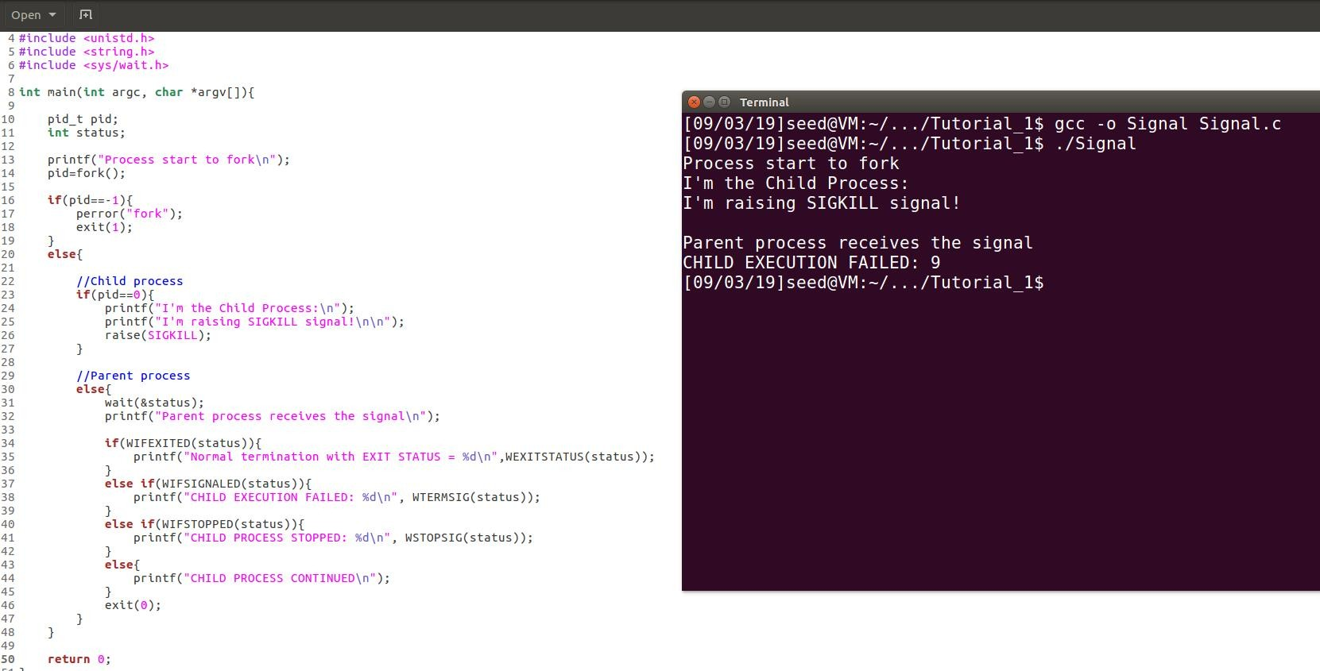
Process Signals 1 – wait()
Raise SIGKILL in child process
Check if child process received a terminating signal
Get status value for child progress’ terminating signal

Slide 24
Thank you

