Slide 1



Tutorial 3

Slide 2
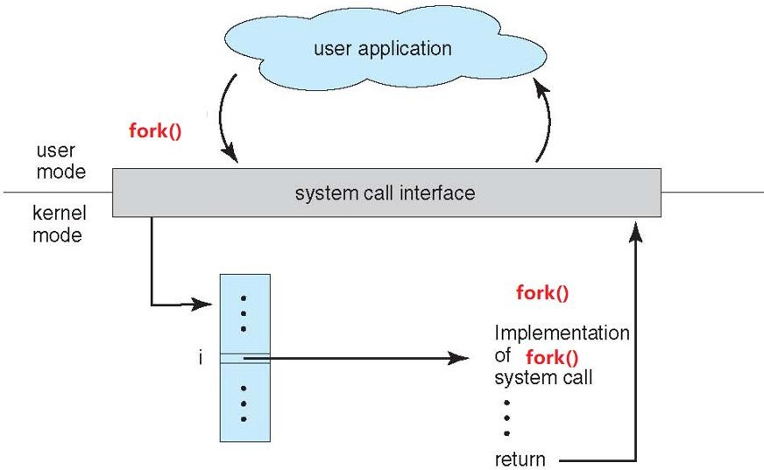
Process creation
Search sys_fork() in sys_call_table[]
Implemented via calling do_fork()

Slide 3
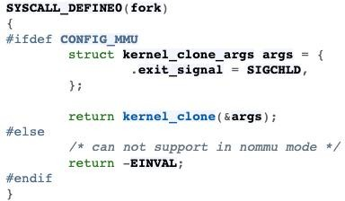
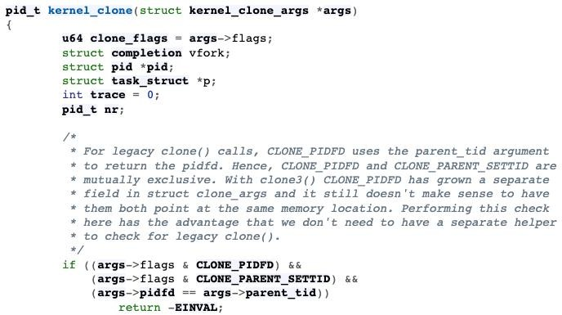
Process creation
https://tinylab.org/riscv-task-implementation/

Slide 4
Process creation (kernel_clone)
Its implementation is defined in ‘/kernel/fork.c’:
Call get_task_pid() to assign an available PID to the new task.
Call copy_process() then either duplicates or shares open files, file system information, signal handlers, process address space, and namespace.
In copy_process, it calls dup_task_struct(), which creates a new kernel stack, thread_info structure, and task_struct for the new process.
wake_up_new_task() to wake up the child process and insert the child process to the running queue.
For more details
https://elixir.bootlin.com/linux/v5.10/source/kernel/fork.c#L2415
You should check basing on your own version

Slide 5
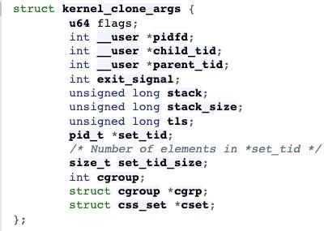
Process creation (kernel_clone)
kernel_clone:
extern pid_t kernel_clone(struct kernel_clone_args *kargs);
Arguments:

Slide 6
Process creation (kernel_clone)
Arguments:
flags: How to clone the child process. When executing fork(), it is set as SIGCHILD.
stack: Specifies the location of the stack used by the child process.
stack_size: Normally set as 0 because it is unused.
parent_tid: Used for clone() to point to user space memory in parent process address space. It is set as NULL when executing fork();
child_tid: Used for clone() to point to user space memory in child process address space. It is set as NULL when executing fork();
tls: Set thread local storage.

Slide 7
Process creation (kernel_clone)
Return value:
Fork successfully: pid of child process
Failed: Err

Slide 8
Program execution (do_execve)
Its implementation is defined in ‘/fs/exec.c’:
struct linux_binprm: This structure is used to hold the arguments that are used when loading binaries. It is defined in ‘include/linux/binfmts.h’
Use prepare_bprm_creds API to initialize the struct
Open your program file and assign corresponding values into struct linux_binprm
Use the bprm_mm_init and prepare_binprm to prepare execute your binary program
Read the file content and copy corresponding information into your struct linux_binprm
Use search_binary_handler to execute your binary program
After execve succeeded, it calls acct_update_integrals and free the binary program by calling free_brpm

Slide 9
Program execution (do_execve)
do_execve:
int do_execve ( struct filename *filename,
const char user *const user * argv, const char user *const user * envp);
Parameters:
filename: Filename of the executable file.
argv: The arguments for executing the file.
envp: System environment variable set.
Return value:
Execute successfully: 0
Failed: Err

Slide 10
Wait for signal (do_wait)
In kernel mode, when system call do_wait() is executed, it is loading exit.ko module.
Its implementation is defined in ‘/kernel/exit.c’:
Create wait_opts structure and add it into wait queue by calling add_wait_queue.
Use set_current_state to update state as TASK_INTERRUPTIBLE or TASK_RUNNING.
When child process terminates, it calls wake_up_parent. Then parent process will go to repeat scanning, so that it can get return of child process’ termination.
For more details:
https://elixir.bootlin.com/linux/v5.10/source/kernel/exit.c(do_wait)

Slide 11
Wait for signal (do_wait)
do_wait:
long do_wait (struct wait_opts *wo);
struct wait_opts:
struct wait_opts { enum pid_type wo_type; //It is defined in ‘/include/linux/pid.h’.
int wo_flags; //Wait options. (0, WNOHANG, WEXITED, etc.)
struct pid *wo_pid; //Kernel's internal notion of a process identifier.
“Find_get_pid()”
struct siginfo user *wo_info; //Singal information.
int user *wo_stat; // Child process’s termination status struct rusage user *wo_rusage; //Resource usage wait_queue_entry_t child_wait; //Task wait queue
int notask_error ;};

Slide 12
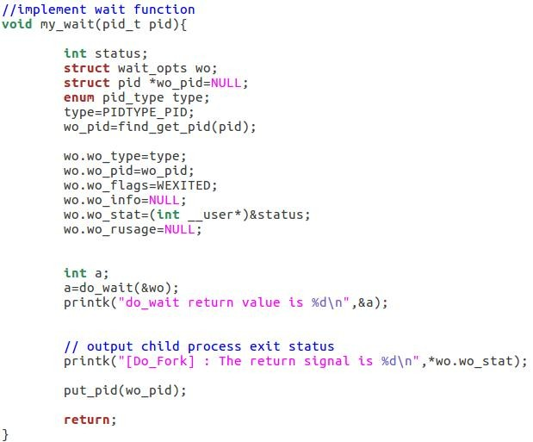
Wait for signal (do_wait)
Look up a PID from hash table and return with it’s count evaluated.
Decrease the count and free memory

Slide 13
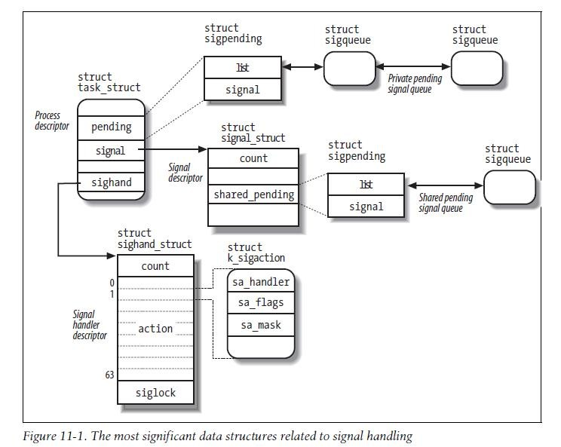
Handle signal (k_sigaction)
For each process in the system, the kernel must keep track of what signals are currently pending or masked. The kernel must keep track of how every thread group is supposed to handle every signal.
To do this, the kernel uses several data structures accessible from the process descriptor. The most significant data structures related to signal handling：

Slide 14
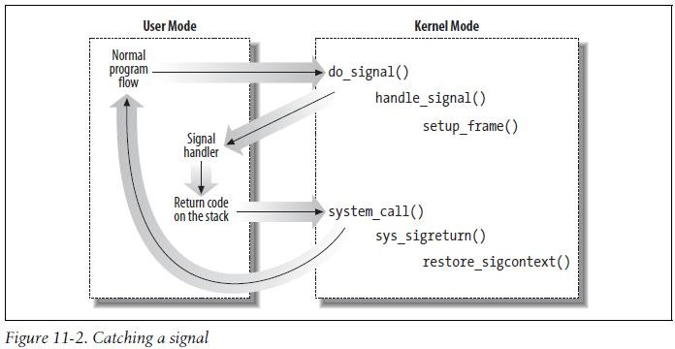
Handle signal (k_sigaction)
The signal field of the process descriptor points to a signal descriptor, a signal_struct structure that keeps track of the shared pending signals.
The of properties of a signal are stored in a k_sigaction structure, which contains the signal properties.
The kernel noticed the arrival of a signal and invoked function to prepare the process descriptor of the process that is supposed to receive the signal. (do_signal())
If a handler has been extablished for the signal, the do_signal() function must enforce its execution. (handle_signal()
)

Slide 15
Kernel Thread
Kthread creation:
struct task_struct *kthread_create( int (*threadfn)(void *data),
void *data,
const char *namefmt, ...);
The data argument will simply be passed to the thread function.
The thread will not start running immediately. It will start to execute when returned task_struct is passed to wake_up_process().
Kthread execution function:
int thread_function(void *data);
It can either call do_exit directly if it is a standalone thread for which no one will call kthread_stop()
Or return when 'kthread_should_stop' is true (which means kthread_stop has been called).

Slide 16
Kernel Thread
Return value:
It returns task_struct when executes successfully.
When fails, it returns ERR_PTR
Kthred start execution with:
int wake_up_process (struct task_struct * p);
ERR_PTR
A convenient function which creates and starts the thread:
struct task_struct *kthread_run( int (*threadfn)(void *data),
void *data,
const char *namefmt, ...);
Same as kthread_create() + wake_up_process()

Slide 17
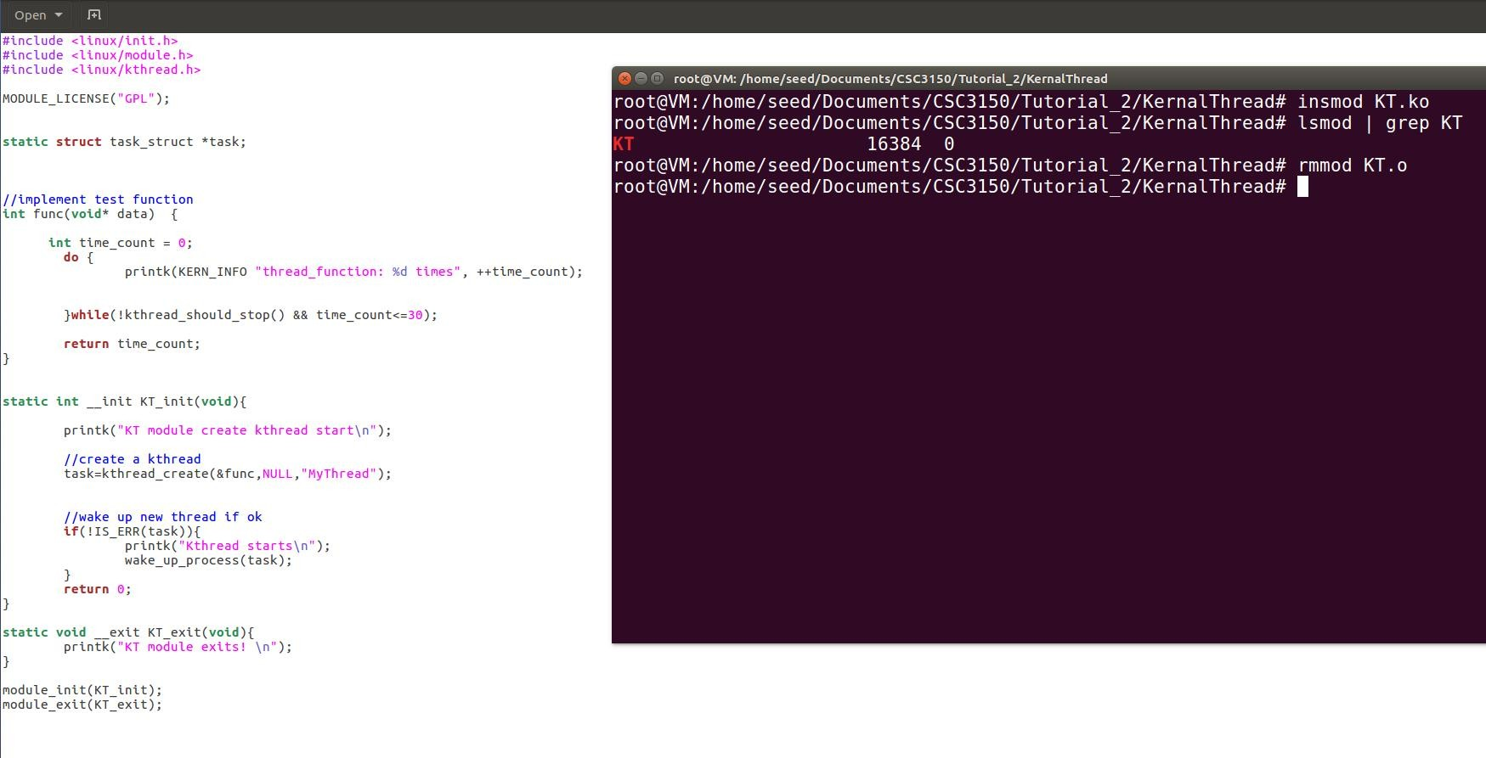

Kernel Thread
GPL: General Public License.
Loading a proprietary or non-GPL-compatible LKM will set a 'taint' flag in the running kernel
Create a kernel thread to execute func

Slide 18
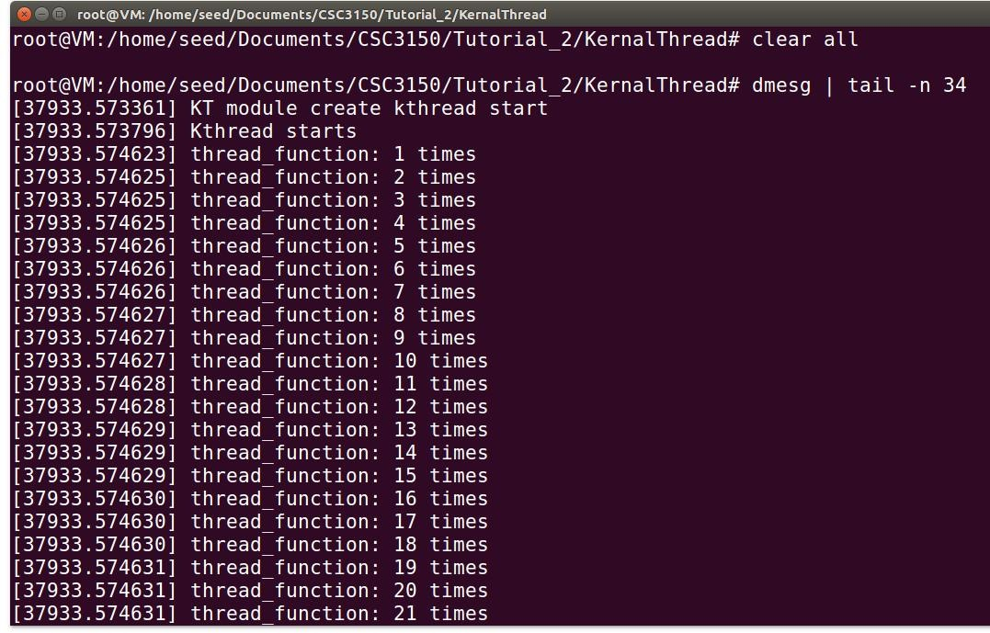
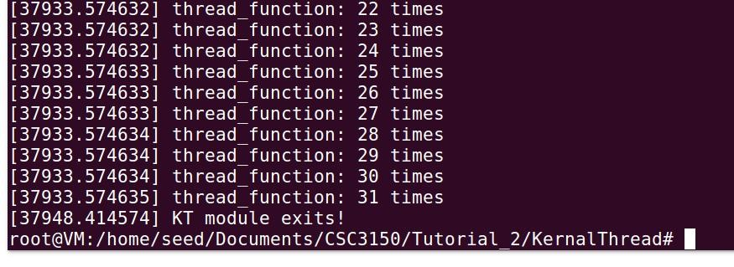
Kernel Thread

Slide 19
Kernel Object
A loadable kernel module (or LKM) is an object file that contains code to extend the running kernel, or so-called base kernel
LKMs are typically used to add support for new hardware and/or file systems, or for adding system calls.
Most current Unix-like systems support loadable kernel modules, although they might use a different name for them,
for example: kernel extension (kext) in MacOS

Slide 20
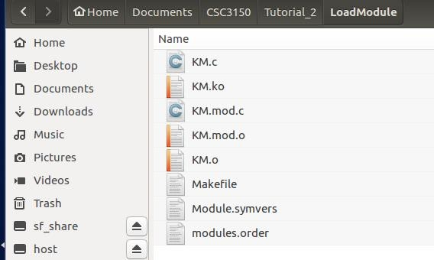
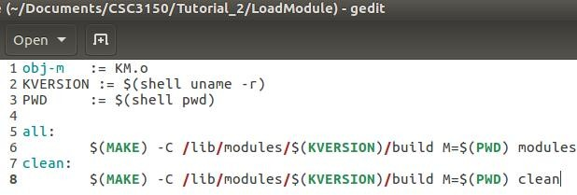
Kernel Object Compiling (Makefile)
Makefile
http://www.cyberciti.biz/tips/compiling-linux-kernel-module.html
Build kernel object
‘KM’ is name of the Kernel Object
Type command “Make”
If you type command “Make clean”, it will clear all built files and leave original c file and makefile .

Slide 21
Insert and Remove Kernel Module
Before insert the kernel object, you have to sign in the root account.
$ sudo su
Insert module
$insmod MODULE_NAME.ko
List the module you insert
$lsmod
$lsmod | grep MODULE_NAME
Remember to remove your module
$rmmod MODULE_NAME.ko

Slide 22
Compile Kernel
Download source code from
http://www.kernel.org
mirro: https://mirror.tuna.tsinghua.edu.cn/kernel/v5.x/
Install Dependency and development tools
sudo apt-get install libncurses-dev gawk flex bison openssl libssl-dev dkms libelf-dev libudev- dev libpci-dev libiberty-dev autoconf llvm dwarves
Extract the source file to /home/seed/work
cp KERNEL_FILE.tar.xz /home/seed/work
cd /home/seed/work
$sudo tar xvf KERNEL_FILE.tar.xz

Slide 23
Compile Kernel
Copy config from /boot to /home/seed/work/KERNEL_FILE
Login root account and go to kernel source directory
$sudo su
$cd /home/seed/work /KERNEL_FILE

Slide 24
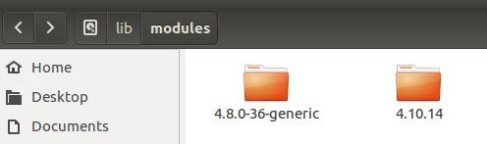


Compile Kernel
Clean previous setting and start configuration
$make mrproper
$make clean
$make menuconfig
save the config and exit
Build kernel Image and modules
$make bzImage -j$(nproc)
$make modules -j$(nproc)
~ 30 mins to finish
$make –j$(nproc)
(you could use this command to replace above two commands)

Slide 25


Compile Kernel
Install kernel modules
$make modules_install
Install kernel
$make install
Reboot to load new kernel
$reboot
(When rebooting, you should select the updated kernel)

Slide 26

Compile Kernel
Check exiting kernel version
$uname -r

Slide 27
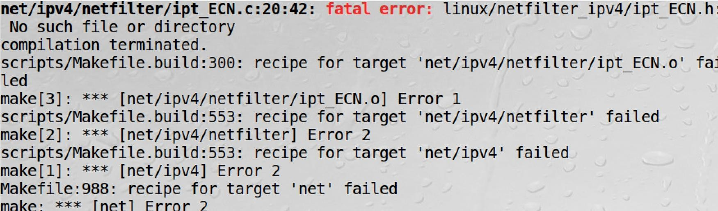
Problem discussion for compiling kernel
Fatal error (No such file or directory)
Ensure your source package is extracted within Linux, not in Windows or Mac.
Filename is Linux is case sensitive, but it is case non-sensitive in Windows or Mac. It may rename some files when extracting them, so that these files cannot be found when compiling.

Slide 28
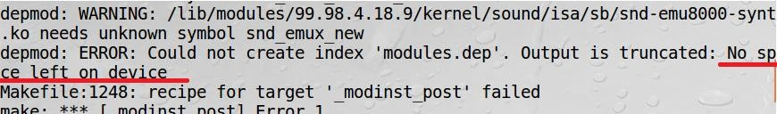
Problem discussion for compiling kernel
Space is not enough
Copy the source file from original space(e.g., /usr/src) to extended space(e.g.,
/home/seed/work)
Remove the source file from original space(e.g., /usr/src)
In source file (stored in extended space), continue to installation.
(Do not start from ‘make clean’, which will remove all the previous built, start from previous interrupted step)

Slide 29
Problem discussion for compiling kernel
Do not compile kernel source code under shared folder.
Copy the source code to extended space.
Then start to compile.
If you compiling it under shared folder, some files might be created failed, and it would lead to error when executing install step.

Slide 30
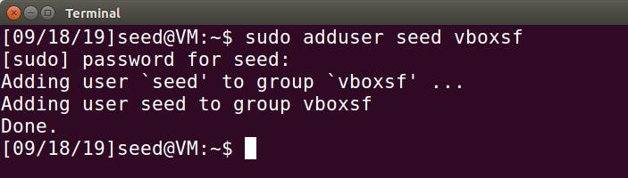
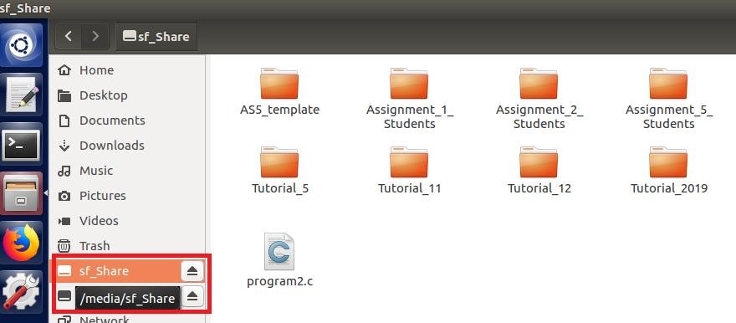
Problem discussion for compiling kernel
Share folder mounting does not work
After creating a Share folder in Shared folder setting, open terminal and type command ‘sudo adduser seed vboxsf’
Reboot the machine
You will see /media/sf_Share will auto mount to your share folder
You could access this share folder via ‘cd /media/sf_Share’.

Slide 31
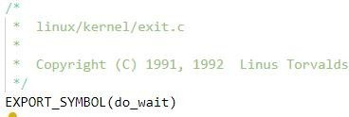

Export Symbol
EXPORT_SYMBOL() provides API to be used in other module.
Before using this symbol in another kernel module, should use ‘extern’ to clarify it.

Slide 32
Export Symbol
If you modify the kernel source code, you should rebuilt the kernel module and install the updated kernel. Then it takes effect.
To save your time, when you rebuilt the kernel, start from ‘make bzImage’. It will only
rebuild the updated modules.
(Do not start from ‘make clean’, which will clean all previous built, and it takes hours to rebuild the kernel modules)
Once the symbol is exported and re-built the kernel module, you will find it’s defined in “Module.symdvers” (auto generated under source code after run “make bzImage”)

Slide 33
Recompile your kernel
If you’ve already compiled and installed the new kernel, then modify the source code and need to make the changes effect. Please start compile from command ‘make bzImage’. (Follow compile steps from Tutorial 2)
To save your time, do not start from ‘make clean’ again, which will remove all your previous built.
Starting from ‘make bzImage’, it will only build the changes.

Slide 34


References
Understanding the Linux KERNEL (3rd edition)
do_fork() (Page 117 – 130)
sigaction (Page 420 – 455)
Linux Kernel Development (3rd edition)
Process descriptor and task structure (Page 24 – 27)
Current task_struct (Page 29 – 30)

Slide 35
Thank you

