Slide 1

Operating System (CSC 3150) Tutorial 5
Liangsen Wang
E-mail: 224040364@link.cuhk.edu.cn

Slide 2
Content
In this tutorial, we will practice related functions for Assignment 2.
Functions you may require:
Keyboard Hit
Terminal Control
Suspend the executing thread
Hints for the game “The greatest adventurer"
Pthread conditional wait and signal

Slide 3
Keyboard Hit
In Assignment 2, we’ve provided a similar function named
int kbhit(void), you could use it directly.
int kbhit(void), If a key has been pressed then it returns a non zero value, otherwise it returns zero.
The termios general terminal interface provides an interface to asynchronous communications devices.
http://man7.org/linux/man-pages/man3/termios.3.html
http://man7.org/linux/man-pages/man2/fcntl.2.html

Slide 4
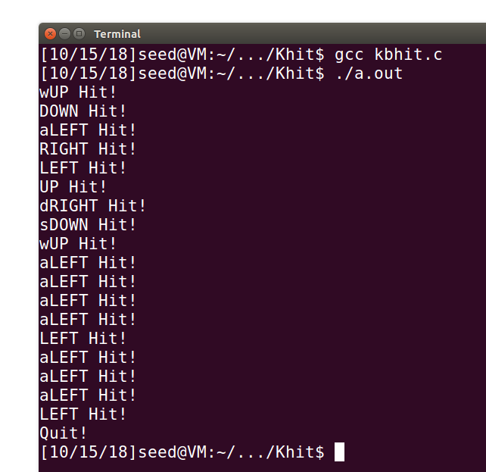
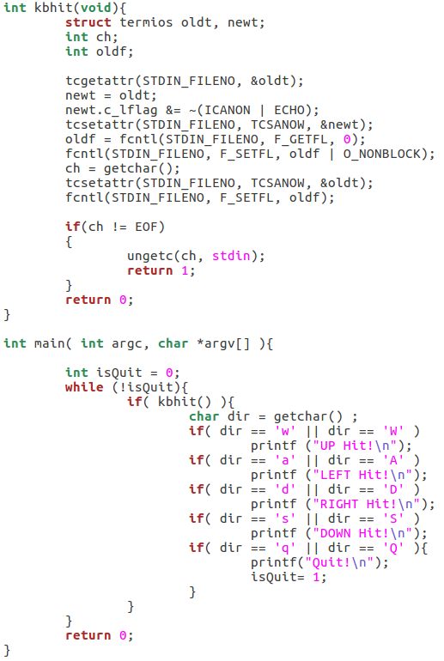
Keyboard Hit
W, A, S,D : up, left, right, down (4 directions), Q (Quit the game)

Slide 5
Keyboard Hit
int getchar(void) function is used to get/read a character from keyboard input.
int putchar(int char) function is a file handling function which is used to write a character on standard output/screen.
int puts(const char *str) writes a string to stdout up to but not including the null character. A newline character is appended to the output.
In Assignment 2, you may use above functions to complete your keyboard read and map write.
https://www.tutorialspoint.com/c_standard_library/c_function_puts.htm

Slide 6
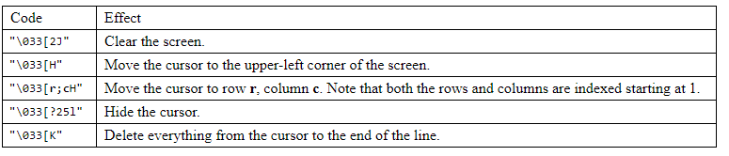
Terminal Control
When printing the message, you could use “\033” to control the cursor in terminal.
https://www.student.cs.uwaterloo.ca/~cs452/terminal.html

Slide 7
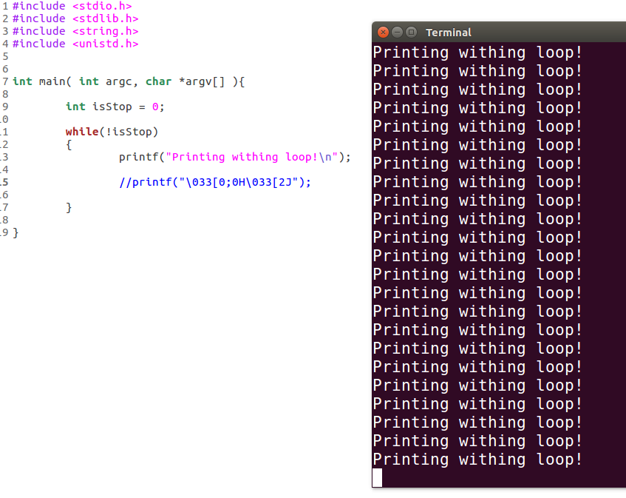
Terminal Control
Move the cursor to the upper-left corner of the screen and clear the screen

Slide 8
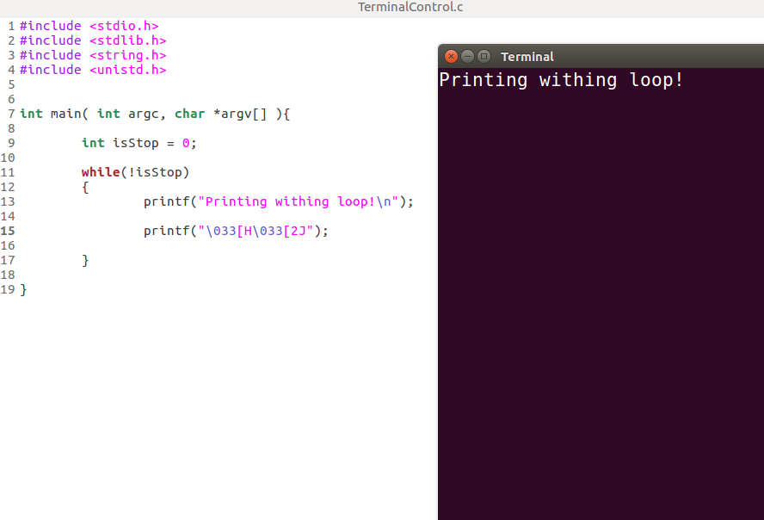
Terminal Control
Move the cursor to the upper-left corner of the screen and clear the screen

Slide 9
Suspend executing thread with three functions
int usleep(useconds_t usec) suspends execution for microsecond intervals.
The usleep() function suspends execution of the calling thread for (at least) usec microseconds.
The sleep may be lengthened slightly by any system activity or by the time spent processing the call or by the granularity of system timers.
The usleep() function returns 0 on success. On error, -1 is returned, with errno set to indicate the cause of the error.
The sleep() function accepts time in seconds while usleep() accepts in microseconds.
The nanosleep() allows the user to specify the sleep period with nanosecond precision.

Slide 10
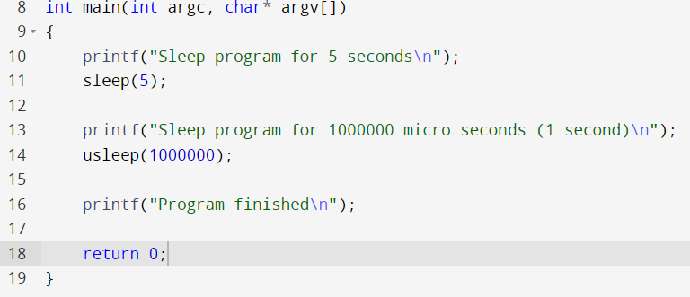
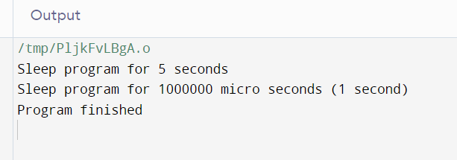

Slide 11
rand() and srand() in C
What is rand() ?
The function rand() is used to generate the pseudo random number. It returns an integer value and its range is from 0 to RAND_MAX.
Parameters
The function accepts no parameter(s) −
Return value
This function returns an integer value between 0 to RAND_MAX.
Like we want to generate a random number between 1-6 then we use this function ：
Num = rand() % 6 + 1;
What is srand()?
srand() is used to initialize random number generators. The argument is passed as a seed for generating a pseudo-random number. Whenever a different seed value is used in srand the pseudo number generator can be expected to generate different series of results the same as rand().
https://www.tutorialspoint.com/rand-and-srand-in-c-cplusplus
https://www.tutorialspoint.com/compile_c_online.php

Slide 12
Assignment 2 Hints
You must use Pthread (multithreading) to implement this assignment.
You can use khbit() to get the input character.
You can provide each object moving on your screen with a thread, and join them to realize multithreading.
You can use mutex to ensure the global variables is not modifed by multiple threads simultaneously.
You can use usleep() to control the speed of the game.
You can generate random number using rand() .

